Slide 1
Operating System Concepts (cont’d)
Course Code: CSC 2209
Course Title: Operating Systems
Dept. of Computer Science
Faculty of Science and Technology
Lecturer No: | 02 | Week No: |  | Semester: | Fall 22-23
Lecturer: | Syma Kamal Chaity, chaity@aiub.edu

Slide 2
Lecture Outline
I/O Structure
Storage Structure
How a Modern Computer Works
Direct Memory Access Structure
Computer-System Architecture
A Dual-Core Design
Clustered Systems
Operating-System Operations
Multiprogramming and Multitasking
Dual-mode and Multimode Operation
Process Management
Memory Management
File-system Management
Caching

Slide 3
Storage Structure
Main memory – only large storage media that the CPU can access directly
Random access
Typically volatile
Typically random-access memory in the form of Dynamic Random-access Memory (DRAM)
Secondary storage – extension of main memory that provides large nonvolatile storage capacity
Hard Disk Drives (HDD) – rigid metal or glass platters covered with magnetic recording material
Disk surface is logically divided into tracks, which are subdivided into sectors
The disk controller determines the logical interaction between the device and the computer
Non-volatile memory (NVM) devices– faster than hard disks, nonvolatile
Various technologies
Becoming more popular as capacity and performance increases, price drops

Slide 4
Storage Hierarchy
Storage systems organized in hierarchy
Speed
Cost
Volatility
Caching – copying information into faster storage system; main memory can be viewed as a cache for secondary storage
Device Driver for each device controller to manage I/O
Provides uniform interface between controller and kernel

Slide 5
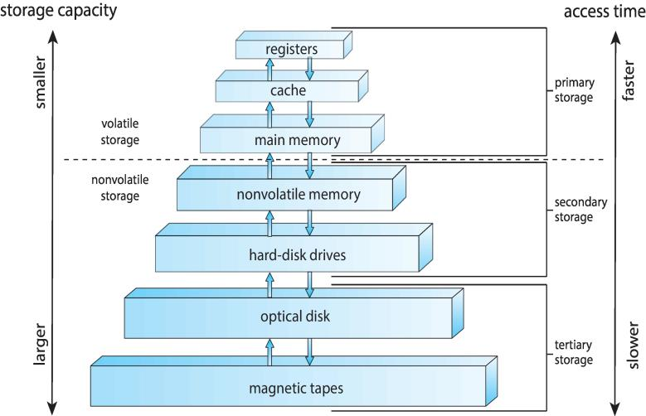
Storage-Device Hierarchy

Slide 6
I/O Structure
After I/O starts, control returns to user program only upon I/O completion
Wait instruction idles the CPU until the next interrupt
Wait loop (contention for memory access)
At most one I/O request is outstanding at a time, no simultaneous I/O processing
After I/O starts, control returns to user program without waiting for I/O completion
System call – request to the OS to allow user to wait for I/O completion
Device-status table contains entry for each I/O device indicating its type, address, and state
OS indexes into I/O device table to determine device status and to modify table entry to include interrupt
Notes:
System Call: A system call is a way for programs to interact with the operating system. A computer program makes a system call when it makes a request to the operating system's kernel.

Slide 7
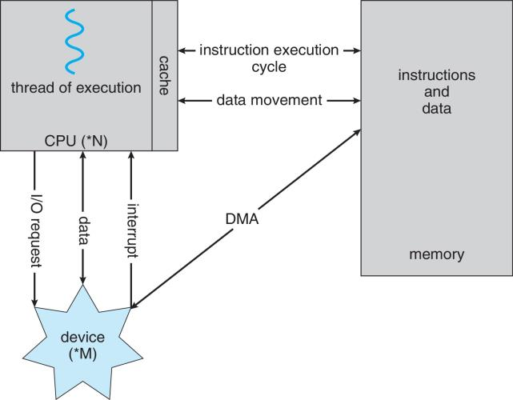
How a Modern Computer Works
A von Neumann architecture
Notes:
Direct Memory Access (DMA)

Slide 8
Direct Memory Access (DMA) Structure
Used for high-speed I/O devices able to transmit information at close to memory speeds
Device controller transfers blocks of data from local buffer storage directly to main memory (RAM) without CPU intervention
Only one interrupt is generated per block, rather than the one interrupt per byte

Slide 9
Computer-System Architecture
Most systems use a single general-purpose processor
Most systems have special-purpose processors as well
Multiprocessors systems growing in use and importance
Also known as parallel systems, tightly-coupled systems
Advantages include:
Increased throughput
Economy of scale
Increased reliability – graceful degradation or fault tolerance
Two types:
Asymmetric Multiprocessing – each processor is assigned a specific task.
Symmetric Multiprocessing – each processor performs all tasks
Notes:
Master slave/ leader follower---
The main difference between multicore and multiprocessor is that the multicore refers to a single CPU with multiple execution units while the multiprocessor refers to a system that has two or more CPUs. Multicores have multiple cores or processing units in a single CPU. A multiprocessor contains multiple CPUs.

Slide 10
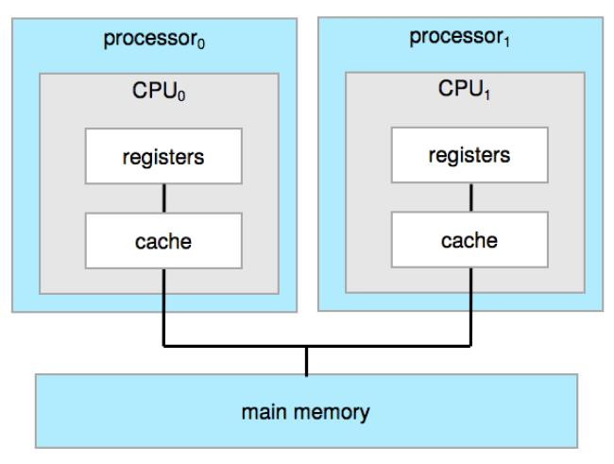
Symmetric Multiprocessing Architecture
Notes:
Registers are a type of computer memory used to quickly accept, store, and transfer data and instructions that are being used immediately by the CPU. The registers used by the CPU are often termed as Processor registers.
Cache is a small amount of memory which is a part of the CPU - closer to the CPU than RAM . It is used to temporarily hold instructions and data that the CPU is likely to reuse.

Slide 11
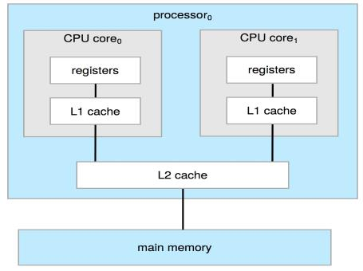
A Dual-Core Design
Multi-chip and multicore
Systems containing all chips
Chassis containing multiple separate systems
Notes:
L1 cache, or primary cache, is extremely fast but relatively small, and is usually embedded in the processor chip as CPU cache. ... Level 3 (L3) cache is specialized memory developed to improve the performance of L1 and L2. L1 or L2 can be significantly faster than L3, though L3 is usually double the speed of DRAM.

Slide 12
Clustered Systems
Like multiprocessor systems, but multiple systems working together
Usually sharing storage via a storage-area network (SAN)
Provides a high-availability service which survives failures
Asymmetric clustering has one machine in hot-standby mode
Symmetric clustering has multiple nodes running applications, monitoring each other
Some clusters are for high-performance computing (HPC)
Applications must be written to use parallelization
Some have distributed lock manager (DLM) to avoid conflicting operations
Notes:
A distributed lock manager (DLM) is a software component provided by your platform vendor. The DLM maintains a list of system resources and provides locking mechanisms to control allocation and modification of Oracle resources. DLM resources are logical concepts, structures of data.

Slide 13
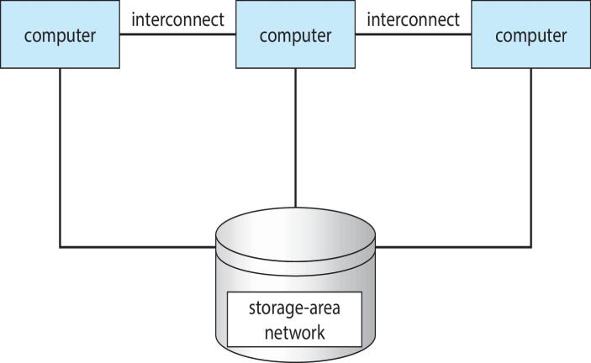
Clustered Systems

Slide 14
Operating-System Operations
Bootstrap program – simple code to initialize the system, load the kernel
Kernel loads / OS
Starts system daemons (services provided outside of the kernel)
Kernel interrupt driven (hardware and software)
Hardware interrupt by one of the devices
Software interrupt (exception or trap):
Software error (e.g., division by zero)
Request for operating system service – system call
Other process problems include infinite loop, processes modifying each other or the operating system

Slide 15
Multiprogramming and Multitasking
Multiprogramming (Batch system) needed for efficiency
Single user cannot keep CPU and I/O devices busy at all times
Multiprogramming organizes jobs (code and data) so CPU always has one to execute
A subset of total jobs in system is kept in memory
One job selected and run via job scheduling
When it has to wait (for I/O for example), OS switches to another job
Timesharing (multitasking) is logical extension in which CPU switches jobs so frequently that users can interact with each job while it is running, creating interactive computing
Response time should be < 1 second
Each user has at least one program executing in memory process
If several jobs ready to run at the same time  CPU scheduling
If processes doesn't fit in memory, swapping moves them in and out to run
Virtual memory allows execution of processes not completely in memory

Slide 16
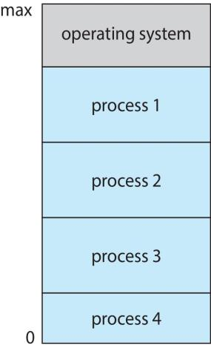
Memory Layout for Multiprogrammed System

Slide 17
Dual-mode and Multimode Operation
Dual-mode operation allows OS to protect itself and other system components
User mode and kernel mode
Mode bit provided by hardware
Provides ability to distinguish when system is running user code or kernel code
Some instructions designated as privileged, only executable in kernel mode
System call changes mode to kernel, return from call resets it to user
Increasingly CPUs support multi-mode operations
i.e. virtual machine manager (VMM) mode for guest VMs

Slide 18
Transition from User to Kernel Mode
Timer to prevent infinite loop / process hogging resources
Timer is set to interrupt the computer after some time period
Keep a counter that is decremented by the physical clock
Operating system set the counter (privileged instruction)
When counter zero generate an interrupt
Set up before scheduling process to regain control or terminate program that exceeds allotted time

Slide 19
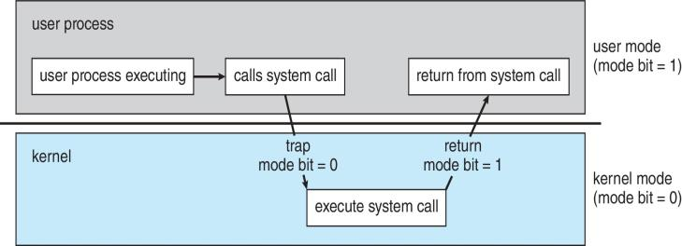
Transition from User to Kernel Mode

Slide 20
Process Management
A process is a program in execution. It is a unit of work within the system. Program is a passive entity, process is an active entity.
Process needs resources to accomplish its task
CPU, memory, I/O, files
Initialization data
Process termination requires reclaim of any reusable resources
Single-threaded process has one program counter specifying location of next instruction to execute
Process executes instructions sequentially, one at a time, until completion
Multi-threaded process has one program counter per thread
Typically system has many processes, some user, some operating system running concurrently on one or more CPUs
Concurrency by multiplexing the CPUs among the processes / threads

Slide 21
Process Management Activities
The operating system is responsible for the following activities in connection with process management:
Creating and deleting both user and system processes
Suspending and resuming processes
Providing mechanisms for process synchronization
Providing mechanisms for process communication
Providing mechanisms for deadlock handling

Slide 22
Memory Management
To execute a program all (or part) of the instructions must be in memory
All (or part) of the data that is needed by the program must be in memory
Memory management determines what is in memory and when
Optimizing CPU utilization and computer response to users
Memory management activities
Keeping track of which parts of memory are currently being used and by whom
Deciding which processes (or parts thereof) and data to move into and out of memory
Allocating and deallocating memory space as needed

Slide 23
File-system Management
OS provides uniform, logical view of information storage
Abstracts physical properties to logical storage unit - file
Each medium is controlled by device (i.e., disk drive, tape drive)
Varying properties include access speed, capacity, data-transfer rate, access method (sequential or random)
File-System management
Files usually organized into directories
Access control on most systems to determine who can access what
OS activities include
Creating and deleting files and directories
Primitives to manipulate files and directories
Mapping files onto secondary storage
Backup files onto stable (non-volatile) storage media

Slide 24
Caching
Important principle, performed at many levels in a computer (in hardware, operating system, software)
Information in use copied from slower to faster storage temporarily
Faster storage (cache) checked first to determine if information is there
If it is, information used directly from the cache (fast)
If not, data copied to cache and used there
Cache smaller than storage being cached
Cache management important design problem
Cache size and replacement policy

Slide 25
Books
Operating Systems Concept
Written by Galvin and Silberschatz
Edition: 9th

Slide 26
References
Operating Systems Concept
Written by Galvin and Silberschatz
Edition: 9th

