Slide 1
CPU Scheduling
Course Code: CSC 2209
Course Title: Operating Systems
Dept. of Computer Science
Faculty of Science and Technology
Lecturer No: | 06 | Week No: | 06 | Semester: | Fall 22-23
Lecturer: | Syma Kamal Chaity & chaity@aiub.edu

Slide 2
Lecture Outline
Basic Concepts
Scheduling Criteria
Scheduling Algorithms

Slide 3
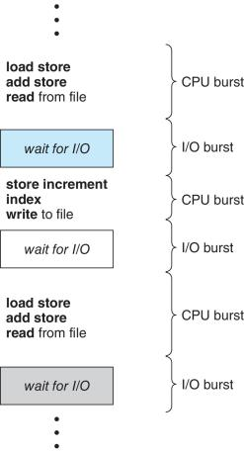
Basic Concepts`1
Maximum CPU utilization obtained with multiprogramming
CPU–I/O Burst Cycle – Process execution consists of a cycle of CPU execution and I/O wait
CPU burst followed by I/O burst
CPU burst distribution is of main concern

Slide 4
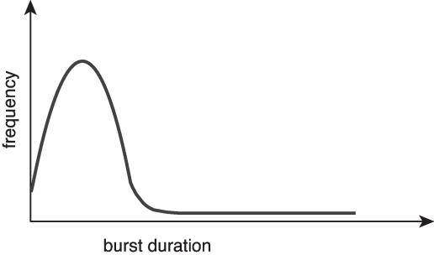
Histogram of CPU-burst Times
Large number of short bursts
Small number of longer bursts

Slide 5
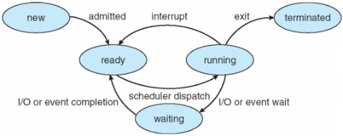
CPU Scheduler
The CPU scheduler selects from among the processes in ready queue, and allocates the a CPU core to one of them
Queue may be ordered in various ways
CPU scheduling decisions may take place when a process:
1. Switches from running to waiting state
2. Switches from running to ready state
3. Switches from waiting to ready
4. Terminates
Scheduling under 1 and 4 is nonpreemptive
All other scheduling is preemptive
Consider access to shared data
Consider preemption while in kernel mode
Consider interrupts occurring during crucial OS activities
Notes:
Will start from here E section
In Preemptive Scheduling, the CPU is allocated to the processes for a specific time period, and non-preemptive scheduling CPU is allocated to the process until it terminates. In Preemptive Scheduling, tasks are switched based on priority while non-preemptiveSchedulign no switching takes place.

Slide 6
Scheduling Criteria
CPU utilization – keep the CPU as busy as possible
Throughput – # of processes that complete their execution per time unit
Turnaround time – amount of time to execute a particular process
Completion time-Arrival time
Waiting time – amount of time a process has been waiting in the ready queue
Response time – amount of time it takes from when a request was submitted until the first response is produced, not output (for time-sharing environment)

Slide 7
Scheduling Algorithm Optimization Criteria
Max CPU utilization
Max throughput
Min turnaround time
Min waiting time
Min response time

Slide 8
First- Come, First-Served (FCFS) Scheduling
Process Burst Time
P₁ 24
P₂ 3
P₃ 3
Suppose that the processes arrive in the order: P₁ , P₂ , P₃ The Gantt Chart for the schedule is:
Waiting time for P₁ = 0; P₂ = 24; P₃ = 27
Average waiting time: (0 + 24 + 27)/3 = 17
Notes:
Waiting time of p1 = 0 ms
Waiting time of p2 = 24-0 = 24 ms
Waiting time of p3 = 27-0 = 27 ms … 24+3 = 27

Slide 9
FCFS Scheduling (cont’d)
Suppose that the processes arrive in the order:
P₂ , P₃ , P₁
The Gantt chart for the schedule is:
Waiting time for P₁ = 6; P₂ = 0; P₃ = 3
Average waiting time: (6 + 0 + 3)/3 = 3
Much better than previous case
Convoy effect - short process before long process
Consider one CPU-bound and many I/O-bound processes
Notes:
P1 waiting time = 6ms
P2 waiting time = 0ms
P3 waiting time = 3 ms

Slide 10
Shortest-Job-First (SJF) Scheduling
Associate with each process the length of its next CPU burst
Use these lengths to schedule the process with the shortest time
SJF is optimal – gives minimum average waiting time for a given set of processes
The difficulty is knowing the length of the next CPU request
Could ask the user

Slide 11
Example of SJF (Non preemptive)
ProcessArriva l Time Burst Time
P₁ 0.0 6
P₂ 2.0 8
P₃ 4.0 7
P₄ 5.0 3
SJF scheduling chart
Average waiting time = (3 + 16 + 9 + 0) / 4 = 7
Notes:
P4 = 0
P1 = 3
P3 = 9
P2 = 16

Slide 12
Determining Length of Next CPU Burst
Can only estimate the length – should be similar to the previous one
Then pick process with shortest predicted next CPU burst
Can be done by using the length of previous CPU bursts, using exponential averaging
Commonly, α set to ½
Preemptive version called shortest-remaining-time-first

Slide 13
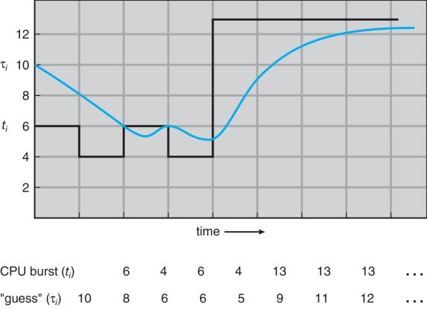
Prediction of the Length of the Next CPU Burst

Slide 14
Examples of Exponential Averaging
α =0
τ_{n+1} = τ_{n}
Recent history does not count
α =1
τ_{n+1} = α t_{n}
Only the actual last CPU burst counts
If we expand the formula, we get:
τ_{n+1} = α t_{n}+(1 - α)α t_{n} ₋₁ + …
+(1 - α )^{j} α t_{n} _{-j} + …
+(1 - α )^{n +1} τ₀
Since both α and (1 - α) are less than or equal to 1, each successive term has less weight than its predecessor

Slide 15
Example of Shortest-remaining-time-first
Now we add the concepts of varying arrival times and preemption to the analysis
ProcessA arri Arrival TimeT Burst Time
P₁ 0 8
P₂ 1 4
P₃ 2 9
P₄ 3 5
Preemptive SJF Gantt Chart
Average waiting time = [(10-1-0)+(1-0-1)+(17-0-2)+(5-0-3)]/4 = 26/4 = 6.5 msec
Waiting time = Total/Actual WT/Max/Last – previous total exec time – AT (Formula)
Notes:
D sum 2021
0 ms ------ p1-----8-- p1
..
1 ms ------- p1/p2-------7/4------p2
…
2 ms -------P1/P2/P3-----7/3/9-------P2
…..
3 ms --------P1/P2/P3/P4-------7/2/9/5 -------P2
……
4ms………. P1/P2/P3/P4---------7/1/9/5---------P2
…….
5 ms ---------- P1/P3/P4---------7/9/5-------P4
P1 = 10 –1– 0 = 9ms
P2 = 1 – 0 – 1 = 0 ms
P3 = 17 – 0 – 2 = 15ms
P4 = 5 – 0 – 3 = 2ms
P2 = 1 – 0 – 1 = 0ms
P3 = 17 – 0 – 2 = 15ms
P4 = 5 – 0 – 3 = 2ms

Slide 16
Round Robin (RR)
Each process gets a small unit of CPU time (time quantum q), usually 10-100 milliseconds. After this time has elapsed, the process is preempted and added to the end of the ready queue.
If there are n processes in the ready queue and the time quantum is q, then each process gets 1/n of the CPU time in chunks of at most q time units at once. No process waits more than (n-1)q time units.
Timer interrupts every quantum to schedule next process
Performance
q large ⇒ FIFO
q small ⇒ q must be large with respect to context switch, otherwise overhead is too high

Slide 17
Example of RR with Time Quantum = 4
Process Burst Time
P₁ 24
P₂ 3
P₃ 3
The Gantt chart is:
Typically, higher average turnaround than SJF, but better response
q should be large compared to context switch time
q usually 10ms to 100ms, context switch < 10 usec

Slide 18
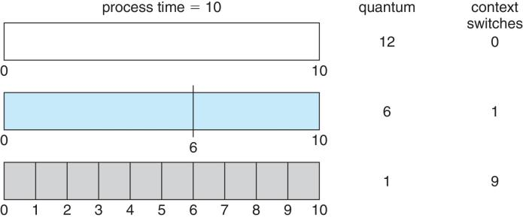
Time Quantum and Context Switch Time

Slide 19
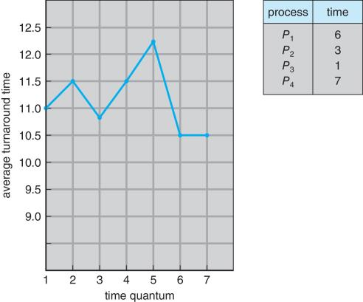
Turnaround Time Varies With The Time Quantum
80% of CPU bursts should be shorter than q

Slide 20
Priority Scheduling
A priority number (integer) is associated with each process
The CPU is allocated to the process with the highest priority (smallest integer ≡ highest priority)
Preemptive
Nonpreemptive
SJF is priority scheduling where priority is the inverse of predicted next CPU burst time
Problem ≡ Starvation – low priority processes may never execute
Solution ≡ Aging – as time progresses increase the priority of the process

Slide 21

Example of Priority Scheduling
ProcessA arri Burst TimeT Priority
P₁ 10 3
P₂ 1 1
P₃ 2 4
P₄ 1 5
P₅ 5 2
Priority scheduling Gantt Chart
Average waiting time = 8.2 msec

Slide 22

Priority Scheduling w/ Round-Robin
ProcessA arri Burst TimeT Priority
P₁ 4 3
P₂ 5 2
P₃ 8 2
P₄ 7 1
P₅ 3 3
Run the process with the highest priority. Processes with the same priority run round-robin
Gantt Chart with 2ms time quantum

Slide 23
Books
Operating Systems Concept
Written by Galvin and Silberschatz
Edition: 9th

Slide 24
References
Operating Systems Concept
Written by Galvin and Silberschatz
Edition: 9th

