Slide 1
Machine Learning
Lecture 1: Introduction to Machine Learning
Instructor: Maheen Zulfiqar

Slide 2
Learning Outcomes
After this lecture, you will be able to:
Define Artificial Intelligence (AI), Machine Learning (ML), and Deep Learning (DL).
Differentiate between AI, ML, and DL.
Describe different types of Machine Learning.
Explain the Machine Learning workflow.
Identify real-world applications of Machine Learning.

Slide 3
Topics Covered Today
Artificial Intelligence
Machine Learning
Deep Learning
Types of Machine Learning
Machine Learning Pipeline
Python Libraries
Applications
Challenges
Ethics

Slide 4
Where Have You Seen Machine Learning?
Examples:
📱 Face Unlock
📧 Gmail Spam Filter
🎬 Netflix Recommendations
🛒 Amazon Recommendations
🚗 Self-Driving Cars
🤖 ChatGPT
Discussion
What do these systems have in common?

Slide 5
What is Artificial Intelligence?
Artificial Intelligence (AI) is the branch of computer science that enables machines to perform tasks requiring human intelligence.
Examples
Speech Recognition
Robotics
Expert Systems
Natural Language Processing
Computer Vision

Slide 6
What is Machine Learning?
Machine Learning is a subset of Artificial Intelligence that enables computers to learn from data without being explicitly programmed.
Key Idea
Learn from Data → Make Predictions
Example:
Spam Detection
House Price Prediction
Medical Diagnosis

Slide 7
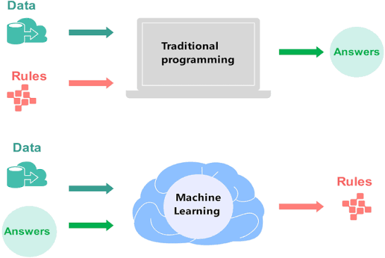
Traditional Programming vs Machine Learning

Slide 8
Deep Learning
What is Deep Learning?
Deep Learning is a subset of Machine Learning based on Artificial Neural Networks with multiple layers.
Applications
Image Recognition
Speech Recognition
Language Translation
Autonomous Vehicles
Generative AI

Slide 9
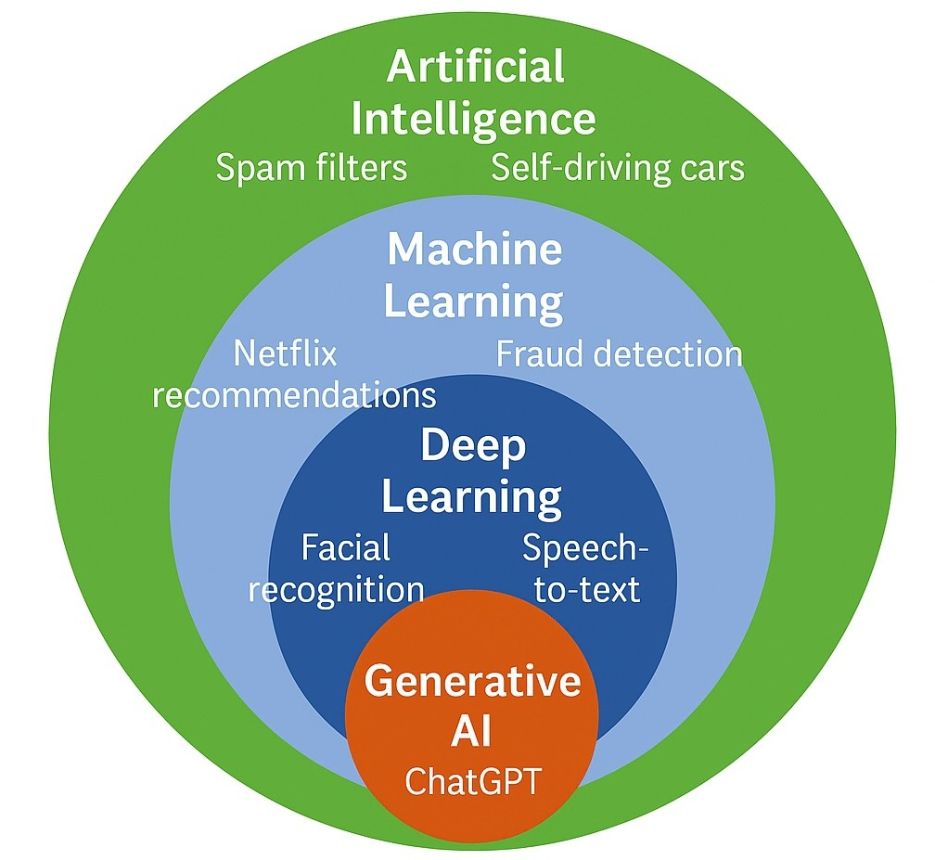
AI vs ML vs DL
AI | ML | DL
Broad field | Subset of AI | Subset of ML
Rule-based or Learning | Learns from data | Neural Networks

Slide 10
Deep learning vs machine learning
 | DL | ML
Data Depecndency | Large data set | Small data sets
Feature Engineering | Self-learning | Requires feature engineering to select important features
Problem Solving | End to end Giving an image of objects: detects and label object in one go | Divide problem into subproblems Giving an image of objects: detects object first, then learns the features to label object.
Execution time | high | low
Test time | low | high

Slide 11
Traditional ML and deep learning
 | Traditional ML | Deep Learning
Feature engineering | Usually required / very important | Usually much less required
Who extracts useful features? | Human | Neural network learns them
Example | Manually calculate mean, variance, edges, texture | CNN automatically learns edges → shapes → complex patterns
Typical workflow | Raw data → Feature Engineering → ML model | Raw data → Deep Neural Network → Prediction
Traditional ML relies heavily on human-designed features, whereas deep learning automatically learns useful feature representations from raw or minimally processed data.

Slide 12
Evolution of AI
Year | Milestone
1950 | Turing Test
1956 | Birth of AI
1980 | Expert Systems
1997 | Deep Blue
2012 | Deep Learning Boom
2022 | Generative AI

Slide 13
Types of Machine Learning
Three Categories
Supervised Learning
Unsupervised Learning
Reinforcement Learning

Slide 14
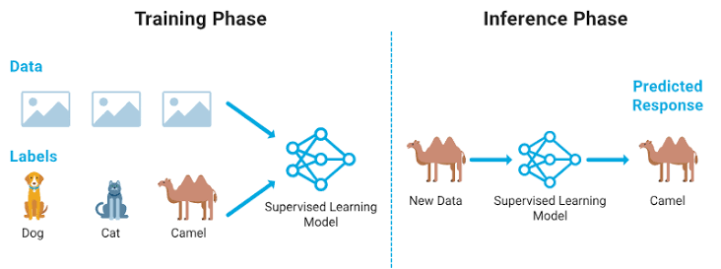
Supervised Learning
Learns from labeled data
Tasks
Classification
Regression
Examples
Spam Detection
Disease Prediction
House Price Prediction

Slide 15
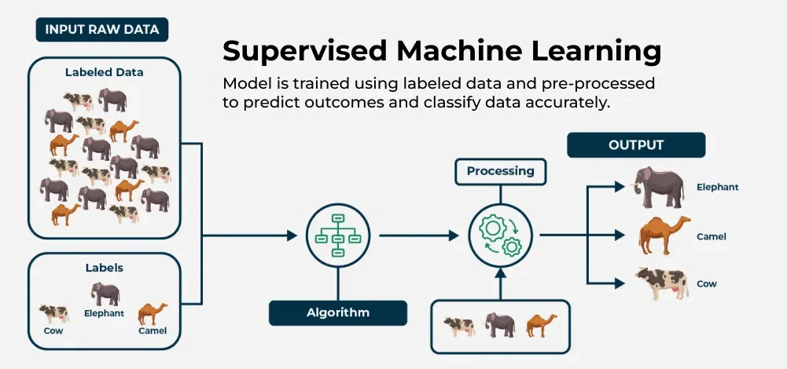
Supervised Learning

Slide 16
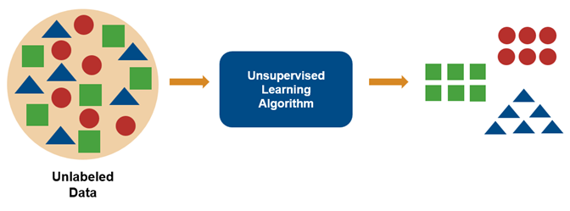
Unsupervised Learning
Learns from unlabeled data
Tasks
Clustering
Association
Dimensionality Reduction
Examples
Customer Segmentation
Market Basket Analysis

Slide 17
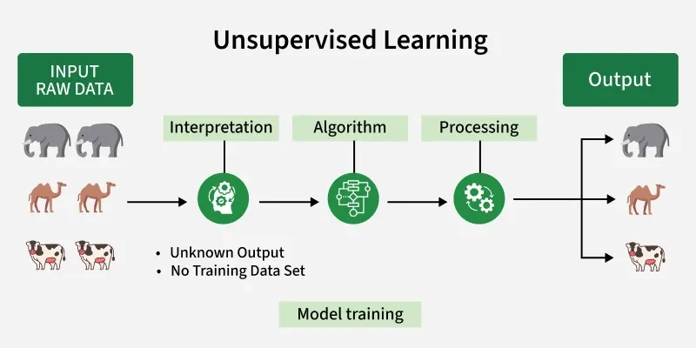
Unsupervised Learning

Slide 18
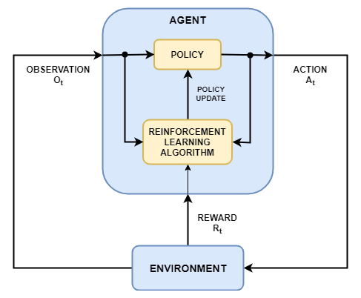
Reinforcement Learning
Learns through interaction
Components
Agent
Environment
Action
Reward
Applications
Robotics
Games
Self-driving Cars

Slide 19
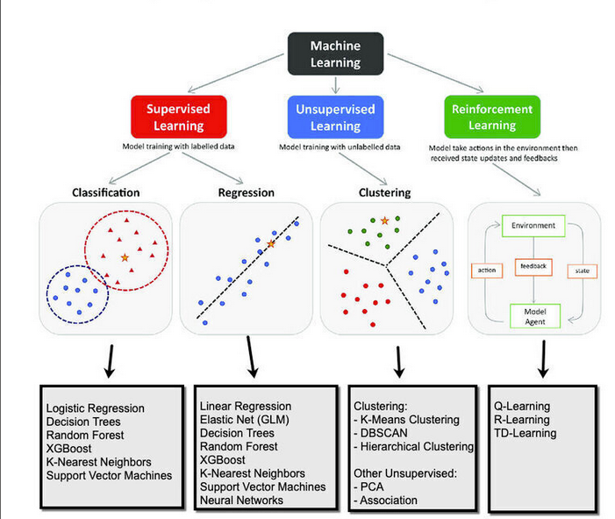
Comparison of Learning Types
Supervised | Unsupervised | Reinforcement
Labeled Data | Unlabeled Data | Reward Based
Prediction | Pattern Discovery | Decision Making

Slide 20
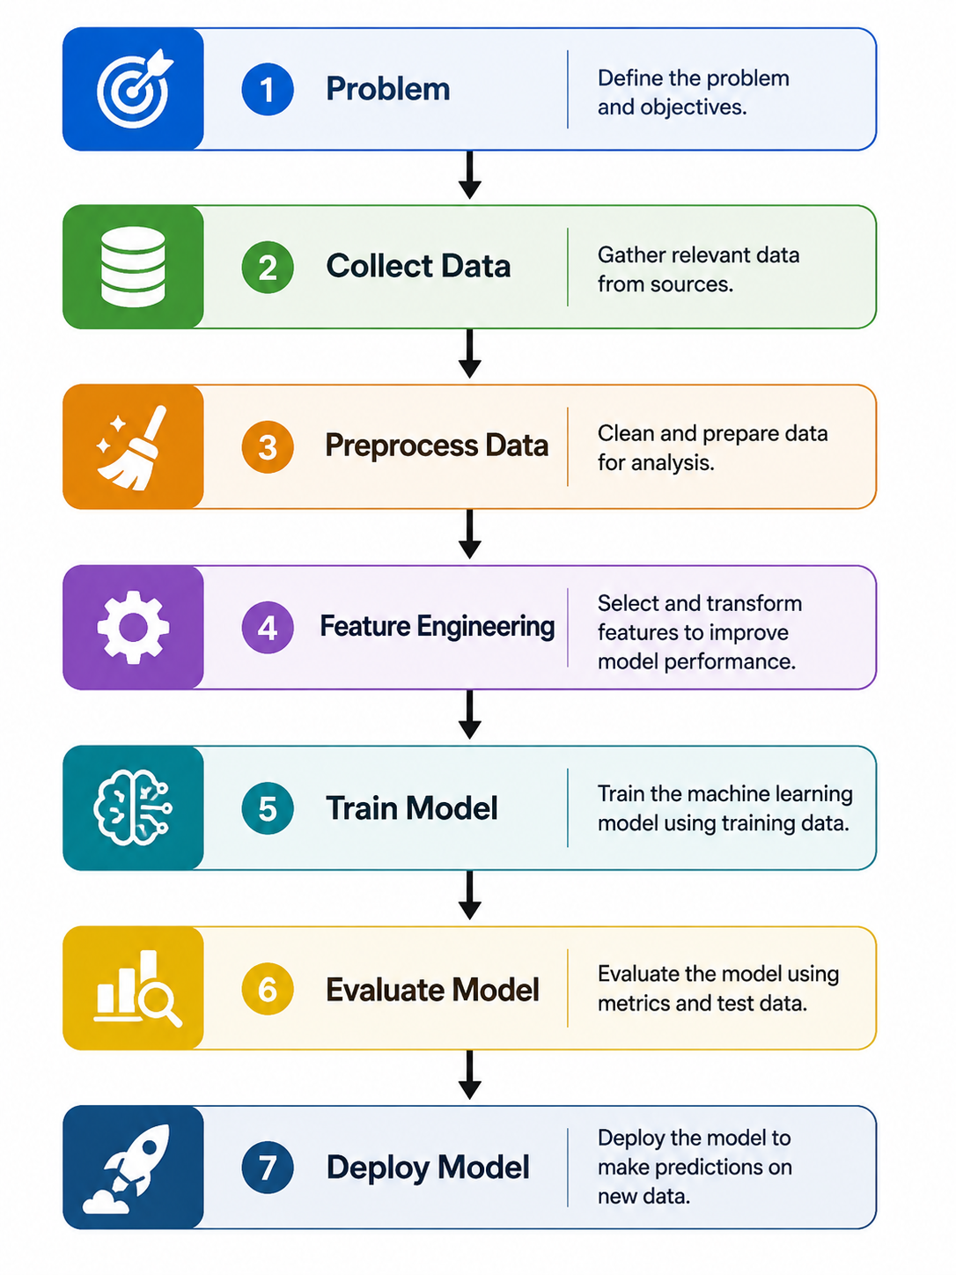
Machine Learning Workflow
Data Science Engineer
ML Engineer
AI Engineer

Slide 21
Python Libraries
Library | Purpose
NumPy | Numerical Computing
Pandas | Data Analysis
Matplotlib | Visualization
Seaborn | Statistical Plots
Scikit-learn | Machine Learning
TensorFlow | Deep Learning
PyTorch | Deep Learning

Slide 22
Applications of Machine Learning
Healthcare
Finance
Agriculture
Transportation
Cybersecurity
Recommendation Systems
Manufacturing
Education

Slide 23
Case Study
Netflix Recommendation System
Uses
Viewing History
Ratings
User Preferences
Result
Personalized Recommendations

Slide 24
Advantages
Learns from data
Automates decisions
High prediction accuracy
Handles large datasets
Personalization

Slide 25
Challenges
Poor Data Quality
Bias
Overfitting
Privacy Issues
High Computational Cost
Interpretability

Slide 26
Classroom Activity
Problem | Learning Type
Spam Detection | ?
Customer Segmentation | ?
Chess Playing | ?
House Price Prediction | ?

Slide 27
Ethics in AI
Important Issues
Fairness
Privacy
Transparency
Accountability
Discussion:
Should AI replace human decision making?

Slide 28
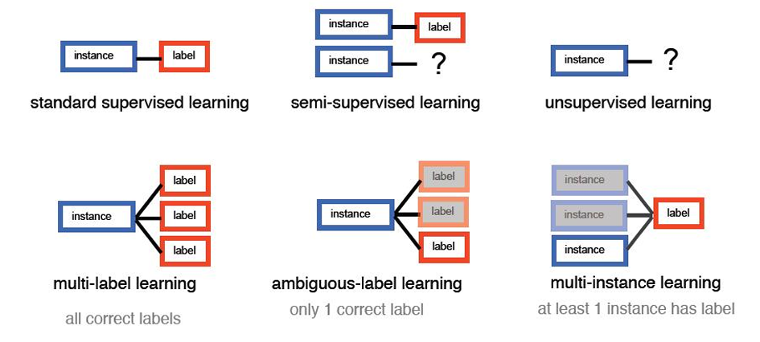

Slide 29
References
Hands-On Machine Learning – Aurélien Géron
Pattern Recognition and Machine Learning – Christopher Bishop
Introduction to Machine Learning with Python – Müller & Guido
Python Machine Learning – Raschka

