Slide 1
Videopulse
Videopulse is a mobile web application that makes it easy to discover and watch online videos.

Slide 2
Technologies Used
Front End :
Backend :
HTML
CSS
Bootstrap
JavaScript
AngularJS
jQuery ( Bootstrap dependency )
JavaScript
Node.js
Express.js
JSON

Slide 3
Application Architecture
index.html
app.routes
app.module
components
data service
home
videoPlayer

Slide 4
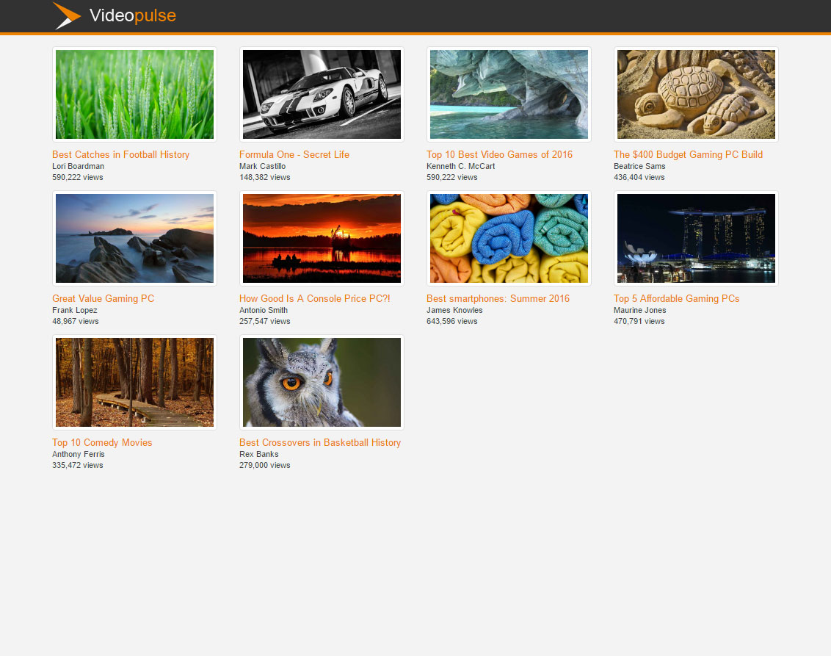
Home Component

Slide 5
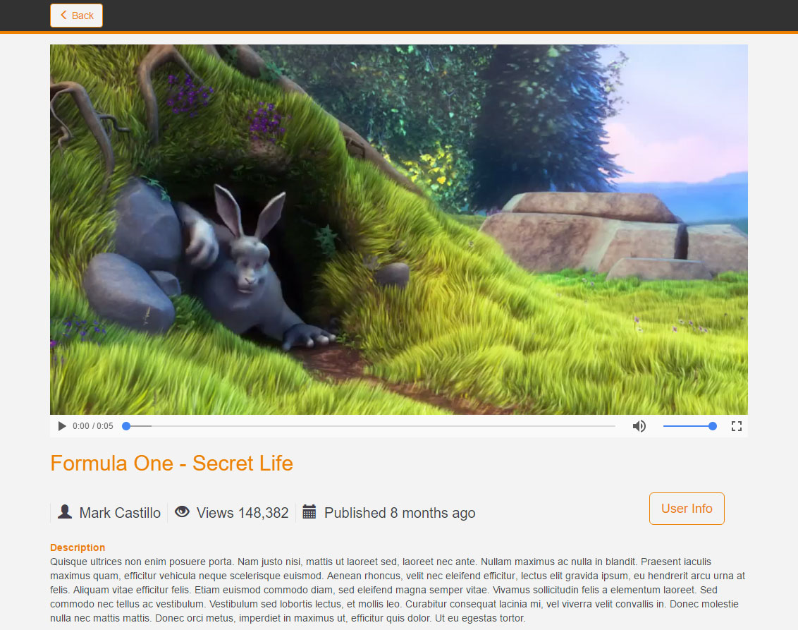
Video Player Component

Slide 6
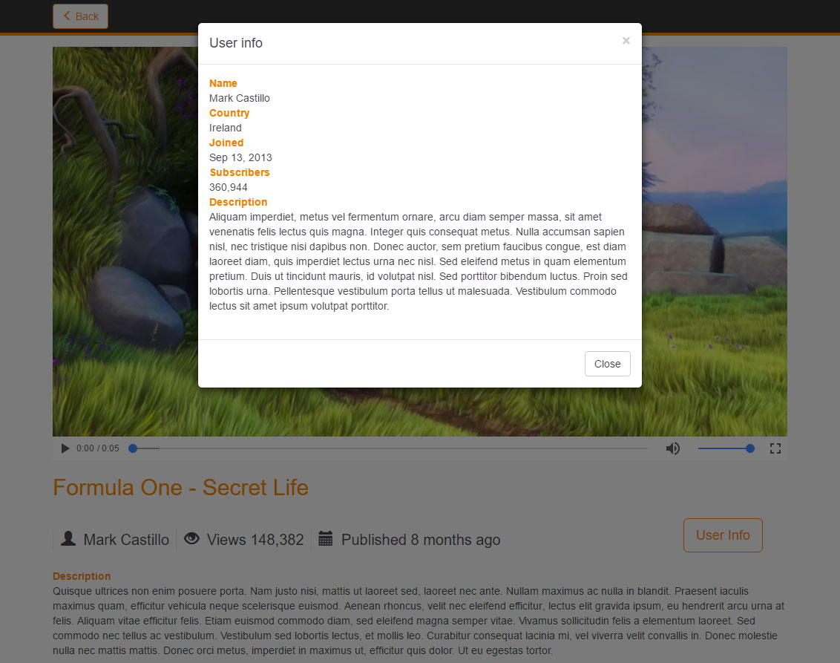
User Info

