Slide 1



Sentiment Analysis from Text Feedback
Organization Name:
Indian Space Research Organisation (ISRO)
Problem Statement:
Web portals like Bhuvan get vast amount of feedback from the users. To go through all the feedbacks can be a tedious job. Develop software to categorize opinions expressed in feedback forums. This can be utilized for feedback management system. The software must provide the following output. 1) Classification of individual comments/reviews. 2) Determining overall rating based on individual comments/reviews. The Multi-Domain Sentiment Dataset contains product reviews taken from Amazon.com from many product types (domains). http://jmcauley.ucsd.edu/data/amazon/
Team Name:
TotallyNotBots
Team Leader Name:
Aayusi Biswas
College Code:
U-0934

Slide 2
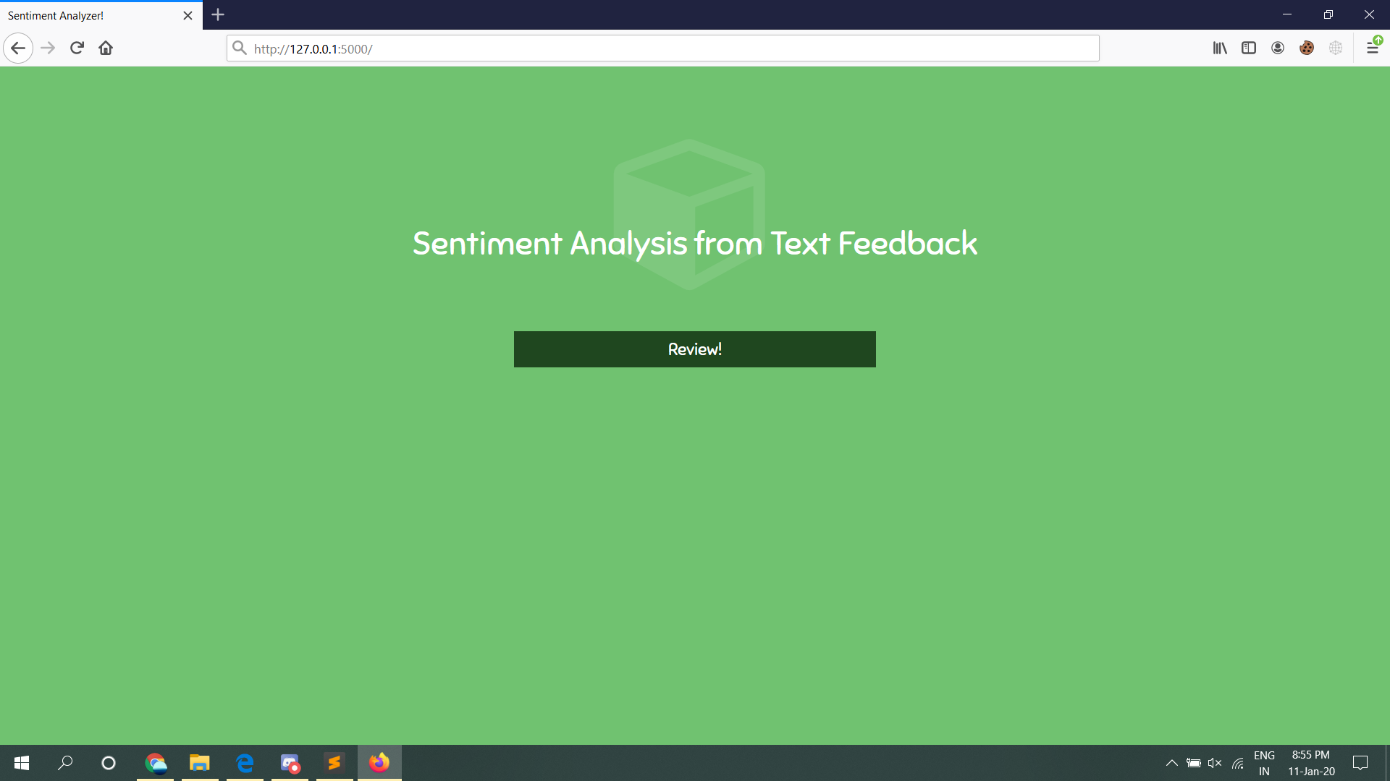
Solution
A web-based software that classifies reviews in real-time as either a 'Positive' or a 'Negative' review of the product. An extensive GridSearch model is trained on nearly 600,000 data points, and predicts the sentiments of the test data with an accuracy of 94.5%
Youtube Video Link: https://youtu.be/fJ7LuKQeErI

Slide 3







Technology Stack
Pickle

Slide 4
Use Cases
Online platforms and portals like Amazon, Bhuvan (by ISRO) have dedicated sections for User reviews and feedbacks. Going through thousands of reviews manually is not practical. Using our Sentiment Analysis model, organizations can get a summary/gist of whether the feedback is positive or negative.
Sometimes a user might give a negative feedback, but rate the product high by mistake. In this case, the rating can be modified based on whether the review matches the given ratings or not. Ex: A customer gives a bad review, but gives a 5-star rating by mistake. Using 5 to update the overall rating would be incorrect, hence the organization can reduce the rating to 3 instead for accurate ratings.

Slide 5
Dependencies
Show stopper
Servers required for ensuring running and uptime of this application, while also guaranteeing quick response times.
Space constraint, owing to a huge dataset and file size for the pickled model.
A model predicting the result with an accuracy of 94.5%
Rather than mapping words directly, the model is well-trained to predict sentiments in twisted sentences.
Ex:
“Bad” – Negative
“Not so bad” – Positive
“Nice” – Positive
“Could have been better” - Negative

