Slide 1
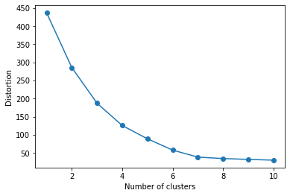
Features Used:
Accounts
Checking
Credit Card
Savings
Checking balance (End – Start)
Checking average deposits – withdrawals
Credit card balance (End – Start)
Credit card uses (# Charges)
Savings balance (End-Start)
Savings number deposits - withdrawals
Distortion plot for optimal clusters

Slide 2

K-means Clustering - Results

Slide 3

K-means Clustering - Results

Slide 4
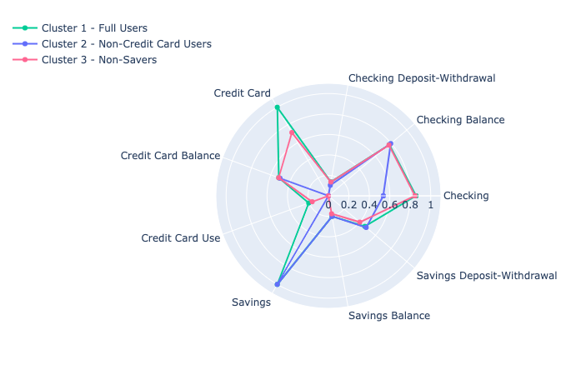
K-means Clustering - Results

Slide 5
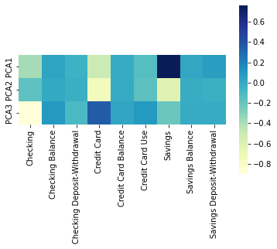
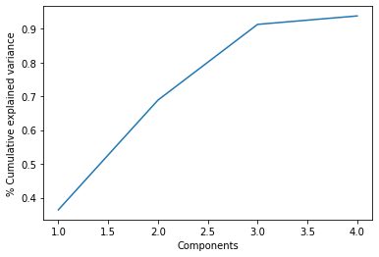
Confirming with Principal Component Analysis

