Slide 1
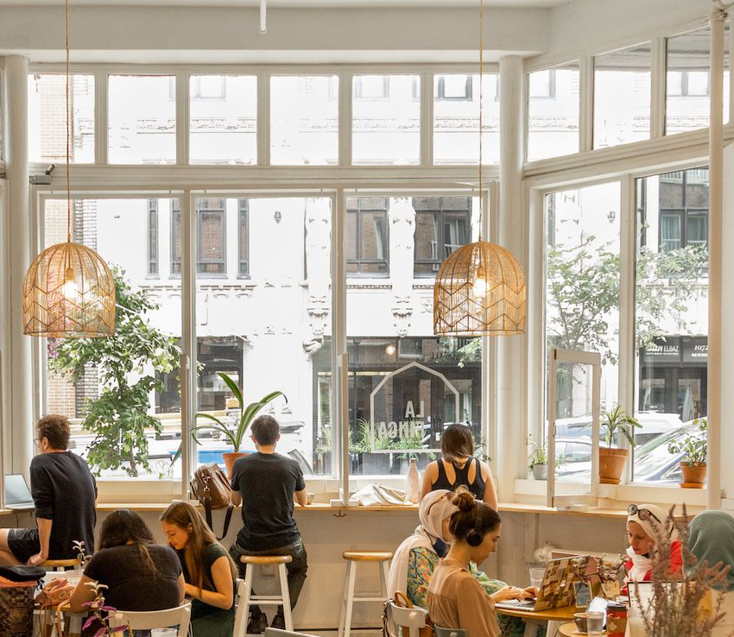
Old Montreal
Café Database

Slide 2
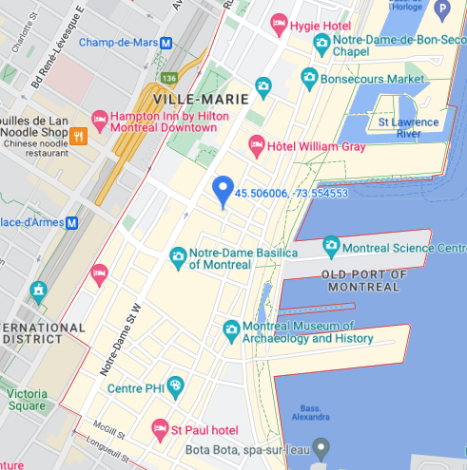
Detecting cafes in Old Montreal
Query: ‘coffee’
Radius: 3km

Slide 3
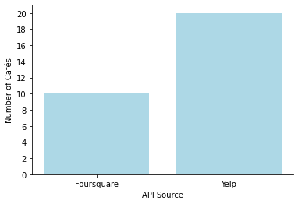
Foursquare vs Yelp in detecting cafes
20
10

Slide 4
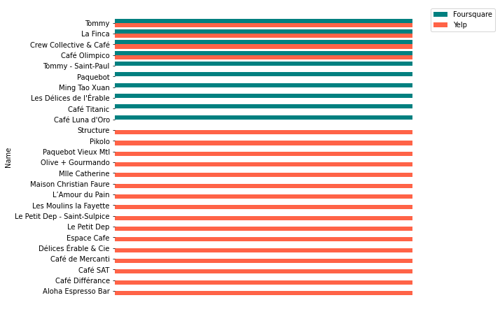
Unique cafes detected by each API

Slide 5
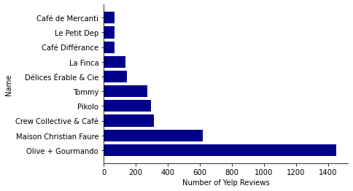
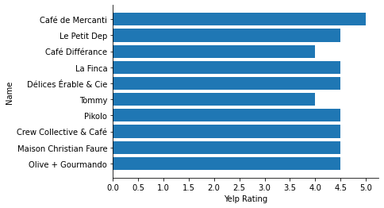
Top 10 cafes in Old Montreal from Yelp

