Slide 1
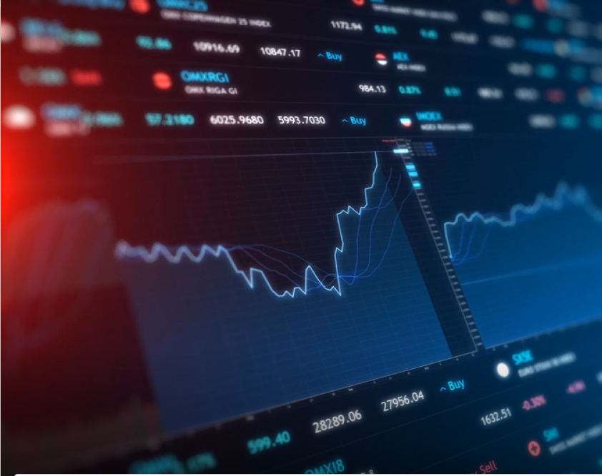
Project Presentation
SALONI YADAV
18CSU188

Slide 2

INTRODUCTION
I started this internship in the month of June with Career Launcher.
I was an intern in CL for the duration of 2 months under the expert guidance. I interned in online mode and learnt about financials markets.
I worked on real world data with stocks and learnt about market algorithms.
We used python mainly in the project .Also, machine learning concepts were involved to some extent.

Slide 3

ABOUT
We were assigned different company stock data to work with. I was assigned Apple Stock data.
Apple Inc. is an American multinational technology company headquartered in Cupertino, California, that designs, develops, and sells consume electronics, computer software, and online services.

Slide 4
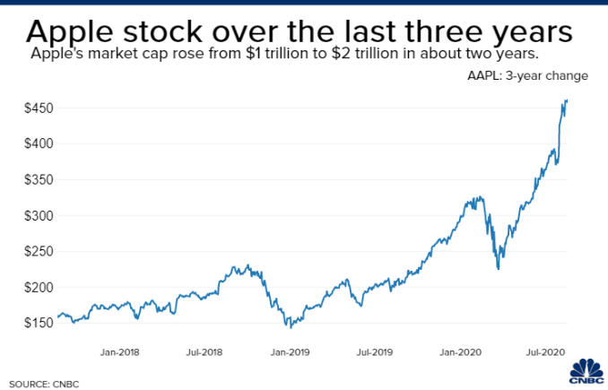

Slide 5

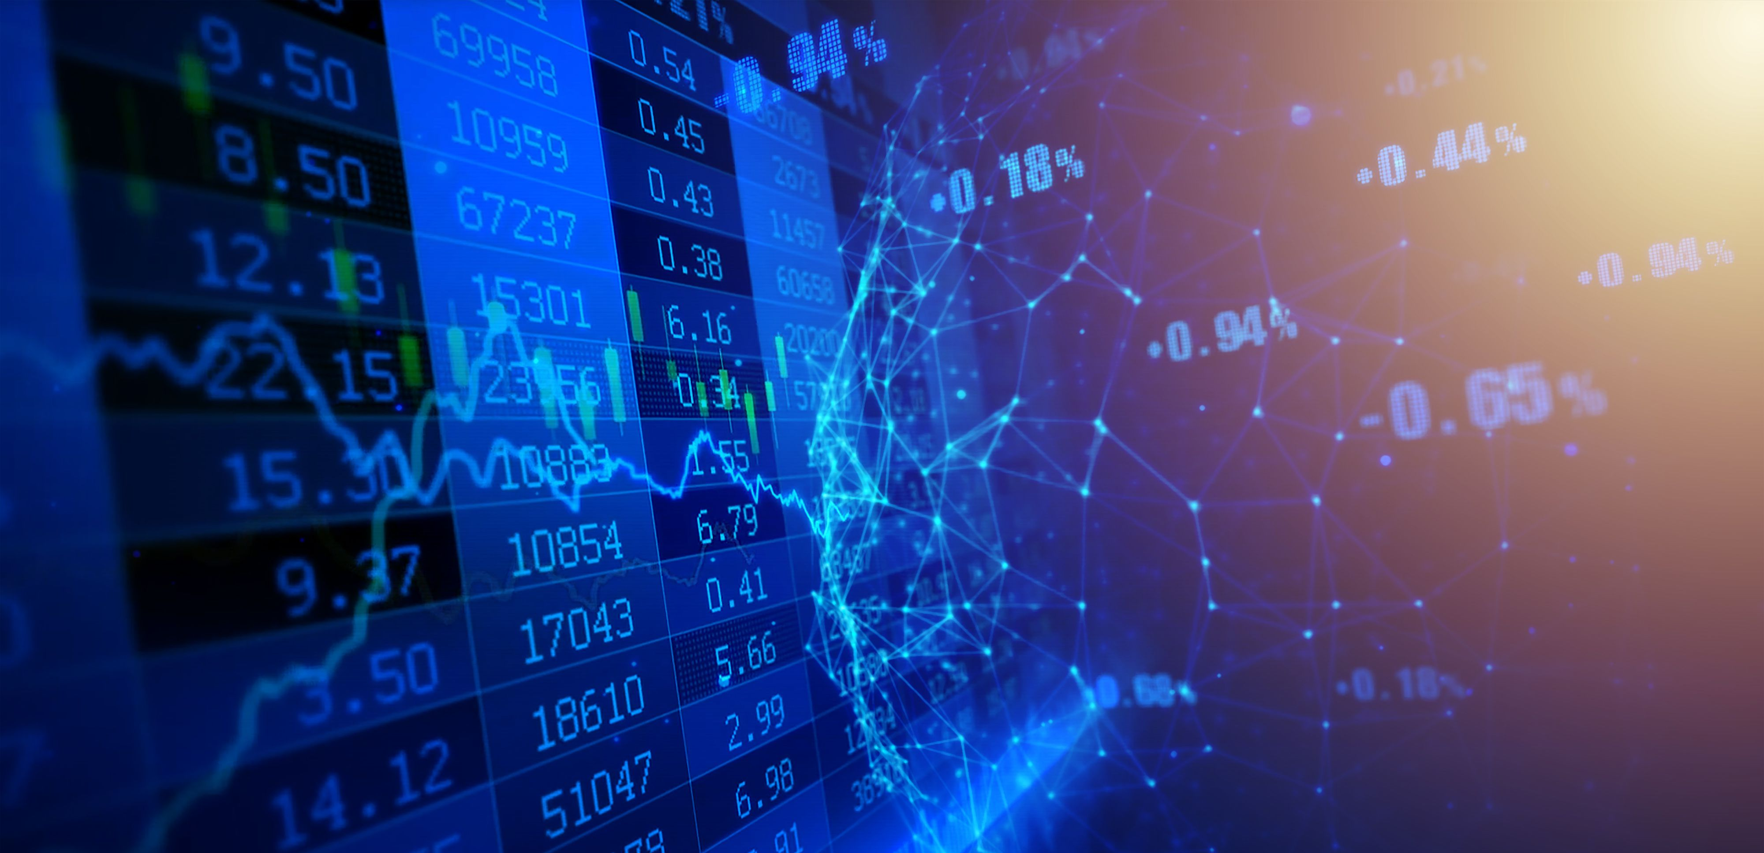
Week 1
Basic Understanding
We were to get acquainted with financial market. How stocks are purchased and sold? What factors matter when share value goes down or up.
Then we were given one company whose shares were of prime importance to us. Financial market is just not all about company stocks.
Commodities like crude oil, gold, silver also have stock values. We had to study trends for crude oil and gold in this week.
Also, we had to explore past ups and downs in stock prices of the company as well as these commodities. In addition to getting acquainted with them.

Slide 6
Week 2
Data Exploration
We used pandas and numpy libraries for data visualizations and many kinds of plots.
Volume-weighted average price (VWAP) is a financial term for the ratio of the value traded to total volume traded over a period.
The measure compares the current price of stock to a benchmark.
We even studied VWAP ( Volume Weighted Average Price ) that are commonly applied by traders on 1 minute and 5 minute charts. These time frames are used when day trading because price action moves quickly. The VWAP indicator starts at the open price and moves up or down based on volume and price action throughout the day.

Slide 7
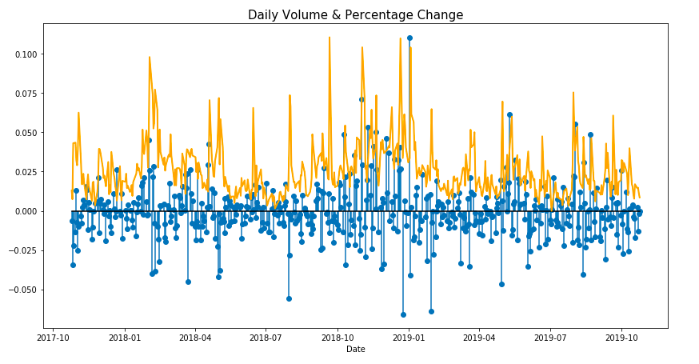
Week 3
DATA VISUALISATION AND TECHNICAL ANALYSIS
Plotting, basic technical indicators and our own customisation, and making our own trade calls were done throughout the week.
We applied VWAP ( Volume Weighted Average Price ) that are commonly applied by traders on 1 minute and 5 minute charts.
These time frames are used when day trading because price action moves quickly.
The VWAP indicator starts at the open price and moves up or down based on volume and price action throughout the day.
We saw that volume traded, and daily percentage change are directly proportional. Whenever the volume traded peeks there is most change between prices of stocks.

Slide 8
Week 4
FUNDAMENTAL ANALYSIS USING REGRESSION
Linear regression when used in context of technical analysis is a method by which to determine the prevailing trend of the past X number of periods.
We were talked to predict outcomes based on OHLC charts.
In OHLC chart shows the open, high, low, and close price for a given period. It can be applied to any timeframe.
Beta is a measurement of market risk or volatility. That is, it indicates how much the price of a stock tends to fluctuate up and down compared to other stocks.
A beta less than 0, which would indicate an inverse relation to the market, is possible but highly unlikely. Companies with volatilities lower than the market have a beta of less than 1 but more than 0.

Slide 9
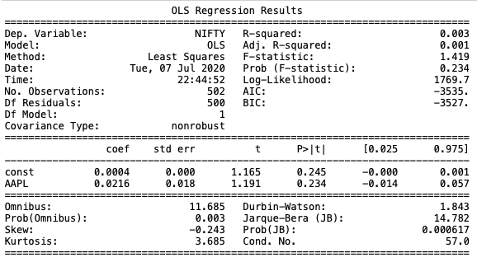
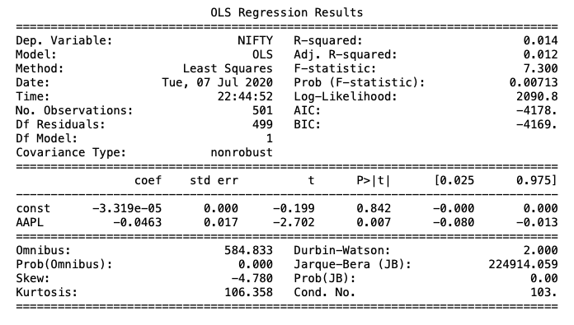
β value is +ve for Daily return and β value is -ve for Monthly return of AAPL.

Slide 10
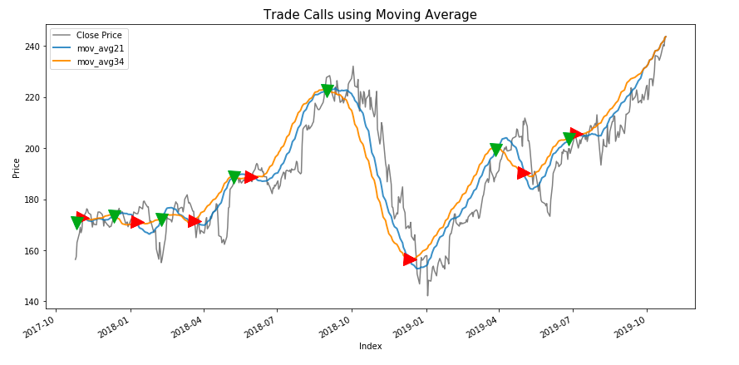
Week 5
The moving average is calculated by adding a stock's prices over a certain period and dividing the sum by the total number of periods.
The strategy is to apply two moving averages to a chart: one longer and one shorter. When the shorter-term MA crosses above the longer-term MA, it's a buy signal, as it indicates that the trend is shifting up. This is known as a "golden cross"
Meanwhile, when the shorter-term MA crosses below the longer-term MA, it's a sell signal, as it indicates that the trend is shifting down. This is known as a "dead/death cross"
TRADE CALL PREDICTION USING CLASSIFICATION
Moving Averages

Slide 11
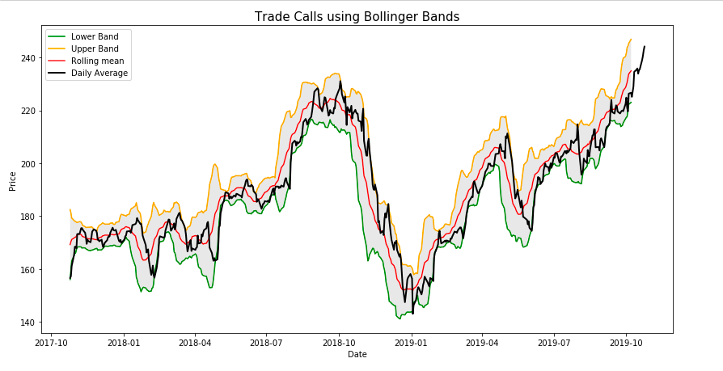
Bollinger Bands
Bollinger Bands are a trading tool used to determine entry and exit points for a trade.
The bands are often used to determine overbought and oversold conditions.
Using only the bands to trade is a risky strategy since the indicator focuses on price and volatility, while ignoring a lot of other relevant information.
Bollinger Bands are a rather simple trading tool,and are incredibly popular with both professional and at-home traders.

Slide 12
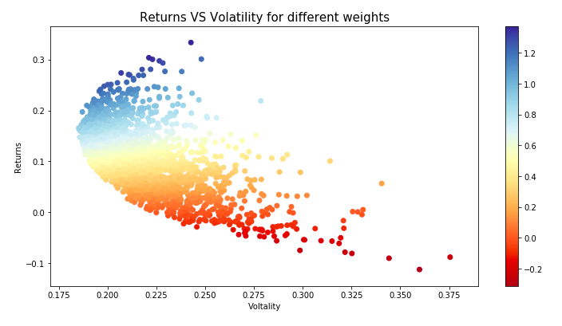
Week 6
MODERN PORTFOLIO THEORY
Sharpie Ratio is used to help investors understand the return of an investment compared to its risk.The ratio is the average return earned in excess of the risk-free rate per unit of volatility or total risk. Volatility is a measure of the price fluctuations of an asset or portfolio.
Generally, the greater the value of the Sharpe ratio, the more attractive the risk-adjusted return.

Slide 13
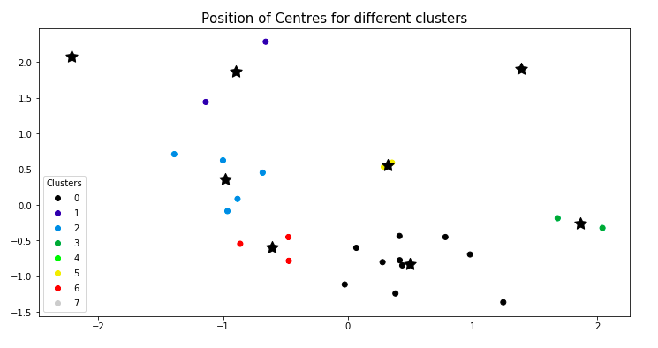
Week 7
CLUSTERING FOR DIVERSE PORTFOLIO ANALYSIS
The clusters made in market are based on volatility and returns of different portfolios.
We had 30 stocks portfolios where we had to perform clustering. Volatile markets tend to have more volatility in their future and quiet markets tend to stay quiet until some random volatility shock (think new information like an earnings announcement) hits the market.

Slide 14

Week 8
Completion Interview and Report Submission

