Slide 1
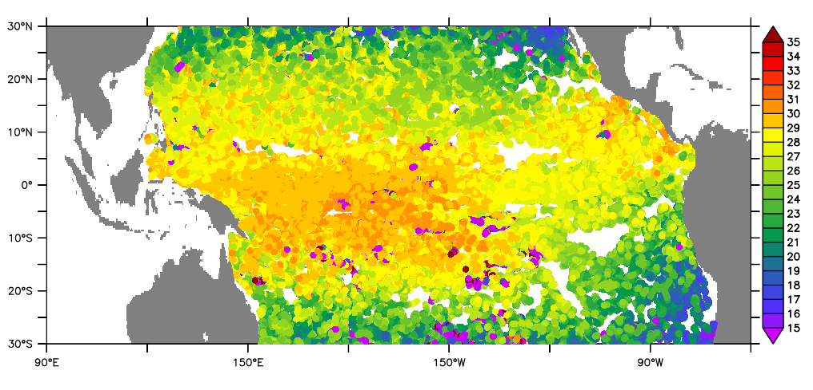
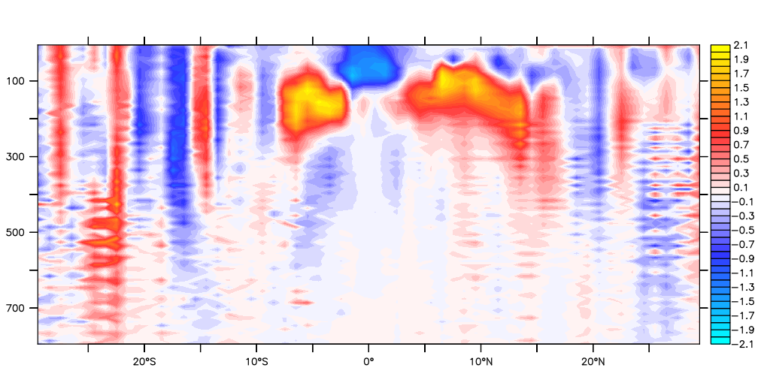
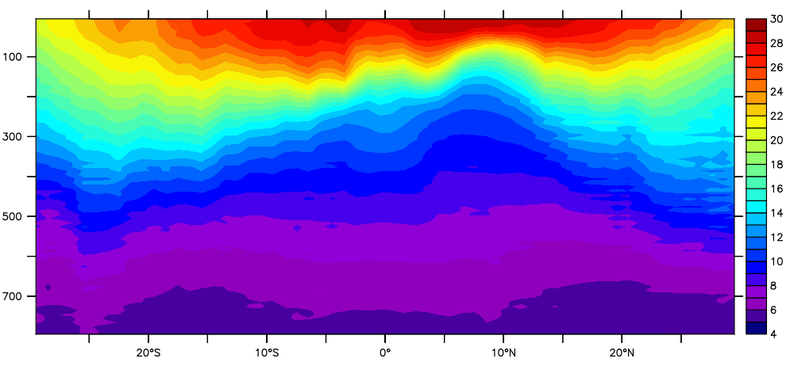
Configuring data in ERDDAP
Kevin O'Brien (University of Washington/JISAO)
Bob Simons (NOAA/NMFS)
Roy Mendelssohn (NOAA/NMFS)

Slide 2
ERDDAP - no introduction needed?
ERDDAP is software that creates a platform for distributing data.
ERDDAP's goal is to give users easier access to scientific data.
ERDDAP is reusable, Free, and Open Source.
It has been installed at more than 60 institutions in at least 10 countries
…..and is on several official lists of recommended data servers.

Slide 3
Finding data and downloading it into your favorite client software is too hard!
Often data servers lack a search system. It's hard to find datasets of interest.
Different data servers use different request protocols. (XML, SOAP+XML, OPeNDAP, WCS, WFS, SOS, HTML form, shopping cart, ...!)
Different data servers return data in different formats. (XML, SOAP+XML, DAP binary, ASCII text, HDF4, HDF 5, NetCDF, ...!) and it usually isn't the file format that you want. (html table , ESRI. asc, .kml, .mat, .csv, .tsv, .json, .xhtml)
Different datasets have time formatted in different ways. ("Jan 2, 1985", "02-JAN-1985", "1/2/85", "2/1/85", "1985-01-02", Year + DayOfyear, "seconds since 1900-01-01", "days since 1-1-1", ...!)
Most datasets have insufficient metadata. That makes it hard to understand the data.
Notes:
ERDDAP is designed to solve these problems.

Slide 4
ERDDAP
ERDDAP
Favorite Client Software
Notes:
For a users point of view, ERDDAP is a data server
\that gives users a simple, consistent way
to download subsets of gridded and tabular scientific datasets
and make graphs and maps.
Because ERDDAP returns data in the file format that the user specifies,
it is easy for users to get the data into their favorite client software.

Slide 5
ERDDAP
OBIS
SOS
THREDDS
Hyrax
ERDDAP
...
3
Database
ERDDAP
Files
2
1
4
Favorite Client Software
Notes:
From a data providers point of view,
ERDDAP is acting as a middleman that can get data
from a wide variety of local and remote data sources
and offer them to users in a consistent way
that hides the details of the actual source.
When a user sends a standardized request to ERDDAP,
ERDDAP translates it into the request format needed by the actual source, for example, a database.
ERDDAP then gets the response from the source, in whatever format that is,
and reformats the data into the file format that the user has requested.

Slide 6
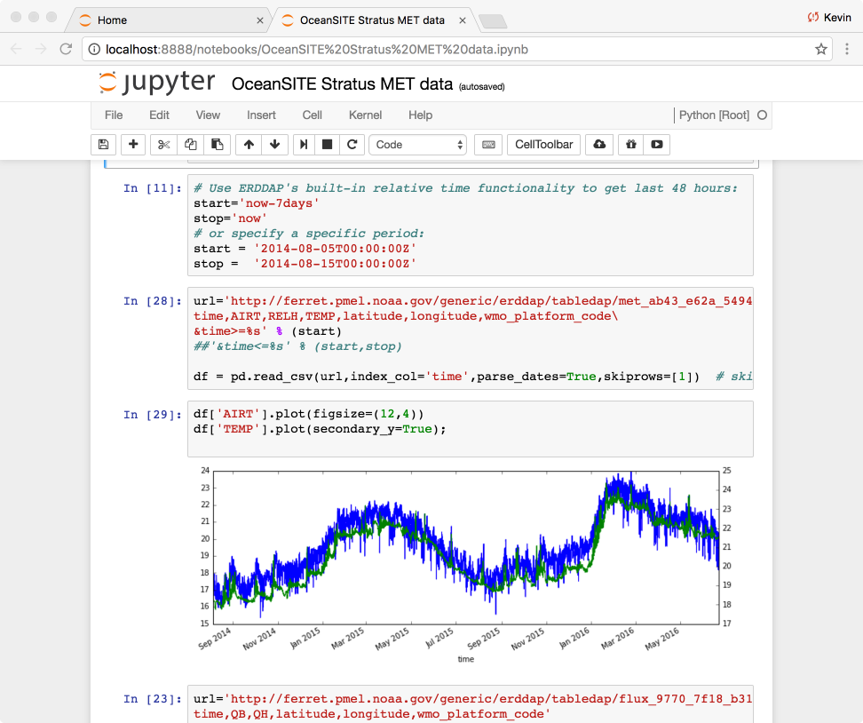
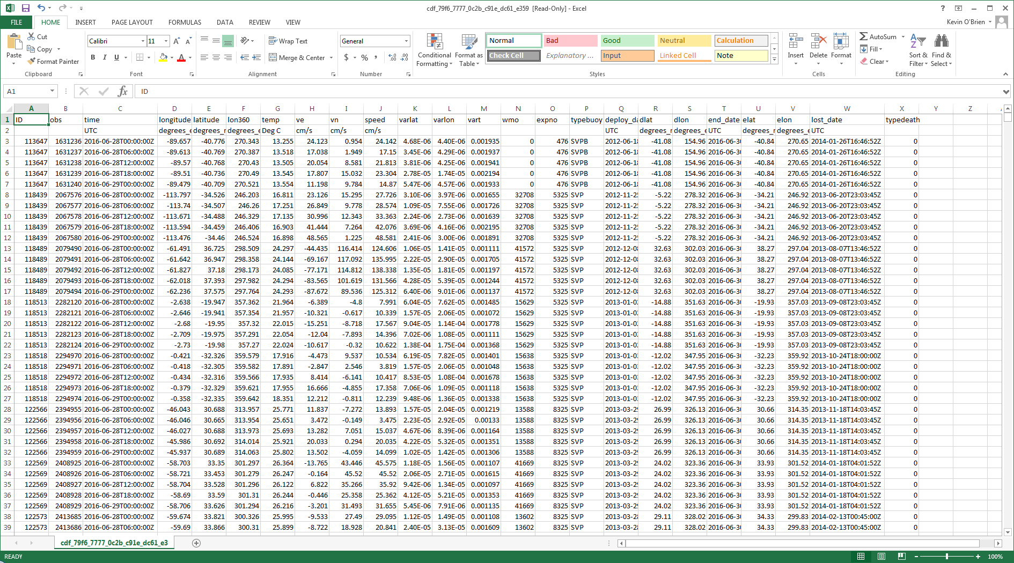
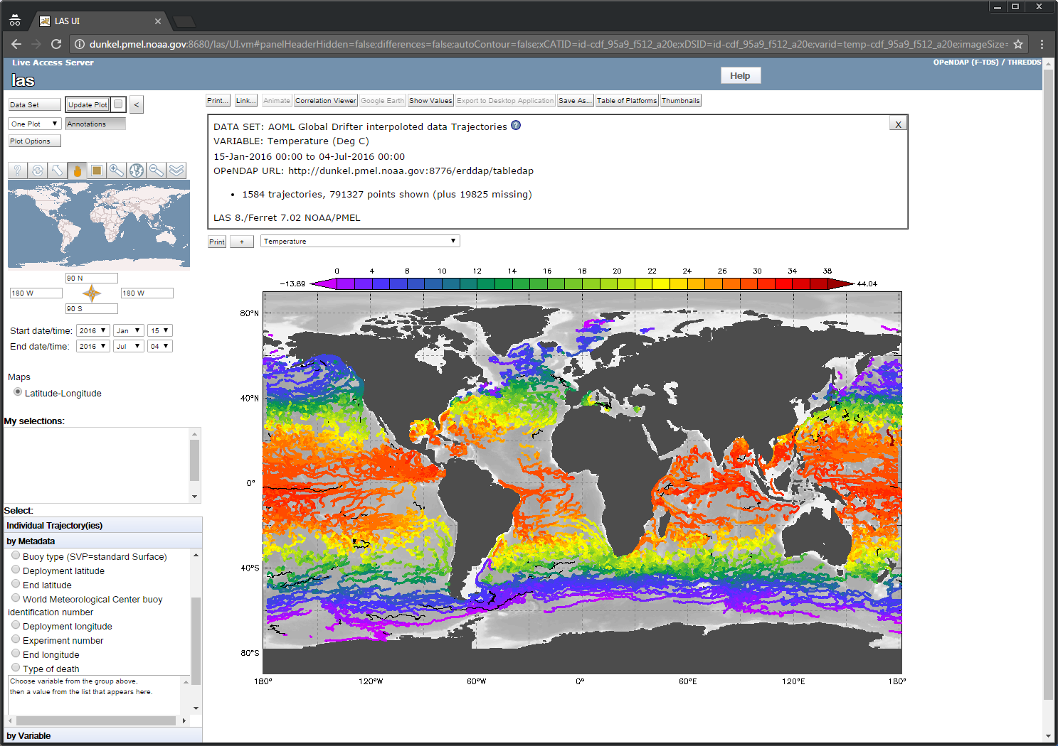
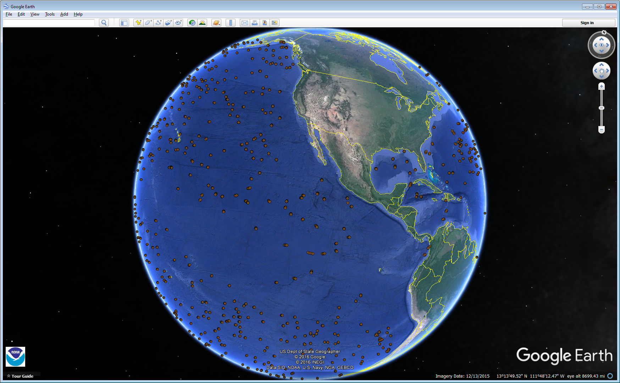
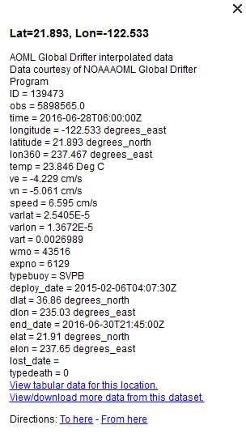
Many clients (Live Access Server, Excel, Google Earth, Matlab®, Jupyter Notebooks, R, etc) can directly access data from ERDDAP

Slide 7
ERDDAP community
JCOMM Observations Coordination Group
pushing ERDDAP as data platform
Integrate data from disparate networks
Global Drifter Program, Sea Level, Argo, Gliders, Tide, Moorings, etc
RT data access
OCG led open access to GTS pilot project
RT Ocean obs available via Observing System Monitoring Center (OSMC) ERDDAP server
Operational workflows such as Surface Ocean CO2 Atlas (SOCAT) project and, soon, NOAA Ocean Acidification Program
NOAA’s Unified Access Framework (UAF) project
And Growing!!

Slide 8

ERDDAP configuration demo
Coral reef data from Abby*
3 separate files
Event
Measurement or Fact
Occurrence
Goal: Configure these data into ERDDAP
On to the demo…...
*I am not a biologist

Slide 9
Thank you!
ERDDAP: coastwatch.pfeg.noaa.gov/erddap/index.html
Kevin.M.O’Brien@noaa.gov
kob@uw.edu
Bob.Simons@noaa.gov

