Slide 1
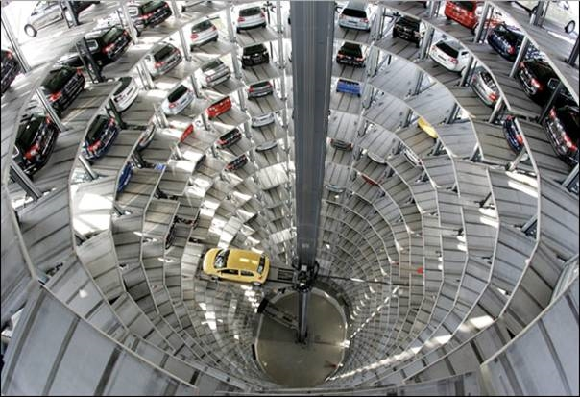
Smart Car Parking System

Slide 2
Introduction

Slide 3
Problem
The traditional parking systems such as multilevel or multi-store car parking systems (non-automated), robot car parking systems, automated multilevel car parking systems etc. have been implemented on a huge scale. But these systems have a major disadvantage of large space consumption

Slide 4
Project Objective
To develop an intelligent, user friendly automated car parking system which reduces the manpower and traffic congestion. To offer safe and secure parking slots within limited area.

Slide 5
Methodology
Propose the system which can able to park vehicle as user scan his RFID card.
System having automated lift which can park vehicle at particular slot of that vehicle
System have admin control for un-park vehicles and recharge user cards.
Automatic parking charges deduction

Slide 6
Working
Stm32 microcotroller controls the all system
System having RDIF reader, LCD display, keypad and 3 servo motors
RFID reader UID from RFID card and process it
Every floor is separated with vehicle types
User is charged accordingly vehicle types.
If user don't have enough balance then he needs to recharge card from admin.
If user exceeds time entered while parking then user get charged for extra time.
Admin can monitor and unpark vehicles that exceeds time limits.

Slide 7
Working Flow

Slide 8
Car parking flow
1. user park car on platform circular disk
2. user scan his RFID card
3. system find out if there is any empty parking slot available
4. system show parking slot available
5. user select vehicle type
6. user enter how much time he wants to park car(day/hours/minute)
7. display show charges for parking
8. system reduce money for that user RFID card
9. lift moves down and got to vehicle type floor (eg. Four wheelers)
10. circular disc rotate to direction of parking slot.
11. Car is slide to parking slot
12. lift come to its position back

Slide 9
Car unparking flow
1. user scan his RFID card
2. system shows how much time vehicle spend in parking slot
3. if it more than user entered then user need to pay extra charge
4. if extra charge then money deduct for that RFID card
5. lift find slot for vehicle of that RFID card
6. rotate disk move to slot direction sliding motor slides vehicle on disk
7. lift come to its position back.

Slide 10
Recharge RFID
1. Admin swap his RFID card
2. enter amount to be recharge
3. swaps users RFID to recharge

Slide 11
Hardware Used

Slide 12
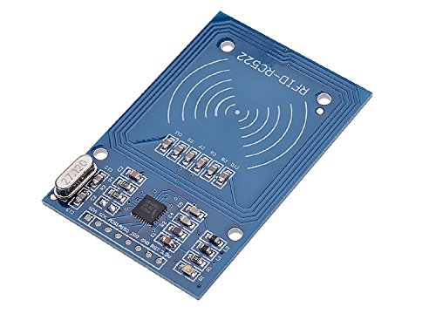
RFID Reader
A radio frequency identification reader (RFID reader) is a device used to gather information from an RFID tag, which is used to track individual objects. Radio waves are used to transfer data from the tag to a reader.

Slide 13
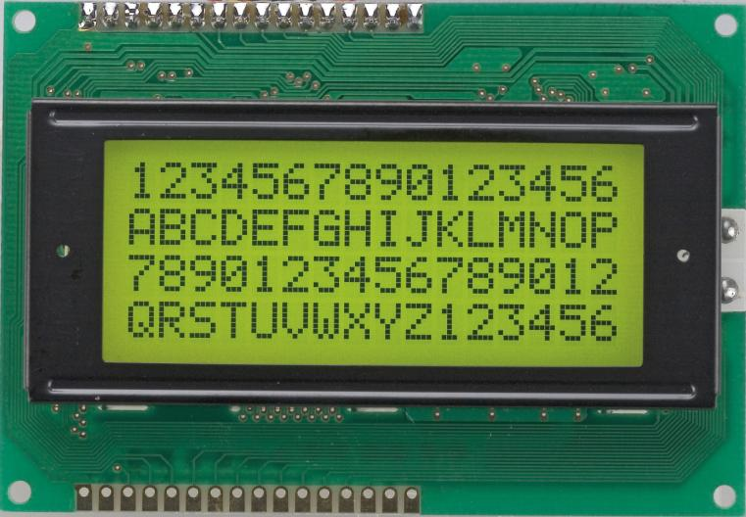
LCD Display
LCD Stands for "Liquid Crystal Display." LCD is a flat panel display technology commonly used in Industrial systems, control devices and monitor devices. It is very useful to display alpha numerical information.

Slide 14
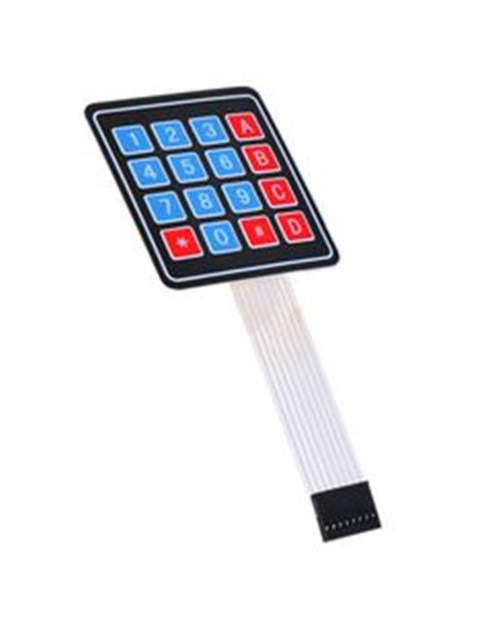
Keypad
Keypads are arrangement of buttons in matrix format. MCU detect the which key is pressed and take action

Slide 15
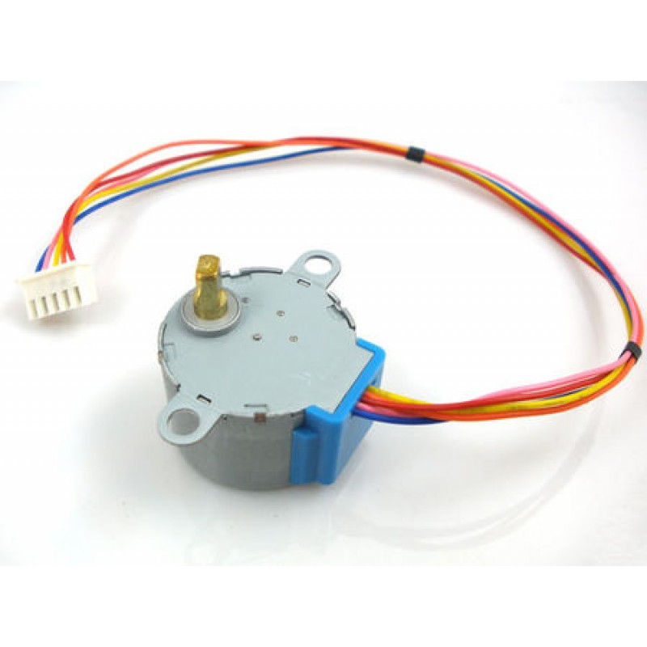
Stepper Motor
Stepper motors are DC motors that move in discrete steps. They have multiple coils that are organized in groups called "phases". By energizing each phase in sequence, the motor will rotate, one step at a time. With a computer controlled stepping you can achieve very precise positioning and/or speed control. For this reason, stepper motors are the motor of choice for many precision motion control applications.

Slide 16
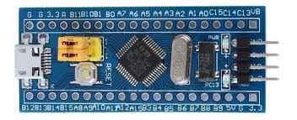
Micro Controller
STM32F103 devices use the Cortex-M3 core, with a maximum CPU speed of 72 MHz. The portfolio covers from 128kb of Flash with motor control peripherals. 64 kb of SRAM.

Slide 17
Block Diagram

Slide 18
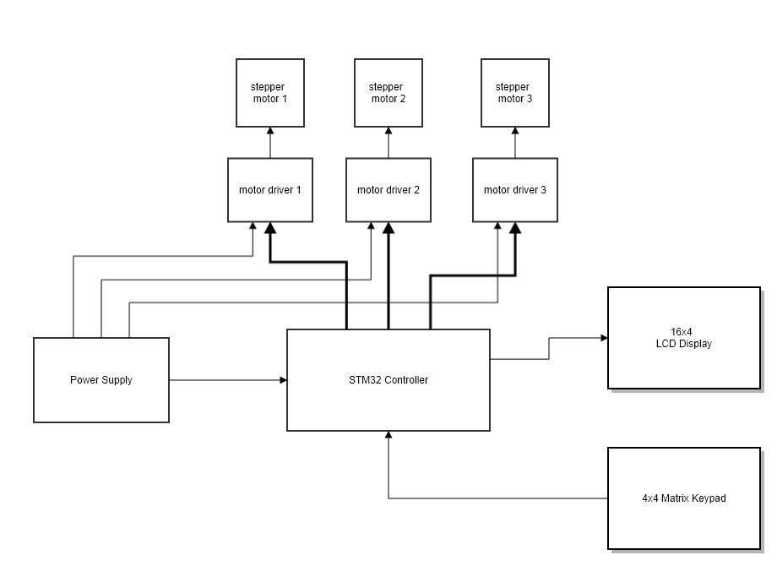

Slide 20
Conclusion

