Slide 1

ZOMATO GLOBAL EXPANSION STRATEGY
- Submitted by Srinivas K
Notes:
Introduce yourself confidently. State that the objective is to convert raw restaurant data into strategic expansion recommendations.

Slide 2
Agenda
Problem Statement
Data Description
Objective Questions
Data Cleaning
Data Analysis & Visualizations
Expansion Suggestions
Dashboard Demonstration
Conclusion
Notes:
Explain that this project focuses on strategic decision-making, not just Excel operations.

Slide 3
Problem Statement
You are hired as a Consultant Data Analyst at Zomato.
The management team wants to expand into new markets and open new restaurants.
Your task is to:
Analyze restaurant performance
Identify high-potential countries
Study competition levels
Suggest suitable cities
Provide dashboard-based reasoning
Notes:
Describe dataset richness and multidimensional structure.

Slide 4
Data Overview
Total Rows: 9552 Total Columns: 20
Category | Attributes
Basic Information | Restaurant ID, Restaurant Name, Address, Cuisines
Location Details | Country Code, City
Service Features | Has Online Delivery, Has Table Booking
Financial & Performance | Price Range, Average Cost for Two, Currency, Votes, Rating, Date Key Opening
Notes:
Explain why cleaning ensures reliable insights.

Slide 5
Data Cleaning Process
To ensure accurate analysis:
Removed duplicate Restaurant IDs
Handled missing ratings
Standardised country names
Used VLOOKUP to map CountryCode to Country
Converted currencies into INR
Checked inconsistent values
Notes:
Explain logical flow of analysis.

Slide 6
Restaurants by Country
Method Used:
Pivot Table
Rows: CountryName
Values: RestaurantID (Count)
Insight:
India has the highest restaurant concentration
Some countries have a very limited presence
Notes:
Explain market saturation concept and why lower density reduces entry barriers.

Slide 7
Restaurants by Year
Method Used:
Pivot Table using Datekey_opening
Insight:
Growth trend visible after 2015
Certain years show aggressive expansion
Year | COUNT of RestaurantID
2010 | 1080
2011 | 1098
2012 | 1022
2013 | 1061
2014 | 1051
2015 | 1024
2016 | 1027
2017 | 1086
2018 | 1102
Notes:
Explain how growth trend reflects industry maturity.

Slide 8
Average Rating
Consistently high quality across markets, with all average ratings clustered between 2.8 - 4.5
Minimal rating gap (0.24) confirms all five countries as low-risk, high-quality markets for expansion.

Slide 9
Average Cost For Two (INR)
Singapore and UK are premium dining markets, with the highest average costs for two at ₹10922 and ₹5786 respectively.
Turkey is the most cost-efficient market (₹146), while Indonesia remains highly affordable (₹1,080), indicating strong value-driven dining options.

Slide 10
Top 10 Cuisines
Cafe cuisine leads by scale, with 13 listings and a 4.29 average rating, indicating strong demand, consistent quality, and resilience in a highly competitive segment.
Indian cuisines strike a balance: Indian and Indian, North Indian combine moderate presence with high customer satisfaction.

Slide 11
Cuisine Performance Analysis
Top performing cuisines:
Fast Food
Multi-Cuisine
Asian
These cuisines show consistent ratings & engagement.
Notes:
Explain adaptability and demand consistency.

Slide 12
Country-Level Competition Analysis
Visualisation Used: Bar Chart (Restaurant Count)
Countries with lesser competition identified.
Notes:
Explain correlation meaning clearly in simple language.

Slide 13
Average Votes per Country
Method:
Pivot Table (Average of Votes)
Insight: Countries with high average votes show strong customer engagement.
Country Name | AVERAGE of Votes
Australia | 111.4166667
Brazil | 19.61666667
Canada | 103
India | 13.212552
Indonesia | 772.0952381
New Zealand | 243.025
Philippines | 407.4090909
Qatar | 163.8
Singapore | 31.9
South Africa | 315.1666667
Sri Lanka | 146.45
Turkey | 431.4705882
United Arab Emirates | 493.5166667
United Kingdom | 205.4875
United States of America | 428.2211982
Grand Total | 156.9097477

Slide 14
Restaurants in India with Price Range 4
Method:
COUNTIFS function
Answer: = COUNTIFS('data cleaning'!D2:D9552,"India",'data cleaning'!Q2:Q9552,4)
388 Resataurants in located in India with a price range of
Insight:
The premium segment exists but is limited.
Notes:
Explain importance of engagement in modern food platforms.

Slide 15
Conditional IF Function Analysis
Method:
Average rating for: Price_range < 4 AND Online Delivery = Yes
Methods Used:
IF + AND + AVERAGE
=ROUND(AVERAGE(IF(('data cleaning'!Q2:Q9552 <4)*('data cleaning'!N2:N9552="Yes"),'data cleaning'!V2:V9552)),2)
Insight: Restaurants offering delivery have slightly better ratings.
Notes:
Explain how moderate ratings allow differentiation opportunity.

Slide 16
Suggested Cities
Used:
Pivot Table + Filter
Selected cities based on:
Moderate competition
High votes
Growing ratings
Notes:
Explain digital transformation advantage.

Slide 17
Conditional Formatting
Highlighted rows for suggested expansion countries:
Sri Lanka
Turkey
New Zealand
Indonesia
Philippines
Qatar
Reason: Low competition + good rating potential

Slide 18
Suggested Countries for Expansion
Based on:
Low restaurant count
Moderate ratings
Growing demand
Recommended:
Sri Lanka
Turkey
Indonesia
Philippines
Qatar
New Zealand
Row Labels | Count of RestaurantID | Average of Rating | Sum of Votes
Indonesia | 21 | 4.3 | 16214
New Zealand | 40 | 4.3 | 9721
Philippines | 22 | 4.5 | 8963
Qatar | 20 | 4.1 | 3276
Sri Lanka | 20 | 3.9 | 2929
Turkey | 34 | 4.3 | 14670

Slide 19
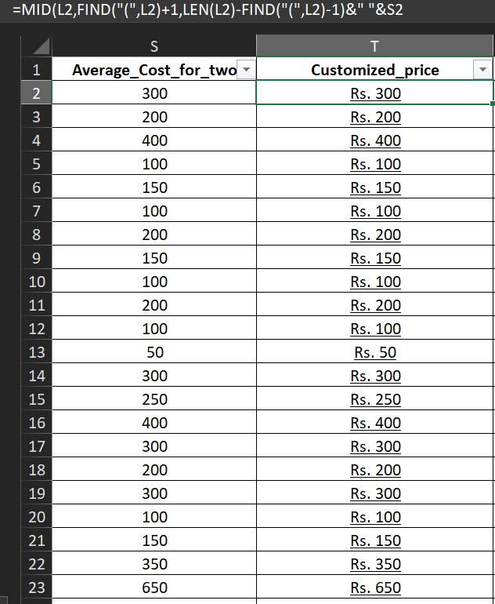
Customised Price Column
Created new column:
Example: ₹ 1200 $ 50
Used: String concatenation formula.
=MID(L2,FIND("(",L2)+1,
LEN(L2)-FIND("(",L2)-1)&" "&S2
Notes:
Explain affordability and acceptance logic.

Slide 20
Array Formula Task
Count restaurants where:
No Online Delivery
Price Range = 1
Avg Cost ≤ 250 INR
Used:
COUNTIFS / Array Formula
=COUNTIFS('data cleaning'!N3:N9553,"No",'data cleaning'!Q3:Q9553,1,'data cleaning'!U3:U9553,"<=250")
Notes:
Explain why saturated premium market increases risk.

Slide 21
Has Online Delivery
Pivot Table:
Has_Online_delivery | AVERAGE of Rating
No | 2.754309859
Yes | 3.288004896
Grand Total | 2.89126793

Slide 22
Conditional & Advanced Logic Used
COUNTIFS for filtered counts
IF + AND helper column
CORREL for statistical analysis
Array formula for multi-condition counting
Notes:
Highlight technical spreadsheet skills.

Slide 23
Weighted Country Scoring Model
Weights Applied:
Competition – 30%
Rating – 25%
Votes – 20%
Cost – 25%
Objective ranking method used.
Notes:
Explain how scoring avoids subjective bias.

Slide 24
Strategic Entry Plan
Mid-range pricing (Range 2–3)
Enable online delivery from launch
Focus on popular cuisines
Start with pilot expansion
Notes:
Explain execution roadmap.

Slide 25
Risk & Mitigation
Risks:
Cultural mismatch
Regulation
Currency volatility
Mitigation:
Local partnerships
Gradual scaling
Market research
Notes:
Show risk awareness and professional thinking.

Slide 26
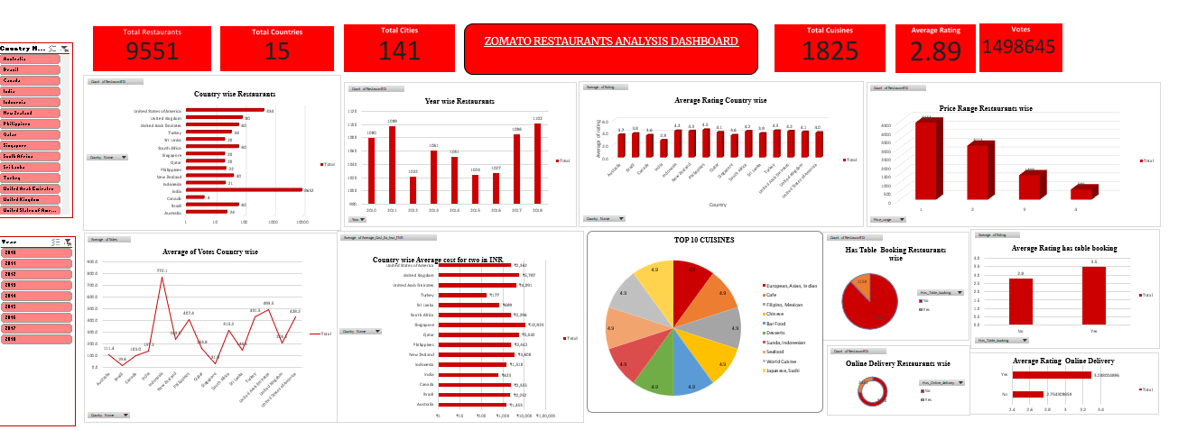
DASHBOARD

Slide 27
Conclusion & Final Recommendation
Zomato should expand into low-competition, moderate-cost markets using a digital-first and mid-range pricing strategy.
This project demonstrates how structured analytics supports strategic business decisions.
Notes:
Deliver final confident closing statement and invite questions.

Slide 28
THANK YOU
Notes:
Deliver final confident closing statement and invite questions.

