Slide 1



ABC Tyre Company LTD

Slide 2
DATABASE MANAGEMENT SYSTEMS
FOR ABC TYRE COMPANY
Name :H.B.T.D.Sanjitha
Reg No : ASP/17/18/059
Index No : 4085

Slide 3

Content
Introduction
ER Diagram
Relational Schema
MYSQL Code

Slide 4
Introduction
This Database is for ABC tyre company store room which used to easily calculate the quantity which is stored, to manage customer stores data, and for fast delivering island wide when an order is placed and so on.

Slide 5
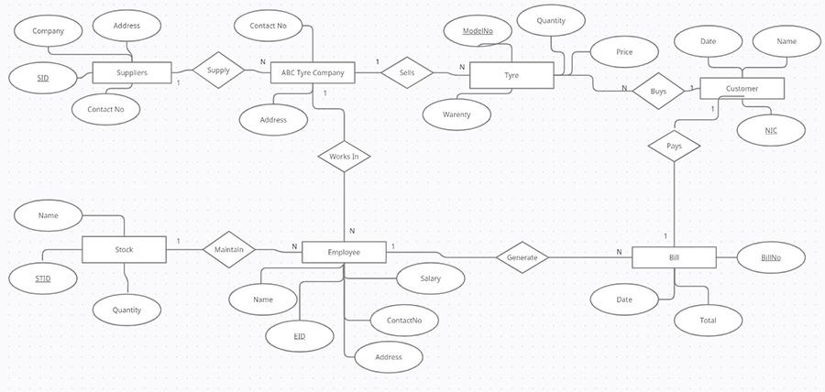
ER Diagram

Slide 6
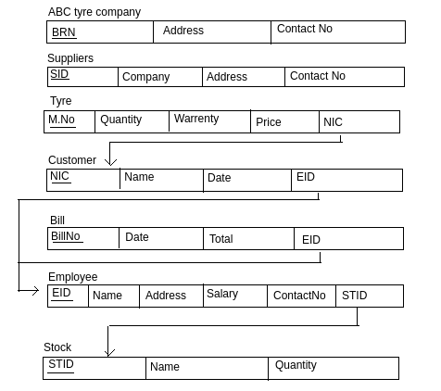
Relational Schema

Slide 7
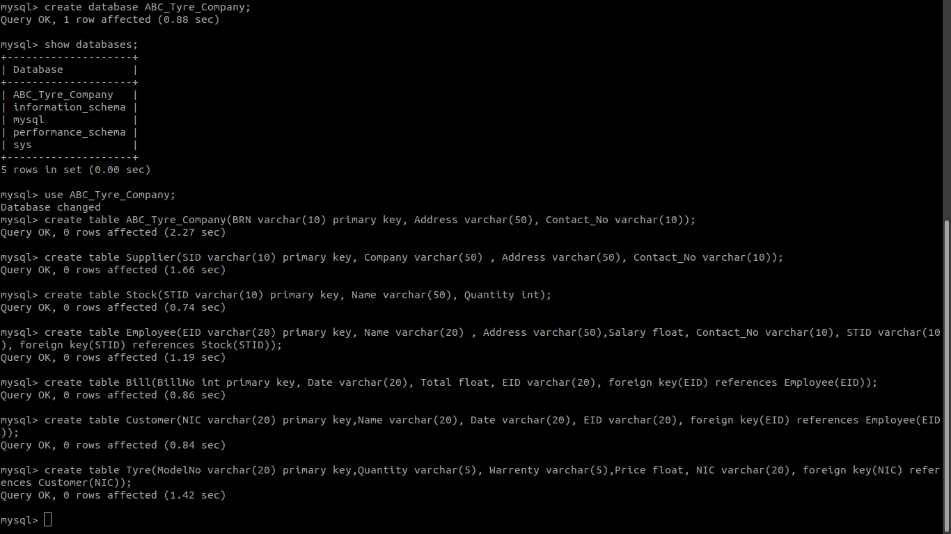
MYSQL Code

Slide 8
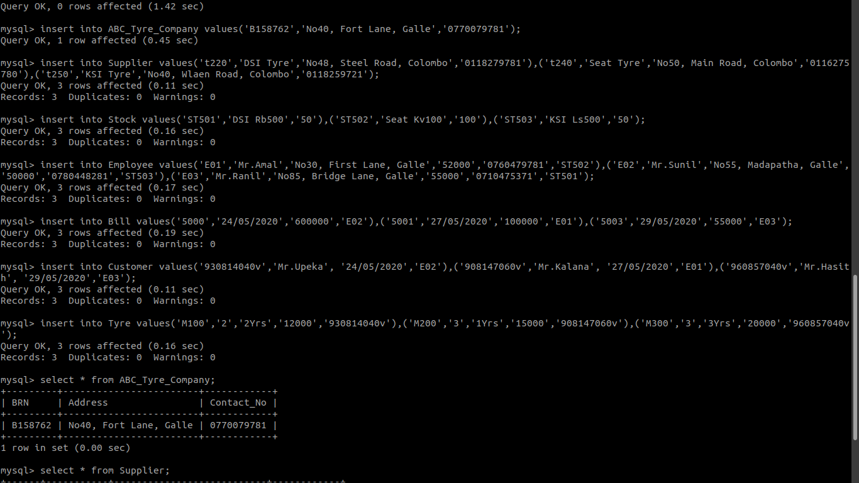

Slide 9


Slide 10
