Slide 1

IPI5: Understanding City Growth as it Relates to Sustainability
Ashley Gilbert, Ryan Pacheco, Ben Whitehead
This Photo by Unknown Author is licensed under CC BY-NC-ND

Slide 2

The Problem
Our goal is to identify characteristics which make a city sustainable, then classify cities based on whether they are growing sustainably or not.
We will be looking at the 5 largest cities in Idaho, California, and New York.

Slide 3

Census Data
NAME: City Name
P002001: Total Population
H001001: Housing Unit Count
P027001: Presence of Non-Relatives
P013001: Median Age (both sexes)
P002002: Total Urban Population
P002005: Total Rural Population
H003001: Occupancy Status Presence of Non-Relatives
H005001: Vacancy_Status
H005002: For_Rent
H005003: Rented_Not_Occupied_
H005004: For_Sale_Only
H005005: Sold_Not_Occupied
H005006:For_Seasonal_Recreational_Or_Occasional_Use
H005007: For_Migrant_Workers
This Photo by Unknown Author is licensed under CC BY-SA

Slide 4

American Community Survey
B01003_001E: Total_Population B00002_001E: Total_Housing B09018_007E: Presence_of_Non-Relatives B01002_001E: Median_Age

Slide 5

Greenhouse Gas Data
EPA data for registered pollutants in the US
Total direct reported emissions
Does not contain commuter emissions data
Gathered per factory

Slide 6

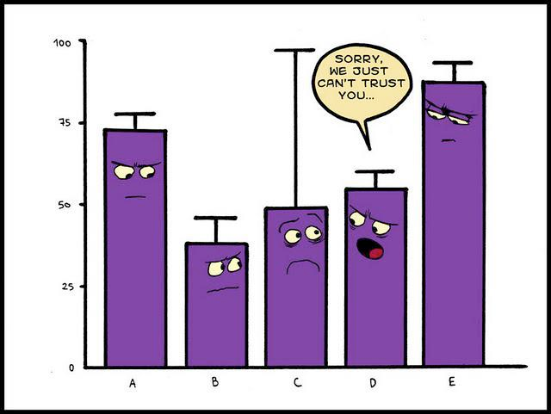

Data Munging
Renamed all columns for census and ACS data, for consistency
Combined 2000,2010 data for census
Joined Greenhouse Gas data to census data on FIPS (entity code)
Mapped columns from ACS data to Census Data and joined on FIPS
Picked the 5 largest cities from the states we’re trying to analyze (from 2000)

Slide 7
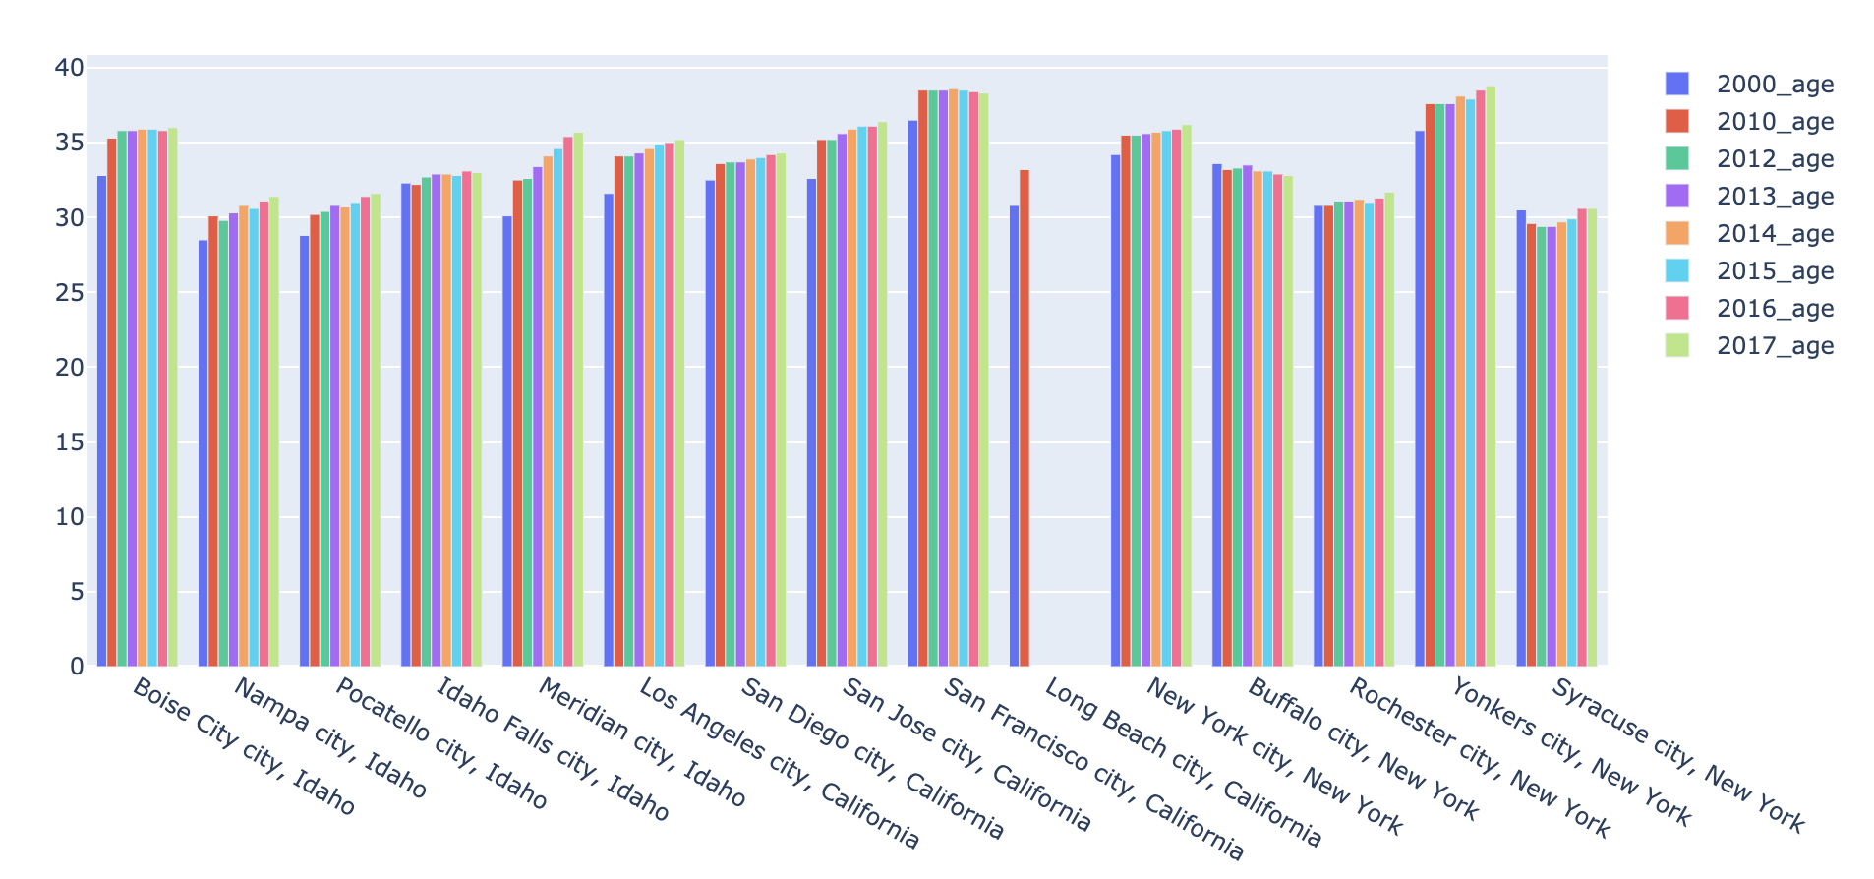
Median Age

Slide 8
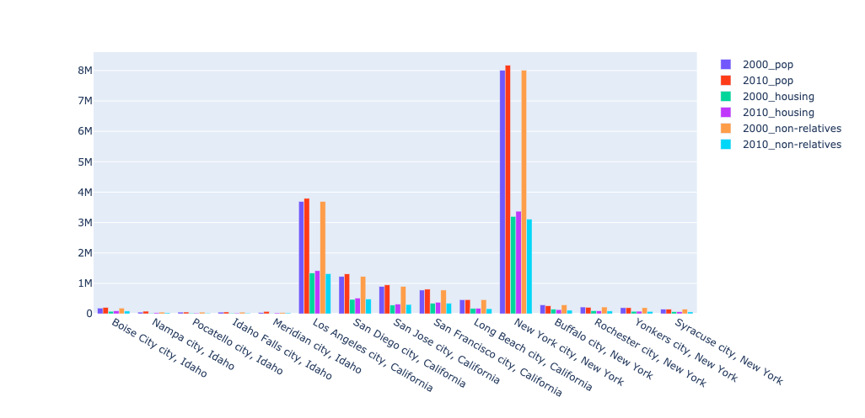
Census Data Plotting

Slide 9
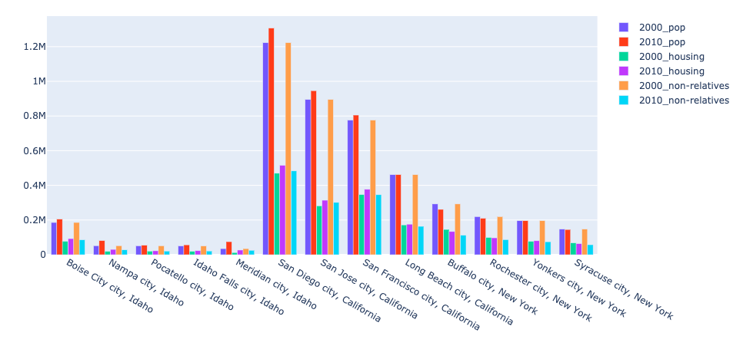
Census Data without NYC or LA

Slide 10
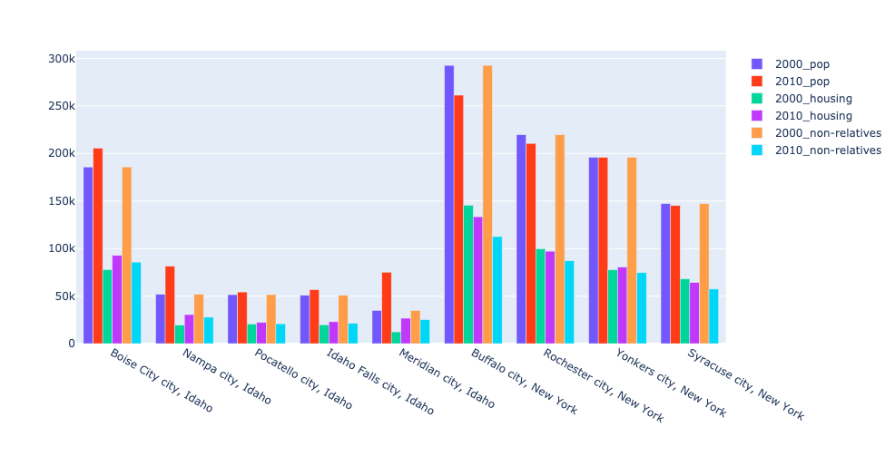
Census data without California

Slide 11
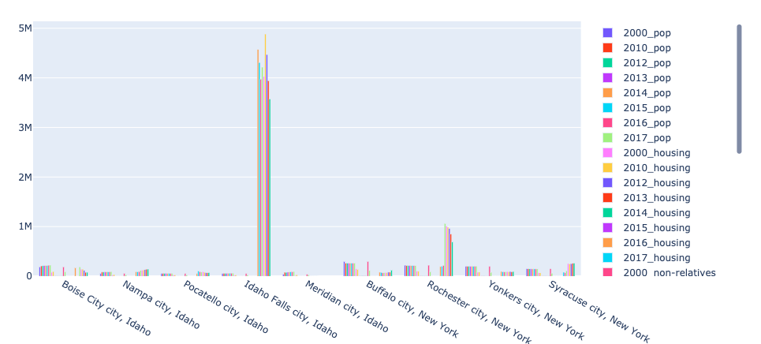
Emissions & ACS Data

Slide 12
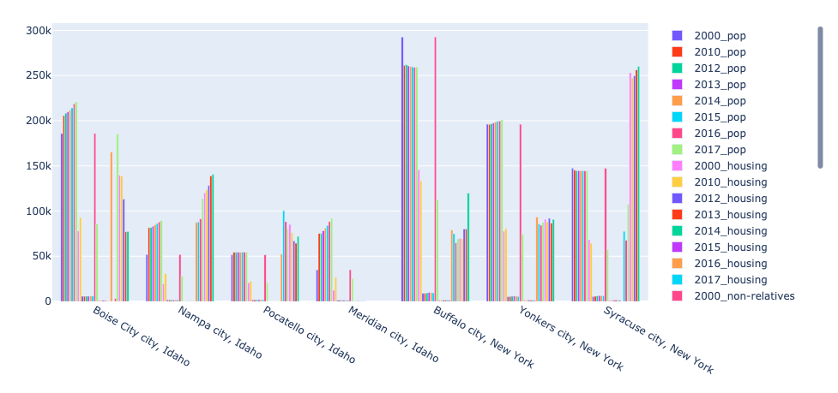
Emissions & ACS data without Idaho Falls

Slide 13

Modeling
Supervised:
What is sustainable?
Need legitimate labeling of data
Too many cities
Unsupervised:
What about clustering?
Data inconsistencies
Not enough data

Slide 14

Conclusion
What is sustainable?
Population Growth
Cost of Living
Housing Available
Median Age
Emissions

Slide 15
Future Work
We want to model this, because the answer to what is sustainable growth lies in a model.
Additional Things Needed For Modeling:
Expert Labeling
Feature Engineering
More Data
More Consistent Data (ACS missing/different columns)

