Slide 1
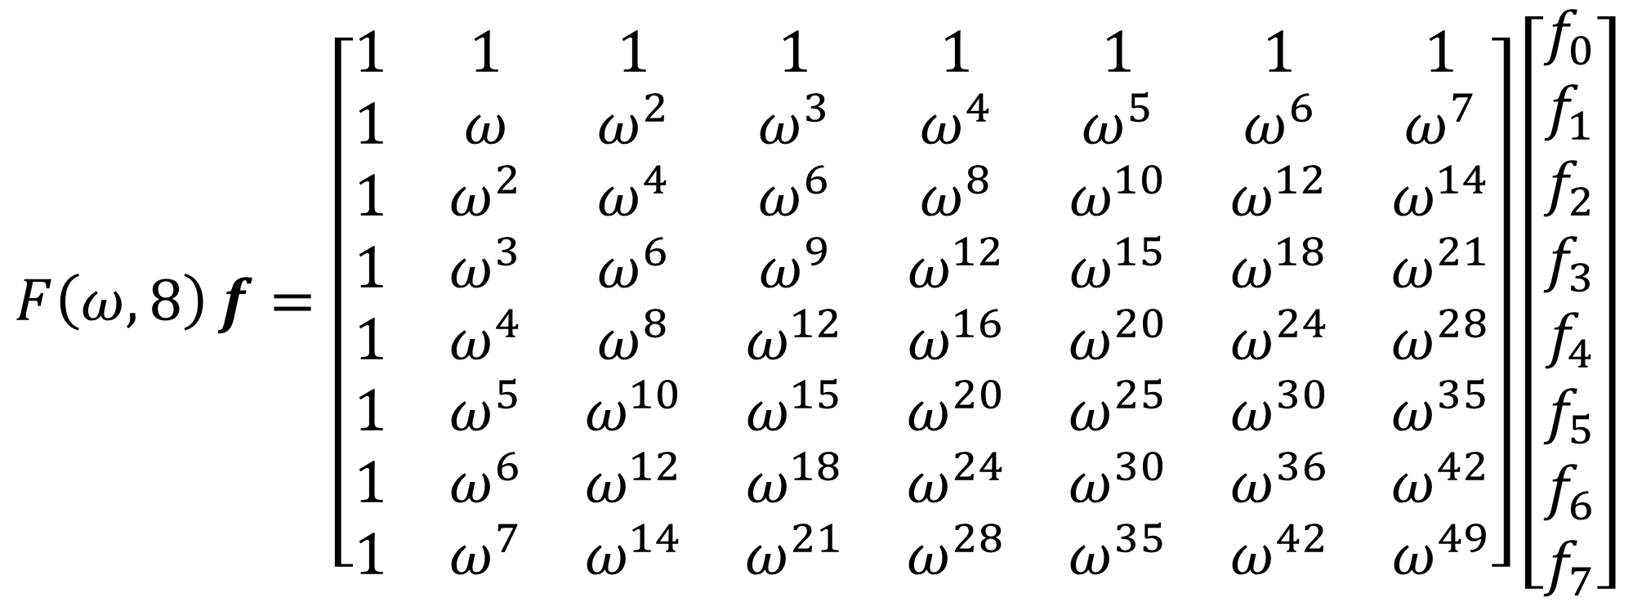
$$F\left(ω,8\right)f=\left[\begin{matrix}1 & 1 & 1 & 1 & 1 & 1 & 1 & 1 \\ 1 & ω & ω^{2} & ω^{3} & ω^{4} & ω^{5} & ω^{6} & ω^{7} \\ 1 & ω^{2} & ω^{4} & ω^{6} & ω^{8} & ω^{10} & ω^{12} & ω^{14} \\ 1 & ω^{3} & ω^{6} & ω^{9} & ω^{12} & ω^{15} & ω^{18} & ω^{21} \\ 1 & ω^{4} & ω^{8} & ω^{12} & ω^{16} & ω^{20} & ω^{24} & ω^{28} \\ 1 & ω^{5} & ω^{10} & ω^{15} & ω^{20} & ω^{25} & ω^{30} & ω^{35} \\ 1 & ω^{6} & ω^{12} & ω^{18} & ω^{24} & ω^{30} & ω^{36} & ω^{42} \\ 1 & ω^{7} & ω^{14} & ω^{21} & ω^{28} & ω^{35} & ω^{42} & ω^{49}\end{matrix}\right]\left[\begin{matrix}f_{0} \\ f_{1} \\ f_{2} \\ f_{3} \\ f_{4} \\ f_{5} \\ f_{6} \\ f_{7}\end{matrix}\right]$$

Slide 2
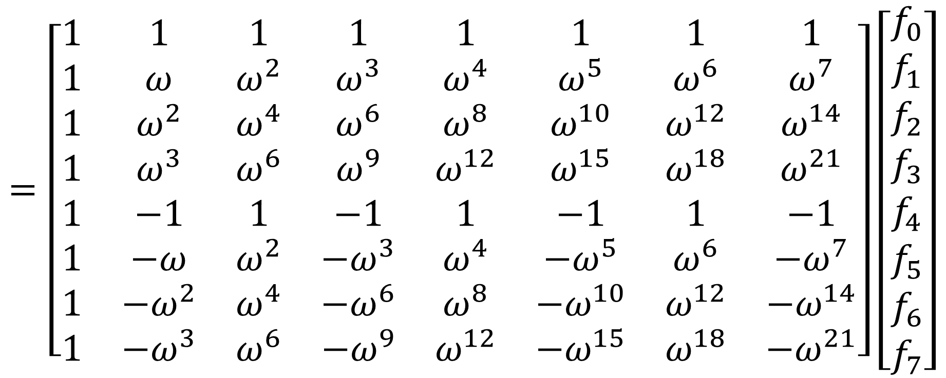
$$=\left[\begin{matrix}1 & 1 & 1 & 1 & 1 & 1 & 1 & 1 \\ 1 & ω & ω^{2} & ω^{3} & ω^{4} & ω^{5} & ω^{6} & ω^{7} \\ 1 & ω^{2} & ω^{4} & ω^{6} & ω^{8} & ω^{10} & ω^{12} & ω^{14} \\ 1 & ω^{3} & ω^{6} & ω^{9} & ω^{12} & ω^{15} & ω^{18} & ω^{21} \\ 1 & −1 & 1 & −1 & 1 & −1 & 1 & −1 \\ 1 & −ω & ω^{2} & −ω^{3} & ω^{4} & −ω^{5} & ω^{6} & −ω^{7} \\ 1 & −ω^{2} & ω^{4} & −ω^{6} & ω^{8} & −ω^{10} & ω^{12} & −ω^{14} \\ 1 & −ω^{3} & ω^{6} & −ω^{9} & ω^{12} & −ω^{15} & ω^{18} & −ω^{21}\end{matrix}\right]\left[\begin{matrix}f_{0} \\ f_{1} \\ f_{2} \\ f_{3} \\ f_{4} \\ f_{5} \\ f_{6} \\ f_{7}\end{matrix}\right]$$

Slide 3
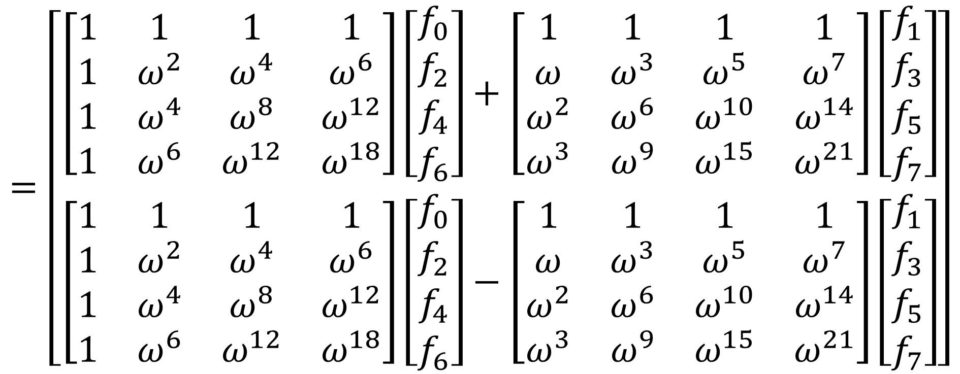
$$=\left[\begin{matrix}\left[\begin{matrix}1 & 1 & 1 & 1 \\ 1 & ω^{2} & ω^{4} & ω^{6} \\ 1 & ω^{4} & ω^{8} & ω^{12} \\ 1 & ω^{6} & ω^{12} & ω^{18}\end{matrix}\right]\left[\begin{matrix}f_{0} \\ f_{2} \\ f_{4} \\ f_{6}\end{matrix}\right]+\left[\begin{matrix}1 & 1 & 1 & 1 \\ ω & ω^{3} & ω^{5} & ω^{7} \\ ω^{2} & ω^{6} & ω^{10} & ω^{14} \\ ω^{3} & ω^{9} & ω^{15} & ω^{21}\end{matrix}\right]\left[\begin{matrix}f_{1} \\ f_{3} \\ f_{5} \\ f_{7}\end{matrix}\right] \\ \left[\begin{matrix}1 & 1 & 1 & 1 \\ 1 & ω^{2} & ω^{4} & ω^{6} \\ 1 & ω^{4} & ω^{8} & ω^{12} \\ 1 & ω^{6} & ω^{12} & ω^{18}\end{matrix}\right]\left[\begin{matrix}f_{0} \\ f_{2} \\ f_{4} \\ f_{6}\end{matrix}\right]−\left[\begin{matrix}1 & 1 & 1 & 1 \\ ω & ω^{3} & ω^{5} & ω^{7} \\ ω^{2} & ω^{6} & ω^{10} & ω^{14} \\ ω^{3} & ω^{9} & ω^{15} & ω^{21}\end{matrix}\right]\left[\begin{matrix}f_{1} \\ f_{3} \\ f_{5} \\ f_{7}\end{matrix}\right]\end{matrix}\right]$$

Slide 4
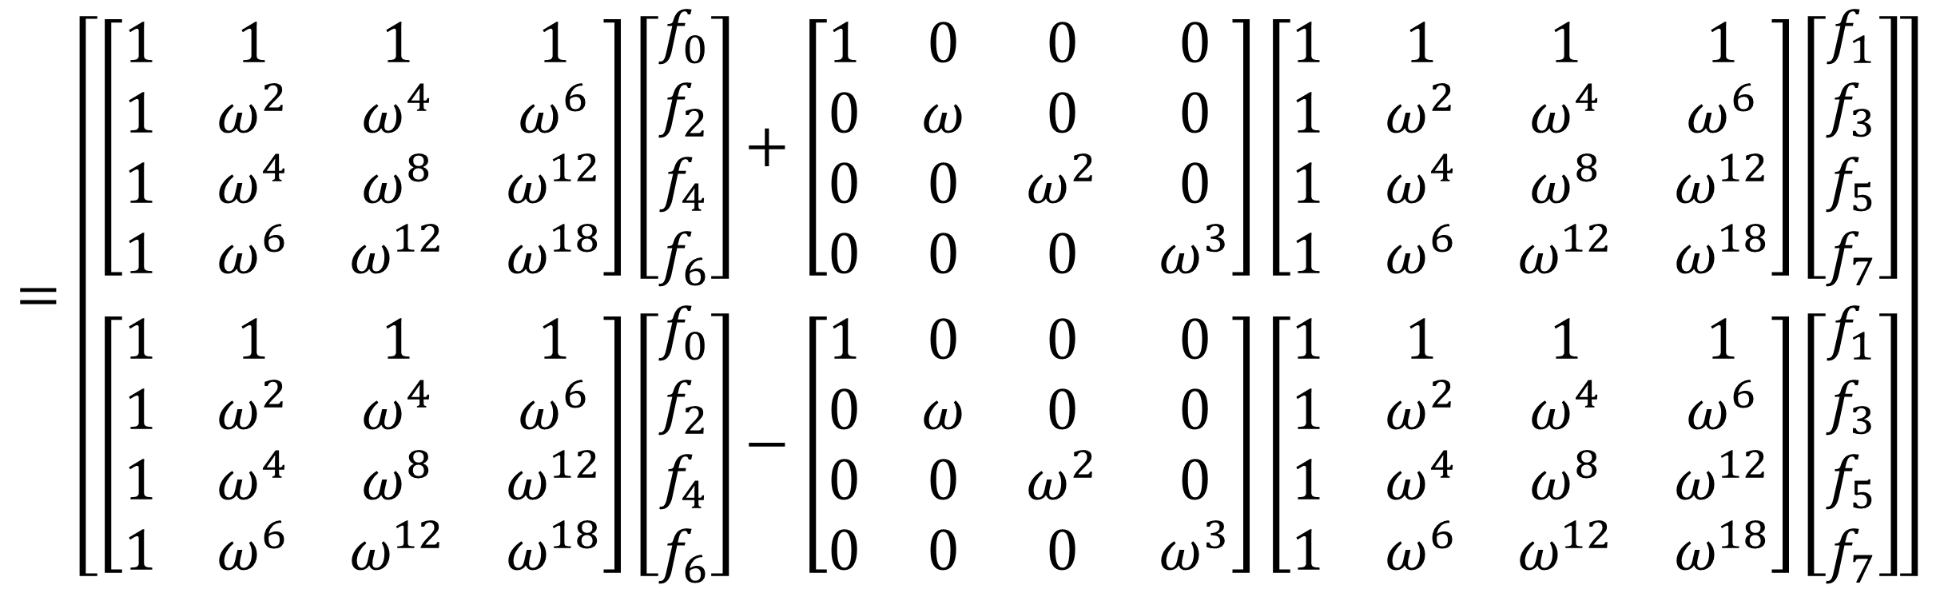
$$=\left[\begin{matrix}\left[\begin{matrix}1 & 1 & 1 & 1 \\ 1 & ω^{2} & ω^{4} & ω^{6} \\ 1 & ω^{4} & ω^{8} & ω^{12} \\ 1 & ω^{6} & ω^{12} & ω^{18}\end{matrix}\right]\left[\begin{matrix}f_{0} \\ f_{2} \\ f_{4} \\ f_{6}\end{matrix}\right]+\left[\begin{matrix}1 & 0 & 0 & 0 \\ 0 & ω & 0 & 0 \\ 0 & 0 & ω^{2} & 0 \\ 0 & 0 & 0 & ω^{3}\end{matrix}\right]\left[\begin{matrix}1 & 1 & 1 & 1 \\ 1 & ω^{2} & ω^{4} & ω^{6} \\ 1 & ω^{4} & ω^{8} & ω^{12} \\ 1 & ω^{6} & ω^{12} & ω^{18}\end{matrix}\right]\left[\begin{matrix}f_{1} \\ f_{3} \\ f_{5} \\ f_{7}\end{matrix}\right] \\ \left[\begin{matrix}1 & 1 & 1 & 1 \\ 1 & ω^{2} & ω^{4} & ω^{6} \\ 1 & ω^{4} & ω^{8} & ω^{12} \\ 1 & ω^{6} & ω^{12} & ω^{18}\end{matrix}\right]\left[\begin{matrix}f_{0} \\ f_{2} \\ f_{4} \\ f_{6}\end{matrix}\right]−\left[\begin{matrix}1 & 0 & 0 & 0 \\ 0 & ω & 0 & 0 \\ 0 & 0 & ω^{2} & 0 \\ 0 & 0 & 0 & ω^{3}\end{matrix}\right]\left[\begin{matrix}1 & 1 & 1 & 1 \\ 1 & ω^{2} & ω^{4} & ω^{6} \\ 1 & ω^{4} & ω^{8} & ω^{12} \\ 1 & ω^{6} & ω^{12} & ω^{18}\end{matrix}\right]\left[\begin{matrix}f_{1} \\ f_{3} \\ f_{5} \\ f_{7}\end{matrix}\right]\end{matrix}\right]$$

Slide 5
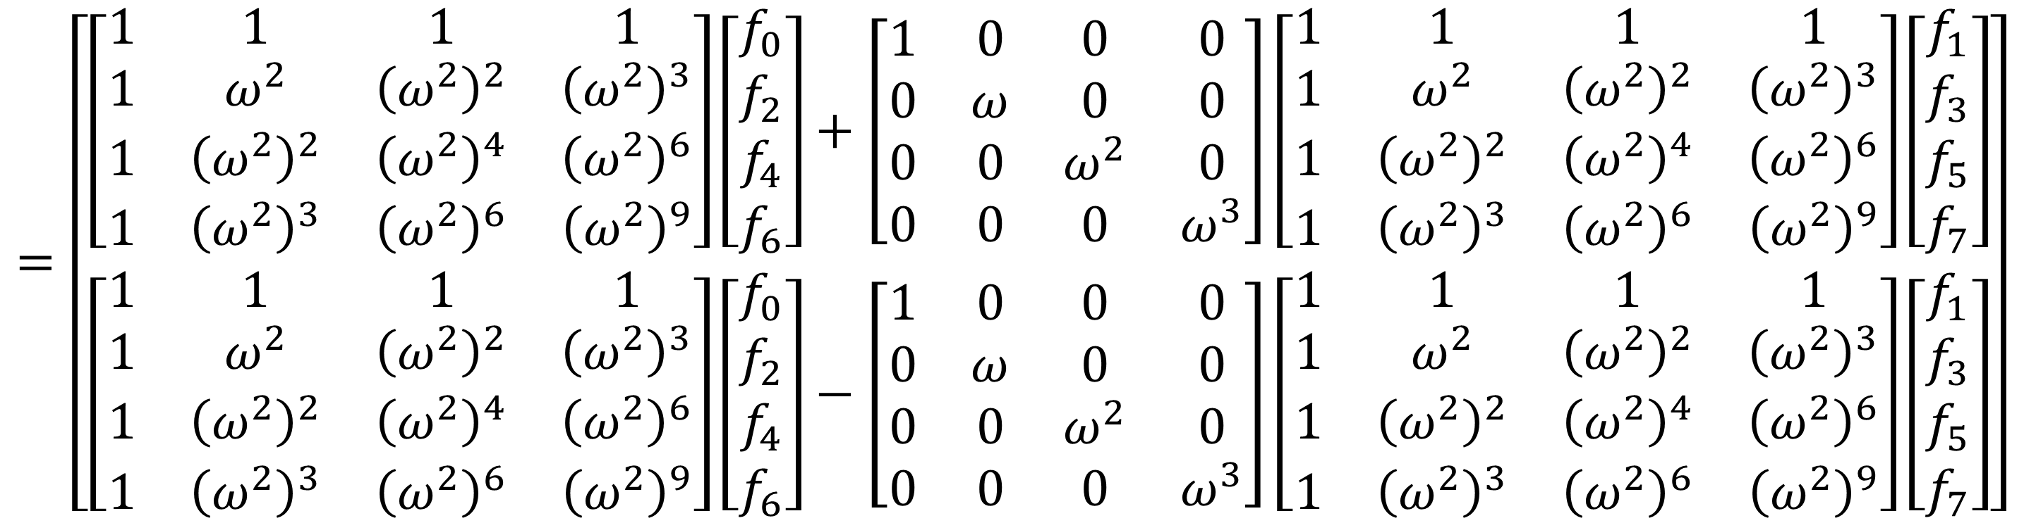
$$=\left[\begin{matrix}\left[\begin{matrix}1 & 1 & 1 & 1 \\ 1 & ω^{2} & {\left(ω^{2}\right)}^{2} & {\left(ω^{2}\right)}^{3} \\ 1 & {\left(ω^{2}\right)}^{2} & {\left(ω^{2}\right)}^{4} & {\left(ω^{2}\right)}^{6} \\ 1 & {\left(ω^{2}\right)}^{3} & {\left(ω^{2}\right)}^{6} & {\left(ω^{2}\right)}^{9}\end{matrix}\right]\left[\begin{matrix}f_{0} \\ f_{2} \\ f_{4} \\ f_{6}\end{matrix}\right]+\left[\begin{matrix}1 & 0 & 0 & 0 \\ 0 & ω & 0 & 0 \\ 0 & 0 & ω^{2} & 0 \\ 0 & 0 & 0 & ω^{3}\end{matrix}\right]\left[\begin{matrix}1 & 1 & 1 & 1 \\ 1 & ω^{2} & {\left(ω^{2}\right)}^{2} & {\left(ω^{2}\right)}^{3} \\ 1 & {\left(ω^{2}\right)}^{2} & {\left(ω^{2}\right)}^{4} & {\left(ω^{2}\right)}^{6} \\ 1 & {\left(ω^{2}\right)}^{3} & {\left(ω^{2}\right)}^{6} & {\left(ω^{2}\right)}^{9}\end{matrix}\right]\left[\begin{matrix}f_{1} \\ f_{3} \\ f_{5} \\ f_{7}\end{matrix}\right] \\ \left[\begin{matrix}1 & 1 & 1 & 1 \\ 1 & ω^{2} & {\left(ω^{2}\right)}^{2} & {\left(ω^{2}\right)}^{3} \\ 1 & {\left(ω^{2}\right)}^{2} & {\left(ω^{2}\right)}^{4} & {\left(ω^{2}\right)}^{6} \\ 1 & {\left(ω^{2}\right)}^{3} & {\left(ω^{2}\right)}^{6} & {\left(ω^{2}\right)}^{9}\end{matrix}\right]\left[\begin{matrix}f_{0} \\ f_{2} \\ f_{4} \\ f_{6}\end{matrix}\right]−\left[\begin{matrix}1 & 0 & 0 & 0 \\ 0 & ω & 0 & 0 \\ 0 & 0 & ω^{2} & 0 \\ 0 & 0 & 0 & ω^{3}\end{matrix}\right]\left[\begin{matrix}1 & 1 & 1 & 1 \\ 1 & ω^{2} & {\left(ω^{2}\right)}^{2} & {\left(ω^{2}\right)}^{3} \\ 1 & {\left(ω^{2}\right)}^{2} & {\left(ω^{2}\right)}^{4} & {\left(ω^{2}\right)}^{6} \\ 1 & {\left(ω^{2}\right)}^{3} & {\left(ω^{2}\right)}^{6} & {\left(ω^{2}\right)}^{9}\end{matrix}\right]\left[\begin{matrix}f_{1} \\ f_{3} \\ f_{5} \\ f_{7}\end{matrix}\right]\end{matrix}\right]$$

Slide 6
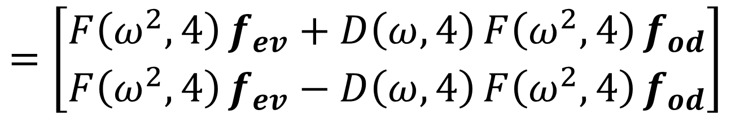
$$=\left[\begin{matrix}F\left(ω^{2},4\right)f_{ev}+D\left(ω,4\right)F\left(ω^{2},4\right)f_{od} \\ F\left(ω^{2},4\right)f_{ev}−D\left(ω,4\right)F\left(ω^{2},4\right)f_{od}\end{matrix}\right]$$

Slide 7
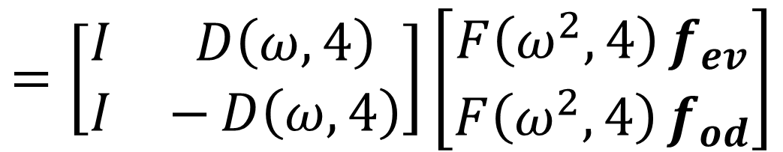
$$=\left[\begin{matrix}I & D\left(ω,4\right) \\ I & −D\left(ω,4\right)\end{matrix}\right]\left[\begin{matrix}F\left(ω^{2},4\right)f_{ev} \\ F\left(ω^{2},4\right)f_{od}\end{matrix}\right]$$

Slide 8
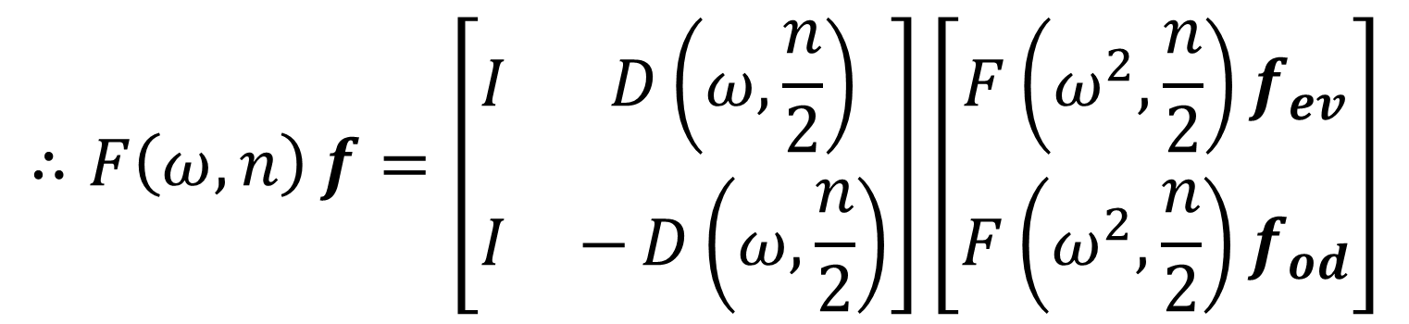
$$∴F\left(ω,n\right)f=\left[\begin{matrix}I & D\left(ω,\frac{n}{2}\right) \\ I & −D\left(ω,\frac{n}{2}\right)\end{matrix}\right]\left[\begin{matrix}F\left(ω^{2},\frac{n}{2}\right)f_{ev} \\ F\left(ω^{2},\frac{n}{2}\right)f_{od}\end{matrix}\right]$$

Slide 9
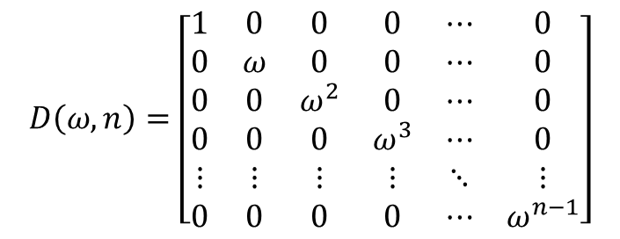
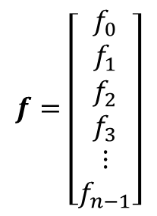
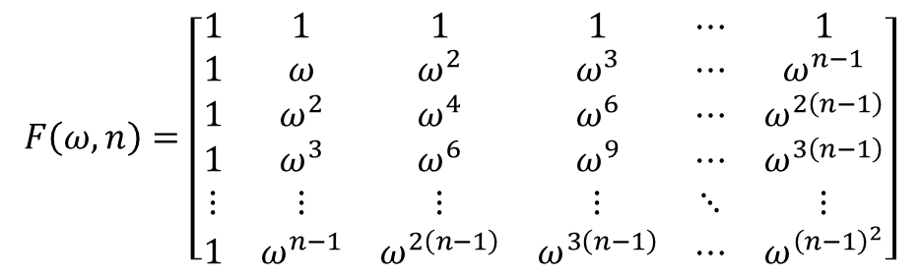
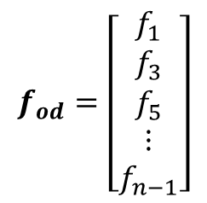
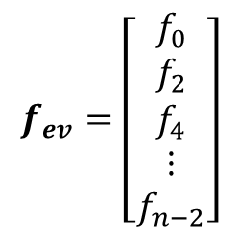
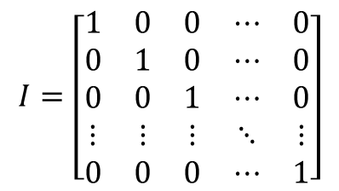
$$F\left(ω,n\right)=\left[\begin{matrix}1 & 1 & 1 & 1 & ⋯ & 1 \\ 1 & ω & ω^{2} & ω^{3} & ⋯ & ω^{n−1} \\ 1 & ω^{2} & ω^{4} & ω^{6} & ⋯ & ω^{2\left(n−1\right)} \\ 1 & ω^{3} & ω^{6} & ω^{9} & ⋯ & ω^{3\left(n−1\right)} \\ ⋮ & ⋮ & ⋮ & ⋮ & ⋱ & ⋮ \\ 1 & ω^{n−1} & ω^{2\left(n−1\right)} & ω^{3\left(n−1\right)} & ⋯ & ω^{{\left(n−1\right)}^{2}}\end{matrix}\right]$$
$$f=\left[\begin{matrix}f_{0} \\ f_{1} \\ f_{2} \\ f_{3} \\ ⋮ \\ f_{n−1}\end{matrix}\right]$$
$$D\left(ω,n\right)=\left[\begin{matrix}1 & 0 & 0 & 0 & ⋯ & 0 \\ 0 & ω & 0 & 0 & ⋯ & 0 \\ 0 & 0 & ω^{2} & 0 & ⋯ & 0 \\ 0 & 0 & 0 & ω^{3} & ⋯ & 0 \\ ⋮ & ⋮ & ⋮ & ⋮ & ⋱ & ⋮ \\ 0 & 0 & 0 & 0 & ⋯ & ω^{n−1}\end{matrix}\right]$$
$$f_{ev}=\left[\begin{matrix}f_{0} \\ f_{2} \\ f_{4} \\ ⋮ \\ f_{n−2}\end{matrix}\right]$$
$$I=\left[\begin{matrix}1 & 0 & 0 & ⋯ & 0 \\ 0 & 1 & 0 & ⋯ & 0 \\ 0 & 0 & 1 & ⋯ & 0 \\ ⋮ & ⋮ & ⋮ & ⋱ & ⋮ \\ 0 & 0 & 0 & ⋯ & 1\end{matrix}\right]$$
$$f_{od}=\left[\begin{matrix}f_{1} \\ f_{3} \\ f_{5} \\ ⋮ \\ f_{n−1}\end{matrix}\right]$$

