Slide 1
OpenCL
Reported by Xinyan Shan

Slide 2
Introduction
OpenCL is a programming framework for heterogeneous computing resources
Resources include CPUs, GPUs, Cell Broadband Engine, FPGAs, DSPs
Many similarities with CUDA

Slide 3
Introduction
Data- and task-based
Utilizes OpenCL C
Float based on IEEE 754
Defines a configuration profile for handheld and embedded devices
Efficiently interoperates with OpenGL, OpenGL ES and other graphics APIs

Slide 4
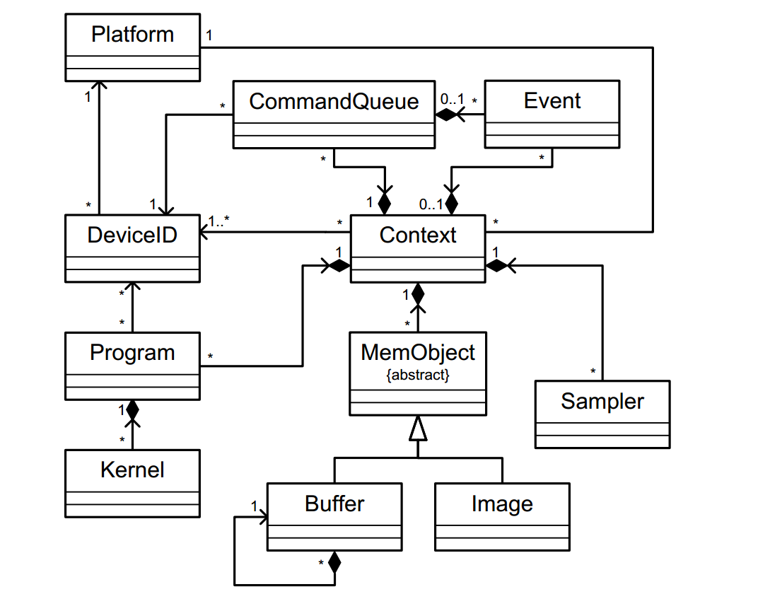
OpenCL class diagram

Slide 5
OpenCL to CUDA Data Parallelism Model Mapping
OpenCL Parallelism Concept | CUDA Equivalent
kernel | kernel
host program | host program
NDRange (index space) | grid
work item | thread
work group | block

Slide 6
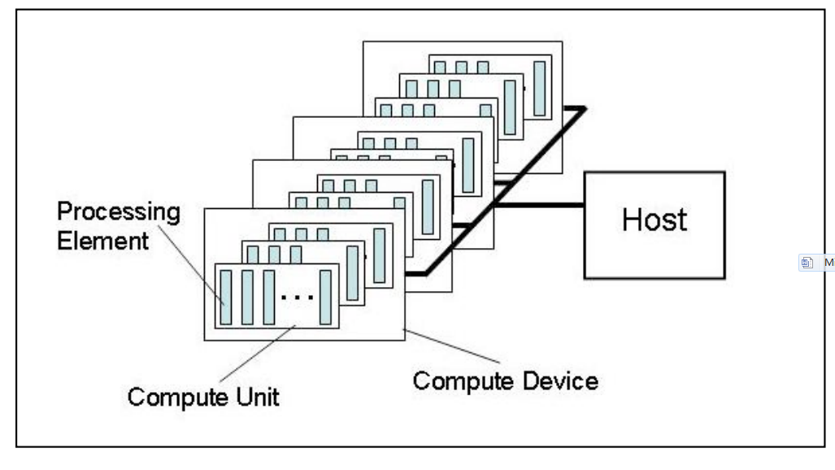
Platform Model

Slide 7
Versions
Platforms Versions
Devices Versions
OpenCL C Versions

Slide 8
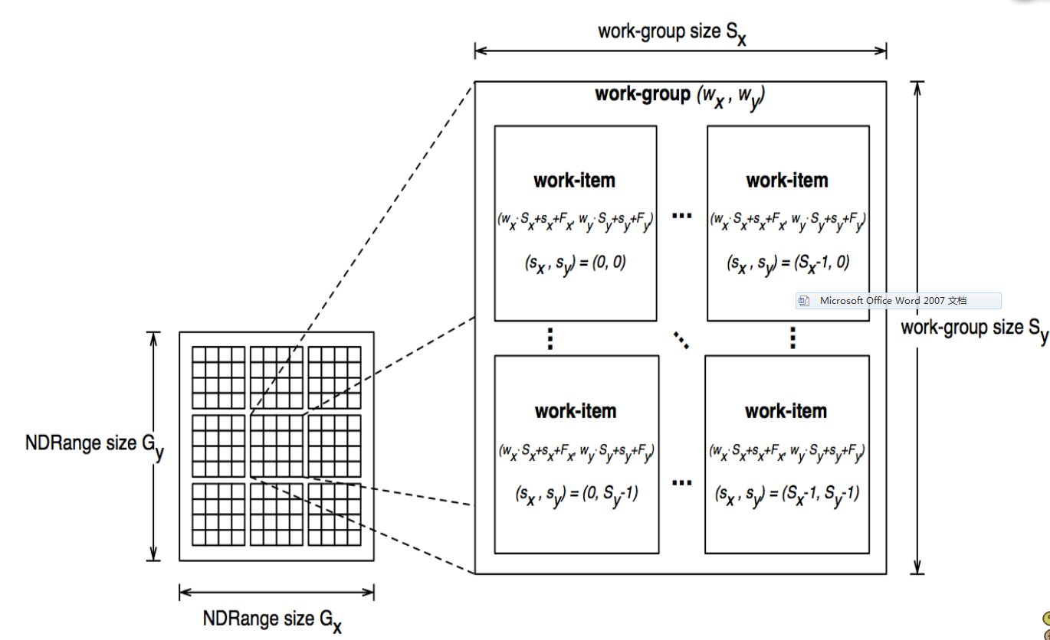
Execution Model

Slide 9
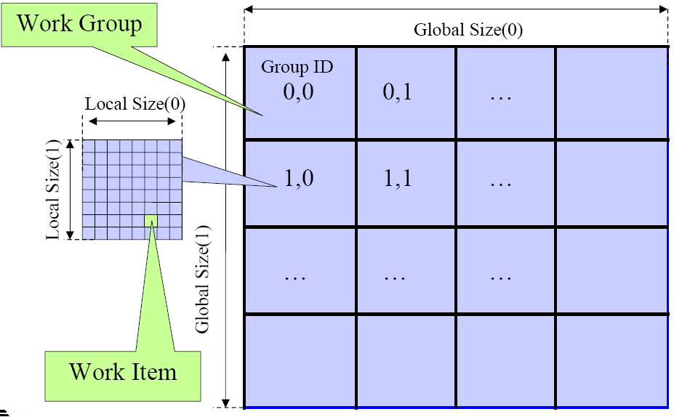
Overview of OpenCL Execution Model

Slide 10

Execution Model
The number of work-groups can be computed as:
Given a global ID and the work-group size, the work-group ID for a work-item is computed as:

Slide 11
Execution Model: Context and Command Queues
Devices
Kernels
Program Objects
Memory Objects
Memory objects contain values that can be operated on by instances of a kernel.

Slide 12
Execution Model: Context and Command Queues
Kernel execution commands
Memory commands
Synchronization commands
In-order Execution
Out-of-order Execution

Slide 13
Memory Model
Global Memory
Constant Memory
Local Memory
Private Memory
OpenCL Memory Types | CUDA Equivalent
global memory | global memory
constant memory | constant memory
local memory | shared memory
private memory | Local memory

Slide 14
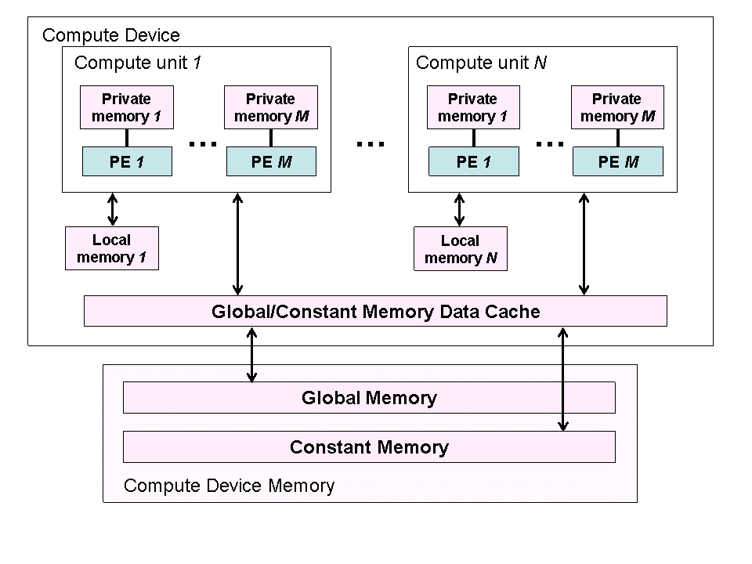
Memory Model

Slide 15
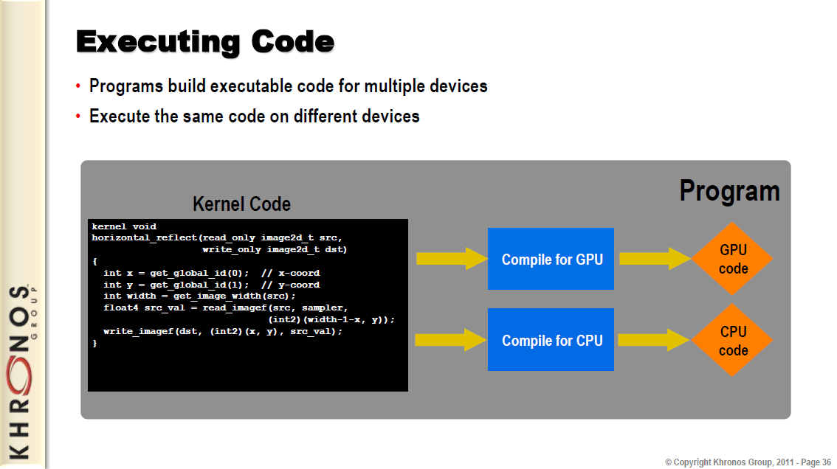
Compiling Code for Multiple Devices

