Slide 1
Communication Two
Sheng Su
2015/12/25 christmas

Slide 2
content
3D rotation and translation
Essential matrix and epipolar constraint
Trifocal tensor

Slide 3
Something need to know before
Homogeneous coordinates

Slide 4
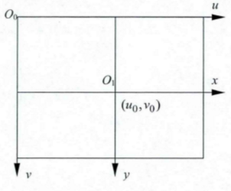
3D rotation and translation
One point represented by x-y is (xn, yn, 1)’
and the same point represented by u-v is (un, vn, 1)’
From u-v to x-y (main coordinate is u-v):
the center of u-v minus the center of x-y.
(x_diff, y_diff)’ = O0 – O1
both O0 and O1 are in u-v
T = (x_diff, y_diff, 1)’
Then any points in x-y
(xn, yn, 1)’ = (un, vn, 1)’ + T
The same in 3D condition

Slide 5
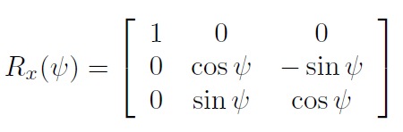
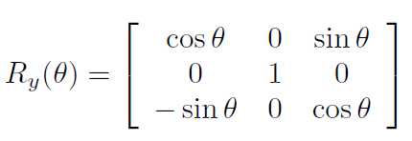
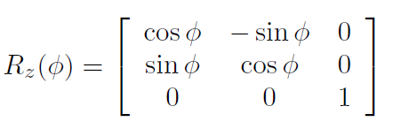
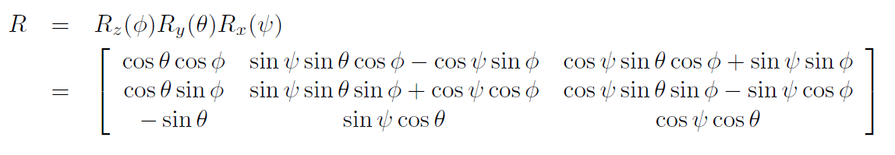
3D rotation and translation
The order of Rx, Ry, Rz is important

Slide 6
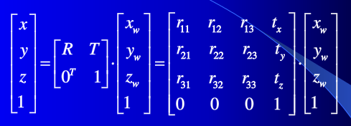
3D rotation and translation
Rotate first, then translate

Slide 7
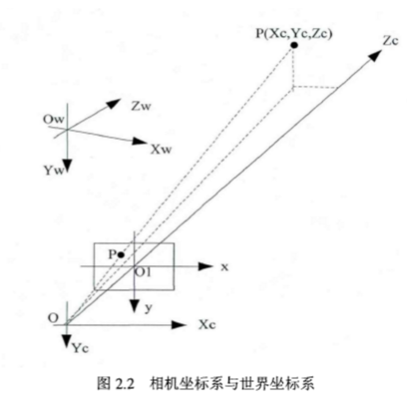
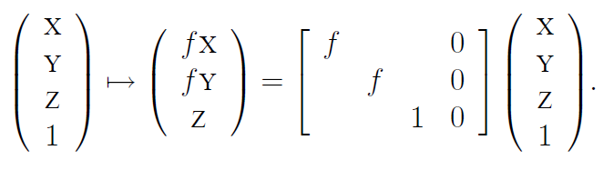
3D rotation and translation

Slide 8
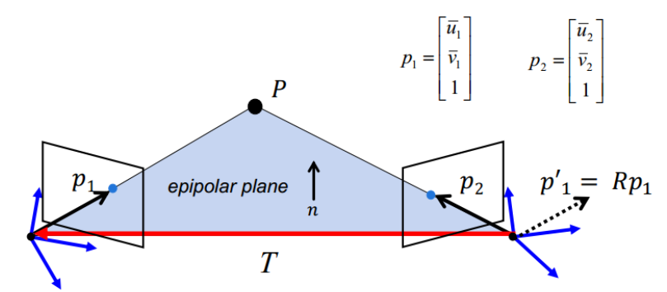
Essential matrix and epipolar constraint

Slide 9
Trifocal tensor
Multiple view geometry in computer vision, part 3.

