Slide 1
PROBABILISTIC ROBOTICS
April 8th,2016
陶学宇

Slide 2
AGENDA
Basic Concepts and Notations
Bayes Filters
Gaussian Filters
Kalman Filter
Extended Kalman Filter
Nonparametric Filters
Particle Filter
Monte Carlo Method
Importance Sampling

Slide 3

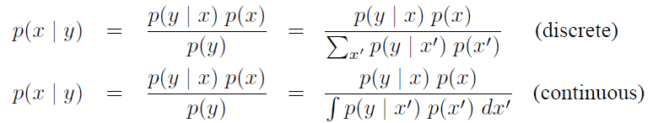
BASIC CONCEPTS AND NOTATIONS
Normal Distributions
Multivariate Normal Distributions
Bayes Rule (priori posterior)

Slide 4
BASIC CONCEPTS AND NOTATIONS
State
Def. Aspects of the robot and its environment that can impact the future
May change over time
E.g. Robot pose, velocity, etc.
State at time t will be denoted xt
Measurement Data
Def. Momentary state of the environment
E.g. Camera images, range scans, etc.
Measurement data at time t will be denoted zt

Slide 5
BASIC CONCEPTS AND NOTATIONS
Control Data
Def. Information about the change of state in the environment
E.g. Velocity, odometer, etc.
Control data at time t will be denoted ut
Probabilistic Generative Laws
State at time xt is generated stochastically
State transition probability
Robot executes a u1 first, and then takes a measurement z1
Measurement probability

Slide 6


BASIC CONCEPTS AND NOTATIONS
Belief Distributions
Def. A belief reflects the robot’s internal knowledge about the state of the environment
Assigns a probability (or density value) to each possible hypothesis with regards to the true state
This posterior is the probability distribution over the state xt at time t, conditioned on all past measurements z1:t and all past controls u1:t

Slide 7
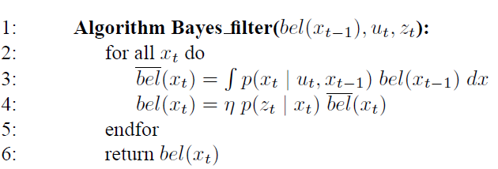
BAYES FILTERS
Calculate the belief distribution from measurement and control data
Calculation process is recursive

Slide 8
BAYES FILTERS
The Bayes filter algorithm possesses two essential steps
Control update, or prediction
Measurement update (所有的滤波算法都是由预测和矫正两部分组成)
Initialization at x0
If x0 is known, initialized with a point mass distribution
Else initialized with a uniform distribution over the domain of x0
Example 1 (see Example_BF.pdf)

Slide 9
KALMAN FILTER(Brief Intro)
Beliefs are represented by multivariate normal distributions
Linear Gaussian Systems
The Kalman filter implements belief computation for continuous states
At time t, the belief is represented by the mean μt and the covariance Σt

Slide 10
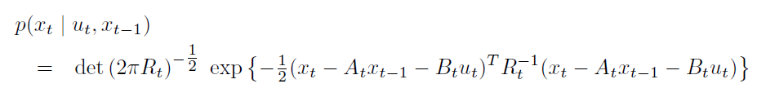

KALMAN FILTER
Three properties for linear Gaussian systems
1. The next state probability must be a linear function in its arguments with added Gaussian noise
The mean of the posterior state is given byAtxt-1+Btut and the covariance by Rt (A B为系统参数)
2. The measurement probability must also be linear in its arguments, with added Gaussian noise (C为测量系统参数)

Slide 11
KALMAN FILTER
The measurement probability is thus given by the following multivariate normal distribution
3. Finally, the initial belief bel(x0) must be normal distributed. We will denote the mean of this belief by μ0 and the covariance by Σ0
These three assumptions are sufficient to ensure that the posterior bel(xt) is always a Gaussian, for any point in time t

Slide 12
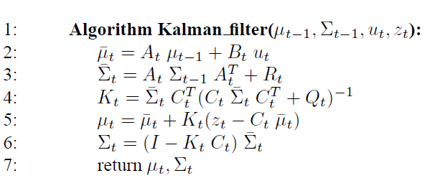
KALMAN FILTER
Kalman Filter Algorithm
Kt is called Kalman gain
Example 2 (see Example_KF.pdf)^{[2]}

Slide 13


EXTENDED KALMAN FILTER
In practice, most systems are NOT linear Gaussian systems (e.g. circular trajectory)
Extended Kalman filter (EKF) overcomes the linearity assumption
xt and zt are represented by nonlinear functions g and h
Linearization Via Taylor Expansion
EKFs utilize (first order) Taylor expansion. Taylor expansion construct a linear approximation to a function g from g’s value and slope. The slope is given by the partial derivative

Slide 14
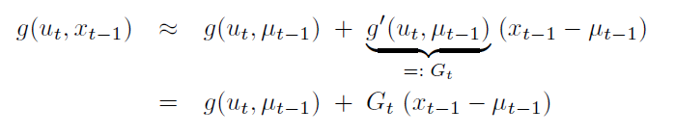
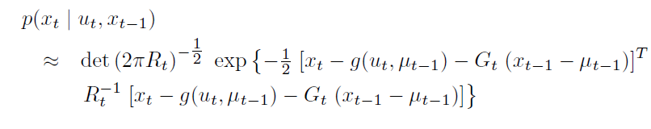
EXTENDED KALMAN FILTER
Taylor Expansion
Gt is a matrix of size n*n, with n denoting the dimension of the state. This matrix is often called the Jacobian

Slide 15
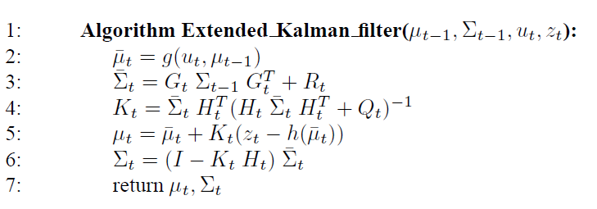
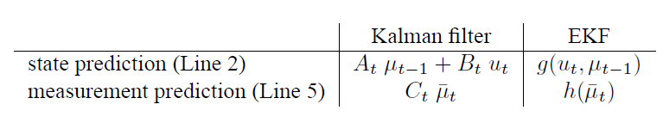
EXTENDED KALMAN FILTER
Extended Kalman Filter Algorithm
Comparison between KF and EKF
Jacobian Gt corresponds to the matrices At and Bt , and the Jacobian Ht corresponds to Ct

Slide 16
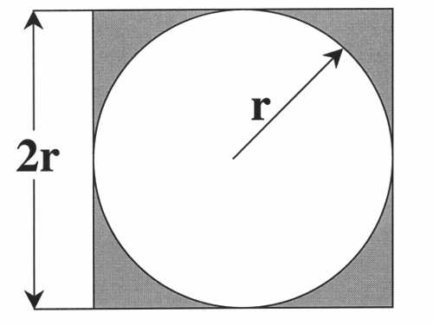
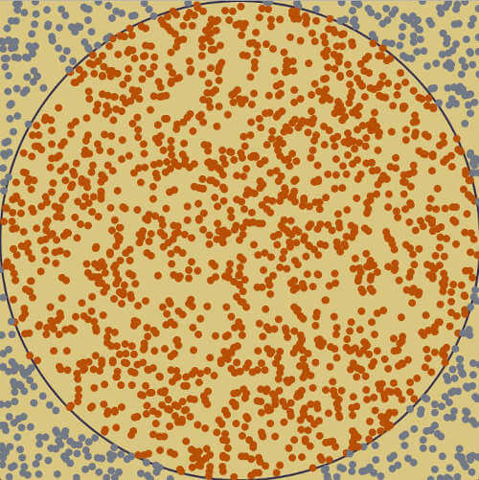
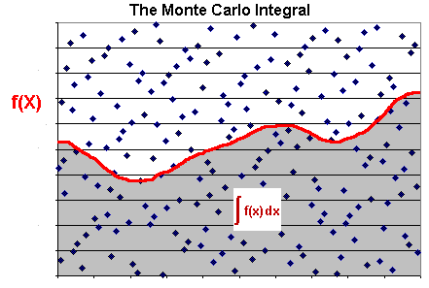

PARTICLE FILTER
Monte Carlo Method
使用随机数来解决很多计算问题的方法
以事件出现的频率估计这一随机事件的概率
E.g. 计算π和不可解析函数的积分^{[3]}

Slide 17
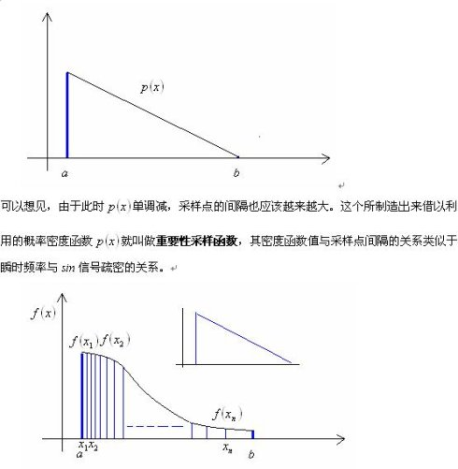
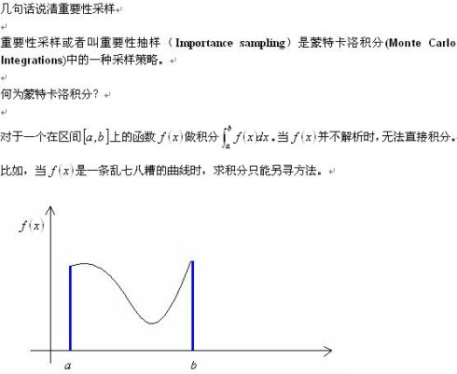
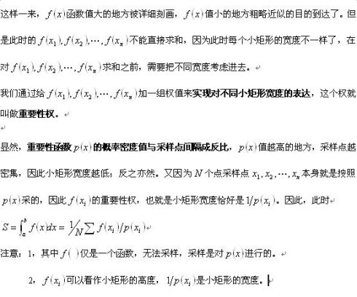
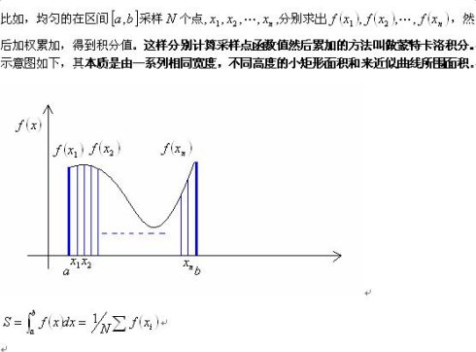
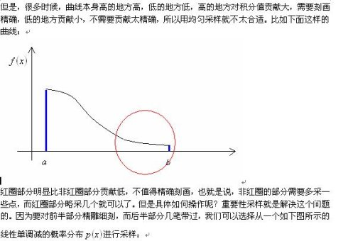
PARTICLE FILTER
Importance Sampling^{[4]}

Slide 18


PARTICLE FILTER
Nonparametric implementation of the Bayes filter
Represent the posterior bel(xt) by a set of random state samples drawn from this posterior
Represent a much broader space of distributions
The samples of a posterior distribution are called particles and are denoted
likelihood for a state hypothesis xt to be included in the particle set Xt shall be proportional to its Bayes filter posterior bel(xt)
The denser a subregion of the state space is populated by samples, the more likely it is that the true state falls into this region

Slide 19
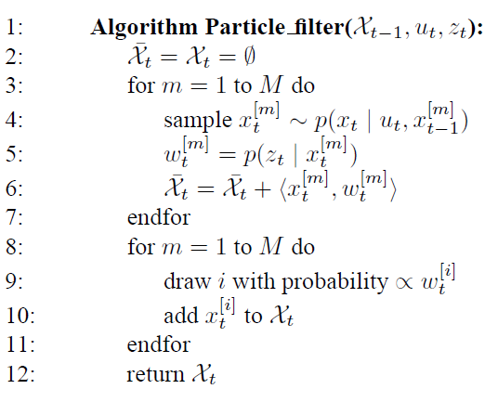
PARTICLE FILTER
Particle Filter Algorithm
Line 4:This step involves sampling
from the next state distribution
Line 5:Calculate importance factor
which is used to incorporate the
measurement zt into the particle set
Line 8 to Line 11:Resampling or importance
resampling . By incorporating the importance
weights into the resampling process,
the distribution of the particles change
Example 3(see Example_PF.pdf)^{[5]}

Slide 20
THE END
Reference
[1]. Burgard, Wolfram. Probabilistic robotics /[M]. MIT Press, 2006.
[2]. 知乎,如何通俗并尽可能详细解释卡尔曼滤波？https://www.zhihu.com/question/23971601
[3].阮一峰博客，蒙特卡罗方法入门, http://www.ruanyifeng.com/blog/2015/07/monte-carlo-method.html
[4].新浪博客,说清楚重要性采样, http://blog.sina.com.cn/s/blog_4e5740460100cw5b.html
[5]. 毕然学长的资料

