Slide 1
Optimization of integral image
yan shuai
2016.04.22

Slide 2
context
Introduction of Integral image
Usual algorithm
Algorithm+
CalcIntImg_tech
Integral image and boxfilter
1
2
3
4
5

Slide 3
Introduction
· The Integral Image or Summed Area Table, was first introduced to us in 1984, but wasn’t properly introduced to the world of Computer Vision till 2001.
·The Integral Image is used as a quick and effective way of calculating the sum of values (pixel values) in a given image – or a rectangular subset of a grid (the given image).
·It can also, or is mainly, used for calculating the average intensity within a given image. If one wants to use the Integral Image, it is normally a wise idea to make sure the image is in greyscale first.

Slide 4
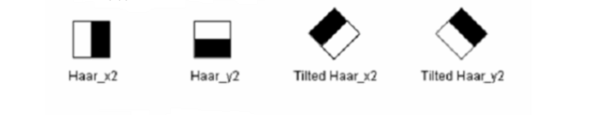
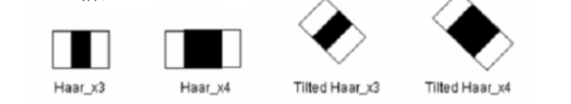
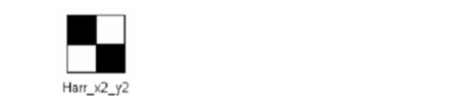
Haar-like feature

Slide 5
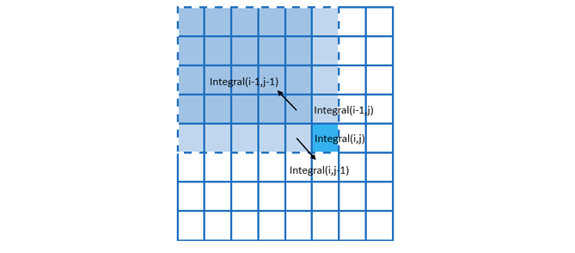
Usual algorithm
Integral(i,j) = Integral(i,j-1) + Integral(i-1,j) - Integral(i-1,j-1) + Image(i,j);
(W-1)+(H-1)+3*(W-1)*(H-1)

Slide 6
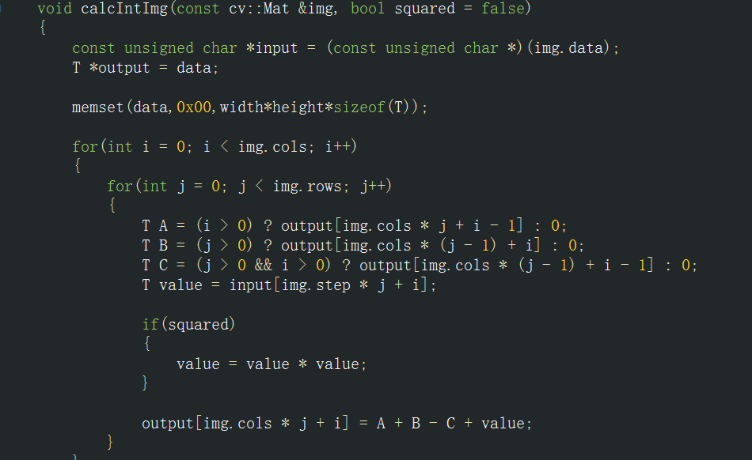
implementation

Slide 7
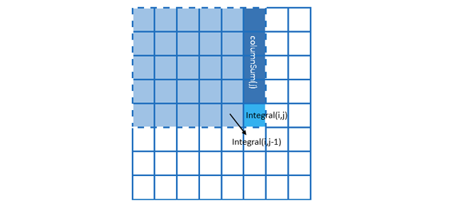
Algorithm+
Integral(i,j) = Integral(i,j-1) + ColumnSum(j);
(W-1)+(H-1)+2*(W-1)*(H-1)

Slide 8
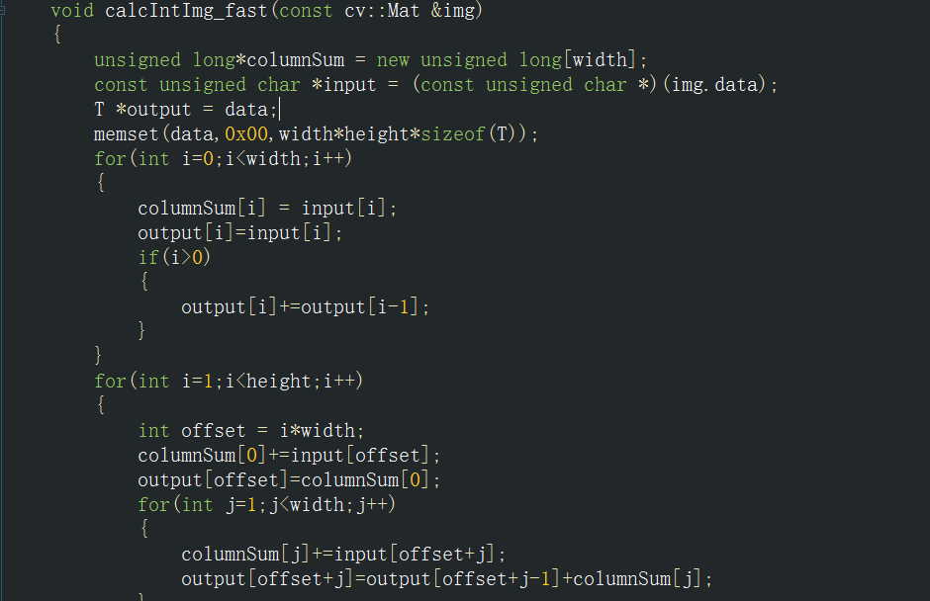
implementation of A+

Slide 9
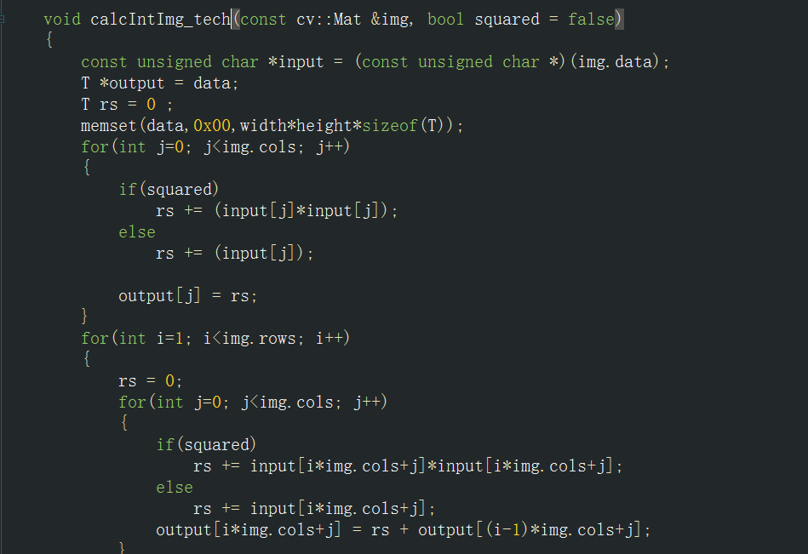
CalcIntImg_tech

Slide 10
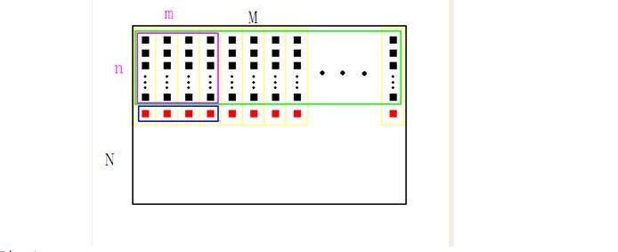
Integral image and boxfilter
·a given image(M,N) and determine (m,n)
·create a array(M) , denoted buff ,to save the temp sum[red square]

Slide 11
Integral image and boxfilter
· when move to a new location, within a rectangle of pixels calculated and stored in the array a
· each time moves to the right, in fact
sum [i] = sum [i-1] - buff [x-1] + buff [x + m-1]
·when the purple rectangle moves to the end of the line,for each buff [i], the need to add a new incoming pixel, minus a pixel out, then began to calculate the new line up.

Slide 12


