Slide 1


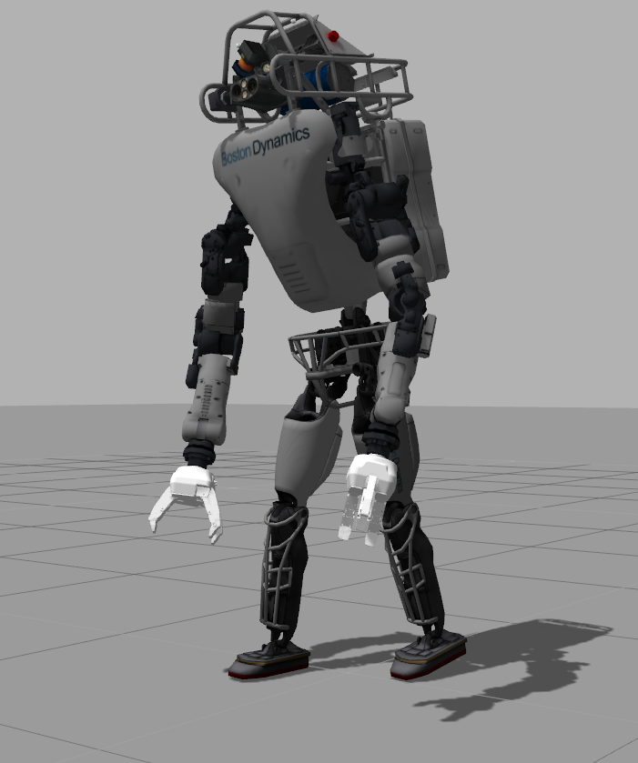
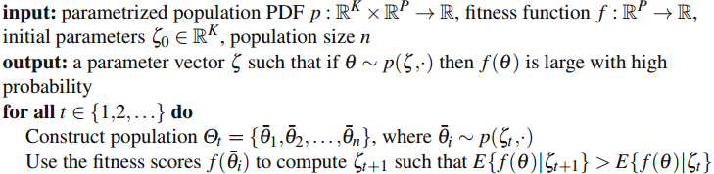
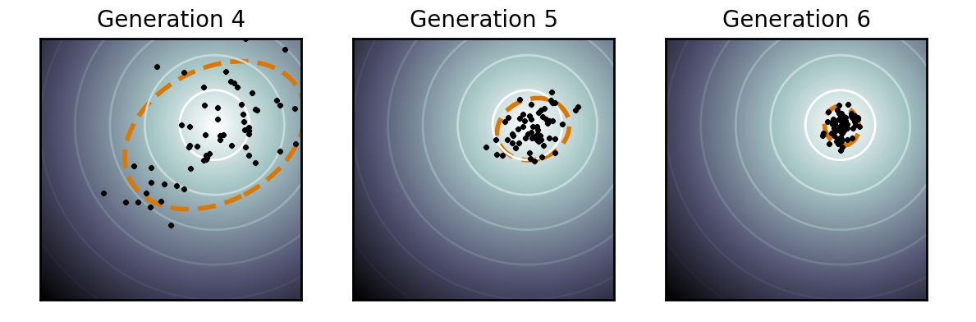
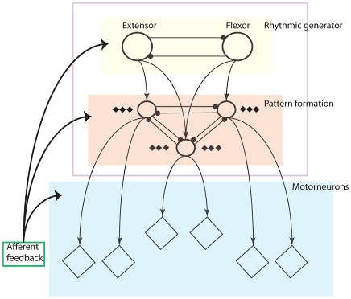
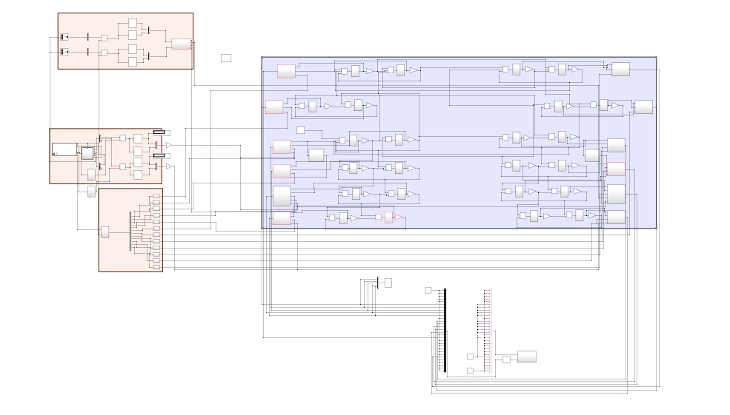
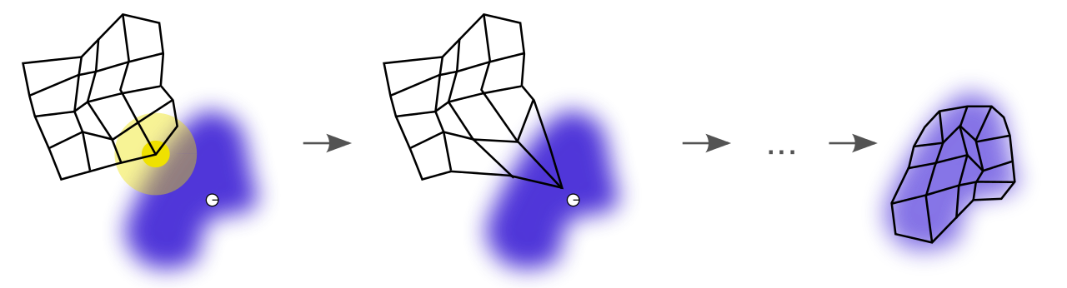
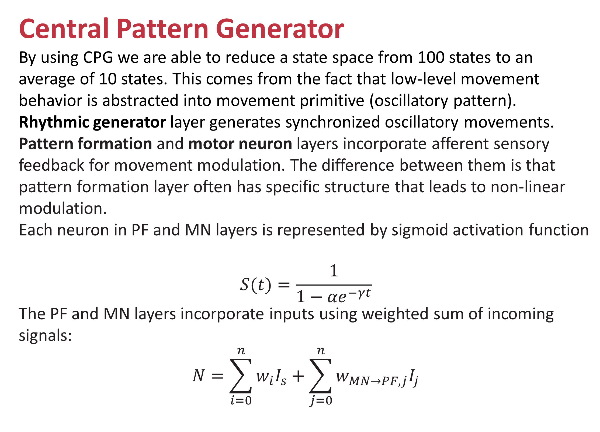
Robot Learning
Batyrlan Nurbekov (Computer Science and Robotics Engineering)
Robotics Engineering Advisor: Dr. Michael Gennert
Computer Science Advisor: Joseph Beck
Abstract
The purpose of the project is to mimic human’s learning and motion mechanisms in order to create an adaptive walking gait. The project tackles the issue of lack of generalization that current learning mechanisms face by remembering past experience, simulating risk averse behavior, and significantly reducing state and action spaces. In addition, the project builds the entire biologically inspired motor hierarchy which allows for great level of adaptability during motion tasks, including, but not limited to walking.
Learning
Overview
A proper set of parameters for CPG is learnt through mechanism that incorporates parameter optimization through CMA-ES (learning) and two Kohonen self-organizing maps to represent configurations for CPG that led to success or failure (memory).
Covariance Matrix Adaptation – Evolutionary Strategies
CMA-ES algorithm is primarily used for offline learning of optimal set of parameters (for CPG) needed for stable gait. The purpose of this mechanism is to simulate evolutionary processes that led to the emergence of a specific movement pattern (e.g. walking). The algorithm is outlined below:
Qualitative Adaptive Reward Learning
The purpose of this module:
memorizing a particular region in parameter (state) space that leads to success/failure
finding global optimal set of parameters in success region after failure region is learnt.
During learning the mechanism is able to make a decision based on Vigilance Threshold to simulate risk-averse behavior based on past experience and disregard new configurations that most likely will lead to failure.
Neurons are updated based on externally defined reward that adapts throughout the learning process.
After receiving a reward neurons in each map move to the sampled configuration by the distance proportional to the reward received (in case of success map) and the cost incurred (in case of failure map).
Results
The learning module was able to learn a policy (set of parameters) that led the robot to making three steps in backward direction over the course of 300 trials.
.
System overview
CPG was implemented in Simulink, whereas the learning algorithm and command node were implemented in Python.
Central Pattern Generator
By using CPG we are able to reduce a state space from 100 states to an average of 10 states. This comes from the fact that low-level movement behavior is abstracted into movement primitive (oscillatory pattern).
Rhythmic generator layer generates synchronized oscillatory movements.
Pattern formation and motor neuron layers incorporate afferent sensory feedback for movement modulation. The difference between them is that pattern formation layer often has specific structure that leads to non-linear modulation.
Each neuron in PF and MN layers is represented by sigmoid activation function
$$S(t)=\frac{1}{1−{αe}^{−γt}}$$
The PF and MN layers incorporate inputs using weighted sum of incoming signals:
$$N=\sum_{i=0}^{n}{w_{i}I_{s}}+\sum_{j=0}^{n}{w_{MN→PF, j}I_{j}}$$
Future work
Generalization of the learnt and memorized experience to environmental changes (e. g. slopped floor, stairs).
Automatic CPG controller structure construction to allow for other motor tasks.
Balancing module that could …
account for Capture Point dynamics in order to make it the gait more robust and allow to walk without falling;
(Controls Approach)
OR
learn online for the purpose of keeping balance and making adjustments to the robot’s posture.
(Learning Approach)
In fact, CACLA algorithm with two deep neural networks as function approximators for actor and critic was implemented for balancing. However, backpropagation proved to be relatively slow. Therefore,
References
Nassour, Li, Icon, CMA-ES pic Others

