Slide 1
Chapter 10: Dictionaries
CMPT 120, Fall 2024

Slide 2
Dictionaries
A dictionary is a collection of 0 or more key:value pairs.
{'spring':1, 'summer':4, 'fall':7 }

Slide 3
Dictionaries
A dictionary is a collection of 0 or more key:value pairs.
{'spring':1, 'summer':4, 'fall':7 }
A dictionary literal begins with a { and ends with a }. A pair is written in the form key:value, and pairs are separated by commas.

Slide 4
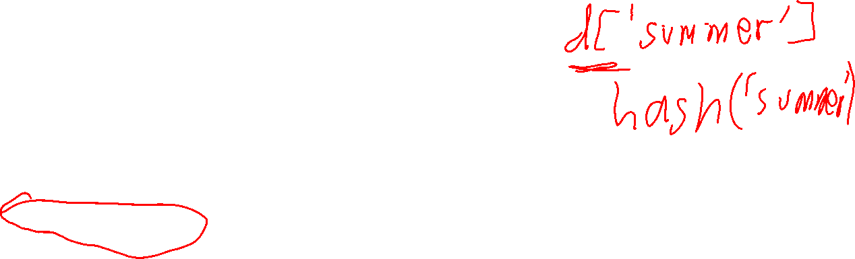
Dictionaries
A dictionary is a collection of 0 or more key:value pairs.
{'spring':1, 'summer':4, 'fall':7 }
A dictionary literal begins with a { and ends with a }. A pair is written in the form key:value, and pairs are separated by commas.
If d is a dictionary with the pair key:value, then d[key] efficiently returns value.
Slicing does not work with dictionaries.

Slide 5
Dictionaries
A dictionary is a collection of 0 or more key:value pairs.
{'spring':1, 'summer':4, 'fall':7 }
A dictionary literal begins with a { and ends with a }. A pair is written in the form key:value, and pairs are separated by commas.
If d is a dictionary with the pair key:value, then d[key] efficiently returns value.
Slicing does not work with dictionaries.
Dictionaries are mutable: you can add, remove, modify pairs.

Slide 6

Dictionaries
A dictionary is a collection of 0 or more key:value pairs.
{'spring':1, 'summer':4, 'fall':7 }
A dictionary literal begins with a { and ends with a }. A pair is written in the form key:value, and pairs are separated by commas.
Accessing values by their key is extremely fast, even for huge dictionaries.
If d is a dictionary with the pair key:value, then d[key] efficiently returns value.
Slicing does not work with dictionaries.
Dictionaries are mutable: you can add, remove, modify pairs.

Slide 7
Dictionaries
A dictionary is a collection of 0 or more key:value pairs.
{'spring':1, 'summer':4, 'fall':7 }
A dictionary literal begins with a { and ends with a }. A pair is written in the form key:value, and pairs are separated by commas.
Accessing values by their key is extremely fast, even for huge dictionaries.
If d is a dictionary with the pair key:value, then d[key] efficiently returns value.
Slicing does not work with dictionaries.
There are many practical applications of dictionaries. You can even use them to implement lists!
Dictionaries are mutable: you can add, remove, modify pairs.

Slide 8

Dictionaries
A dictionary is a collection of 0 or more key:value pairs.
{'spring':1, 'summer':4, 'fall':7 }
Important! Dictionary keys are unique: a dictionary cannot have duplicate keys!

Slide 9

Dictionaries
A dictionary is a collection of 0 or more key:value pairs.
{'spring':1, 'summer':4, 'fall':7 }
Important! Dictionary keys are unique: a dictionary cannot have duplicate keys!
Duplicate values are okay. It’s just keys that must be unique in a dictionary.

Slide 10
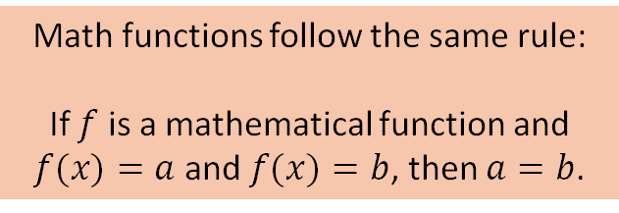

Dictionaries
A dictionary is a collection of 0 or more key:value pairs.
{'spring':1, 'summer':4, 'fall':7 }
Important! Dictionary keys are unique: a dictionary cannot have duplicate keys!
Math functions follow the same rule: If $f$ is a mathematical function and $f(x)=a$ and $f(x)=b$, then $a=b$.
If d is a dictionary, then this always true:
if d[x]==a and d[x]==b, then a==b
Duplicate values are okay. It’s just keys that must be unique in a dictionary.

Slide 11
Dictionaries
A dictionary is a collection of 0 or more key:value pairs.
sem_code = {'spring': 1, 'summer': 4, 'fall': 7}
print(sem_code)
?

Slide 12
Dictionaries
A dictionary is a collection of 0 or more key:value pairs.
sem_code = {'spring': 1, 'summer': 4, 'fall': 7}
print(sem_code) # {'spring': 1, 'summer': 4,
# 'fall': 7}
print(sem_code.keys())
?

Slide 13
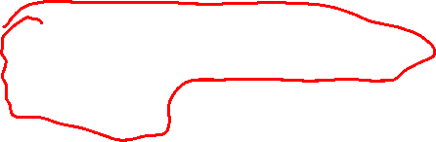
Dictionaries
A dictionary is a collection of 0 or more key:value pairs.
sem_code = {'spring': 1, 'summer': 4, 'fall': 7}
print(sem_code) # {'spring': 1, 'summer': 4,
# 'fall': 7}
print(sem_code.keys()) # dict_keys(['spring', 'summer',
# 'fall’])
print(sem_code.values())
?

Slide 14
Dictionaries
A dictionary is a collection of 0 or more key:value pairs.
sem_code = {'spring': 1, 'summer': 4, 'fall': 7}
print(sem_code) # {'spring': 1, 'summer': 4,
# 'fall': 7}
print(sem_code.keys()) # dict_keys(['spring', 'summer',
# 'fall’])
print(sem_code.values()) # dict_values([1, 4, 7])
print(len(sem_code))
?

Slide 15
Dictionaries
A dictionary is a collection of 0 or more key:value pairs.
sem_code = {'spring': 1, 'summer': 4, 'fall': 7}
print(sem_code) # {'spring': 1, 'summer': 4,
# 'fall': 7}
print(sem_code.keys()) # dict_keys(['spring', 'summer',
# 'fall’])
print(sem_code.values()) # dict_values([1, 4, 7])
print(len(sem_code)) # 3

Slide 16
Dictionaries
A dictionary is a collection of 0 or more key:value pairs.
sem_code = {'spring': 1, 'summer': 4, 'fall': 7}
print(sem_code['fall']) # 7
print(sem_code['summer']) # 4
print(sem_code['spring']) # 1
print(sem_code['autumn'])
Accessing values by their key is extremely fast, even for huge dictionaries.
?

Slide 17
Dictionaries
A dictionary is a collection of 0 or more key:value pairs.
sem_code = {'spring': 1, 'summer': 4, 'fall': 7}
print(sem_code['fall']) # 7
print(sem_code['summer']) # 4
print(sem_code['spring']) # 1
print(sem_code['autumn']) # KeyError: 'autumn' is not a key
Accessing values by their key is extremely fast, even for huge dictionaries.

Slide 18

Dictionaries
A dictionary is a collection of 0 or more key:value pairs.
You can add key:value pairs by assignment: d[key] = value adds key:value to dictionary d
sem_code = {} # empty dictionary
sem_code['spring'] = 1 # {'spring': 1}
sem_code['summer'] = 4 # {'spring': 1, 'summer': 4}
sem_code['fall'] = 7 # {'spring': 1, 'summer': 4, 'fall': 7}
sem_code['spring'] = 2 # {'spring': 2, 'summer': 4, 'fall': 7}
The last example shows that if a key already exists, then its value gets replaced.

Slide 19

Dictionaries
A dictionary is a collection of 0 or more key:value pairs.
sem_code = {'spring': 1, 'summer': 4, 'fall': 7}
print('fall' in sem_code) # True
print('autumn' in sem_code) # False
print(1 in sem_code) # False
print(1 in sem_code.values()) # True
print(2 in sem_code.values()) # False
print(7 in sem_code.values()) # True
print('7' in sem_code.values()) # False
With a dictionary, the in operator will quickly tell you if the dictionary has that key, or not.
in searches the keys of the dictionary.
Use x in d.values() to search values … but careful, this is very slow compared to searching keys!

Slide 20
Dictionaries
Challenge
Find all the English words that are the reverse of an English word. For example, “top” is the reverse of “pot”, and “stressed” is the reverse of “desserts”.
Do this as efficiently as possible. Make your code short and easy to read.

Slide 21
Dictionaries
Challenge
Write a function that returns, as a dictionary, the frequency counts of all the characters in a string. For example, “ball” would return {'b':1, 'a':1, 'l':2}.
Use this to determine the frequency counts of letters in all English words.

Slide 22
Dictionaries
Challenge
Write a program that takes a dictionary of frequency counts of letters in a string and prints them in order from most frequent to least frequent. For example, {'b':1, 'a':1, 's':2} would print:
s 2
a 1
b 1
The order of letters with the same count doesn’t matter.
Print the letters of all words in English from most frequent to least frequent.

