Slide 1
Chapter 7: More Loops, and Reading Files
CMPT 120, Fall 2024

Slide 2
While-loops
Please see the chapter 7 lecture notes for an introduction to while loops. For some reason while loops are missing from the textbook.
???
What would you guess this code does?
while True:
print('hello')
print('world')

Slide 3
While-loops
What would you guess this code does?
while True:
print('hello')
print('world')
hello
world
hello
world
hello
world
hello
world
hello
world
…
It’s an example of an infinite loop. The indented print statements are run forever.

Slide 4
While-loops
This is a flow chart of the code that shows visually what’s happening.
What would you guess this code does?
while True:
print('hello')
print('world')
print('hello')
print('world')
hello
world
hello
world
hello
world
hello
world
hello
world
…
It’s an example of an infinite loop. The indented print statements are run forever.

Slide 5
While-loops
This is a flow chart of the code that shows visually what’s happening.
What would you guess this code does?
while True:
print('hello')
print('world')
print('dead code!)
print('hello')
print('world')
hello
world
hello
world
hello
world
hello
world
hello
world
…
Any code after the loop never runs.
It’s an example of an infinite loop. The indented print statements are run forever.

Slide 6

While-loops
This code repeatedly asks the user to enter a password, stopping only when the enter 'swordfish’.
While-loops are used when you need a loop but don’t know ahead of time how many times it will execute.
pwd = ''
while pwd != 'swordfish':
pwd = input('Enter password: ')

Slide 7
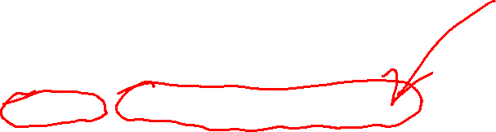
While-loops
This the while-loop header.
While-loops are used when you need a loop but don’t know ahead of time how many times it will execute.
pwd = ''
while pwd != 'swordfish':
pwd = input('Enter password: ')
This the while-loop body. It can have as many statements as needed. They should be consistently indented under the header.

Slide 8
While-loops
The header starts with the keyword while.
While-loops are used when you need a loop but don’t know ahead of time how many times it will execute.
pwd = ''
while pwd != 'swordfish':
pwd = input('Enter password: ')

Slide 9
While-loops
The while loop condition comes next. It must be a Boolean expression.
While-loops are used when you need a loop but don’t know ahead of time how many times it will execute.
pwd = ''
while pwd != 'swordfish':
pwd = input('Enter password: ')

Slide 10

While-loops
The header ends with a colon, :
While-loops are used when you need a loop but don’t know ahead of time how many times it will execute.
pwd = ''
while pwd != 'swordfish':
pwd = input('Enter password: ')

Slide 11
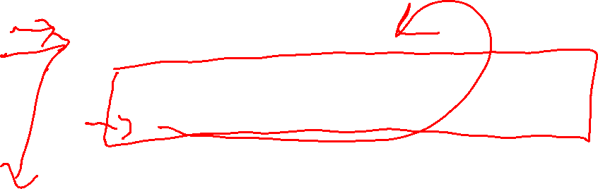
While-loops
While-loops are used when you need a loop but don’t know ahead of time how many times it will execute.
pwd = ''
while pwd != 'swordfish':
pwd = input('Enter password: ')
When a while loop runs, Python first checks the condition:
If condition is True Run the body, and then afterwards check the condition again.
If condition is False Jump out of the while-loop and run the statement after it.

Slide 12
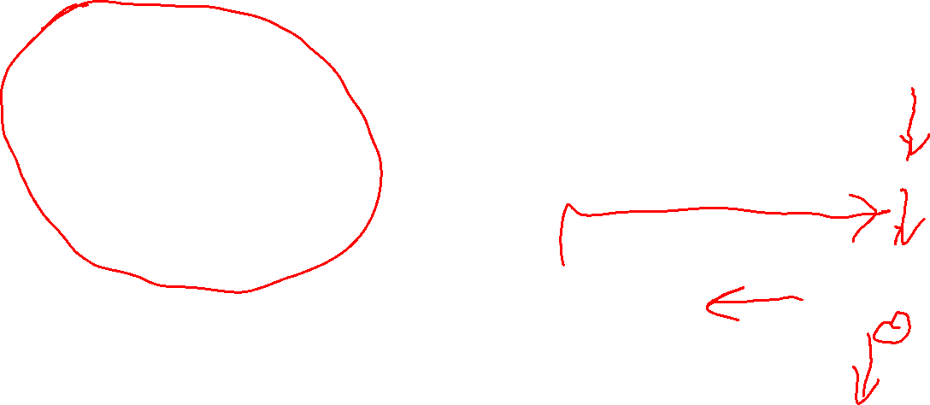
While-loops
pwd = ''
while pwd != 'swordfish':
pwd = input('Enter password: ')
When a while loop is run, Python first checks the condition:
condition is True Run the body, and then afterwards check the condition again
condition is False Jump out of the while-loop and run the statement after it
A flow chart showing how the code runs.
pwd = ''
True
pwd = input('Enter password: ')
pwd != 'swordfish'
False

Slide 13
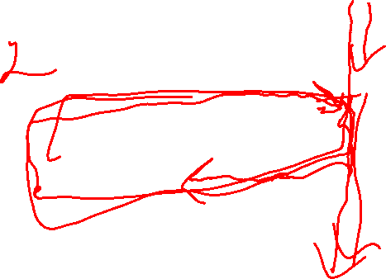
While-loops
pwd = ''
while pwd != 'swordfish':
pwd = input('Enter password: ')
When a while loop is run, Python first checks the condition:
condition is True Run the body, and then afterwards check the condition again
condition is False Jump out of the while-loop and run the statement after it
pwd = ''
True
pwd = input('Enter password: ')
pwd != 'swordfish'
How many execution paths are there through this code?
???
False

Slide 14

While-loops
pwd = ''
while pwd != 'swordfish':
pwd = input('Enter password: ')
When a while loop is run, Python first checks the condition:
condition is True Run the body, and then afterwards check the condition again
condition is False Jump out of the while-loop and run the statement after it
pwd = ''
True
pwd = input('Enter password: ')
pwd != 'swordfish'
How many execution paths are there through this code?
Arbitrarily many! You can go “around the loop” any number of times.
False

Slide 15
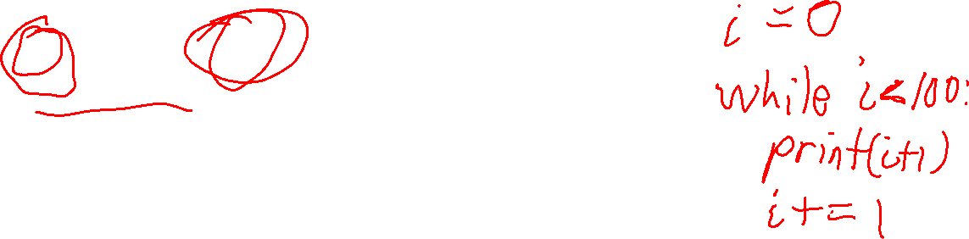
While-loops
A ranged for-loop can be converted to a while-loop …
for i in range(100): print(i + 1)
???

Slide 16
While-loops
A ranged for-loop can be converted to a while-loop …
for i in range(100): print(i + 1)
i = 0
while i < 100: print(i + 1) i += 1

Slide 17

While-loops
A ranged for-loop can be converted to a while-loop …
Initialization of loop variable
Loop condition (execute body as long as it’s True)
for i in range(100): print(i + 1)
i = 0
while i < 100: print(i + 1) i += 1
Increment loop variable

Slide 18
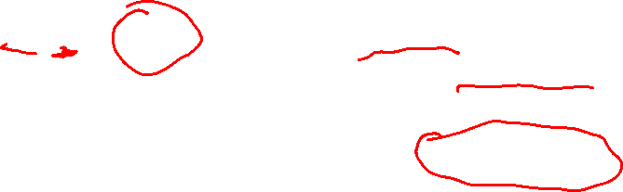
While-loops
The most general ranged for-loop can be re-written like this …
Initialization of loop variable
for i in range(a, b, step): print(i + 1)
i = a
while i < b: print(i + 1) i += step
Loop condition (execute body as long as it’s True)
Increment loop variable

Slide 19
While-loops
The for-loop is shorter and simpler. The loop variable is initialized and incremented automatically.
The while-loop is a little more involved. The loop variable must be initialized and incremented by the programmer.
for i in range(a, b, step): print(i + 1)
i = a
while i < b: print(i + 1) i += step
The while loop is more general-purpose than the ranged for-loop. You can do any kind of loop with a while-loop, e.g. loops where you don’t know ahead of time how many times they’ll loop.

Slide 20
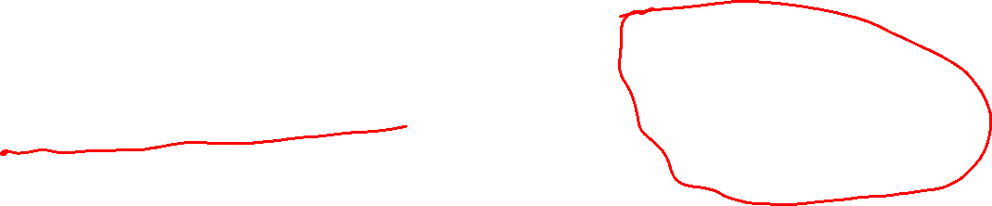
While-loops
The for-loop is shorter and simpler. The loop variable is initialized and incremented automatically.
The while-loop is a little more involved. The loop variable must be initialized and incremented by the programmer.
for i in range(a, b, step): print(i + 1)
i = a
while i < b: print(i + 1) i += step
The while loop is more general-purpose than the ranged for-loop. You can code any kind of loop with a while-loop, e.g. loops where you don’t know ahead of time how many times they’ll loop.
Rule of Thumb Use ranged for-loops when you know ahead of time how many times the loop runs. Otherwise, use a while-loop.

Slide 21
Looping Over Strings
Python lets you loop over the characters of a string …
???
for letter in 'hello!':
print(letter)

Slide 22

Looping Over Strings
Python lets you loop over the characters of a string …
h
e
l
l
o
!
for letter in 'hello!':
print(letter)

Slide 23

Looping Over Strings
Python lets you loop over the characters of a string …
???
for letter in 'hello!':
print(letter, end='-')

Slide 24

Looping Over Strings
Python lets you loop over the characters of a string …
for letter in 'hello!':
print(letter, end='-')
h-e-l-l-o-!-

Slide 25
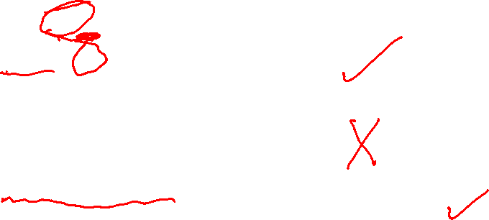
Looping Over Strings
The in operator tests if a string appears in another string as a substring.
s = 'hello!'
if 'lo' in s:
print('contains "lo"') if 'elo' in s:
print('contains "elo"')
if '?' not in s:
print('does not contain "?"')
???

Slide 26
Looping Over Strings
The in operator tests if a string appears in another string as a substring
s = 'hello!'
if 'lo' in s:
print('contains "lo"') if 'elo' in s:
print('contains "elo"')
if '?' not in s:
print('does not contain "?"')
contains "lo"
does not contain "?"

Slide 27
Looping Over Strings
We can search for a letter in s string using a for-loop:
for letter in 'mumble':
if letter == 'm' or letter == 'M':
print('this word has an "m"')
???

Slide 28
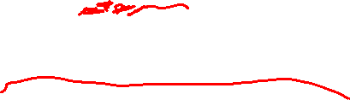
Looping Over Strings
We can search for a letter in s string using a for-loop:
for letter in 'mumble':
if letter == 'm' or letter == 'M':
print('this word has an "m"')
this word has an "m"
this word has an "m"

Slide 29

Looping Over Strings
for letter in 'mumble':
if letter == 'm' or letter == 'M':
print('this word has an "m"')
Let’s put this in a function …
def has_m_print(word):
for letter in word:
if letter == 'm' or letter == 'M':
print('this word has an "m"')

Slide 30

Looping Over Strings
for letter in 'mumble':
if letter == 'm' or letter == 'M':
print('this word has an "m"')
def has_m_print(word):
for letter in word:
if letter == 'm' or letter == 'M':
print('this word has an "m"')
This function is more useful if we made it a Boolean function …

Slide 31
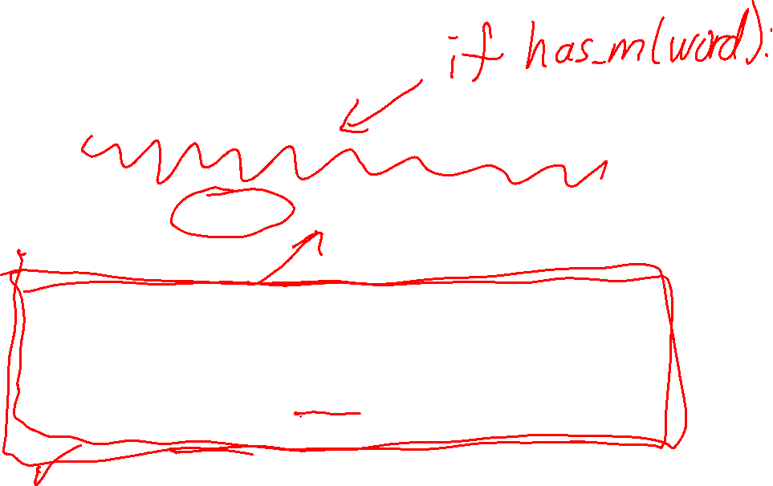
Looping Over Strings
def has_m_print(word):
for letter in word:
if letter == 'm' or letter == 'M':
print('this word has an "m"')
def has_m(word):
for letter in word:
if letter == 'm' or letter == 'M':
return True return False
This Boolean function is a little simpler, and more flexible … it doesn’t print anything.

Slide 32
Looping Over Strings
def has_m(word):
for letter in word:
if letter == 'm' or letter == 'M':
return True return False
We can re-write has_m_print using has_m …
def has_m_print(word):
???

Slide 33
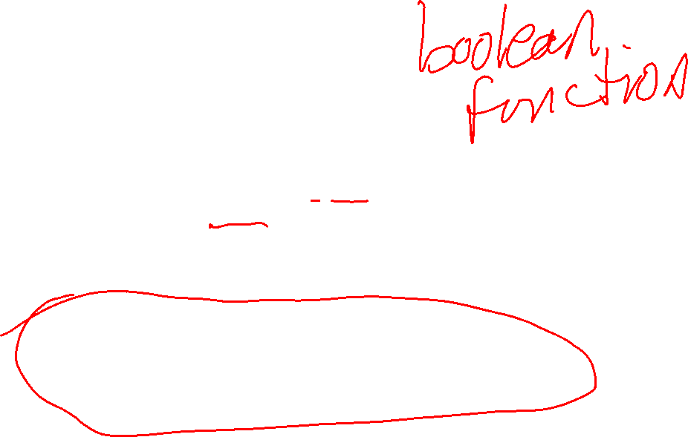
Looping Over Strings
def has_m(word):
for letter in word:
if letter == 'm' or letter == 'M':
return True return False
We can re-write has_m_print using has_m …
def has_m_print(word):
if has_m(word):
print('this word has an "m"')

Slide 34

Looping Over Strings
has_m can be written in a few different ways …
2
def has_m(word):
for letter in word:
if letter.lower() == 'm':
return True return False
1
def has_m(word):
for letter in word:
if letter == 'm' or letter == 'M':
return True return False
3
def has_m(word):
for letter in word:
if letter in 'mM':
return True return False
4
def has_m(word):
return 'm' in word.lower()
has_m('MANY PEOPLE LIKE PYTHON')
e.g.
This version is nice and short, but converting the entire word to lowercase may not be necessary.
M is the first character of the string. No need to convert all the other letters to lower case.

Slide 35

Looping Over Strings
has_m can be written in a few different ways …
def has_m(word):
for letter in word:
if letter.lower() == 'm':
return True return False
def has_m(word):
for letter in word:
if letter == 'm' or letter == 'M':
return True return False
def has_m(word):
for letter in word:
if letter in 'mM':
return True return False
The has_m function is an example of a pure function.
def has_m(word):
return 'm' in word.lower()
A pure function is a function whose output only depends upon its input, and doesn’t have any side-effects like printing, reading/writing a file, …
All functions in math are pure! In general, it is good design to make functions pure when possible. They tend to be easier to use and reason about.

Slide 36
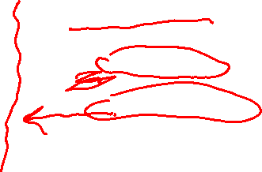
Looping Over Strings
Here is an example of a wrong way to write has_m …
def bad_has_m(word):
for letter in word:
if letter.lower() == 'm':
return True
else:
return False
???

Slide 37
Looping Over Strings
Here is an example of a wrong way to write has_m …
def bad_has_m(word):
for letter in word:
if letter.lower() == 'm':
return True
else:
return False
Error! Putting the else here causes the function to exit after checking just the first character.

Slide 38
Looping Over Strings
Here is an example of a wrong way to write has_m …
def another_bad_has_m(word):
for letter in word:
return letter.lower() == 'm'
???

Slide 39
Looping Over Strings
Here is an example of a wrong way to write has_m …
def another_bad_has_m(word):
for letter in word:
return letter.lower() == 'm'
Error! This only checks the first character in the word, and then immediately returns.

Slide 40
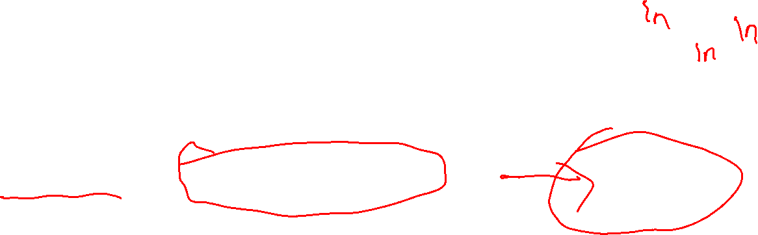
Reading Text Files
Suppose the text file story.txt is in on your computer …
story.txt
Once upon a time,
the world was full of magic.
Everyone was constantly
doing card tricks.
To read the contents of story.txt, we first create file object …
file_object
file_object = open('story.txt')
Python reads the contents of the file a line at a time using the file object.

Slide 41

Reading Text Files
Suppose the text file story.txt is in on your computer …
story.txt
Once upon a time,
the world was full of magic.
Everyone was constantly
doing card tricks.
To read the contents of story.txt, we first create file object …
file_object
file_object = open('story.txt')
first_line = file_object.readline()
print(first_line) # Once upon a time,
second_line = file_object.readline() print(second_line) # the world was full of magic
Python reads the contents of the file a line at a time using the file object.

Slide 42
Reading Text Files
Suppose the text file story.txt is in on your computer …
story.txt
Once upon a time,
the world was full of magic.
Everyone was constantly
doing card tricks.
To read the contents of story.txt, we first create file object …
file_object
Example of a function that is not pure.
file_object = open('story.txt')
first_line = file_object.readline()
print(first_line) # Once upon a time,
second_line = file_object.readline() print(second_line) # the world was full of magic
Each time file_object.readline() is called it returns the next line of the file.

Slide 43
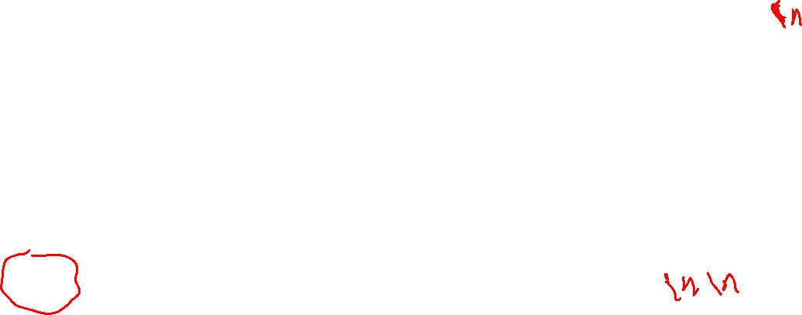
Reading Text Files
Suppose the text file story.txt is in on your computer …
story.txt
Once upon a time,
the world was full of magic.
Everyone was constantly
doing card tricks.
To read the contents of story.txt, we first create file object …
file_object
file_object = open('story.txt')
print(file_object.readline())
print(file_object.readline())
print(file_object.readline())
print(file_object.readline())
This prints the entire file …
Once upon a time,
the world was full of magic.
Everyone was constantly
doing card tricks.
It’s double-spaced because the first three lines end with a \n character (the newline character)

Slide 44
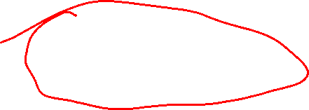
Reading Text Files
Suppose the text file story.txt is in on your computer …
story.txt
Once upon a time,
the world was full of magic.
Everyone was constantly
doing card tricks.
To read the contents of story.txt, we first create file object …
file_object
file_object = open('story.txt')
print(file_object.readline().strip())
print(file_object.readline().strip())
print(file_object.readline().strip())
print(file_object.readline().strip())
Once upon a time,
the world was full of magic.
Everyone was constantly
doing card tricks.
Calling .strip() on a string removes all \n characters at the end and the start. It also removes tabs, spaces, …

Slide 45
Reading Text Files
Suppose the text file story.txt is in on your computer …
story.txt
Once upon a time,
the world was full of magic.
Everyone was constantly
doing card tricks.
To read the contents of story.txt, we first create file object …
file_object
file_object = open('story.txt')
print(file_object.readline().strip())
print(file_object.readline().strip())
print(file_object.readline().strip())
print(file_object.readline().strip())
print(file_object.readline().strip())
print(file_object.readline().strip())
Once upon a time,
the world was full of magic.
Everyone was constantly
doing card tricks.
Calling .readline() after the last line prints empty lines.

Slide 46
Reading Text Files
Suppose the text file story.txt is in on your computer …
story.txt
Once upon a time,
the world was full of magic.
Everyone was constantly
doing card tricks.
To read the contents of story.txt, we first create file object …
file_object
file_object = open('story.txt')
print(file_object.readline().strip())
print(file_object.readline().strip())
print(file_object.readline().strip())
print(file_object.readline().strip())
print(file_object.readline().strip())
print(file_object.readline().strip())
How many times should we call .readline() to print the entire file? We don’t know the file length ahead of time.
???

Slide 47
Reading Text Files
Suppose the text file story.txt is in on your computer …
story.txt
Once upon a time,
the world was full of magic.
Everyone was constantly
doing card tricks.
To read the contents of story.txt, we first create file object …
file_object
file_object = open('story.txt’)
for line in file_object: print(line)
How many times should we call .readline() to print the entire file? We don’t know the file length ahead of time.
This loops through all the lines of the file.

Slide 48
Reading Text Files
Suppose the text file story.txt is in on your computer …
story.txt
Once upon a time,
the world was full of magic.
Everyone was constantly
doing card tricks.
To read the contents of story.txt, we first create file object …
file_object
file_object = open('story.txt’)
num_lines = 0 for line in file_object: num_lines += 1 print(line.strip())
print(f'The file has {num_lines} lines')
This prints and counts the number of lines in a file.

Slide 49

Reading Text Files
Suppose the text file story.txt is in on your computer …
story.txt
Once upon a time,
the world was full of magic.
Everyone was constantly
doing card tricks.
To read the contents of story.txt, we first create file object …
file_object
file_object = open('story.txt’)
line_num = 0 for line in file_object: line_num += 1 print(f'{line_num}: ' + line.strip())
???

Slide 50
Reading Text Files
Suppose the text file story.txt is in on your computer …
story.txt
Once upon a time,
the world was full of magic.
Everyone was constantly
doing card tricks.
To read the contents of story.txt, we first create file object …
file_object
file_object = open('story.txt’)
line_num = 0 for line in file_object: line_num += 1 print(f'{line_num}: ' + line.strip())
1: Once upon a time,
2: the world was full of magic.
3: Everyone was constantly
4: doing card tricks.

Slide 51
Reading Text Files
Suppose the text file story.txt is in on your computer …
story.txt
Once upon a time,
the world was full of magic.
Everyone was constantly
doing card tricks.
To read the contents of story.txt, we first create file object …
file_object
file_object = open('story.txt’)
line_num = 0 for line in file_object: line_num += 1
line = line.strip()
if len(line) > 100: print(f'{line_num}: ' + line)
This prints just the lines with more than 100 characters in them. This could be useful for checking your homework assignments!

Slide 52
Reading a word list
words.txt
aa
aah
aahed
aahing
aahs
aal
aalii
...
zymosis
zymotic
zymurgies
zymurgy
The text file words.txt is a list of over 100,000 English words:
one word per line
in alphabetical order.
Challenge What % of English words contain the letter m one or more times?

Slide 53
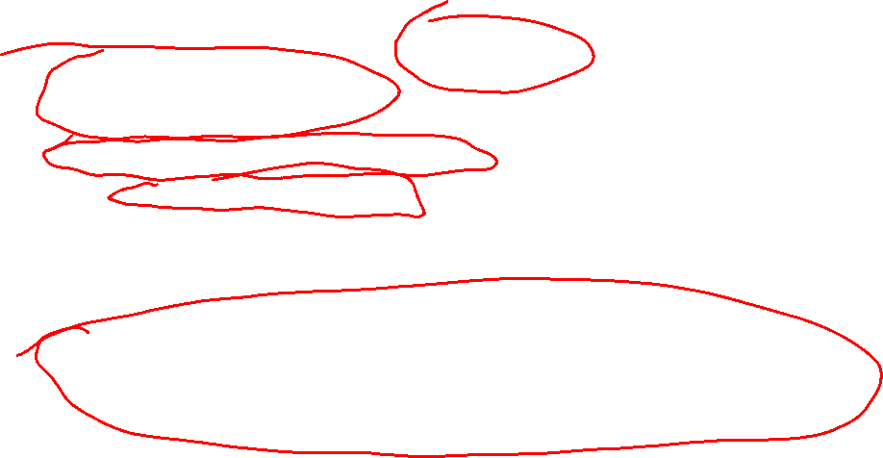
Reading a word list
words.txt
file_object = open('words.txt')
total_words = 0
total_m_words = 0
for line in file_object:
total_words += 1
if has_m(line):
total_m_words += 1
pct = 100 * total_m_words / total_words
print(f'{pct:.1f}% of the words have an "m"')
aa
aah
aahed
aahing
aahs
aal
aalii
...
zymosis
zymotic
zymurgies
zymurgy
def has_m(word):
return 'm' in word.lower()

Slide 54
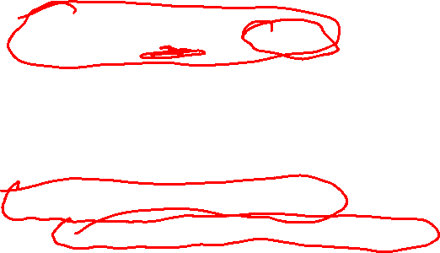
Reading a word list
Checking just for the letter m is not super useful. Let’s generalize has_m to search for more characters.
def has_m(word):
return 'm' in word.lower()
words.txt
aa
aah
aahed
aahing
aahs
aal
aalii
...
zymosis
zymotic
zymurgies
zymurgy
def uses_any(word, letters):
"""Returns True just when one or more of the characters in letters are in word. Otherwise, it
returns False. Converts all letters to lowercase.
"""
for c in word.lower():
if c in letters.lower():
return True
return False

Slide 55
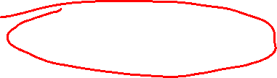
Reading a word list
Checking just for the letter m is not super useful. Let’s generalize has_m to search for more characters.
def has_m(word):
return uses_any(word, 'm')
words.txt
aa
aah
aahed
aahing
aahs
aal
aalii
...
zymosis
zymotic
zymurgies
zymurgy
def uses_any(word, letters):
"""Returns True just when one or more of the characters in letters are in word. Otherwise, it
returns False. Converts all letters to lowercase.
"""
for c in word.lower():
if c in letters.lower():
return True
return False

Slide 56
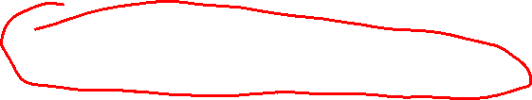
Reading a word list
def has_vowel(word):
return uses_any(word, 'aeiou')
Challenge How many English words do not have one of the vowels a, e, i, o, or u?
words.txt
aa
aah
aahed
aahing
aahs
aal
aalii
...
zymosis
zymotic
zymurgies
zymurgy

Slide 57
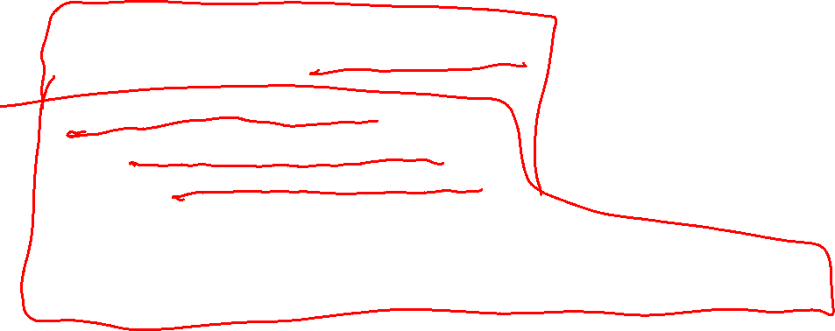
Reading a word list
file_object = open('words.txt')
non_vowel_words = 0
for line in file_object:
if not has_vowel(line):
non_vowel_words += 1
print(f'{non_vowel_words} words have no vowels')
Challenge How many English words do not have one of the vowels a, e, i, o, or u?
words.txt
aa
aah
aahed
aahing
aahs
aal
aalii
...
zymosis
zymotic
zymurgies
zymurgy

Slide 58
Reading a word list
file_object = open('words.txt')
non_vowel_words = 0
for line in file_object:
if not has_vowel(line):
non_vowel_words += 1
print(f'{non_vowel_words} words have no vowels')
Challenge How many English words do not have one of the vowels a, e, i, o, or u?
words.txt
aa
aah
aahed
aahing
aahs
aal
aalii
...
zymosis
zymotic
zymurgies
zymurgy
by
byrl
byrls
bys
...
xylyl
xylyls
xyst
xysts
107 words have no vowels

Slide 59
Reading a word list
file_object = open('words.txt')
non_vowel_words = 0
for line in file_object:
if not has_vowel(line):
non_vowel_words += 1
print(f'{non_vowel_words} words have no vowels')
Challenge How many English words do not have one of the vowels a, e, i, o, or u?
words.txt
aa
aah
aahed
aahing
aahs
aal
aalii
...
zymosis
zymotic
zymurgies
zymurgy
by
byrl
byrls
bys
...
xylyl
xylyls
xyst
xysts
107 words have no vowels
Many of the output words have a y, which is sometimes a vowel. Let’s modify the code to exclude words with a y …

Slide 60

Reading a word list
Many of the output words have a y, which is sometimes a vowel. Let’s modify the code to exclude words with a y.
file_object = open('words.txt’)
non_vowel_words = 0
for line in file_object:
if 'y' not in line and not has_vowel(line):
non_vowel_words += 1
print(f'{non_vowel_words} words have no vowels')
words.txt
aa
aah
aahed
aahing
aahs
aal
aalii
...
zymosis
zymotic
zymurgies
zymurgy

Slide 61
Reading a word list
Many of the output words have a y, which is sometimes a vowel. Let’s modify the code to exclude words with a y.
file_object = open('words.txt’)
non_vowel_words = 0
for line in file_object:
if 'y' not in line and not has_vowel(line):
non_vowel_words += 1
print(f'{non_vowel_words} words have no vowels')
words.txt
aa
aah
aahed
aahing
aahs
aal
aalii
...
zymosis
zymotic
zymurgies
zymurgy
crwth
crwths
cwm
cwms
nth
phpht
pht
psst
sh
shh
tsk
tsks
tsktsk
tsktsks
14 words have no vowels

Slide 62
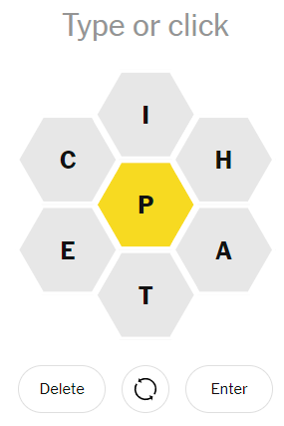
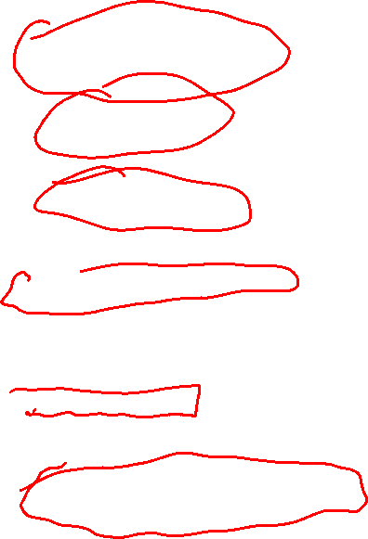
Spelling Bee is a popular on-line game where you try to find as many words as you can from a set of letters:
Each word must use the center letter, P in this case e.g. CHAT is invalid
Letters do not need to be connected e.g. CHAP is valid
Letters can repeat e.g. TEEPEE is valid
Some words:
TAPE, 4
PATH, 4
CHEAP, 5
PATCH, 5
APPETITE, 8
PATHETIC, 15
…
Word Scoring
3 or fewer letters: 0 points
4 or more letters: 1 point per letter
Pangram bonus
7 bonus points if all 7 different letters are used (plus you still get 1 point per letter)
Each puzzle is guaranteed to have at least one pangram

Slide 63
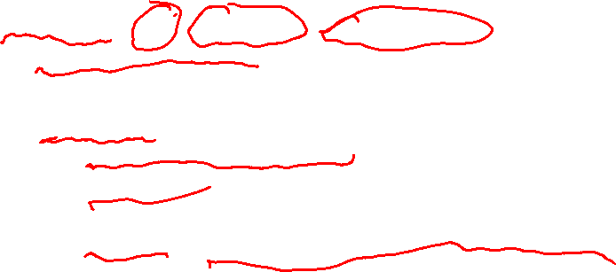
Word Scoring
3 or fewer letters: 0 points
4 or more letters: 1 point per letter
Pangram bonus
7 bonus points if all 7 different letters are used (plus you still get 1 point per letter)
Each puzzle is guaranteed to have at least one pangram
All seven letters: CIHPETA
The word we want to score
The required letter: P
def word_score(word, required, puzzle_letters):
if required not in word or len(word) < 4:
return 0
for c in word:
if c not in puzzle_letters:
return 0
return len(word) + pangram_bonus(word, puzzle_letters)
Some words:
TAPE, 4
PATH, 4
CHEAP, 5
PATCH, 5
APPETITE, 8
PATHETIC, 15
…

Slide 64
Word Scoring
3 or fewer letters: 0 points
4 or more letters: 1 point per letter
Pangram bonus
7 bonus points if all 7 different letters are used (plus you still get 1 point per letter)
Each puzzle is guaranteed to have at least one pangram
All seven letters: CIHPETA
The word we want to score
The required letter: P
def word_score(word, required, puzzle_letters):
if required not in word or len(word) < 4:
return 0
for c in word:
if c not in puzzle_letters:
return 0
return len(word) + pangram_bonus(word, puzzle_letters)
If the word is too short, or does not contain P, the score is 0.
Some words:
TAPE, 4
PATH, 4
CHEAP, 5
PATCH, 5
APPETITE, 8
PATHETIC, 15
…

Slide 65
Word Scoring
3 or fewer letters: 0 points
4 or more letters: 1 point per letter
Pangram bonus
7 bonus points if all 7 different letters are used (plus you still get 1 point per letter)
Each puzzle is guaranteed to have at least one pangram
All seven letters: CIHPETA
The word we want to score
The required letter: P
def word_score(word, required, puzzle_letters):
if required not in word or len(word) < 4:
return 0
for c in word:
if c not in puzzle_letters:
return 0
return len(word) + pangram_bonus(word, puzzle_letters)
If the word has any letters not in the puzzle, it gets 0.
Some words:
TAPE, 4
PATH, 4
CHEAP, 5
PATCH, 5
APPETITE, 8
PATHETIC, 15
…

Slide 66
Word Scoring
3 or fewer letters: 0 points
4 or more letters: 1 point per letter
Pangram bonus
7 bonus points if all 7 different letters are used (plus you still get 1 point per letter)
Each puzzle is guaranteed to have at least one pangram
All seven letters: CIHPETA
The word we want to score
The required letter: P
def word_score(word, required, puzzle_letters):
if required not in word or len(word) < 4:
return 0
for c in word:
if c not in puzzle_letters:
return 0
return len(word) + pangram_bonus(word, puzzle_letters)
Some words:
TAPE, 4
PATH, 4
CHEAP, 5
PATCH, 5
APPETITE, 8
PATHETIC, 15
…
If the code gets to this point, the score is the number of letters plus the pangram bonus …

Slide 67
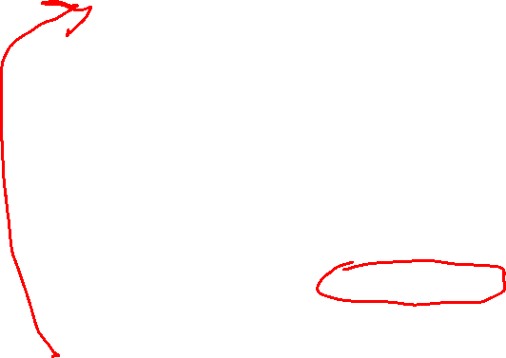
Word Scoring
3 or fewer letters: 0 points
4 or more letters: 1 point per letter
Pangram bonus
7 bonus points if all 7 different letters are used (plus you still get 1 point per letter)
Each puzzle is guaranteed to have at least one pangram
All seven letters: CIHPETA
The word we want to score
The required letter: P
def word_score(word, required, puzzle_letters):
if required not in word or len(word) < 4:
return 0
for c in word:
if c not in puzzle_letters:
return 0
return len(word) + pangram_bonus(word, puzzle_letters)
Some words:
TAPE, 4
PATH, 4
CHEAP, 5
PATCH, 5
APPETITE, 8
PATHETIC, 15
…
def pangram_bonus(word, puzzle_letters):
for c in puzzle_letters:
if c not in word:
return 0
return 7
Note: make sure to define pangram_bonus above word_score.

Slide 68
Word Scoring
3 or fewer letters: 0 points
4 or more letters: 1 point per letter
Pangram bonus
7 bonus points if all 7 different letters are used (plus you still get 1 point per letter)
Each puzzle is guaranteed to have at least one pangram
print(word_score('TAPE', 'P', 'CIHPETA')) # 4
print(word_score('PATH', 'P', 'CIHPETA')) # 4
print(word_score('CHEAP', 'P', 'CIHPETA')) # 5
print(word_score('PATCH', 'P', 'CIHPETA')) # 5
print(word_score('APPETITE', 'P', 'CIHPETA')) # 8
print(word_score('PATHETIC', 'P', 'CIHPETA')) # 15
Some words:
TAPE, 4
PATH, 4
CHEAP, 5
PATCH, 5
APPETITE, 8
PATHETIC, 15
…

Slide 69
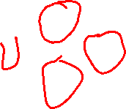
Word Scoring
3 or fewer letters: 0 points
4 or more letters: 1 point per letter
Pangram bonus
7 bonus points if all 7 different letters are used (plus you still get 1 point per letter)
Each puzzle is guaranteed to have at least one pangram
How can use the word_score function to find all the words in Spelling Bee puzzle?
Some words:
TAPE, 4
PATH, 4
CHEAP, 5
PATCH, 5
APPETITE, 8
PATHETIC, 15
…

Slide 70

Word Scoring
3 or fewer letters: 0 points
4 or more letters: 1 point per letter
Pangram bonus
7 bonus points if all 7 different letters are used (plus you still get 1 point per letter)
Each puzzle is guaranteed to have at least one pangram
How can use the word_score function to find all the words in Spelling Bee puzzle?
For each word in words.txt do the following:
If the Spelling Bee score of word is non-zero, print it.
When done, print a count of many words were found,
and the sum of all scores (which is the highest possible
score for the puzzle).
Some words:
TAPE, 4
PATH, 4
CHEAP, 5
PATCH, 5
APPETITE, 8
PATHETIC, 15
…

Slide 71
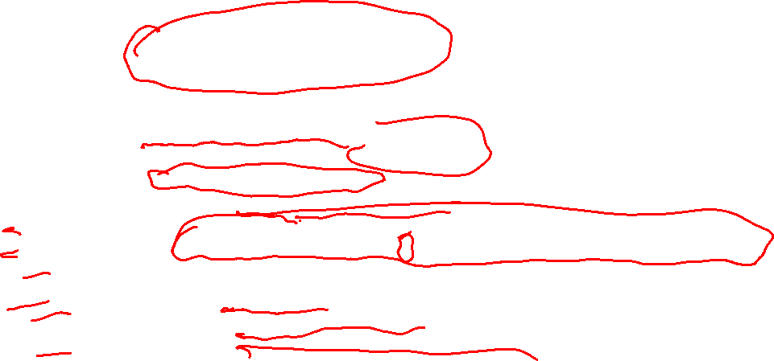
Word Scoring
3 or fewer letters: 0 points
4 or more letters: 1 point per letter
Pangram bonus
7 bonus points if all 7 different letters are used (plus you still get 1 point per letter)
Each puzzle is guaranteed to have at least one pangram
How can use the word_score function to find all the words in Spelling Bee puzzle?
puzzle_letters = 'SIGLENP'
required_letter = 'G'
total_score = 0 scoring_words = 0
file_object = open('words.txt')
for w in file_object:
w = w.strip().upper()
score = word_score(w, required_letter, puzzle_letters)
total_score += score
if score > 0:
scoring_words += 1
print(f'{w}, {score} points')
print()
print(f'Total score: {total_score}')
print(f'Total scoring words: {scoring_words}')
Some words:
TAPE, 4
PATH, 4
CHEAP, 5
PATCH, 5
APPETITE, 8
PATHETIC, 15
…

Slide 72
Word Scoring
3 or fewer letters: 0 points
4 or more letters: 1 point per letter
Pangram bonus
7 bonus points if all 7 different letters are used (plus you still get 1 point per letter)
Each puzzle is guaranteed to have at least one pangram
How can use the word_score function to find all the words in Spelling Bee puzzle?
ACCEPT, 6 points
ACCEPTEE, 8 points
APACE, 5 points
APACHE, 6 points
...
TIPCAT, 6 points
TIPI, 4 points
TIPPET, 6 points
Total score: 566
Total scoring words: 92
This runs in less than a tenth of a second on my computer!
Some words:
TAPE, 4
PATH, 4
CHEAP, 5
PATCH, 5
APPETITE, 8
PATHETIC, 15
…

Slide 73
Word Scoring
3 or fewer letters: 0 points
4 or more letters: 1 point per letter
Pangram bonus
7 bonus points if all 7 different letters are used (plus you still get 1 point per letter)
Each puzzle is guaranteed to have at least one pangram
How can use the word_score function to find all the words in Spelling Bee puzzle?
ACCEPT, 6 points
ACCEPTEE, 8 points
APACE, 5 points
APACHE, 6 points
...
TIPCAT, 6 points
TIPI, 4 points
TIPPET, 6 points
Total score: 566
Total scoring words: 92
This runs in less than a tenth of a second on my computer!
Some words:
TAPE, 4
PATH, 4
CHEAP, 5
PATCH, 5
APPETITE, 8
PATHETIC, 15
…
This is not how humans would solve this puzzle!
But computers are so fast that checking all possible words is a reasonable method.

