Slide 1
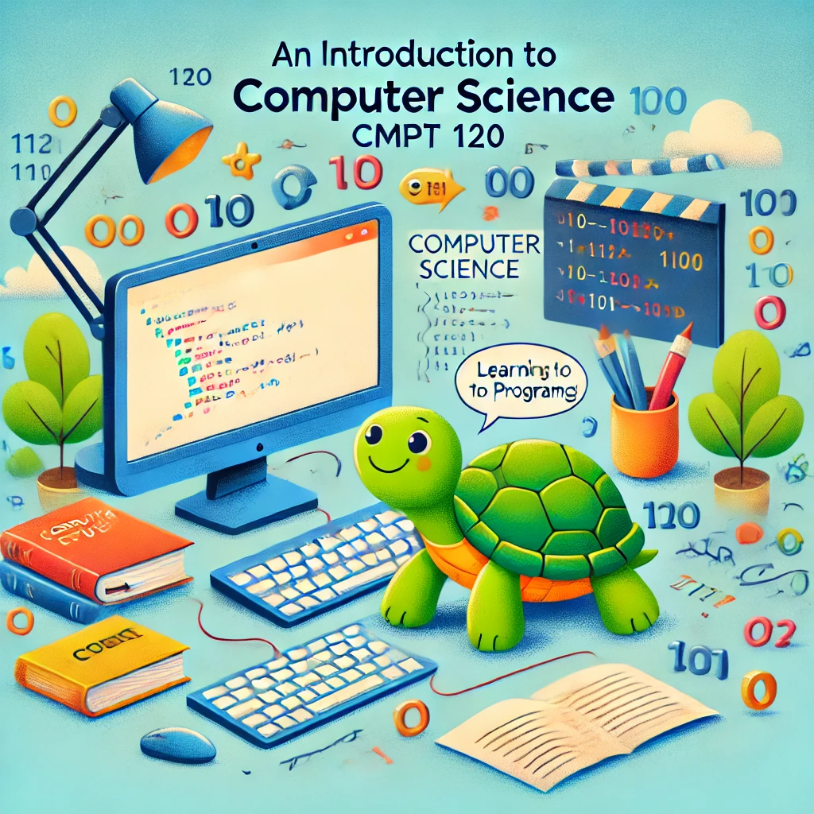
CMPT 120-D100
Fall 2024 SFU Burnaby
Instructor: Toby Donaldson

Slide 2
CMPT 120
An introduction to computer science and Python programming
Assumes you have not taken a prior programmer course

Slide 3
CMPT 120
Check out Canvas
Dates and grades of assignments, quizzes, and exams
Office hours for teaching assistants (TAs)
Announcements, tech support, etc.
Course notes are on a different website
Find it through the Canvas home page
Weekly lecture notes and homework activities (with solutions)

Slide 4
What’ll you’ll need for this course
All the notes are freely online
Textbook is online
Lectures and practice questions are based on the textbook

Slide 5
What’ll you’ll need for this course
All the notes are freely online
Textbook is online
Lectures and practice questions are based on the textbook
You should install Python on your own computer
Go to python.org and download it

Slide 6
What’ll you’ll need for this course
All the notes are freely online
Textbook is online
Lectures and practice questions are based on the textbook
You should install Python on your own computer
Go to python.org and download it
You need a programming text editor (IDE) to write and run programs
IDLE, which comes with Python, is good for this course
VS Code is very popular in the software industry
You can find other Python editors online, including web pages that run Python

Slide 7
What’ll you’ll need for this course
The lecture notes, homework questions, and assignments are mostly written in (Jupyter) notebooks
You can view them directly on the web
No need to interact with the notebooks, but here are some options if you want to:
Google Colab (probably the easiest overall, but you need a Google account)
Jupyter web viewer by typing a URL: https://nbviewer.org/
VS Code, which takes a bit of setup; search the web for how to view notebooks in VS Code

Slide 8
Background Survey
…

