Slide 1
Algorithms: Binary Search
CMPT 120, Fall 2024

Slide 2
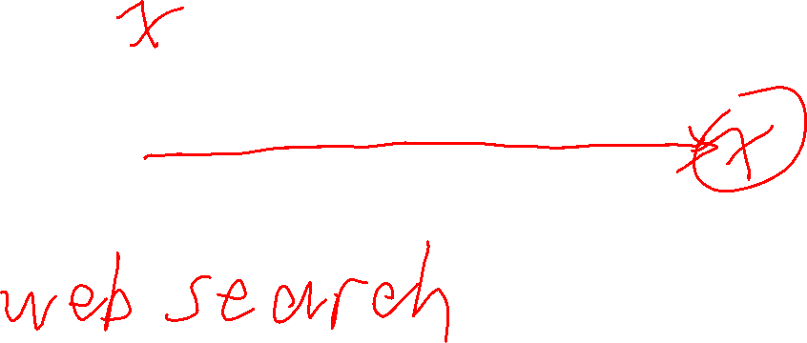
Algorithms
Previously we saw linear search, an algorithm that finds a target value by checking each item in order …
An algorithm is a finite sequence of precise instructions that solves a
computational problem.
0
n-1

Slide 3

Algorithms
Previously we saw linear search, an algorithm that finds a target value by checking each item in order …
An algorithm is a finite sequence of precise instructions that solves a
computational problem.
0
n-1
In the worst case, you may need to check all n items in the list. If n is big, or the checking is slow, this is inefficient!
How might we search faster in the worst case?

Slide 4

Binary Search
N=15, Is 18 in the list?
List is in ascending sorted order.
Idea #1: if the items of the list are in sorted order, then we can sometimes prove an item is not in the list without comparing all the items.
1, 3, 4, 6, 8, 9, 10, 15, 16, 17, 22, 30, 35, 36, 40

Slide 5

Binary Search
N=15, Is 18 in the list?
List is in ascending sorted order.
Idea #1: if the items of the list are in sorted order, then we can sometimes prove an item is not in the list without comparing all the items.
1, 3, 4, 6, 8, 9, 10, 15, 16, 17, 22, 30, 35, 36, 40
1, 3, 4, 6, 8, 9, 10, 15, 16, 17, 22, 30, 35, 36, 40
Linear search only needs to 11 comparisons to prove 18 is not in the list. Since we know the numbers are in sorted order, once we get to 22 then we know 18 cannot be in the rest of the list.
In some cases you still need to do n comparisons. So the worst case is n comparisons.

Slide 6

Binary Search
N=15, Is 18 in the list?
List is in ascending sorted order.
Idea #2: instead of starting the search from the beginning, start in the middle. Then we can cross-off half the numbers with a single comparison.
1, 3, 4, 6, 8, 9, 10, 15, 16, 17, 22, 30, 35, 36, 40
middle-most value
1, 3, 4, 6, 8, 9, 10, 15, 16, 17, 22, 30, 35, 36, 40
If 18 is in the list, it must be in this half.

Slide 7

Binary Search
N=15, Is 18 in the list?
List is in ascending sorted order.
Idea #2: instead of starting the search from the beginning, start in the middle. Then we can cross-off half the numbers with a single comparison.
1, 3, 4, 6, 8, 9, 10, 15, 16, 17, 22, 30, 35, 36, 40
middle-most value
1, 3, 4, 6, 8, 9, 10, 15, 16, 17, 22, 30, 35, 36, 40
After 1 comparison, we’ve discarded 8 values!

Slide 8

Binary Search
N=15, Is 18 in the list?
List is in ascending sorted order.
Idea #2: instead of starting the search from the beginning, start in the middle. Then we can cross-off half the numbers with a single comparison.
1, 3, 4, 6, 8, 9, 10, 15, 16, 17, 22, 30, 35, 36, 40
middle-most value
1, 3, 4, 6, 8, 9, 10, 15, 16, 17, 22, 30, 35, 36, 40
Now we do the same thing on this smaller list.

Slide 9
Binary Search
N=15, Is 18 in the list?
List is in ascending sorted order.
Idea #2: instead of starting the search from the beginning, start in the middle. Then we can cross-off half the numbers with a single comparison.
1, 3, 4, 6, 8, 9, 10, 15, 16, 17, 22, 30, 35, 36, 40
middle-most value
1, 3, 4, 6, 8, 9, 10, 15, 16, 17, 22, 30, 35, 36, 40
If 18 is in the list, it must be in this half.

Slide 10

Binary Search
N=15, Is 18 in the list?
List is in ascending sorted order.
Idea #2: instead of starting the search from the beginning, start in the middle. Then we can cross-off half the numbers with a single comparison.
1, 3, 4, 6, 8, 9, 10, 15, 16, 17, 22, 30, 35, 36, 40
middle-most value
1, 3, 4, 6, 8, 9, 10, 15, 16, 17, 22, 30, 35, 36, 40
1 comparison discarded 4 values
If 18 is in the list, it must be in this half.

Slide 11
Binary Search
N=15, Is 18 in the list?
List is in ascending sorted order.
Idea #2: instead of starting the search from the beginning, start in the middle. Then we can cross-off half the numbers with a single comparison.
1, 3, 4, 6, 8, 9, 10, 15, 16, 17, 22, 30, 35, 36, 40
1, 3, 4, 6, 8, 9, 10, 15, 16, 17, 22, 30, 35, 36, 40
We do the same thing on this smaller list.

Slide 12
Binary Search
N=15, Is 18 in the list?
List is in ascending sorted order.
Idea #2: instead of starting the search from the beginning, start in the middle. Then we can cross-off half the numbers with a single comparison.
1, 3, 4, 6, 8, 9, 10, 15, 16, 17, 22, 30, 35, 36, 40
middle-most value
1, 3, 4, 6, 8, 9, 10, 15, 16, 17, 22, 30, 35, 36, 40
If 18 is in the list, it must be in this half.

Slide 13
Binary Search
N=15, Is 18 in the list?
List is in ascending sorted order.
Idea #2: instead of starting the search from the beginning, start in the middle. Then we can cross-off half the numbers with a single comparison.
1, 3, 4, 6, 8, 9, 10, 15, 16, 17, 22, 30, 35, 36, 40
middle-most value
1, 3, 4, 6, 8, 9, 10, 15, 16, 17, 22, 30, 35, 36, 40
1 comparison discarded 2 values
If 18 is in the list, it must be in this half.

Slide 14
Binary Search
N=15, Is 18 in the list?
List is in ascending sorted order.
Idea #2: instead of starting the search from the beginning, start in the middle. Then we can cross-off half the numbers with a single comparison.
1, 3, 4, 6, 8, 9, 10, 15, 16, 17, 22, 30, 35, 36, 40
1, 3, 4, 6, 8, 9, 10, 15, 16, 17, 22, 30, 35, 36, 40
There’s only one element in this list, and it’s not 18. So we’re done: we proven 18 is not in the list.

Slide 15

Binary Search
N=15, Is 18 in the list?
List is in ascending sorted order.
Idea #2: instead of starting the search from the beginning, start in the middle. Then we can cross-off half the numbers with a single comparison.
1, 3, 4, 6, 8, 9, 10, 15, 16, 17, 22, 30, 35, 36, 40
1️⃣
3️⃣
4️⃣
2️⃣
1, 3, 4, 6, 8, 9, 10, 15, 16, 17, 22, 30, 35, 36, 40
The red numbers are the ones we compared: only 4 comparisons were needed to show 18 is not in the list.
Basic linear search | 15 comparisons
Smarter linear search | 11 comparisons
Binary search | 4 comparisons

Slide 16

Binary Search
List is in ascending sorted order.
Binary search removes about half the remaining candidate values for each comparison.
n
Linear search removes 1 of the remaining candidate values for each comparison.

Slide 17
Binary Search
List is in ascending sorted order.
Binary search removes about half the remaining candidate values for each comparison.
n
Linear search removes 1 of the remaining candidate values for each comparison.

Slide 18

Binary Search
List is in ascending sorted order.
Binary search removes about half the remaining candidate values for each comparison.
n
Linear search removes 1 of the remaining candidate values for each comparison.
n/2

Slide 19

Binary Search
List is in ascending sorted order.
Binary search removes about half the remaining candidate values for each comparison.
n
Linear search removes 1 of the remaining candidate values for each comparison.
n/2

Slide 20

Binary Search
List is in ascending sorted order.
Binary search removes about half the remaining candidate values for each comparison.
n
Linear search removes 1 of the remaining candidate values for each comparison.
n/2
n/4

Slide 21
Binary Search
List is in ascending sorted order.
Binary search removes about half the remaining candidate values for each comparison.
n
Linear search removes 1 of the remaining candidate values for each comparison.
n/2
n/4

Slide 22

Binary Search
List is in ascending sorted order.
Binary search removes about half the remaining candidate values for each comparison.
n
Linear search removes 1 of the remaining candidate values for each comparison.
n/2
n/4
n/8

Slide 23

Binary Search
List is in ascending sorted order.
Binary search removes about half the remaining candidate values for each comparison.
n
Linear search removes 1 of the remaining candidate values for each comparison.
n/2
n/4
n/8

Slide 24
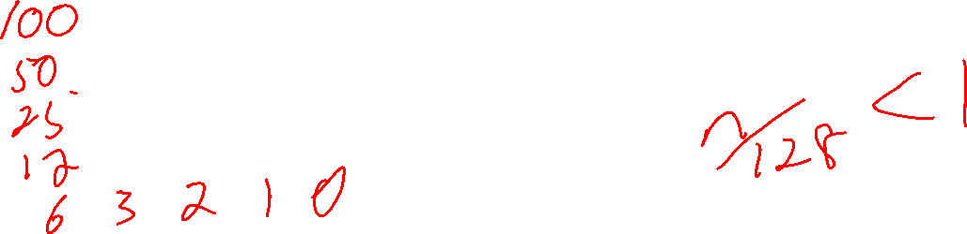
Binary Search
List is in ascending sorted order.
Binary search removes about half the remaining candidate values for each comparison.
n
Linear search removes 1 of the remaining candidate values for each comparison.
n/2
n/4
n/8
n/16

Slide 25
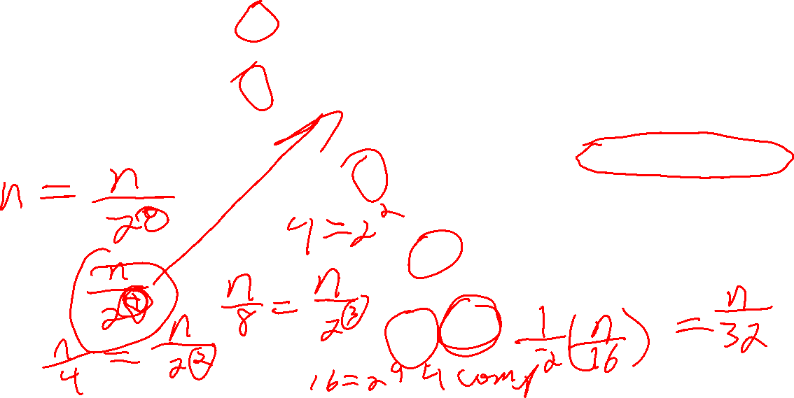
Binary Search
List is in ascending sorted order.
Binary search removes about half the remaining candidate values for each comparison.
n
Linear search removes 1 of the remaining candidate values for each comparison.
n/2
In binary search, the size of the list being searched is cut in half after each comparison: n, n/2, n/4, n/8, n/16, n/32, …
n/4
The size of the list being searched decreases exponentially!
n/8
n/16

Slide 26
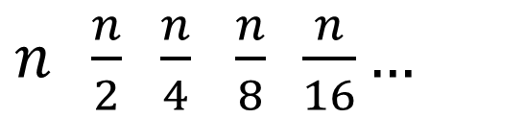
Binary Search
In binary search, the list sizes decrease like this …
Binary search removes about half the remaining candidate values for each comparison.
$n \frac{n}{2} \frac{n}{4}$ $\frac{n}{8} \frac{n}{16}…$

Slide 27
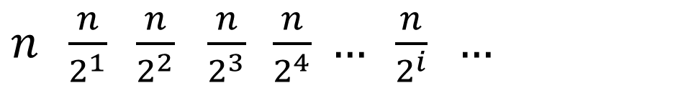
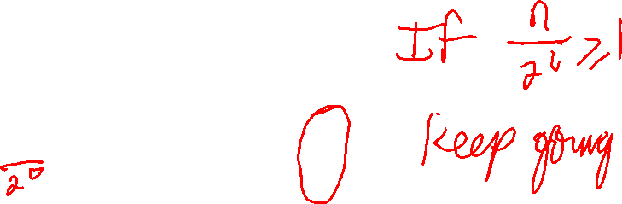
Binary Search
In binary search, the list sizes decrease like this …
Binary search removes about half the remaining candidate values for each comparison.
$n \frac{n}{2} \frac{n}{4}$ $\frac{n}{8} \frac{n}{16}…$
$n \frac{n}{2^{1}} \frac{n}{2^{2}}$ $\frac{n}{2^{3}} \frac{n}{2^{4}} … \frac{n}{2^{i}} …$

Slide 28
Binary Search
In binary search, the list sizes decrease like this …
Binary search removes about half the remaining candidate values for each comparison.
$n \frac{n}{2} \frac{n}{4}$ $\frac{n}{8} \frac{n}{16}…$
Binary search stops for the smallest value of i where this term is less than 1.
$n \frac{n}{2^{1}} \frac{n}{2^{2}}$ $\frac{n}{2^{3}} \frac{n}{2^{4}} … \frac{n}{2^{i}} …$

Slide 29

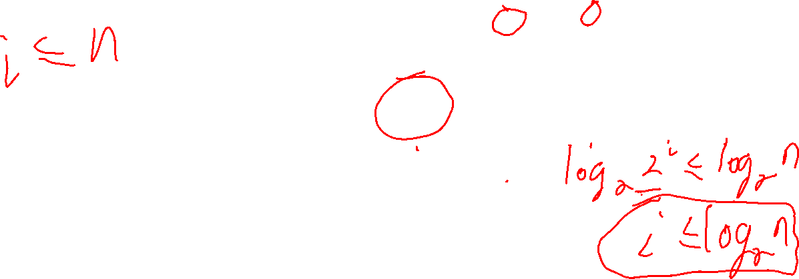
Binary Search
In binary search, the list sizes decrease like this …
Binary search removes about half the remaining candidate values for each comparison.
$n \frac{n}{2} \frac{n}{4}$ $\frac{n}{8} \frac{n}{16}…$
Binary search stops for the smallest value of i where this term is less than 1.
$n \frac{n}{2^{1}} \frac{n}{2^{2}}$ $\frac{n}{2^{3}} \frac{n}{2^{4}} … \frac{n}{2^{i}} …$
When this is true, binary search keeps doing comparisons …
$$1≤\frac{n}{2^{i}}$$
Do some algebra …

Slide 30
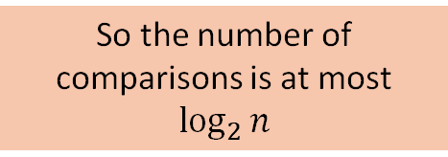


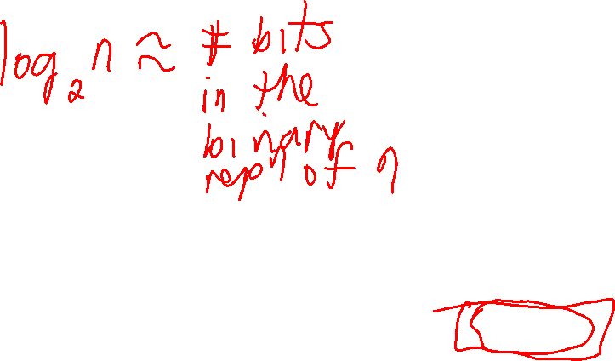

Binary Search
In binary search, the list sizes decrease like this …
Binary search removes about half the remaining candidate values for each comparison.
$n \frac{n}{2} \frac{n}{4}$ $\frac{n}{8} \frac{n}{16}…$
Binary search stops for the smallest value of i where this term is less than 1.
$n \frac{n}{2^{1}} \frac{n}{2^{2}}$ $\frac{n}{2^{3}} \frac{n}{2^{4}} … \frac{n}{2^{i}} …$
When this is true, binary search keeps doing comparisons …
$$1≤\frac{n}{2^{i}}$$
Do some algebra …
$$2^{i}≤n$$
$$\log_{2}{2^{i}≤\log_{2}{n}}$$
So the number of comparisons is at most $\log_{2}{n}$
$${i≤log}_{2}{n}$$

Slide 31

Binary Search
Implementing binary search is surprisingly tricky: you need to get every detail right!
def binary_search_loop(x, lst):
"""Returns an index i such that list[i] == x.
If x is not in lst, returns -1.
lst must be in sorted order, from smallest to biggest.
"""
lo = 0
hi = len(lst) - 1
while lo <= hi:
mid = (lo + hi) // 2 # // is integer division
if lst[mid] == x:
return mid # x found at location mid
elif x < lst[mid]:
hi = mid - 1
else: # lst[mid] < x
lo = mid + 1
return -1 # x not in lst
lo
hi
Only this sub-list is searched.

Slide 32

Binary Search
def binary_search_helper(x, lst, lo, hi):
"""Returns an index i such that lo <= i <= hi and list[i] == x.
If x is not found in the range lo to hi, returns -1.
lst must be in sorted order, from smallest to biggest.
"""
if lo > hi:
return -1
else:
mid = (lo + hi) // 2
if lst[mid] == x:
return mid
elif x < lst[mid]:
return binary_search_helper(x, lst, lo, mid - 1)
else:
return binary_search_helper(x, lst, mid + 1, hi)
def binary_search_recursive(x, lst):
return binary_search_helper(x, lst, 0, len(lst) - 1)
Implementing binary search is surprisingly tricky: you need to get every detail right!
lo
hi
Only this sub-list is searched.
Binary search is naturally implemented as a recursive algorithm. As is often the case with recursive functions, we use a helper function with extra parameters.

Slide 33
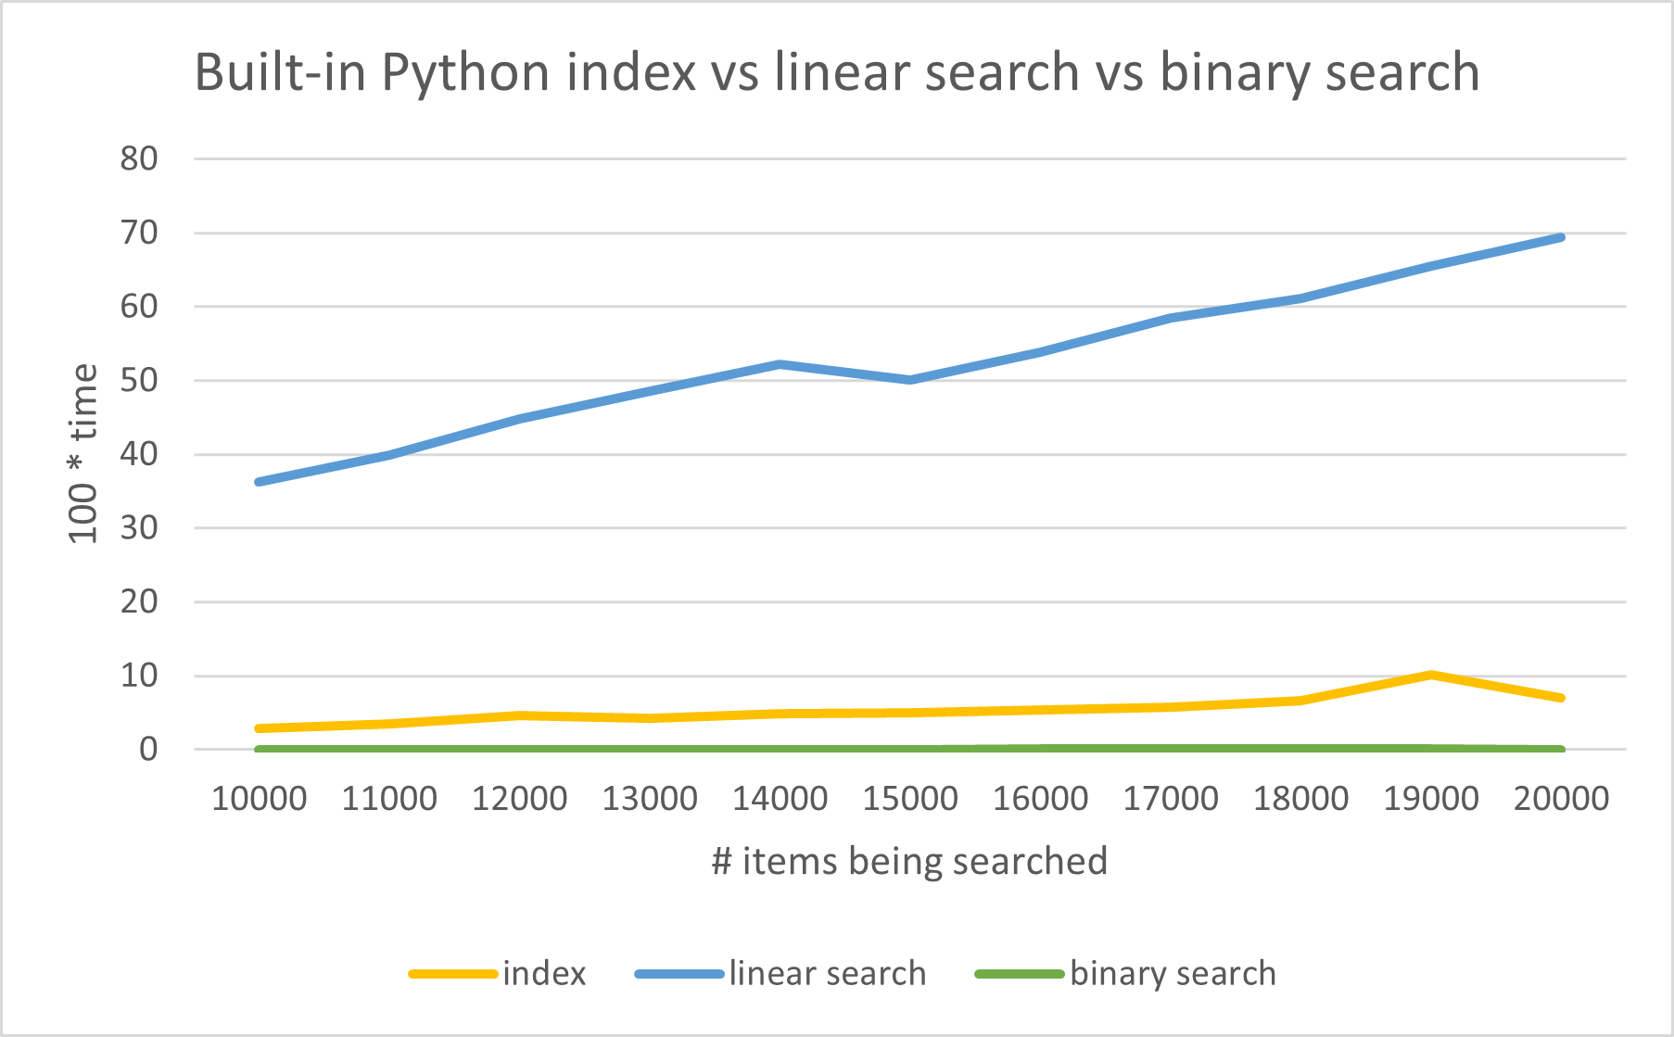
Binary Search
As predicted in theory, binary search (the green line at the bottom) is much faster than linear search.

Slide 34
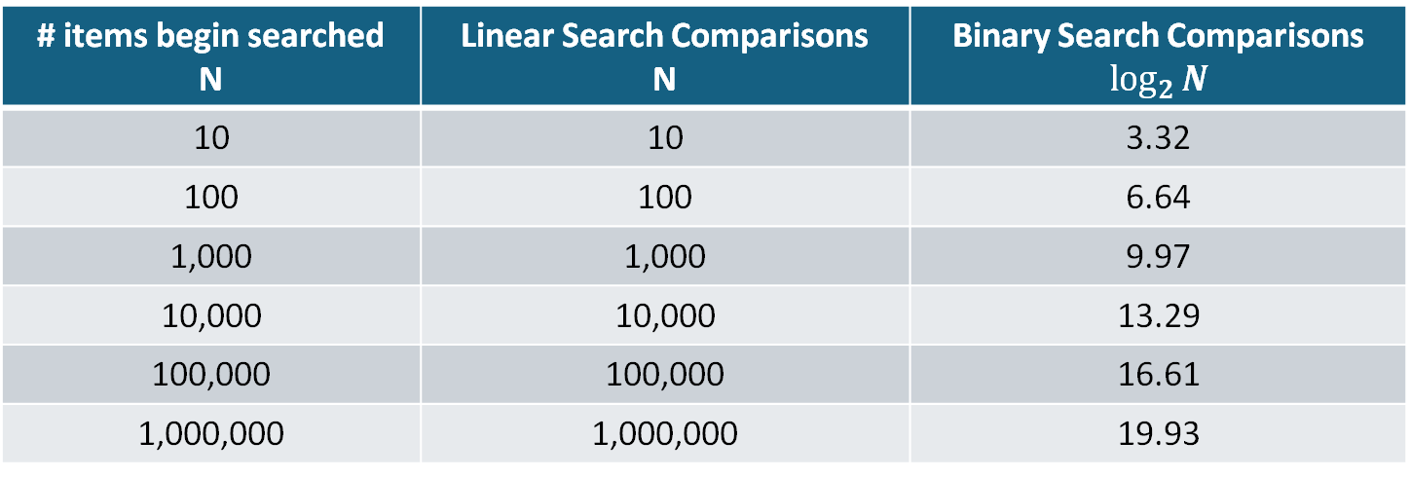

Binary Search
# items begin searched N | Linear Search Comparisons N | Binary Search Comparisons $$\log_{2}{N}$$
10 | 10 | 3.32
100 | 100 | 6.64
1,000 | 1,000 | 9.97
10,000 | 10,000 | 13.29
100,000 | 100,000 | 16.61
1,000,000 | 1,000,000 | 19.93

Slide 35
Binary Search
# items begin searched N | Linear Search Comparisons N | Binary Search Comparisons $$\log_{2}{N}$$
10 | 10 | 3.32
100 | 100 | 6.64
1,000 | 1,000 | 9.97
10,000 | 10,000 | 13.29
100,000 | 100,000 | 16.61
1,000,000 | 1,000,000 | 19.93
Binary search does at most 20 comparisons when searching 1 million items!

Slide 36
Binary Search
Despite it’s blazingly fast performance, binary search has a major issue …

Slide 37
Binary Search
Despite it’s blazingly fast performance, binary search has a major issue …
Arranging list values into sorted order is more expensive than linear search.

Slide 38

Binary Search
Despite it’s blazingly fast performance, binary search has a major issue …
Arranging list values into sorted order is more expensive than linear search.
It’s a bit like saying how you can make your car drive a long distance without using much gas …

Slide 39
Binary Search
Despite it’s blazingly fast performance, binary search has a major issue …
Arranging list values into sorted order is more expensive than linear search.
It’s a bit like saying how you can make your car drive a long distance without using much gas …
Just put it at the top of a steep hill and push it down!

Slide 40
Binary Search
Despite it’s blazingly fast performance, binary search has a major issue …
Arranging list values into sorted order is more expensive than linear search.
It’s a bit like saying how you can make your car drive a long distance without using much gas …
Just put it at the top of a steep hill and push it down!
But the hard part is getting it to the top of the hill.

