Slide 1
Chapter 3 Functions (and simple loops)
Remember!
Assignment 1 is due this Wednesday
I have office hours in C9001 (this room) the hour before Wednesday’s class
CMPT 120-D1 Fall 2024

Slide 2
Functions
A function is a “black box” that takes some input and returns some output.
Input
Function
Output

Slide 3
Functions
A function is a “black box” that takes some input and returns some output.
Input
4
Function
math.sqrt
Output
2

Slide 4

Functions
A function is a “black box” that takes some input and returns some output.
Input
4
Function
math.sqrt
x = math.sqrt(4)
Output
2

Slide 5
Defining New Functions
This defines a new function named print_a_joke() that takes no input.
def print_a_joke () :
print("Knock knock!")
print("Who's there?")
print("A broken pencil.")
print("A broken pencil who?")
print("Never mind, it's pointless.")

Slide 6
Defining New Functions
This is the function header.
This is the function body.
This defines a new function named print_a_joke() that takes no input.
def print_a_joke () :
print("Knock knock!")
print("Who's there?")
print("A broken pencil.")
print("A broken pencil who?")
print("Never mind, it's pointless.")

Slide 7
Defining New Functions
This defines a new function named print_a_joke() that takes no input.
def print_a_joke () :
print("Knock knock!")
print("Who's there?")
print("A broken pencil.")
print("A broken pencil who?")
print("Never mind, it's pointless.")
A function definition starts with the keyword def.

Slide 8
Defining New Functions
After def comes the function name.
This defines a new function named print_a_joke() that takes no input.
def print_a_joke () :
print("Knock knock!")
print("Who's there?")
print("A broken pencil.")
print("A broken pencil who?")
print("Never mind, it's pointless.")
A function definition starts with the keyword def.

Slide 9
Defining New Functions
After def comes the function name.
After the name comes the parameter list.
( is an open parenthesis ) is a closed parenthesis
This defines a new function named print_a_joke() that takes no input.
def print_a_joke () :
print("Knock knock!")
print("Who's there?")
print("A broken pencil.")
print("A broken pencil who?")
print("Never mind, it's pointless.")
A function definition starts with the keyword def.

Slide 10

Defining New Functions
After def comes the function name.
After the name comes the parameter list.
( is an open parenthesis ) is a closed parenthesis
This defines a new function named print_a_joke() that takes no input.
After the parameter list comes a : (colon).
def print_a_joke () :
print("Knock knock!")
print("Who's there?")
print("A broken pencil.")
print("A broken pencil who?")
print("Never mind, it's pointless.")
A function definition starts with the keyword def.

Slide 11

Defining New Functions
The body of a function definition consists of 1 or more statements.
This particular function body has 5 print statements.
This defines a new function named print_a_joke() that takes no input.
def print_a_joke () :
print("Knock knock!")
print("Who's there?")
print("A broken pencil.")
print("A broken pencil who?")
print("Never mind, it's pointless.")
Important! The statements in the body of a function must be consistently indented.

Slide 12
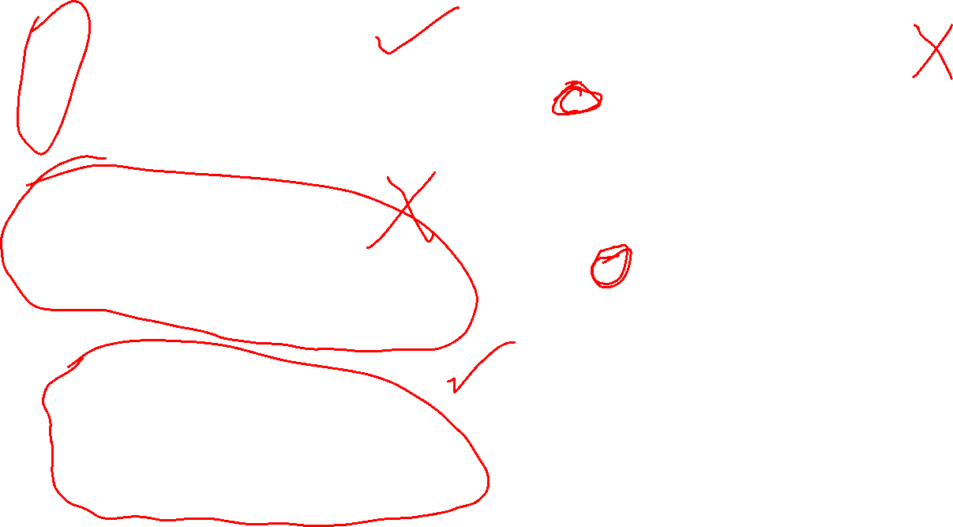
def print_a_joke():
print("Knock knock!")
print("Who's there?")
print("A broken pencil.")
print("A broken pencil who?")
print("Never mind, it's pointless.")
def print_a_joke():
print("Knock knock!")
print("Who's there?")
print("A broken pencil.")
print("A broken pencil who?")
print("Never mind, it's pointless.")
def print_a_joke():
print("Knock knock!")
print("Who's there?")
print("A broken pencil.")
print("A broken pencil who?")
print("Never mind, it's pointless.")
def print_a_joke():
print("Knock knock!")
print("Who's there?")
print("A broken pencil.")
print("A broken pencil who?")
print("Never mind, it's pointless.")
def print_a_joke():
print("Knock knock!")
print("Who's there?")
print("A broken pencil.")
print("A broken pencil who?")
print("Never mind, it's pointless.")
Which functions are
correctly indented?

Slide 13
def print_a_joke():
print("Knock knock!")
print("Who's there?")
print("A broken pencil.")
print("A broken pencil who?")
print("Never mind, it's pointless.")
Works!
def print_a_joke():
print("Knock knock!")
print("Who's there?")
print("A broken pencil.")
print("A broken pencil who?")
print("Never mind, it's pointless.")
Syntax error!
def print_a_joke():
print("Knock knock!")
print("Who's there?")
print("A broken pencil.")
print("A broken pencil who?")
print("Never mind, it's pointless.")
Syntax error!
def print_a_joke():
print("Knock knock!")
print("Who's there?")
print("A broken pencil.")
print("A broken pencil who?")
print("Never mind, it's pointless.")
Syntax error!
def print_a_joke():
print("Knock knock!")
print("Who's there?")
print("A broken pencil.")
print("A broken pencil who?")
print("Never mind, it's pointless.")
Which functions are
correctly indented?
Works!

Slide 14
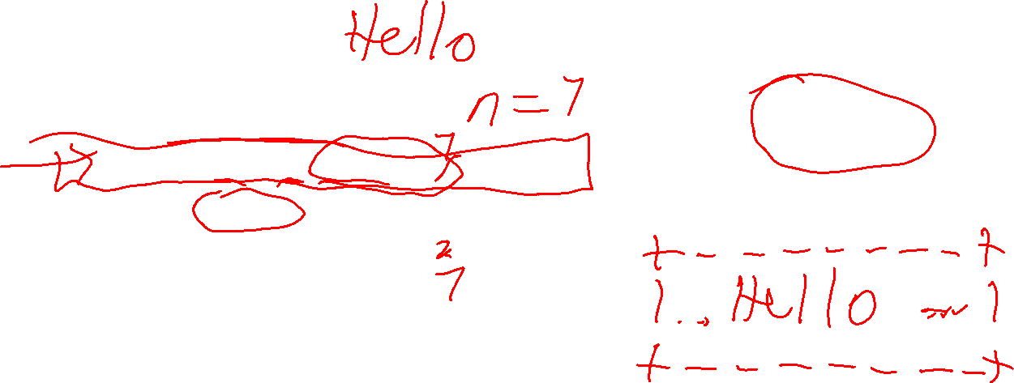
Read this function. What are its parts? What does it do?
print_in_box('Hello')
def print_in_box(word):
n = len(word) + 2
print('+' + '-' * n + '+’)
print('| ' + word + ' |')
print('+' + '-' * n + '+')
+-------+
| Hello |
+-------+

Slide 15
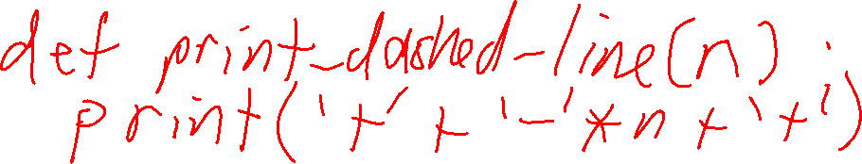
print_in_box('Hello')
def print_in_box(word):
n = len(word) + 2
print('+' + '-' * n + '+')
print('| ' + word + ' |')
print('+' + '-' * n + '+')
+-------+
| Hello |
+-------+
These two lines are identical. Identical code is often a sign you should make a function …

Slide 16
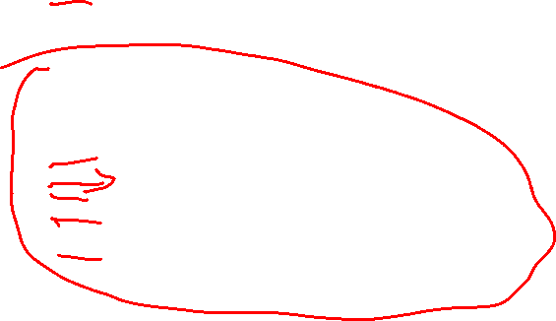
def print_dashed_line(n): print('+' + '-' * n + '+’)
def print_in_box(word):
n = len(word) + 2
print_dashed_line(n)
print('| ' + word + ' |') print_dashed_line(n)
def print_in_box(word):
n = len(word) + 2
print('+' + '-' * n + '+')
print('| ' + word + ' |') print('+' + '-' * n + '+')
This code is a little easier to read.

Slide 17
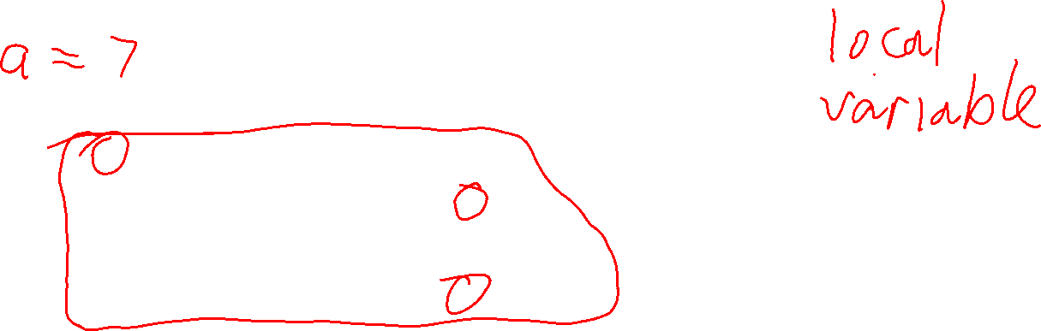
def print_dashed_line(n): print('+' + '-' * n + '+')
def print_in_box(word):
n = len(word) + 2
print_dashed_line(n)
print('| ' + word + ' |') print_dashed_line(n)
Notice the variable n is defined inside the print_in_box function.

Slide 18
def print_dashed_line(n): print('+' + '-' * n + '+')
def print_in_box(word):
n = len(word) + 2
print_dashed_line(n)
print('| ' + word + ' |') print_dashed_line(n)
Notice the variable n is defined inside the print_in_box function.
A variable defined inside a function is called a local variable.

Slide 19
def print_dashed_line(n): print('+' + '-' * n + '+')
def print_in_box(word):
n = len(word) + 2
print_dashed_line(n)
print('| ' + word + ' |') print_dashed_line(n)
Notice the variable n is defined inside the print_in_box function.
A variable defined inside a function is called a local variable.
Local variables only exist inside the function they’re defined.

Slide 20
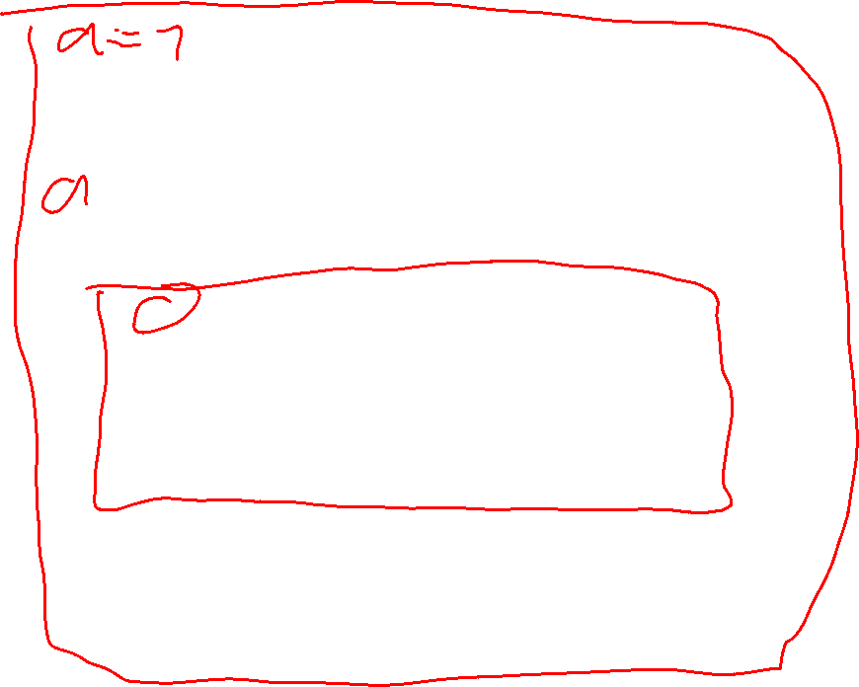
def print_dashed_line(n): print('+' + '-' * n + '+')
def print_in_box(word):
n = len(word) + 2
print_dashed_line(n)
print('| ' + word + ' |') print_dashed_line(n)
Notice the variable n is defined inside the print_in_box function.
A variable defined inside a function is called a local variable.
We say that the scope of a local variable is the function it’s defined in.
Local variables only exist inside the function they’re defined.

Slide 21
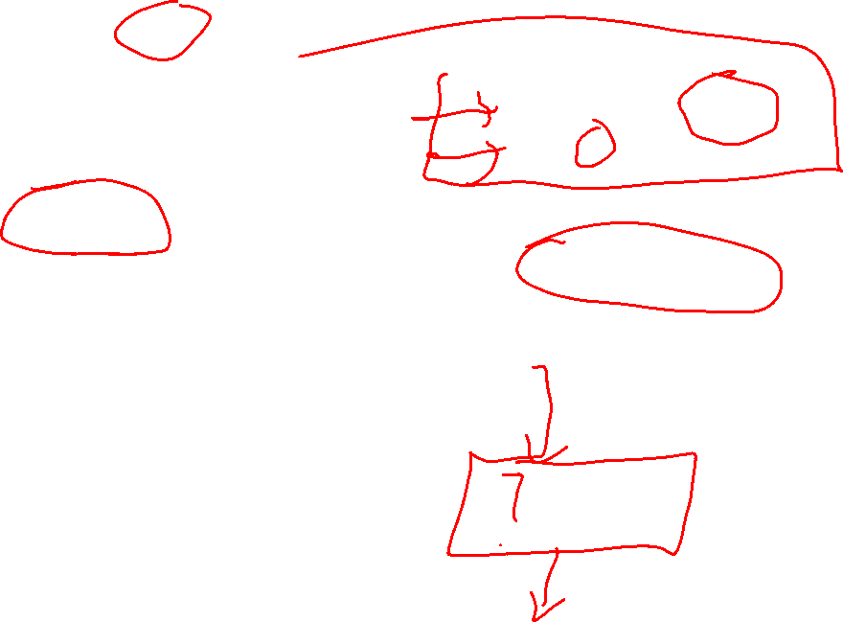
def print_dashed_line(n): print('+' + '-' * n + '+')
print_in_box('Hello') print(n)
def print_in_box(word):
n = len(word) + 2
print_dashed_line(n)
print('| ' + word + ' |') print_dashed_line(n)
You cannot read or write local variables outside of their function.
NameError: n is not defined

Slide 22
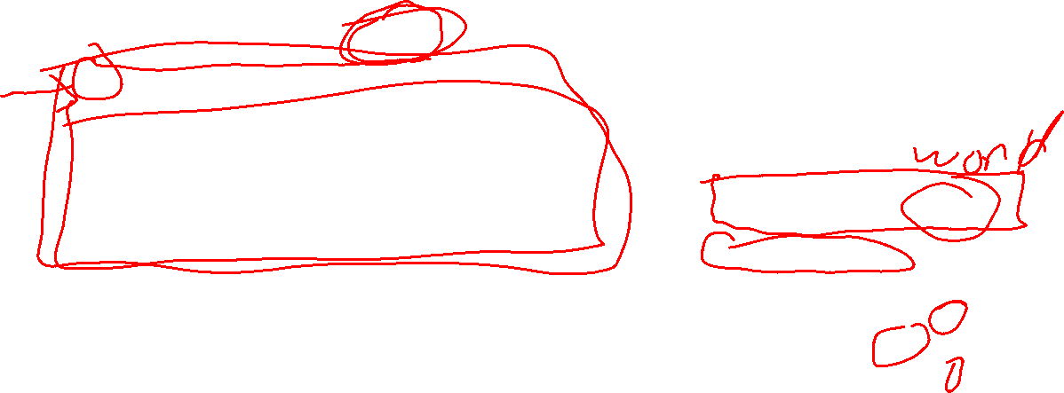
def print_dashed_line(n): print('+' + '-' * n + '+')
The parameter word is also a local variable. word only exists inside the function body.
def print_in_box(word):
n = len(word) + 2
print_dashed_line(n)
print('| ' + word + ' |') print_dashed_line(n)
print_in_box('Hello')
word = 'Hello'
n = len(word) + 2
print_dashed_line(n)
print('| ' + word + ' |') print_dashed_line(n)
When calling print_in_box('Hello'), it’s as if we wrote code like this.
Both word and n are local variables.

Slide 23
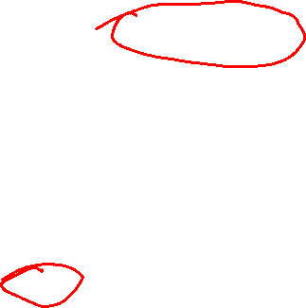
def print_dashed_line(n): print('+' + '-' * n + '+')
Important When you pass a value to a function, Python copies the value. This is called pass by value.
def print_in_box(word):
n = len(word) + 2
print_dashed_line(n)
print('| ' + word + ' |') print_dashed_line(n)
A copy of the argument is assigned to the parameter.
word = 'Hello'
n = len(word) + 2
print_dashed_line(n)
print('| ' + word + ' |') print_dashed_line(n)
'Hello' is the argument word is the parameter

Slide 24
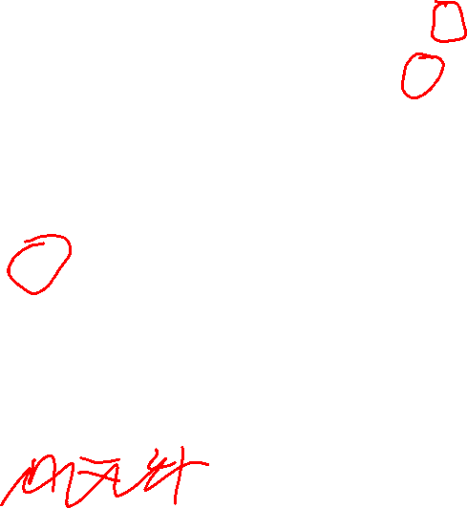
def print_dashed_line(n): print('+' + '-' * n + '+')
def print_in_box(word):
n = len(word) + 2
print_dashed_line(n)
print('| ' + word + ' |') print_dashed_line(n)
Notice a local variable named n appears in both functions.

Slide 25
def print_dashed_line(n): print('+' + '-' * n + '+')
def print_in_box(word):
n = len(word) + 2
print_dashed_line(n)
print('| ' + word + ' |') print_dashed_line(n)
Notice a local variable named n appears in both functions.
The n in print_dashed_line is different than the n in print_in_box.

Slide 26
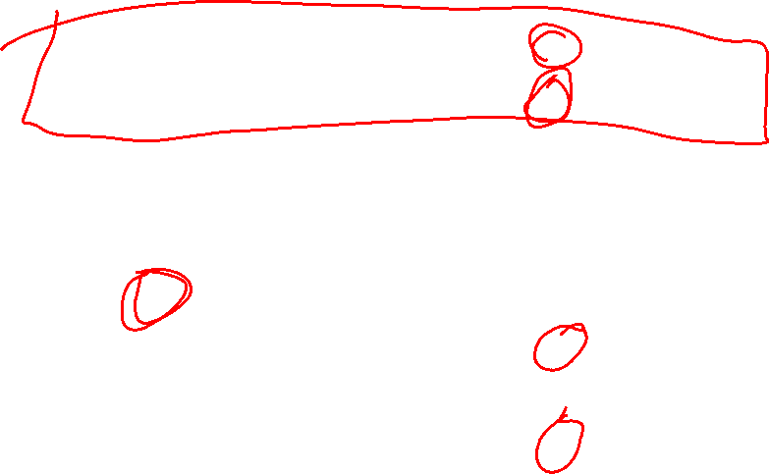
def print_dashed_line(n): print('+' + '-' * n + '+')
def print_in_box(word):
n = len(word) + 2
print_dashed_line(n)
print('| ' + word + ' |') print_dashed_line(n)
Notice a local variable named n appears in both functions.
The n in print_dashed_line is different than the n in print_in_box.
Neither function can access the n in the other one. Local variables are private in the function they are defined.
Python automatically keeps track of which n is which.

Slide 27
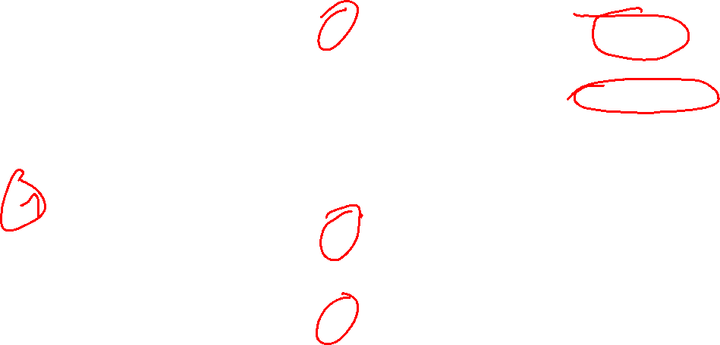
def print_dashed_line(n): print('+' + '-' * n + '+')
n = 2
print_in_box('Hello’)
print(n)
def print_in_box(word):
n = len(word) + 2
print_dashed_line(n)
print('| ' + word + ' |') print_dashed_line(n)
Now there are three n variables! Two local ones, and a global variable called n.
+-------+
| Hello |
+-------+
2

Slide 28
def print_dashed_line(n): print('+' + '-' * n + '+')
n = 2
print_in_box('Hello’)
print(n)
def print_in_box(word):
n = len(word) + 2
print_dashed_line(n)
print('| ' + word + ' |') print_dashed_line(n)
Now there are three n variables! Two local ones, and a global variable called n.
+-------+
| Hello |
+-------+
2
Code outside of functions can only access global variables, so 2 is printed.

Slide 29
def print_dashed_line(n): print('+' + '-' * n + '+')
n = 2
print_in_box('Hello’)
print(n)
def print_in_box(word):
n = len(word) + 2
print_dashed_line(n)
print('| ' + word + ' |') print_dashed_line(n)
Now there are three n variables! Two local ones, and a global variable called n.
+-------+
| Hello |
+-------+
2
Code outside of functions can only access global variables, so 2 is printed.
Important It’s okay, and usually good, for functions to use whatever local variable names make the most sense in them. Make your variable names self-descriptive.

Slide 30
Repeating
with for-loops
Suppose you want to print the numbers 0 to 3.
0
1
2
3

Slide 31
Repeating
with for-loops
Suppose you want to print the numbers 0 to 3.
This works, but if you want to print out 1000 numbers it will get tedious!
print(0)
print(1)
print(2)
print(3)
0
1
2
3

Slide 32

Repeating
with for-loops
This prints 0 to 3 using a for-loop.
Suppose you want to print the numbers 0 to 3.
for i in range(4):
print(i)
0
1
2
3

Slide 33
Repeating
with for-loops
Suppose you want to print the numbers 0 to 3.
Prints the same thing
for i in range(4):
print(i)
print(0)
print(1)
print(2)
print(3)
0
1
2
3

Slide 34
Repeating
with for-loops
This is the for-loop header.
Suppose you want to print the numbers 0 to 3.
for i in range(4):
print(i)
0
1
2
3
This is the for-loop body.

Slide 35
Repeating
with for-loops
Suppose you want to print the numbers 0 to 3.
for i in range(4):
print(i)
0
1
2
3
A for-loop always starts with the keyword for

Slide 36
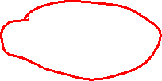
Repeating
with for-loops
This is the loop variable. It can be any variable name you like. i is the traditional variable, short for “index”
Suppose you want to print the numbers 0 to 3.
for i in range(4):
print(i)
0
1
2
3
A for-loop always starts with the keyword for

Slide 37
Repeating
with for-loops
This is the loop variable. It can be any variable name you like. i is the traditional variable, short for “index”
The keyword in always comes after the loop variable.
Suppose you want to print the numbers 0 to 3.
for i in range(4):
print(i)
0
1
2
3
A for-loop always starts with the keyword for

Slide 38
Repeating
with for-loops
This is the loop variable. It can be any variable name you like. i is the traditional variable, short for “index”
The keyword in always comes after the loop variable.
Suppose you want to print the numbers 0 to 3.
for i in range(4):
print(i)
0
1
2
3
A for-loop always starts with the keyword for
This expression makes the loop repeat 4 times. Each time through the loop i gets the value 0, then 1, then 2, …
In a for-loop, range(n) generates the numbers 0, 1, 2, …, n-1.
Starts at 0, ends at n-1.

Slide 39
Repeating
with for-loops
This is the loop variable. It can be any variable name you like. i is the traditional variable, short for “index”
The keyword in always comes after the loop variable.
A colon : marks the end of the for-loop header.
Suppose you want to print the numbers 0 to 3.
for i in range(4):
print(i)
0
1
2
3
A for-loop always starts with the keyword for
This expression makes the loop repeat 4 times. Each time through the loop i gets the value 0, then 1, then 2, …
In a for-loop, range(n) generates the numbers 0, 1, 2, …, n-1.
Starts at 0, ends at n-1.

Slide 40
Repeating
with for-loops
Suppose you want to print the numbers 0 to 3.
for i in range(4):
print(i)
0
1
2
3
The statements in the body of a for-loop must be consistently indented at least 1 space.
This particular body has only one statement. In general, a for-loop body can have as many statements as you like.

Slide 41
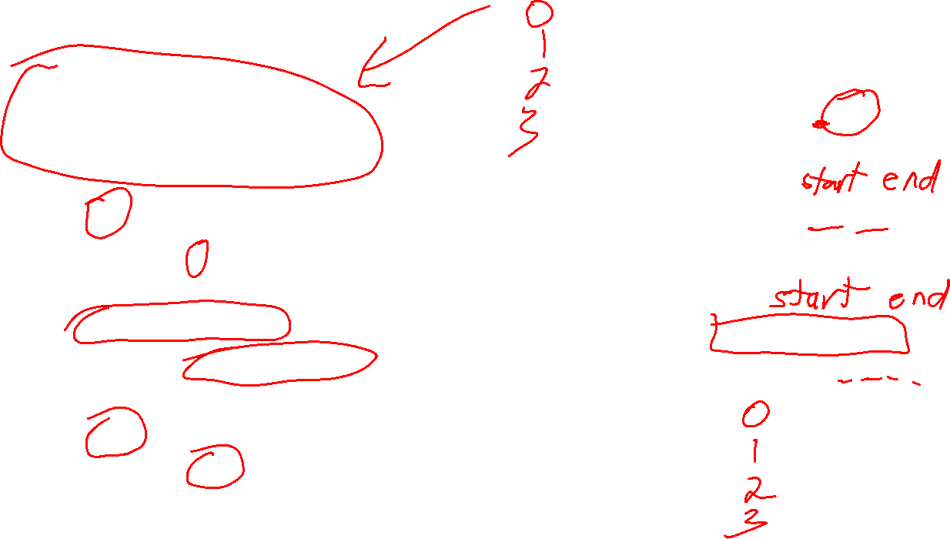
Loops in green boxes all print the same thing.
for i in range(4):
print(i)
for i in range(3+1):
print(i)
for k in range(4):
print(k)
for i in range(0, 4):
print(i)
for index_value in range(4):
print(index_value)
for i in range(5, 9):
print(i-5)
i = 5, 6, 7, 8
for int in range(4):
print(int)
Error!

Slide 42
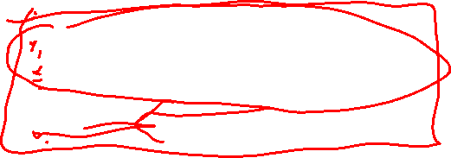
Repeating
with for-loops
for i in range(3):
for j in range(2):
print('*', end='') print()

Slide 43
Repeating
with for-loops
for i in range(3):
for j in range(2):
print('*', end='') print()
**
**
**

Slide 44
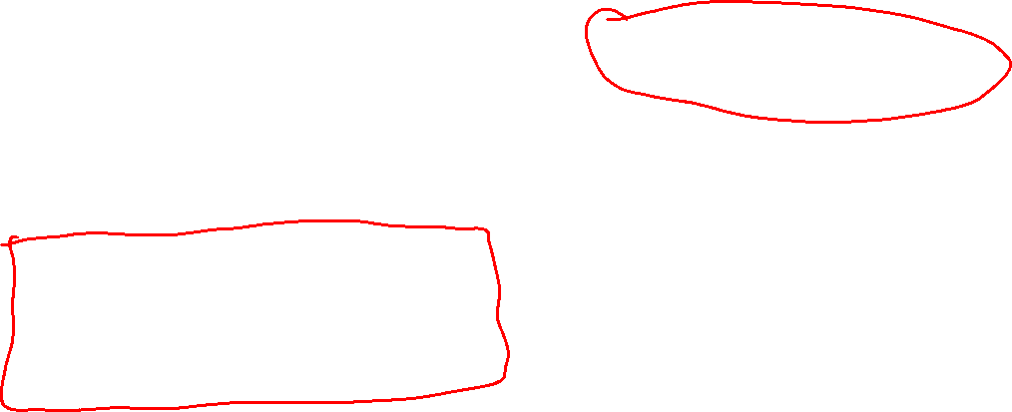
Repeating
with for-loops
for j in range(2):
print('*', end='')
print()
for i in range(3):
for j in range(2):
print('*', end='') print()
**
**
**
for j in range(2):
print('*', end='')
print()
for j in range(2):
print('*', end='')
print()

Slide 45

Repeating
with for-loops
for i in range(3):
for j in range(i):
print('*', end='') print()

Slide 46

Repeating
with for-loops
for i in range(3):
for j in range(i):
print('*', end='') print()
*
**

Slide 47
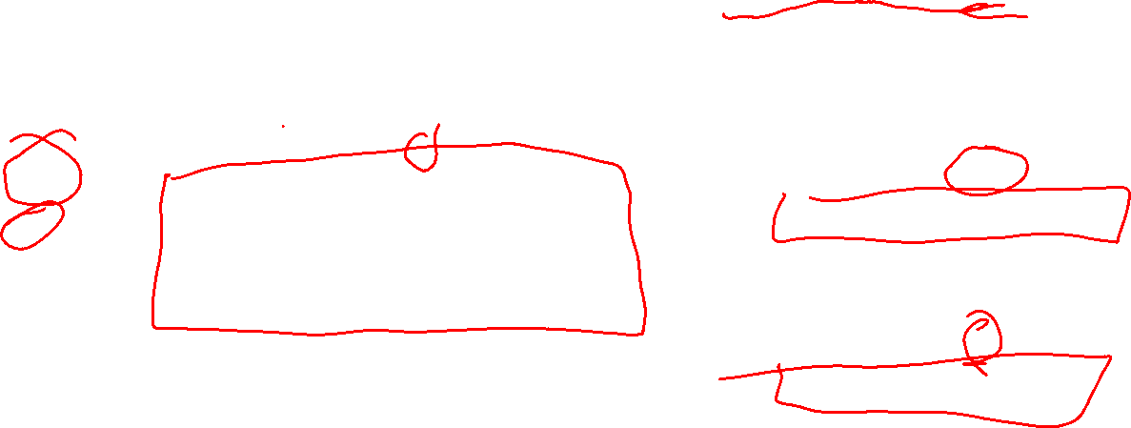
Repeating
with for-loops
for j in range(0):
print('*', end='')
print()
for i in range(3):
for j in range(i):
print('*', end='') print()
*
**
for j in range(1):
print('*', end='')
print()
for j in range(2):
print('*', end='')
print()

Slide 48
Example: Multiplication Table
As practice with for-loops, lets build a program that prints a multiplication table like this …
1 2 3 4 5 6 7 8 9 10
----------------------------------------
1 | 1 2 3 4 5 6 7 8 9 10
2 | 2 4 6 8 10 12 14 16 18 20
3 | 3 6 9 12 15 18 21 24 27 30
4 | 4 8 12 16 20 24 28 32 36 40
5 | 5 10 15 20 25 30 35 40 45 50
6 | 6 12 18 24 30 36 42 48 54 60
7 | 7 14 21 28 35 42 49 56 63 70
8 | 8 16 24 32 40 48 56 64 72 80
9 | 9 18 27 36 45 54 63 72 81 90
10 | 10 20 30 40 50 60 70 80 90 100

