Slide 1
Chapter 9: Lists
CMPT 120, Fall 2024

Slide 2
Lists
[] # empty list
[5, -2]
['on','off']
['a', 'b', 'c']
A list is a sequence of 0 or more values. The order of the values matters.
A list literal begins with a [ and ends with a ]. The values are separated by commas.
Lists can be indexed and slice using the same notation as for strings.
Major difference from strings: lists are mutable, i.e. they can be modified.

Slide 3
Lists
L = [4, 7, 0, 7, 2, 6]
A list is a sequence of 0 or more values. The order of the values matters.
0
1
2
3
4
5
We can represent a list in memory as a sequence of numbered boxes as shown.
4
7
0
7
2
6
L

Slide 4
Lists
L = [4, 7, 0, 7, 2, 6]
A list is a sequence of 0 or more values. The order of the values matters.
0
1
2
3
4
5
We can represent a list in memory as a sequence of numbered boxes as shown.
4
7
0
7
2
6
L
L[0]
L[1]
L[2]
L[3]
L[4]
L[5]

Slide 5
Lists
L = [4, 7, 0, 7, 2, 6]
A list is a sequence of 0 or more values. The order of the values matters.
0
1
2
3
4
5
We can represent a list in memory as a sequence of numbered boxes as shown.
4
7
0
7
2
6
L
L[0]
L[1]
L[2]
L[3]
L[4]
L[5]
print(L[0]) # 4 print(L[3]) # 7 print(L[5]) # 6
print(L[6]) # IndexError
print(len(L)) # 6

Slide 6
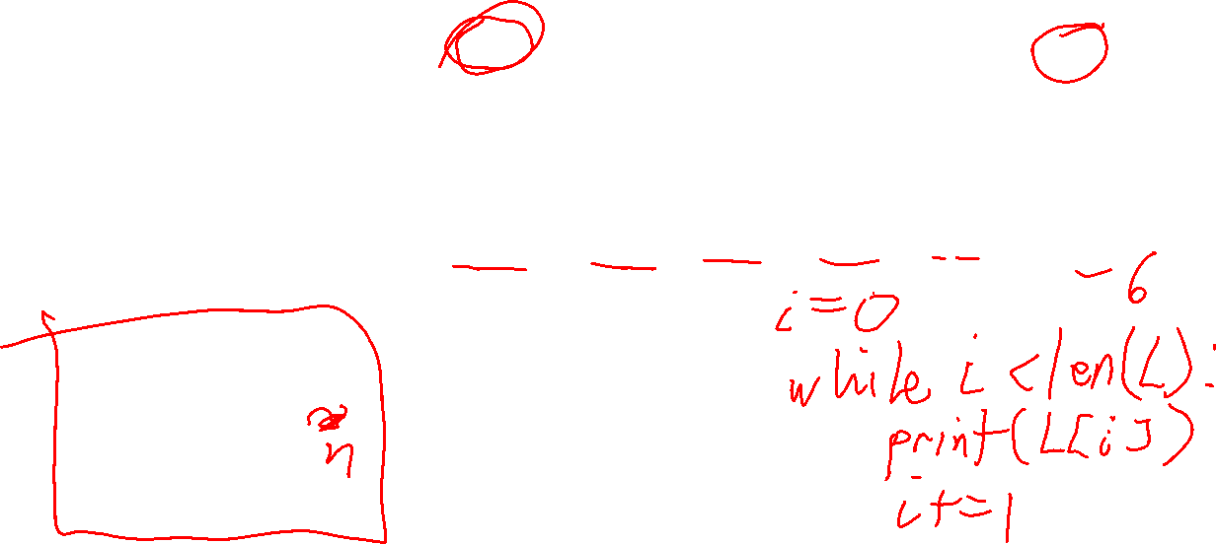
Lists
L = [4, 7, 0, 7, 2, 6]
A list is a sequence of 0 or more values. The order of the values matters.
0
1
2
3
4
5
4
7
0
7
2
6
L
We can represent a list in memory as a sequence of numbered boxes as shown.
L[0]
L[1]
L[2]
L[3]
L[4]
L[5]
for n in L: print(c)
4
7
0
7
2
6

Slide 7
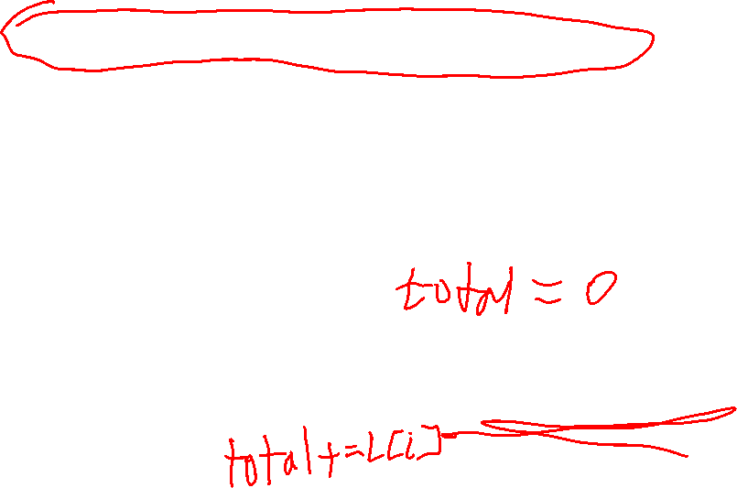
Lists
L = [4, 7, 0, 7, 2, 6]
A list is a sequence of 0 or more values. The order of the values matters.
0
1
2
3
4
5
4
7
0
7
2
6
L
We can represent a list in memory as a sequence of numbered boxes as shown.
L[0]
L[1]
L[2]
L[3]
L[4]
L[5]
for n in L: print(c)
4
7
0
7
2
6
i = 0 while i < len(L): print(L[i]) i += 1

Slide 8
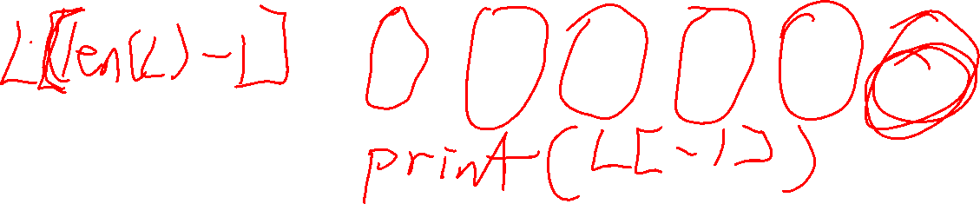
Lists
L = [4, 7, 0, 7, 2, 6]
As with strings, we can access values on a list with negative index values.
-6
-5
-4
-3
-2
-1
0
1
2
3
4
5
4
7
0
7
2
6
L
L[0]
L[1]
L[2]
L[3]
L[4]
L[5]
L[-6]
L[-5]
L[-4]
L[-3]
L[-2]
L[-1]

Slide 9
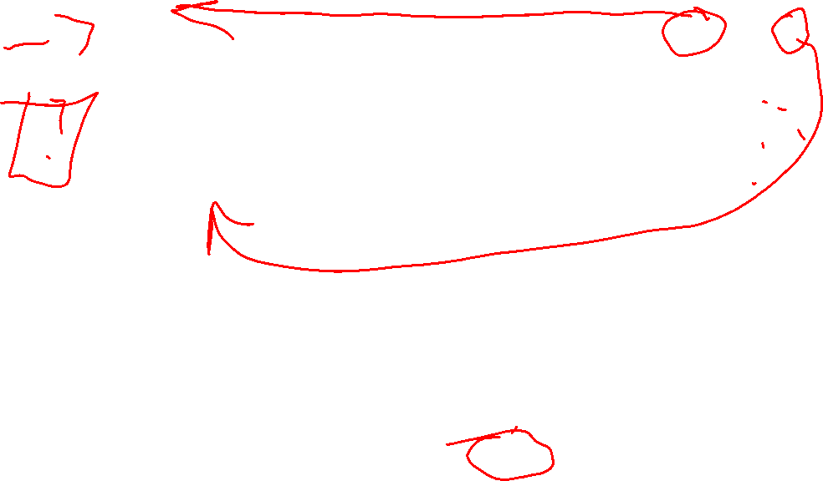
Lists
L = [4, 7, 0, 7, 2, 6]
-6
-5
-4
-3
-2
-1
0
1
2
3
4
5
4
7
0
7
2
6
L
L[0]
L[1]
L[2]
L[3]
L[4]
L[5]
L[-6]
L[-5]
L[-4]
L[-3]
L[-2]
L[-1]
print(L[0]) # 4 print(L[3]) # 7 print(L[5]) # 6
print(L[6]) # IndexError
print(L[-6]) # 4 print(L[-3]) # 7 print(L[-1]) # 6
print(L[-7]) # IndexError

Slide 10

Lists
L[start:end] is the list with the values: L[start], L[start+1], …, L[end-2], L[end-1]
A slice of a list is a subsequence of consecutive values in a list.
L[start:end] is all the values beginning with L[start] and then up to, but not including, L[end]

Slide 11
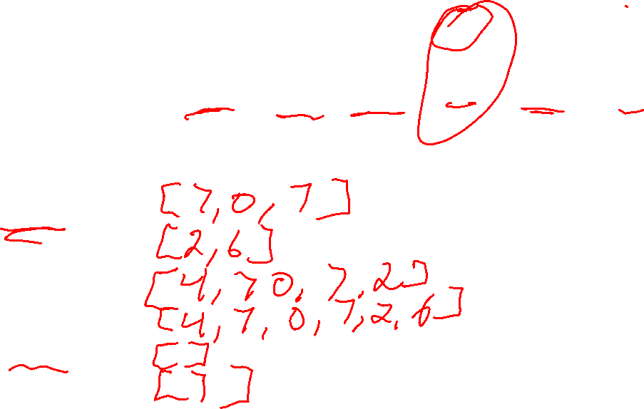
Lists
L = [4, 7, 0, 7, 2, 6]
A slice of a list is a subsequence of consecutive values in a list.
0
1
2
3
4
5
4
7
0
7
2
6
L
L[0]
L[1]
L[2]
L[3]
L[4]
L[5]
print(L[1:4]) #
print(L[4:6]) #
print(L[0:5]) #
print(L[0:6]) # print(L[3:3]) #
print(L[3:4]) #

Slide 12
Lists
L = [4, 7, 0, 7, 2, 6]
A slice of a list is a subsequence of consecutive values in a list.
0
1
2
3
4
5
4
7
0
7
2
6
L
L[0]
L[1]
L[2]
L[3]
L[4]
L[5]
print(L[1:4]) # [7, 0, 7]
print(L[4:6]) # [2, 6]
print(L[0:5]) # [4, 7, 0, 7, 2]
print(L[0:6]) # [4, 7, 0, 7, 2, 6] print(L[3:3]) # []
print(L[3:4]) # [7]

Slide 13

Lists
L = [4, 7, 0, 7, 2, 6]
A slice of a list is a subsequence of consecutive values in a list.
0
1
2
3
4
5
4
7
0
7
2
6
L
L[0]
L[1]
L[2]
L[3]
L[4]
L[5]
print(L[1:]) # [7, 0, 7, 2, 6]
print(L[:5]) # [4, 7, 0, 7]
print(L[:]) # [4, 7, 0, 7, 2, 6]

Slide 14
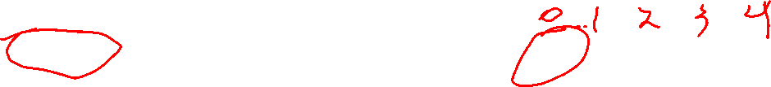
List Mutability
L = [4, 7, 0, 7, 2, 6]
print(L[0]) # 4 print(len(s)) # 6
L[0] = -5 # [-5, 7, 0, 7, 2, 6]
print(L[0]) # -5
In Python, you can add, remove, or change values of a list. Python lists are mutable.

Slide 15

List Mutability
L = ['MIT', 'UVIC', 'YVR', 'UBC']
L[2] = 'SFU'
# ['MIT', 'UVIC', 'SFU', 'UBC']
Since lists are mutable, it is fast to change an item in the middle of a list …

Slide 16
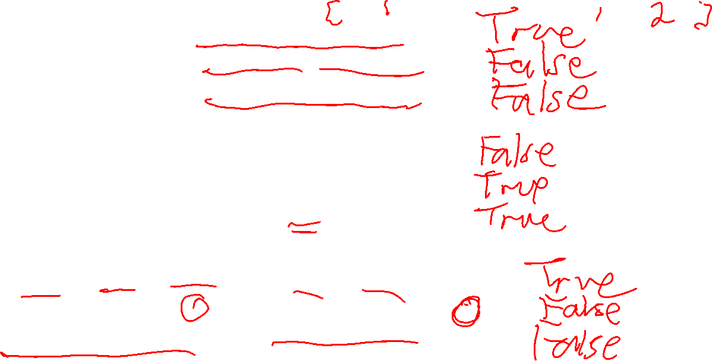
Comparing Lists
[1, 2] == [1, 2] # [1, 2] == [2, 1] #
[1, 2] == [1, 2, 3] #
Two lists are equal if they have the same values in the same order.
[1, 2] != [1, 2] # [1, 2] != [2, 1] #
[1, 2] != [1, 2, 3] #
['BC', 'AB', 'ON'] == ['BC', 'AB', 'ON'] # ['BC', 'AB', 'ON'] == ['BC', 'AB', 'On'] #
['BC', 'AB', 'ON'] == ['BC', 'ON'] #

Slide 17
Comparing Lists
[1, 2] == [1, 2] # True [1, 2] == [2, 1] # False
[1, 2] == [1, 2, 3] # False
Two lists are equal if they have the same values in the same order.
[1, 2] != [1, 2] # False [1, 2] != [2, 1] # True
[1, 2] != [1, 2, 3] # True
['BC', 'AB', 'ON'] == ['BC', 'AB', 'ON'] # True ['BC', 'AB', 'ON'] == ['BC', 'AB', 'On'] # False
['BC', 'AB', 'ON'] == ['BC', 'ON'] # False

Slide 18

Appending Lists
am = ['Al', 'Ned', 'Bob']
pm = ['Ned', 'Zia']
all_day = am + pm
print(all_day)
# ['Al', 'Ned', 'Bob', 'Ned', 'Zia']
As with strings, + and * append lists.

Slide 19
Appending Lists
pm = ['Ned', 'Zia’]
rep = 3 * pm
print(rep)
# ['Ned', 'Zia', 'Ned', 'Zia’,
# 'Ned', 'Zia']
As with strings, + and * append lists.

Slide 20

min, max, and sum of a list
Python comes with built-in min, max and sum functions …
scores = [85, 80, 70, 85, 95]
print(min(scores)) # 70
print(max(scores)) # 95
print(sum(scores)) # 415
print(sum(scores) / len(scores)) # 83.0
This calculates the average of a list of numbers.

Slide 21

min and max, of a list
For lists of strings, min returns the alphabetically first string, and max returns the alphabetically last string …
winners = ['Bob', 'Zia', 'El', 'Bo']
print(min(winners)) # Bo
print(max(winners)) # Zia

Slide 22
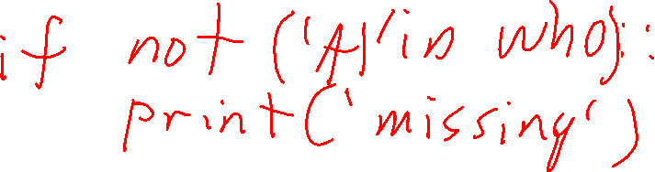
list methods
Python lists have several built-in functions that are called methods. They use a dot-notation calling syntax …
who = ['Al', 'Bob', 'Cam', 'Dan']
if 'Cam' in who: print('Found him!')
x in L returns True if x occurs one or more times in list L, and False otherwise.
x not in L returns the opposite of x in L

Slide 23
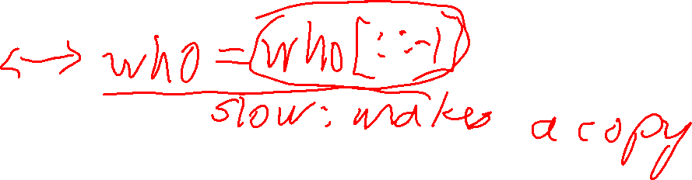
list methods
Python lists have several built-in functions that are called methods. They use a dot-notation calling syntax …
who = ['Al', 'Bob', 'Cam', 'Dan']
who.reverse()
print(who) # ['Dan', 'Cam', 'Bob', 'Al']
L.reverse() reverses the order of the items on list L. L is changed, i.e no copy is made.

Slide 24
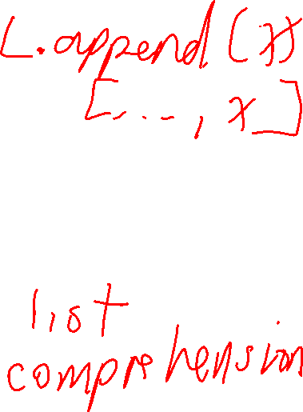
list methods
Python lists have several built-in functions that are called methods. They use a dot-notation calling syntax …
who = []
who.append('Alice') # ['Al']
who.append('Bob') # ['Al', 'Bob']
who.append('Cathy') # ['Al', 'Bob', 'Cam']
who.append('Dan') # ['Al', 'Bob', 'Cam', 'Dan']
L.append(x) adds the value x to the right end of list L. L is modified, i.e. no copy is made.

Slide 25

list methods
Python lists have several built-in functions that are called methods. They use a dot-notation calling syntax …
who = ['Al', 'Bob', 'Cam', 'Dan']
who.pop() # ['Al', 'Bob', 'Cam']
who.pop() # ['Al', 'Bob']
who.pop() # ['Al']
who.pop() # []
who.pop() # IndexError: can’t pop from empty list
L.pop() removes the last value of a list. L is modified, i.e. no copy is made.

Slide 26

list methods
Python lists have several built-in functions that are called methods. They use a dot-notation calling syntax …
who = ['Al', 'Bob', 'Cam', 'Dan']
last_name = who.pop() # who == ['Al', 'Bob', 'Cam']
# last_name == 'Dan'
L.pop() also returns the value that it removes.

Slide 27
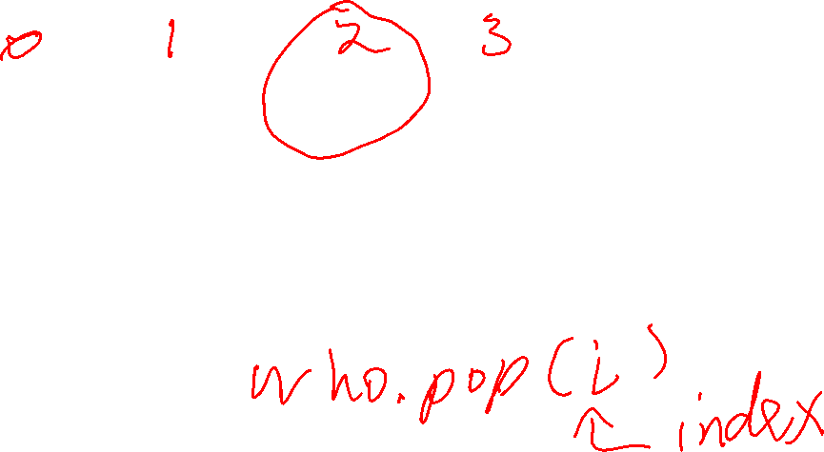
list methods
Python lists have several built-in functions that are called methods. They use a dot-notation calling syntax …
who = ['Al', 'Bob', 'Cam', 'Dan']
third_name = who.pop(2) # who == ['Al', 'Bob', 'Dan']
# third_name == 'Cam'
L.pop(i) removes and returns the value at index location i.

Slide 28

list methods
Python lists have several built-in functions that are called methods. They use a dot-notation calling syntax …
who = ['Al', 'Bob', 'Cam', 'Bob']
who.remove('Bob')
print(who) # ['Al', 'Cam', 'Bob']
who.remove('Joe') # ValueError: 'Joe' is not a # value on the list
L.remove(x) removes the first (left-most) occurrence of x in list L.

Slide 29

list methods
Python lists have several built-in functions that are called methods. They use a dot-notation calling syntax …
nums = [0, 1, 2, 3]
nums.insert(2, 'X')
print(nums) # [0, 1, 'X', 2, 3]
L.insert(i, x) adds x to list L so that x is at index location i.

Slide 30
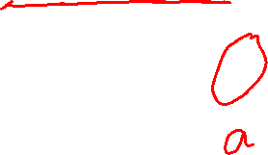
list and strings
Python lists have several built-in functions that are called methods. They use a dot-notation calling syntax …
name = 'Alice'
letters = list(name)
print(letters) # ['A', 'l', 'i', 'c', 'e']
list(s) returns a new list consisting of the characters of string s.

Slide 31

list and strings
Python lists have several built-in functions that are called methods. They use a dot-notation calling syntax …
letters = ['A', 'l', 'i', 'c', 'e']
name = ''.join(letters) print(name) # Alice
csv = ', '.join(letters) print(csv) # A, l, i, c, e
s.join(L) returns a new string consisting of the values of L separate by string s.
join does not put ', ' at the end, only between values

Slide 32

list and strings
Python lists have several built-in functions that are called methods. They use a dot-notation calling syntax …
toys = ['car', 'bike', 'boat’]
squished = ''.join(toys) print(name) # carbikeboat
excited = '!! '.join(toys) print(excited) # car!! bike!! boat
s.join(L) returns a new string consisting of the values of L separate by string s.
join does not put '!! ' at the end, only between values

Slide 33

list and strings
Python lists have several built-in functions that are called methods. They use a dot-notation calling syntax …
s = 'car bike boat'
lst = s.split()
print(lst) # ['car', 'bike', 'boat']
s.split() returns a list of the values in s, where the values in s are separated by a space

Slide 34
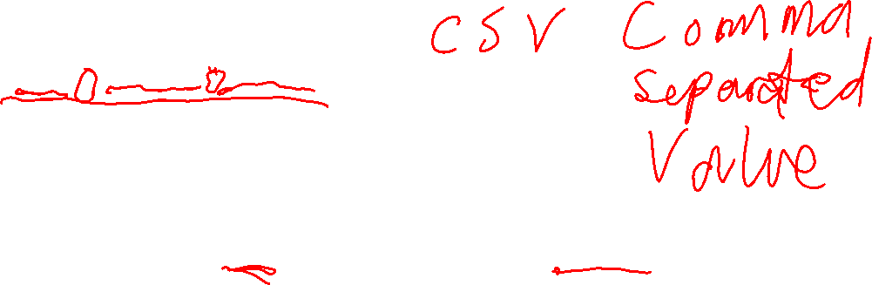
list and strings
Python lists have several built-in functions that are called methods. They use a dot-notation calling syntax …
s = 'car, bike, boat'
lst = s.split(',')
print(lst) # ['car', ' bike', ' boat']
Note the spaces at the start of bike and boat. That makes sense: s.split(',') gets the values around each comma.

Slide 35

list and strings
Python lists have several built-in functions that are called methods. They use a dot-notation calling syntax …
s = 'car, bike, boat'
lst = s.split(', ')
print(lst) # ['car', 'bike', 'boat']
Splitting on a comma and a space removes the spaces in the list.

Slide 36

list and strings
Python lists have several built-in functions that are called methods. They use a dot-notation calling syntax …
s = 'car , bike, boat'
lst = s.split(', ')
print(lst) # ['car ', ' bike', ' boat']
When splitting a comma-separated string with split, you often get spaces like this.
You can call .strip() on all the strings to remove unwanted leading/trailing spaces …

Slide 37

list and strings
Python lists have several built-in functions that are called methods. They use a dot-notation calling syntax …
s = 'car , bike, boat'
lst = s.split(', ')
print(lst) # ['car ', ' bike', ' boat']
for i in range(len(lst)): lst[i] = lst[i].strip()
print(lst) # ['car', 'bike', 'boat']
This loop replaces all the strings in lst with copies that have their leading/trailing spaces removed.

Slide 38

list and strings
Removing leading/trailing whitespace from a list of strings is a fairly common operation, so lets write it as a function …
def strip_list(lst):
""" Strip leading and trailing whitespace from each string in lst.
"""
i = 0
while i < len(lst):
lst[i] = lst[i].strip()
i += 1

Slide 39

list and strings
Removing leading/trailing whitespace from a list of strings is a fairly common operation, so lets write it as a function …
Important! When you past a list as an argument to a function, the list is not copied. The actual list is passed. This is called pass by reference.
def strip_list(lst):
""" Strip leading and trailing whitespace from each string in lst.
"""
i = 0
while i < len(lst):
lst[i] = lst[i].strip()
i += 1

Slide 40
list and strings
Removing leading/trailing whitespace from a list of strings is a fairly common operation, so lets write it as a function …
def strip_list(lst):
""" Strip leading and trailing whitespace from each string in lst.
"""
i = 0
while i < len(lst):
lst[i] = lst[i].strip()
i += 1
Each string is replaced with a stripped version. This done in-place without copying the list.
There’s no return value because the passed-in list is modified in-place.

Slide 41

list and strings
Removing leading/trailing whitespace from a list of strings is a fairly common operation, so lets write it as a function …
s = 'car , bike, boat' things = s.split(', ')
print(things) # ['car ', ' bike', ' boat']
strip_list(things)
print(things) # ['car', 'bike', 'boat']
def strip_list(lst):
""" ...
"""
i = 0
while i < len(lst):
lst[i] = lst[i].strip()
i += 1

Slide 42
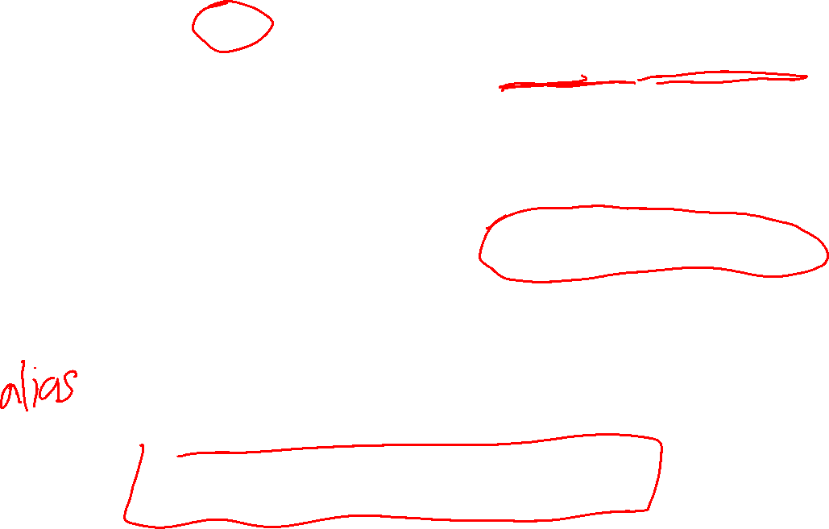
def strip_list(lst):
""" ...
"""
i = 0
while i < len(lst):
lst[i] = lst[i].strip()
i += 1
s = 'car , bike, boat' things = s.split(', ')
print(things) # ['car ', ' bike', ' boat']
strip_list(things)
print(things) # ['car', 'bike', 'boat']
Aliasing
When strip_list is running, the underlying list has two names: lst and things. We say they are aliases for the list.
lst
['car ', ' bike', ' boat']
things

Slide 43

list and strings
The .read() method of a file object returns the entire contents of the file as one big string.
joke.txt
file_obj = open('joke.txt')
big_string = file_obj.read()
lines = big_string.split('\n')
print(lines)
Who's there?\n
A broken pencil.\n
A broken pencil who?\n
Never mind. It's pointless.
Remember: in a text file, lines end with a \n character (called newline). It is usually not visible in editors.
# ["Who's there?", 'A broken pencil.', # 'A broken pencil who?', # "Never mind. It's pointless."]

Slide 44
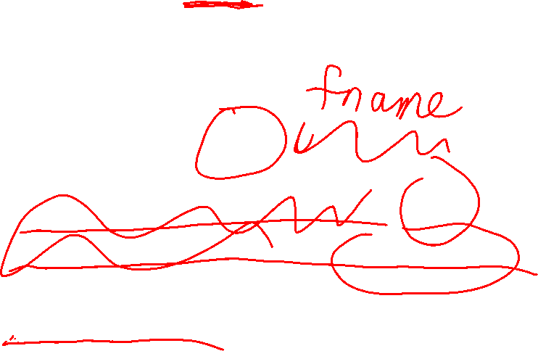
list and strings
def get_lines(fname): """Returns a list of lines of the text file fname. """
file_obj = open('joke.txt')
big_string = file_obj.read()
lines = big_string.split('\n')
return lines
This is a useful function! The code on the previous slide could be written: print(get_lines('joke.txt'))
This function is pretty long. Can you make it shorter? …

Slide 45

list and strings
def get_lines(fname): """Returns a list of lines of the text file fname. """
return open(fname).read().split('\n')
We can “chain together” the methods calls into a single expression.

Slide 46
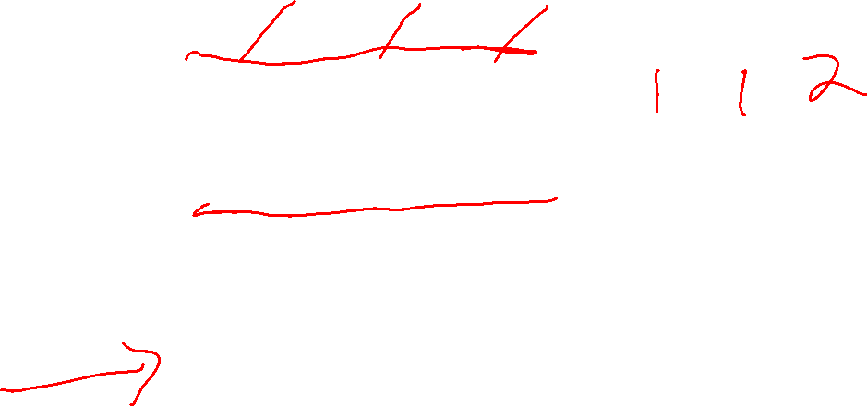
Sorting lists
[4, 1, 6, 1, 3, 2]
unsorted
Sorting is the process of re-arranging the values of a list into ascending order.
[1, 1, 2, 3, 4, 6]
sorted
['dog', 'zebra', 'dog', 'cat']
unsorted
['cat', 'dog', 'dog', 'zebra']
sorted

Slide 47
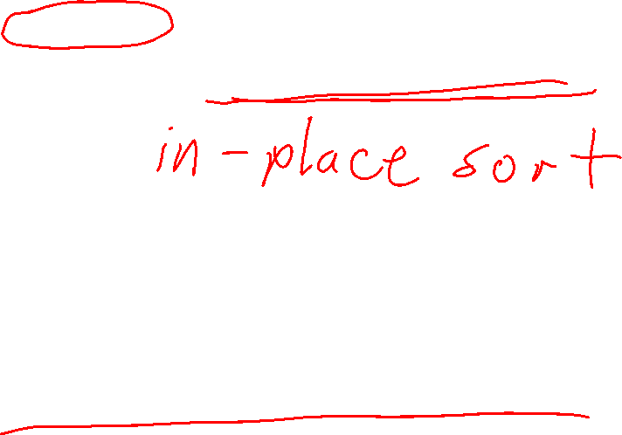
Sorting lists
nums = [4, 1, 6, 1, 3, 2]
nums.sort()
print(nums) # [1, 1, 2, 3, 4, 6]
Sorting is the process of re-arranging the values of a list into ascending order.
Python’s built in list.sort() methods is very efficient and sorts the list in-place, i.e. no copy is made.
pets = ['dog', 'zebra', 'dog', 'cat']
pets.sort()
print(pets) # ['cat', 'dog', 'dog', 'zebra']

Slide 48
Sorting lists
nums = [4, 1, 6, 1, 3, 2]
nums.sort() nums.reverse()
print(nums) # [6, 4, 3, 2, 1, 1]
Sorting is the process of re-arranging the values of a list into ascending order.
Python’s built in list.sort() methods is very efficient and sorts the list in-place, i.e. no copy is made.
pets = ['dog', 'zebra', 'dog', 'cat']
pets.sort() pets.reverse()
print(pets) # ['zebra', 'dog', 'dog', 'cat']
Call list.reverse() after sorting if you want the values from biggest to smallest.

