Slide 1
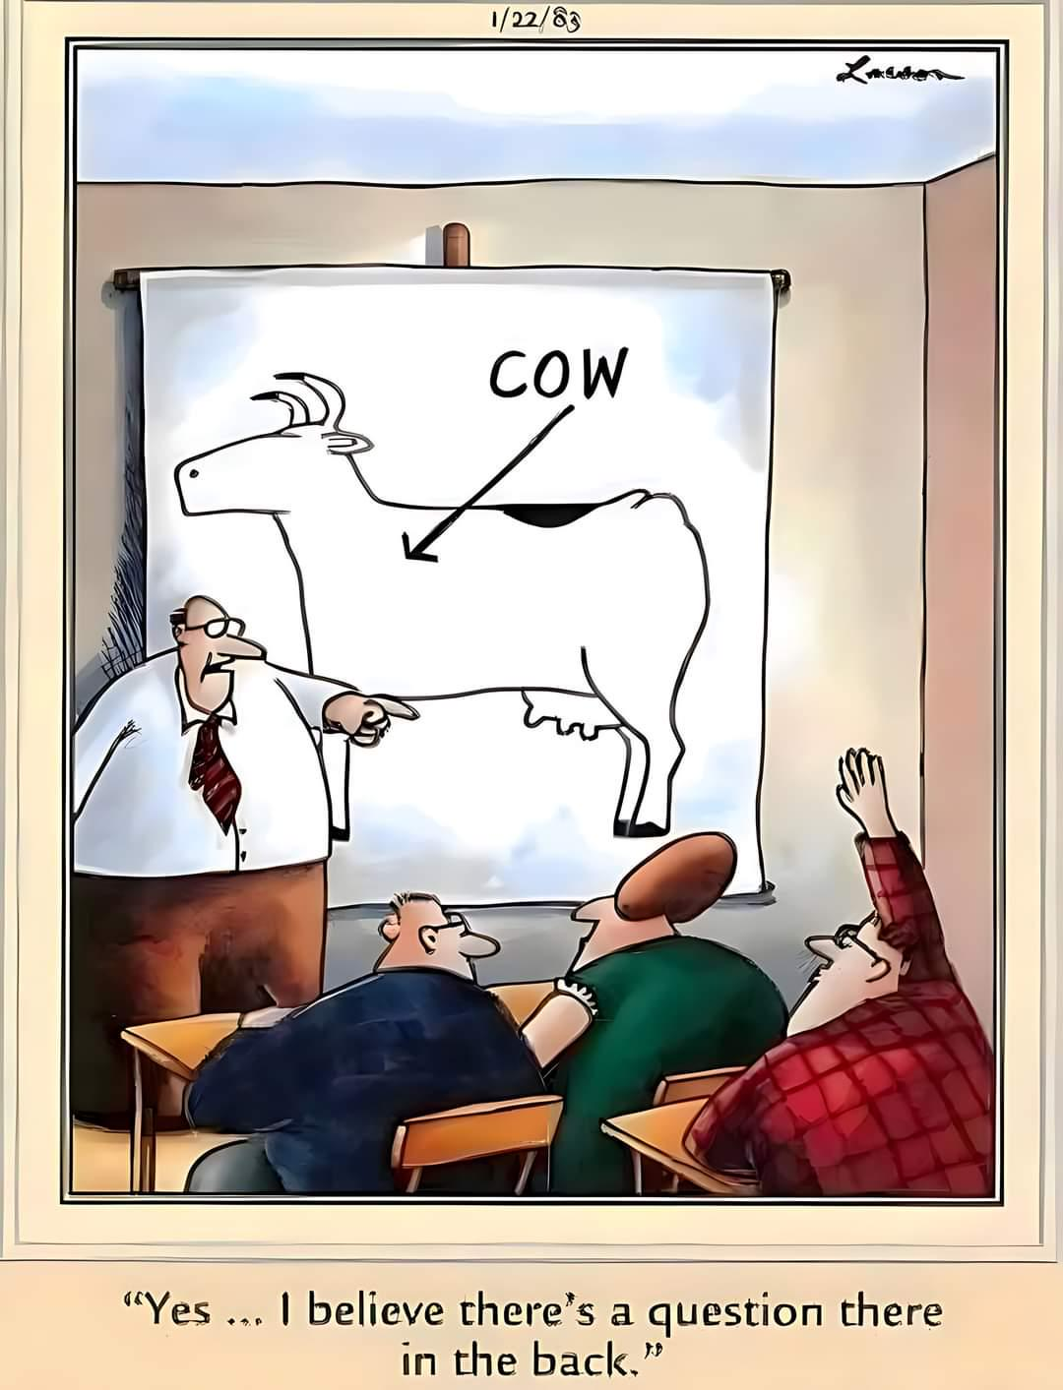
Chapter 2 Variables and Statements
CMPT 120-D1 Fall 2024

Slide 2
What is a computer?

Slide 3
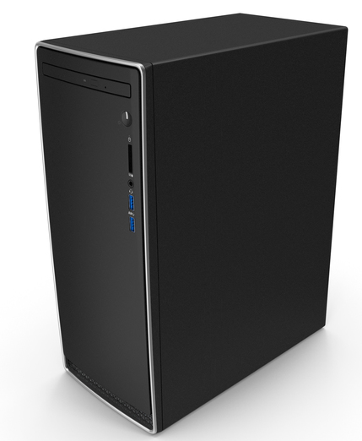
Computer

Slide 4
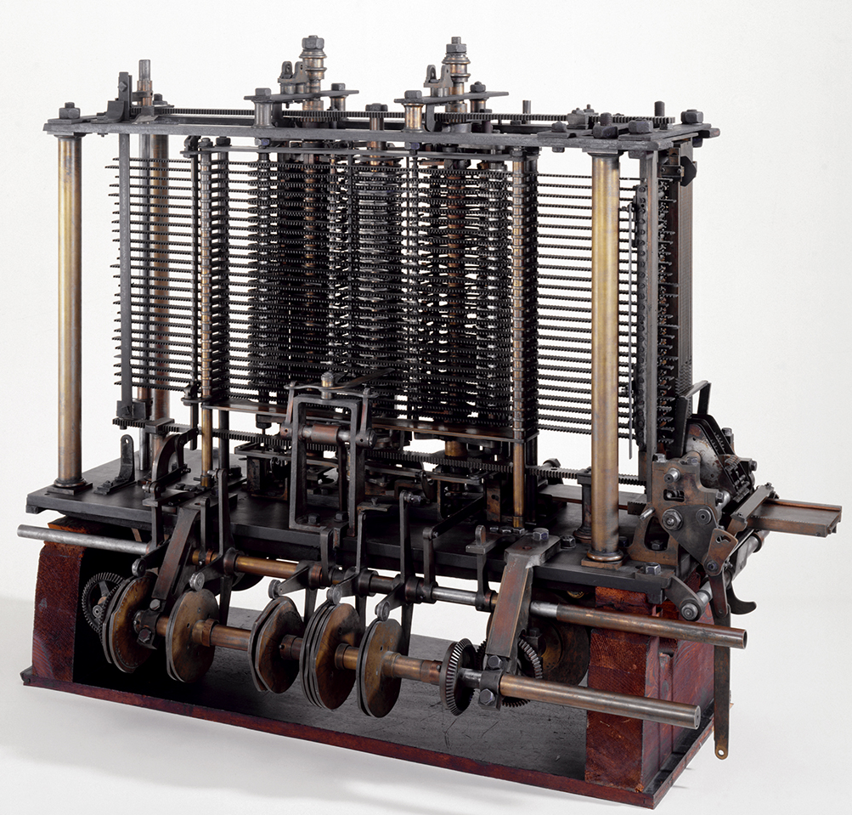
Computer
Analytical Engine, 1837 Created by Charles Babbage Hand-cranked, never completed

Slide 5
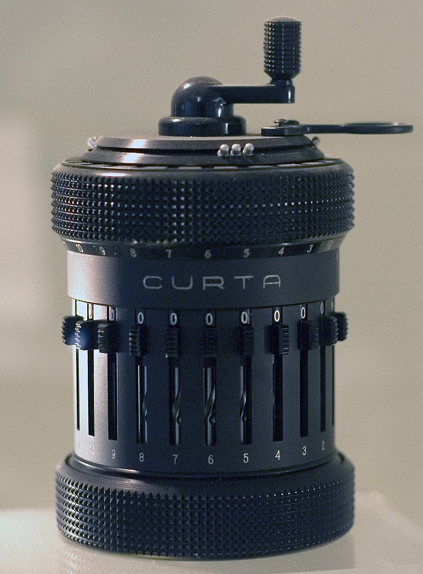
Computer
Curta Calculator, 1948 Hand-held mechanical calculator

Slide 6
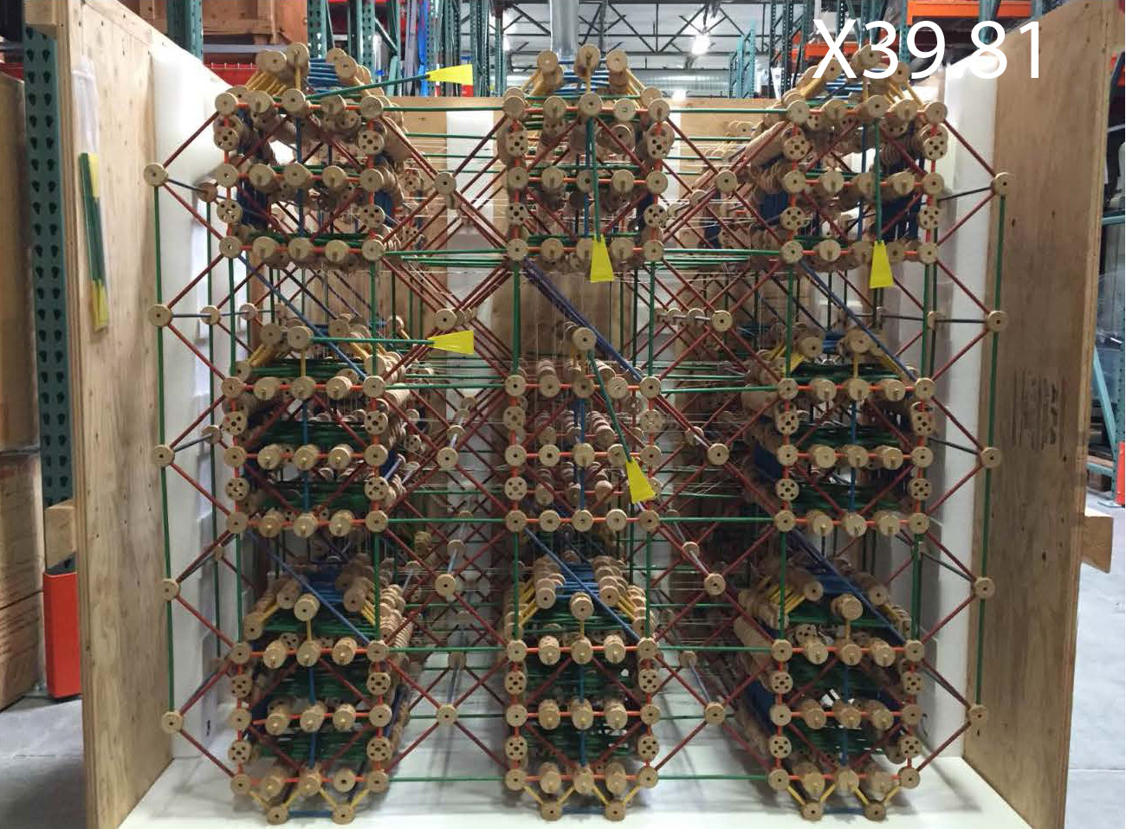
Computer
Tinker Toy Computer, 1978 Hand-cranked, plays Tic Tac Toe

Slide 7
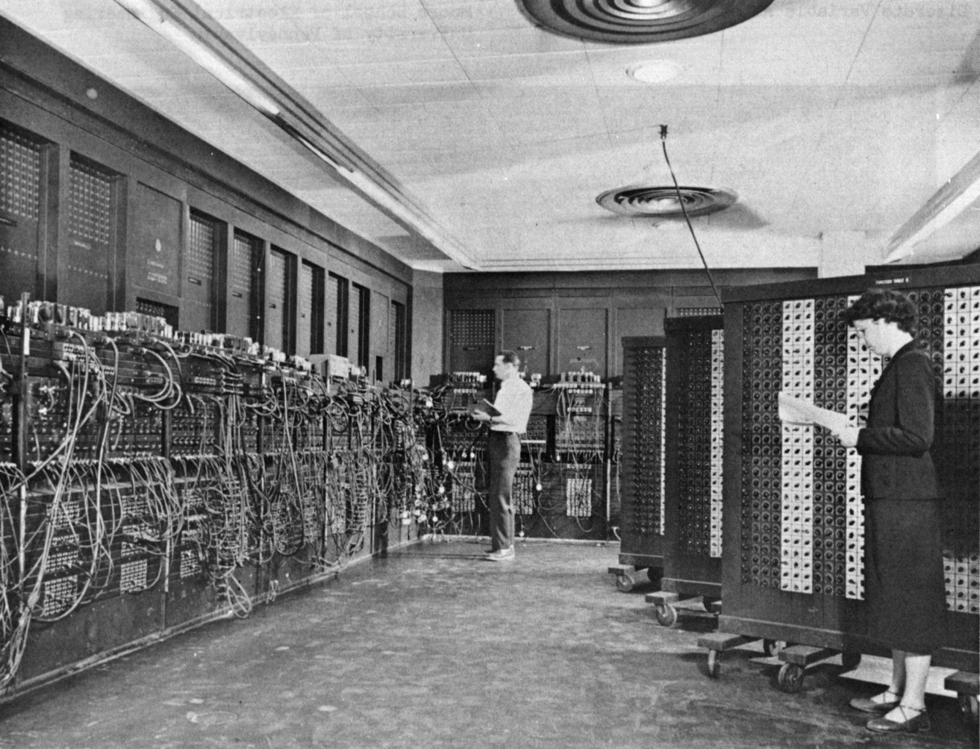
Computer
ENIAC, 1948 First general-purpose electronic computer Used decimal instead of binary

Slide 8
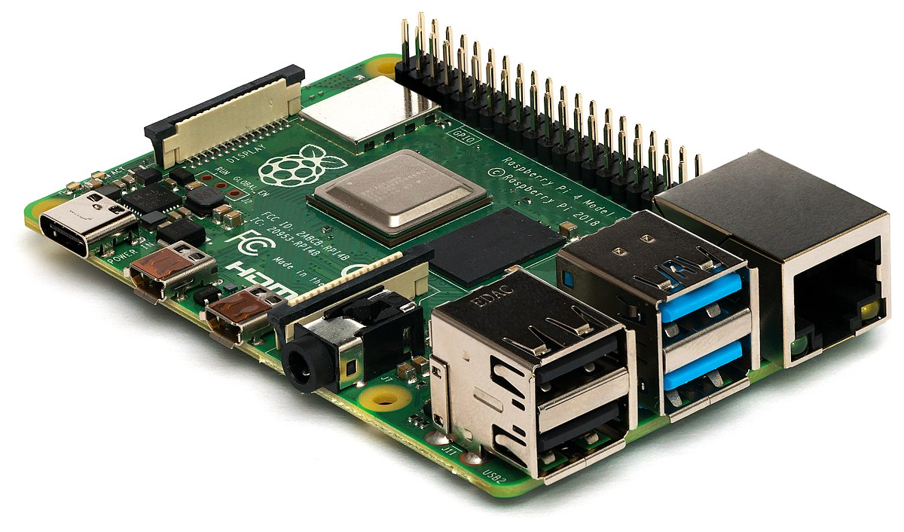
Computer
Raspberry Pi Very small, for embedded systems

Slide 9

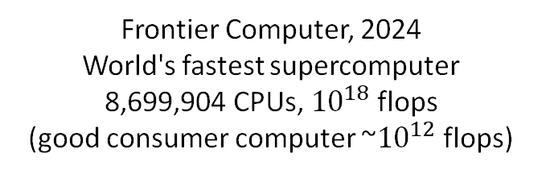
Computer
Frontier Computer, 2024 World's fastest supercomputer 8,699,904 CPUs, ${10}^{18}$ flops
(good consumer computer ~${10}^{12}$ flops)
flops = floating point operations per second

Slide 10
We will usually think of a computer in
an abstract way …
CPU Central Processing Unit
I/O Input and Output
Main Memory RAM Random Access Memory
Single CPU Computer

Slide 11
CPU is the “brain” of the computer. Does basic arithmetic, logic, reads/writes memory, ….
CPUs in a phone or laptop are very fast, e.g. they perform billions of low-level instructions per second.
CPU Central Processing Unit
I/O Input and Output
Main Memory RAM Random Access Memory
Single CPU Computer

Slide 12
CPU is the “brain” of the computer. Does basic arithmetic, logic, reads/writes memory, ….
CPUs in a phone or laptop are very fast, e.g. they perform billions of low-level instructions per second.
CPU Central Processing Unit
I/O Input and Output
Main Memory RAM Random Access Memory
Main memory is “short term memory” where data and instructions are stored.
Single CPU Computer
Laptops and phones usually have large amounts of fast main memory.

Slide 13






CPU is the “brain” of the computer. Does basic arithmetic, logic, reads/writes memory, ….
CPUs in a phone or laptop are very fast, e.g. they perform billions of low-level instructions per second.
CPU Central Processing Unit
I/O refers to input and output devices you could attach a computer to …
I/O Input and Output
Internet
VR goggles
Main Memory RAM Random Access Memory
Not all computers have screens or keyboards or mice! E.g. computer that controls stop lights at an intersection.
Main memory is “short term memory” where data and instructions are stored.
Single CPU Computer
Laptops and phones usually have large amounts of fast main memory.

Slide 14
At the lowest level, we imagine main memory (RAM) consists of many 0/1 bits.
16 megabytes of RAM has 8 * 16 * 1000000 bits = 128,000,000 bits
0100111010110000111010100110100110
1 byte = 8 bits
Most computers operate on fixed-size chunks of bits, e.g. a 64-bit computer operates on 64-bits at a time.
1111101000100010110011011100100100
0010001110111100000110100011101011
1110101010111100100001111110000000
0100001001011110111111010011100000
For readability, we’ll now use regular base-10 numbers to represent the bits. But remember, underneath, it’s all bits!
…
Main Memory (RAM)

Slide 15
At the lowest level, we imagine main memory (RAM) consists of many 0/1 bits.
16 megabytes of RAM has 8 * 16 * 1000000 bits = 128,000,000 bits
Address | Value
… | …
47339 | 0
47340 | 556345
47341 | -454
47342 | 3279267
47343 | 454277
… | …
1 byte = 8 bits
Most computers operate on fixed-size chunks of bits, e.g. a 64-bit computer operates on 64-bits at a time.
RAM is addressable, meaning that each chunk of 64 bits has a numeric address. We can quickly read/write those bits if we know the address.
This is also why some languages have max values for their numbers: the numbers fit in 64 bits.
Remember: Python ints have no pre-defined max value.
Main Memory (RAM)

Slide 16
In assembly language programming, the programmer must keep track of addresses and values. This is error-prone and tedious!
Given address 47341, the computer can read/write the value there extremely quickly.
Address | Value
… | …
47339 | 0
47340 | 556345
47341 | -454
47342 | 3279267
47343 | 454277
… | …
The value -454 is stored at address 47341.
High-level programming languages like Python keep track of memory values using human-readable names …
Main Memory (RAM)

Slide 17
In assembly language programming, the programmer must keep track of addresses and values. This is error-prone and tedious!
Given address 47341, the computer can read/write the value there extremely quickly.
Address | Value
… | …
47339 | 0
47340 | 556345
score | -454
47342 | 3279267
47343 | 454277
… | …
The value -454 is stored at address 47341.
47341
-454 is still stored at address 47341, but the programmer thinks of it as the value of the variable named score.
High-level programming languages like Python keep track of memory values using human-readable names …
Main Memory (RAM)

Slide 18
Python programmers usually think of memory as containing named variables with values.
score: -454
In Python, we will almost never care about the exact memory location of a variables, or the underlying bits.
Main Memory (RAM)
Python automatically handles the address and bits.

Slide 19
Usually we will just write the name and value for a variable, like in math.
score: -454

Slide 20

Sometimes it’s useful to think of a variable as a named bucket that contains a value …
… or as labelling a box.
score
-454
-454
score
-454
… or as pointing, or referring, to its value.
score
score
-454

Slide 21
Python’s Assignment Statement
X = Y

Slide 22
Python’s Assignment Statement
= is called the assignment operator
X = Y

Slide 23
Python’s Assignment Statement
= is called the assignment operator
X = Y
X is on the left-hand side of the =, so it’s called the LHS, or L-value
For us, L-values will always be variables.

Slide 24
Python’s Assignment Statement
= is called the assignment operator
X = Y
Y is on the right-hand side of the =, so it’s called the RHS, or R-value
X is on the left-hand side of the =, so it’s called the LHS, or L-value
An R-value can be any expression that evaluates to some value.
For us, L-values will always be variables.

Slide 25
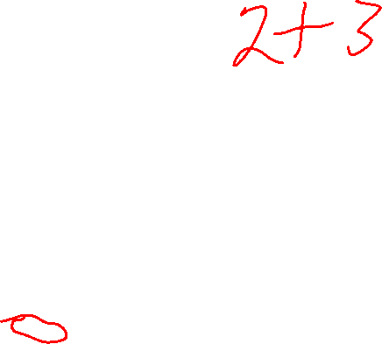
Python’s Assignment Statement
= is called the assignment operator
X = Y
Y is on the right-hand side of the =, so it’s called the RHS, or R-value
X is on the left-hand side of the =, so it’s called the LHS, or L-value
As assignment statement works like this:
Evaluate Y to gets it value.
Put a copy of Y’s value into variable X (over-writing a value already in X).
An R-value can be any expression that evaluates to some value.
For us, L-values will always be variables.

Slide 26
Python’s Assignment Statement
X = Y
Evaluate Y to gets it value.
Put a copy of Y’s value into variable X (over-writing the value already in X).
a = 2 b = 4 + a c = (b – 1) ** a

Slide 27
Python’s Assignment Statement
X = Y
Evaluate Y to gets it value.
Put a copy of Y’s value into variable X (over-writing the value already in X).
This statement defines the variable a, and then assigns it the initial value 2.
a = 2 b = 4 + a c = (b – 1) ** a
a
2

Slide 28
Python’s Assignment Statement
X = Y
Evaluate Y to gets it value.
Put a copy of Y’s value into variable X (over-writing the value already in X).
This statement defines the variable b …
a = 2 b = 4 + a c = (b – 1) ** a
a
2
b
?

Slide 29
Python’s Assignment Statement
X = Y
Evaluate Y to gets it value.
Put a copy of Y’s value into variable X (over-writing the value already in X).
Then it evaluates 4 + a …
a = 2 b = 4 + a c = (b – 1) ** a
a
2
To evaluate 4 + a:
Replace a with its value 2 4 + 2
Evaluate 4 + 2 6
Put a copy of 6 into b
b
6

Slide 30
Python’s Assignment Statement
X = Y
Evaluate Y to gets it value.
Put a copy of Y’s value into variable X (over-writing the value already in X).
This defines variable c …
a = 2 b = 4 + a c = (b – 1) ** a
a
2
b
6
c
?

Slide 31
Python’s Assignment Statement
X = Y
Evaluate Y to gets it value.
Put a copy of Y’s value into variable X (over-writing the value already in X).
Then evaluate (b - 1) ** a …
a = 2 b = 4 + a c = (b – 1) ** a
a
2
To evaluate (b – 1) ** a:
Replace a with its value 2 (b – 1) ** 2
Replace b with its value 6 (6 – 1) ** 2
Evaluate 6 – 1 5 ** 2
Evaluate 5 ** 2 25
Put 25 into c
b
6
c
25

Slide 32
Function Arguments
This is a function call.
p = 3 x = math.pow(1+1, p)

Slide 33
Function Arguments
p = 3 x = math.pow(1+1, p)
math.pow is the name of the function.

Slide 34
Function Arguments
p = 3 x = math.pow(1+1, p)
This is the list of inputs. math.pow takes two inputs …

Slide 35
Function Arguments
Function call lists always start with a ( and end with a )
( and ) are called parentheses, or round brackets.
p = 3 x = math.pow(1+1, p)
This is the list of inputs. math.pow takes two inputs …

Slide 36
Function Arguments
p = 3 x = math.pow(1+1, p)
This is the first input …
… this is the second input.

Slide 37
Function Arguments
p = 3 x = math.pow(1+1, p)
This is the first input …
… this is the second input.
Instead of calling these inputs, we often call them function arguments.

Slide 38
Function Arguments
p = 3 x = math.pow(1+1, p)
This is the first argument …
… this is the second argument.

Slide 39
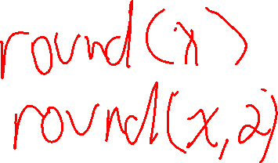
Function Arguments
p = 3 x = math.pow(1+1, p)
This is the first argument …
… this is the second argument.
it always takes exactly 2 arguments: math.pow(x, y)
math.pow is a 2-argument function

Slide 40
Function Arguments
p = 3 x = math.pow(1+1, p)
When a function is called, the arguments are first evaluated …
x = math.pow(2, 3)

Slide 41
Function Arguments
p = 3 x = math.pow(2, 3)
Then the resulting values are passed to the function, and the function returns a value

Slide 42
Function Arguments
p = 3 x = 8
The final result is that x gets the value 8.

Slide 43
Source Code Comments
A source code comment is a note that a programmer writes in their program that is just for them or other humans.
Python ignores source code comments … it just skips over them.
# set the length of side 1 of the right triangle
side1 = 3
# set the length of side 2 of the right triangle
side2 = 4
# calculate the hypotenuse of the triangle using the Pythagorean theorem
hypotenuse = math.sqrt(side1 ** 2 + side2 ** 2)
# print the results
print(hypotenuse)

Slide 44
Source Code Comments
A source code comment is a note that a programmer writes in their program that is just for them or other humans.
Python ignores source code comments … it just skips over them.
# set the length of side 1 of the right triangle
side1 = 3
# set the length of side 2 of the right triangle
side2 = 4
# calculate the hypotenuse of the triangle using the Pythagorean theorem
hypotenuse = math.sqrt(side1 ** 2 + side2 ** 2)
# print the results
print(hypotenuse)
Python source code comments always start with the # character.

Slide 45
Source Code Comments
A source code comment is a note that a programmer writes in their program that is just for them or other humans.
Python ignores source code comments … it just skips over them.
# set the length of side 1 of the right triangle
side1 = 3
# set the length of side 2 of the right triangle
side2 = 4
# calculate the hypotenuse of the triangle using # the Pythagorean theorem
hypotenuse = math.sqrt(side1 ** 2 + side2 ** 2)
# print the results
print(hypotenuse)
Python source code comments always start with the # character.
Good comments make your code more readable.

Slide 46
Source Code Comments
A source code comment is a note that a programmer writes in their program that is just for them or other humans.
Python ignores source code comments … it just skips over them.
Good comments make your code more readable.
# set the length of side 1 of the right triangle
side1 = 3
# set the length of side 2 of the right triangle
side2 = 4
# calculate the hypotenuse of the triangle using # the Pythagorean theorem
hypotenuse = math.sqrt(side1 ** 2 + side2 ** 2)
# print the results
print(hypotenuse)
These comments are questionable: the code is already pretty clear.
The variables have self-descriptive names, which helps a lot with readability.

Slide 47
Source Code Comments
A source code comment is a note that a programmer writes in their program that is just for them or other humans.
Python ignores source code comments … it just skips over them.
Good comments make your code more readable.
# set the length of side 1 of the right triangle
side1 = 3
# set the length of side 2 of the right triangle
side2 = 4
# calculate the hypotenuse of the triangle using # the Pythagorean theorem
hypotenuse = math.sqrt(side1 ** 2 + side2 ** 2)
# print the results
print(hypotenuse)
This comment is more useful, since it explains the expression inside math.sqrt

Slide 48
1
2
# set the length of side 1 of the right triangle
side1 = 3
# set the length of side 2 of the right triangle
side2 = 4
# calculate the hypotenuse of the triangle using # the Pythagorean theorem
hypotenuse = math.sqrt(side1 ** 2 + side2 ** 2)
# print the results
print(hypotenuse)
# set the length of side 1 of the right triangle
a = 3
# set the length of side 2 of the right triangle
b = 4
# calculate the hypotenuse of the triangle using # the Pythagorean theorem
h = math.sqrt(a ** 2 + b ** 2)
# print the results
print(h)
Which version do you find to be the most readable?
3
4
side1 = 3
side2 = 4
hypotenuse = math.sqrt(side1 ** 2 + side2 ** 2)
print(hypotenuse)
a = 3
b = 4
h = math.sqrt(a ** 2 + b ** 2)
print(h)

Slide 49

Source Code Comments
A good way to write some programs is to write down each step in comments first, and then fill in the code …
# set the length of side 1 of the right triangle
# set the length of side 2 of the right triangle
# calculate the hypotenuse of the triangle using # the Pythagorean theorem
# print the results
This is pseudocode: a program written in English-like form to be easy for humans to read.

Slide 50
Source Code Comments
A good way to write some programs is to write down each step in comments first, and then fill in the code …
# set the length of side 1 of the right triangle
side1 = 3
# set the length of side 2 of the right triangle
# calculate the hypotenuse of the triangle using # the Pythagorean theorem
# print the results

Slide 51
Source Code Comments
A good way to write some programs is to write down each step in comments first, and then fill in the code …
# set the length of side 1 of the right triangle
side1 = 3
# set the length of side 2 of the right triangle
side2 = 4
# calculate the hypotenuse of the triangle using # the Pythagorean theorem
hypotenuse = math.sqrt(side1 ** 2 + side2 ** 2)
# print the results

Slide 52

Source Code Comments
A good way to write some programs is to write down each step in comments first, and then fill in the code …
# set the length of side 1 of the right triangle
side1 = 3
# set the length of side 2 of the right triangle
side2 = 4
# calculate the hypotenuse of the triangle using # the Pythagorean theorem
hypotenuse = math.sqrt(side1 ** 2 + side2 ** 2)
# print the results
print(hypotenuse)

