Slide 1
Chapter 8: Strings, Slices, and Writing to Files
CMPT 120, Fall 2024

Slide 2
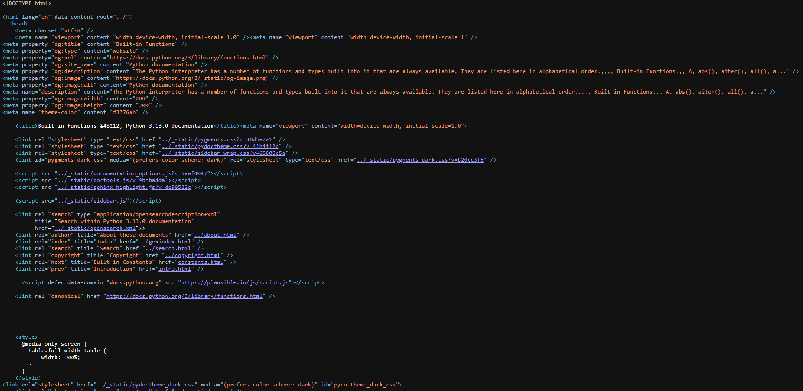

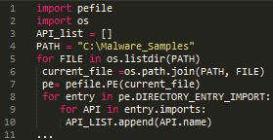
Strings
Web pages are often “big strings” … type ctrl-U on Chrome to see the text of page …
A string is a sequence of 0 or more characters. The order of the characters matters.
Text files can be thought of as strings with names stored on a disk text file …
Python source code is stored as a string …

Slide 3

Unicode is the standard encoding of characters that most of the world’s software uses.
Unicode gives a precise code number to all the worlds letters, punctuation, and symbols.

Slide 4
Strings
'Paper!'
A string is a sequence of 0 or more characters. The order of the characters matters.
"Paper!"
A string literal begins and ends with quote marks, listing each character.
"""Paper!"""
'''Paper!'''

Slide 5
Strings
'Paper!'
A string is a sequence of 0 or more characters. The order of the characters matters.
"Paper!"
A string literal begins and ends with quote marks, listing each character.
"""Paper!"""
The kind of quote marks are the start and end of a string literal must match.
'''Paper!'''

Slide 6
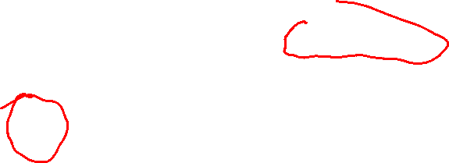
Strings
Careful! Escape characters in a string literal start with a \ and a have a special meaning.
A string is a sequence of 0 or more characters. The order of the characters matters.
'a\nb'
\n is an escape character called newline. It is usually used to represent a new line in a string or file.
\n is treated as one character in the string
A string literal begins and ends with quote marks, listing each character.
Even though it is written as a \ and an n, in a string literal it is represents a single character, a newline.

Slide 7

Strings
Careful! Escape characters in a string literal start with a \ and a have a special meaning.
A string is a sequence of 0 or more characters. The order of the characters matters.
'\t\t\t'
\n represents a newline character
\t represents a tab character \\ represents a \ character \' represents a ' character \" represents a " character
This string consists of three tab characters
A string literal begins and ends with quote marks, listing each character.
Remember: an escape character represents one character in the string, despite being written with two characters.

Slide 8
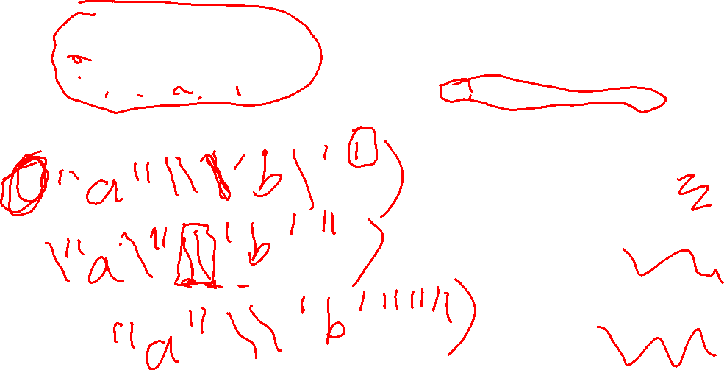
Strings
Careful! Escape characters in a string literal start with a \ and a have a special meaning.
print(???)
What string literal can replace ??? in print so it prints this?
"a"\'b'
\n represents a newline character
\t represents a tab character \\ represents a \ character \' represents a ' character \" represents a " character
print(' ')
print(" ")
print(""" """)

Slide 9
Strings
Careful! Escape characters in a string literal start with a \ and a have a special meaning.
print(???)
What string literal can replace ??? in print so it prints this?
"a"\'b'
\n represents a newline character
\t represents a tab character \\ represents a \ character \' represents a ' character \" represents a " character
print('"a"\\\'b\'')
print("\"a\"\\'b'")
print(""""a"\\'b'""")

Slide 10
Strings
Careful! Escape characters in a string literal start with a \ and a have a special meaning.
print(???)
What string literal can replace ??? in print so it prints this?
"a"\'b'
\n represents a newline character
\t represents a tab character \\ represents a \ character \' represents a ' character \" represents a " character
print('"a"\\\'b\'')
print("\"a\"\\'b'")
print(""""a"\\'b'""")

Slide 11
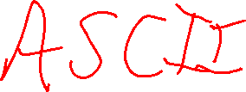
Strings
A string is a sequence of 0 or more characters. The order of the characters matters.
0
1
2
3
4
5
We can represent a string in memory as a sequence of numbered boxes as shown.
P
a
p
e
r
!

Slide 12
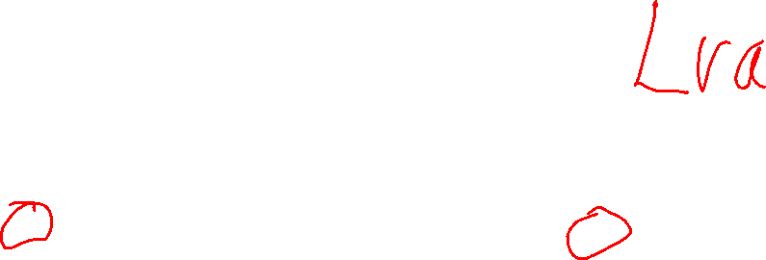
Strings
These are the index values, or indices, of the characters of the string.
A string is a sequence of 0 or more characters. The order of the characters matters.
0
1
2
3
4
5
We can represent a string in memory as a sequence of numbered boxes as shown.
P
a
p
e
r
!

Slide 13
Strings
These are the index values, or indices, of the characters of the string.
A string is a sequence of 0 or more characters. The order of the characters matters.
The last index is always 1 less than the string’s length.
The first index is always 0.
0
1
2
3
4
5
We can represent a string in memory as a sequence of numbered boxes as shown.
P
a
p
e
r
!

Slide 14
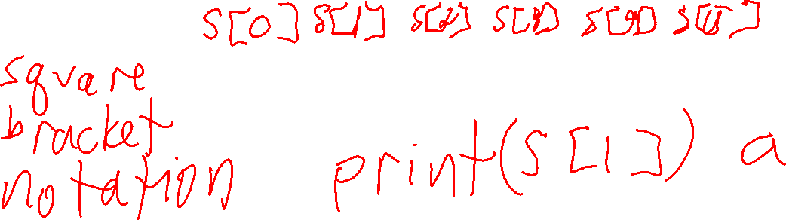
Strings
s = 'Paper!'
A string is a sequence of 0 or more characters. The order of the characters matters.
0
1
2
3
4
5
s
P
a
p
e
r
!

Slide 15
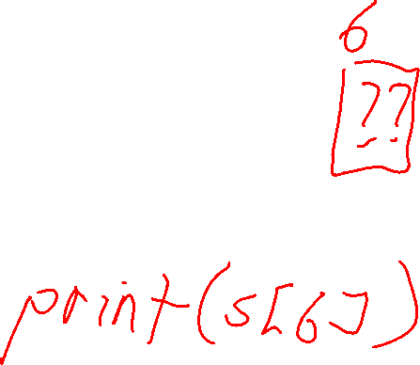
Strings
s = 'Paper!'
A string is a sequence of 0 or more characters. The order of the characters matters.
0
1
2
3
4
5
s
P
a
p
e
r
!
s[0]
s[1]
s[2]
s[3]
s[4]
s[5]

Slide 16
Strings
s = 'Paper!'
A string is a sequence of 0 or more characters. The order of the characters matters.
0
1
2
3
4
5
s
P
a
p
e
r
!
s[0]
s[1]
s[2]
s[3]
s[4]
s[5]
print(s[0]) # P print(s[3]) # e print(s[5]) # !
print(s[6]) # IndexError

Slide 17
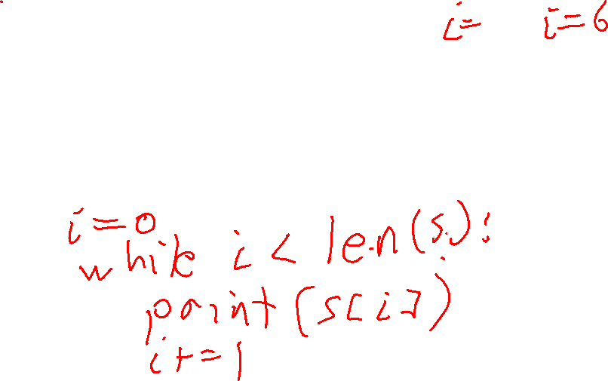
Strings
s = 'Paper!'
A string is a sequence of 0 or more characters. The order of the characters matters.
0
1
2
3
4
5
P
a
p
e
r
!
s
P
a
p
e
r
!
s[0]
s[1]
s[2]
s[3]
s[4]
s[5]
for c in s: print(c)

Slide 18
Strings
s = 'Paper!'
A string is a sequence of 0 or more characters. The order of the characters matters.
0
1
2
3
4
5
P
a
p
e
r
!
s
P
a
p
e
r
!
s[0]
s[1]
s[2]
s[3]
s[4]
s[5]
for c in s: print(c)
i = 0 while i < len(s): print(s[i]) i += 1

Slide 19
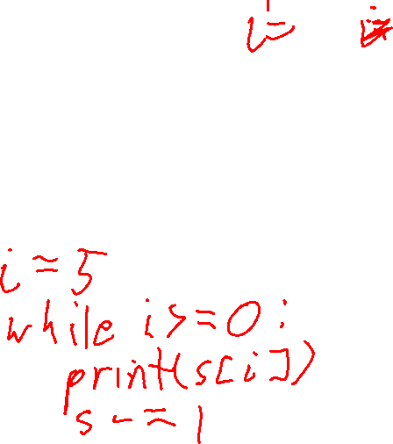
Strings
s = 'Paper!'
A string is a sequence of 0 or more characters. The order of the characters matters.
0
1
2
3
4
5
!
r
e
P
a
P
s
P
a
p
e
r
!
s[0]
s[1]
s[2]
s[3]
s[4]
s[5]
Print letters in reverse using a while loop?

Slide 20

Strings
s = 'Paper!'
A string is a sequence of 0 or more characters. The order of the characters matters.
0
1
2
3
4
5
!
r
e
P
a
P
s
P
a
p
e
r
!
s[0]
s[1]
s[2]
s[3]
s[4]
s[5]
Print letters in reverse using a while loop?
i = len(s) - 1 while i >= 0: print(s[i]) i -= 1

Slide 21
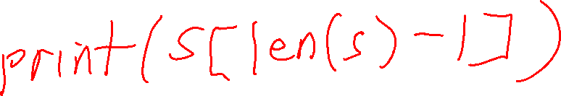
Strings
s = 'Paper!'
A string is a sequence of 0 or more characters. The order of the characters matters.
0
1
2
3
4
5
s
P
a
p
e
r
!
s[0]
s[1]
s[2]
s[3]
s[4]
s[5]
How can you print the last character of string s?
???

Slide 22
Strings
s = 'Paper!'
A string is a sequence of 0 or more characters. The order of the characters matters.
0
1
2
3
4
5
s
P
a
p
e
r
!
s[0]
s[1]
s[2]
s[3]
s[4]
s[5]
How can you print the last character of string s?
print(s[len(s)-1])

Slide 23

Strings
s = 'Paper!'
A string is a sequence of 0 or more characters. The order of the characters matters.
0
1
2
3
4
5
s
P
a
p
e
r
!
s[0]
s[1]
s[2]
s[3]
s[4]
s[5]
How can you print the last character of string s?
This is a lot to write to get the last character! So Python provides another kind of indexing: negative indexing
print(s[len(s)-1])

Slide 24
Strings
s = 'Paper!'
A string is a sequence of 0 or more characters. The order of the characters matters.
-6
-5
-4
-3
-2
-1
0
1
2
3
4
5
s
P
a
p
e
r
!
These are the negative indices of string s. The right-most character is always -1, then it goes down by 1 each character.
s[0]
s[1]
s[2]
s[3]
s[4]
s[5]

Slide 25
Strings
s = 'Paper!'
A string is a sequence of 0 or more characters. The order of the characters matters.
-6
-5
-4
-3
-2
-1
0
1
2
3
4
5
s
P
a
p
e
r
!
These are the negative indices of string s. The right-most character is always -1, then it goes down by 1 each character.
s[0]
s[1]
s[2]
s[3]
s[4]
s[5]
s[-6]
s[-5]
s[-4]
s[-3]
s[2]
s[-1]

Slide 26
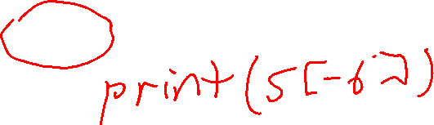
Strings
s = 'Paper!'
A string is a sequence of 0 or more characters. The order of the characters matters.
-6
-5
-4
-3
-2
-1
0
1
2
3
4
5
s
P
a
p
e
r
!
These are the negative indices of string s. The right-most character is always -1, then it goes down by 1 each character.
s[0]
s[1]
s[2]
s[3]
s[4]
s[5]
s[-6]
s[-5]
s[-4]
s[-3]
s[2]
s[-1]
print(s[0]) # P print(s[3]) # e print(s[5]) # !
print(s[6]) # IndexError

Slide 27

Strings
s = 'Paper!'
A string is a sequence of 0 or more characters. The order of the characters matters.
-6
-5
-4
-3
-2
-1
0
1
2
3
4
5
s
P
a
p
e
r
!
These are the negative indices of string s. The right-most character is always -1, then it goes down by 1 each character.
s[0]
s[1]
s[2]
s[3]
s[4]
s[5]
s[-6]
s[-5]
s[-4]
s[-3]
s[2]
s[-1]
print(s[0]) # P print(s[3]) # e print(s[5]) # !
print(s[6]) # IndexError
print(s[-6]) # P print(s[-3]) # e print(s[-1]) # !
print(s[-7]) # IndexError

Slide 28

Strings
s = 'Paper!'
A string is a sequence of 0 or more characters. The order of the characters matters.
-6
-5
-4
-3
-2
-1
0
1
2
3
4
5
s
P
a
p
e
r
!
These are the negative indices of string s. The right-most character is always -1, then it goes down by 1 each character.
s[0]
s[1]
s[2]
s[3]
s[4]
s[5]
s[-6]
s[-5]
s[-4]
s[-3]
s[2]
s[-1]
print(s[len(s) - 1])
print(s[-1])

Slide 29
String Slices
A slice of a string is a subsequence of consecutive characters in a string.
0
1
2
3
4
5
s
P
a
p
e
r
!
s[0]
s[1]
s[2]
s[3]
s[4]
s[5]

Slide 30
String Slices
A slice of a string is a subsequence of consecutive characters in a string.
s[start:end] is the string with the characters: s[start], s[start+1], …, s[end-2], s[end-1]
0
1
2
3
4
5
s
P
a
p
e
r
!
s[0]
s[1]
s[2]
s[3]
s[4]
s[5]

Slide 31
String Slices
s[start:end] is all the characters beginning from s[start] and then up to, but not including, s[end]
A slice of a string is a subsequence of consecutive characters in a string.
s[start:end] is the string with the characters: s[start], s[start+1], …, s[end-2], s[end-1]
0
1
2
3
4
5
s
P
a
p
e
r
!
s[0]
s[1]
s[2]
s[3]
s[4]
s[5]

Slide 32
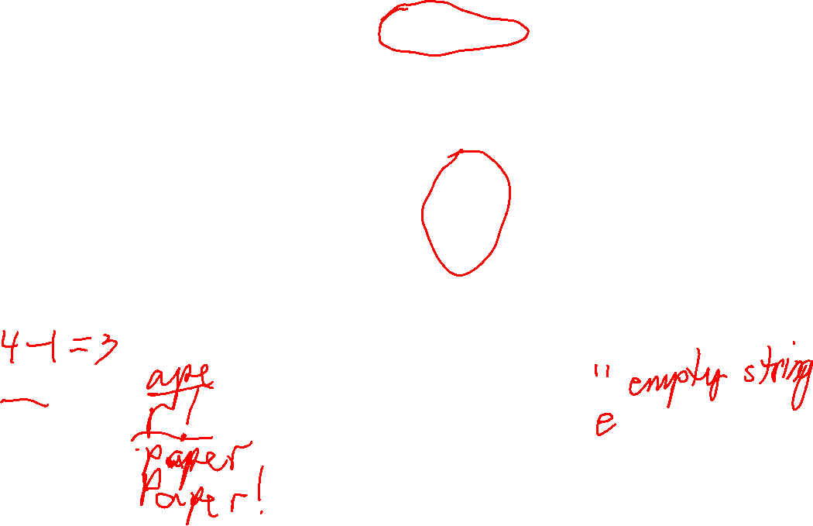
String Slices
s[start:end] is all the characters beginning from s[start] and then up to, but not including, s[end]
A slice of a string is a subsequence of consecutive characters in a string.
s[start:end] is the string with the characters: s[start], s[start+1], …, s[end-2], s[end-1]
0
1
2
3
4
5
s
P
a
p
e
r
!
s[0]
s[1]
s[2]
s[3]
s[4]
s[5]
print(s[1:4]) #
print(s[4:6]) #
print(s[0:5]) #
print(s[0:6]) #
print(s[3:3]) #
print(s[3:4]) #

Slide 33
String Slices
s[start:end] is all the characters beginning from s[start] and then up to, but not including, s[end]
A slice of a string is a subsequence of consecutive characters in a string.
s[start:end] is the string with the characters: s[start], s[start+1], …, s[end-2], s[end-1]
0
1
2
3
4
5
s
P
a
p
e
r
!
s[0]
s[1]
s[2]
s[3]
s[4]
s[5]
print(s[1:4]) # ape
print(s[4:6]) # r!
print(s[0:5]) # Paper
print(s[0:6]) # Paper!
print(s[3:3]) # empty string
print(s[3:4]) # e
Notice that slice s[start:end] has length end – start.

Slide 34
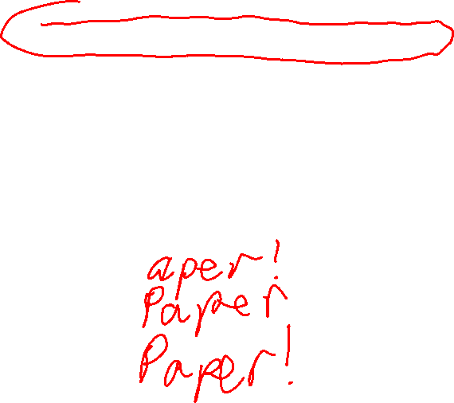
String Slices
s[start:end] is all the characters beginning from s[start] and then up to, but not including, s[end]
A slice of a string is a subsequence of consecutive characters in a string.
s[start:end] is the string with the characters: s[start], s[start+1], …, s[end-2], s[end-1]
0
1
2
3
4
5
s
P
a
p
e
r
!
s[0]
s[1]
s[2]
s[3]
s[4]
s[5]
print(s[1:]) #
print(s[:5]) #
print(s[:]) #

Slide 35

String Slices
s[start:end] is all the characters beginning from s[start] and then up to, but not including, s[end]
A slice of a string is a subsequence of consecutive characters in a string.
s[start:end] is the string with the characters: s[start], s[start+1], …, s[end-2], s[end-1]
0
1
2
3
4
5
s
P
a
p
e
r
!
s[0]
s[1]
s[2]
s[3]
s[4]
s[5]
print(s[1:]) # aper!
print(s[:5]) # Paper
print(s[:]) # Paper!

Slide 36
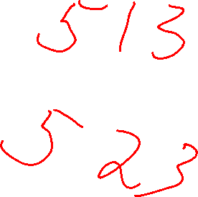
String Immutability
s = 'Paper!'
In Pythion, you cannot add, remove, or change characters of a string. Python strings are immutable.

Slide 37
String Immutability
s = 'Paper!'
print(s[0]) # ok: reading a character or print(len(s)) # getting length doesn’t # change s
In Pythion, you cannot add, remove, or change characters of a string. Python strings are immutable.

Slide 38
String Immutability
s = 'Paper!'
print(s[0]) # ok: reading a character or print(len(s)) # getting length doesn’t # change s
s[0] = 'c' # TypeError: can’t change a # a string
In Pythion, you cannot add, remove, or change characters of a string. Python strings are immutable.

Slide 39
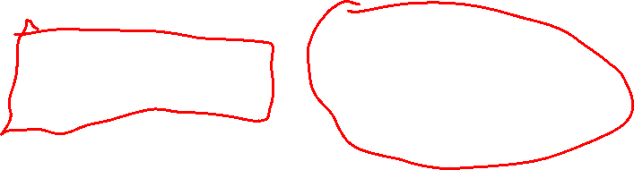
String Immutability
s = 'Paper!'
print(s[0]) # ok: reading a character or print(len(s)) # getting length doesn’t # change s
s[0] = 'c' # TypeError: can’t change a # a string
In Pythion, you cannot add, remove, or change characters of a string. Python strings are immutable.
s
Assignments and slices are fast and cheap with immutable strings …
s = 'Paper!' t = s
Paper!
t
s and t can both safely refer to the same underlying string.

Slide 40
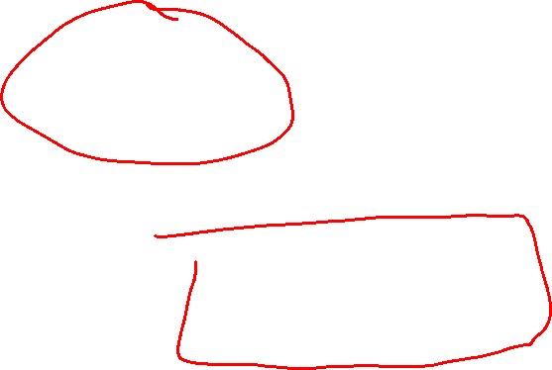
String Immutability
s = 'Paper!'
print(s[0]) # ok: reading a character or print(len(s)) # getting length doesn’t # change s
s[0] = 'c' # TypeError: can’t change a # a string
In Pythion, you cannot add, remove, or change characters of a string. Python strings are immutable.
Assignments and slices are fast and cheap with immutable strings …
s
s = 'Paper!' t = s[1:4] # ape
Paper!
t
No need to copy the characters to make a slice!

Slide 41
String Immutability
s = 'Paper!'
print(s[0]) # ok: reading a character or print(len(s)) # getting length doesn’t # change s
s[0] = 'c' # TypeError: can’t change a # a string
In Pythion, you cannot add, remove, or change characters of a string. Python strings are immutable.
Lines are frequently modified in a text editor, and having to re-copy them for every change would probably be too slow.
On the downside, Python strings would be a bad choice for a text editor…

Slide 42
Comparing Strings
s = 'The big red ?og barked.'
How can you change the ? to a 'd' in s without modifying s?

Slide 43
Comparing Strings
s[12]
s = 'The big red ?og barked.'
How can you change the ? to a 'd' in s without modifying s?

Slide 44
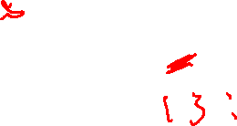
Comparing Strings
s[12]
s = 'The big red ?og barked.'
s[:12]
s[:12]
How can you change the ? to a 'd' in s without modifying s?
Make a new string using slicing and appending.

Slide 45

Comparing Strings
s[12]
s = 'The big red ?og barked.'
s[:12]
s[:12]
How can you change the ? to a 'd' in s without modifying s?
s_fixed = s[:12] + 'd' + s[13:]
'The big red dog barked.'
Make a new string using slicing and appending.

Slide 46
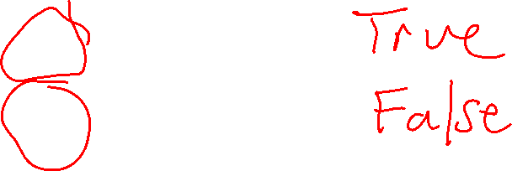
Comparing Strings
'Paper!' == 'Paper!'
'Paper!' != 'Paper!'
Two strings are equal if they have the same characters in the same order.

Slide 47
Comparing Strings
'Paper!' == 'Paper!'
True
'Paper!' != 'Paper!'
False
Two strings are equal if they have the same characters in the same order.

Slide 48
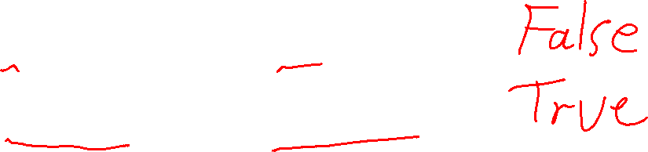
Comparing Strings
'Paper!' == 'Paper!'
True
'Paper!' != 'Paper!'
False
Two strings are equal if they have the same characters in the same order.
'Paper!' == 'paper!'
'Paper!' != 'paper!'

Slide 49
Comparing Strings
'Paper!' == 'Paper!'
True
'Paper!' != 'Paper!'
False
Two strings are equal if they have the same characters in the same order.
'Paper!' == 'paper!'
False
'Paper!' != 'paper!'
True

Slide 50
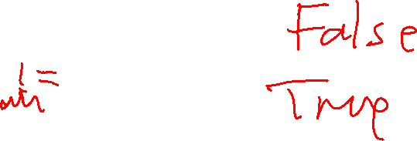
Comparing Strings
'Paper!' == 'Paper!'
True
'Paper!' != 'Paper!'
False
Two strings are equal if they have the same characters in the same order.
'Paper!' == 'paper!'
False
'Paper!' != 'paper!'
True
'Paper!' == 'Paper'
'Paper!' == 'Paper'

Slide 51

Comparing Strings
'Paper!' == 'Paper!'
True
'Paper!' != 'Paper!'
False
Two strings are equal if they have the same characters in the same order.
'Paper!' == 'paper!'
False
'Paper!' != 'paper!'
True
'Paper!' == 'Paper'
False
'Paper!' == 'Paper'
True

Slide 52
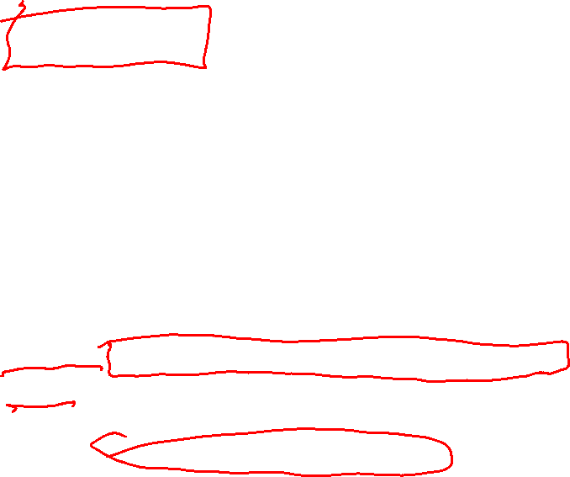
Comparing Strings
def same(s, t): """Returns True if s == t, False otherwise. """
Challenge Write a Boolean function called same(s, t) that returns True if s == t, and False otherwise. Do not use == or != or < etc. except to compare single characters.
???
def test_same():
print('testing same ...')
assert same('hello', 'hello') == True
assert same('hello', 'ello') == False
assert same('hello', 'Hello') == False
assert same('', '') == True
assert same('', 'a') == False
print(' ...all same tests passed')
Use this test function to help write it …

Slide 53
Reversing a String
def reverse(s): """Returns a copy of s reversed. E.g. 'cat' becomes 'tac' """
Challenge Write a function called reverse(s) that returns a copy of string s with its characters in reverse order. Don’t use any built-in Python reversing functions.
???
def test_reverse():
print('testing reverse ...')
assert reverse('') == ''
assert reverse('a') == 'a'
assert reverse('ab') == 'ba'
assert reverse('abc') == 'cba'
assert reverse('hello!') == '!olleh'
assert reverse('racecar') == 'racecar'
print(' ...all reverse tests passed')
Use this test function to help write it …

Slide 54
Checking Palindromes
def is_palindrome(s): """Returns True if s is a
palindrome, False otherwise. """
Challenge Write a Boolean function called is_palindrome(s) that returns True if s is a palindrome, i.e. equal to its reverse, and False otherwise. Don’t use any built-in Python reversing functions.
???
def test_is_palindrome():
print('testing is_palindrome ...')
assert is_palindrome('') == True
assert is_palindrome('a') == True
assert is_palindrome('ab') == False
assert is_palindrome('aa') == True
assert is_palindrome('aaa') == True
assert is_palindrome('racecar') == True
print(' ...all is_palindrome tests passed')
Use this test function to help write it …

Slide 55
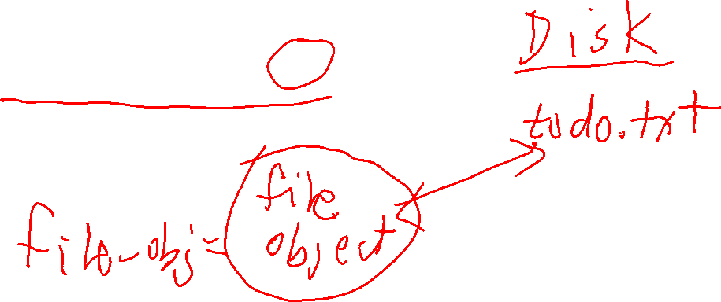
Writing to Text Files
To write to a text file, you must first open it with the 'w' option. Then use file object’s write method append strings to it.
file_object = open('todo.txt', 'w')

Slide 56
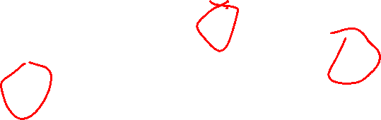
Writing to Text Files
To write to a text file, you must first open it with the 'w' option. Then use file object’s write method append strings to it.
file_object = open('todo.txt', 'w')
file_object.write('1. Learn to write poems.\n')
file_object.write('2. Get a job at a poetry company.\n')
file_object.write('3. Profit!\n')

Slide 57
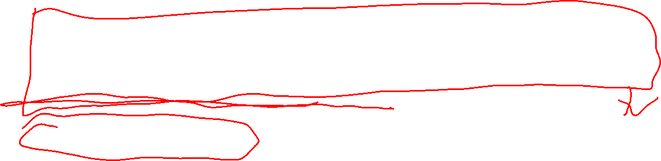
Writing to Text Files
To write to a text file, you must first open it with the 'w' option. Then use file object’s write method append strings to it.
file_object = open('todo.txt', 'w')
file_object.write('1. Learn to write poems.\n')
file_object.write('2. Get a job at a poetry company.\n')
file_object.write('3. Profit!\n')
todo.txt
Content may not actually be written to the file until you call file_object.close()
file_object.close()
1. Learn to write poems. 2. Get a job at a poetry company.
3. Profit!

Slide 58

Writing to Text Files
To write to a text file, you must first open it with the 'w' option. Then use file object’s write method append strings to it.
Careful!
If todo.txt doesn’t exist before calling open, it will be created.
If todo.txt already exists before calling open, it will be erased(!).
You must call .close() to ensure the content is actually written to the file.
file_object = open('todo.txt', 'w')
file_object.write('1. Learn to write poems.\n')
file_object.write('2. Get a job at a poetry company.\n')
file_object.write('3. Profit!\n')
todo.txt
Content may not actually be written to the file until you call file_object.close()
file_object.close()
1. Learn to write poems. 2. Get a job at a poetry company.
3. Profit!
Strings are typically written to a “buffer” in memory, and then the buffer is written when closed. This is usually faster than writing to the file on each call to write.

