Slide 1
Chapter 6: Functions with return values
CMTP 120, Fall 2024

Slide 2
Functions that Return Values
In math, we define functions like this …
f(x) = 2x + 1
When we pass a number to f(x), we can evaluate it to get a new number.
f(1) = 2*1 + 1 = 3
f(2) = 2*2 + 1 = 5
We’ll say that f(x) returns a value.
f(3) = 2*3 + 1 = 7

Slide 3
Functions that Return Values
In Python we would define the function like this …
f(x) = 2x + 1
def f(x): return 2 * x + 1
return causes the function to stop, and f(x) is said to return the value of the expression

Slide 4
Functions that Return Values
return causes the function to stop, and f(x) is said to return the value of the expression
In Python we would define the function like this …
def f(x): return 2 * x + 1
a = f(1) print(a) # ??? b = 2 + f(2 + 1) print(b) # ???
f(x) = 2x + 1

Slide 5
Functions that Return Values
return causes the function to stop, and f(x) is said to return the value of the expression
In Python we would define the function like this …
def f(x): return 2 * x + 1
a = f(1) print(a) # 3 b = 2 + f(2 + 1) print(b) # 9
f(x) = 2x + 1

Slide 6
Functions that Return Values
import math
def circle_area(radius):
area = math.pi * radius**2
return area
A function that returns a value should always end with a call to a return statement.

Slide 7
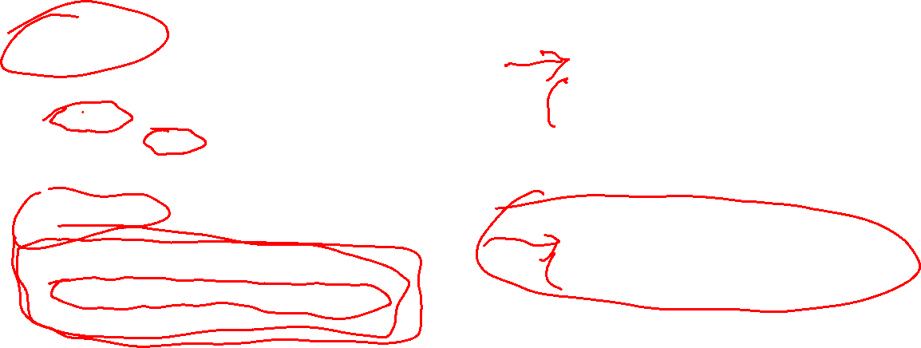
Functions that Return Values
Alternate ways to write the circle_area function. What looks most readable to you?
1
3
import math
def circle_area(radius):
area = math.pi * radius**2
return area
def circle_area(radius):
import math
area = math.pi * radius**2
return area
2
4
import math
def circle_area(radius):
return math.pi * radius**2
def circle_area(radius):
import math
return math.pi * radius**2

Slide 8
Dead Code

Slide 9

Functions that Return Values
import math
def circle_area(radius):
area = math.pi * radius**2
return area
print('done!')
Any statements after a return are not executed.
The print after the return is dead code: it can never run.
Always delete dead code!

Slide 10
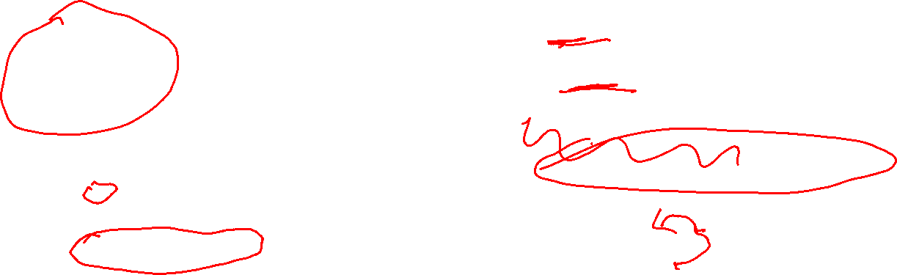
Functions that Return Values
Some more examples of functions with dead code.
def dead_code_ex1():
return 1
return 2 # dead code
return 3 # dead code
def dead_code_ex3():
if x <= 0:
print('up')
elif x >= 0:
print('down')
else:
print('around') # dead code
def dead_code_ex2():
n = 0
for i in range(n):
print('Hello!') # dead code
def dead_code_ex4():
dead_code_ex4()
print('done!') # dead code

Slide 11
Functions that Don’t Return Values
greet(name) is an example of a function that does not return a value. It ends without calling return.
def greet(name):
print(f'Hello {name}!')
x = greet('Elon') # prints greeting
print(x) # ???
In some programming languages this code causes a syntax error because greet returns nothing so you can’t assign it to a variable.
But Python allows it!

Slide 12
Functions that Don’t Return Values
greet(name) is an example of a function that does not return a value. It ends without calling return.
def greet(name):
print(f'Hello {name}!')
x = greet('Elon') # prints greeting
print(x) # None
In some programming languages this code causes a syntax error because greet returns nothing so you can’t assign it to a variable.
None appearing in your Python programs is never a good sign. It usually means you have a mistake or design error somewhere in your program.
But Python allows it!
A function that does not return a value “returns” the special value None, which indicates no value was intentionally returned.

Slide 13
Functions with conditionals
Challenge Write a function called my_abs(x) that returns the absolute value of x. Do not use the built-in abs function.
my_abs(-4) returns 4 my_abs(5) returns 5
my_abs(0) returns 0

Slide 14
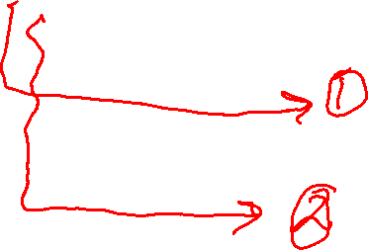
Functions with conditionals
Challenge Write a function called my_abs(x) that returns the absolute value of x. Do not use the built-in abs function.
def my_abs(x):
if x < 0: return –x else: return x
This function has two returns, and two execution paths. Exactly one of the returns is guaranteed to be called, no matter the value of x.

Slide 15
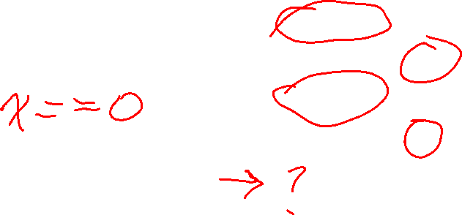
Functions with conditionals
Challenge Write a function called my_abs(x) that returns the absolute value of x. Do not use the built-in abs function.
def bad_abs(x):
if x < 0: return –x if x > 0: return x
What’s the bug in this function?

Slide 16
Functions with conditionals
Challenge Write a function called my_abs(x) that returns the absolute value of x. Do not use the built-in abs function.
def bad_abs(x):
if x < 0: return –x if x > 0: return x
# oops: x == 0 gets here!
What’s the bug in this function?
The problem is that if x is 0, then neither return statement is run. If x is 0, the program “falls off” the end of the function without a return.

Slide 17
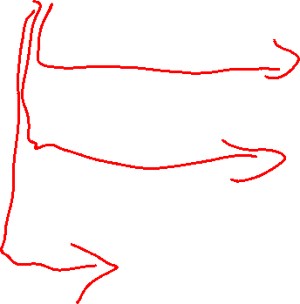
Functions with conditionals
Challenge Write a function called my_abs(x) that returns the absolute value of x. Do not use the built-in abs function.
def bad_abs(x):
if x < 0: return –x if x > 0: return x
# oops: x == 0 gets here!
What’s the bug in this function?
There are three execution paths through this function:
one ending with return –x
one ending with return x
one ending with nothing
The problem is that if x is 0, then neither return statement is run. If x is 0, the program “falls off” the end of the function without a return.

Slide 18
Functions with conditionals
Challenge Write a function called my_abs(x) that returns the absolute value of x. Do not use the built-in abs function.
def bad_abs(x):
if x < 0: return –x if x > 0: return x
# oops: x == 0 gets here!
What’s the bug in this function?
There are three execution paths through this function:
one ending with return –x
one ending with return x
one ending with nothing
The problem is that if x is 0, then neither return statement is run. If x is 0, the program “falls off” the end of the function without a return.
When x is 0 the function ends without a return, so None is returned. This is a bad mistake!

Slide 19
Functions with conditionals
Challenge Write a function called my_abs(x) that returns the absolute value of x. Do not use the built-in abs function.
def bad_abs(x):
if x < 0: return –x if x > 0: return x
def fixed1_abs(x):
if x <= 0: return –x if x > 0: return x
def fixed3_abs(x):
if x < 0: return –x if x > 0: return x if x == 0: return 0
def fixed2_abs(x):
if x < 0: return –x if x >= 0: return x

Slide 20
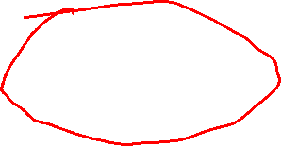
Functions with conditionals
Challenge Write a function called my_abs(x) that returns the absolute value of x. Do not use the built-in abs function.
def bad_abs(x):
if x < 0: return –x if x > 0: return x
def my_abs(x):
if x < 0: return –x else: return x
In Python, these are probably the two most common ways to write an absolute value function. The code for both is short, readable, correct, and efficient.
def my_abs2(x):
if x < 0: return –x return x

Slide 21
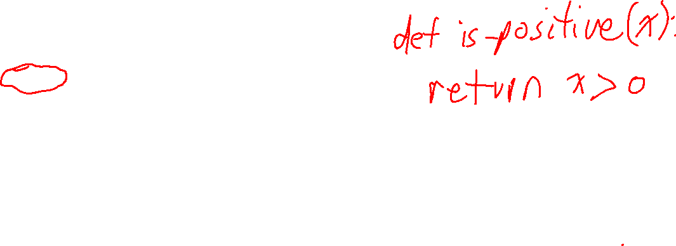
Boolean functions
A function that returns only either True or False is called a boolean function.
def is_positive(x):
if x > 0:
return True
else:
return False
A shorter way to write this function …

Slide 22
Boolean functions
A function that returns only either True or False is called a boolean function.
def is_positive(x):
if x > 0:
return True
else:
return False
def is_positive(x):
return x > 0
A shorter way to write this function …

Slide 23
Boolean functions
A function that returns only either True or False is called a boolean function.
def is_positive(x):
if x > 0:
return True
else:
return False
def is_positive(x):
return x > 0
A shorter way to write this function …
This is a boolean expression. It evaluates to either True or False.
Most programmers prefer this style. Once you get used to it, it is quite readable.

Slide 24
Boolean functions
Challenge Write a boolean function called is_prime(n) that returns True if the int n is a prime, and False otherwise.
def is_prime(n):
pass
A prime number is an integer greater than one that is evenly divisible by only 1 and itself.
Some primes: 2, 3, 5, 7, 11, …, 101, …
Some not primes: 4, 6, 8, 9, 10, 12, …, 1001, …

Slide 25
Boolean functions
Challenge Write a boolean function called is_prime(n) that returns True if the int n is a prime, and False otherwise.
def is_prime(n):
pass
A prime number is an integer greater than one that is evenly divisible by only 1 and itself.
Some primes: 2, 3, 5, 7, 11, …, 101, …
Some not primes: 4, 6, 8, 9, 10, 12, …, 1001, …

Slide 26
Boolean functions
See lecture notes for an implementation of is_prime.
def is_prime(n):
pass
Challenge Write a boolean function called is_prime(n) that returns True if the int n is a prime, and False otherwise.
We can use is_prime to count how many primes are <= some number n.
def num_primes(n):
"""Returns the number of primes less than, or equal to, n.
"""
count = 0
for i in range(2, n + 1):
if is_prime(i):
count += 1
return count
A prime number is an integer greater than one that is evenly divisible by only 1 and itself.
primes: 2, 3, 5, 7, 11, …, 101, … not primes: 4, 6, 8, 9, 10, 12, …, 1001, …

Slide 27
Recursive Functions
What is the sum of the numbers from 1 to n?
1+ 2 + 3 + … + (n-1) + n

Slide 28
Recursive Functions
What is the sum of the numbers from 1 to n?
S(n) = 1 + 2 + 3 + … + (n-1) + n

Slide 29
Recursive Functions
What is the sum of the numbers from 1 to n?
S(n) = 1 + 2 + 3 + … + (n-1) + n
S(n) = n + (n-2) + (n-3) + … + 2 + 1

Slide 30
Recursive Functions
What is the sum of the numbers from 1 to n?
S(n) = 1 + 2 + 3 + … + (n-1) + n
S(n) = n + (n-2) + (n-3) + … + 2 + 1

Slide 31
Recursive Functions
What is the sum of the numbers from 1 to n?
S(n) = 1 + 2 + 3 + … + (n-1) + n
+
S(n) = n + (n-2) + (n-3) + … + 2 + 1
2*S(n) = (n+1) + (n+1) + (n+1) + ... + (n+1) + (n+1)

Slide 32
Recursive Functions
What is the sum of the numbers from 1 to n?
S(n) = 1 + 2 + 3 + … + (n-1) + n
+
S(n) = n + (n-2) + (n-3) + … + 2 + 1
2*S(n) = (n+1) + (n+1) + (n+1) + ... + (n+1) + (n+1)
The term (n+1) occurs n times, so it all sums to n(n+1)

Slide 33
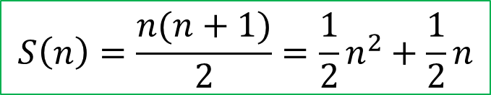
Recursive Functions
What is the sum of the numbers from 1 to n?
S(n) = 1 + 2 + 3 + … + (n-1) + n
+
S(n) = n + (n-2) + (n-3) + … + 2 + 1
2*S(n) = (n+1) + (n+1) + (n+1) + ... + (n+1) + (n+1)
2*S(n) = n*(n+1)
The term (n+1) occurs n times, so it all sums to n(n+1)
S(n) = n*(n+1) / 2
$$S\left(n\right)=\frac{n(n+1)}{2}=\frac{1}{2}n^{2}+\frac{1}{2}n$$

Slide 34
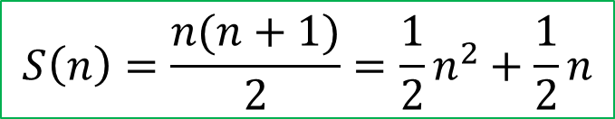
Recursive Functions
What is the sum of the numbers from 1 to n?
1+ 2 + 3 + … + (n-1) + n
def S(n):
return n * (n + 1) // 2
$$S\left(n\right)=\frac{n(n+1)}{2}=\frac{1}{2}n^{2}+\frac{1}{2}n$$
This is fast and simple: the best way to implement S(n).
Only three operations are needed, no matter the size of n.

Slide 35
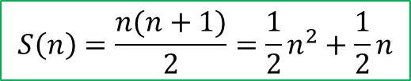
Recursive Functions
What is the sum of the numbers from 1 to n?
1+ 2 + 3 + … + (n-1) + n
$$S\left(n\right)=\frac{n(n+1)}{2}=\frac{1}{2}n^{2}+\frac{1}{2}n$$
def S(n):
return n * (n + 1) // 2
def S(n):
total = 0 for i in range(n + 1): total += i return total
Another way of calculating the sum is to use a loop …

Slide 36
Recursive Functions
What is the sum of the numbers from 1 to n?
1+ 2 + 3 + … + (n-1) + n
$$S\left(n\right)=\frac{n(n+1)}{2}=\frac{1}{2}n^{2}+\frac{1}{2}n$$
def S(n):
return n * (n + 1) // 2
def S(n):
total = 0 for i in range(n + 1): total += i return total
+= is called n times … so the amount of work this function does is proportional to n
Another way of calculating the sum is to use a loop …
So this is much more work than the 3 operations done by the other function.

Slide 37
Recursive Functions
What is the sum of the numbers from 1 to n?
1+ 2 + 3 + … + (n-1) + n
$$S\left(n\right)=\frac{n(n+1)}{2}=\frac{1}{2}n^{2}+\frac{1}{2}n$$
def S(n):
return n * (n + 1) // 2
Another way of calculating the sum is to use a recurrence relation …
$$S\left(n\right)=1+2+3+…+\left(n−1\right)+n$$

Slide 38
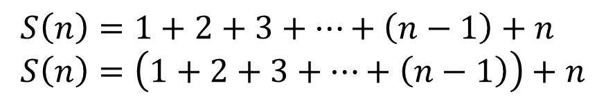
Recursive Functions
What is the sum of the numbers from 1 to n?
1+ 2 + 3 + … + (n-1) + n
$$S\left(n\right)=\frac{n(n+1)}{2}=\frac{1}{2}n^{2}+\frac{1}{2}n$$
def S(n):
return n * (n + 1) // 2
Another way of calculating the sum is to use a recurrence relation …
$$S\left(n\right)=1+2+3+…+\left(n−1\right)+n \\ S\left(n\right)=\left(1+2+3+…+\left(n−1\right)\right)+n$$

Slide 39
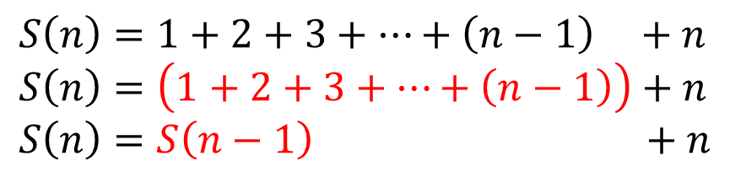
Recursive Functions
What is the sum of the numbers from 1 to n?
1+ 2 + 3 + … + (n-1) + n
$$S\left(n\right)=\frac{n(n+1)}{2}=\frac{1}{2}n^{2}+\frac{1}{2}n$$
def S(n):
return n * (n + 1) // 2
Another way of calculating the sum is to use a recurrence relation …
$$S\left(n\right)=1+2+3+…+\left(n−1\right) +n \\ S\left(n\right)=\left(1+2+3+…+\left(n−1\right)\right)+n \\ S\left(n\right)=S\left(n−1\right) +n$$

Slide 40
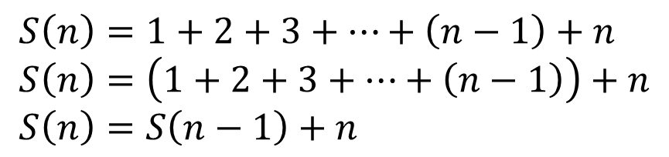
Recursive Functions
What is the sum of the numbers from 1 to n?
1+ 2 + 3 + … + (n-1) + n
$$S\left(n\right)=\frac{n(n+1)}{2}=\frac{1}{2}n^{2}+\frac{1}{2}n$$
def S(n):
return n * (n + 1) // 2
Another way of calculating the sum is to use a recurrence relation …
$$S\left(n\right)=1+2+3+…+\left(n−1\right)+n \\ S\left(n\right)=\left(1+2+3+…+\left(n−1\right)\right)+n \\ S\left(n\right)=S\left(n−1\right)+n$$
S(1) = S(0) + 1 S(0) = S(-1) + 0 S(-1) = S(-2) + -1 …
Problem! This keeps going forever …

Slide 41
Recursive Functions
What is the sum of the numbers from 1 to n?
1+ 2 + 3 + … + (n-1) + n
$$S\left(n\right)=\frac{n(n+1)}{2}=\frac{1}{2}n^{2}+\frac{1}{2}n$$
def S(n):
return n * (n + 1) // 2
Another way of calculating the sum is to use a recurrence relation …
$$S\left(n\right)=1+2+3+…+\left(n−1\right)+n \\ S\left(n\right)=\left(1+2+3+…+\left(n−1\right)\right)+n \\ S\left(n\right)=S\left(n−1\right)+n$$
S(1) = S(0) + 1 S(0) = S(-1) + 0 S(-1) = S(-2) + -1 …
We stop the recursion with by setting S(0) = 0
Problem! This keeps going forever …

Slide 42
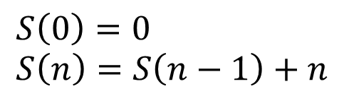
Recursive Functions
What is the sum of the numbers from 1 to n?
1+ 2 + 3 + … + (n-1) + n
$$S\left(n\right)=\frac{n(n+1)}{2}=\frac{1}{2}n^{2}+\frac{1}{2}n$$
def S(n):
return n * (n + 1) // 2
Base case: no recursion
Remember All useful recursive functions have at least one base case and at least one recursive case.
Another way of calculating the sum is to use a recurrence relation …
$$S\left(0\right)=0 \\ S\left(n\right)=S\left(n−1\right)+n$$
Recursive case: S calls itself

Slide 43
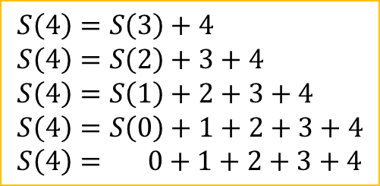
Recursive Functions
What is the sum of the numbers from 1 to n?
1+ 2 + 3 + … + (n-1) + n
$$S\left(n\right)=\frac{n(n+1)}{2}=\frac{1}{2}n^{2}+\frac{1}{2}n$$
def S(n):
return n * (n + 1) // 2
Another way of calculating the sum is to use a recurrence relation …
$$S\left(0\right)=0 \\ S\left(n\right)=S\left(n−1\right)+n$$
$$S\left(4\right)=S\left(3\right)+4 \\ S\left(4\right)=S\left(2\right)+3+4 \\ S\left(4\right)=S\left(1\right)+2+3+4 \\ S\left(4\right)=S\left(0\right)+1+2+3+4 \\ S\left(4\right)= 0+1+2+3+4$$

Slide 44
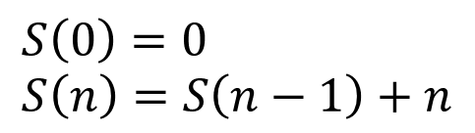
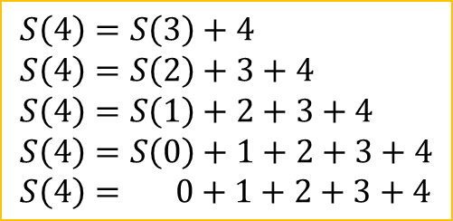
Recursive Functions
What is the sum of the numbers from 1 to n?
1+ 2 + 3 + … + (n-1) + n
$$S\left(n\right)=\frac{n(n+1)}{2}=\frac{1}{2}n^{2}+\frac{1}{2}n$$
def S(n):
return n * (n + 1) // 2
def S(n):
if n == 0: return 0 else: return S(n-1) + n
Another way of calculating the sum is to use a recurrence relation …
$$S\left(0\right)=0 \\ S\left(n\right)=S\left(n−1\right)+n$$
$$S\left(4\right)=S\left(3\right)+4 \\ S\left(4\right)=S\left(2\right)+3+4 \\ S\left(4\right)=S\left(1\right)+2+3+4 \\ S\left(4\right)=S\left(0\right)+1+2+3+4 \\ S\left(4\right)= 0+1+2+3+4$$

Slide 45
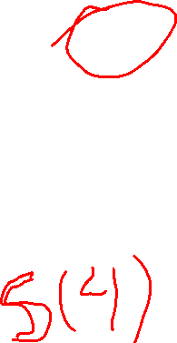
Recursive Functions
Stack trace of calling S(4)
Remember: Every time a function is called a copy of it is pushed on top of the call stack.
Before calling S(4) the call stack is empty.
Bottom of the Call Stack

Slide 46
Recursive Functions
Stack trace of calling S(4)
Remember: Every time a function is called a copy of it is pushed on top of the call stack.
S(4) called, so it’s pushed on top of the stack.
def S(4):
if 4 == 0: return 0 else: return S(4-1) + 4
Bottom of the Call Stack

Slide 47
Recursive Functions
Stack trace of calling S(4)
Remember: Every time a function is called a copy of it is pushed on top of the call stack.
S(3) is called here, so the call to S(3) is pushed on top of the stack
def S(4):
if 4 == 0: return 0 else: return S(4-1) + 4
Bottom of the Call Stack

Slide 48
Recursive Functions
Stack trace of calling S(4)
Remember: Every time a function is called a copy of it is pushed on top of the call stack.
Now the call to S(3) is on the top of the stack.
def S(3):
if 3 == 0: return 0 else: return S(3-1) + n
def S(4):
if 4 == 0: return 0 else: return S(4-1) + 4
The call to S(4) has not finished yet … it sits waiting for S(3) to finish.
Bottom of the Call Stack

Slide 49
Recursive Functions
Stack trace of calling S(4)
Remember: Every time a function is called a copy of it is pushed on top of the call stack.
Next S(2) is called here, and the call to S(2) is pushed on top of the stack.
def S(3):
if 3 == 0: return 0 else: return S(3-1) + 3
def S(4):
if 4 == 0: return 0 else: return S(4-1) + 4
Bottom of the Call Stack

Slide 50
Recursive Functions
Stack trace of calling S(4)
Remember: Every time a function is called a copy of it is pushed on top of the call stack.
def S(2):
if 2 == 0: return 0 else: return S(2-1) + 2
def S(3):
if 3 == 0: return 0 else: return S(3-1) + 3
The calls to S(3) and S(4) are not finished … they are waiting for results! To they sit here on the stack.
def S(4):
if 4 == 0: return 0 else: return S(4-1) + 4
Bottom of the Call Stack

Slide 51
Recursive Functions
Stack trace of calling S(4)
Now S(1) is called here, and so the call to S(1) is push on top of the stack.
Remember: Every time a function is called a copy of it is pushed on top of the call stack.
def S(2):
if 2 == 0: return 0 else: return S(2-1) + 2
def S(3):
if 3 == 0: return 0 else: return S(3-1) + 3
def S(4):
if 4 == 0: return 0 else: return S(4-1) + 4
Bottom of the Call Stack

Slide 52
Recursive Functions
Now S(0) is called here, and so the call to S(0) is push on top of the stack.
def S(1):
if 1 == 0: return 0 else: return S(1-1) + 1
Stack trace of calling S(4)
Remember: Every time a function is called a copy of it is pushed on top of the call stack.
def S(2):
if 2 == 0: return 0 else: return S(2-1) + 2
def S(3):
if 3 == 0: return 0 else: return S(3-1) + 3
def S(4):
if 4 == 0: return 0 else: return S(4-1) + 4
Bottom of the Call Stack

Slide 53

Recursive Functions
When S(0) is called, the non-recursive base case is called.
def S(0):
if 0 == 0: return 0 else: return S(0-1) + 0
def S(1):
if 1 == 0: return 0 else: return S(1-1) + 1
Stack trace of calling S(4)
Remember: Every time a function is called a copy of it is pushed on top of the call stack.
def S(2):
if 2 == 0: return 0 else: return S(2-1) + 2
def S(3):
if 3 == 0: return 0 else: return S(3-1) + 3
def S(4):
if 4 == 0: return 0 else: return S(4-1) + 4
Bottom of the Call Stack

Slide 54
Recursive Functions
def S(0):
if 0 == 0: return 0 else: return S(0-1) + 0
Notice that at the point just before S(0) returns 0, 5 calls to S(n) are on the stack. This takes up a lot of memory and is a major reason why recursion is unpopular in practice.
def S(1):
if 1 == 0: return 0 else: return S(1-1) + 1
Stack trace of calling S(4)
Remember: Every time a function is called a copy of it is pushed on top of the call stack.
def S(2):
if 2 == 0: return 0 else: return S(2-1) + 2
The numbers 4, 3, 2, 1, 0 are stored in the headers.
def S(3):
if 3 == 0: return 0 else: return S(3-1) + 3
def S(4):
if 4 == 0: return 0 else: return S(4-1) + 4
Bottom of the Call Stack

Slide 55
Recursive Functions
def S(0):
if 0 == 0: return 0 else: return S(0-1) + 0
Now the S(0) returns 0, and it is popped off the top of the stack, leaving 0 as the return value.
def S(1):
if 1 == 0: return 0 else: return S(1-1) + 1
Stack trace of calling S(4)
Remember: Every time a function is called a copy of it is pushed on top of the call stack.
def S(2):
if 2 == 0: return 0 else: return S(2-1) + 2
def S(3):
if 3 == 0: return 0 else: return S(3-1) + 3
def S(4):
if 4 == 0: return 0 else: return S(4-1) + 4
Bottom of the Call Stack

Slide 56

Recursive Functions
0
The result of the call to S(0) here is now known: it’s 0. So we replace it with 0.
def S(1):
if 1 == 0: return 0 else: return S(1-1) + 1
Stack trace of calling S(4)
Remember: Every time a function is called a copy of it is pushed on top of the call stack.
def S(2):
if 2 == 0: return 0 else: return S(2-1) + 2
def S(3):
if 3 == 0: return 0 else: return S(3-1) + 3
def S(4):
if 4 == 0: return 0 else: return S(4-1) + 4
Bottom of the Call Stack

Slide 57
Recursive Functions
def S(1):
if 1 == 0: return 0 else: return 0 + 1
Stack trace of calling S(4)
This evaluates to 1.
Remember: Every time a function is called a copy of it is pushed on top of the call stack.
def S(2):
if 2 == 0: return 0 else: return S(2-1) + 2
def S(3):
if 3 == 0: return 0 else: return S(3-1) + 3
def S(4):
if 4 == 0: return 0 else: return S(4-1) + 4
Bottom of the Call Stack

Slide 58
Recursive Functions
def S(1):
if 1 == 0: return 0 else: return 1
Stack trace of calling S(4)
This evaluates to 1.
Remember: Every time a function is called a copy of it is pushed on top of the call stack.
def S(2):
if 2 == 0: return 0 else: return S(2-1) + 2
def S(3):
if 3 == 0: return 0 else: return S(3-1) + 3
def S(4):
if 4 == 0: return 0 else: return S(4-1) + 4
Bottom of the Call Stack

Slide 59
Recursive Functions
def S(1):
if 1 == 0: return 0 else: return 1
The call to S(1) is done, and so it is popped from the stack and 1 is left in its place.
Stack trace of calling S(4)
Remember: Every time a function is called a copy of it is pushed on top of the call stack.
def S(2):
if 2 == 0: return 0 else: return S(2-1) + 2
def S(3):
if 3 == 0: return 0 else: return S(3-1) + 3
def S(4):
if 4 == 0: return 0 else: return S(4-1) + 4
Bottom of the Call Stack

Slide 60

Recursive Functions
Stack trace of calling S(4)
1
Remember: Every time a function is called a copy of it is pushed on top of the call stack.
def S(2):
if 2 == 0: return 0 else: return S(2-1) + 2
The call to S(1) inside of S(2) is now replaced by 1.
def S(3):
if 3 == 0: return 0 else: return S(3-1) + 3
def S(4):
if 4 == 0: return 0 else: return S(4-1) + 4
Bottom of the Call Stack

Slide 61
Recursive Functions
Stack trace of calling S(4)
Remember: Every time a function is called a copy of it is pushed on top of the call stack.
def S(2):
if 2 == 0: return 0 else: return 1 + 2
The call to S(1) inside of S(2) is now replaced by 1.
def S(3):
if 3 == 0: return 0 else: return S(3-1) + 3
def S(4):
if 4 == 0: return 0 else: return S(4-1) + 4
Bottom of the Call Stack

Slide 62
Recursive Functions
Stack trace of calling S(4)
Remember: Every time a function is called a copy of it is pushed on top of the call stack.
def S(2):
if 2 == 0: return 0 else: return 3
The expression evaluates to 3.
def S(3):
if 3 == 0: return 0 else: return S(3-1) + 3
def S(4):
if 4 == 0: return 0 else: return S(4-1) + 4
Bottom of the Call Stack

Slide 63
Recursive Functions
Stack trace of calling S(4)
Remember: Every time a function is called a copy of it is pushed on top of the call stack.
def S(2):
if 2 == 0: return 0 else: return 3
Now the call to S(2) is done. It is popped off the top of the stack and replaced by its return value 3.
def S(3):
if 3 == 0: return 0 else: return S(3-1) + 3
def S(4):
if 4 == 0: return 0 else: return S(4-1) + 4
Bottom of the Call Stack

Slide 64

Recursive Functions
Stack trace of calling S(4)
Remember: Every time a function is called a copy of it is pushed on top of the call stack.
3
def S(3):
if 3 == 0: return 0 else: return S(3-1) + 3
S(2) gets replace by its value 3.
def S(4):
if 4 == 0: return 0 else: return S(4-1) + 4
Bottom of the Call Stack

Slide 65
Recursive Functions
Stack trace of calling S(4)
Remember: Every time a function is called a copy of it is pushed on top of the call stack.
def S(3):
if 3 == 0: return 0 else: return 3 + 3
S(2) gets replace by its value 3.
def S(4):
if 4 == 0: return 0 else: return S(4-1) + 4
Bottom of the Call Stack

Slide 66
Recursive Functions
Stack trace of calling S(4)
Remember: Every time a function is called a copy of it is pushed on top of the call stack.
def S(3):
if 3 == 0: return 0 else: return 6
The expression evaluates to 6.
def S(4):
if 4 == 0: return 0 else: return S(4-1) + 4
Bottom of the Call Stack

Slide 67
Recursive Functions
Stack trace of calling S(4)
Remember: Every time a function is called a copy of it is pushed on top of the call stack.
def S(3):
if 3 == 0: return 0 else: return 6
Now the call to S(3) is done. It is popped off the top of the stack and replaced by its return value 6.
def S(4):
if 4 == 0: return 0 else: return S(4-1) + 4
Bottom of the Call Stack

Slide 68
Recursive Functions
Stack trace of calling S(4)
Remember: Every time a function is called a copy of it is pushed on top of the call stack.
def S(3):
if 3 == 0: return 0 else: return 6
Now the call to S(3) is done. It is popped off the top of the stack and replaced by its return value 6.
def S(4):
if 4 == 0: return 0 else: return S(4-1) + 4
Bottom of the Call Stack

Slide 69
Recursive Functions
Stack trace of calling S(4)
Remember: Every time a function is called a copy of it is pushed on top of the call stack.
6
S(3) gets replaced by its value 6.
def S(4):
if 4 == 0: return 0 else: return S(4-1) + 4
Bottom of the Call Stack

Slide 70
Recursive Functions
Stack trace of calling S(4)
Remember: Every time a function is called a copy of it is pushed on top of the call stack.
S(3) gets replaced by its value 6.
def S(4):
if 4 == 0: return 0 else: return 6 + 4
Bottom of the Call Stack

Slide 71
Recursive Functions
Stack trace of calling S(4)
Remember: Every time a function is called a copy of it is pushed on top of the call stack.
The expression evaluates to 10
def S(4):
if 4 == 0: return 0 else: return 10
Bottom of the Call Stack

Slide 72
Recursive Functions
Stack trace of calling S(4)
Remember: Every time a function is called a copy of it is pushed on top of the call stack.
Now the call to S(4) is done, so it is popped from the stack and 10 is left in its place.
def S(4):
if 4 == 0: return 0 else: return 10
Bottom of the Call Stack

Slide 73
Recursive Functions
Stack trace of calling S(4)
Remember: Every time a function is called a copy of it is pushed on top of the call stack.
No more function calls on the stack, so this is the final answer.
10
Bottom of the Call Stack

Slide 74
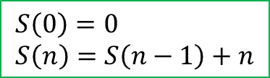

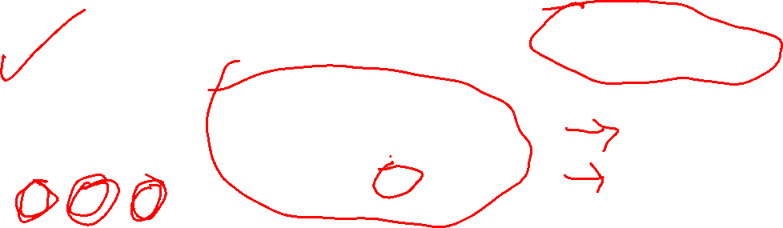
Recursive Functions
What is the sum of the numbers from 1 to n?
1+ 2 + 3 + … + (n-1) + n
$$S\left(0\right)=0 \\ S\left(n\right)=S\left(n−1\right)+n$$
$$S\left(n\right)=\frac{n(n+1)}{2}=\frac{1}{2}n^{2}+\frac{1}{2}n$$
def S(n):
total = 0 for i in range(n + 1): total += i return total
def S(n):
if n == 0: return 0 else: return S(n-1) + n
def S(n):
return n * (n + 1) // 2
Formula
Fast
Doesn’t use much memory
Loop
Slow
Doesn’t use much memory
Recursion
Slow
Uses a lot of memory

Slide 75
What’s the pattern?
0, 1, 1, 2, 3, 5, 8, 13, 21, 34, ???, …

Slide 76
Fibonacci Numbers
This sequence of numbers shows up surprisingly often in nature and various applications.
What’s the pattern?
0, 1, 1, 2, 3, 5, 8, 13, 21, 34, 55, …
=21+34

Slide 77
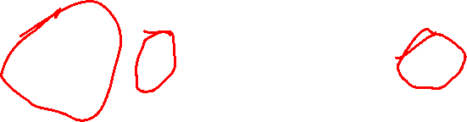
Fibonacci Numbers
What’s the pattern?
0, 1, 1, 2, 3, 5, 8, 13, 21, 34, 55, …
Each of these numbers is the sum of the two immediately before it.

Slide 78
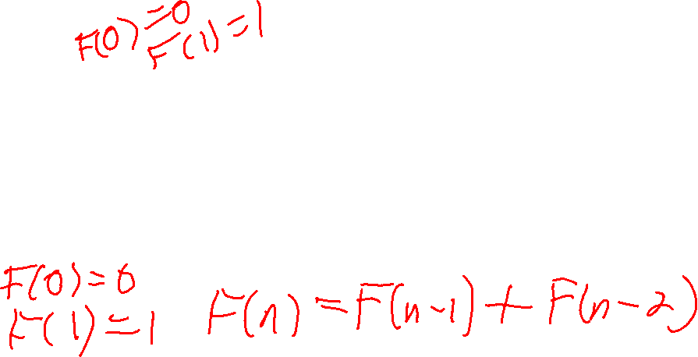
Fibonacci Numbers
What’s the pattern?
0, 1, 1, 2, 3, 5, 8, 13, 21, 34, 55, …
The first two numbers are special: they are set to be 0 and 1.
Each of these numbers is the sum of the two immediately before it.

Slide 79





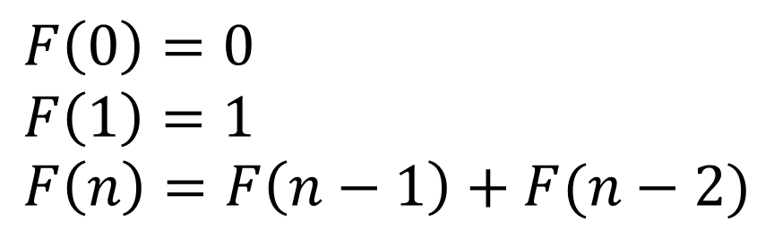






Fibonacci Numbers
What’s the pattern?
$$F(0)$$
$$F(1)$$
$$F(2)$$
$$F(3)$$
$$F(4)$$
$$F(5)$$
$$F(6)$$
$$F(7)$$
$$F(8)$$
$$F(9)$$
$$F(10)$$
0, 1, 1, 2, 3, 5, 8, 13, 21, 34, 55, …
This recurrence relation precisely defines the values of each number in the sequence.
$$F\left(0\right)=0 \\ F\left(1\right)=1 \\ F\left(n\right)=F\left(n−1\right)+F(n−2)$$

Slide 80





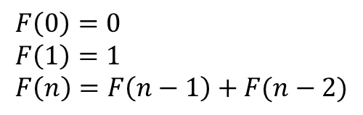







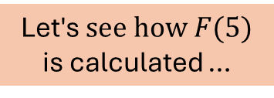
Fibonacci Numbers
$$F(0)$$
$$F(1)$$
$$F(2)$$
$$F(3)$$
$$F(4)$$
$$F(5)$$
$$F(6)$$
$$F(7)$$
$$F(8)$$
$$F(9)$$
$$F(10)$$
0, 1, 1, 2, 3, 5, 8, 13, 21, 34, 55, …
$$F\left(0\right)=0 \\ F\left(1\right)=1 \\ F\left(n\right)=F\left(n−1\right)+F(n−2)$$
Let's$see how F(5)$ is calculated …
$$F(5)$$

Slide 81


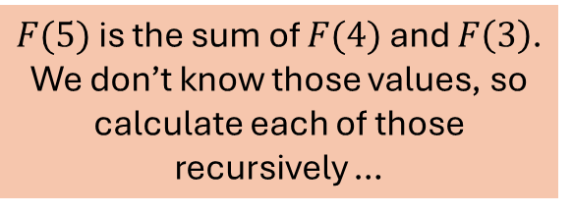
Fibonacci Numbers
$$F(0)$$
$$F(1)$$
$$F(2)$$
$$F(3)$$
$$F(4)$$
$$F(5)$$
$$F(6)$$
$$F(7)$$
$$F(8)$$
$$F(9)$$
$$F(10)$$
0, 1, 1, 2, 3, 5, 8, 13, 21, 34, 55, …
$$F\left(0\right)=0 \\ F\left(1\right)=1 \\ F\left(n\right)=F\left(n−1\right)+F(n−2)$$
$$F(5)$$
$$F(4)$$
$$F(3)$$
$F(5)$ is the sum of $F(4)$ and $F\left(3\right)$. We don’t know those values, so calculate each of those recursively …

Slide 82


Fibonacci Numbers
$$F(0)$$
$$F(1)$$
$$F(2)$$
$$F(3)$$
$$F(4)$$
$$F(5)$$
$$F(6)$$
$$F(7)$$
$$F(8)$$
$$F(9)$$
$$F(10)$$
0, 1, 1, 2, 3, 5, 8, 13, 21, 34, 55, …
$$F\left(0\right)=0 \\ F\left(1\right)=1 \\ F\left(n\right)=F\left(n−1\right)+F(n−2)$$
$$F(5)$$
$$F(4)$$
$$F(3)$$
$$F(3)$$
$$F(2)$$

Slide 83
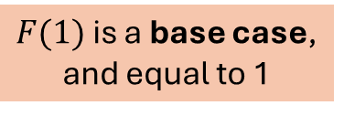


Fibonacci Numbers
$$F(0)$$
$$F(1)$$
$$F(2)$$
$$F(3)$$
$$F(4)$$
$$F(5)$$
$$F(6)$$
$$F(7)$$
$$F(8)$$
$$F(9)$$
$$F(10)$$
0, 1, 1, 2, 3, 5, 8, 13, 21, 34, 55, …
$$F\left(0\right)=0 \\ F\left(1\right)=1 \\ F\left(n\right)=F\left(n−1\right)+F(n−2)$$
$$F(5)$$
$$F(4)$$
$$F(3)$$
$$F(3)$$
$$F(2)$$
$$F(1)$$
$$F(2)$$
$F(1)$ is a base case, and equal to 1

Slide 84

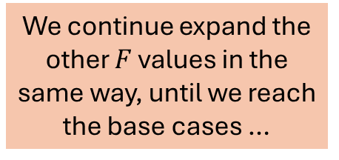
Fibonacci Numbers
$$F(0)$$
$$F(1)$$
$$F(2)$$
$$F(3)$$
$$F(4)$$
$$F(5)$$
$$F(6)$$
$$F(7)$$
$$F(8)$$
$$F(9)$$
$$F(10)$$
0, 1, 1, 2, 3, 5, 8, 13, 21, 34, 55, …
$$F\left(0\right)=0 \\ F\left(1\right)=1 \\ F\left(n\right)=F\left(n−1\right)+F(n−2)$$
$$F(5)$$
$$F(4)$$
$$F(3)$$
$$F(3)$$
$$F(2)$$
$$F(1)$$
We continue expand the other $F$ values in the same way, until we reach the base cases …
$$F(2)$$
$$1$$

Slide 85


Fibonacci Numbers
$$F(0)$$
$$F(1)$$
$$F(2)$$
$$F(3)$$
$$F(4)$$
$$F(5)$$
$$F(6)$$
$$F(7)$$
$$F(8)$$
$$F(9)$$
$$F(10)$$
0, 1, 1, 2, 3, 5, 8, 13, 21, 34, 55, …
$$F\left(0\right)=0 \\ F\left(1\right)=1 \\ F\left(n\right)=F\left(n−1\right)+F(n−2)$$
$$F(5)$$
$$F(4)$$
$$F(3)$$
$$F(3)$$
$$F(2)$$
$$F(1)$$
$$F(2)$$
$$1$$
$$F(2)$$
$$F(1)$$

Slide 86


Fibonacci Numbers
$$F(0)$$
$$F(1)$$
$$F(2)$$
$$F(3)$$
$$F(4)$$
$$F(5)$$
$$F(6)$$
$$F(7)$$
$$F(8)$$
$$F(9)$$
$$F(10)$$
0, 1, 1, 2, 3, 5, 8, 13, 21, 34, 55, …
$$F\left(0\right)=0 \\ F\left(1\right)=1 \\ F\left(n\right)=F\left(n−1\right)+F(n−2)$$
$$F(5)$$
$$F(4)$$
$$F(3)$$
$$F(3)$$
$$F(2)$$
$$F(1)$$
$$F(2)$$
$$1$$
$$F(2)$$
$$F(1)$$
$$F(1)$$
$$F(0)$$

Slide 87


Fibonacci Numbers
$$F(0)$$
$$F(1)$$
$$F(2)$$
$$F(3)$$
$$F(4)$$
$$F(5)$$
$$F(6)$$
$$F(7)$$
$$F(8)$$
$$F(9)$$
$$F(10)$$
0, 1, 1, 2, 3, 5, 8, 13, 21, 34, 55, …
$$F\left(0\right)=0 \\ F\left(1\right)=1 \\ F\left(n\right)=F\left(n−1\right)+F(n−2)$$
$$F(5)$$
$$F(4)$$
$$F(3)$$
$$F(3)$$
$$F(2)$$
$$F(1)$$
$$F(2)$$
$$F(1)$$
$$F(0)$$
$$1$$
$$F(2)$$
$$F(1)$$
$$F(1)$$
$$F(0)$$

Slide 88


Fibonacci Numbers
$$F(0)$$
$$F(1)$$
$$F(2)$$
$$F(3)$$
$$F(4)$$
$$F(5)$$
$$F(6)$$
$$F(7)$$
$$F(8)$$
$$F(9)$$
$$F(10)$$
0, 1, 1, 2, 3, 5, 8, 13, 21, 34, 55, …
$$F\left(0\right)=0 \\ F\left(1\right)=1 \\ F\left(n\right)=F\left(n−1\right)+F(n−2)$$
$$F(5)$$
$$F(4)$$
$$F(3)$$
$$F(3)$$
$$F(2)$$
$$F(1)$$
$$F(2)$$
$$F(1)$$
$$F(0)$$
$$1$$
$$F(2)$$
$$F(1)$$
$$F(1)$$
$$F(0)$$
$$F(1)$$
$$F(0)$$

Slide 89







Fibonacci Numbers
$$F(0)$$
$$F(1)$$
$$F(2)$$
$$F(3)$$
$$F(4)$$
$$F(5)$$
$$F(6)$$
$$F(7)$$
$$F(8)$$
$$F(9)$$
$$F(10)$$
0, 1, 1, 2, 3, 5, 8, 13, 21, 34, 55, …
$$F\left(0\right)=0 \\ F\left(1\right)=1 \\ F\left(n\right)=F\left(n−1\right)+F(n−2)$$
$$F(5)$$
$$F(4)$$
$$F(3)$$
Now all the F values have been expanded, and we can add up the values from the bottom of the tree moving upward …
$$F(2)$$
$$F(1)$$
$$F(3)$$
$$F(2)$$
$$F(1)$$
$$F(0)$$
$$1$$
$$F(2)$$
$$F(1)$$
$$F(1)$$
$$F(0)$$
$$1$$
$$0$$
$$F(1)$$
$$F(0)$$
$$1$$
$$1$$
$$0$$
$$1$$
$$0$$

Slide 90
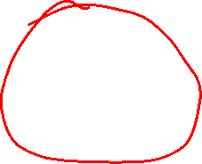


Fibonacci Numbers
$$F(0)$$
$$F(1)$$
$$F(2)$$
$$F(3)$$
$$F(4)$$
$$F(5)$$
$$F(6)$$
$$F(7)$$
$$F(8)$$
$$F(9)$$
$$F(10)$$
0, 1, 1, 2, 3, 5, 8, 13, 21, 34, 55, …
$$F\left(0\right)=0 \\ F\left(1\right)=1 \\ F\left(n\right)=F\left(n−1\right)+F(n−2)$$
$$F(5)$$
$$F(4)$$
$$F(3)$$
Now all the F values have been expanded, and we can add up the values from the bottom of the tree moving upward …
$$F(2)$$
$$F(1)$$
$$F(3)$$
$$F(2)$$
$$F(1)$$
$$F(0)$$
$$1$$
$$F(2)$$
$$F(1)$$
$$F(1)$$
$$F(0)$$
$$1$$
$$0$$
$$1$$
$$0$$
$$1$$
$$1$$
$$0$$
$$1$$
$$0$$

Slide 91

Fibonacci Numbers
$$F(0)$$
$$F(1)$$
$$F(2)$$
$$F(3)$$
$$F(4)$$
$$F(5)$$
$$F(6)$$
$$F(7)$$
$$F(8)$$
$$F(9)$$
$$F(10)$$
0, 1, 1, 2, 3, 5, 8, 13, 21, 34, 55, …
$$F\left(0\right)=0 \\ F\left(1\right)=1 \\ F\left(n\right)=F\left(n−1\right)+F(n−2)$$
$$F(5)$$
$$F(4)$$
$$F(3)$$
Now all the F values have been expanded, and we can add up the values from the bottom of the tree moving upward …
$$F(2)$$
$$F(1)$$
$$F(3)$$
$$F(2)$$
$$F(1)$$
$$F(0)$$
$$1$$
$$1$$
$$F(1)$$
$$F(1)$$
$$F(0)$$
$$1$$
$$0$$
$$1$$
$$0$$
$$1$$
$$1$$
$$0$$
$$1$$
$$0$$

Slide 92
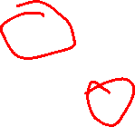

Fibonacci Numbers
$$F(0)$$
$$F(1)$$
$$F(2)$$
$$F(3)$$
$$F(4)$$
$$F(5)$$
$$F(6)$$
$$F(7)$$
$$F(8)$$
$$F(9)$$
$$F(10)$$
0, 1, 1, 2, 3, 5, 8, 13, 21, 34, 55, …
$$F\left(0\right)=0 \\ F\left(1\right)=1 \\ F\left(n\right)=F\left(n−1\right)+F(n−2)$$
$$F(5)$$
$$F(4)$$
$$F(3)$$
Now all the F values have been expanded, and we can add up the values from the bottom of the tree moving upward …
$$F(2)$$
$$F(1)$$
$$F(3)$$
$$F(2)$$
$$F(1)$$
$$F(0)$$
$$1$$
$$1$$
$$1$$
$$F(1)$$
$$F(0)$$
$$1$$
$$0$$
$$1$$
$$0$$
$$1$$
$$1$$
$$0$$
$$1$$
$$0$$

Slide 93

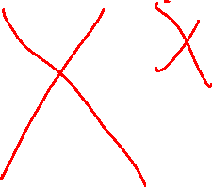
Fibonacci Numbers
$$F(0)$$
$$F(1)$$
$$F(2)$$
$$F(3)$$
$$F(4)$$
$$F(5)$$
$$F(6)$$
$$F(7)$$
$$F(8)$$
$$F(9)$$
$$F(10)$$
0, 1, 1, 2, 3, 5, 8, 13, 21, 34, 55, …
$$F\left(0\right)=0 \\ F\left(1\right)=1 \\ F\left(n\right)=F\left(n−1\right)+F(n−2)$$
$$F(5)$$
$$F(4)$$
$$F(3)$$
Now all the F values have been expanded, and we can add up the values from the bottom of the tree moving upward …
$$F(2)$$
$$F(1)$$
$$2$$
$$F(2)$$
$$F(1)$$
$$F(0)$$
$$1$$
$$1$$
$$1$$
$$F(1)$$
$$F(0)$$
$$1$$
$$0$$
$$1$$
$$0$$
$$1$$
$$1$$
$$0$$
$$1$$
$$0$$

Slide 94


Fibonacci Numbers
$$F(0)$$
$$F(1)$$
$$F(2)$$
$$F(3)$$
$$F(4)$$
$$F(5)$$
$$F(6)$$
$$F(7)$$
$$F(8)$$
$$F(9)$$
$$F(10)$$
0, 1, 1, 2, 3, 5, 8, 13, 21, 34, 55, …
$$F\left(0\right)=0 \\ F\left(1\right)=1 \\ F\left(n\right)=F\left(n−1\right)+F(n−2)$$
$$F(5)$$
$$F(4)$$
$$F(3)$$
Now all the F values have been expanded, and we can add up the values from the bottom of the tree moving upward …
$$F(2)$$
$$F(1)$$
$$2$$
$$F(2)$$
$$F(1)$$
$$F(0)$$
$$1$$
$$1$$
$$1$$
$$1$$
$$0$$
$$1$$
$$0$$
$$1$$
$$0$$
$$1$$
$$1$$
$$0$$
$$1$$
$$0$$

Slide 95

Fibonacci Numbers
$$F(0)$$
$$F(1)$$
$$F(2)$$
$$F(3)$$
$$F(4)$$
$$F(5)$$
$$F(6)$$
$$F(7)$$
$$F(8)$$
$$F(9)$$
$$F(10)$$
0, 1, 1, 2, 3, 5, 8, 13, 21, 34, 55, …
$$F\left(0\right)=0 \\ F\left(1\right)=1 \\ F\left(n\right)=F\left(n−1\right)+F(n−2)$$
$$F(5)$$
$$F(4)$$
$$F(3)$$
Now all the F values have been expanded, and we can add up the values from the bottom of the tree moving upward …
$$F(2)$$
$$F(1)$$
$$2$$
$$1$$
$$F(1)$$
$$F(0)$$
$$1$$
$$1$$
$$1$$
$$1$$
$$0$$
$$1$$
$$0$$
$$1$$
$$0$$
$$1$$
$$1$$
$$0$$
$$1$$
$$0$$

Slide 96

Fibonacci Numbers
$$F(0)$$
$$F(1)$$
$$F(2)$$
$$F(3)$$
$$F(4)$$
$$F(5)$$
$$F(6)$$
$$F(7)$$
$$F(8)$$
$$F(9)$$
$$F(10)$$
0, 1, 1, 2, 3, 5, 8, 13, 21, 34, 55, …
$$F\left(0\right)=0 \\ F\left(1\right)=1 \\ F\left(n\right)=F\left(n−1\right)+F(n−2)$$
$$F(5)$$
$$3$$
$$F(3)$$
Now all the F values have been expanded, and we can add up the values from the bottom of the tree moving upward …
$$F(2)$$
$$F(1)$$
$$2$$
$$1$$
$$F(1)$$
$$F(0)$$
$$1$$
$$1$$
$$1$$
$$1$$
$$0$$
$$1$$
$$0$$
$$1$$
$$0$$
$$1$$
$$1$$
$$0$$
$$1$$
$$0$$

Slide 97
Fibonacci Numbers
$$F(0)$$
$$F(1)$$
$$F(2)$$
$$F(3)$$
$$F(4)$$
$$F(5)$$
$$F(6)$$
$$F(7)$$
$$F(8)$$
$$F(9)$$
$$F(10)$$
0, 1, 1, 2, 3, 5, 8, 13, 21, 34, 55, …
Let’s do the right tree all at once to speed save some time drawing …
$$F\left(0\right)=0 \\ F\left(1\right)=1 \\ F\left(n\right)=F\left(n−1\right)+F(n−2)$$
$$F(5)$$
$$3$$
$$F(3)$$
Now all the F values have been expanded, and we can add up the values from the bottom of the tree moving upward …
$$F(2)$$
$$F(1)$$
$$2$$
$$1$$
$$F(1)$$
$$F(0)$$
$$1$$
$$1$$
$$1$$
$$1$$
$$0$$
$$1$$
$$0$$
$$1$$
$$0$$
$$1$$
$$1$$
$$0$$
$$1$$
$$0$$

Slide 98





Fibonacci Numbers
$$F(0)$$
$$F(1)$$
$$F(2)$$
$$F(3)$$
$$F(4)$$
$$F(5)$$
$$F(6)$$
$$F(7)$$
$$F(8)$$
$$F(9)$$
$$F(10)$$
0, 1, 1, 2, 3, 5, 8, 13, 21, 34, 55, …
Let’s do the right tree all at once to speed save some time drawing …
$$F\left(0\right)=0 \\ F\left(1\right)=1 \\ F\left(n\right)=F\left(n−1\right)+F(n−2)$$
$$F(5)$$
$$3$$
$$2$$
Now all the F values have been expanded, and we can add up the values from the bottom of the tree moving upward …
$$1$$
$$1$$
$$2$$
$$1$$
$$1$$
$$0$$
$$1$$
$$1$$
$$1$$
$$1$$
$$0$$
$$1$$
$$0$$
$$1$$
$$0$$
$$1$$
$$1$$
$$0$$
$$1$$
$$0$$

Slide 99

Fibonacci Numbers
$$F(0)$$
$$F(1)$$
$$F(2)$$
$$F(3)$$
$$F(4)$$
$$F(5)$$
$$F(6)$$
$$F(7)$$
$$F(8)$$
$$F(9)$$
$$F(10)$$
0, 1, 1, 2, 3, 5, 8, 13, 21, 34, 55, …
$$F\left(0\right)=0 \\ F\left(1\right)=1 \\ F\left(n\right)=F\left(n−1\right)+F(n−2)$$
$$5$$
Finally the answer!
$$3$$
$$2$$
Now all the F values have been expanded, and we can add up the values from the bottom of the tree moving upward …
$$1$$
$$1$$
$$2$$
$$1$$
$$1$$
$$0$$
$$1$$
$$1$$
$$1$$
$$1$$
$$0$$
$$1$$
$$0$$
$$1$$
$$0$$
$$1$$
$$1$$
$$0$$
$$1$$
$$0$$

Slide 100
Fibonacci Numbers
$$F(0)$$
$$F(1)$$
$$F(2)$$
$$F(3)$$
$$F(4)$$
$$F(5)$$
$$F(6)$$
$$F(7)$$
$$F(8)$$
$$F(9)$$
$$F(10)$$
0, 1, 1, 2, 3, 5, 8, 13, 21, 34, 55, …
$$F\left(0\right)=0 \\ F\left(1\right)=1 \\ F\left(n\right)=F\left(n−1\right)+F(n−2)$$
$$5$$
$$3$$
$$2$$
As you can see, a lot of the calculations are repeated …
$$1$$
$$1$$
$$2$$
$$1$$
$$1$$
$$0$$
$$1$$
$$1$$
$$1$$
$$1$$
$$0$$
$$1$$
$$0$$
$$1$$
$$0$$
$$1$$
$$1$$
$$0$$
$$1$$
$$0$$
Same!

Slide 101
Fibonacci Numbers
$$F(0)$$
$$F(1)$$
$$F(2)$$
$$F(3)$$
$$F(4)$$
$$F(5)$$
$$F(6)$$
$$F(7)$$
$$F(8)$$
$$F(9)$$
$$F(10)$$
0, 1, 1, 2, 3, 5, 8, 13, 21, 34, 55, …
$$F\left(0\right)=0 \\ F\left(1\right)=1 \\ F\left(n\right)=F\left(n−1\right)+F(n−2)$$
$$5$$
$$3$$
$$2$$
As you can see, a lot of the calculations are repeated …
$$1$$
$$1$$
$$2$$
$$1$$
$$1$$
$$0$$
$$1$$
$$1$$
$$1$$
$$1$$
$$0$$
This slows down the calculation and takes up a lot of memory.
$$1$$
$$0$$
$$1$$
$$0$$
$$1$$
$$1$$
$$0$$
$$1$$
$$0$$
Same!

Slide 102

Fibonacci Numbers
$$F(0)$$
$$F(1)$$
$$F(2)$$
$$F(3)$$
$$F(4)$$
$$F(5)$$
$$F(6)$$
$$F(7)$$
$$F(8)$$
$$F(9)$$
$$F(10)$$
0, 1, 1, 2, 3, 5, 8, 13, 21, 34, 55, …
$$F\left(0\right)=0 \\ F\left(1\right)=1 \\ F\left(n\right)=F\left(n−1\right)+F(n−2)$$
def F(n):
"""Returns the nth Fibonacci number.
"""
if n == 0: # base case 1
return 0
elif n == 1: # base case 2
return 1
else: # recursive case
return F(n - 1) + F(n - 2)
Converting this recurrence relation to Python is relatively easy …

Slide 103
Fibonacci Numbers
$$F(0)$$
$$F(1)$$
$$F(2)$$
$$F(3)$$
$$F(4)$$
$$F(5)$$
$$F(6)$$
$$F(7)$$
$$F(8)$$
$$F(9)$$
$$F(10)$$
0, 1, 1, 2, 3, 5, 8, 13, 21, 34, 55, …
$$F\left(0\right)=0 \\ F\left(1\right)=1 \\ F\left(n\right)=F\left(n−1\right)+F(n−2)$$
def F(n):
"""Returns the nth Fibonacci number.
"""
if n == 0: # base case 1
return 0
elif n == 1: # base case 2
return 1
else: # recursive case
return F(n - 1) + F(n - 2)
Converting this recurrence relation to Python is relatively easy …
But it runs slowly … F(40) takes over 20 seconds to calculate on my computer!

Slide 104
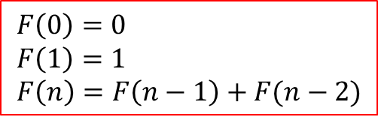
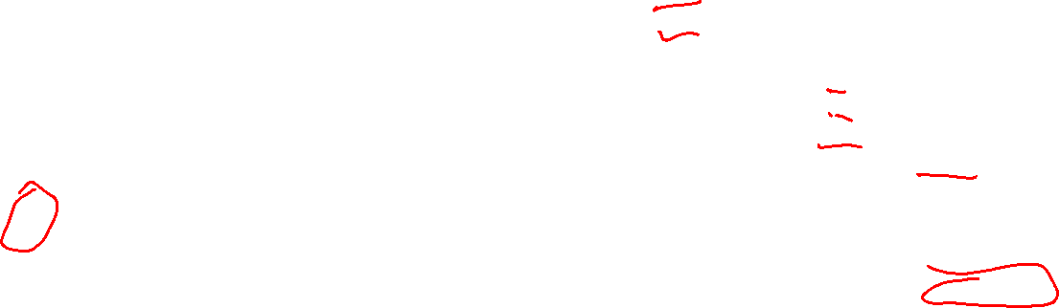
$$F(0)$$
$$F(1)$$
$$F(2)$$
$$F(3)$$
$$F(4)$$
$$F(5)$$
$$F(6)$$
$$F(7)$$
$$F(8)$$
$$F(9)$$
$$F(10)$$
0, 1, 1, 2, 3, 5, 8, 13, 21, 34, 55, …
$$F\left(0\right)=0 \\ F\left(1\right)=1 \\ F\left(n\right)=F\left(n−1\right)+F(n−2)$$
def F(n):
"""Returns the nth Fibonacci number.
"""
if n == 0: # base case 1
return 0
elif n == 1: # base case 2
return 1
else: # recursive case
return F(n - 1) + F(n - 2)
def F_loop(n): """Returns the nth Fibonacci number.
"""
a = 0
b = 1
for i in range(n):
a_old = a
b_old = b
a = b_old
b = a_old + b_old
return a
F(40) takes over 20 seconds to calculate on my computer!
This for-loop version directly sums the previous two numbers.
F_loop(40) on my computer takes 0.00005 seconds to calculate.

