Slide 1
Chapter 8: Strings, Slices, and Writing to Files
CMPT 120, Fall 2024

Slide 2
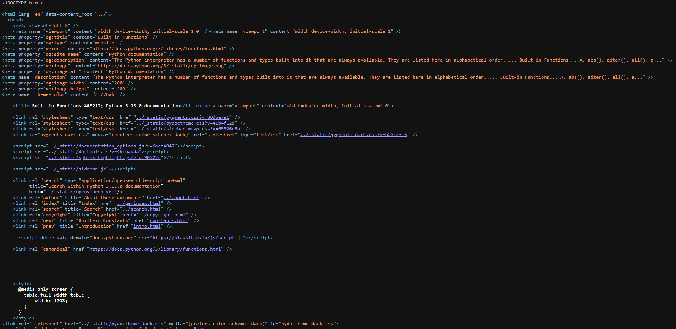

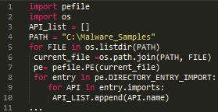
Strings
Web pages are often “big strings” … type ctrl-U on Chrome to see the text of page …
A string is a sequence of 0 or more characters. The order of the characters matters.
Text files can be thought of as strings with names stored on a disk text file …
Python source code is stored as a string …

Slide 3

Unicode is the standard encoding of characters that most of the world’s software uses.
Unicode gives a precise code number to all the worlds letters, punctuation, and symbols.

Slide 4
Strings
'Paper!'
A string is a sequence of 0 or more characters. The order of the characters matters.
"Paper!"
A string literal begins and ends with quote marks, listing each character.
"""Paper!"""
'''Paper!'''

Slide 5
Strings
'Paper!'
A string is a sequence of 0 or more characters. The order of the characters matters.
"Paper!"
A string literal begins and ends with quote marks, listing each character.
"""Paper!"""
The kind of quote marks are the start and end of a string literal must match.
'''Paper!'''

Slide 6
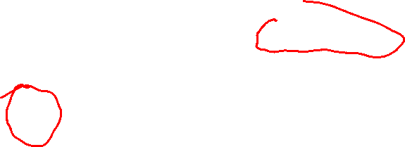
Strings
Careful! Escape characters in a string literal start with a \ and a have a special meaning.
A string is a sequence of 0 or more characters. The order of the characters matters.
'a\nb'
\n is an escape character called newline. It is usually used to represent a new line in a string or file.
\n is treated as one character in the string
A string literal begins and ends with quote marks, listing each character.
Even though it is written as a \ and an n, in a string literal it is represents a single character, a newline.

Slide 7

Strings
Careful! Escape characters in a string literal start with a \ and a have a special meaning.
A string is a sequence of 0 or more characters. The order of the characters matters.
'\t\t\t'
\n represents a newline character
\t represents a tab character \\ represents a \ character \' represents a ' character \" represents a " character
This string consists of three tab characters
A string literal begins and ends with quote marks, listing each character.
Remember: an escape character represents one character in the string, despite being written with two characters.

Slide 8
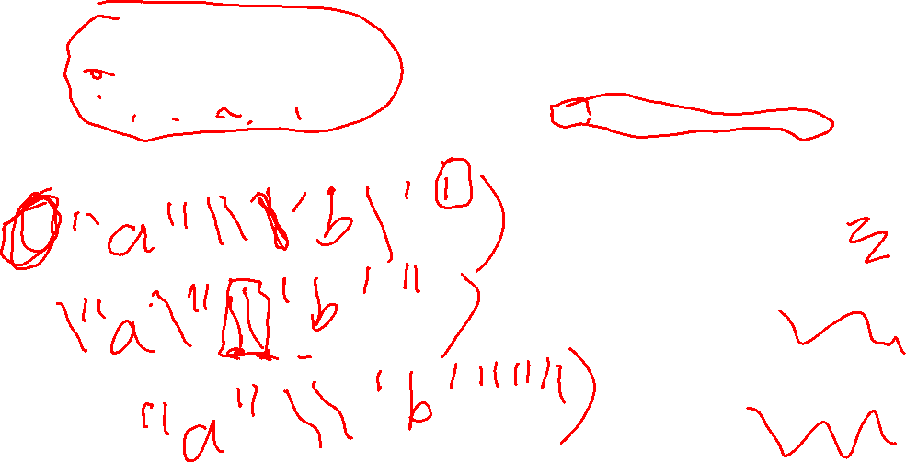
Strings
Careful! Escape characters in a string literal start with a \ and a have a special meaning.
print(???)
What string literal can replace ??? in print so it prints this?
"a"\'b'
\n represents a newline character
\t represents a tab character \\ represents a \ character \' represents a ' character \" represents a " character
print(' ')
print(" ")
print(""" """)

Slide 9
Strings
Careful! Escape characters in a string literal start with a \ and a have a special meaning.
print(???)
What string literal can replace ??? in print so it prints this?
"a"\'b'
\n represents a newline character
\t represents a tab character \\ represents a \ character \' represents a ' character \" represents a " character
print('"a"\\\'b\'')
print("\"a\"\\'b'")
print(""""a"\\'b'""")

Slide 10
Strings
Careful! Escape characters in a string literal start with a \ and a have a special meaning.
print(???)
What string literal can replace ??? in print so it prints this?
"a"\'b'
\n represents a newline character
\t represents a tab character \\ represents a \ character \' represents a ' character \" represents a " character
print('"a"\\\'b\'')
print("\"a\"\\'b'")
print(""""a"\\'b'""")

Slide 11
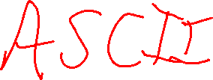
Strings
A string is a sequence of 0 or more characters. The order of the characters matters.
0
1
2
3
4
5
We can represent a string in memory as a sequence of numbered boxes as shown.
P
a
p
e
r
!

Slide 12
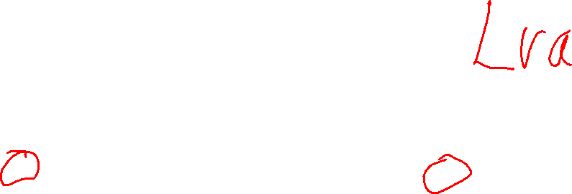
Strings
These are the index values, or indices, of the characters of the string.
A string is a sequence of 0 or more characters. The order of the characters matters.
0
1
2
3
4
5
We can represent a string in memory as a sequence of numbered boxes as shown.
P
a
p
e
r
!

Slide 13
Strings
These are the index values, or indices, of the characters of the string.
A string is a sequence of 0 or more characters. The order of the characters matters.
The last index is always 1 less than the string’s length.
The first index is always 0.
0
1
2
3
4
5
We can represent a string in memory as a sequence of numbered boxes as shown.
P
a
p
e
r
!

Slide 14
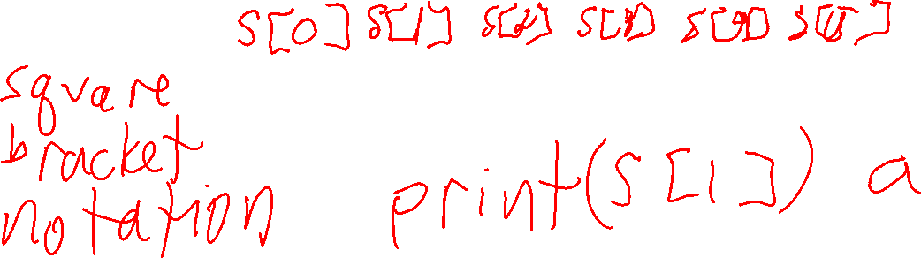
Strings
s = 'Paper!'
A string is a sequence of 0 or more characters. The order of the characters matters.
0
1
2
3
4
5
s
P
a
p
e
r
!

Slide 15
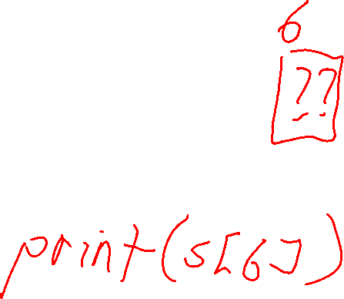
Strings
s = 'Paper!'
A string is a sequence of 0 or more characters. The order of the characters matters.
0
1
2
3
4
5
s
P
a
p
e
r
!
s[0]
s[1]
s[2]
s[3]
s[4]
s[5]

Slide 16
Strings
s = 'Paper!'
A string is a sequence of 0 or more characters. The order of the characters matters.
0
1
2
3
4
5
s
P
a
p
e
r
!
s[0]
s[1]
s[2]
s[3]
s[4]
s[5]
print(s[0]) # P print(s[3]) # e print(s[5]) # !
print(s[6]) # IndexError

Slide 17
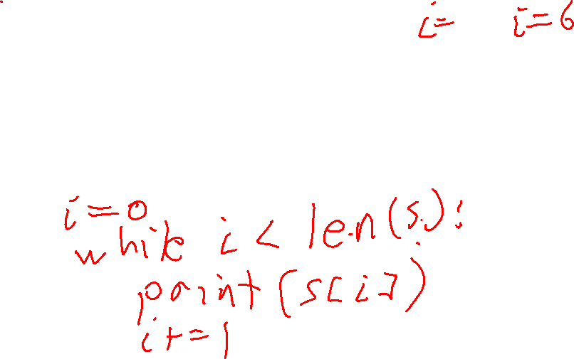
Strings
s = 'Paper!'
A string is a sequence of 0 or more characters. The order of the characters matters.
0
1
2
3
4
5
P
a
p
e
r
!
s
P
a
p
e
r
!
s[0]
s[1]
s[2]
s[3]
s[4]
s[5]
for c in s: print(c)

Slide 18
Strings
s = 'Paper!'
A string is a sequence of 0 or more characters. The order of the characters matters.
0
1
2
3
4
5
P
a
p
e
r
!
s
P
a
p
e
r
!
s[0]
s[1]
s[2]
s[3]
s[4]
s[5]
for c in s: print(c)
i = 0 while i < len(s): print(s[i]) i += 1

Slide 19
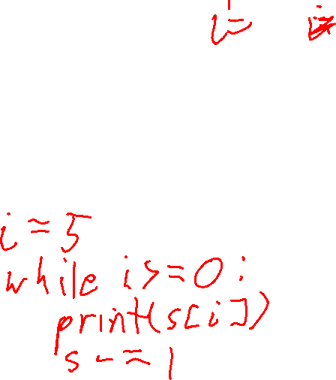
Strings
s = 'Paper!'
A string is a sequence of 0 or more characters. The order of the characters matters.
0
1
2
3
4
5
!
r
e
P
a
P
s
P
a
p
e
r
!
s[0]
s[1]
s[2]
s[3]
s[4]
s[5]
Print letters in reverse using a while loop?

Slide 20

Strings
s = 'Paper!'
A string is a sequence of 0 or more characters. The order of the characters matters.
0
1
2
3
4
5
!
r
e
P
a
P
s
P
a
p
e
r
!
s[0]
s[1]
s[2]
s[3]
s[4]
s[5]
Print letters in reverse using a while loop?
i = len(s) - 1 while i >= 0: print(s[i]) i -= 1

Slide 21
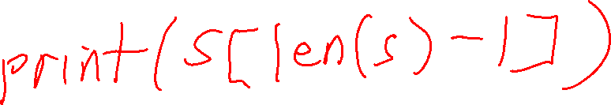
Strings
s = 'Paper!'
A string is a sequence of 0 or more characters. The order of the characters matters.
0
1
2
3
4
5
s
P
a
p
e
r
!
s[0]
s[1]
s[2]
s[3]
s[4]
s[5]
How can you print the last character of string s?
???

Slide 22
Strings
s = 'Paper!'
A string is a sequence of 0 or more characters. The order of the characters matters.
0
1
2
3
4
5
s
P
a
p
e
r
!
s[0]
s[1]
s[2]
s[3]
s[4]
s[5]
How can you print the last character of string s?
print(s[len(s)-1])

Slide 23

Strings
s = 'Paper!'
A string is a sequence of 0 or more characters. The order of the characters matters.
0
1
2
3
4
5
s
P
a
p
e
r
!
s[0]
s[1]
s[2]
s[3]
s[4]
s[5]
How can you print the last character of string s?
This is a lot to write to get the last character! So Python provides another kind of indexing: negative indexing
print(s[len(s)-1])

Slide 24
Strings
s = 'Paper!'
A string is a sequence of 0 or more characters. The order of the characters matters.
-6
-5
-4
-3
-2
-1
0
1
2
3
4
5
s
P
a
p
e
r
!
These are the negative indices of string s. The right-most character is always -1, then it goes down by 1 each character.
s[0]
s[1]
s[2]
s[3]
s[4]
s[5]

Slide 25
Strings
s = 'Paper!'
A string is a sequence of 0 or more characters. The order of the characters matters.
-6
-5
-4
-3
-2
-1
0
1
2
3
4
5
s
P
a
p
e
r
!
These are the negative indices of string s. The right-most character is always -1, then it goes down by 1 each character.
s[0]
s[1]
s[2]
s[3]
s[4]
s[5]
s[-6]
s[-5]
s[-4]
s[-3]
s[2]
s[-1]

Slide 26
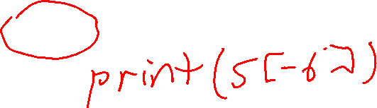
Strings
s = 'Paper!'
A string is a sequence of 0 or more characters. The order of the characters matters.
-6
-5
-4
-3
-2
-1
0
1
2
3
4
5
s
P
a
p
e
r
!
These are the negative indices of string s. The right-most character is always -1, then it goes down by 1 each character.
s[0]
s[1]
s[2]
s[3]
s[4]
s[5]
s[-6]
s[-5]
s[-4]
s[-3]
s[2]
s[-1]
print(s[0]) # P print(s[3]) # e print(s[5]) # !
print(s[6]) # IndexError

Slide 27

Strings
s = 'Paper!'
A string is a sequence of 0 or more characters. The order of the characters matters.
-6
-5
-4
-3
-2
-1
0
1
2
3
4
5
s
P
a
p
e
r
!
These are the negative indices of string s. The right-most character is always -1, then it goes down by 1 each character.
s[0]
s[1]
s[2]
s[3]
s[4]
s[5]
s[-6]
s[-5]
s[-4]
s[-3]
s[2]
s[-1]
print(s[0]) # P print(s[3]) # e print(s[5]) # !
print(s[6]) # IndexError
print(s[-6]) # P print(s[-3]) # e print(s[-1]) # !
print(s[-7]) # IndexError

Slide 28

Strings
s = 'Paper!'
A string is a sequence of 0 or more characters. The order of the characters matters.
-6
-5
-4
-3
-2
-1
0
1
2
3
4
5
s
P
a
p
e
r
!
These are the negative indices of string s. The right-most character is always -1, then it goes down by 1 each character.
s[0]
s[1]
s[2]
s[3]
s[4]
s[5]
s[-6]
s[-5]
s[-4]
s[-3]
s[2]
s[-1]
print(s[len(s) - 1])
print(s[-1])

Slide 29
String Slices
A slice of a string is a subsequence of consecutive characters in a string.
0
1
2
3
4
5
s
P
a
p
e
r
!
s[0]
s[1]
s[2]
s[3]
s[4]
s[5]

Slide 30
String Slices
A slice of a string is a subsequence of consecutive characters in a string.
s[start:end] is the string with the characters: s[start], s[start+1], …, s[end-2], s[end-1]
0
1
2
3
4
5
s
P
a
p
e
r
!
s[0]
s[1]
s[2]
s[3]
s[4]
s[5]

Slide 31
String Slices
s[start:end] is all the characters beginning from s[start] and then up to, but not including, s[end]
A slice of a string is a subsequence of consecutive characters in a string.
s[start:end] is the string with the characters: s[start], s[start+1], …, s[end-2], s[end-1]
0
1
2
3
4
5
s
P
a
p
e
r
!
s[0]
s[1]
s[2]
s[3]
s[4]
s[5]

Slide 32
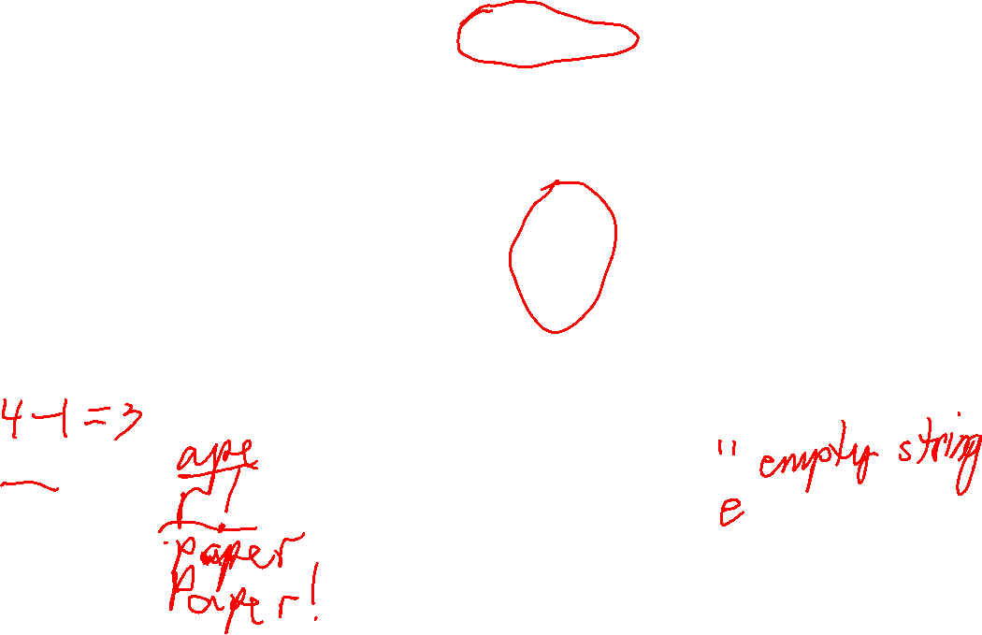
String Slices
s[start:end] is all the characters beginning from s[start] and then up to, but not including, s[end]
A slice of a string is a subsequence of consecutive characters in a string.
s[start:end] is the string with the characters: s[start], s[start+1], …, s[end-2], s[end-1]
0
1
2
3
4
5
s
P
a
p
e
r
!
s[0]
s[1]
s[2]
s[3]
s[4]
s[5]
print(s[1:4]) #
print(s[4:6]) #
print(s[0:5]) #
print(s[0:6]) #
print(s[3:3]) #
print(s[3:4]) #

Slide 33
String Slices
s[start:end] is all the characters beginning from s[start] and then up to, but not including, s[end]
A slice of a string is a subsequence of consecutive characters in a string.
s[start:end] is the string with the characters: s[start], s[start+1], …, s[end-2], s[end-1]
0
1
2
3
4
5
s
P
a
p
e
r
!
s[0]
s[1]
s[2]
s[3]
s[4]
s[5]
print(s[1:4]) # ape
print(s[4:6]) # r!
print(s[0:5]) # Paper
print(s[0:6]) # Paper!
print(s[3:3]) # empty string
print(s[3:4]) # e
Notice that slice s[start:end] has length end – start.

Slide 34
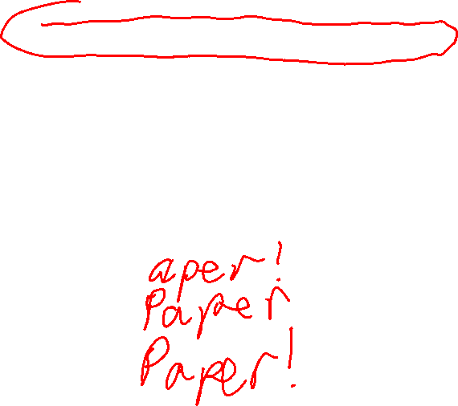
String Slices
s[start:end] is all the characters beginning from s[start] and then up to, but not including, s[end]
A slice of a string is a subsequence of consecutive characters in a string.
s[start:end] is the string with the characters: s[start], s[start+1], …, s[end-2], s[end-1]
0
1
2
3
4
5
s
P
a
p
e
r
!
s[0]
s[1]
s[2]
s[3]
s[4]
s[5]
print(s[1:]) #
print(s[:5]) #
print(s[:]) #

Slide 35

String Slices
s[start:end] is all the characters beginning from s[start] and then up to, but not including, s[end]
A slice of a string is a subsequence of consecutive characters in a string.
s[start:end] is the string with the characters: s[start], s[start+1], …, s[end-2], s[end-1]
0
1
2
3
4
5
s
P
a
p
e
r
!
s[0]
s[1]
s[2]
s[3]
s[4]
s[5]
print(s[1:]) # aper!
print(s[:5]) # Paper
print(s[:]) # Paper!

Slide 36
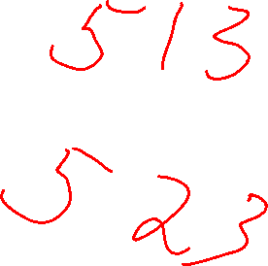
String Immutability
s = 'Paper!'
In Pythion, you cannot add, remove, or change characters of a string. Python strings are immutable.

Slide 37
String Immutability
s = 'Paper!'
print(s[0]) # ok: reading a character or print(len(s)) # getting length doesn’t # change s
In Pythion, you cannot add, remove, or change characters of a string. Python strings are immutable.

Slide 38
String Immutability
s = 'Paper!'
print(s[0]) # ok: reading a character or print(len(s)) # getting length doesn’t # change s
s[0] = 'c' # TypeError: can’t change a # a string
In Pythion, you cannot add, remove, or change characters of a string. Python strings are immutable.

Slide 39

String Immutability
s = 'Paper!'
print(s[0]) # ok: reading a character or print(len(s)) # getting length doesn’t # change s
s[0] = 'c' # TypeError: can’t change a # a string
In Pythion, you cannot add, remove, or change characters of a string. Python strings are immutable.
s
Assignments and slices are fast and cheap with immutable strings …
s = 'Paper!' t = s
Paper!
t
s and t can both safely refer to the same underlying string.

Slide 40
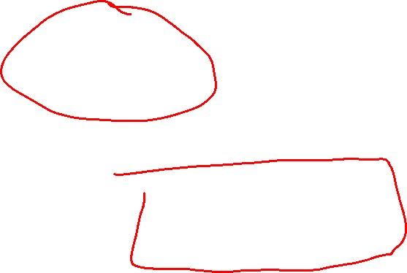
String Immutability
s = 'Paper!'
print(s[0]) # ok: reading a character or print(len(s)) # getting length doesn’t # change s
s[0] = 'c' # TypeError: can’t change a # a string
In Pythion, you cannot add, remove, or change characters of a string. Python strings are immutable.
Assignments and slices are fast and cheap with immutable strings …
s
s = 'Paper!' t = s[1:4] # ape
Paper!
t
No need to copy the characters to make a slice!

Slide 41
String Immutability
s = 'Paper!'
print(s[0]) # ok: reading a character or print(len(s)) # getting length doesn’t # change s
s[0] = 'c' # TypeError: can’t change a # a string
In Pythion, you cannot add, remove, or change characters of a string. Python strings are immutable.
Lines are frequently modified in a text editor, and having to re-copy them for every change would probably be too slow.
On the downside, Python strings would be a bad choice for a text editor…

Slide 42
Comparing Strings
s = 'The big red ?og barked.'
How can you change the ? to a 'd' in s without modifying s?

Slide 43
Comparing Strings
s[12]
s = 'The big red ?og barked.'
How can you change the ? to a 'd' in s without modifying s?

Slide 44
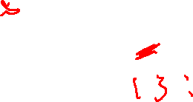
Comparing Strings
s[12]
s = 'The big red ?og barked.'
s[:12]
s[:12]
How can you change the ? to a 'd' in s without modifying s?
Make a new string using slicing and appending.

Slide 45

Comparing Strings
s[12]
s = 'The big red ?og barked.'
s[:12]
s[:12]
How can you change the ? to a 'd' in s without modifying s?
s_fixed = s[:12] + 'd' + s[13:]
'The big red dog barked.'
Make a new string using slicing and appending.

Slide 46
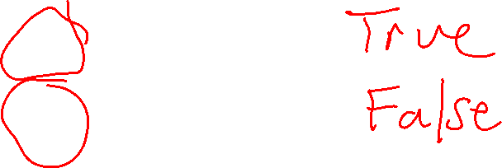
Comparing Strings
'Paper!' == 'Paper!'
'Paper!' != 'Paper!'
Two strings are equal if they have the same characters in the same order.

Slide 47
Comparing Strings
'Paper!' == 'Paper!'
True
'Paper!' != 'Paper!'
False
Two strings are equal if they have the same characters in the same order.

Slide 48
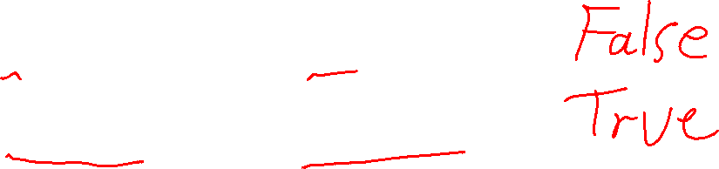
Comparing Strings
'Paper!' == 'Paper!'
True
'Paper!' != 'Paper!'
False
Two strings are equal if they have the same characters in the same order.
'Paper!' == 'paper!'
'Paper!' != 'paper!'

Slide 49
Comparing Strings
'Paper!' == 'Paper!'
True
'Paper!' != 'Paper!'
False
Two strings are equal if they have the same characters in the same order.
'Paper!' == 'paper!'
False
'Paper!' != 'paper!'
True

Slide 50
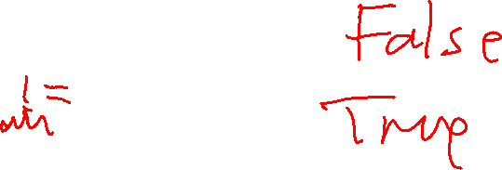
Comparing Strings
'Paper!' == 'Paper!'
True
'Paper!' != 'Paper!'
False
Two strings are equal if they have the same characters in the same order.
'Paper!' == 'paper!'
False
'Paper!' != 'paper!'
True
'Paper!' == 'Paper'
'Paper!' == 'Paper'

Slide 51

Comparing Strings
'Paper!' == 'Paper!'
True
'Paper!' != 'Paper!'
False
Two strings are equal if they have the same characters in the same order.
'Paper!' == 'paper!'
False
'Paper!' != 'paper!'
True
'Paper!' == 'Paper'
False
'Paper!' == 'Paper'
True

Slide 52
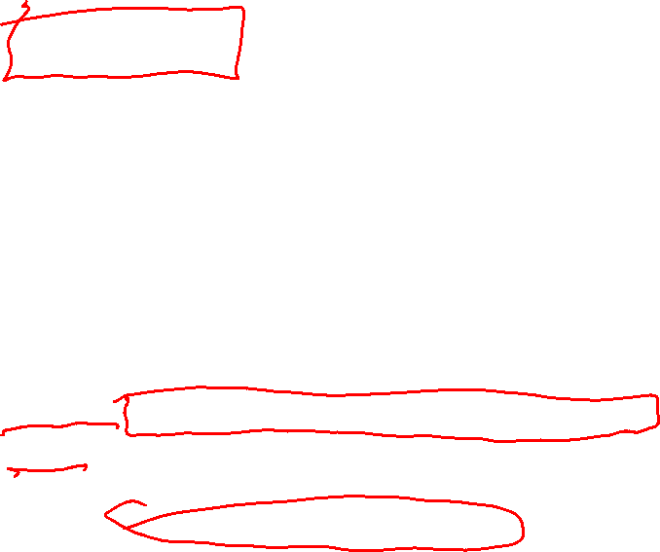
Comparing Strings
def same(s, t): """Returns True if s == t, False otherwise. """
Challenge Write a Boolean function called same(s, t) that returns True if s == t, and False otherwise. Do not use == or != or < etc. except to compare single characters.
???
def test_same():
print('testing same ...')
assert same('hello', 'hello') == True
assert same('hello', 'ello') == False
assert same('hello', 'Hello') == False
assert same('', '') == True
assert same('', 'a') == False
print(' ...all same tests passed')
Use this test function to help write it …

Slide 53
Reversing a String
def reverse(s): """Returns a copy of s reversed. E.g. 'cat' becomes 'tac' """
Challenge Write a function called reverse(s) that returns a copy of string s with its characters in reverse order. Don’t use any built-in Python reversing functions.
???
def test_reverse():
print('testing reverse ...')
assert reverse('') == ''
assert reverse('a') == 'a'
assert reverse('ab') == 'ba'
assert reverse('abc') == 'cba'
assert reverse('hello!') == '!olleh'
assert reverse('racecar') == 'racecar'
print(' ...all reverse tests passed')
Use this test function to help write it …

Slide 54
Checking Palindromes
def is_palindrome(s): """Returns True if s is a
palindrome, False otherwise. """
Challenge Write a Boolean function called is_palindrome(s) that returns True if s is a palindrome, i.e. equal to its reverse, and False otherwise. Don’t use any built-in Python reversing functions.
???
def test_is_palindrome():
print('testing is_palindrome ...')
assert is_palindrome('') == True
assert is_palindrome('a') == True
assert is_palindrome('ab') == False
assert is_palindrome('aa') == True
assert is_palindrome('aaa') == True
assert is_palindrome('racecar') == True
print(' ...all is_palindrome tests passed')
Use this test function to help write it …

