Slide 1
Telecom Churn Predictive ML Model

Slide 2
Customer Churn:-
Loss of customers is called “customer churn”
Indicators of customer churn: lack of activity in the network over a period of time by a prepaid customer
Objective: To trace this lack of activity in future for each active customer and provide a customized strategy to retain them
.Churn prediction is a supervised ML model where the behavior of existing customers can be labelled as churner or non-churner.

Slide 3
Customer Life Cycle:-
New Customer
Active
Customer
Inactive
Customer
Churner

Slide 4
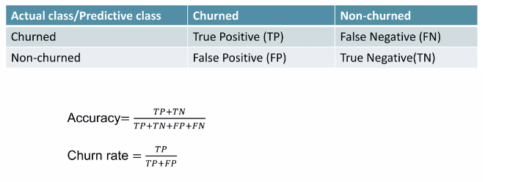

Slide 5
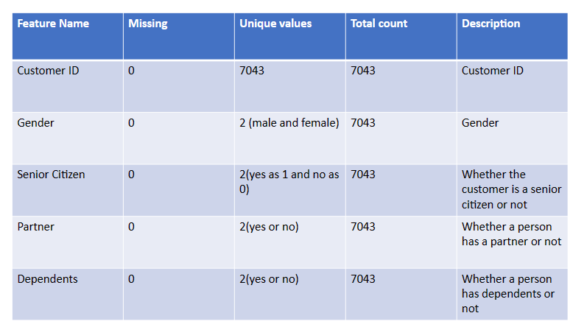

Slide 6
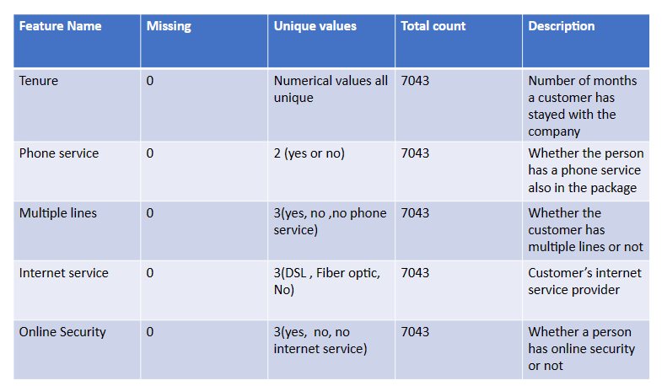

Slide 7
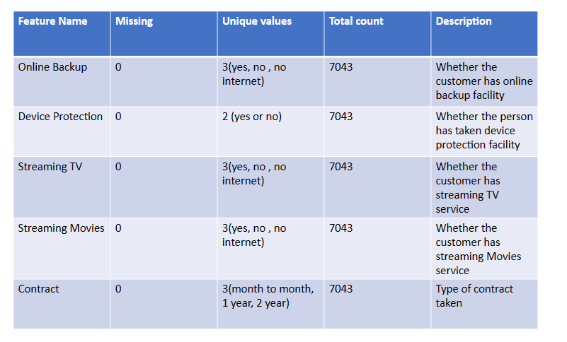

Slide 8
