Slide 1


K.RAMAKRISHNAN COLLEGE OF ENGINEERING
(AUTONOMOUS)
HOUSE PRICE ANALYSIS AND PREDICTION
Presented by,
Name : P Parkavi
Register No. : 8115U23IT066
Roll. No. : ITB2304
Year & Section : III - B
Course Code : ITB1303
Course Name : DATA MINING TECHNIQUES (TCPR)
Date of Review : 15.12.2025

Slide 2
OBJECTIVE
The objective of this project is to design and implement a system that leverages modern computational techniques to enhance accuracy, efficiency, and reliability in data processing and decision-making. The system aims to reduce manual effort, optimize resources, and provide real-time insights for improved performance.

Slide 3
AGENDA
Title
Abstract
Introduction
purpose of the project
scope of the project
significance of the project
Literature survey
Existing System and Proposed solution
Hardware and software require
system design/architecture
modules description
conclusion and Future Enhancement
Reference

Slide 4
INTRODUCTION
With the rapid growth of technology and data, organizations face challenges in handling large volumes of information and transforming them into actionable insights. Traditional systems are often limited by scalability, accuracy, and speed. To address these issues, this project proposes an intelligent architecture that integrates advanced algorithms, modular design, and user-friendly tools.

Slide 5
SCOPE OF THE PROJECT
Collecting and cleaning housing dataset
Identifying key factors that influence house prices
Analyzing data using data mining techniques
Visualizing housing price trends and patterns
Building a machine learning model for house price prediction
Predicting house prices based on selected features

Slide 6
PURPOSE OF THE PROJECT
To analyze how various factors like location, size, and number of rooms influence house prices.
To understand trends and patterns in the real estate market using data mining techniques.
To develop a prediction model that can estimate house prices accurately.
To help buyers, sellers, and developers make better, data-driven decisions.
To provide visualizations and insights that make house price information easy to understand.

Slide 7
SIGNIFICANE OF THE PROJECT
Provides accurate, data-driven insights into the housing market
Helps buyers, sellers, and investors understand property values easily
Analyzes key factors such as location, size, and property features
Identifies trends that influence house price changes
Supports better and informed decision-making
Reduces financial risks in real estate investments
Improves planning for individuals and real estate professionals

Slide 8
LITERATURE SURVEY
S.No | BASE PAPER | MERIT | DEMERIT
1 | DRS: Dynamic Resource Scheduling for Real-Time Analytics over Fast Streams | Ensures efficient real-time data processing with optimized resource usage | Limited performance in highly unpredictable data environments
2 | RT-DAP: Real-Time Data Analytics Platform for Industrial Process Monitoring | Provides real-time monitoring and fast decision support | Mainly suitable for industrial systems; needs customization for other domains
3 | Business Process Optimization using AI and Big Data Analytics | Improves operational efficiency by reducing processing time and resource cost | Requires high-quality data and good technical infrastructure
4 | OCEP: Ontology-based Complex Event Processing Framework | Supports semantic integration and accurate decision making from heterogeneous data | Ontology processing increases system complexity and overhead

Slide 9
EXISTING SYSTEM AND PROPOSED SOLUTION
Existing System The existing system for house price analysis mostly relies on manual methods, traditional property valuation, and basic statistical tools. Buyers and sellers often depend on brokers, personal judgment, or general market trends without accurate data support.
Proposed Solution The proposed solution introduces a data-driven, automated system that uses data mining and machine learning techniques to analyze large housing datasets and predict house prices accurately. The system will collect and clean data, identify key factors influencing prices, and apply predictive models such as regression or decision trees to generate reliable price estimates.

Slide 10
HARDWARE AND SOFTWARE REQUIREMENTS
Hardware Requirements
Computer or laptop with minimum i3 processor (i5 recommended).
At least 20 GB free storage space for project files and datasets.
Stable internet connection to download libraries and datasets.
Software Requirements
Operating system: Windows, macOS, or Linux.
Python latest version installed on the system.
Code editor or IDE like VS Code, PyCharm, or Jupyter Notebook.
Python libraries such as pandas, numpy, matplotlib, seaborn, scikit-learn, plotly.
CSV files or MySQL database if needed for storing data.

Slide 11
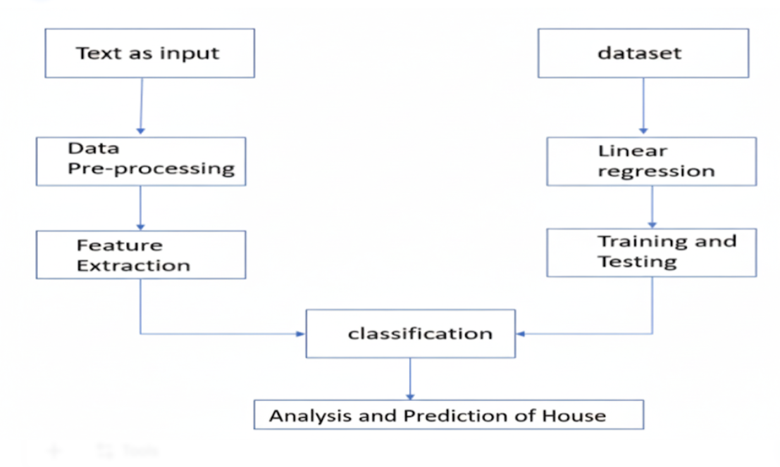
PROPOSED ARCHITECTURE

Slide 12
MODULES INVOLVED
User Authentication Module – Provides secure login and access control.
Data pre processing Module – Handles data collection, cleaning, and organization.
Analytics/Processing Module – Implements algorithms and models for analysis.
Visualization Module – Generates graphs, charts, and dashboards for insights.
Reporting Module – Summarizes results and exports them in different formats.
Administration Module – Manages roles, permissions, and system monitoring.

Slide 13
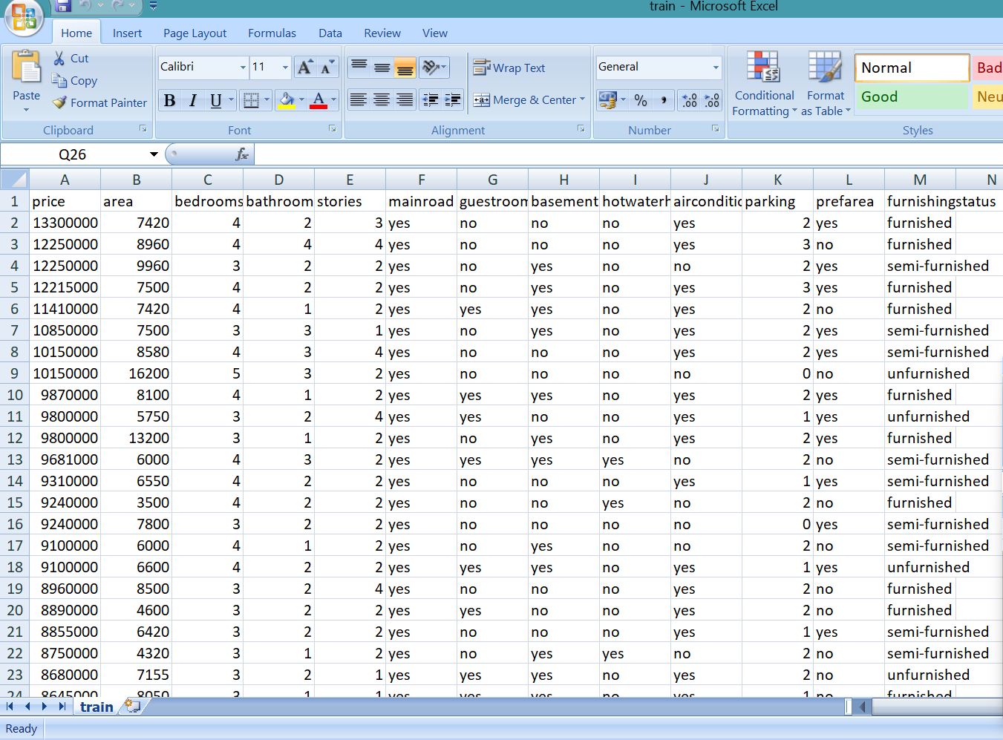
EXPERIMENTAL RESULTS

Slide 14
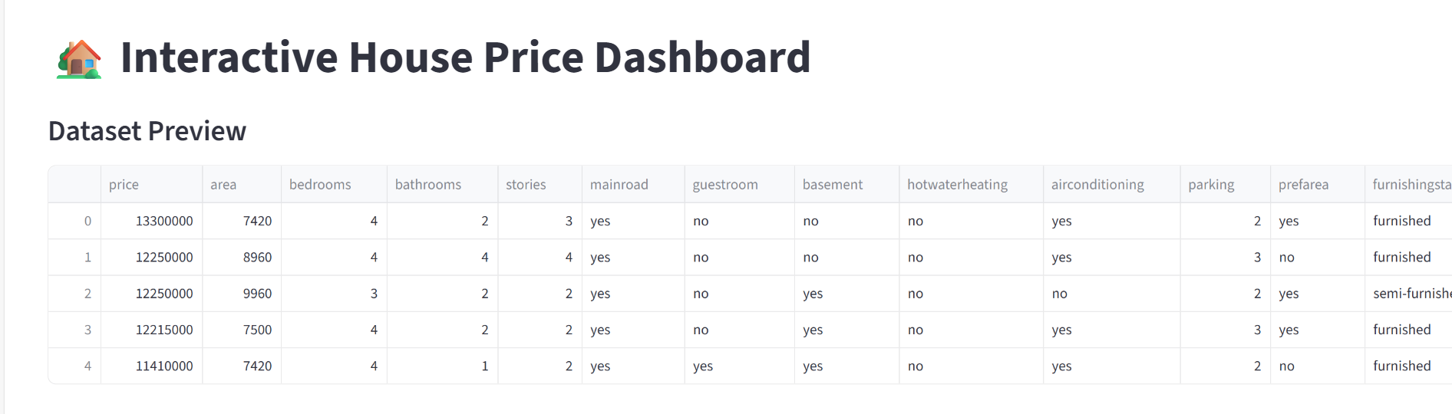
EXPERIMENTAL RESULTS

Slide 15
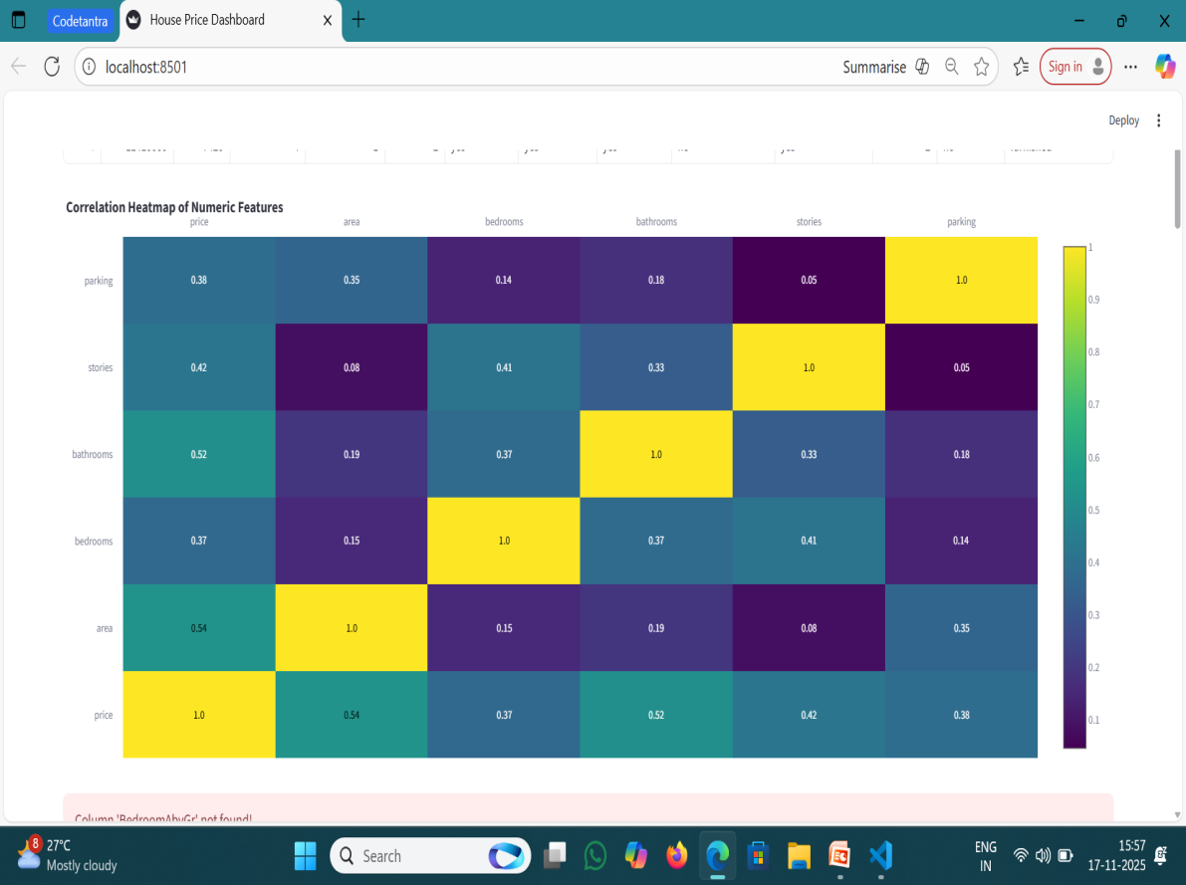
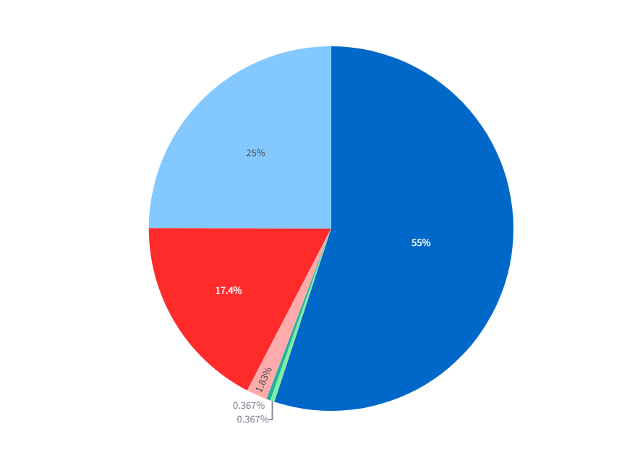
EXPERIMENTAL RESULTS
HEAT MAP(DATASET OF HOUSE)
PIE CHART(BEDROOM DISTRIBUTION)

Slide 16
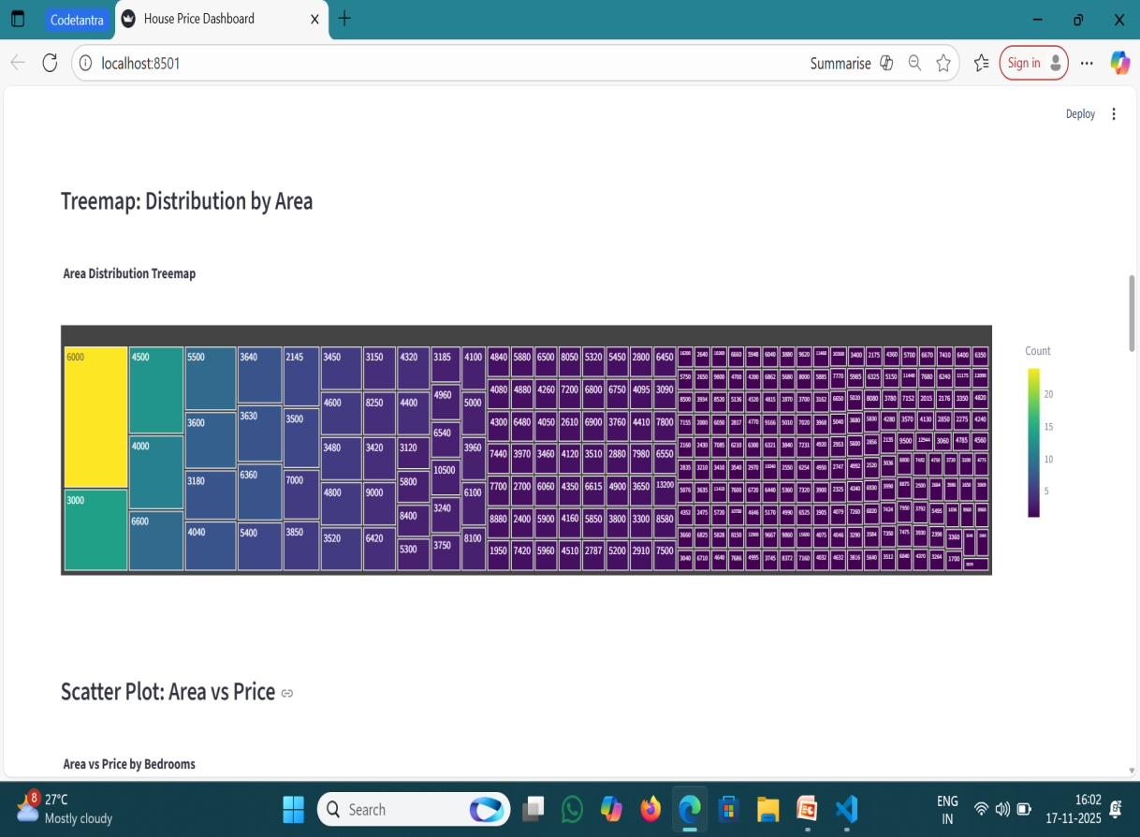
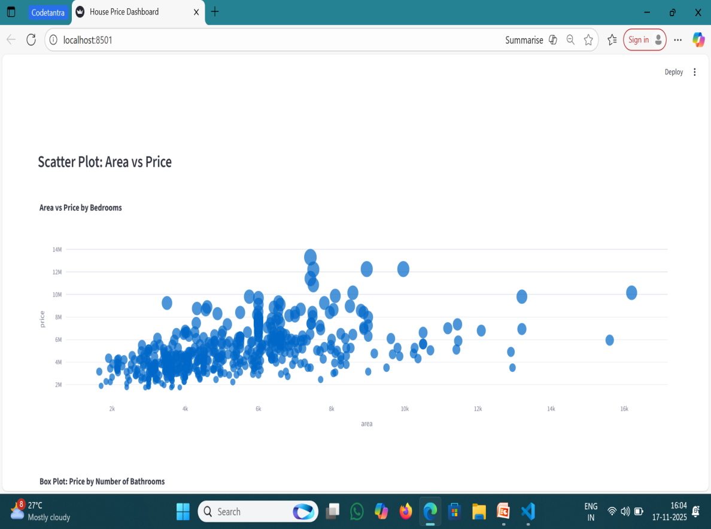
EXPERIMENTAL RESULTS
TREE MAP (AREA DISTRIBUTION) SCATTER PLOT (AREA VS PRICE)

Slide 17
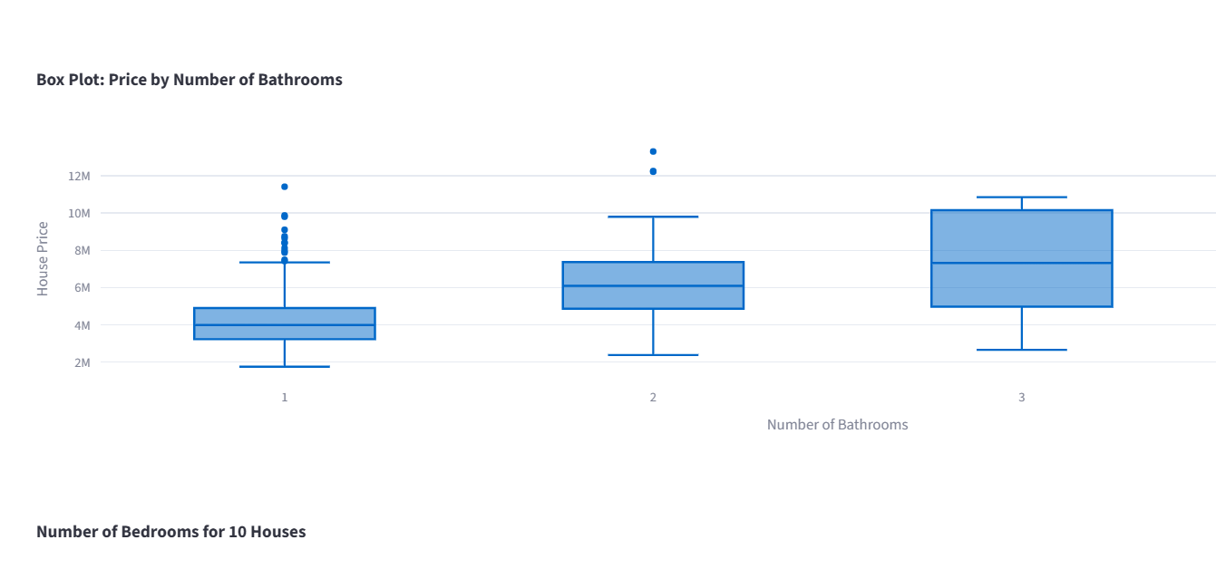
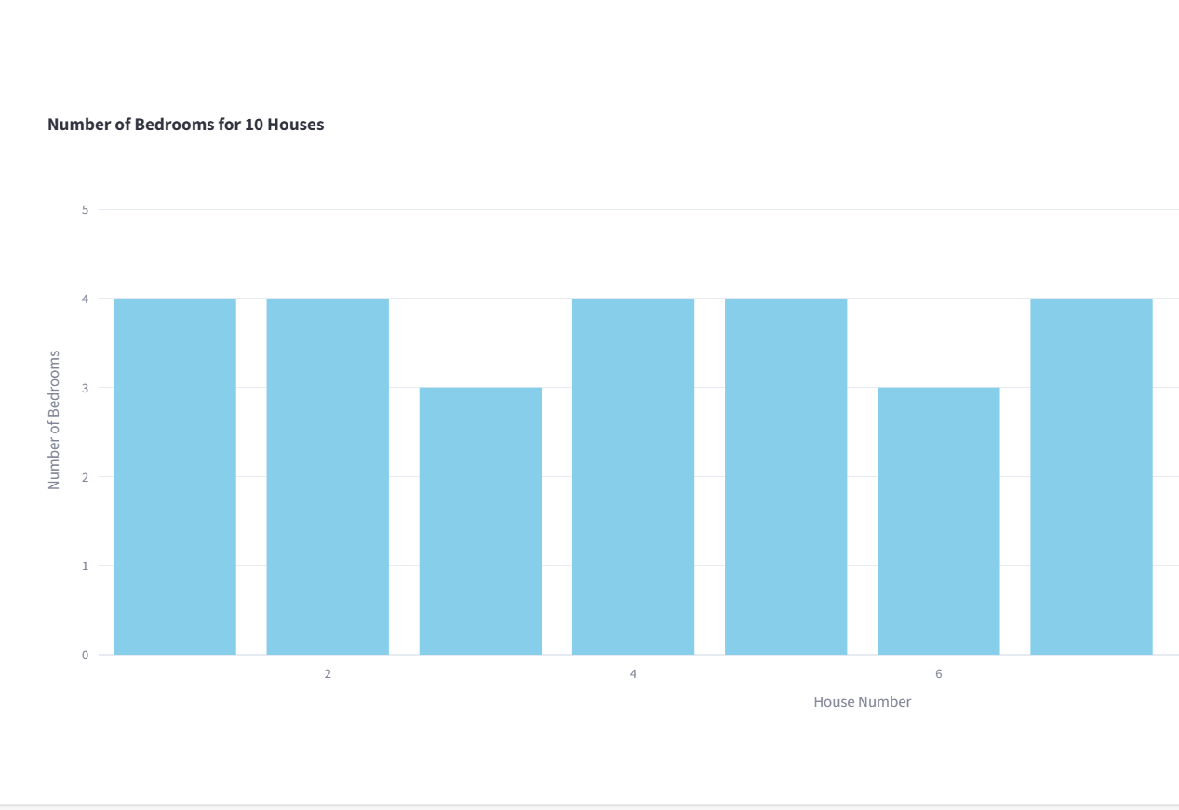
EXPERIMENTAL RESULTS
BOX PLOT (PRICE BY BATHROOMS) BAR CHART (BEDROOMS FOR FIRST 10 HOUSES)

Slide 18
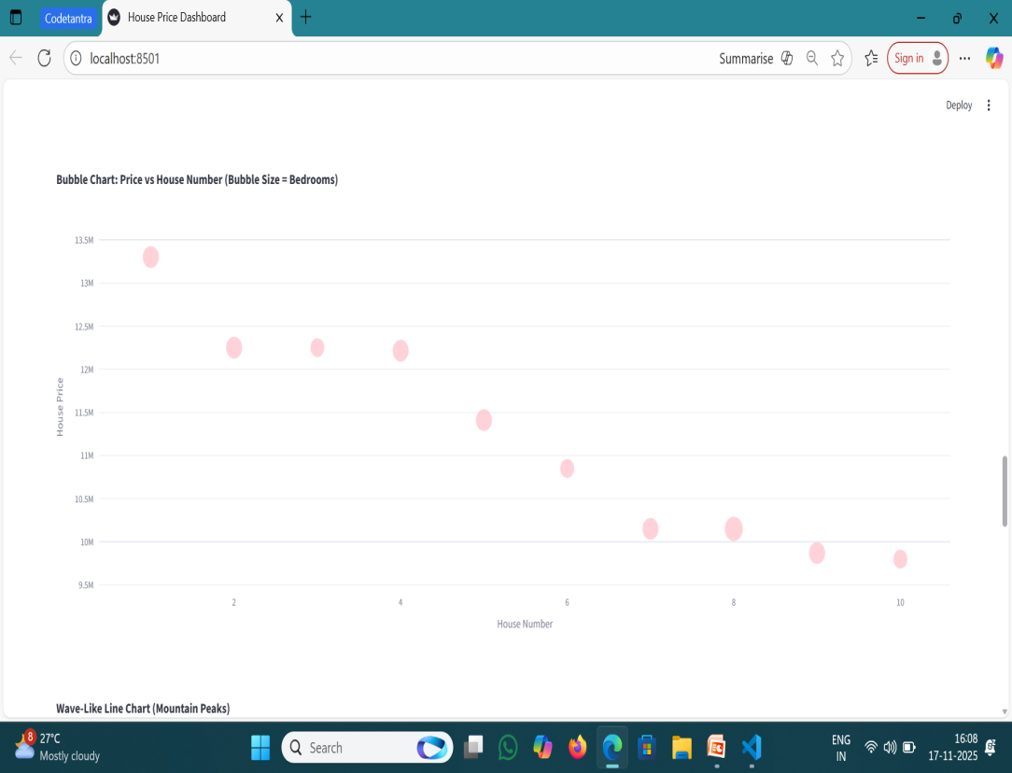
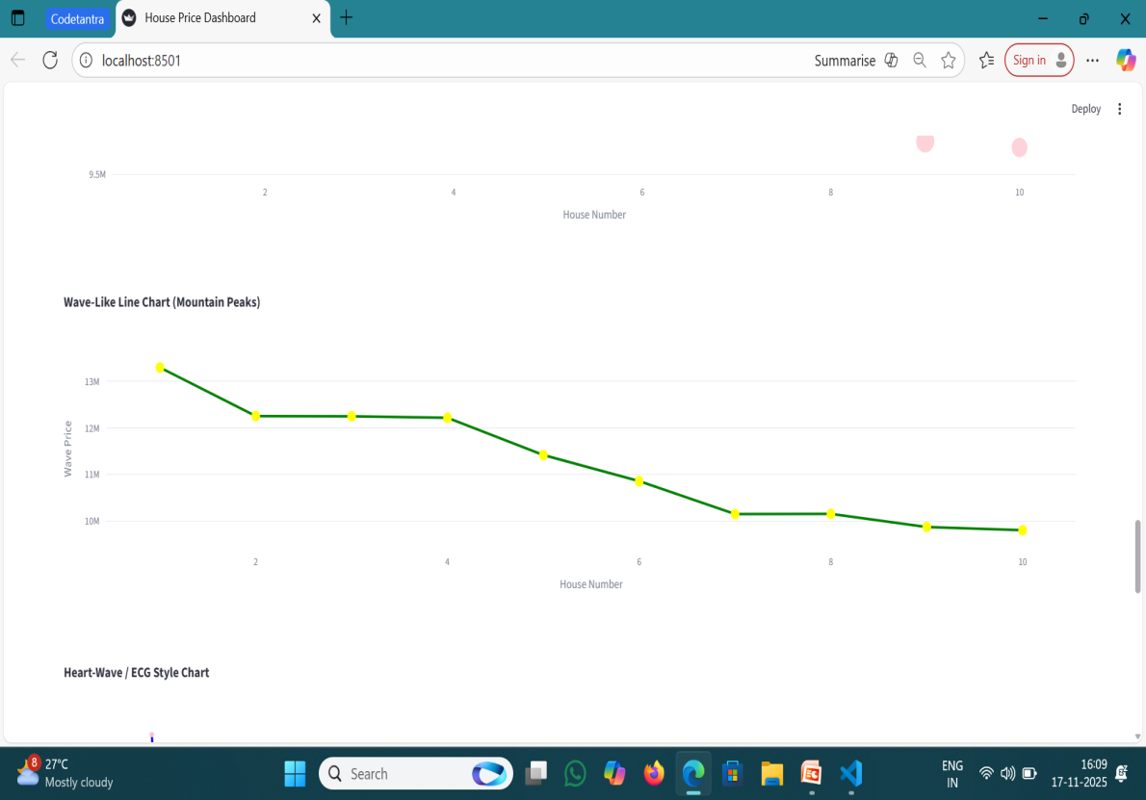
EXPERIMENTAL RESULTS
BUBBLE CHART (PRICE VS HOUSE NUMBER) LINE CHART (WAVE-LIKE LINE CHART)

Slide 19
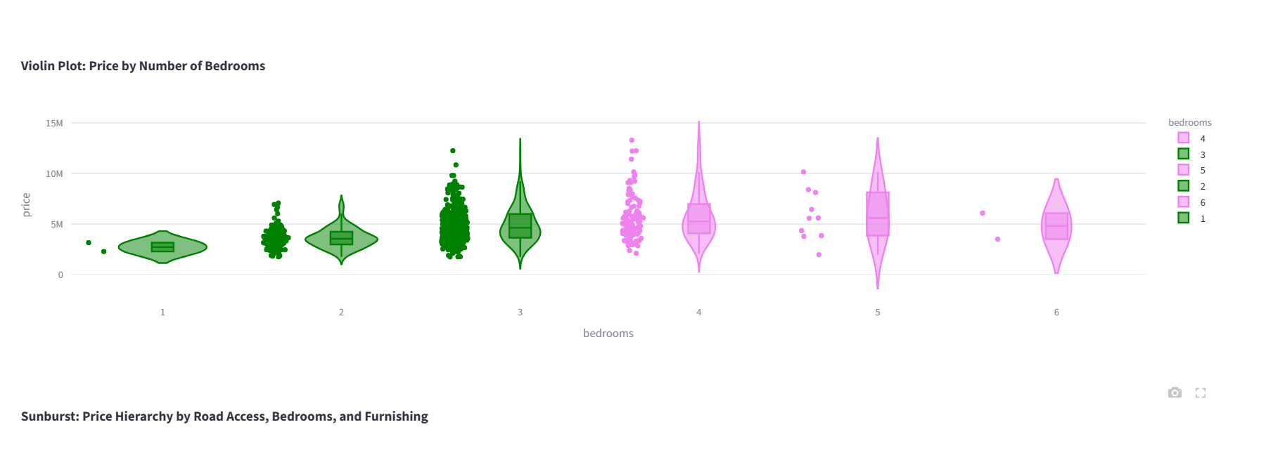
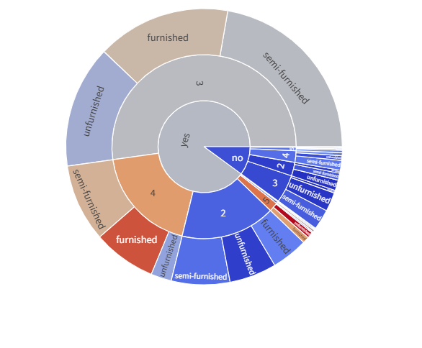
EXPERIMENTAL RESULTS
VIOLIN PLOT(PRICE BY BEDROOMS ) SUNBURST CHART

Slide 20
CONCLUSION AND FUTURE ENHANCEMENT
Here is a simple and clear Conclusion for the project,The House Price ,Analysis and Prediction project successfully demonstrates how data mining and machine learning techniques can be used to understand the factors that influence housing prices and to accurately predict future property values. By analyzing real-world datasets, the project provides meaningful insights into market trends, price variations, and relationships between different housing features.

Slide 21
REFERENCES
Han, J., Pei, J., & Kamber, M. (2011). Data Mining: Concepts and Techniques. Elsevier.
Goodfellow, I., Bengio, Y., & Courville, A. (2016). Deep Learning. MIT Press.
UCI Machine Learning Repository – https://archive.ics.uci.edu
Kaggle Datasets – https://www.kaggle.com/datasets
Official Documentation of Python, TensorFlow, and MySQL.

