Slide 1
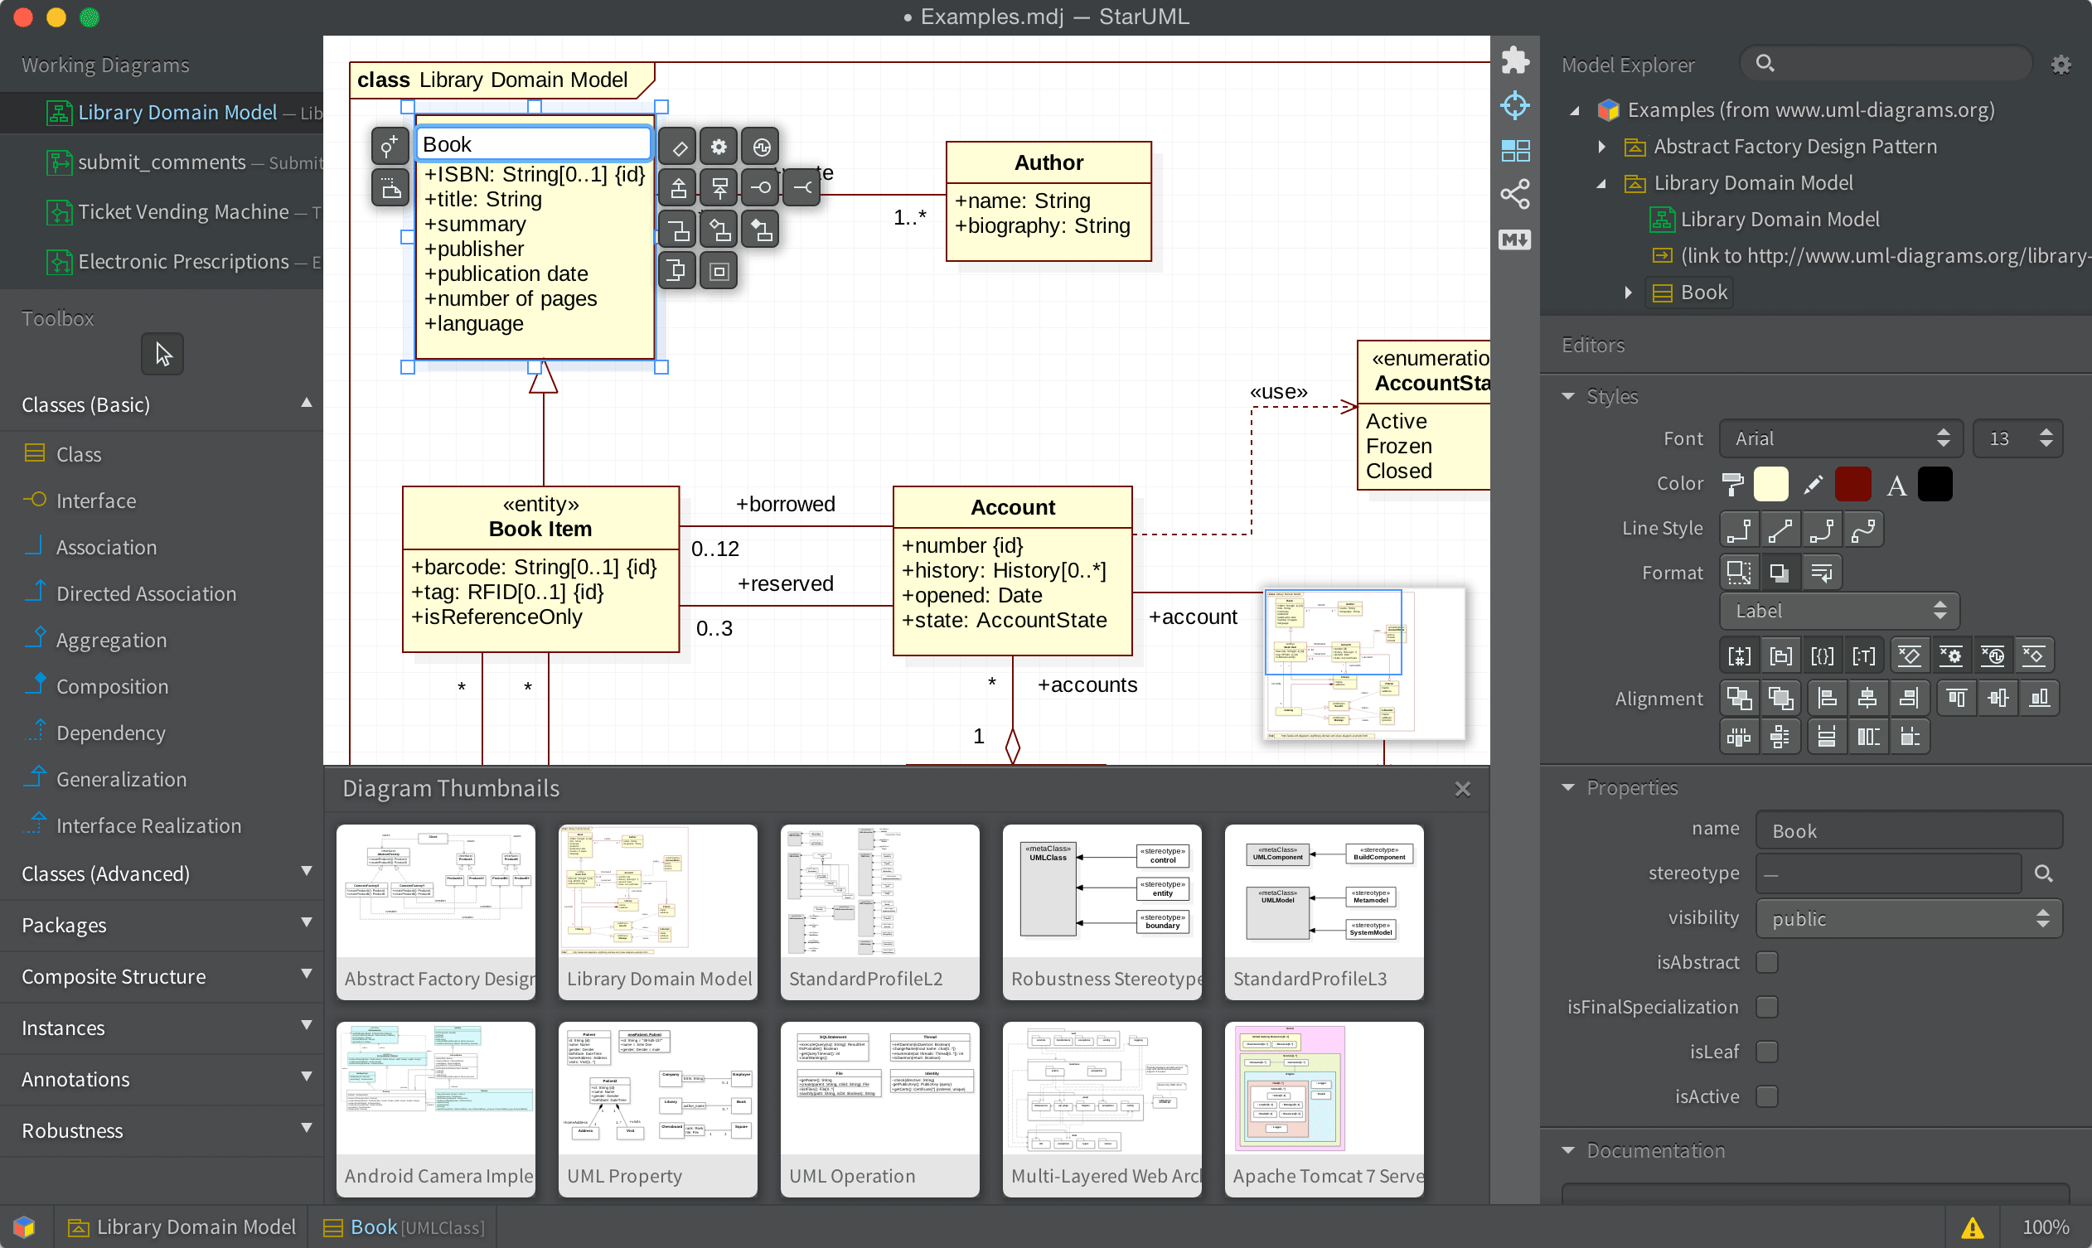
QuickEdit
Diagram Area
Toolbar
Sidebar
Navigator
Working
Diagrams
Model
Explorer
Editors
Holder
Toolbox
Style
Editor
Property
Editor
Documentation
Editor
Statusbar
Bottom Panel

