Slide 1
UNIT-III
PIPELINING AND I/O ORGANISATION

Slide 2
LEARNING OBJECTIVES
Pipelining
  Types of Pipelining
  Major hazard in pipeline execution
  Array and Vector processor
Input-Output Organization
  Peripheral devices
  Input-output interface
  Asynchronous data transfer
  Modes of data transfer
  Priority interrupt
  Direct memory access
  Input-output processor

Slide 3
PIPELINING
  A technique of decomposing a sequential process into sub operations, with each sub process being executed in a partial dedicated segment that operates concurrently with all other segments.

Slide 4
ARITHMETIC PIPELINING
Pipelining
A_{i} * B_{i} + C_{i} for i = 1, 2, 3, ... , 7
A_{i}
B_{i}
Memory
C_{i}
Segment 1
R1
R2
Multiplier
Segment 2
R3
R4
Segment 3
Adder
R5
R1 ← A_{i}, R2 ← B_{i} Load A_{i} and B_{i}
R3 ← R1 * R2, R4 ← C_{i} Multiply and load C_{i}
R5 ← R3 + R4 Add

Slide 5
OPERATIONS IN EACH PIPELINE STAGE
Pipelining
Clock
Pulse Number
Segment 1
Segment 2
Segment 3
  R1 R2 R3 R4 R5
  1 A1 B1
  2 A2 B2 A1 * B1 C1
  3 A3 B3 A2 * B2 C2 A1 * B1 + C1
  4 A4 B4 A3 * B3 C3 A2 * B2 + C2
  5 A5 B5 A4 * B4 C4 A3 * B3 + C3
  6 A6 B6 A5 * B5 C5 A4 * B4 + C4
  7 A7 B7 A6 * B6 C6 A5 * B5 + C5
  8 A7 * B7 C7 A6 * B6 + C6
  9 A7 * B7 + C7

Slide 6
GENERAL PIPELINE
Pipelining
General Structure of a 4-Segment Pipeline
Clock
Input
S
R
S
R
S
R
S
R
1
1
2
2
3
3
4
4
Space-Time Diagram
1
2
3
4
5
6
7
8
9
Clock cycles
Segment
1
T1
T2
T3
T4
T5
T6
2
T1
T2
T3
T4
T5
T6
3
T1
T2
T3
T4
T5
T6
4
T1
T2
T3
T4
T5
T6
Behavior of the pipeline is illustrated with a space time diagram.
Space time diagram:
This shows the segment utilization as a function of time.

Slide 7
Cont….
Space Time diagram
The horizontal axis displays the time in clock cycle and vertical axis gives the segment number
Diagram shows 6 task (T1 to T6)executed in four segment
Task
is defined as the total operation performed going through all the segment in the pipeline

Slide 8
Cont….
Consider
k: segment pipeline with clock cycle time t_{p} to execute n tasks
first task T1 requires a time equal kt_{p} to complete its operation since there are k segments in the pipe .
Remaining n-1 tasks emerge from the pipe at the rate of one task per clock cycle and they will complete after a time equal to (n-1)tp.
Therefore to complete n task using k-segement pipeline requires K+(n-1) clock cycle.
Example 4 segment , 6task time required to complete op. 4+(6-1)=9 clock cycle

Slide 9
Cont…
For nonpipeline unit that perform the same operation and takes a time equal to t_{n} to complete each h task.
The total time required for n tasks =nt_{n}
Speedup of a pipeline processing over an equivalent nonpipeline processing is defined by the ratio
S=nt_{n} / (K+n-1)t_{p}
As the number of tasks increases , n beomes larger the k-1, and k+n-1 approaches the value of n under this condition ,the speedup becomes S=t_{n} /t_{p}
If we assume that the time it takes to process a task is the same in the pipeline and nonpipeline circuit, tn=ktp
Including the assumption speedup reduces to S=Kt_{p}/t_{p}=K
This shows that the theoretical max. speedup that a pipeline can provide is k, where k is the no. of segment in the pipeline

Slide 10
PIPELINE SPEEDUP
Pipelining
  n: Number of tasks to be performed
Conventional Machine (Non-Pipelined)
  t_{n}: Clock cycle
  τ₁: Time required to complete the n tasks
  τ₁ = n * t_{n}
Pipelined Machine (k stages)K- segemnt pipeline
  t_{p}: Clock cycle (time to complete each suboperation)
  τ_{κ}: Time required to complete the n tasks
  τ_{κ} = (k + n - 1) * t_{p}
Speedup
  S_{k}: Speedup
S_{k} = n*t_{n} / (k + n - 1)*t_{p}
t_{n}
lim
S_{k} =
t_{p}
( = k, if t_{n} = k * t_{p} )
n → ∞

Slide 11
PIPELINE AND MULTIPLE FUNCTION UNITS
Pipelining
Example
- 4-stage pipeline
- subopertion in each stage; t_{p} = 20nS
- 100 tasks to be executed
- 1 task in non-pipelined system; 20*4 = 80nS
Pipelined System
(k + n - 1)*t_{p} = (4 + 99) * 20 = 2060nS
Non-Pipelined System
tn= n*k*t_{p} = 100 * 80 = 8000nS
Speedup
S_{k} = 8000 / 2060 = 3.88
4-Stage Pipeline is basically identical to the system with 4 identical function units

Slide 12
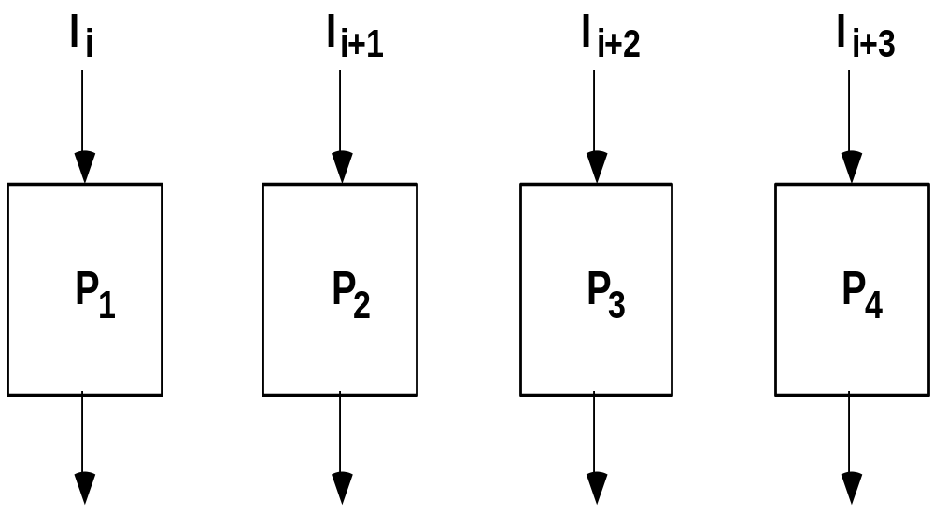
Cont…
Pipelining
Multiple Functional Units

Slide 13
ARITHMETIC PIPELINE
Floating-point adder
Exponents
Mantissas
a
b
A
B
X = A x 2ª
Y = B x 2^{b}
R
R
[1] Compare the exponents
[2] Align the mantissa
[3] Add/sub the mantissa
[4] Normalize the result
Segment 1:
Compare
Difference
exponents
by subtraction
R
Segment 2:
Choose exponent
Align mantissa
R
Segment 3:
Add or subtract
mantissas
R
R
Segment 4:
Adjust
Normalize
exponent
result
R
R

Slide 14
ARITHMETIC PIPELINE
Reasons why pipeline cannot operate at its max theoretical rate
  Different segment take different time to complete their sub operation.
  Clock cycle must be equal to time delay of the segment with the max. propagation time.
  This cause all other segment to waste time while waiting for the next clock pulse
  Moreover it is not always correct to assume that a non pipe circuit has the same delay as that of an equivalent pipeline circuit.
  Many intermediate register not required in single unit, can be constructed using combinational circuit

Slide 15
4-STAGE FLOATING POINT ADDER
Arithmetic Pipeline
p
q
A = a x 2
B = b x 2
p
a
q
b
Stages:
Exponent
Other
Fraction
S1
subtractor
fraction
selector
r = max(p,q)
Fraction with min(p,q)
t = |p - q|
Right shifter
S2
Fraction
adder
r
c
Leading zero
S3
counter
c
Left shifter
r
d
Exponent
S4
adder
s
d
r
s
C = A + B = c x 2 = d x 2
(r = max (p,q), 0.5 ≤ d < 1)

Slide 16
INSTRUCTION CYCLE
Instruction Pipeline
Six Phases* in an Instruction Cycle
[1] Fetch an instruction from memory
[2] Decode the instruction
[3] Calculate the effective address of the operand
[4] Fetch the operands from memory
[5] Execute the operation
[6] Store the result in the proper place
* Some instructions skip some phases
* Effective address calculation can be done in
the part of the decoding phase
* Storage of the operation result into a register
is done automatically in the execution phase
==> 4-Stage Pipeline
[1] FI: Fetch an instruction from memory
[2] DA: Decode the instruction and calculate
the effective address of the operand
[3] FO: Fetch the operand
[4] EX: Execute the operation

Slide 17
INSTRUCTION PIPELINE
Execution of Three Instructions in a 4-Stage Pipeline
Conventional
i
FI
DA
FO
EX
i+1
FI
DA
FO
EX
i+2
FI
DA
FO
EX
Pipelined
i
FI
DA
FO
EX
i+1
FI
DA
FO
EX
i+2
FI
DA
FO
EX

Slide 18
INSTRUCTION EXECUTION IN A 4-STAGE PIPELINE
Instruction Pipeline
Segment1:
Fetch instruction
from memory
Decode instruction
Segment2:
and calculate
effective address
yes
Branch?
no
Segment3:
Fetch operand
from memory
Segment4:
Execute instruction
Interrupt
yes
Interrupt?
handling
no
Update PC
Empty pipe
Step:
1
2
3
4
5
6
7
8
9
10
11
12
13
Instruction
1
FI
DA
FO
EX
2
FI
DA
FO
EX
(Branch)
3
FI
DA
FO
EX
4
FI
FI
DA
FO
EX
5
FI
DA
FO
EX
6
FI
DA
FO
EX
7
FI
DA
FO
EX

Slide 19
Cont…
Instruction Pipeline
Segment1:
Fetch instruction
from memory
Decode instruction
Segment2:
and calculate
effective address
yes
Branch?
no
Segment3:
Fetch operand
from memory
Segment4:
Execute instruction
Interrupt
yes
Interrupt?
handling
no
Update PC
Empty pipe

Slide 20
SPACE TIME DIAGRAM
Step:
1
2
3
4
5
6
7
8
9
10
11
12
13
Instruction
1
FI
DA
FO
EX
2
FI
DA
FO
EX
(Branch)
3
FI
DA
FO
EX
4
FI
FI
DA
FO
EX
5
FI
DA
FO
EX
6
FI
DA
FO
EX
7
FI
DA
FO
EX

Slide 21
MAJOR HAZARDS IN PIPELINED EXECUTION
Instruction Pipeline
  Structural hazards(Resource Conflicts)
  Hardware Resources required by the instructions in simultaneous overlapped execution cannot be met
  Data hazards (Data Dependency Conflicts)
  An instruction scheduled to be executed in the pipeline requires the result of a previous instruction, which is not yet available

Slide 22
Cont…
Instruction Pipeline
  R1 <- B + C
  R1 <- R1 + 1
ADD
DA
B,C
+
Data dependency
INC
DA
bubble
R1
+1
  Control hazards
  Branches and other instructions that change the PC
  make the fetch of the next instruction to be delayed
JMP
ID
PC
+
PC
Branch address dependency
bubble
IF
ID
OF
OE
OS
Hazards in pipelines may make it
necessary to stall the pipeline
Pipeline Interlock:
Detect Hazards Stall until it is cleared

Slide 23
STRUCTURAL HAZARDS
Instruction Pipeline
Structural Hazards
Occur when some resource has not been duplicated enough to allow all combinations of instructions in the pipeline to execute
Example: With one memory-port, a data and an instruction fetch
cannot be initiated in the same clock
i
FI
DA
FO
EX
i+1
FI
DA
FO
EX
i+2
stall
stall
FI
DA
FO
EX
The Pipeline is stalled for a structural hazard
<- Two Loads with one port memory
-> Two-port memory will serve without stall

Slide 24
DATA HAZARDS
Instruction Pipeline
Data Hazards
Occurs when the execution of an instruction depends on the results of a previous instruction
ADD R1, R2, R3
SUB R4, R1, R5
Data hazard can be dealt with either hardware techniques or software technique
Hardware Technique
Interlock
- hardware detects the data dependencies and delays the scheduling
of the dependent instruction by stalling enough clock cycles
Forwarding (bypassing, short-circuiting)
- Accomplished by a data path that routes a value from a source
(usually an ALU) to a user, bypassing a designated register.
- This allows the value to be produced to be used at an earlier stage in the
pipeline than would otherwise be possible
Software Technique
Instruction Scheduling(compiler) for delayed load

Slide 25
FORWARDING HARDWARE
Instruction Pipeline
Example:
ADD R1, R2, R3
SUB R4, R1, R5
3-stage Pipeline
I: Instruction Fetch
A: Decode, Read Registers,
ALU Operations
E: Write the result to the destination register
Register
file
MUX
MUX
Bypass
path
Result
write bus
ALU
R4
ALU result buffer
ADD
I
A
E
SUB
I
A
E
Without Bypassing
SUB
I
A
E
With Bypassing

Slide 26
INSTRUCTION SCHEDULING
Instruction Pipeline
a = b + c;
d = e - f;
Unscheduled code:
Scheduled Code:
LW Rb, b
LW Rc, c
ADD Ra, Rb, Rc
SW a, Ra
LW Re, e
LW Rf, f
SUB Rd, Re, Rf
SW d, Rd
LW Rb, b
LW Rc, c
LW Re, e
ADD Ra, Rb, Rc
LW Rf, f
SW a, Ra
SUB Rd, Re, Rf
SW d, Rd
Delayed Load
A load requiring that the following instruction not use its result

Slide 27
CONTROL HAZARDS
Instruction Pipeline
Branch Instructions
- Branch target address is not known until
the branch instruction is completed
- Stall -> waste of cycle times
Branch
Instruction
FI DA FO EX
Next
Instruction
FI DA FO EX
Target address available
Dealing with Control Hazards
* Prefetch Target Instruction
* Branch Target Buffer
* Loop Buffer
* Branch Prediction
* Delayed Branch

Slide 28
Cont…
Instruction Pipeline
Prefetch Target Instruction
  Fetch instructions in both streams, branch not taken and branch taken
  Both are saved until branch is executed.
  Then, select the right instruction stream and discard the wrong stream
Branch Target Buffer(BTB; Associative Memory)
  Entry: Address of previously executed branches;
  Target instruction and the next few instructions
  When fetching an instruction, search BTB.
  If found, fetch the instruction stream in BTB;
  If not, new stream is fetched and update BTB

Slide 29
CONTROL HAZARDS
Instruction Pipeline
Loop Buffer(High Speed Register file)
  Storage of entire loop that allows to execute a loop
  without accessing memory
Branch Prediction
  Guessing the branch condition, and fetch an instruction
  stream based on the guess. Correct guess eliminates the
  branch penalty
Delayed Branch
  Compiler detects the branch and rearranges the instruction
  sequence by inserting useful instructions that keep the
  pipeline busy in the presence of a branch instruction

Slide 30
RISC PIPELINE
RISC
- Machine with a very fast clock cycle that
executes at the rate of one instruction per cycle
<- Simple Instruction Set
Fixed Length Instruction Format
Register-to-Register Operations
Instruction Cycles of Three-Stage Instruction Pipeline
Data Manipulation Instructions
I: Instruction Fetch
A: Decode, Read Registers, ALU Operations
E: Write a Register
Load and Store Instructions
I: Instruction Fetch
A: Decode, Evaluate Effective Address
E: Register-to-Memory or Memory-to-Register
Program Control Instructions
I: Instruction Fetch
A: Decode, Evaluate Branch Address
E: Write Register(PC)

Slide 31
DELAYED LOAD
RISC Pipeline
  LOAD: R1 ← M[address 1]
  LOAD: R2 ← M[address 2]
  ADD: R3 ← R1 + R2
  STORE: M[address 3] ← R3
Three-segment pipeline timing
Pipeline timing with data conflict
clock cycle 1 2 3 4 5 6
Load R1 I A E
Load R2 I A E
Add R1+R2 I A E
Store R3 I A E
Pipeline timing with delayed load
clock cycle 1 2 3 4 5 6 7
Load R1 I A E
Load R2 I A E
NOP I A E
Add R1+R2 I A E
Store R3 I A E
The data dependency is taken
care by the compiler rather
than the hardware

Slide 32
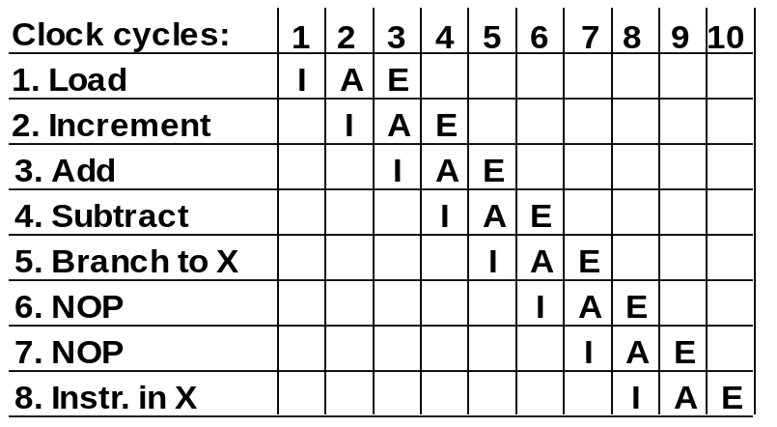
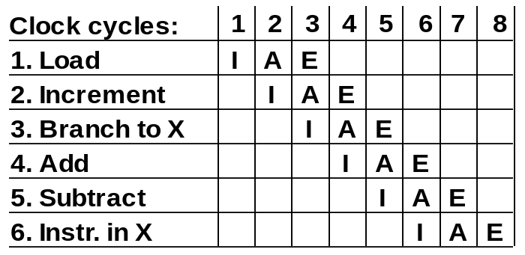
DELAYED BRANCH
RISC Pipeline
Compiler analyzes the instructions before and after
the branch and rearranges the program sequence by
inserting useful instructions in the delay steps
Using no-operation instructions
Rearranging the instructions

Slide 33
VECTOR PROCESSING
Vector Processing
Vector Processing Applications
Problems that can be efficiently formulated in terms of vectors
  Long-range weather forecasting
  Petroleum explorations
  Seismic data analysis
  Medical diagnosis
  Aerodynamics and space flight simulations
  Artificial intelligence and expert systems
  Mapping the human genome
  Image processing
Vector Processor (computer)
Ability to process vectors, and related data structures such as matrices
and multi-dimensional arrays, much faster than conventional computers
Vector Processors may also be pipelined

Slide 34
VECTOR PROGRAMMING
Vector Processing
DO 20 I = 1, 100
20 C(I) = B(I) + A(I)
Conventional computer
Initialize I = 0
20 Read A(I)
Read B(I)
Store C(I) = A(I) + B(I)
Increment I = i + 1
If I ≤ 100 goto 20
Vector computer
C(1:100) = A(1:100) + B(1:100)

Slide 35
VECTOR INSTRUCTIONS
Vector Processing
f1: V ∗ V
f2: V ∗ S
f3: V x V ∗ V
f4: V x S ∗ V
V: Vector operand
S: Scalar operand
Type Mnemonic Description (I = 1, ..., n)
  f1 VSQR Vector square root B(I) ∗ SQR(A(I))
  VSIN Vector sine B(I) ∗ sin(A(I))
  VCOM Vector complement A(I) ∗ A(I)
  f2 VSUM Vector summation S ∗ Σ A(I)
  VMAX Vector maximum S ∗ max{A(I)}
  f3 VADD Vector add C(I) ∗ A(I) + B(I)
  VMPY Vector multiply C(I) ∗ A(I) * B(I)
  VAND Vector AND C(I) ∗ A(I) . B(I)
  VLAR Vector larger C(I) ∗ max(A(I),B(I))
  VTGE Vector test > C(I) ∗ 0 if A(I) < B(I)
  C(I) ∗ 1 if A(I) > B(I)
  f4 SADD Vector-scalar add B(I) ∗ S + A(I)
  SDIV Vector-scalar divide B(I) ∗ A(I) / S

Slide 36
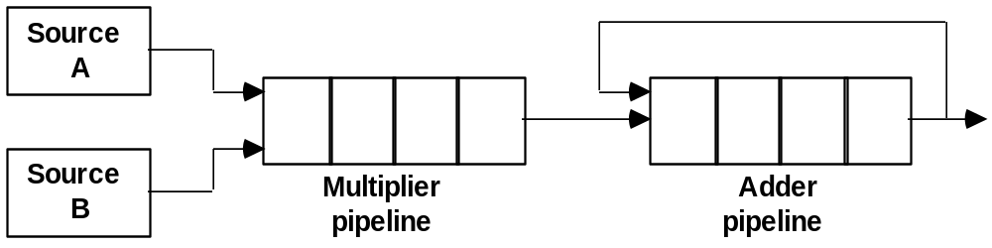
VECTOR INSTRUCTION FORMAT
Vector Processing
Vector Instruction Format
Pipeline for Inner Product

Slide 37
MULTIPLE MEMORY MODULE AND INTERLEAVING
Vector Processing
Multiple Module Memory
Address bus
M0 M1 M2 M3
AR
AR
AR
AR
Memory
Memory
Memory
Memory
array
array
array
array
DR
DR
DR
DR
Data bus
Address Interleaving
Different sets of addresses are assigned to different memory modules

Slide 38
Cont…
Pipeline and vector processing may require simultaneous access to memory from two or more sources
An instruction pipeline may require fetching of an instruction at the same time from two different segment
Similarly arithmetic pipeline may require two or more operand to enter the pipeline at the same time
Instead of using two memory buses for simultaneous access the memory can be partitioned into number of modules connected to common memory add and data buses
A memory module is a memory array with its own address and data registers
AR receives info from the from a common address bus and DR communicate with bi directional data bus
2 least significant bits can be used of the address can be used to distinguish between the 4 module
Modular sys permits one module to initiate a memory access while other in the process of reading and writing a word in each module<number>

Slide 39
Cont…
Advantage of modular memory
It allows the use of a technique called interleaving
In an interleaved memory ,diff sets of address are assigned to diff memory module.
Useful in system with pipeline and vector processing
By staggering the memory access the effective memory cycle time can be reduced
A CPU with instruction pipeline can take advantage of multiple memory module so that each segment in the pipeline can access memory independent of memory access from other segment

Slide 40
ARRAY PROCESSORS
An array processor is a processor that perform computation on large arrays of data.
An attached array processor is an auxiliary processor attached to a general purpose computer.
  It intend to improve the performance of the host computer in specific numeric calculation tasks
A SIMD array processor is a processor that has a single instruction multiple data organization.
  It manipulates vector instruction by means of multiple functional unit responding to a common instruction
Although both type of array processor manipulates vectors their internal organization is different.

Slide 41
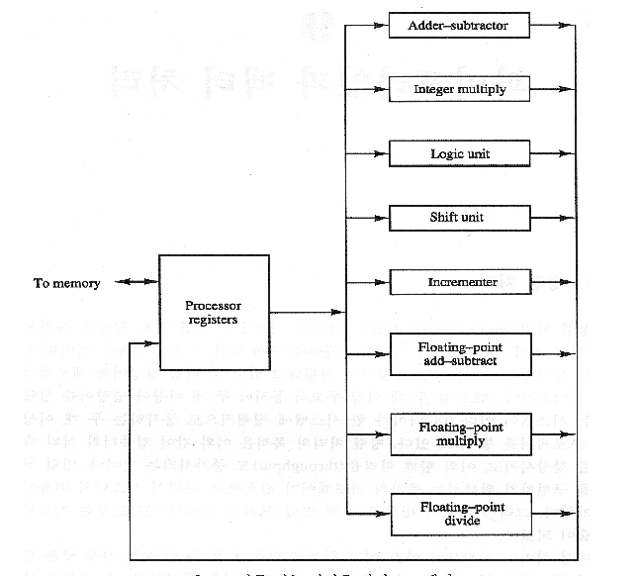
MULTIPLE FUNCTION UNIT
  Multiple Functional Unit:
  Separate the execution unit into eight functional units operating in parallel

Slide 42
CONCLUSIONS
Parallel processing
Pipelining
  Arithmetic
  Instruction
Vector processing
Array Processors

Slide 43
SUMMARY
CPU architecture and instruction set.
Different approach for design of Control Unit
Role of control unit
Instruction formats and types
Addressing Modes
RISC/CISC architecture
Flynn’s classifications
Types of pipelining

Slide 44
LEARNING OBJECTIVES
Input-Output Organization:
  Peripheral devices
  Input-output interface
  Asynchronous data transfer
  Modes of data transfer
  Priority interrupt
  Direct memory access
  Input-output processor

Slide 45
INPUT-OUTPUT ORGANIZATION
Peripheral Devices
Input-Output Interface
Asynchronous Data Transfer
Modes of Transfer
Priority Interrupt
Direct Memory Access
Input-Output Processor
Serial Communication

Slide 46
PERIPHERAL DEVICES
Peripheral Devices
Input Devices
Output Devices
Keyboard
Optical input devices
- Card Reader
- Paper Tape Reader
- Bar code reader
- Digitizer
- Optical Mark Reader
Magnetic Input Devices
- Magnetic Stripe Reader
Screen Input Devices
- Touch Screen
- Light Pen
- Mouse
Analog Input Devices
Card Puncher, Paper Tape Puncher
CRT
Printer (Impact, Ink Jet,
Laser, Dot Matrix)
Plotter
Analog
Voice

Slide 47
INPUT/OUTPUT INTERFACE
Input/Output Interfaces
Provides a method for transferring information between internal storage (such as memory and CPU registers) and external I/O devices
Resolves the differences between the computer and peripheral devices
  Peripherals - Electromechanical Devices
  CPU or Memory - Electronic Device
  Data Transfer Rate
    Peripherals - Usually slower
    CPU or Memory - Usually faster than peripherals
      Some kinds of Synchronization mechanism may be needed
  Unit of Information
    Peripherals – Byte, Block, …
    CPU or Memory – Word
  Data representations may differ

Slide 48
I/O BUS AND INTERFACE MODULES
Input/Output Interfaces
I/O bus
Data
Processor
Address
Control
Interface
Interface
Interface
Interface
Keyboard
Magnetic
Magnetic
and
Printer
disk
tape
display
terminal
Each peripheral has an interface module associated with it
Interface
- Decodes the device address (device code)
- Decodes the commands (operation)
- Provides signals for the peripheral controller
- Synchronizes the data flow and supervises
the transfer rate between peripheral and CPU or Memory
Typical I/O instruction
Op. code
Device address
Function code
(Command)

Slide 49
CONNECTION OF I/O BUS
Input/Output Interfaces
Connection of I/O Bus to CPU
Op.
Device
Function
Accumulator
Computer
code
address
code
register
I/O
control
CPU
Sense lines
Data lines
I/O
bus
Function code lines
Device address lines
Connection of I/O Bus to One Interface
Data lines
Peripheral
register
Device
address
Buffer register
Output
peripheral
I/O
bus
AD = 1101
device
Interface
Logic
and
controller
Function code
Command
decoder
Sense lines
Status
register

Slide 50
I/O BUS AND MEMORY BUS
Input/Output Interfaces
Functions of Buses
MEMORY BUS is for information transfers between CPU and the MM
I/O BUS is for information transfers between CPU and I/O devices through their I/O interface
Physical Organizations
  Many computers use a common single bus system for both memory and I/O interface units
      Use one common bus but separate control lines or each function
      Use one common bus with common control lines for both functions
    Some computer systems use two separate buses, one to communicate with memory and the other with I/O interfaces.

Slide 51
Cont…
Input/Output Interfaces
Functions of Buses
I/O Bus
  Communication between CPU and all interface units is via a common I/O Bus.
  An interface connected to a peripheral device may have a number of data registers , a control register, and a status register.
  A command is passed to the peripheral by sending to the appropriate interface register.
  Function code and sense lines are not needed (Transfer of data, control, and status information is always via the common I/O Bus).

Slide 52
ISOLATED vs MEMORY MAPPED I/O
Input/Output Interfaces
Isolated I/O
- Separate I/O read/write control lines in addition to memory read/write control lines
- Separate (isolated) memory and I/O address spaces
- Distinct input and output instructions
Memory-mapped I/O
  - A single set of read/write control lines
  (no distinction between memory and I/O transfer)
  - Memory and I/O addresses share the common address space
  -> reduces memory address range available
  - No specific input or output instruction
  -> The same memory reference instructions can be used for I/O transfers
  - Considerable flexibility in handling I/O operations

Slide 53
I/O INTERFACE
Input/Output Interfaces
Port A
I/O data
register
Bidirectional
Bus
CPU
data bus
buffers
Port B
I/O data
register
Chip select
I/O
Device
CS
Internal bus
Register select
RS1
Timing
Control
Control
Register select
register
RS0
and
I/O read
Control
RD
Status
Status
I/O write
WR
register
CS RS1 RS0 Register selected
0 x x None - data bus in high-impedence
1 0 0 Port A register
1 0 1 Port B register
1 1 0 Control register
1 1 1 Status register

Slide 54
I/O INTERFACE
Programmable Interface
Information in each port can be assigned a meaning depending on the mode of operation of the I/O device
  → Port A = Data; Port B = Command; Port C = Status
CPU initializes(loads) each port by transferring a byte to the Control Register
→ Allows CPU can define the mode of operation of each port
→ Programmable Port: By changing the bits in the control register, it is possible to change the interface characteristics

Slide 55
ASYNCHRONOUS DATA TRANSFER
Synchronous and Asynchronous Operations
Synchronous - All devices derive the timing information from common clock line
Asynchronous - No common clock
Asynchronous Data Transfer
Asynchronous data transfer between two independent units requires control signals to be transmitted between the communicating units to indicate the time at which data is being transmitted.

Slide 56
ASYNCHRONOUS DATA TRANSFER
Two Asynchronous Data Transfer Methods
Strobe pulse
A strobe pulse is supplied by one unit to indicate the other unit when the transfer has to occur
Handshaking
A control signal is accompanied with each data being transmitted to indicate the presence of data.
The receiving unit responds with another control signal to acknowledge receipt of the data.

Slide 57
STROBE CONTROL
Asynchronous Data Transfer
* Employs a single control line to time each transfer
* The strobe may be activated by either the source or
the destination unit
Source-Initiated Strobe
for Data Transfer
Destination-Initiated Strobe
for Data Transfer
Block Diagram
Block Diagram
Data bus
Source
Data bus
Destination
Source
Destination
unit
unit
unit
Strobe
unit
Strobe
Timing Diagram
Timing Diagram
Valid data
Valid data
Data
Data
Strobe
Strobe

Slide 58
HANDSHAKING
Asynchronous Data Transfer
Strobe Methods
Source-Initiated
The source unit that initiates the transfer has no way of knowing whether the destination unit has actually received data
Destination-Initiated
The destination unit that initiates the transfer no way of knowing whether the source has actually placed the data on the bus
To solve this problem, the HANDSHAKE method introduces a second control signal to provide a Reply to the unit that initiates the transfer

Slide 59
SOURCE-INITIATED TRANSFER USING HANDSHAKE
Asynchronous Data Transfer
Data bus
Block Diagram
Source
Data valid
Destination
unit
Data accepted
unit
Timing Diagram
Data bus
Valid data
Data valid
Data accepted
Sequence of Events
Source unit
Destination unit
Place data on bus.
Enable data valid.
Accept data from bus.
Enable data accepted
Disable data valid.
Invalidate data on bus.
Disable data accepted.
Ready to accept data
(initial state).
* Allows arbitrary delays from one state to the next
* Permits each unit to respond at its own data transfer rate
* The rate of transfer is determined by the slower unit

Slide 60
DESTINATION-INITIATED TRANSFER USING HANDSHAKE
Asynchronous Data Transfer
Data bus
Block Diagram
Source
Data valid
Destination
unit
Ready for data
unit
Timing Diagram
Ready for data
Data valid
Data bus
Valid data
Sequence of Events
Source unit
Destination unit
Ready to accept data.
Place data on bus.
Enable ready for data.
Enable data valid.
Accept data from bus.
Disable data valid.
Disable ready for data.
Invalidate data on bus
(initial state).

Slide 61
Cont…
Asynchronous Data Transfer
Handshaking provides a high degree of flexibility and reliability because the successful completion of a data transfer relies on active participation by both units
If one unit is faulty, data transfer will not be completed
  Can be detected by means of a timeout mechanism

Slide 62
ASYNCHRONOUS SERIAL TRANSFER
Asynchronous Data Transfer
Four Different Types of Transfer
Asynchronous Serial Transfer
Asynchronous serial transfer
Synchronous serial transfer
Asynchronous parallel transfer
Synchronous parallel transfer
- Employs special bits which are inserted at both ends of the character code
- Each character consists of three parts; Start bit; Data bits; Stop bits.
1
1
0
0
0
1
0
1
Start
Character bits
Stop
bit
(1 bit)
bits
(at least 1 bit)

Slide 63
ASYNCHRONOUS SERIAL TRANSFER
Asynchronous Data Transfer
A character can be detected by the receiver from the knowledge of 4 rules;
  When data are not being sent, the line is kept in the 1-state (idle state)
  The initiation of a character transmission is detected by a Start Bit , which is always a 0
  The character bits always follow the Start Bit
  After the last character , a Stop Bit is detected when the line returns to the 1-state for at least 1 bit time
The receiver knows in advance the transfer rate of the bits and the number of information bits to expect

Slide 64
UNIVERSAL ASYNCHRONOUS RECEIVER-TRANSMITTER
Asynchronous Data Transfer
A typical asynchronous communication interface available as an IC
Transmit
Bidirectional
Transmitter
Shift
data
data bus
Bus
register
register
Register select
buffers
Control
Transmitter
Transmitter
register
control
clock
Chip select
and clock
CS
Internal Bus
RS
Timing
Status
Receiver
Receiver
CS RS Oper. Register selected
register
control
clock
I/O read
RD
and
and clock
0 x x None
Control
Receive
I/O write
WR
Receiver
Shift
data
1 0 WR Transmitter register
register
register
1 1 WR Control register
1 0 RD Receiver register
1 1 RD Status register

Slide 65
Cont…
Asynchronous Data Transfer
Transmitter Register
  Accepts a data byte(from CPU) through the data bus
  Transferred to a shift register for serial transmission.
  Receiver
  Receives serial information into another shift register
  Complete data byte is sent to the receiver register
Status Register Bits
  Used for I/O flags and for recording errors
Control Register Bits
  Define baud rate( rate at which serial information is transmitted and is equivalent to the data transfer in bits per second, no. of bits in each character, whether to generate and check parity and no. of stop bits

Slide 66
FIRST-IN-FIRST-OUT(FIFO) BUFFER
Asynchronous Data Transfer
* Input data and output data at two different rates
* Output data are always in the same order in which the data entered the buffer.
* Useful in some applications when data is transferred asynchronously
4 x 4 FIFO Buffer (4 4-bit registers Ri),
4 Control Registers(flip-flops Fi, associated with each Ri)
R1
R2
R3
R4
Data
4-bit
4-bit
4-bit
4-bit
Data
input
register
register
register
register
output
Clock
Clock
Clock
Clock
Insert
S
F
S
F
F
S
S
F
F
S
1
2
3
S
F
4
Output
F'
F
F'
ready
F'
F'
R
R
R
F'
R
R
1
2
3
R
4
Input ready
Delete
Master clear

Slide 67
MODES OF TRANSFER
- PROGRAM-CONTROLLED I/O -
3 different Data Transfer Modes between the central
computer(CPU or Memory) and peripherals;
Program-Controlled I/O
Interrupt-Initiated I/O
Direct Memory Access (DMA)
Program-Controlled I/O(Input Dev to CPU)
Data bus
Interface
I/O bus
Address bus
Data register
Data valid
I/O
CPU
I/O read
device
I/O write
Status
F
Data accepted
register
Read status register
Check flag bit
flag
= 0
Polling or Status Checking
= 1
Continuous CPU involvement
CPU slowed down to I/O speed
Simple
Least hardware
Read data register
Transfer data to memory
no
Operation
complete?
yes
Continue with
program

Slide 68
MODES OF TRANSFER
- INTERRUPT INITIATED I/O & DMA
Interrupt Initiated I/O
  Polling takes valuable CPU time
  Open communication only when some data has to be passed -> Interrupt.
  I/O interface, instead of the CPU, monitors the I/O device
  When the interface determines that the I/O device is ready for data transfer, it generates an Interrupt
  Request to the CPU
    Upon detecting an interrupt, CPU stops momentarily the task it is doing, branches to the service routine to process the data transfer, and then returns to the task it was performing

Slide 69
MODES OF TRANSFER
- INTERRUPT INITIATED I/O & DMA
DMA (Direct Memory Access)
- Large blocks of data transferred at a high speed to
or from high speed devices, magnetic drums, disks, tapes,
etc.
- DMA controller
Interface that provides I/O transfer of data directly
to and from the memory and the I/O device
- CPU initializes the DMA controller by sending a
memory address and the number of words to be
transferred
- Actual transfer of data is done directly between
the device and memory through DMA controller
-> Freeing CPU for other tasks

Slide 70
PRIORITY INTERRUPT
Priority Interrupt
Priority
- Determines which interrupt is to be served first
when two or more requests are made simultaneously
- Also determines which interrupts are permitted to
interrupt the computer while another is being serviced
- Higher priority interrupts can make requests while
servicing a lower priority interrupt

Slide 71
TYPES OF PRIORITY INTERRUPT
Priority Interrupt by Software(Polling)
-Priority is established by the order of polling the devices(interrupt sources)
- Flexible since it is established by software
- Low cost since it needs a very little hardware
- Very slow
Priority Interrupt by Hardware
- Require a priority interrupt manager which accepts
all the interrupt requests to determine the highest priority request
- Fast since identification of the highest priority interrupt request is identified by the hardware
- Fast since each interrupt source has its own interrupt vector to access directly to its own service routine

Slide 72
HARDWARE PRIORITY INTERRUPT
- DAISY-CHAIN -
Processor data bus
VAD 1
VAD 2
VAD 3
* Serial hardware priority function
* Interrupt Request Line
- Single common line
* Interrupt Acknowledge Line
- Daisy-Chain
Device 1
Device 2
Device 3
To next
PI
PO
PI
PO
PI
PO
device
Interrupt request
INT
Interrupt acknowledge
CPU
INTACK
Interrupt Request from any device(>=1)
-> CPU responds by INTACK <- 1
-> Any device receives signal(INTACK) 1 at PI puts the VAD on the bus
Among interrupt requesting devices the only device which is physically closest to CPU gets INTACK=1, and it blocks INTACK to propagate to the next device

Slide 73
Cont…
Priority Interrupt
One stage of the daisy chain priority arrangement
PI RF PO Enable
0 0 0 0
0 1 0 0
1 0 1 0
1 1 1 1
Priority in
Enable
VAD
PI
Vector address
Interrupt
request
from device
RF
Priority out
PO
S
Q
R
Delay
Interrupt request to CPU

Slide 74
PARALLEL PRIORITY INTERRUPT
Interrupt register
Bus
Buffer
Disk
0
I
0
y
Printer
1
I
x
1
Priority
0
Reader
2
I
encoder
2
0
VAD
Keyboard
3
I
0
to CPU
3
0
0
IEN
IST
0
Mask
0
register
1
Enable
2
Interrupt
3
to CPU
INTACK
from CPU

Slide 75
Cont…
Priority Interrupt
IEN: Set or Clear by instructions ION or IOF
IST: Represents an unmasked interrupt has occurred. INTACK: enables tristate Bus Buffer to load VAD generated by the Priority Logic
Interrupt Register:
- Each bit is associated with an Interrupt Request from different Interrupt Source - different priority level
- Each bit can be cleared by a program instruction
Mask Register:
- Mask Register is associated with Interrupt Register
- Each bit can be set or cleared by an Instruction

Slide 76
INTERRUPT PRIORITY ENCODER
Priority Interrupt
Determines the highest priority interrupt when
more than one interrupts take place
Priority Encoder Truth table
Inputs
Outputs
I₀
I₁
I₂
I₃
x y IST
Boolean functions
1 d d d
0 0 1
0 1 d d
0 1 1
0 0 1 d
1 0 1
x = I₀' I₁'
0 0 0 1
1 1 1
y = I₀' I₁ + I₀’ I₂’
0 0 0 0
d d 0
(IST) = I₀ + I₁ + I₂ + I₃

Slide 77
INTERRUPT CYCLE
Priority Interrupt
At the end of each Instruction cycle
- CPU checks IEN and IST
- If IEN • IST = 1, CPU -> Interrupt Cycle
  SP ← SP - 1 Decrement stack pointer
  M[SP] ←  PC Push PC into stack
  INTACK ←  1 Enable interrupt acknowledge
  PC ←  VAD Transfer vector address to PC
  IEN ←  0 Disable further interrupts
  Go To Fetch To execute the first instruction in the interrupt service routine

Slide 78
INTERRUPT SERVICE ROUTINE
Priority Interrupt
address
Memory
I/O service programs
0
JMP DISK
DISK
7
Program to service
1
JMP PTR
magnetic disk
VAD=00000011
3
2
JMP RDR
PTR
Program to service
3
JMP KBD
8
line printer
KBD
interrupt
1
Main program
RDR
749
current instr.
Program to service
750
character reader
KBD
4
Stack
Program to service
11
5
keyboard
2
256
Disk
interrupt
255
256
750
6
9
10
Initial and Final Operations
Each interrupt service routine must have an initial and final set of
operations for controlling the registers in the hardware interrupt system
Initial Sequence
[1] Clear lower level Mask reg. bits
[2] IST <- 0
[3] Save contents of CPU registers
[4] IEN <- 1
[5] Go to Interrupt Service Routine
Final Sequence
[1] IEN <- 0
[2] Restore CPU registers
[3] Clear the bit in the Interrupt Reg
[4] Set lower level Mask reg. bits
[5] Restore return address, IEN <- 1

Slide 79

DIRECT MEMORY ACCESS
Block of data transfer from high speed devices, Drum, Disk, Tape
DMA controller - Interface which allows I/O transfer directly between Memory and Device, freeing CPU for other tasks
CPU initializes DMA Controller by sending memory address and the block size(number of words)
CPU bus signals for DMA transfer
ABUS
Address bus
High-impedence
(disabled)
when BG is
enabled
Bus request
BR
DBUS
Data bus
Bus granted
BG
CPU
RD
Read
WR
Write

Slide 80
Cont…
Block diagram of DMA controller
Address bus
Data bus
Data bus
Address bus
buffers
buffers
DMA select
DS
Address register
Register select
RS
Internal Bus
Read
RD
Word count register
Write
WR
Control
logic
Control register
Bus request
BR
Bus grant
BG
Interrupt
Interrupt
DMA request
DMA acknowledge
to I/O device

Slide 81
DMA I/O OPERATION
Direct Memory Access
Starting an I/O
- CPU executes instruction to
Load Memory Address Register
Load Word Counter
Load Function(Read or Write) to be performed
Issue a GO command
Upon receiving a GO Command DMA performs I/O
operation as follows independently from CPU
Input
[1] Input Device <- R (Read control signal)
[2] Buffer(DMA Controller) <- Input Byte; and
assembles the byte into a word until word is full
[4] M <- memory address, W(Write control signal)
[5] Address Reg <- Address Reg +1; WC(Word Counter) <- WC - 1
[6] If WC = 0, then Interrupt to acknowledge done, else go to [1]
Output
[1] M <- M Address, R
M Address R <- M Address R + 1, WC <- WC - 1
[2] Disassemble the word
[3] Buffer <- One byte; Output Device <- W, for all disassembled bytes
[4] If WC = 0, then Interrupt to acknowledge done, else go to [1]

Slide 82
CYCLE STEALING
Direct Memory Access
While DMA I/O takes place, CPU is also executing instructions DMA Controller and CPU both access Memory -> Memory Access Conflict
Memory Bus Controller
  Coordinating the activities of all devices requesting memory access
  Priority System
Memory accesses by CPU and DMA Controller are interwoven, with the top priority given to DMA Controller -> Cycle Stealing

Slide 83
CYCLE STEALING
Direct Memory Access
Cycle Steal
- CPU is usually much faster than I/O(DMA), thus CPU uses the most of the memory cycles
- DMA Controller steals the memory cycles from CPU
- For those stolen cycles, CPU remains idle
- For those slow CPU, DMA Controller may steal most of the memory cycles which may cause CPU remain idle long time
While DMA I/O takes place, CPU is also executing instructions DMA Controller and CPU both access Memory -> Memory Access Conflict
Memory Bus Controller
- Coordinating the activities of all devices requesting memory access
- Priority System
Memory accesses by CPU and DMA Controller are interwoven, with the top priority given to DMA Controller -> Cycle Stealing

Slide 84
DMA TRANSFER
Direct Memory Access
Interrupt
BG
Random-access
CPU
memory unit (RAM)
BR
RD
WR
Addr
Data
RD
WR
Addr
Data
Read control
Write control
Data bus
Address bus
Address
select
RD
WR
Addr
Data
DS
DMA ack.
RS
DMA
I/O
BR
Controller
Peripheral
device
BG
DMA request
Interrupt

Slide 85
INPUT/OUTPUT PROCESSOR
- CHANNEL -
Channel
- Processor with direct memory access capability that communicates with I/O devices
- Channel accesses memory by cycle stealing
- Channel can execute a Channel Program
- Stored in the main memory
- Consists of Channel Command Word(CCW)
- Each CCW specifies the parameters needed by the channel to control the I/O devices and perform data transfer operations
- CPU initiates the channel by executing an channel I/O class instruction and once initiated, channel operates independently of the CPU
Central
processing
unit (CPU)
Peripheral devices
Memory
Memory Bus
unit
PD
PD
PD
PD
Input-output
processor
I/O bus
(IOP)

Slide 86
CHANNEL / CPU COMMUNICATION
Input/Output Processor
CPU operations
IOP operations
Send instruction
to test IOP.path
Transfer status word
to memory
If status OK, then send
start I/O instruction
to IOP.
Access memory
for IOP program
CPU continues with
another program
Conduct I/O transfers
using DMA;
Prepare status report.
I/O transfer completed;
Interrupt CPU
Request IOP status
Transfer status word
Check status word
to memory location
for correct transfer.
Continue

Slide 87
CONCLUSIONS
Input/Output Processor
Input-Output Organization
Peripheral devices
Input-output interface
Asynchronous data transfer
Modes of data transfer
Priority interrupt
Direct memory access
Input-output processor.

Slide 88
OBJECTIVE QUESTIONS
The status bits are also called ____________
ALU is capable of
a. Performing Calculations b. Monitoring System
c. Controlling Operations d. Storage of Data
In addition of two signed numbers, represented in 2’s complement form generates an overflow if
  a. A.B=0 b. A+B=1
  c. A Ex-or B=0 d. A Ex-or B-1
Addition of to a (1111)₂4 bit binary number ‘A’ results:-
a. Incrementing A b. Addition of (F)_{H}
c. No change d. Decrementing A
How many char per sec can be transmitted over a 1200 baud line in the following (char code 8 bit)
  Sync Serial b. Async –2 stop bit c. Async-1 stop bit

Slide 89
Cont…
Indicate whether the following constitute a control, status, or data transfer commands.
  Skip next instruction if flag is set
  Seek a given record on a magnetic disk
  Check if I/O device is ready
  Move printer paper to beginning of next page
  Read interface status register
A ________ is a group of signals operating common to several hardware units.
Agreement between sending and receiving unit of data item is called Handshaking (T/F)

Slide 90
SHORT QUESTIONS
What is I/O processor and what are its function and advantage? Also discuss how I/O interrupt make more efficient use of CPU
How many characters per seconds can be transmitted over a 1200 baud lines in each of the following modes? (Assume a character code of 8 bits)
  Synchronous serial transmission
  Asynchronous serial transmission with 2 stop bits
  Asynchronous serial transmission with one stop bit
Why I/O interface is required?
Differentiate between the following
  Isolated I/O and memory mapped I/O
  Strobe and handshaking
An information is inserted into a FIFO buffer at a rate of m bytes per seconds. The information is deleted at a rate of n byte per second. The maximum capacity of the buffer is k bytes.
  How long does it take for an empty buffer to fill up when m>n
  How long does it take for an empty buffer to fill up when m<n
  Is the FIFO buffer needed if m=n?

Slide 91
Cont…
The input status bit in an interface is cleared as soon as the input is read. Why is this important?
What is the difference between a subroutine and an interrupt service routine?
Consider a daisy chain arrangement. Assume that after a device generates an interrupt request, it turns off that request as soon as it receives the interrupt acknowledge signal. Is it necessary to disable interrupts in the processor before entering the interrupt service routine? Why?
In most computers, interrupts are not acknowledged until the current machine instruction completes execution. Consider the possibility of suspending operation of the processor in the middle of executing an instruction in order to acknowledge an interrupt. Discuss the difficulties that may rise.
In some computers, the processor responds only to the leading edge of the interrupt-request signal on one of its interrupt lines. What happens if two independent devices are connected to this line? What happens

Slide 92
LONG QUESTIONS
Derive an algorithm for evaluating the square root of a binary fixed point number.
Design a parallel priority interrupt hardware for a system with eight interface sources
What do mean you by RISC pipeline? Specify pipelining configuration for 3 segment pipeline.
Explain four possible hardware schemes that can be used in an instruction pipeline in order to minimize the performance degradation caused by instruction branching
In a seven register bus organization of CPU the propagation delays are given, 30s for multiplexer, 60 ns to perform the add operation in the ALU and 20 ns in the destination decoder, and 10 ns to clock the data into destination register. What is the minimum cycle time that can be used for the clock
In a certain scientific computation it is necessary to perform the arithmetic operation (Ai + Bi)(Ci + Di) with a stream of numbers. Specify a pipeline configuration to carry out this task. List the contents of all the registers in the pipeline for i=1 to 6

Slide 93
Cont…
A data communication link employs the character-controlled protocol with data transparency using DLE characters. The text message that the transmitter sends between STX and ETX is as follows:
DLE STX DLE DLE ETX DLE DLE ETX DLE ETX
What is the binary value of the transparent text data ?
Write short note on any one of the following
    Direct memory access
    I/P processor
Write an interrupt service routine that performs all these required functions:
    Save contents of processor registers.
    Check which flag is set (input/output).
    Service the device whose flag is set.
    Restore contents of processor registers.
    Turn the interrupt facility on.
    Return to the running program.
The input device is serviced only if a special location, MOD, contains all 1's. The output device is serviced only if location MOD contains all 0's

Slide 94
RESEARCH PROBLEM
Interrupts and bus arbitration require means for selecting one of several requests based on their priority. Design a circuit that implements a rotating scheme for four input lines,REQ1 through REQ4.Initially ,REQ1 has the highest and REQ4 has lowest priority. After some lines receives services, it becomes the lowest priority line, and the next line receives highest. For example, after REQ2 has been serviced, the priority order, starting with the highest, becomes REQ3,REQ4, REQ1,REQ2. Your circuit should generate four output grant signals GR1 through GR4, one for each input request line. One of these outputs should be arrested when a pulse is received on a line called DECIDE
The DMA facility allows parallelism between CPU and I/O transfer with a limitation: the CPU cannot use the bus if an I/O transfer is in progress. As an improvement, a designer proposed dual port memory connected on two different buses: one for communication with CPU and the other for I/O transfer .Though this provides full parallelism, the hardware cost/ increases due to additional circuits. Another designer proposed of having I/O memory as a separate module physically present in the I/O controller but logically in the main memory space (equivalent to the video buffer in the CRT controller). What are the merits and demerits of second approach

Slide 95
REFERENCES
Hayes P. John, Computer Architecture and Organisation, McGraw Hill Comp., 1988.
Mano M., Computer System Architecture, Prentice-Hall Inc. 1993.
Patterson, D., Hennessy, J., Computer Architecture - A
Quantitative Approach, second edition, Morgan Kaufmann Publishers, Inc. 1996;
Stallings, William, Computer Organization and Architecture, 5th edition, Prentice Hall International, Inc., 2000.
Tanenbaum, A., Structured Computer Organization, 4th ed., Prentice- Hall Inc. 1999.
Hamacher, Vranesic, Zaky, Computer Organization, 4th ed., McGraw Hill Comp., 1996.

