Slide 1
UNIT-IV
MEMORY ORGANIZATION
&
MULTIPROCESSORS

Slide 2
LEARNING OBJECTIVES
Memory organization
Memory hierarchy
Types of memory
Memory management hardware
Characteristics of multiprocessor
Interconnection Structure
Interprocessor Communication & Synchronization

Slide 3
MEMORY ORGANIZATION
Memory hierarchy
Main memory
Auxiliary memory
Associative memory
Cache memory
  Storage technologies and trends
  Locality of reference
  Caching in the memory hierarchy
Virtual memory
Memory management hardware.

Slide 4
RANDOM-ACCESS MEMORY (RAM)
Key features
  RAM is packaged as a chip.
  Basic storage unit is a cell (one bit per cell).
  Multiple RAM chips form a memory.
Static RAM (SRAM)
  Each cell stores bit with a six-transistor circuit.
  Retains value indefinitely, as long as it is kept powered.
    Relatively insensitive to disturbances such as electrical noise.
  Faster and more expensive than DRAM.

Slide 5
Cont…
Dynamic RAM (DRAM)
  Each cell stores bit with a capacitor and transistor.
  Value must be refreshed every 10-100 ms.
  Sensitive to disturbances.
  Slower and cheaper than SRAM.

Slide 6
SRAM VS DRAM SUMMARY
Tran. Access
per bit time Persist? Sensitive? Cost Applications
SRAM 6 1X Yes No 100x cache memories
DRAM 1 10X No Yes 1X Main memories,
frame buffers

Slide 7
CONVENTIONAL DRAM ORGANIZATION
d x w DRAM:
  dw total bits organized as d supercells of size w bits
16 x 8 DRAM chip
cols
memory
controller
0
1
2
3
2 bits
/
0
addr
1
rows
2
supercell
(2,1)
(to CPU)
3
8 bits
/
data
internal row buffer

Slide 8
READING DRAM SUPERCELL (2,1)
Step 1(a): Row access strobe (RAS) selects row 2.
Step 1(b): Row 2 copied from DRAM array to row buffer.
16 x 8 DRAM chip
cols
memory
controller
RAS = 2
0
1
2
3
2
/
0
addr
1
rows
2
8
/
3
data
internal row buffer

Slide 9
READING DRAM SUPERCELL (2,1)
Step 2(a): Column access strobe (CAS) selects column 1.
Step 2(b): Supercell (2,1) copied from buffer to data lines, and eventually back to the CPU.
16 x 8 DRAM chip
cols
memory
controller
CAS = 1
0
1
2
3
2
/
0
To CPU
addr
1
rows
2
supercell
(2,1)
3
8
/
data
supercell
(2,1)
internal row buffer
internal buffer

Slide 10
MEMORY MODULES
addr (row = i, col = j)
: supercell (i,j)
DRAM 0
64 MB
memory module
consisting of
eight 8Mx8 DRAMs
DRAM 7
bits
56-63
bits
48-55
bits
40-47
bits
32-39
bits
24-31
bits
16-23
bits
8-15
bits
0-7
63
63
56
56
55
55
48
48
47
47
40
40
39
39
32
32
31
31
24
24
23
23
16
16
15
15
8
8
7
7
0
0
Memory
controller
64-bit doubleword at main memory address A
64-bit doubleword at main memory address A
64-bit doubleword

Slide 11
ENHANCED DRAMS
All enhanced DRAMs are built around the conventional DRAM core.
  Fast page mode DRAM (FPM DRAM)
    Access contents of row with [RAS, CAS, CAS, CAS, CAS] instead of [(RAS,CAS), (RAS,CAS), (RAS,CAS), (RAS,CAS)].
  Extended data out DRAM (EDO DRAM)
    Enhanced FPM DRAM with more closely spaced CAS signals.
  Synchronous DRAM (SDRAM)
    Driven with rising clock edge instead of asynchronous control signals.

Slide 12
Cont…
  Double data-rate synchronous DRAM (DDR SDRAM)
    Enhancement of SDRAM that uses both clock edges as control signals.
  Video RAM (VRAM)
    Like FPM DRAM, but output is produced by shifting row buffer
    Dual ported (allows concurrent reads and writes)

Slide 13
NONVOLATILE MEMORIES
DRAM and SRAM are volatile memories
  Lose information if powered off.
Nonvolatile memories retain value even if powered off.
  Generic name is read-only memory (ROM).
  Misleading because some ROMs can be read and modified.
Types of ROMs
  Programmable ROM (PROM)
  Eraseable programmable ROM (EPROM)
  Electrically eraseable PROM (EEPROM)
  Flash memory

Slide 14
Cont…
Firmware
  Program stored in a ROM
    Boot time code, BIOS (basic input/output system)
    graphics cards, disk controllers.

Slide 15
TYPICAL BUS STRUCTURE CONNECTING
CPU AND MEMORY
A bus is a collection of parallel wires that carry address, data, and control signals.
Buses are typically shared by multiple devices.
CPU chip
register file
ALU
system bus
memory bus
main
memory
bus interface
I/O
bridge

Slide 16
MEMORY READ TRANSACTION (1)
CPU places address A on the memory bus.
register file
Load operation: movl A, %eax
ALU
%eax
main memory
I/O bridge
A
0
bus interface
x
A

Slide 17
MEMORY READ TRANSACTION (2)
Main memory reads A from the memory bus, retreives word x, and places it on the bus.
register file
Load operation: movl A, %eax
ALU
%eax
main memory
I/O bridge
x
0
bus interface
x
A

Slide 18
MEMORY READ TRANSACTION (3)
CPU read word x from the bus and copies it into register %eax.
register file
Load operation: movl A, %eax
ALU
%eax
x
main memory
I/O bridge
0
bus interface
x
A

Slide 19
MEMORY WRITE TRANSACTION (1)
CPU places address A on bus. Main memory reads it and waits for the corresponding data word to arrive.
register file
Store operation: movl %eax, A
ALU
%eax
y
main memory
I/O bridge
0
A
bus interface
A

Slide 20
MEMORY WRITE TRANSACTION (2)
CPU places data word y on the bus.
register file
Store operation: movl %eax, A
ALU
%eax
y
main memory
I/O bridge
y
0
bus interface
A

Slide 21
MEMORY WRITE TRANSACTION (3)
Main memory read data word y from the bus and stores it at address A.
register file
Store operation: movl %eax, A
ALU
%eax
y
main memory
I/O bridge
0
bus interface
y
A

Slide 22
DISK GEOMETRY
Disks consist of platters, each with two surfaces.
Each surface consists of concentric rings called tracks.
Each track consists of sectors separated by gaps.
tracks
surface
track k
gaps
spindle
sectors

Slide 23
DISK GEOMETRY
(MULTIPLE-PLATTER VIEW)
Aligned tracks form a cylinder.
cylinder k
surface 0
platter 0
surface 1
surface 2
platter 1
surface 3
surface 4
platter 2
surface 5
spindle

Slide 24
DISK CAPACITY
Capacity: maximum number of bits that can be stored.
  Vendors express capacity in units of gigabytes (GB), where 1 GB = 10^9.
Capacity is determined by these technology factors:
  Recording density (bits/in): number of bits that can be squeezed into a 1 inch segment of a track.
  Track density (tracks/in): number of tracks that can be squeezed into a 1 inch radial segment.
  Areal density (bits/in2): product of recording and track density.

Slide 25
Cont…
Modern disks partition tracks into disjoint subsets called recording zones
  Each track in a zone has the same number of sectors, determined by the circumference of innermost track.
  Each zone has a different number of sectors/track

Slide 26
COMPUTING DISK CAPACITY
Capacity = (# bytes/sector) x (avg. # sectors/track) x (# tracks/surface) x (# surfaces/platter) x (# platters/disk)
Example:
  512 bytes/sector
  300 sectors/track (on average)
  20,000 tracks/surface
  2 surfaces/platter
  5 platters/disk
Capacity = 512 x 300 x 20000 x 2 x 5
= 30,720,000,000 = 30.72 GB

Slide 27
DISK OPERATION
(SINGLE-PLATTER VIEW)
The disk surface
spins at a fixed
rotational rate
The read/write head
is attached to the end
of the arm and flies over
the disk surface on
a thin cushion of air.
spindle
spindle
spindle
spindle
spindle
By moving radially, the arm can position the read/write head over any track.

Slide 28
DISK OPERATION
(MULTI-PLATTER VIEW)
read/write heads
move in unison
from cylinder to cylinder
arm
spindle

Slide 29
DISK ACCESS TIME
Average time to access some target sector approximated by :
  T_{access} = T_{avg} _{seek} + T _{avg rotation} + T_{avg transfer}
Seek time (T_{avg seek})
  Time to position heads over cylinder containing target sector.
  Typical T _{avg seek} = 9 ms
Rotational latency (T_{avg rotation})
  Time waiting for first bit of target sector to pass under r/w head.
  T_{avg rotation} = 1/2 x 1/RPMs x 60 sec/1 min

Slide 30
DISK ACCESS TIME
Transfer time (T_{avg transfer})
  Time to read the bits in the target sector.
  T _{avg transfer} = 1/RPM x 1/(avg # sectors/track) x 60 secs/1 min.

Slide 31
DISK ACCESS TIME EXAMPLE
Given:
  Rotational rate = 7,200 RPM
  Average seek time = 9 ms.
  Avg # sectors/track = 400.
Derived:
  T _{avg rotation} = 1/2 x (60 secs/7200 RPM) x 1000 ms/sec = 4 ms.
  T _{avg transfer} = 60/7200 RPM x 1/400 secs/track x 1000 ms/sec = 0.02 ms
  T _{access} = 9 ms + 4 ms + 0.02 ms

Slide 32
DISK ACCESS TIME EXAMPLE
Important points:
  Access time dominated by seek time and rotational latency.
  First bit in a sector is the most expensive, the rest are free.
  SRAM access time is about 4 ns/double word, DRAM about 60 ns
    Disk is about 40,000 times slower than SRAM,
    2,500 times slower then DRAM.

Slide 33
LOGICAL DISK BLOCKS
Modern disks present a simpler abstract view of the complex sector geometry:
  The set of available sectors is modeled as a sequence of b-sized logical blocks (0, 1, 2, ...)
Mapping between logical blocks and actual (physical) sectors
  Maintained by hardware/firmware device called disk controller.
  Converts requests for logical blocks into (surface,track,sector) triples.
Allows controller to set aside spare cylinders for each zone.
  Accounts for the difference in “formatted capacity” and “maximum capacity”.

Slide 34
I/O BUS
CPU chip
register file
ALU
system bus
memory bus
main
memory
bus interface
I/O
bridge
I/O bus
Expansion slots for
other devices such
as network adapters.
USB
controller
graphics
adapter
disk
controller
mouse
keyboard
monitor
disk

Slide 35
READING A DISK SECTOR (1)
CPU chip
CPU initiates a disk read by writing a command, logical block number, and destination memory address to a port (address) associated with disk controller.
register file
ALU
main
memory
bus interface
I/O bus
USB
controller
graphics
adapter
disk
controller
mouse
keyboard
monitor
disk

Slide 36
READING A DISK SECTOR (2)
CPU chip
Disk controller reads the sector and performs a direct memory access (DMA) transfer into main memory.
register file
ALU
main
memory
bus interface
I/O bus
USB
controller
graphics
adapter
disk
controller
mouse
keyboard
monitor
disk

Slide 37
READING A DISK SECTOR (3)
CPU chip
When the DMA transfer completes, the disk controller notifies the CPU with an interrupt (i.e., asserts a special “interrupt” pin on the CPU)
register file
ALU
main
memory
bus interface
I/O bus
USB
controller
graphics
adapter
disk
controller
mouse
keyboard
monitor
disk

Slide 38
LOCALITY EXAMPLE
Claim: Being able to look at code and get a qualitative sense of its locality is a key skill for a professional programmer.
Question: Does this function have good locality?
int sumarrayrows(int a[M][N])
{
int i, j, sum = 0;
for (i = 0; i < M; i++)
for (j = 0; j < N; j++)
sum += a[i][j];
return sum
}

Slide 39
LOCALITY EXAMPLE
Question: Does this function have good locality?
int sumarraycols(int a[M][N])
{
int i, j, sum = 0;
for (j = 0; j < N; j++)
for (i = 0; i < M; i++)
sum += a[i][j];
return sum
}

Slide 40
LOCALITY EXAMPLE
Question: Can you permute the loops so that the function scans the 3-d array a[] with a stride-1 reference pattern (and thus has good spatial locality)?
int sumarray3d(int a[M][N][N])
{
int i, j, k, sum = 0;
for (i = 0; i < M; i++)
for (j = 0; j < N; j++)
for (k = 0; k < N; k++)
sum += a[k][i][j];
return sum
}

Slide 41
MEMORY HIERARCHIES
Some fundamental and enduring properties of hardware and software:
  Fast storage technologies cost more per byte and have less capacity.
  The gap between CPU and main memory speed is widening.
  Well-written programs tend to exhibit good locality.
These fundamental properties complement each other beautifully.
They suggest an approach for organizing memory and storage systems known as a memory hierarchy.

Slide 42
AUXILIARY MEMORY
Physical Mechanism
Magnetic
Electronic
Electromechenical
Characteristic of any device
Access mode
Access Time
Transfer Rate
Capacity
Cost

Slide 43
AN EXAMPLE MEMORY HIERARCHY
Smaller,
faster,
and
costlier
(per byte)
storage
devices
L0:
registers
CPU registers hold words retrieved from L1 cache.
L1:
on-chip L1
cache (SRAM)
L1 cache holds cache lines retrieved from the L2 cache memory.
L2:
off-chip L2
cache (SRAM)
L2 cache holds cache lines retrieved from main memory.
L3:
main memory
(DRAM)
Larger,
slower,
and
cheaper
(per byte)
storage
devices
Main memory holds disk
blocks retrieved from local
disks.
L4:
local secondary storage
(local disks)
Local disks hold files retrieved from disks on remote network servers.
L5:
remote secondary storage
(distributed file systems, Web servers)

Slide 44
ACCESS METHODS
• Sequential
– Start at the beginning and read through in order
– Access time depends on location of data and previous location – e.g. tape
• Direct
– Individual blocks have unique address
– Access is by jumping to vicinity plus sequential search
– Access time depends on location and previous location – e.g. disk

Slide 45
Cont..
Random
– Individual addresses identify locations exactly
– Access time is independent of location or previous access – e.g. RAM
• Associative
– Data is located by a comparison with contents of a portion of the store
– Access time is independent of location or previous access – e.g. cache

Slide 46
PERFORMANCE
• Access time
– Time between presenting the address and getting the valid data
• Memory Cycle time
– Time may be required for the memory to “recover” before next access
– Cycle time is access + recovery
• Transfer Rate
– Rate at which data can be moved

Slide 47
MAIN MEMORY
SRAM vs. DRAM
• Both volatile
– Power needed to preserve data
• Dynamic cell
– Simpler to build, smaller
– More dense
– Less expensive
– Needs refresh
– Larger memory units (DIMMs)
• Static
– Faster – Cache

Slide 48
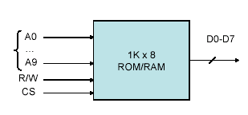
Cont…
1K x 8:
1K = 2n,
n: number of address lines
8: number of data lines
R/W: Read/Write Enable
CS: Chip Select.

Slide 49
PROBLEMS
a) For a memory capacity of 2048 bytes, using 128x8 chips, we need 2048/128=16 chips.
b) We need 11 address lines to access 2048 = 211, the common lines are 7 (since each chip has 7 address lines; 128= 2⁷)
c) We need a decoder to select which chip is to accessed. Draw a diagram to show the connections.

Slide 50
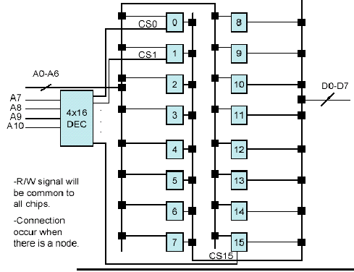
Cont…

Slide 51
Cont…
The address range for chip 0 will be:
0000 0000000 to 0000 1111111 , thus
000 to 07F (Hexadecimal)
The address range for chip 1 will be:
0001 0000000 to 0001 1111111 , thus
080 to 0FF (Hexadecimal)
And so on until we hit 7FF. (check this!)

Slide 52
MAGNETIC DISK AND DRUMS
Magnetic Disk and Drums are similar in operation
High Rotating surfaces with magnetic recording medium
Rotating surface
  Disk- a round flat plate
  Drum – cylinder
Rotating surface rotates at uniform speed and is not stopped or started during access operations
Bits are recorded as magnetic spots on the surface as it passes a stationary mechanism-WRITE HEAD
Stored bits are detected by a change in a magnetic field produced by a recorded spot on a surface as it passes thru the READ HEAD
  HEAD –(conducting coil)

Slide 53
MAGNETIC DISK
Bits are stored in magnetized surface in spots along the concentric circle called tracks
Track divided into sections –sectors
  Single read/write head for each disk surface-the track address bits are used by a mechanical assembly to move the head into the specified track position be for reading and writing.
  Separate read/write head for each track in each surface .The address bits can then select a particular track electronically through a decoder circuit.
More expensive found in large computer

Slide 54
Cont…
Permanent timing tracks are used in disks to synchronize the bits and recognize the sectors
A disk system is addressed by address bits that specify the disk no. The disk surface, sector no., and the track within the sector
After the read/write heads are positioned in the specified track. The system has to wait until the rotating disk reaches the specified sector under the read/write head.
Information transfer is very fast once the beginning of a sector has been reached
Disk with multiple heads and simultaneous transfer of bits from several tracks at the same time

Slide 55
Cont…
A track in a given sector near the circumference is longer than a track near the center of the disk.
If bits are recorded with equal density, some tracks will contain more recorded bits than other
To make all records in a sector of equal length, some disks uses variable recording density with higher density on tracks near the center than on tracks near the circumference. This equalizes the number of bits on all tracks of a given sector
Disks
  Hard disk
  Floppy Disk

Slide 56
MAGNETIC TAPES
A magnetic tape transport system consist of the electrical, mechanical ,electronic component to provide the parts and control mechanism for a magnetic tape
Tape is a strip of plastic coated with a magnetic recording medium
Bits are recorded as magnetic spots on the tape along several tracks
Read/Write heads are mounted on in each track so that data can be recorded and read as a sequence of characters
Magnetic tape can’t be stopped or started fast enough between individuals characters because of this info is recorded in blocks where the tape can be stopped.

Slide 57
Cont…
The tape start moving while in a gap and attains constant
speed by the time it reaches the next record
Each record on a tape has an identification bit pattern at the beginning and end.
By reading the bit pattern at the end of the record the control recognizes the beginning of a gap.
A tape is addressed by specifying the record number and the number of characters in a record.
Records may be fixed or variable length

Slide 58
ASSOCIATIVE MEMORY
It is a memory unit accessed by content (Content Addressable Memory CAM).
Word read/written no address specified memory find the empty unused location to store the data similarly memory located all word which match the specified content and marks them for reading
Uniquely suited for parallel searches by data association.
More expensive than RAM because each cell must have storage and logic circuits for matching with an external argument.
Each word in memory is compared with the argument register (A). If a word matches, then the corresponding bit in the match register will be set.
(K) is the key register responsible for masking the data to select a field in the argument word.

Slide 59
Cont…
Fig.1:Block diagram of Associative memory
Argument register (A)
A₁
A_{j}
A_{n}
Key register (R)
K₁
K_{j}
K_{n}
Match register
Input
Word 1
C₁₁
C_{1j}
C_{1n}
M_{1n}
Associative memory
Array and logic
M words
N bits per word
M
Word i
C_{i1}
C_{ij}
C_{in}
M_{in}
Read
Word m
C_{m1}
C_{mj}
C_{mn}
M_{mn}
Write
Bit1
Bitj
Bitn
Output
A 101 111100
K 111 000000
Word 1 100111100
Word 2 101 000001
Fig.2:An Associative array of one word

Slide 60
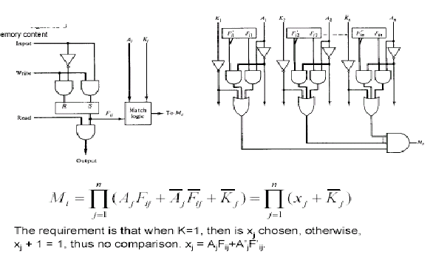
Cont…
Match logic for one word of associative memory
One cell for associative memory

Slide 61
Cont…
• A read operation takes place for those locations where M_{i}=1.
• Usually one location, but if more than one, then locations will be read in sequence.
• A write can be done in a RAM like addressing, thus device will operate in a RAM writing CAM reading.
• A TAG register is available with a number of bits that is the same as the number of word, to keep track of which locations are empty (0) or full (1), after a read/write operation.

Slide 62
LOCALITY
Principle of Locality:
  Programs tend to reuse data and instructions near those they have used recently, or that were recently referenced themselves.
  Temporal locality: Recently referenced items are likely to be referenced in the near future.
  Spatial locality: Items with nearby addresses tend to be referenced close together in time.
Locality Example:
  Data
    Reference array elements in succession (stride-1 reference pattern):
    Reference sum each iteration:
  Instructions
    Reference instructions in sequence:
    Cycle through loop repeatedly:
sum = 0;
for (i = 0; i < n; i++)
sum += a[i];
return sum;
Spatial locality
Temporal locality
Spatial locality
Temporal locality

Slide 63
LOCALITY EXAMPLE
Locality Example:
  Data
    Reference array elements in succession (stride-1 reference pattern):
    Reference sum each iteration:
  Instructions
    Reference instructions in sequence:
    Cycle through loop repeatedly:
sum = 0;
for (i = 0; i < n; i++)
sum += a[i];
return sum;
Spatial locality
Temporal locality
Spatial locality
Temporal locality

Slide 64
CACHE MEMORY
References at any given time tend to be confined within a few localized area in memory - Locality of Reference
To lesser memory reference –Cache

Slide 65
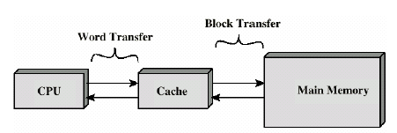
CACHE ($)
• Small amount of fast memory
• Sits between normal main memory and CPU
• May be located on CPU chip or module

Slide 66
CACHE READ OPERATION
Start
Hit ratio=#hits/#memory calls
Require address (RA) from CPU
Is block containing RA in cache?
No
Access main memory for block containing RA
Yes
Fetch RA word and deliver in CPU
Allocate cache for main memory for block
Add main memory block to cache line
Deliver RA word to CPU
Done

Slide 67
Cont…
• Transformation of data from Memory to $ is referred to as Mapping.
• 3 types of mapping:
– Associative Mapping (fastest, most flexible)
– Direct mapping (HW efficient)
– Set-associative mapping
CPU
Main Memory
32 K * 12
Mem: 15-bit address
Same address is sent to $
Cache
Memory
52*11
Example of Cache Memory

Slide 68
CACHES
Cache: A smaller, faster storage device that acts as a staging area for a subset of the data in a larger, slower device.
Fundamental idea of a memory hierarchy:
    For each k, the faster, smaller device at level k serves as a cache for the larger, slower device at level k+1.
Why do memory hierarchies work?
    Programs tend to access the data at level k more often than they access the data at level k+1.
    Thus, the storage at level k+1 can be slower, and thus larger and cheaper per bit.
    Net effect: A large pool of memory that costs as much as the cheap storage near the bottom, but that serves data to programs at the rate of the fast storage near the top.

Slide 69
CACHING IN A MEMORY HIERARCHY
Smaller, faster, more expensive
device at level k caches a
subset of the blocks from level k+1
8
Level k:
4
9
14
3
10
Data is copied between
levels in block-sized transfer units
10
4
0
1
2
3
4
Larger, slower, cheaper storage
device at level k+1 is partitioned
into blocks.
Level k+1:
4
5
6
7
8
9
10
10
11
12
13
14
15

Slide 70
GENERAL CACHING CONCEPTS
Program needs object d, which is stored in some block b.
Cache hit
  Program finds b in the cache at level k. E.g., block 14.
Request
12
14
Request
14
12
0
1
2
3
Level
k:
4*
9
14
12
14
3
4*
12
Request
12
4*
0
1
2
3
Level
k+1:
4
5
6
7
4*
8
9
10
11
12
13
14
15
12

Slide 71
Cont…
Cache miss
  b is not at level k, so level k cache must fetch it from level k+1. E.g., block 12.
  If level k cache is full, then some current block must be replaced (evicted). Which one is the “victim”?
    Placement policy: where can the new block go? E.g., b mod 4
    Replacement policy: which block should be evicted? E.g., LRU

Slide 72
Cont…
Types of cache misses:
  Cold (compulsary) miss
    Cold misses occur because the cache is empty.
  Conflict miss
    Most caches limit blocks at level k+1 to a small subset (sometimes a singleton) of the block positions at level k.
    E.g. Block i at level k+1 must be placed in block (i mod 4) at level k+1.
    Conflict misses occur when the level k cache is large enough, but multiple data objects all map to the same level k block.
    E.g. Referencing blocks 0, 8, 0, 8, 0, 8, ... would miss every time.
  Capacity miss
    Occurs when the set of active cache blocks (working set) is larger than the cache.

Slide 73
EXAMPLES OF CACHING IN THE HIERARCHY
Cache Type
What Cached
Where Cached
Latency (cycles)
Managed By
Registers
4-byte word
CPU registers
0
Compiler
TLB
Address translations
On-Chip TLB
0
Hardware
L1 cache
32-byte block
On-Chip L1
1
Hardware
L2 cache
32-byte block
Off-Chip L2
10
Hardware
Virtual Memory
4-KB page
Main memory
100
Hardware+OS
Buffer cache
Parts of files
Main memory
100
OS
Network buffer cache
Parts of files
Local disk
10,000,000
AFS/NFS client
Browser cache
Web pages
Local disk
10,000,000
Web browser
Web cache
Web pages
Remote server disks
1,000,000,000
Web proxy server

Slide 74
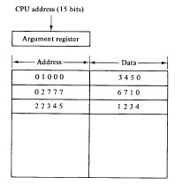
ASSOCIATIVE MAPPING:
• The 15-bit address as well as its corresponding data word are stored in $.
• If a match in address is found (address from CPU is placed in (A) register), data word is sent to CPU.
Associative Mapping of Cache (all no. in octal)

Slide 75
Cont…
If no match, then data word is accessed from Memory, and the address data pair are transferred to $.
If $ is full, a replacement algorithm is used to free some space.

Slide 76
DIRECT MAPPING
• A RAM is used for Cache ($).
• The 15-bit address is divided into
Index=k, and TAG=n-k.
n=15 (address for Memory), k=9 (address for $).
• Each word in $ consists of the data word along with its associated TAG.
• When CPU issues a read, the index part is used to locate the address in $, and then the remaining portion is compared to TAG, if there is a match, then that is a HIT.
IF there is no match, then this is a MISS.
• If MISS, then read from Memory and store word + TAG in $ again.

Slide 77
ADDRESSING RELATIONSHIP BETWEEN CACHE AND MAIN
Tag (6bits) | Index (9 bits)
00 000
77 777
32K*12
Main Memory
Address=15 bits
Data =12 bits
000
777
512*12
Cache Memory
Address=9 bits
Data =12 bits
Octal
address
Octal address

Slide 78
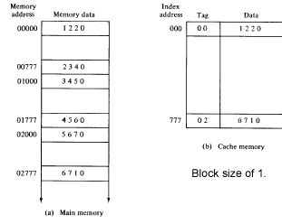
DIRECT MAPPING CACHE ORGANISATION

Slide 79
Cont…
• Disadvantage
what if two or more words whose addresses have the same index but different TAG? Increase MISS ratio!
• Usually, this will happen when words are far away in the address range
Far from $ size, i.e. after 512 location in this example.
64x8 = 512
64 blocks
8 words/block
Block (6 bits) Word (3 bits)
Index=007 Block 0, word 8
Index=103 Block 8, word 4
$

Slide 80
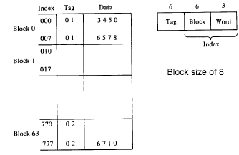
DIRECT MAPPING
64x8 = 512
64 blocks
8 words/block

Slide 81

Cont…

Slide 82
SET ASSOCIATIVE
Improvement over direct mapping

Slide 83
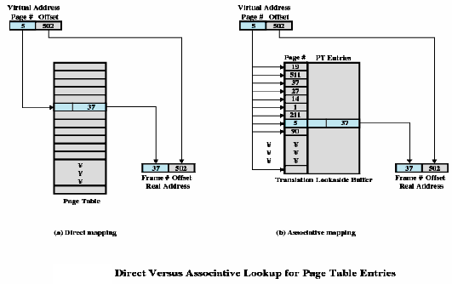
Cont…

Slide 84
WRITING TO $
Two methods:
Write through
  update main memory with every memory write operation with cache being updated in parallel if it contain the word at the specified address
Write back
  only cache location is updated during write operation. This location is then marked by a flag so that later when the word is removed from the it is copied into main memory

Slide 85
VIRTUAL MEMORY
Virtual memory (VM) is used to give programmers the illusion that they have a very large memory at their command.
A computer has a limited memory size.
VM provides a mechanism for translating program oriented addresses into correct memory addresses.
Address mapping can be performed using an extra memory chip, using main memory itself (portion of it) or using associative memory using page tables.

Slide 86
PROBLEMS
a) Memory is 64Kx16, and $ is 1K words, with block size of 4.
b) Each $ location will have the 16-bits of data, added to them the number of TAG bits, as well as the valid bit, thus 23-bits.
Index = 10 bits TAG = 6 bits
Block = 8 bits, word = 2 bits

Slide 87
HARDWARE AND CONTROL STRUCTURES
Memory references are dynamically translated into physical addresses at run time
  A process may be swapped in and out of main memory such that it occupies different regions
A process may be broken up into pieces that do not need to located contiguously in main memory
All pieces of a process do not need to be loaded in main memory during execution

Slide 88
EXECUTION OF A PROGRAM
Operating system brings into main memory a few pieces of the program
Resident set - portion of process that is in main memory
An interrupt is generated when an address is needed that is not in main memory
Operating system places the process in a blocking state

Slide 89
EXECUTION OF A PROGRAM
Piece of process that contains the logical address is brought into main memory
  Operating system issues a disk I/O Read request
  Another process is dispatched to run while the disk I/O takes place
  An interrupt is issued when disk I/O complete which causes the operating system to place the affected process in the Ready state

Slide 90
ADVANTAGES OF BREAKING
A PROCESS
More processes may be maintained in main memory
  Only load in some of the pieces of each process
  With so many processes in main memory, it is very likely a process will be in the Ready state at any particular time
A process may be larger than all of main memory

Slide 91
TYPES OF MEMORY
Real memory
  Main memory
Virtual memory
  Memory on disk
  Allows for effective multiprogramming and relieves the user of tight constraints of main memory

Slide 92
MEMORY TABLE FOR MAPPING A VIRTUAL ADDRESS
Virtual address
Virtual
address register
(20 bits)
Memory
mapping
table
Main
memory address
(15 bits)
Main
memory
Main memory
Buffer register
Memory table
buffer register

Slide 93
ADDRESS AND MEMORY SPACE SPLIT INTO GROUPS OF 1K WORDS
Page 0
Page 1
Page 2
Page 3
Page 4
Page 5
Page 6
Page 7
Block 0
Block 1
Block 2
Block 3
Memory space
N=4 K=2¹²
Address space
N=8 K=2¹³

Slide 94
MEMORY TABLE IN A PAGED SYSTEM
Page No.
Line No.
101 | 0101010011
Presence
bit
000 |  | 0
001 | 11 | 1
010 | 00 | 1
011 |  | 0
100 |  | 0
101 | 01 | 1
110 | 10 | 1
111 |  | 0
Block 0
Block 1
Block 2
Block 3
Table
address
01 | 0101010011
Main memory
Address register
MBR
01 | 1
Main
Page table

Slide 95
ASSOCIATIVE MEMORY PAGE TABLE
Page No.
Virtual register.
101 | Line Number
Argument register.
111 00
Key register
000 | 11
001 | 00
010 | 01
011 | 10
Associative memory
Page No. Block No

Slide 96
THRASHING
Swapping out a piece of a process just before that piece is needed
The processor spends most of its time swapping pieces rather than executing user instructions

Slide 97
PRINCIPLE OF LOCALITY
Program and data references within a process tend to cluster
Only a few pieces of a process will be needed over a short period of time
Possible to make intelligent guesses about which pieces will be needed in the future
This suggests that virtual memory may work efficiently

Slide 98
SUPPORT NEEDED FOR VIRTUAL MEMORY
Hardware must support paging and segmentation
Operating system must be able to management the movement of pages and/or segments between secondary memory and main memory

Slide 99
PAGING
Each process has its own page table
Each page table entry contains the frame number of the corresponding page in main memory
A bit is needed to indicate whether the page is in main memory or not

Slide 100
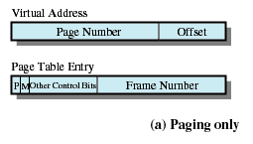
PAGING

Slide 101
MODIFY BIT IN PAGE TABLE
Modify bit is needed to indicate if the page has been altered since it was last loaded into main memory
If no change has been made, the page does not have to be written to the disk when it needs to be swapped out

Slide 102
PAGE TABLES
The entire page table may take up too much main memory
Page tables are also stored in virtual memory
When a process is running, part of its page table is in main memory

Slide 103
TRANSLATION LOOKASIDE BUFFER
Each virtual memory reference can cause two physical memory accesses
  One to fetch the page table
  One to fetch the data
To overcome this problem a high-speed cache is set up for page table entries
  Called a Translation Lookaside Buffer (TLB)

Slide 104
TRANSLATION LOOKASIDE BUFFER
Contains page table entries that have been most recently used
Given a virtual address, processor examines the TLB
If page table entry is present (TLB hit), the frame number is retrieved and the real address is formed
If page table entry is not found in the TLB (TLB miss), the page number is used to index the process page table
First checks if page is already in main memory
  If not in main memory a page fault is issued
The TLB is updated to include the new page entry

Slide 105
PAGE SIZE
Smaller page size, less amount of internal fragmentation
Smaller page size, more pages required per process
More pages per process means larger page tables
Larger page tables means large portion of page tables in virtual memory
Secondary memory is designed to efficiently transfer large blocks of data so a large page size is better

Slide 106
PAGE SIZE
Small page size, large number of pages will be found in main memory
As time goes on during execution, the pages in memory will all contain portions of the process near recent references. Page faults low.
Increased page size causes pages to contain locations further from any recent reference. Page faults rise.

Slide 107
SEGMENTATION
May be unequal, dynamic size
Simplifies handling of growing data structures
Allows programs to be altered and recompiled independently
Lends itself to sharing data among processes
Lends itself to protection

Slide 108
SEGMENT TABLES
Corresponding segment in main memory
Each entry contains the length of the segment
A bit is needed to determine if segment is already in main memory
Another bit is needed to determine if the segment has been modified since it was loaded in main memory

Slide 109
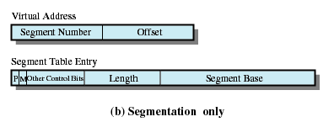
SEGMENT TABLE ENTRIES

Slide 110
COMBINED
PAGING AND SEGMENTATION
Paging is transparent to the programmer
Segmentation is visible to the programmer
Each segment is broken into fixed-size pages

Slide 111
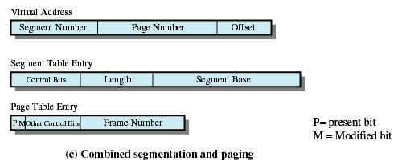
COMBINED
SEGMENTATION AND PAGING

Slide 112
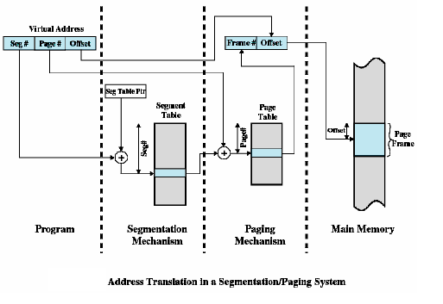
Cont…

Slide 113
FETCH POLICY
Fetch Policy
  Determines when a page should be brought into memory
  Demand paging only brings pages into main memory when a reference is made to a location on the page
    Many page faults when process first started
  Prepaging brings in more pages than needed
    More efficient to bring in pages that reside contiguously on the disk

Slide 114
PLACEMENT POLICY
Determines where in real memory a process piece is to reside
Important in a segmentation system
Paging or combined paging with segmentation hardware performs address translation

Slide 115
REPLACEMENT POLICY
Placement Policy
  Which page is replaced?
  Page removed should be the page least likely to be referenced in the near future
  Most policies predict the future behavior on the basis of past behavior

Slide 116
Cont…
Frame Locking
  If frame is locked, it may not be replaced
  Kernel of the operating system
  Control structures
  I/O buffers
  Associate a lock bit with each frame

Slide 117
BASIC REPLACEMENT ALGORITHMS
Optimal policy
  Selects for replacement that page for which the time to the next reference is the longest
  Impossible to have perfect knowledge of future events

Slide 118
BASIC REPLACEMENT ALGORITHMS
Least Recently Used (LRU)
  Replaces the page that has not been referenced for the longest time
  By the principle of locality, this should be the page least likely to be referenced in the near future
  Each page could be tagged with the time of last reference. This would require a great deal of overhead.

Slide 119
Cont…
First-in, first-out (FIFO)
  Treats page frames allocated to a process as a circular buffer
  Pages are removed in round-robin style
  Simplest replacement policy to implement
  Page that has been in memory the longest is replaced
  These pages may be needed again very soon

Slide 120
Cont…
Clock Policy
  Additional bit called a use bit
  When a page is first loaded in memory, the use bit is set to 1
  When the page is referenced, the use bit is set to 1
  When it is time to replace a page, the first frame encountered with the use bit set to 0 is replaced.
  During the search for replacement, each use bit set to 1 is changed to 0

Slide 121
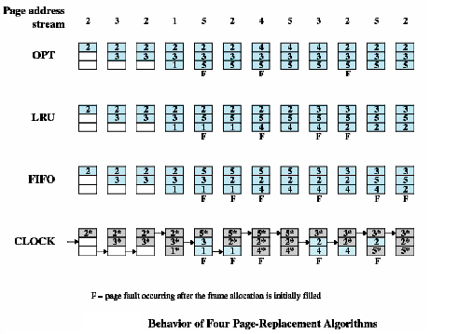
Cont…

Slide 122
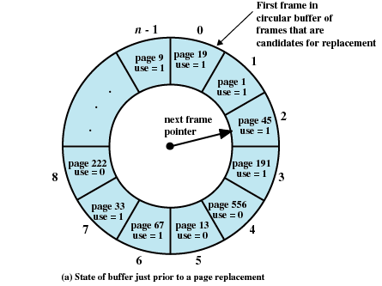
Cont…

Slide 123
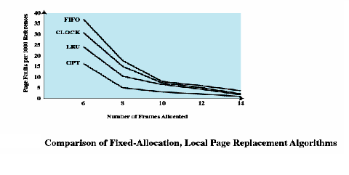
COMPARISON OF PLACEMENT ALGORITHMS

Slide 124
BASIC
REPLACEMENT ALGORITHMS
Page Buffering
  Replaced page is added to one of two lists
    Free page list if page has not been modified
    Modified page list

Slide 125
RESIDENT SET SIZE
Fixed-allocation
  Gives a process a fixed number of pages within which to execute
  When a page fault occurs, one of the pages of that process must be replaced
Variable-allocation
  Number of pages allocated to a process varies over the lifetime of the process

Slide 126
FIXED ALLOCATION, LOCAL SCOPE
Decide ahead of time the amount of allocation to give a process
If allocation is too small, there will be a high page fault rate
If allocation is too large there will be too few programs in main memory

Slide 127
VARIABLE ALLOCATION GLOBAL SCOPE
Easiest to implement
Adopted by many operating systems
Operating system keeps list of free frames
Free frame is added to resident set of process when a page fault occurs
If no free frame, replaces one from another process

Slide 128
Cont…
When new process added, allocate number of page frames based on application type, program request, or other criteria
When page fault occurs, select page from among the resident set of the process that suffers the fault
Reevaluate allocation from time to time

Slide 129
CLEANING POLICY
Demand cleaning
  A page is written out only when it has been selected for replacement
Precleaning
  Pages are written out in batches

Slide 130
CLEANING POLICY
Best approach uses page buffering
  Replaced pages are placed in two lists
    Modified and unmodified
  Pages in the modified list are periodically written out in batches
  Pages in the unmodified list are either reclaimed if referenced again or lost when its frame is assigned to another page

Slide 131
LOAD CONTROL
Determines the number of processes that will be resident in main memory
Too few processes, many occasions when all processes will be blocked and much time will be spent in swapping
Too many processes will lead to thrashing

Slide 132
PROCESS SUSPENSION
Lowest priority process
Faulting process
  This process does not have its working set in main memory so it will be blocked anyway
Last process activated
  This process is least likely to have its working set resident

Slide 133
Cont…
Process with smallest resident set
  This process requires the least future effort to reload
Largest process
  Obtains the most free frames
Process with the largest remaining execution window

Slide 134
LINUX MEMORY MANAGEMENT
Page directory
Page middle directory
Page table

Slide 135
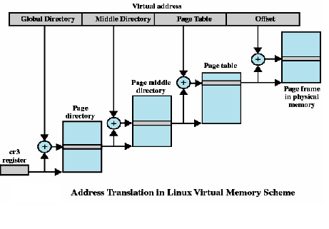
Cont…

Slide 136
CONCLUSIONS
Memory hierarchy
Types of memory
Mapping schemes
Paging
Segmentation
Replacement Algorithm

Slide 137
MULTIPLE PROCESSOR ORGANIZATION
Single instruction, single data stream - SISD
Single instruction, multiple data stream - SIMD
Multiple instruction, single data stream - MISD
Multiple instruction, multiple data stream- MIMD

Slide 138
SINGLE INSTRUCTION, SINGLE DATA STREAM - SISD
Single processor
Single instruction stream
Data stored in single memory
Uni-processor

Slide 139
SINGLE INSTRUCTION, MULTIPLE DATA STREAM - SIMD
Single machine instruction
Controls simultaneous execution
Number of processing elements
Lockstep basis
Each processing element has associated data memory
Each instruction executed on different set of data by different processors
Vector and array processors

Slide 140
MULTIPLE INSTRUCTION, SINGLE DATA STREAM - MISD
Sequence of data
Transmitted to set of processors
Each processor executes different instruction
sequence
Never been implemented

Slide 141
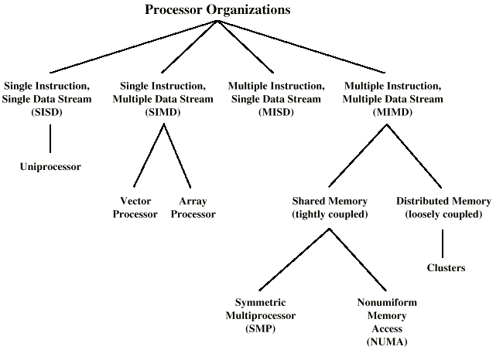
TAXONOMY OF PARALLEL PROCESSOR ARCHITECTURES

Slide 142
MIMD - OVERVIEW
General purpose processors
Each can process all instructions necessary
Further classified by method of processor communication

Slide 143
TIGHTLY COUPLED - SMP
Processors share memory
Communicate via that shared memory
Symmetric Multiprocessor (SMP)
  Share single memory or pool
  Shared bus to access memory
  Memory access time to given area of memory is approximately the same for each processor

Slide 144
TIGHTLY COUPLED - NUMA
Non-uniform memory access
Access times to different regions of memory may differ.

Slide 145
LOOSELY COUPLED - CLUSTERS
Collection of independent uniprocessors or SMPs
Interconnected to form a cluster
Communication via fixed path or network connections

Slide 146
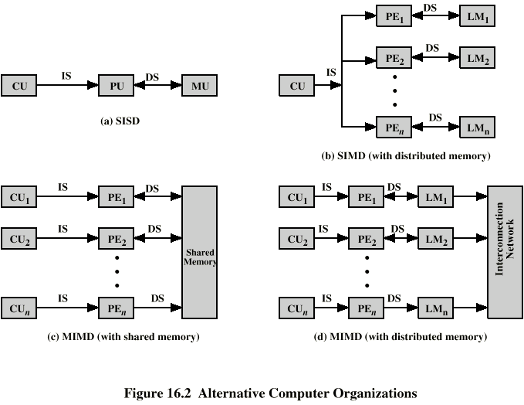
PARALLEL ORGANIZATIONS - SISD

Slide 147
PARALLEL ORGANIZATIONS - SIMD

Slide 148
PARALLEL ORGANIZATIONS - MIMD SHARED MEMORY

Slide 149
PARALLEL ORGANIZATIONS - MIMD
DISTRIBUTED MEMORY

Slide 150
SYMMETRIC MULTIPROCESSORS
A stand alone computer with the following characteristics
  Two or more similar processors of comparable capacity
  Processors share same memory and I/O
  Processors are connected by a bus or other internal connection
  Memory access time is approximately the same for each processor
  All processors share access to I/O
    Either through same channels or different channels giving paths to same devices
  All processors can perform the same functions (hence symmetric)
  System controlled by integrated operating system
    providing interaction between processors
    Interaction at job, task, file and data element levels

Slide 151
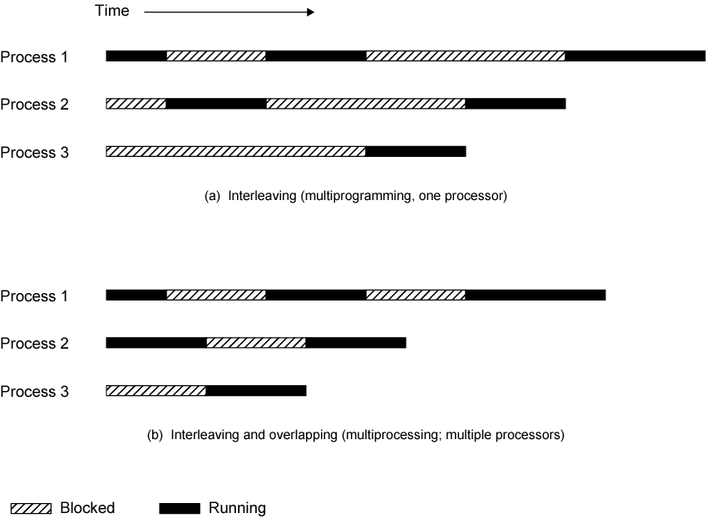
MULTIPROGRAMMING AND MULTIPROCESSING

Slide 152
SMP ADVANTAGES
Performance
  If some work can be done in parallel
Availability
  Since all processors can perform the same functions, failure of a single processor does not halt the system
Incremental growth
  User can enhance performance by adding additional processors
Scaling
  Vendors can offer range of products based on number of processors

Slide 153
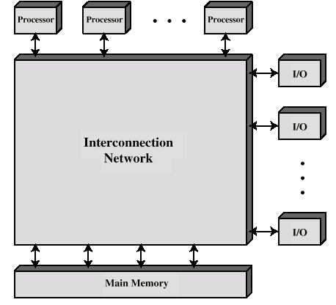
BLOCK DIAGRAM OF TIGHTLY COUPLED MULTIPROCESSOR

Slide 154
ORGANIZATION CLASSIFICATION
Time shared or common bus
Multiport memory
Central control unit

Slide 155
TIME SHARED BUS
Simplest form
Structure and interface similar to single processor system
Following features provided
  Addressing - distinguish modules on bus
  Arbitration - any module can be temporary master
  Time sharing - if one module has the bus, others must wait and may have to suspend
Now have multiple processors as well as multiple I/O modules

Slide 156
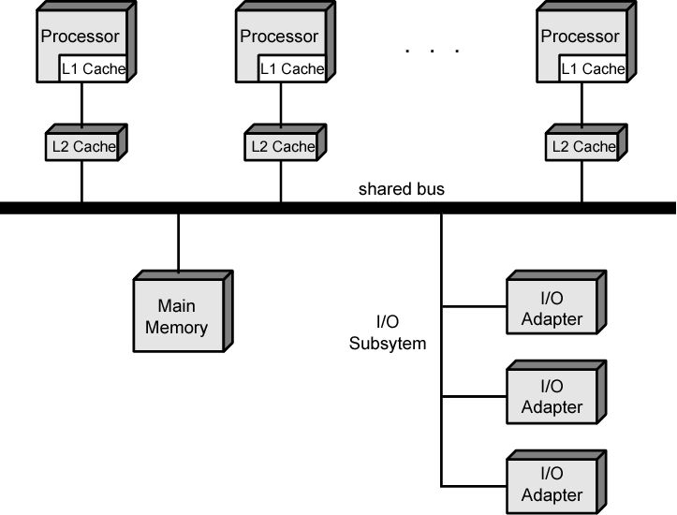
SYMMETRIC MULTIPROCESSOR ORGANIZATION

Slide 157
TIME SHARE BUS - ADVANTAGES
Simplicity
Flexibility
Reliability

Slide 158
TIME SHARE BUS - DISADVANTAGE
Performance limited by bus cycle time
Each processor should have local cache
  Reduce number of bus accesses
Leads to problems with cache coherence
  Solved in hardware - see later

Slide 159
OPERATING SYSTEM ISSUES
Simultaneous concurrent processes
Scheduling
Synchronization
Memory management
Reliability and fault tolerance

Slide 160
CACHE COHERENCE AND MESI PROTOCOL
Problem - multiple copies of same data in different caches
Can result in an inconsistent view of memory
Write back policy can lead to inconsistency
Write through can also give problems unless caches monitor memory traffic

Slide 161
SOFTWARE SOLUTIONS
Compiler and operating system deal with problem
Overhead transferred to compile time
Design complexity transferred from hardware to software
However, software tends to make conservative decisions
  Inefficient cache utilization
Analyze code to determine safe periods for caching shared variables

Slide 162
HARDWARE SOLUTION
Cache coherence protocols
Dynamic recognition of potential problems
Run time
More efficient use of cache
Transparent to programmer
Directory protocols
Snoopy protocols

Slide 163
DIRECTORY PROTOCOLS
Collect and maintain information about copies of data in cache
Directory stored in main memory
Requests are checked against directory
Appropriate transfers are performed
Creates central bottleneck
Effective in large scale systems with complex interconnection schemes

Slide 164
SNOOPY PROTOCOLS
Distribute cache coherence responsibility among cache controllers
Cache recognizes that a line is shared
Updates announced to other caches
Suited to bus based multiprocessor
Increases bus traffic

Slide 165
WRITE INVALIDATE
Multiple readers, one writer
When a write is required, all other caches of the line are invalidated
Writing processor then has exclusive (cheap) access until line required by another processor
Used in Pentium II and PowerPC systems
State of every line is marked as modified, exclusive, shared or invalid
MESI

Slide 166
WRITE UPDATE
Multiple readers and writers
Updated word is distributed to all other processors
Some systems use an adaptive mixture of both solutions

Slide 167
INCREASING PERFORMANCE
Processor performance can be measured by the rate at which it executes instructions
MIPS rate = f * IPC
  f processor clock frequency, in MHz
  IPC is average instructions per cycle
Increase performance by increasing clock frequency and increasing instructions that complete during cycle
May be reaching limit
  Complexity
  Power consumption

Slide 168
MULTITHREADING AND CHIP MULTIPROCESSORS
Instruction stream divided into smaller streams (threads)
Executed in parallel
Wide variety of multithreading designs

Slide 169
DEFINITIONS OF THREADS AND PROCESSES
Thread in multithreaded processors may or may not be same as software threads
Process:
  An instance of program running on computer
  Resource ownership
    Virtual address space to hold process image
  Scheduling/execution
  Process switch

Slide 170
Cont…
Thread: dispatch able unit of work within process
  Includes processor context (which includes the program counter and stack pointer) and data area for stack
  Thread executes sequentially
  Interruptible: processor can turn to another thread
Thread switch
  Switching processor between threads within same process
  Typically less costly than process switch

Slide 171
IMPLICIT AND EXPLICIT MULTITHREADING
All commercial processors and most experimental ones use explicit multithreading
  Concurrently execute instructions from different explicit threads
  Interleave instructions from different threads on shared pipelines or parallel execution on parallel pipelines
Implicit multithreading is concurrent execution of multiple threads extracted from single sequential program
  Implicit threads defined statically by compiler or dynamically by hardware

Slide 172
APPROACHES TO EXPLICIT MULTITHREADING
Interleaved
  Fine-grained
  Processor deals with two or more thread contexts at a time
  Switching thread at each clock cycle
  If thread is blocked it is skipped
Blocked
  Coarse-grained
  Thread executed until event causes delay
  E.g. Cache miss
  Effective on in-order processor
  Avoids pipeline stall

Slide 173
Cont…
Simultaneous (SMT)
  Instructions simultaneously issued from multiple threads to execution units of superscalar processor
Chip multiprocessing
  Processor is replicated on a single chip
  Each processor handles separate threads

Slide 174
SCALAR PROCESSOR APPROACHES
Single-threaded scalar
  Simple pipeline
  No multithreading
Interleaved multithreaded scalar
  Easiest multithreading to implement
  Switch threads at each clock cycle
  Pipeline stages kept close to fully occupied
  Hardware needs to switch thread context between cycles
Blocked multithreaded scalar
  Thread executed until latency event occurs
  Would stop pipeline
  Processor switches to another thread

Slide 175
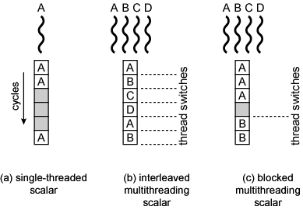
SCALAR DIAGRAMS

Slide 176
MULTIPLE INSTRUCTION ISSUE PROCESSORS (1)
Superscalar
  No multithreading
Interleaved multithreading superscalar:
  Each cycle, as many instructions as possible issued from single thread
  Delays due to thread switches eliminated
  Number of instructions issued in cycle limited by dependencies
Blocked multithreaded superscalar
  Instructions from one thread
  Blocked multithreading used

Slide 177
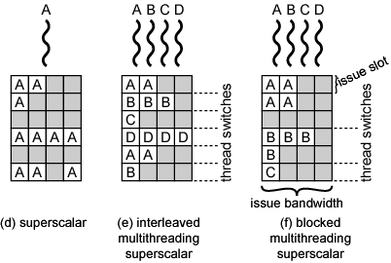
MULTIPLE INSTRUCTION ISSUE DIAGRAM (1)

Slide 178
MULTIPLE INSTRUCTION ISSUE PROCESSORS (2)
Very long instruction word (VLIW)
  E.g. IA-64
  Multiple instructions in single word
  Typically constructed by compiler
  Operations that may be executed in parallel in same word
  May pad with no-ops
Interleaved multithreading VLIW
  Similar efficiencies to interleaved multithreading on superscalar architecture
Blocked multithreaded VLIW
  Similar efficiencies to blocked multithreading on superscalar architecture

Slide 179
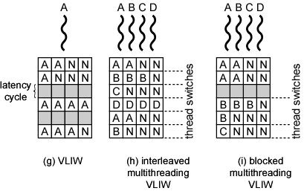
MULTIPLE INSTRUCTION ISSUE DIAGRAM (2)

Slide 180
Parallel, Simultaneous-Execution of Multiple Threads
Simultaneous multithreading
  Issue multiple instructions at a time
  One thread may fill all horizontal slots
  Instructions from two or more threads may be issued
  With enough threads, can issue maximum number of instructions on each cycle
Chip multiprocessor
  Multiple processors
  Each has two-issue superscalar processor
  Each processor is assigned thread
    Can issue up to two instructions per cycle per thread

Slide 181
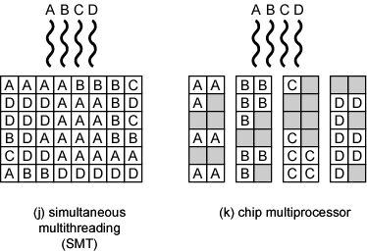
PARALLEL DIAGRAM

Slide 182
EXAMPLES
Some Pentium 4
  Intel calls it hyper threading
  SMT with support for two threads
  Single multithreaded processor, logically two processors
IBM Power5
  High-end PowerPC
  Combines chip multiprocessing with SMT
  Chip has two separate processors
  Each supporting two threads concurrently using SMT

Slide 183
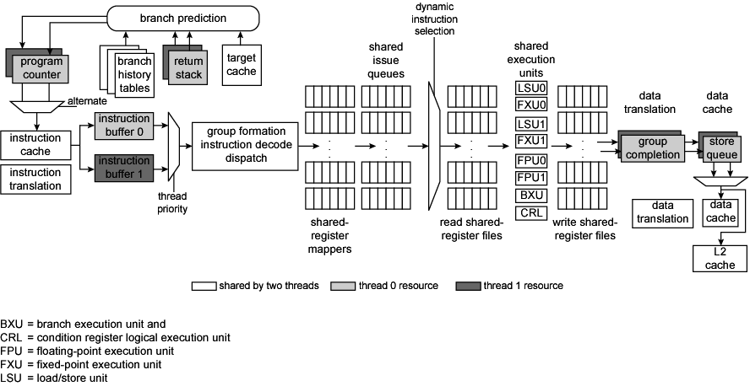
POWER5 INSTRUCTION DATA FLOW

Slide 184
CLUSTERS
Alternative to SMP
High performance
High availability
Server applications
A group of interconnected whole computers
Working together as unified resource
Illusion of being one machine
Each computer called a node

Slide 185
CLUSTER BENEFITS
Absolute scalability
Incremental scalability
High availability
Superior price/performance

Slide 186
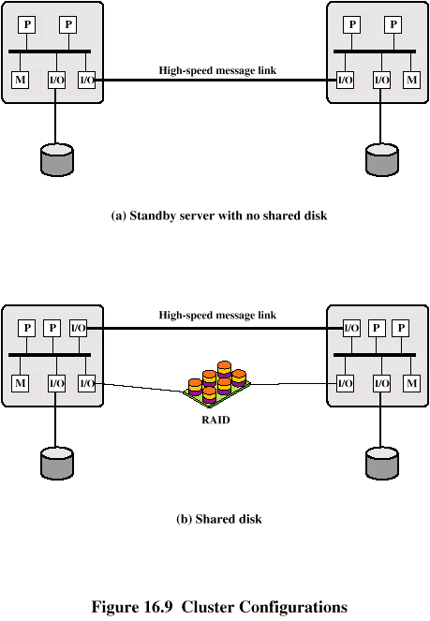
CLUSTER CONFIGURATIONS - STANDBY SERVER, NO SHARED DISK

Slide 187
CLUSTER CONFIGURATIONS -
SHARED DISK

Slide 188
OPERATING SYSTEMS
DESIGN ISSUES
Failure Management
  High availability
  Fault tolerant
  Failover
    Switching applications & data from failed system to alternative within cluster
  Failback
    Restoration of applications and data to original system
    After problem is fixed
Load balancing
  Incremental scalability
  Automatically include new computers in scheduling
  Middleware needs to recognise that processes may switch between machines

Slide 189
PARALLELIZING
Single application executing in parallel on a number of machines in cluster
  Complier
    Determines at compile time which parts can be executed in parallel
    Split off for different computers
  Application
    Application written from scratch to be parallel
    Message passing to move data between nodes
    Hard to program
    Best end result
  Parametric computing
    If a problem is repeated execution of algorithm on different sets of data
    e.g. simulation using different scenarios
    Needs effective tools to organize and run

Slide 190
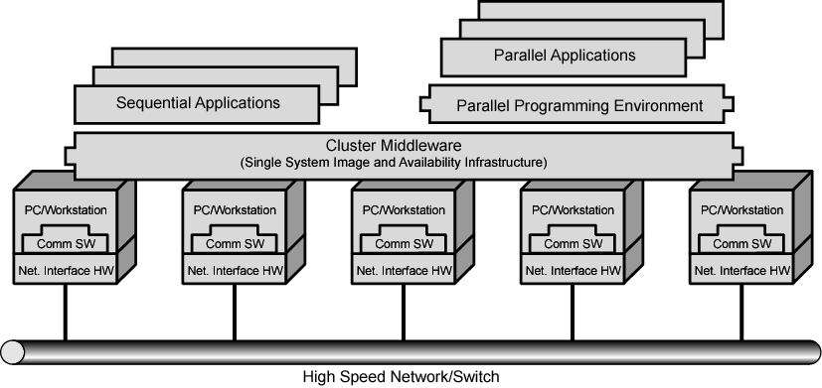
CLUSTER COMPUTER ARCHITECTURE

Slide 191
CLUSTER MIDDLEWARE
Unified image to user
  Single system image
Single point of entry
Single file hierarchy
Single control point
Single virtual networking
Single memory space
Single job management system
Single user interface
Single I/O space
Single process space
Checkpointing
Process migration

Slide 192
CLUSTER V. SMP
Both provide multiprocessor support to high demand applications.
Both available commercially
  SMP for longer
SMP:
  Easier to manage and control
  Closer to single processor systems
    Scheduling is main difference
    Less physical space
    Lower power consumption
Clustering:
  Superior incremental & absolute scalability
  Superior availability Redundancy

Slide 193
NONUNIFORM MEMORY ACCESS (NUMA)
Alternative to SMP & clustering
Uniform memory access
  All processors have access to all parts of memory
    Using load & store
  Access time to all regions of memory is the same
  Access time to memory for different processors same
  As used by SMP
Nonuniform memory access
  All processors have access to all parts of memory
    Using load & store
  Access time of processor differs depending on region of memory
  Different processors access different regions of memory at different speeds

Slide 194
NONUNIFORM MEMORY ACCESS (NUMA)
Cache coherent NUMA
  Cache coherence is maintained among the caches of the various processors
  Significantly different from SMP and clusters

Slide 195
MOTIVATION
SMP has practical limit to number of processors
  Bus traffic limits to between 16 and 64 processors
In clusters each node has own memory
  Apps do not see large global memory
  Coherence maintained by software not hardware
NUMA retains SMP flavour while giving large scale multiprocessing
  e.g. Silicon Graphics Origin NUMA 1024 MIPS R10000 processors
Objective is to maintain transparent system wide memory while permitting multiprocessor nodes, each with own bus or internal interconnection system

Slide 196
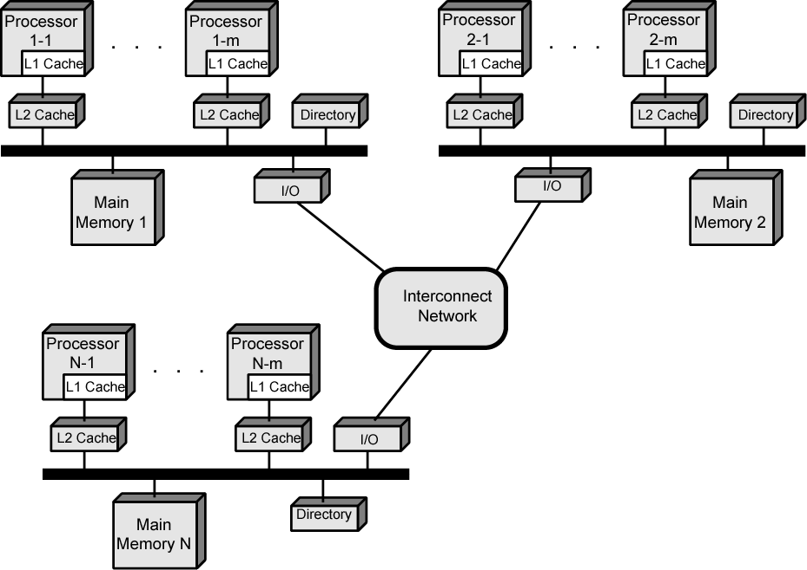
CC-NUMA ORGANIZATION

Slide 197
CC-NUMA OPERATION
Each processor has own L1 and L2 cache
Each node has own main memory
Nodes connected by some networking facility
Each processor sees single addressable memory space
Memory request order:
  L1 cache (local to processor)
  L2 cache (local to processor)
  Main memory (local to node)
  Remote memory
    Delivered to requesting (local to processor) cache
Automatic and transparent

Slide 198
MEMORY ACCESS SEQUENCE
Each node maintains directory of location of portions of memory and cache status
e.g. node 2 processor 3 (P2-3) requests location 798 which is in memory of node 1
  P2-3 issues read request on snoopy bus of node 2
  Directory on node 2 recognises location is on node 1
  Node 2 directory requests node 1’s directory
  Node 1 directory requests contents of 798
  Node 1 memory puts data on (node 1 local) bus
  Node 1 directory gets data from (node 1 local) bus
  Data transferred to node 2’s directory
  Node 2 directory puts data on (node 2 local) bus
  Data picked up, put in P2-3’s cache and delivered to processor

Slide 199
CACHE COHERENCE
Node 1 directory keeps note that node 2 has copy of data
If data modified in cache, this is broadcast to other nodes
Local directories monitor and purge local cache if necessary
Local directory monitors changes to local data in remote caches and marks memory invalid until writeback
Local directory forces writeback if memory location requested by another processor

Slide 200
NUMA Pros & Cons
Effective performance at higher levels of parallelism than SMP
No major software changes
Performance can breakdown if too much access to remote memory
  Can be avoided by:
    L1 & L2 cache design reducing all memory access
      Need good temporal locality of software
    Good spatial locality of software
    Virtual memory management moving pages to nodes that are using them most
Not transparent
  Page allocation, process allocation and load balancing changes needed
Availability?

Slide 201
VECTOR COMPUTATION
Maths problems involving physical processes present different difficulties for computation
  Aerodynamics, seismology, meteorology
  Continuous field simulation
High precision
Repeated floating point calculations on large arrays of numbers

Slide 202
VECTOR COMPUTATION
Supercomputers handle these types of problem
  Hundreds of millions of flops
  $10-15 million
  Optimised for calculation rather than multitasking and I/O
  Limited market
    Research, government agencies, meteorology
Array processor
  Alternative to supercomputer
  Configured as peripherals to mainframe & mini
  Just run vector portion of problems

Slide 203
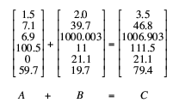
VECTOR ADDITION EXAMPLE

Slide 204
APPROACHES
General purpose computers rely on iteration to do vector calculations
In example this needs six calculations
Vector processing
  Assume possible to operate on one-dimensional vector of data
  All elements in a particular row can be calculated in parallel

Slide 205
APPROACHES
Parallel processing
  Independent processors functioning in parallel
  Use FORK N to start individual process at location N
  JOIN N causes N independent processes to join and merge following JOIN
      O/S Co-ordinates JOINs
      Execution is blocked until all N processes have reached JOIN

Slide 206
PROCESSOR DESIGNS
Pipelined ALU
  Within operations
  Across operations
Parallel ALUs
Parallel processors

Slide 207
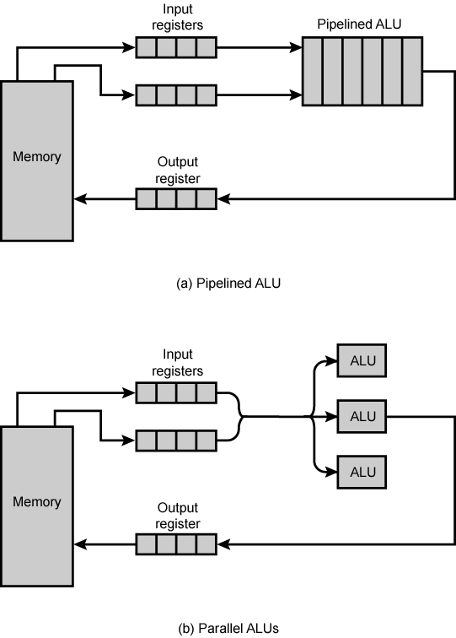
APPROACHES TO VECTOR COMPUTATION

Slide 208
CHAINING
Cray Supercomputers
Vector operation may start as soon as first element of operand vector available and functional unit is free
Result from one functional unit is fed immediately into another
If vector registers used, intermediate results do not have to be stored in memory

Slide 209
COMPUTER ORGANIZATIONS
Single Control Unit
  Uniprocessor
  Pipelined ALU
  Parallel ALU’s
Multiple Control Units
  Multipleprocessors
  Parallel Processors

Slide 210
PARALLEL COMPUTING
Parallel Computing is a central and important problem in many computationally intensive applications, such as image processing, database processing, robotics, and so forth.
Given a problem, the parallel computing is the process of splitting the problem into several subproblems, solving these subproblems simultaneously, and combing the solutions of subproblems to get the solution to the original problem.

Slide 211
PARALLEL COMPUTING STRUCTURES
Pipelined Computers : a pipeline computer performs overlapped computations to exploit temporal parallelism.
Array Processors : an array processor uses multiple synchronized arithmetic logic units to achieve spatial parallelism.
Multiprocessor Systems : a multiprocessor system achieves asynchronous parallelism through a set of interactive processors

Slide 212

PIPELINE COMPUTERS
Normally, four major steps to execute an instruction:
  Instruction Fetch (IF)
  Instruction Decoding (ID)
  Operand Fetch (OF)
  Execution (EX)

Slide 213
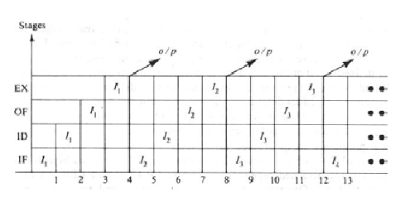
NON PIPELINE PROCESSORS

Slide 214
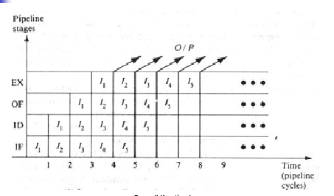
PIPELINE PROCESSORS

Slide 215
ARRAY PROCESSORS
An array processor is a synchronous parallel computer with multiple arithmetic logic units, called processing elements (PE), that can operate in parallel.
The PEs are synchronized to perform the same function at the same time.
Only a few array computers are designed primarily for numerical computation, while the others are for research purposes.

Slide 216
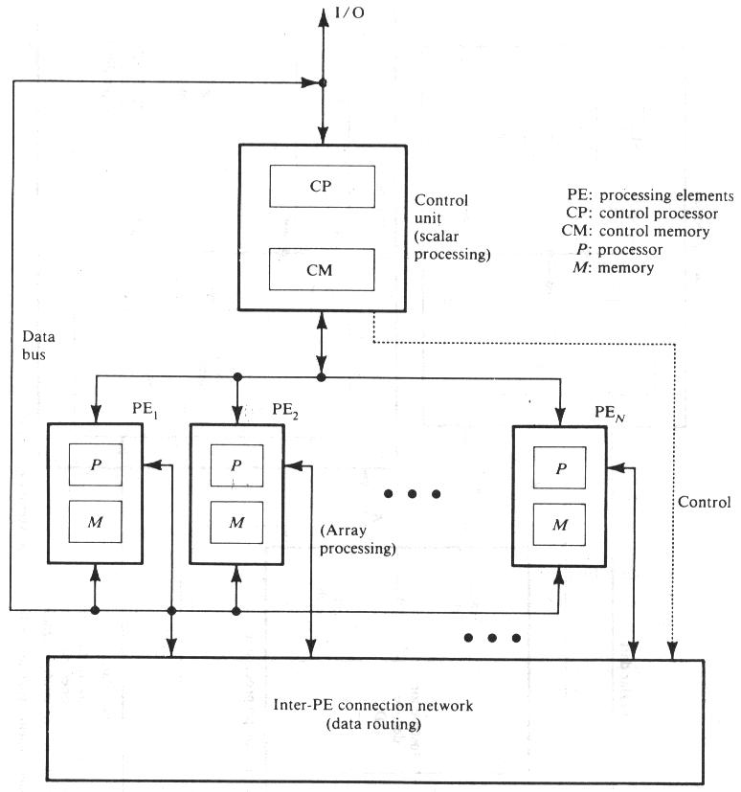
FUNCTIONAL STRCUTURE OF ARRAY PROCESSORS

Slide 217
MULTIPROCESSOR SYSTEM
A multiprocessor system is a single computer that includes multiple processors (computer modules).
Processors may communicate and cooperate at different levels in solving a given problem.
The communication may occur by sending messages from one processor to the other or by sharing a common memory.
A multiprocessor system is controlled by one operating system which provides interaction between processors and their programs at the process, data set and data element levels.

Slide 218
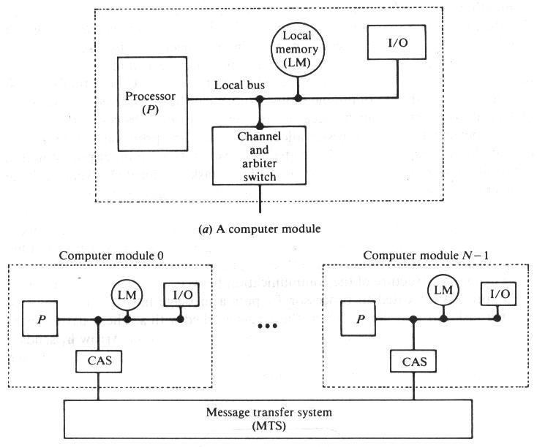
FUNCTIONAL STRUCTURE OF MULTIPROCESSOR SYSTEM

Slide 219
MULTICOMPUTERS
There is a group of processors, in which each of the processors has sufficient amount of local memory.
The communication between the processors is through messages.
There is neither a common memory nor a common clock.
This is also called distributed processing.

Slide 220
GRID COMPUTING
Grid Computing enables geographically dispersed computers or computing clusters to dynamically and virtually share applications, data, and computational resources.
It uses standard TCP/IP networks to provide transparent access to technical computing services wherever capacity is available, transforming technical computing into an information utility that is available across a department or organization.

Slide 221
MULTIPLICITY OF MULTIPLE DATA STREAMS
In general, digital computers may be classified into four categories, according to the multiplicity of instruction and data streams.
An instruction stream is a sequence of instructions as executed by the machine.
A data stream is a sequence of data including input, partial, or temporary results, called for by the instruction stream.
Flynn’s four machine organizations : SISD, SIMD, MISD, MIMD.

Slide 222
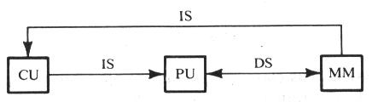
SISD
Single Instruction stream-Single Data stream (SISD)
Instructions are executed sequentially but may be overlapped in their execution stages (pipelining).

Slide 223
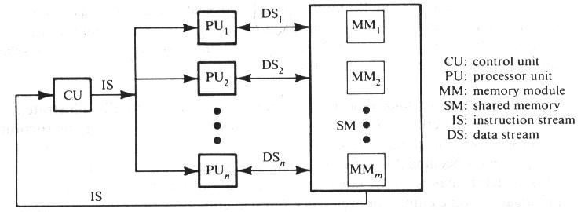
SIMD
Single Instruction stream-Multiple Data stream (SIMD)
There are multiple PEs supervised by the same control unit.

Slide 224
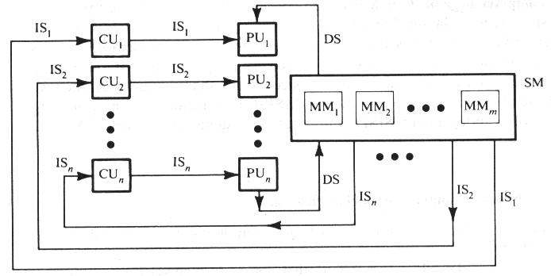
MISD
Multiple Instruction stream-Single Data stream (MISD)
The results (output) of one processor may become the input of the next processor in the macro pipe.
No real embodiment of this class exists.

Slide 225
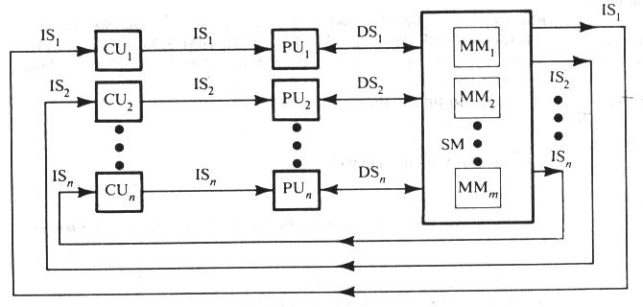
MIMD
Multiple Instruction stream-Multiple Data stream (MIMD)
Most Multiprocessor systems and Multicomputer systems can be classified in this category.

Slide 226
SHARED MEMORY MULTIPROCESSOR
Tightly-Coupled MIMD architectures shared memory among its processors.
Interconnected architecture:
  Bus-connected architecture – the processors, parallel memories, network interfaces, and device controllers are tied to the same connection bus.
  Directly connect architecture – the processors are connected directly to the high-end mainframes.

Slide 227
DISTRIBUTED MEMORY MULTIPROCESSORS
Loosely coupled MIMD architectures have distributed local memories attached to multiple processor nodes.
Message passing is the major communication method among the processor.
Most multiprocessors are designed to be scalable in performance.

Slide 228
INTERCONNECTION ARCHITECTURE
Time shared common bus
Multiport memory
Crossbar switch
Multistage switching network
Hypercube system

Slide 229
NETWORK TOPOLOGIES
Let’s assume processors function independently and communicate with each other. For these communications, the processors must be connected using physical links. Such a model is called a network model or direct-connection machine.
Network topologies:
  Complete Graph (Fully Connected Network)
  Hypercubes
  Mesh Network
  Pyramid Network
  Star Graphs

Slide 230
COMPLETE GRAPH
Complete graph is a fully connected network.
The distance between any two processor (or processing nodes) is always 1.
If complete graph network with n nodes, each node has degree n-1.
An example of n = 5:

Slide 231
HYPERCUBE (K- CUBE)
A k-cube is a k-regular graph with 2^{k} nodes which are labeled by the k-bits binary numbers.
A k-regular graph is a graph in which each node has degree k.
The distance between two nodes a = (a₁a₂…a_{k}) and b = (b₁b₂…b_{k}) is the number of bits in which a and b differ. If two nodes is adjacent to each other, their distance is 1 (only 1 bit differ.)
If a hypercube with n nodes (n = 2^{k}), the longest distance between any two nodes is log₂n (=k).

Slide 232
HYPERCUBE STRUCTURE
k = 1
k = 2
00
01
0
1
10
11
k = 3
k = 4
0100
0101
1100
1101
100
101
0000
1001
000
001
0001
1000
0110
0111
1110
1111
110
111
0010
0011
1010
1011
010
011

Slide 233
MESH NETWORK
The arrangement of processors in the form of a grid is called a mesh network.
A 2-dimensional mesh:
A k-dimensional mesh is a set of (k-1) dimensional meshes with corresponding processor communications.

Slide 234
3- DIMENSIONAL MESH
A 3-d mesh with 4 copies of 4×4 2-d meshes

Slide 235
PYRAMID NETWORK
A pyramid network is constructed similar to a rooted tree. The root contains one processor.
At the next level there are four processors in the form of a 2-dimensional mesh and all the four are children of the root.
All the nodes at the same level are connected in the form of a 2-dimensional mesh.
Each nonleaf node has four children nodes at the next level.
The longest distance between any two nodes is 2×height of the tree.

Slide 236
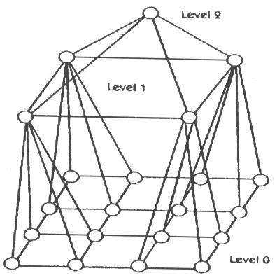
2-D PYRAMID NETWORK STRUCTURE
A pyramid of height 2

Slide 237
STAR GRAPHS
k-star graph, consider the permutation with k symbols.
There are n nodes, if there are n (=k!) permutations.
Any two nodes are adjacent, if and only if their corresponding permutations differ only in the leftmost and in any one other position.
A k-star graph can be considered as a connection of k copies of (k-1)-star graphs.

Slide 238

A 3 STAR GRAPHS
k=3, there are 6 permutations:
P₅ = (3, 2, 1)
P₀ = (1, 2, 3)
P₃ = (2, 3, 1)
P₂ = (2, 1, 3)
P₁ = (1, 3, 2)
P₄ = (3, 1, 2)
What degree of each node for 4-star graph?

Slide 239
INTERPROCESS ARBITRATION
Asynchronous/ Synchronous
Serial Arbitration (Daisy Chain)
Parallel Arbitration
Dynamic Arbitration Algorithm
Time Slice
Polling
LRU
FIFO
Rotating Daisy Chain

Slide 240
CACHE COHERENCE
A protocol for managing the caches of a multiprocessor system so that no data is lost or overwritten before the data is transferred from a cache to the target memory.
When two or more computer processors work together on a single program, known as multiprocessing, each processor may have its own memory cache that is separate from the larger RAM that the individual processors will access.
A memory cache, sometimes called a cache store or RAM cache, is a portion of memory made of high-speed static RAM (SRAM) instead of the slower and cheaper dynamic RAM (DRAM) used for main memory.
Memory caching is effective because most programs access the same data or instructions over and over. By keeping as much of this information as possible in SRAM, the computer avoids accessing the slower DRAM.

Slide 241
Cont…
When multiple processors with separate caches share a common memory, it is necessary to keep the caches in a state of coherence by ensuring that any shared operand that is changed in any cache is changed throughout the entire system.
This is done in either of two ways: through a directory-based or a snooping system.

Slide 242
Cont…
In a directory-based system, the data being shared is placed in a common directory that maintains the coherence between caches.
The directory acts as a filter through which the processor must ask permission to load an entry from the primary memory to its cache.
When an entry is changed the directory either updates or invalidates the other caches with that entry.

Slide 243
Cont…
In a snooping system, all caches on the bus monitor (or snoop) the bus to determine if they have a copy of the block of data that is requested on the bus.
Every cache has a copy of the sharing status of every block of physical memory it has.
Cache misses and memory traffic due to shared data blocks limit the performance of parallel computing in multiprocessor computers or systems.
Cache coherence aims to solve the problems associated with sharing data.

Slide 244
CACHE COHERENCE
In a shared memory multiprocessor with a separate cache memory for each processor, it is possible to have many copies of any one instruction operand: one copy in the main memory and one in each cache memory.
When one copy of an operand is changed, the other copies of the operand must be changed also.
Cache coherence is the discipline that ensures that changes in the values of shared operands are propagated throughout the system in a timely fashion.

Slide 245
LEVELS OF CACHE COHERENCE
  There are three distinct levels of cache coherence:
  Every write operation appears to occur instantaneously.
  All processes see exactly the same sequence of changes of values for each separate operand.
  Different processes may see an operand assume different sequences of values. (This is considered noncoherent behavior.)
In both level 2 behavior and level 3 behavior, a program can observe stale data. Recently, computer designers have come to realize that the programming discipline required to deal with level 2 behavior is sufficient to deal also with level 3 behavior. Therefore, at some point only level 1 and level 3 behavior will be seen in machines

Slide 246
INTERPROCESSOR COMMUNICATION & SYNCHRONIZATION
Various processors in multiprocessor environment need to communicate with each other.
A communication path can be established through common i/o channels.
They might need to send any request, message or a procedure.

Slide 247
TECHNIQUES
SHARED MEMORY
  POLLING
  SOFTWARE-INITIATED INTERPROCESSOR INTERRUPT
I/O PATH

Slide 248
DESIGN OF OPERATING SYSTEMS
FOR MULTIPROCESSORS
To prevent conflicting use of shared resources by many processors.
Master-slave configuration
Separate operating system
Distributed operating system

Slide 249
MASTER-SLAVE ORGANIZATION
In this mode , one processor , designated as master , always execute the operating system functions.
The remaining processors, denoted as slaves , don’t perform the operating system functions.
If a slave needs an operating system service, it must request it by interrupting the master.

Slide 250
SEPARATE OPERATING SYSTEM
Each processor can execute the os routines it needs.
Suitable for loosely coupled systems where every processor may have its own copy of entire os.

Slide 251
DISTRIBUTED OPERATING SYSTEM
The OS routines are distributed among the available processors.
Each particular OS function is assigned to only one processor at a time.
Also called as floating OS since the routines float from one processor to another.

Slide 252
COMMUNICATION IN LOOSELY COUPLED MULTIPROCESSOR
Memory is distributed, no shared memory
Communication occurs by means of message passing through I/O channels.
When the sending processor & receiving processor name each other as source & destination , a channel of communication is established.
A message is then sent with header & various data object used to communicate b/w any two nodes.
OS in each node contain routing information indicating the alternative paths that can be used to send information to other nodes.

Slide 253
SYNCHRONIZATION
It refers to the special case where the data used to communicate b/w processors is control information.
It is needed to enforce the correct sequence of processes & to ensure mutually exclusive access to shared writable data.

Slide 254
MUTUAL EXCLUSION
A properly functioning multiprocessor system must provide a mechanism that will guarantee orderly access to shared memory .
This is necessary to protect data from data being changed simultaneously by two or more processors.

Slide 255
CRITICAL SECTION
It is a program sequence that , once begun, must complete execution before another processor accesses the same shared resource.

Slide 256
SEMAPHORE
A binary variable , it is often used to indicate whether or not a processor is executing a critical section.
A software controlled flag that is stored in a memory location that all processor can access.

Slide 257
BINARY SEMAPHORE
When semaphore=1 implies A processor is executing A critical program & shared memory is not available to other processors.
When semaphore=0 implies shared memory is available to any requesting processor.

Slide 258
TESTING & SETTING SEMAPHORE
TSL means Test and Set while locked
SEM : A LSB of Memory word’s address
TSL SEM
  R←M[SEM] Test Semaphore
  M[SEM]<-1 Set Semaphore

Slide 259
CONCLUSIONS
Characteristics of multiprocessor
Multiprocessing
Interconnection Structure
Interconnection arbitration
Interprocessor Communication & Synchronization

Slide 260
OBJECTIVE QUESTIONS
How many 128 x 8 RAM chips are needed to provide a memory capacity of 2048 bytes?
  a) 16 b)32 c) 4 d) 64
How many lines of the address bus must be used to access 2048 bytes of memory? How many of these lines will be common to all chips?
  a) 7 b) 11 c) 4 d) None of these
How many lines must be decoded for chip select? Specify the size of the decoders?
  a) 4*16 b) 3*8 c) 2*4 d) None of these
_________ and ___________ are hardware approach to solve cache coherence problem.
______________ structure is similar to cross bar telephone exchange
_____________ memory system has separate bus between memory module and processor

Slide 261
Cont…
In a computer with a virtual memory system, the execution of an instruction may be interrupted by a page fault. Note that bringing a new page into the main memory involves a DMA transfer, which requires execution of other instruction. Is it simpler to abandon the interrupted instruction and completely re execute it later? Can this be done
_________ classification is based on data and instruction streams
____________ is needed to enforce the correct sequence of process and to ensure mutually exclusive access to shared writable data.
________ loads portion of O/S from disk to main memory and then control is transferred to O/S.

Slide 262
SHORT QUESTIONS
Name common interconnection structure used in a multiprocessor system.
A block set associative cache consist of a total of 64 blocks divided into four blocks set. The main memory contains 4096 blocks, each consisting of 128 words.
  How many bits are there in main memory address
  How many bits are there in each of the TAG,SET and WORD fields
In a computer with a virtual memory system, the execution of an instruction may be interrupted by a page fault. What state has to be saved so that this instruction can be resumed
When a page generates a reference to a page that does not reside in the physical memory, execution of the program is suspended until the request is loaded into the main memory. What difficulties might arise when an instruction in one page has an operand in different page? What capabilities must CPU have to handle this situation?

Slide 263
Cont…
How synchronization problem can be solved by using semaphore?
Explain the need for memory hierarchy and discuss the reasons for not having a large enough main memory for storing the totality of information in a computer system.
What information does page table contain?
Give difference between magnetic drum and disk.
Differentiate between paging and segmentation
What do you understand by tightly coupled process.

Slide 264
LONG QUESTIONS
Enumerate some requirements which are needed specially for multiprocessor system from the viewpoint of memory processor failures, communication and software.
A computer system needs 2 KB of RAM, 2KB of ROM and 3 I/O ports with 3 registers in each. The first 1 KB of memory space is occupied by ROM and finally the I/O port addresses. To construct this memory system 512 x 8 RAM chips are used. Show the complete memory map of the system.
What is I/O processor and what are its functions & advantages? Also discuss how I/O interrupts make more efficient use of CPU
Design parallel priority interrupt with 8 interrupt sources
Discuss organization and key characteristics and types of multiprocessors. Discuss two dimension of scheduling functions of tightly coupled multiprocessor
Write short notes on any two :-
(a) Cache memory (b) Virtual memory (c) Memory management hardware

Slide 265
Cont…
7. In case of Direct-mapping cache & Fully associated Cache and considering their merits discuss / answer the following;
rank these in terms of hardware complexity & implementation cost.
With each cache organization, what is the effect of block-mapping policies on the hit-issue ratio.
8. Discuss any two address translation schemes used in virtual memory environment
9. What do you mean by Cache memory? What is Cache Coherence? Why
does it occur? Explain in details Mapping procedures used while considering
organization of cache memory.
10. A computer employs RAM chops of 256 x 8 and ROM chips of 1024 x 8. The Computer system needs 2K bytes of RAM, 4K bytes of RAOM, and four interface units, each with four registers. A memory mapped I/O organization is used. The two highest order bits of the address bus are assigned 00 of RAM , 01 of ROM, and 10 for interface registers. 10
(a) How many RAM and ROM Chips are needed?
(b) Draw a memory address map.
(c) Give address range in hexadecimal for RAM, ROM and interface.

Slide 266
RESEARCH PROBLEM
In a paging system the virtual address contains 8K sizes pages with the bit configuration as 1010011001101 the corresponding page table entry for the page number is 11, what is the content of the main memory
Calculate the page faults if the computer system is having 4 page frames and the virtual address contain 12 pages to be accommodated. The pages referenced in this order 12 34123 257 12 consider the policies FIFO and LRU and analyze the result.

Slide 267
REFERENCES
Hayes P. John, Computer Architecture and Organisation, McGraw Hill Comp., 1988.
Mano M., Computer System Architecture, Prentice-Hall Inc. 1993.
Patterson, D., Hennessy, J., Computer Architecture - A
Quantitative Approach, second edition, Morgan Kaufmann Publishers, Inc. 1996;
Stallings, William, Computer Organization and Architecture, 5th edition, Prentice Hall International, Inc., 2000.
Tanenbaum, A., Structured Computer Organization, 4th ed., Prentice- Hall Inc. 1999.
Hamacher, Vranesic, Zaky, Computer Organization, 4th ed., McGraw Hill Comp., 1996.

