Slide 1
UNIT-I
COMPUTER ORGANIZATION

Slide 2
LEARNING OBJECTIVES
  Multiplexer and Demultiplexer
  Decoder
  Adder
  Flip-Flop
  Registers

Slide 3
COMBINATIONAL CIRCUIT
A MULTIPLEXER (MUX)
Consider an integer ‘m’, which is constrained by the following relation:
m = 2^{n}, where m and n are both integers.
A m-to-1 Multiplexer has
    m Inputs: I₀, I₁, I₂, ................ I_{(m-1)}
    one Output: Y
    n Control inputs: S₀, S₁, S₂, ...... S_{(n-1)}
    One (or more) Enable input(s)
such that Y may be equal to one of the inputs, depending upon the control inputs.

Slide 4
4-to-1 MULTIPLEXER
A 4-to-1 Multiplexer:
I0
2^{n} inputs
I1
Y
I2
1 output
I3
Enable (G)
S0
S1
n control inputs

Slide 5
CHARACTERISTIC TABLE OF A MULTIPLEXER
If the MUX is enabled,
s₀ s₁
0 0 Y=I0
0 1 Y=I1
1 0 Y=I2
1 1 Y=I3
Putting the above information in the form of a Boolean equation,
Y =G. I0. S’1. S’0 + G. I1. S’1. S0 + G. I2. S1. S’0 + G. I3. S1. S0

Slide 6
IMPLEMENTING DIGITAL FUNCTIONS
Implementation of F(A,B,C,D)=∑ (m(1,3,5,7,8,10,12,13,14), d(4,6,15)) By using a 16-to-1 multiplexer:
0
I0
1
I1
0
I2
1
I3
0
I4
1
I5
0
I6
F
1
I7
1
I8
0
I9
1
I10
0
I11
1
I12
1
I13
I14
1
I15
0
NOTE: 4,6 and 15 MAY BE
CONNECTED to either 0 or 1
S₃
S₂
S₁
S₀

Slide 7
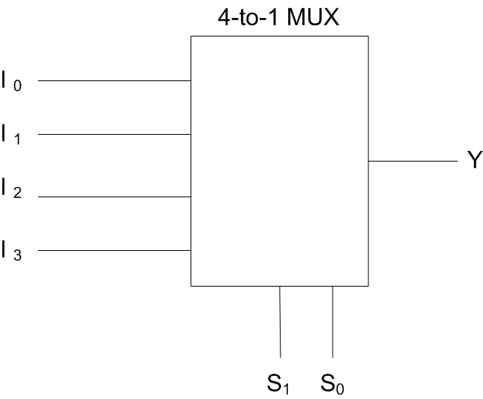
Cont…
In this example to design a 3 variable logical function, we try to use a 4-to-1 MUX rather than a 8-to-1 MUX.
F(x, y, z)=∑ (m(1, 2, 4, 7)

Slide 8
Cont..
In a canonic form:
F = x’.y’.z+ x’.y.z’+x.y’.z’ +x.y.z …… (1)
One Possible Solution:
Assume that x = S1 , y = S0 .
If F is to be obtained from the output of a 4-to-1 MUX,
F =S’1. S’0. I0 + S’1. S0. I1 + S1. S’0. I2 + S1. S0. I3 …. (2)
From (1) and (2),
I0 = I3 =Z I1 = I2 =Z’

Slide 9
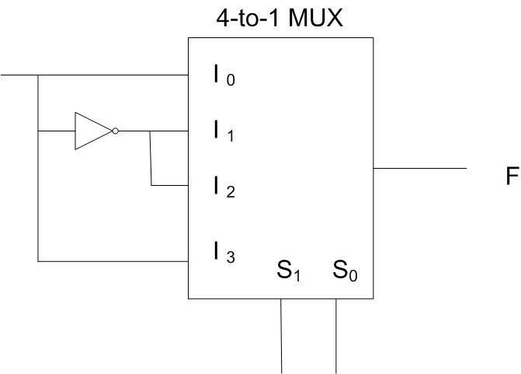
Cont..
Z
X
Y

Slide 10
Cont…
Another Possible Solution:
Assume that z = S1 , x = S0 .
If F is to be obtained from the output of a 4-to-1 MUX,
F = S’0 .I0 . S1 + S’0 .I1 . S’1 + S0 .I2 . S’1 + S0 .I3 . S1 ……(3)
From (1) and (2),
I0 = y’ = I2
I1 = y = I3

Slide 11
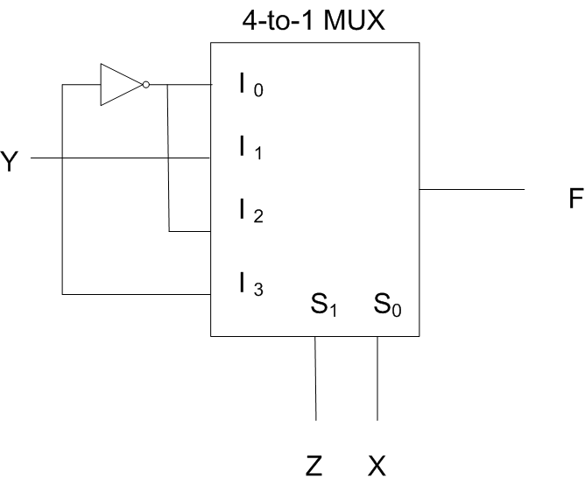
Cont…

Slide 12
RELATIONSHIP BETWEEN
A MULTIPLEXER AND A DEMULTIPLEXER
I0
I1
I2
I3
Y0
Y1
Y2
Y4
4 to 1
MUX
1 to 4
DEMUX
_{Y out}
Input
S1 S0
S1 S0

Slide 13
Demultiplexer (DMUX)/ Decoder
A 1-to-m DMUX, with ACTIVE HIGH Outputs, has
1 Input: I ( also called as the Enable input when the device is called a Decoder)
m ACTIVE HIGH Outputs: Y₀, Y₁, Y₂, ..................................... …………….Y_{(m-1)}
n Control inputs: S₀, S₁, S₂, ...... S_{(m-1)}

Slide 14
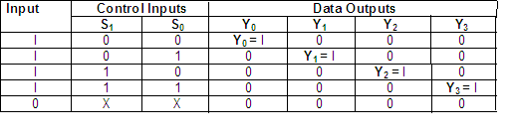
CHARACTERISTIC TABLE
Characteristic table of the 1-to-4 DMUX with ACTIVE HIGH Outputs
Table 2

Slide 15
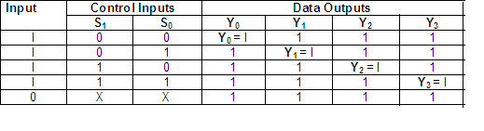
CHARACTERISTIC TABLE
Characteristic Table of a 1-to-4 DMUX, with ACTIVE LOW Outputs
Table 3

Slide 16
A Decoder is a Demultiplexer with a change in the name of the inputs
DECODER/DEMULTIPLEXER
Y0
Y1
Y2
Y4
2 to 4
Decoder
ENABLE
INPUT
S1 S0
When the IC is used as a Decoder, the input I is called an Enable input

Slide 17
DECODER
In Tables 2 and 3, when Enable is 0, i.e. when the IC is Disabled, all the Outputs remain ‘unexcited’.
The ‘unexcited’ state of an Output is 0 for an IC with ACTIVE HIGH Outputs.
The ‘unexcited’ state of an Output is 1 for an IC with ACTIVE LOW Outputs.
Enable Input:
In a Decoder, the Enable Input can be ACTIVE LOW or ACTIVE HIGH.

Slide 18
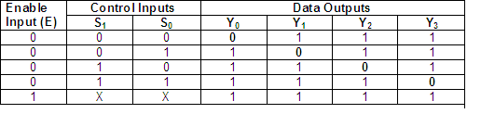
CHARACTERISTIC TABLE
Characteristic Table of a 2-to-4 DECODER, with ACTIVE LOW Outputs and with ACTIVE LOW Enable Input:
Table 4
Logic expressions for the outputs of the Decoder of Table 4:
Y0 = E + S1 + S0 Y1 = E + S1+ S0‘
Y2 = E + S1‘ + S0 Y3 = E + S1‘ + S0‘

Slide 19
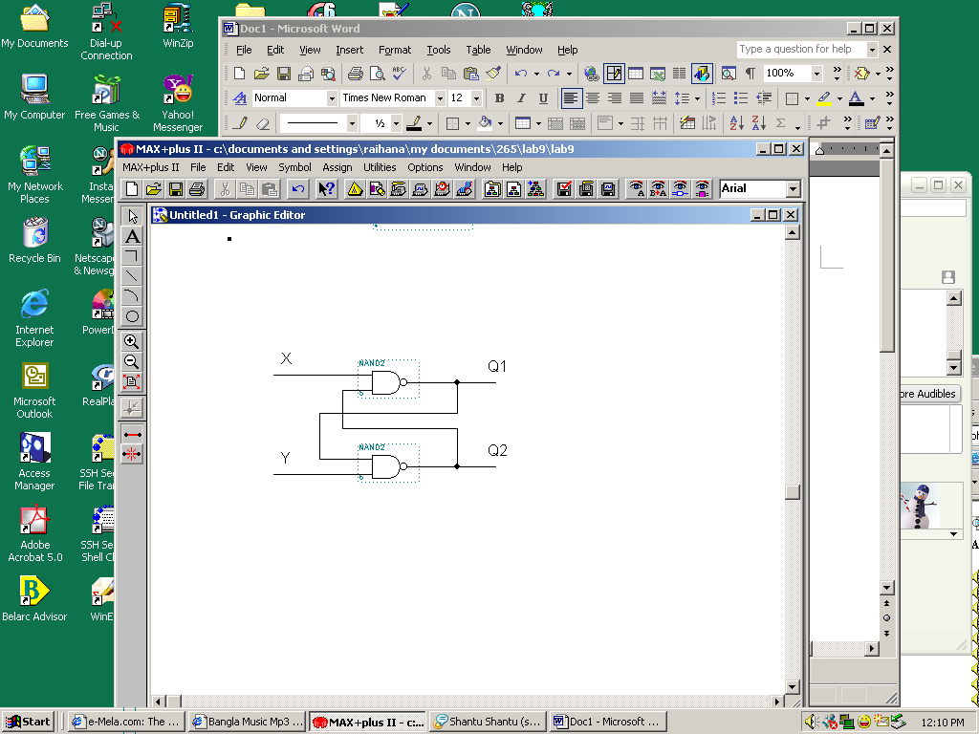
CROSS COUPLED NAND GATES
A cross-coupled set of NAND gates
Characteristic table:
X Y Q1 Q2
0 0 1 1
0 1 1 0
1 0 0 1
For this case, the outputs can be obtained by using the following procedure:
Assume a set of values for Q1 and Q2, which exist before the inputs of X = 1 and Y =1 are applied.
Obtain the new set of values for Q1 and Q2
Verify whether the procedure yields valid results.

Slide 20
Cont…
X | Y | OLD Outputs |  | NEW Outputs
 |  | Q1 | Q2 | Q1 | Q2
0 | 0 | ----- | ---- | 1 | 1
0 | 1 | ---- | ---- | 1 | 0
1 | 0 | ---- | ---- | 0 | 1
1 | 1 | 1 | 0 | 1 | 0
 |  | 0 | 1 | 0 | 1

Slide 21
CONCLUSIONS
Multiplexer is a combinational circuit that selects binary information from one of many output lines and direct it to single output line based on the selection lines.
De-multiplexing is an opposite process to a multiplexing process it perform "one to many" operation.
  It has only one input (D) and 'n' number of outputs (y0, y1, y2, and y3......... yn-1).
  Demultiplexing accepts one input and can distribute it to several outputs the select code or control word determines to which output the input is connected.
Demultiplexer can also be used as a decoder e.g. binary to decimal decoder.
A decoder is a combinational circuit that converts binary information from n input lines to a maximum of second unique output lined.
A strobe or enable input E is incorporated which helps in cascading and is generally active low, which means it perform its intended operation when it is low

Slide 22
ADDERS

Slide 23
OVERVIEW
Iterative combinational circuits
Binary adders
  Half and full adders
  Ripple carry and carry lookahead adders
Binary subtraction
Binary adder-subtractors
  Signed binary numbers
  Signed binary addition and subtraction
  Overflow
Binary multiplication
Other arithmetic functions
  Design by contraction

Slide 24
ITERATIVE COMBINATIONAL CIRCUITS
Arithmetic functions
  Operate on binary vectors
  Use the same subfunction in each bit position
Can design functional block for subfunction and repeat to obtain functional block for overall function
Cell - subfunction block
Iterative array - a array of interconnected cells
An iterative array can be in a single dimension (1D) or multiple dimensions

Slide 25
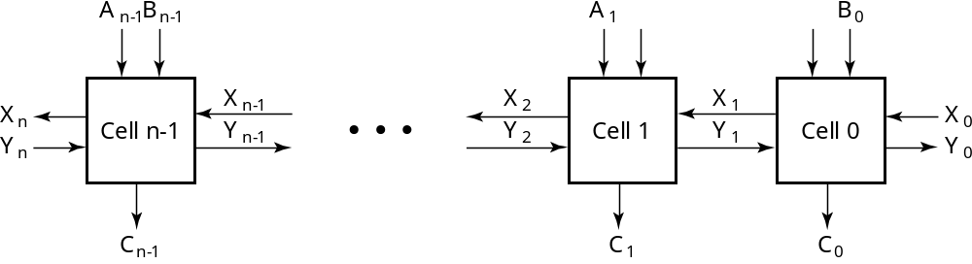
BLOCK DIAGRAM OF A 1D ITERATIVE ARRAY
Example: n = 32
  Number of inputs = ?
  Truth table rows = ?
  Equations with up to ? input variables
  Equations with huge number of terms
  Design impractical!
Iterative array takes advantage of the regularity to make design feasible
Notes:
Number of Inputs = 66
Truth Table Rows = 2⁶⁶
Equations with up to 66 variables

Slide 26
FUNCTIONAL BLOCKS: ADDITION
Binary addition used frequently
Addition Development:
  Half-Adder (HA), a 2-input bit-wise addition functional block,
  Full-Adder (FA), a 3-input bit-wise addition functional block,
  Ripple Carry Adder, an iterative array to perform binary addition, and
  Carry-Look-Ahead Adder (CLA), a hierarchical structure to improve performance.

Slide 27
FUNCTIONAL BLOCK: HALF-ADDER
A 2-input, 1-bit width binary adder that performs the following computations:
A half adder adds two bits to produce a two-bit sum
The sum is expressed as a sum bit , S and a carry bit, C
The half adder can be specified
as a truth table for S and C ⇒
X
0
0
1
1
+ Y
+ 0
+ 1
+ 0
+ 1
C S
0 0
0 1
0 1
1 0
X
Y
C
S
0
0
0
0
0
1
0
1
1
0
0
1
1
1
1
0

Slide 28
LOGIC SIMPLIFICATION: HALF-ADDER
The K-Map for S, C is:
This is a pretty trivial map!
By inspection:
and
These equations lead to several implementations.
S
Y
C
Y
1
0
1
0
1
X
1
X
1
S
=
X
⋅
Y
+
X
⋅
Y
=
X
⊕
Y
2
3
2
3
S
=
(
X
+
Y
)
⋅
(
X
+
Y
)
C
=
X
⋅
Y
C
=
(
(
X
⋅
Y
)
)

Slide 29
FIVE IMPLEMENTATIONS: HALF-ADDER
We can derive following sets of equations for a half-adder:
a), (b), and (e) are SOP, POS, and XOR implementations for S.
In (c), the C function is used as a term in the AND-NOR implementation of S, and in (d), the function is used in a POS term for S.
(
a
)
S
=
X
⋅
Y
+
X
⋅
Y
(
d
)
S
=
(
X
+
Y
)
⋅
C
C
=
X
⋅
Y
C
=
(
X
+
Y
)
(
b
)
S
=
(
X
+
Y
⋅
+
=
⊕
)
(
X
Y
)
(
e
)
S
X
Y
C
=
X
⋅
Y
C
=
X
⋅
Y
(
c
)
S
=
(
C
+
X
⋅
Y
)
C
=
X
⋅
Y
C

Slide 30
IMPLEMENTATIONS: HALF-ADDER
The most common half adder implementation is:
A NAND only implementation is:
X
S
Y
S
=
X
⊕
Y
C
C
=
X
⋅
Y
C
X
S
=
(
X
+
Y
)
⋅
C
C
=
(
(
X
⋅
Y
)
)
S
Y

Slide 31
FUNCTIONAL BLOCK: FULL-ADDER
A full adder is similar to a half adder, but includes a carry-in bit from lower stages. Like the half-adder, it computes a sum bit, S and a carry bit, C.
  For a carry-in (Z) of
  0, it is the same as
  the half-adder:
  For a carry- in
  (Z) of 1:
Z
0
0
0
0
X
0
0
1
1
+ Y
+ 0
+ 1
+ 0
+ 1
C S
0
0
0 1
0 1
1 0
Z
1
1
1
1
X
0
0
1
1
+ Y
+ 0
+ 1
+ 0
+ 1
C S
0 1
1 0
1 0
1
1

Slide 32
LOGIC OPTIMIZATION: FULL-ADDER
Full-Adder Truth Table:
Full-Adder K-Map:
X
Y
Z
C
S
0
0
0
0
0
0
0
1
0
1
0
1
0
0
1
0
1
1
1
0
1
0
0
0
1
1
0
1
1
0
1
1
0
1
0
1
1
1
1
1
S
Y
C
Y
1
1
1
0
1
3
2
0
1
3
2
X
1
1
X
1
1
1
4
5
7
6
4
5
7
6
Z
Z

Slide 33
EQUATIONS: FULL-ADDER
From the K-Map, we get:
The S function is the three-bit XOR function (Odd Function):
The Carry bit C is 1 if both X and Y are 1 (the sum is 2), or if the sum is 1 and a carry-in (Z) occurs. Thus C can be re-written as:
The term X·Y is carry generate.
The term X⊕Y is carry propagate.
S
=
X
Y
Z
+
X
Y
Z
+
X
Y
Z
+
X
Y
Z
C
=
X
Y
+
X
Z
+
Y
Z
S
=
X
⊕
Y
⊕
Z
C
=
X
Y
+
(
X
⊕
Y
)
Z

Slide 34
IMPLEMENTATION: FULL ADDER
Full Adder Schematic
Here X, Y, and Z, and C
(from the previous pages)
are A, B, C_{i} and C_{o},
respectively. Also,
G = generate and
P = propagate.
Note: This is really a combination
of a 3-bit odd function (for S)) and
Carry logic (for C_{o}):
(G = Generate) OR (P =Propagate AND C_{i} = Carry In)
Co = G + P · Ci
A_{i}
B_{i}
G_{i}
P_{i}
C_{i}
C_{i+1}
S_{i}

Slide 35
BINARY ADDERS
To add multiple operands, we “bundle” logical signals together into vectors and use functional blocks that operate on the vectors
Example: 4-bit ripple carry
adder: Adds input vectors A(3:0) and B(3:0) to get
a sum vector S(3:0)
Note: carry out of cell i
becomes carry in of cell
i + 1
Description
Subscript
Name
3 2 1 0
Carry In
0 1 1 0
C_{i}
Augend
1 0 1 1
A_{i}
Addend
0 0 1 1
B_{i}
Sum
1 1 1 0
S_{i}
Carry out
0 0 1 1
C_{i+1}

Slide 36
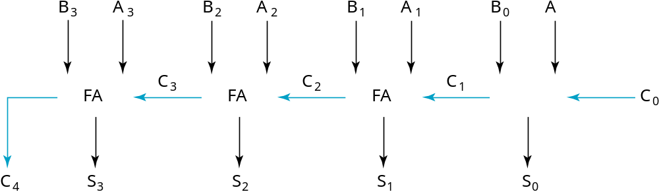
4-BIT RIPPLE-CARRY BINARY ADDER
A four-bit Ripple Carry Adder made from four 1-bit Full Adders:

Slide 37
UNSIGNED SUBTRACTION
Algorithm:
  Subtract the subtrahend N from the minuend M
  If no end borrow occurs, then M ³ N, and the result is a non-negative number and correct.
  If an end borrow occurs, the N > M and the difference M − N + 2n is subtracted from 2n, and a minus sign is appended to the result.
Examples:
0 1
1001 0100
− 0111 − 0111
0010 1101
10000
− 1101
(−) 0011

Slide 38
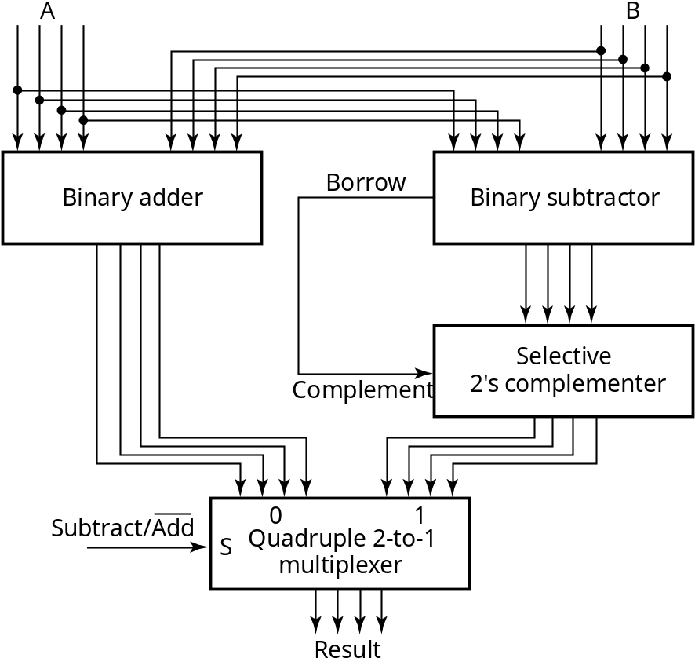
Cont…
The subtraction, 2^{n} − N, is taking the 2’s complement of N
To do both unsigned addition and unsigned subtraction requires:
Quite complex!
Goal: Shared simpler
logic for both addition
and subtraction
Introduce complements
as an approach

Slide 39
COMPLEMENTS
Two complements:
  Diminished Radix Complement of N
    (r − 1)’s complement for radix r
    1’s complement for radix 2
    Defined as (r^{n} − 1) − Ν
  Radix Complement
    r’s complement for radix r
    2’s complement in binary
    Defined as r^{n} − N
Subtraction is done by adding the complement of the subtrahend
If the result is negative, takes its 2’s complement

Slide 40
BINARY 1'S COMPLEMENT
For r = 2, N = 01110011₂, n = 8 (8 digits):
(r^{n} – 1) = 256 -1 = 255₁₀ or 11111111₂
The 1's complement of 01110011₂ is then:
11111111
– 01110011
10001100
Since the 2^{n} – 1 factor consists of all 1's and since 1 – 0 = 1 and 1 – 1 = 0, the one's complement is obtained by complementing each individual bit (bitwise NOT).

Slide 41
BINARY 2'S COMPLEMENT
For r = 2, N = 01110011₂, n = 8 (8 digits), we have:
(r^{n} ) = 256₁₀ or 100000000₂
The 2's complement of 01110011 is then:
100000000
– 01110011
10001101
Note the result is the 1's complement plus 1, a fact that can be used in designing hardware

Slide 42
ALTERNATE 2’S COMPLEMENT METHOD
Given: an n-bit binary number, beginning at the least significant bit and proceeding upward:
  Copy all least significant 0’s
  Copy the first 1
  Complement all bits thereafter.
2’s Complement Example:
  10010100
  Copy underlined bits:
  100
  and complement bits to the left:
  01101100

Slide 43
SUBTRACTION WITH 2’S COMPLEMENT
For n-digit, unsigned numbers M and N, find M − N in base 2:
  Add the 2's complement of the subtrahend N to the minuend M:
  M + (2^{n} − N) = M − N + 2^{n}
  If M > N, the sum produces end carry r^{n} which is discarded; from above, M − N remains.
  If M < N, the sum does not produce an end carry and, from above, is equal to 2^{n} − ( N − M ), the 2's complement of ( N − M ).
  To obtain the result − (N – M) , take the 2's complement of the sum and place a − to its left.

Slide 44
UNSIGNED 2’S COMPLEMENT SUBTRACTION
Find 01010100₂ – 01000011₂
01010100 01010100
– 01000011 + 10111101
00010001
The carry of 1 indicates that no correction of the result is required.
1
2’s comp

Slide 45
UNSIGNED 2’S COMPLEMENT SUBTRACTION
Find 01000011₂ – 01010100₂
01000011 01000011
– 01010100 + 10101100
11101111
00010001
The carry of 0 indicates that a correction of the result is required.
Result = – (00010001)
0
2’s comp
2’s comp

Slide 46
SIGNED INTEGERS
Positive numbers and zero can be represented by unsigned n-digit, radix r numbers.We need a representation for negative numbers.
To represent a sign (+ or –) we need exactly one more bit of information (1 binary digit gives 2¹ = 2 elements which is exactly what is needed).
Since computers use binary numbers, by convention, the most significant bit is interpreted as a sign bit:
s a_{n–2} … a₂a₁a₀
where:
s = 0 for Positive numbers
s = 1 for Negative numbers and
a_{i} = 0 or 1 represent the magnitude in some form.

Slide 47
SIGNED INTEGER REPRESENTATIONS
Signed-Magnitude – here the n – 1 digits are interpreted
as a positive magnitude.
Signed-Complement – here the digits are interpreted as the rest of the complement of the number. There are two possibilities here:
  Signed 1's Complement
    Uses 1's Complement Arithmetic
  Signed 2's Complement
    Uses 2's Complement Arithmetic

Slide 48
EXAMPLE
r =2, n=3
Number
Sign
-
Mag.
1's Comp.
2's Comp.
+3
011
011
011
+2
010
010
010
+1
001
001
001
+0
000
000
000
–
0
100
111
—
–
1
101
110
111
–
2
110
101
110
–
3
111
100
101
–
4
—
—
100

Slide 49
SIGNED-MAGNITUDE ARITHMETIC
If the parity of the three signs is 0
  Add the magnitudes.
  Check for overflow (a carry out of the MSB)
  The sign of the result is the same as the sign of the
  first operand.
If the parity of the three signs is 1
  Subtract the second magnitude from the first.
  If a borrow occurs:
    take the two’s complement of result
    make the result sign the complement of the
      sign of the first operand.
    Overflow will never occur.

Slide 50
SIGNED-COMPLEMENT ARITHMETIC
Addition:
  1. Add the numbers including the sign bits, discarding a carry out of the sign bits (2's Complement), or using an end-around carry (1's Complement).
  2. If the sign bits were the same for both numbers and the sign of the result is different, an overflow has occurred.
  3. The sign of the result is computed in step 1.
Subtraction:
  Form the complement of the number you are subtracting and follow the rules for addition.

Slide 51
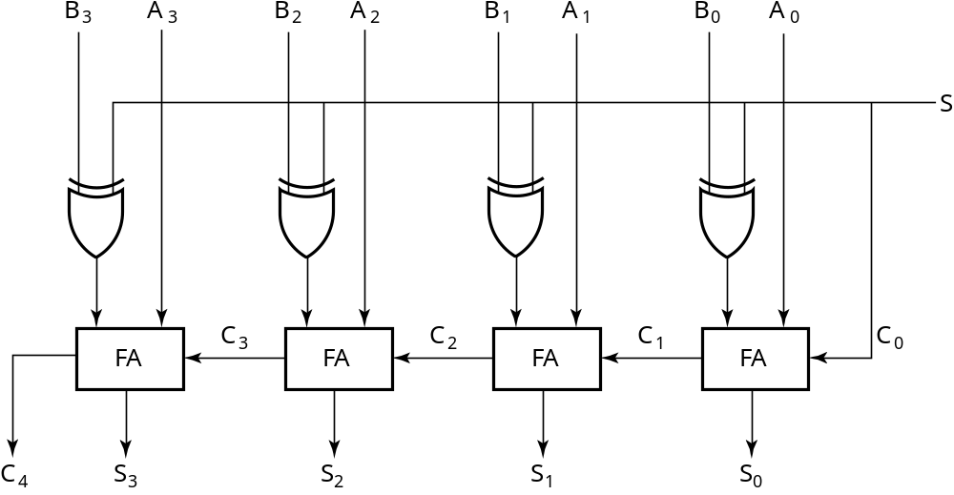
2’S COMPLEMENT ADDER/SUBTRACTOR
Subtraction can be done by addition of the 2's Complement.
1. Complement each bit (1's Complement.)
2. Add 1 to the result.
The circuit shown computes A + B and A – B:
For S = 1, subtract,
the 2’s complement
of B is formed by using
XORs to form the 1’s
comp and adding the 1
applied to C₀.
For S = 0, add, B is
passed through
unchanged

Slide 52
OVERFLOW DETECTION
Overflow occurs if n + 1 bits are required to contain the result from an n-bit addition or subtraction
Overflow can occur for:
  Addition of two operands with the same sign
  Subtraction of operands with different signs
Signed number overflow cases with correct result sign
0 0 1 1
+ 0 − 1 − 0 + 1
0 0 1 1
Detection can be performed by examining the result signs which should match the signs of the top operand

Slide 53
Cont…
Signed number cases with carries C_{n} and C_{n-1} shown for correct result signs:
0 0 0 0 1 1 1 1
0 0 1 1
+ 0 - 1 - 0 + 1
0 0 1 1
Signed number cases with carries shown for erroneous result signs (indicating overflow):
0 1 0 1 1 0 1 0
0 0 1 1
+ 0 - 1 -0 + 1
1 1 0 0
Simplest way to implement overflow V = C_{n} + C_{n - 1}
This works correctly only if 1’s complement and the addition of the carry in of 1 is used to implement the complementation! Otherwise fails for - 10 ... 0

Slide 54
ARITHMETIC FUNCTIONS
Convenient to design the functional blocks by contraction - removal of redundancy from circuit to which input fixing has been applied
Functions
  Incrementing
  Decrementing
  Multiplication by Constant
  Division by Constant
  Zero Fill and Extension

Slide 55
INCREMENTING & DECREMENTING
Incrementing
  Adding a fixed value to an arithmetic variable
  Fixed value is often 1, called counting (up)
  Examples: A + 1, B + 4
  Functional block is called incrementer
Decrementing
  Subtracting a fixed value from an arithmetic variable
  Fixed value is often 1, called counting (down)
  Examples: A − 1, B − 4
  Functional block is called decrementer

Slide 56
MULTIPLICATION/DIVISION BY 2N
(a) Multiplication
by 100
  Shift left by 2
(b) Division
by 100
  Shift right by 2
  Remainder
  preserved
B
3
B
2
B
1
B
0
0
0
C
5
C
4
C
3
C
2
C
1
C
0
(a)
B
3
B
2
B
1
B
0
0
0
C
3
C
2
C
1
C
0
C
2
1
C
2
2
(b)

Slide 57
ZERO FILL
Zero fill - filling an m-bit operand with 0s to become an n-bit operand with n > m
Filling usually is applied to the MSB end of the operand, but can also be done on the LSB end
Example: 11110101 filled to 16 bits
  MSB end: 0000000011110101
  LSB end: 1111010100000000

Slide 58
EXTENSION
Extension - increase in the number of bits at the MSB end of an operand by using a complement representation
  Copies the MSB of the operand into the new positions
  Positive operand example - 01110101 extended to 16 bits:
  0000000001110101
  Negative operand example - 11110101 extended to 16 bits:
  1111111111110101

Slide 59
CONCLUSIONS
A half adder is a combinational circuit that adds two bits to produce a two-bit sum
The sum is expressed as a sum bit , S and a carry bit, C
A full adder is similar to a half adder, but includes a carry-in bit from lower stages. Like the half-adder, it computes a sum bit, S and a carry bit, C.
Negative number have three representation
  Sign Magnitude
  1’s complement
  2’s complement

Slide 60
FLIP-FLOPS

Slide 61
FLIP-FLOPS
Last time, we saw how latches can be used as memory in a circuit.
Latches introduce new problems:
  We need to know when to enable a latch.
  We also need to quickly disable a latch.
  In other words, it’s difficult to control the timing of latches in a large circuit.
We solve these problems with two new elements: clocks and flip-flops
  Clocks tell us when to write to our memory.
  Flip-flops allow us to quickly write the memory at clearly defined times.
  Used together, we can create circuits without worrying about the memory timing.

Slide 62
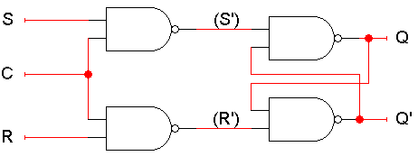
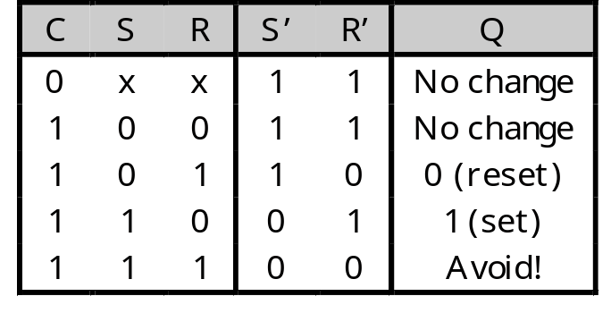
SR LATCH WITH A CONTROL INPUT
Here is an SR latch with a control input C.
Notice the hierarchical design!
  The dotted blue box is the S’R’ latch.
  The additional NAND gates are simply used to generate the correct inputs for the S’R’ latch.
The control input acts just like an enable.

Slide 63
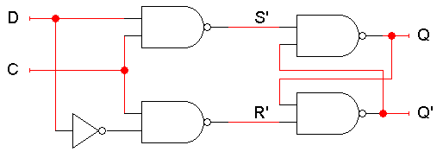
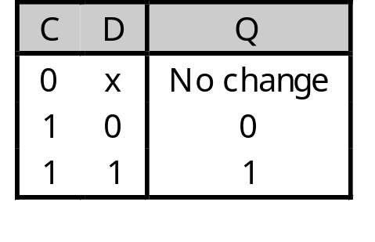
D LATCH
Finally, a D latch is based on an S’R’ latch. The additional gates generate the S’ and R’ signals, based on inputs D (“data”) and C (“control”).
  When C = 0, S’ and R’ are both 1, so the state Q does not change.
  When C = 1, the latch output Q will equal the input D.
No more messing with one input for set and another input for reset!
Also, this latch has no “bad” input combinations to avoid. Any of the four possible assignments to C and D are valid.

Slide 64
USING LATCHES IN REAL LIFE
We can connect some latches, acting as memory, to an ALU.
Let’s say these latches contain some value that we want to increment.
  The ALU should read the current latch value.
  It applies the “G = X + 1” operation.
  The incremented value is stored back into the latches.
At this point, we have to stop the cycle, so the latch value doesn’t get incremented again by accident.
One convenient way to break the loop is to disable the latches.
+1
S
ALU
G
X
D
Q
Latches
C

Slide 65
PROBLEM WITH LATCHES
The problem is exactly when to disable the latches. You have to wait long enough for the ALU to produce its output, but no longer.
  But different ALU operations have different delays. For instance, arithmetic operations might go through an adder, whereas logical operations don’t.
  Changing the ALU implementation, such as using a carry-lookahead adder instead of a ripple-carry adder, also affects the delay.
In general, it’s very difficult to know how long operations take, and how long latches should be enabled for.
+1
S
ALU
G
X
D
Q
Latches
C

Slide 66
MAKING LATCHES WORK RIGHT
Our example used latches as memory for an ALU.
  Let’s say there are four latches initially storing 0000.
  We want to use an ALU to increment that value to 0001.
Normally the latches should be disabled, to prevent unwanted data from being accidentally stored.
  In our example, the ALU can read the current latch contents, 0000, and compute their increment, 0001.
  But the new value cannot be stored back while the latch is disabled.
+1
S
ALU
G
X
0001
0000
D
Q
Latches
C
0

Slide 67
WRITING TO THE LATCHES
After the ALU has finished its increment operation, the latch can be enabled, and the updated value is stored.
The latch must be quickly disabled again, before the ALU has a chance to read the new value 0001 and produce a new result 0010.
+1
S
ALU
G
X
0001
0001
D
Q
Latches
C
1
+1
S
ALU
G
X
0010
0001
D
Q
Latches
C
0

Slide 68
ISSUES
So to use latches correctly within a circuit, we have to:
  Keep the latches disabled until new values are ready to be stored.
  Enable the latches just long enough for the update to occur.
There are two main issues we need to address:
How do we know exactly when the new values are ready?
We’ll add another signal to our circuit. When this new signal becomes 1, the latches will know that the ALU computation has completed and data is ready to be stored.
How can we enable and then quickly disable the latches?
This can be done by combining latches together in a special way, to form what are called flip-flops.

Slide 69

CLOCKS AND SYNCHRONIZATION
A clock is a special device that whose output continuously alternates between 0 and 1.
The time it takes the clock to change from 1 to 0 and back to 1 is called the clock period, or clock cycle time.
The clock frequency is the inverse of the clock period. The unit of measurement for frequency is the hertz.
Clocks are often used to synchronize circuits.
  They generate a repeating, predictable pattern of 0s and 1s that can trigger certain events in a circuit, such as writing to a latch.
  If several circuits share a common clock signal, they can coordinate their actions with respect to one another.
This is similar to how humans use real clocks for synchronization.
clock period

Slide 70

SYNCHRONIZING EXAMPLE
We can use a clock to synchronize our latches with the ALU.
  The clock signal is connected to the latch control input C.
  The clock controls the latches. When it becomes 1, the latches will be enabled for writing.
The clock period must be set appropriately for the ALU.
  It should not be too short. Otherwise, the latches will start writing before the ALU operation has finished.
  It should not be too long either. Otherwise, the ALU might produce a new result that will accidentally get stored, as we saw before.
The faster the ALU runs, the shorter the clock period can be.
+1
S
ALU
G
X
D
Q
Latches
C

Slide 71
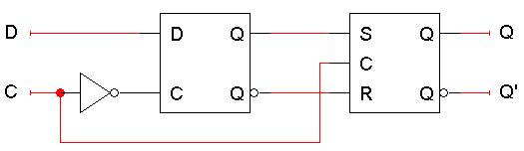
FLIP-FLOPS
The second issue was how to enable a latch for just an instant.
Here is the internal structure of a D flip-flop.
  The flip-flop inputs are C and D, and the outputs are Q and Q’.
  The D latch on the left is the master, while the SR latch on the right is called the slave.
Note the layout here.
  The flip-flop input D is connected directly to the master latch.
  The master latch output goes to the slave.
  The flip-flop outputs come directly from the slave latch.

Slide 72
D FLIP-FLOPS WHEN C=0
The D flip-flop’s control input C enables either the D latch or the SR latch, but not both.
When C = 0:
  The master latch is enabled, and it monitors the flip-flop input D. Whenever D changes, the master’s output changes too.
  The slave is disabled, so the D latch output has no effect on it. Thus, the slave just maintains the flip-flop’s current state.

Slide 73
D FLIP-FLOPS WHEN C=1
As soon as C becomes 1,
  The master is disabled. Its output will be the last D input value seen just before C became 1.
  Any subsequent changes to the D input while C = 1 have no effect on the master latch, which is now disabled.
  The slave latch is enabled. Its state changes to reflect the master’s output, which again is the D input value from right when C became 1.

Slide 74
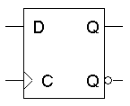
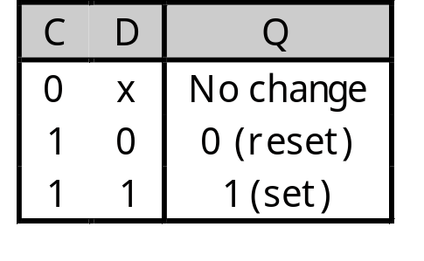
POSITIVE EDGE TRIGGERING
This is called a positive edge-triggered flip-flop.
  The flip-flop output Q changes only after the positive edge of C.
  The change is based on the flip-flop input values that were present right at the positive edge of the clock signal.
The D flip-flop’s behavior is similar to that of a D latch except for the positive edge-triggered nature, which is not explicit in this table.

Slide 75
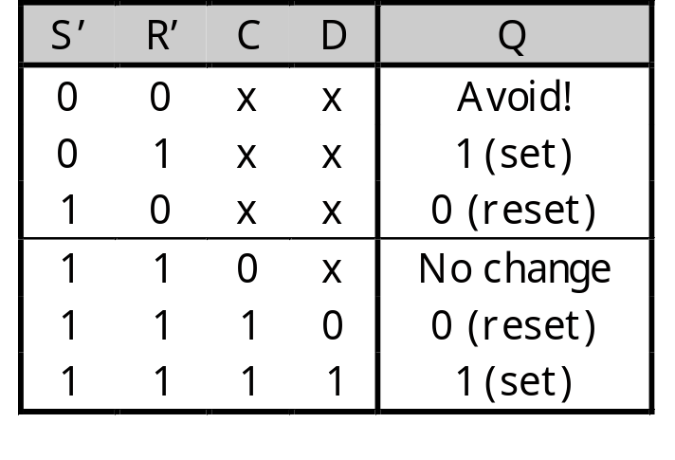
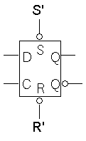
DIRECT INPUTS
One last thing to worry about… what is the starting value of Q?
We could set the initial value synchronously, at the next positive clock edge, but this actually makes circuit design more difficult.
Instead, most flip-flops provide direct, or asynchronous, inputs that let you immediately set or clear the state.
  You would “reset” the circuit once, to initialize the flip-flops.
  The circuit would then begin its regular, synchronous operation.
Here is a LogicWorks D flip-flop with active-low direct inputs.
Direct inputs to set or reset the flip-flop
S’R’ = 11 for “normal” operation of the D flip-flop

Slide 76
EXAMPLE
We can use the flip-flops’ direct inputs to initialize them to 0000.
During the clock cycle, the ALU outputs 0001, but this does not affect the flip-flops yet.
+1
S
C
Q₀
G₀
ALU
G
X
0000
D
Q
Flip-flops
C
C
Q₀
G₀
+1
S
ALU
G
X
0001
0000
D
Q
Flip-flops
C

Slide 77
Cont…
The ALU output is copied into the flip-flops at the next positive edge of the clock signal.
The flip-flops automatically “shut off,” and no new data can be written until the next positive clock edge... even though the ALU produces a new output.
+1
S
C
Q₀
G₀
ALU
G
X
0001
0001
D
Q
Flip-flops
C
+1
S
C
Q₀
G₀
ALU
G
X
0010
0001
D
Q
Flip-flops
C

Slide 78
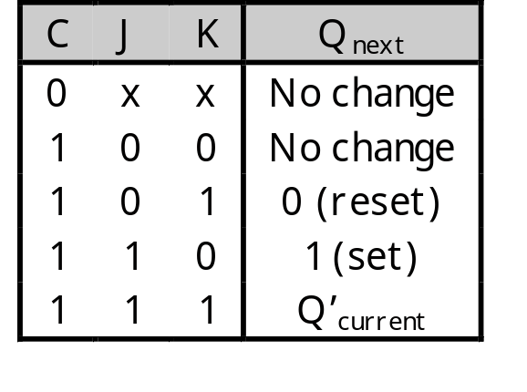
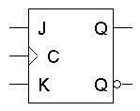
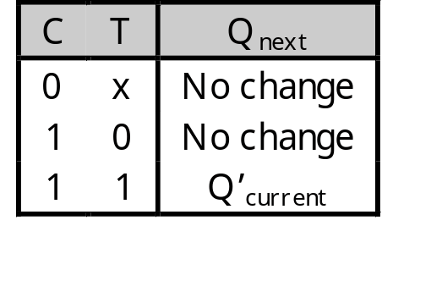
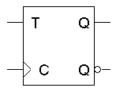
FLIP-FLOP VARIATIONS
We can make different versions of flip-flops based on the D flip-flop, just like we made different latches based on the S’R’ latch.
A JK flip-flop has inputs that act like S and R, but the inputs JK=11 are used to complement the flip-flop’s current state.
A T flip-flop can only maintain or complement its current state.

Slide 79
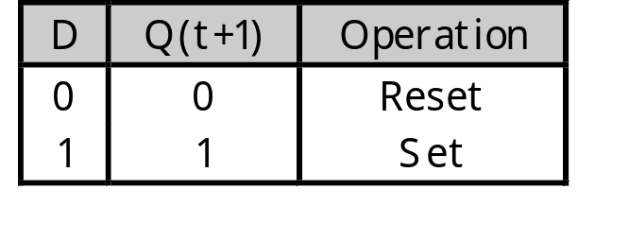
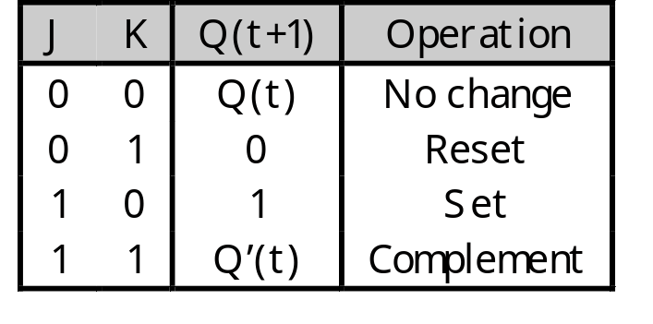
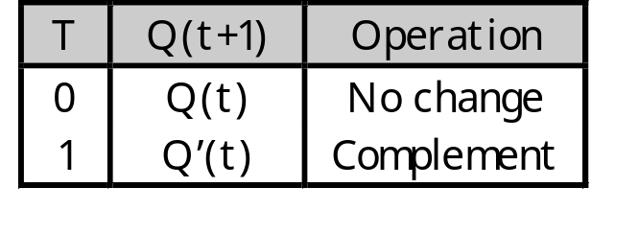
CHARACTERISTIC TABLES
The tables that we’ve made so far are called characteristic tables.
  They show the next state Q(t+1) in terms of the current state Q(t) and the inputs.
  For simplicity, the control input C is not usually listed.
  Again, these tables don’t indicate the positive edge-triggered behavior of the flip-flops that we’ll be using.

Slide 80
CHARACTERISTIC EQUATIONS
We can also write characteristic equations, where the next state Q(t+1) is defined in terms of the current state Q(t) and inputs.
Q(t+1) = D
Q(t+1) = K’Q(t) + JQ’(t)
Q(t+1) = T’Q(t) + TQ’(t)
= T ⊕ Q(t)

Slide 81
FLIP FLOP TIMING DIAGRAMS
“Present state” and “next state” are relative terms.
In the example JK flip-flop timing diagram on the left, you can see that at the first positive clock edge, J=1, K=1 and Q(1) = 1.
We can use this information to find the “next” state, Q(2) = Q(1)’.
Q(2) appears right after the first positive clock edge, as shown on the right. It will not change again until after the second clock edge.
1 2 3 4
1 2 3 4
C
J
K
Q
C
J
K
Q
These values at clock cycle 1...
… determine the “next” Q

Slide 82
“PRESENT” AND “NEXT” ARE RELATIVE
Similarly, the values of J, K and Q at the second positive clock edge can be used to find the value of Q during the third clock cycle.
When we do this, Q(2) is now referred to as the “present” state, and Q(3) is now the “next” state.
1 2 3 4
1 2 3 4
C
J
K
Q
C
J
K
Q

Slide 83
POSITIVE EDGE TRIGGERED
One final point to repeat: the flip-flop outputs are affected only by the input values at the positive edge.
  In the diagram below, K changes rapidly between the second and third positive edges.
  But it’s only the input values at the third clock edge (K=1, and J=0 and Q=1) that affect the next state, so here Q changes to 0.
This is a fairly simple timing model. In real life there are “setup times” and “hold times” to worry about as well, to account for internal and external delays.
1 2 3 4
C
J
K
Q

Slide 84
SUMMARY
To use memory in a larger circuit, we need to:
  Keep the latches disabled until new values are ready to be stored.
  Enable the latches just long enough for the update to occur.
A clock signal is used to synchronize circuits. The cycle time reflects how long combinational operations take.
Flip-flops further restrict the memory writing interval, to just the positive edge of the clock signal.
  This ensures that memory is updated only once per clock cycle.
  There are several different kinds of flip-flops, but they all serve the same basic purpose of storing bits.

Slide 85
BASIC RS FLIP-FLOP (NAND)
1
0
1
0
S (set)
R (reset)
S R Q Q’
1 0 0 1
1 1 0 1 (after S = 1, R = 0)
0 1 1 0
1 1 1 0 (after S = 0, R = 1)
0 0 1 1
1
2
Q
Q’
’
(a) Logic diagram (b) Truth table
A flip-flop holds 1 "bit".
"Bit" ::= "binary digit."

Slide 86
CLOCKED D FLIP-FLOP
D
CP
3
1
Q
Q’
2
4
5
The present state is held when CP is low.

Slide 87
CLOCK PULSE DEFINITION
Positive Pulse
Negative Pulse
Positive
Edge
Negative
Edge
Negative
Edge
Positive
Edge
Edges can also be referred to as leading and trailing.

Slide 88
MASTER-SLAVE FLIP-FLOP
Y
Y’
S
R
CP
S
R
S
R
Q
Q’
Master
Slave
MASTER-SLAVE FLIP-FLOP

Slide 89
Master-Slave Flip-flop
Master
Slave
D
P
Q
P
Q
C
No matter how long the clock pulse, both circuits cannot be active at the same time.
Notes:
When C = 1 output of master (P) follows D input and because of inverted C input output of master unable to influence output of slave
When C = 1->0 master slave output influenced by master output - note masters inputs disabled at this time (i.e. Value of D just before negative clock edge copied to Q output - a negative edge triggered device)
Because of master-slave behaviour transparency removed
***** ATTENTION, Q and Q-bar in figure wrong way around.

Slide 90
PARALLEL REGISTERS

Slide 91
4-BIT PARALLEL REGISTER
DATA [ 3 : 0 ]
CLOCK
D Q
DF1
D Q
DF1
D Q
DF1
D Q
DF1
CLK
CLK
CLK
CLK
Q [ 3 : 0 ]

Slide 92
4-BIT REGISTER WITH ENABLE
DATA [ 3 : 0 ]
CLOCK
D Q
DF1
D Q
DF1
D Q
DF1
D Q
DF1
CLK
CLK
CLK
CLK
Q [ 3 : 0 ]

Slide 93
REGISTER FILES (SIMPLIFIED)
Register 2
Q
D
Register 1
CLK
Address - log₂(num registers)
D and Q are both sets of lines, with the number of lines equal to the
width of each register.
There are often multiple address ports, as well as additional data
ports.

Slide 94
CONCLUSIONS
Flip Flop is a basic memory element which store one bit at a time and have two states set and reset.
There are different types of flip flop S-R,D,T, Master Slave.
The number of inputs and the way inputs are given define the type of flip flop.
Registers : combination of flip flop
Different operations can be performed on the register.
  SISO
  PIPO
  SIPO
  PISO

Slide 95
LEARNING OBJECTIVES
  Organization And Architecture
  Register Transfer and Micro operations
  Basic Computer Organization and Design

Slide 96
ORGANIZATION AND ARCHITECTURE
  Organization and architecture.
  Historical perspective of Computer architecture:
    ISA, organization, implementation, architecture classification.
  Measuring performance:
  Evaluation of computer
    performance, comparison between different machines.
  System buses:
    bus structure, multiple bus hierarchies, arbitration, timings.

Slide 97
COMPUTER ARCHITECTURE
Computer architecture
  conceptual design and fundamental operational structure of a computer system.
  It is a blueprint and functional description of requirements (especially speeds and interconnections) and design implementations for the various parts of a computer
    focusing largely on the way by which the central processing unit (CPU) performs internally and accesses addresses in memory.
  It may also be defined as the science and art of selecting and interconnecting hardware components to create computers that meet functional, performance and cost goals.

Slide 98
COMPUTER ARCHITECTURE
H/W and S/W
Components of a computer
Internal registers (accumulators, instruction pointers etc)
  An I/O (Input/ Output) system to talk to external devices
  A bus system to transfer data and addresses
  A clock that is the “master control” for the computer
Hierarchy of languages
  High- level (C++, Fortran, Pascal, Basic)
  Assembly language (particular to single processor)
  Machine language (1’s and 0’s that control the hardware)

Slide 99
COMPUTER ARCHITECTURE
Computer architecture
  Instruction Set Architecture
  Implementation
Organization
Hardware

Slide 100
STRUCTURE AND FUNCTION
Structure: The way in which the components are
Interrelated
Function: The operation of each individual component as part of the structure
The basic functions that a computer can perform are:
  Data processing
  Data storage
  Data movement
  Control

Slide 101
SUBCATEGORIES
Computer architecture comprises at least three main subcategories
Instruction set architecture, or ISA,
  abstract image of a computing system seen by a machine language (or assembly language) programmer, including the instruction set, memory address modes, processor registers, and address and data formats.
2. Microarchitecture, also known as Computer organization
  lower level, more concrete, description of the system that involves how the constituent parts of the system are interconnected and how they interoperate in order to implement the ISA.
  Example:The size of a computer's cache for instance, is an organizational issue that generally has nothing to do with the ISA.

Slide 102
Cont..
3. System Design which includes all of the other hardware components within a computing system such as:
  system interconnects such as computer buses and switches
  memory controllers and hierarchies
  CPU off-load mechanisms such as direct memory access
  Issues like multi-processing.

Slide 103
ARCHITECTURE & ORGANIZATION
Architecture is those attributes visible to the
Programmer
  Instruction set, number of bits used for data
  representation, I/O mechanisms, addressing techniques.
    e.g. Is there a multiply instruction?
Organization is how features are implemented
  Control signals, interfaces, memory technology.
    e.g. Is there a hardware multiply unit or is it done by repeated addition?

Slide 104
Cont..
Once both ISA and microarchitecture has been specified, the actual device needs to be designed into hardware.
This design process is often called implementation.
Implementation is usually not considered architectural definition, but rather hardware design engineering

Slide 105
IMPLEMENTATION
Implementation can be further broken down into three pieces:
Logic Implementation/Design –
  blocks that were defined in the micro architecture are implemented as logic equations.
Circuit Implementation/Design –
  speed critical blocks or logic equations or logic gates are implemented at the transistor level.
Physical Implementation/Design –
  circuits are drawn out, the different circuit components are placed in a chip floor-plan or on a board and the wires connecting them are routed.
For CPUs, the entire implementation process is often called CPU design.

Slide 106
DESIGN GOALS
The exact form of a computer system
  depends on the constraints and goals.
Computer architectures usually trade off standards,
  cost, memory capacity, latency and throughput.
  Sometimes other considerations, such as features, size, weight, reliability, expandability and power consumption are factors as well.
  the cost is allocated proportionally to assure that the data rate is nearly the same for all parts of the computer, with the most costly part being the slowest. In this
    skillful commercial integrators optimize personal computers

Slide 107
Cont…
Cost
Generally cost is held constant, determined by either system or commercial requirements.
Performance
Computer performance is often described in terms of clock speed (usually in MHz or GHz). This refers to the cycles per second of the main clock of the CPU.
  However, this metric is somewhat misleading, as a machine with a higher clock rate may not necessarily have higher performance. As a result manufacturers have moved away from clock speed as a measure of performance.
Computer performance can also be measured with the amount of cache a processor contains.
  If the speed, MHz or GHz, more the speed the more cache and faster the processor.

Slide 108
PERFORMANCE
Modern CPUs executes multiple instructions per clock cycle, which speeds up a program.
Other factors influence speed are, the mix of functional units, bus speeds, available memory, and the type and order of instructions in the programs being run.
There are two main types of speed, latency and throughput.
  Latency
    is the time between the start of a process and its completion.
  Throughput
    is the amount of work done per unit time.

Slide 109
Cont..
Interrupt latency have maximum response time of the system to an electronic event
  (e.g. when the disk drive finishes moving some data).
Performance is affected by a very wide range of design choices
  for example, adding cache usually makes latency worse (slower) but makes throughput better.
Computers that control machinery usually need low interrupt latencies. These computers operate in a real-time environment and fail if an operation is not completed in a specified amount of time.
  For example, computer-controlled anti-lock brakes must begin braking almost immediately after they have been instructed to brake.

Slide 110
Cont..
The performance of a computer can be measured using other metrics, depending upon its application domain.
A system may be
  CPU bound (as in numerical calculation)
  I/O bound (as in a web serving application) or
  memory bound (as in video editing).
Power consumption has become important in servers and portable devices like laptops.

Slide 111
Cont..
Benchmarking tries to take all these factors into account by measuring the time, a computer takes to run through a series of test programs.
Although benchmarking shows strengths, it may not help one to choose a computer. Often the measured machines split on different measures.
For example, one system might handle scientific applications quickly, while another might play popular video games more smoothly. Furthermore, designers have been known to add special features to their products, whether in hardware or software, which permit a specific benchmark to execute quickly but which do not offer similar advantages to other, more general tasks.

Slide 112
POWER CONSUMPTION
Power consumption is another design criterion of modern computers.
Power efficiency can often be traded for performance or cost benefits.
With the increasing power density of modern circuits as the number of transistors per chip scales (Moore's Law), power efficiency has increased in importance.
  Recent processor designs such as the Intel Core 2 put more emphasis on increasing power efficiency.
  Also, in the world of embedded computing, power efficiency has been the primary design goal next to performance.

Slide 113
ARCHITCTURE & ORGANIZATION
All Intel x86 family share the same basic architecture.
The IBM System/370 family share the same basic architecture since 1970
This gives code compatibility
  At least backwards
Organization differs between different versions

Slide 114
STRUCTURE & FUNCTION
A hierarchical system is a set of interrelated subsystems, each of the latter, in turn, hierarchical in structure until we reach some lowest level of elementary subsystem.
Structure is the way in which components relate to each other
Function is the operation of individual components as part of the structure

Slide 115
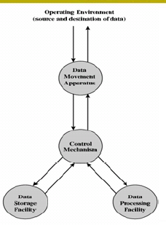
FUNCTION
• All computer functions are:
– Data processing
– Data storage
– Data movement
– Control
A functional view of computer

Slide 116
FUNCTIONS
Computer must be able to process the data.
The data may take wide variety of form and the range of processing requirement.
Some fundamental methods or types of data processing

Slide 117
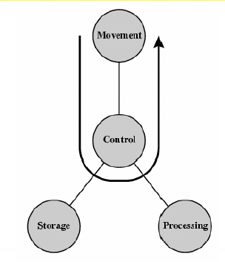
OPERATIONS (1)
DATA MOVEMENT
Computer can function as data movement
device, simply transfer the data from
peripheral or communication line to another

Slide 118
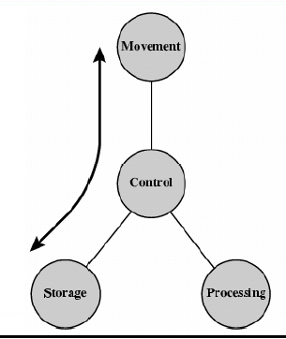
OPERATIONS (2)
STORAGE
It can function as storage device
With data transfer from the
external environment to computer
Storage (read and vice versa (write)

Slide 119
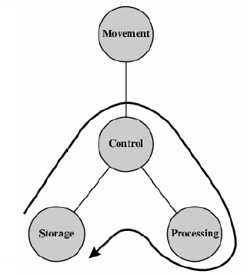
OPERATION (3)
PROCESSING FROM/TO STORAGE
Shows operation involving
Data processing on in storage

Slide 120
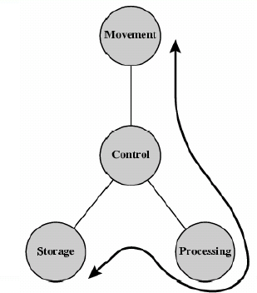
OPERATION (4)
PROCESSING FROM STORAGE TO I/O STRUCTURE - TOP LEVEL
Shows operation involving
Data processing between storage
And external environment

Slide 121
FOUR MAIN STRUCTURAL COMPONENT
CPU: Controls the operation of computer and performs its data processing functions .Often referred as processor
Main Memory : Stores data
I/O : Moves data between computer and its external environment
System interconnection: Some mechanism that provides communication among, CPU, main memory and I/O

Slide 122
COMPONENTS OF CPU
Control unit :Controls the operation of the CPU and hence computer
  ALU: performs the computer’s data processing functions
  Register: Provides storage internal to the CPU
  CPU interconnection: Some mechanism that provides communication among control unit, ALU and registers

Slide 123
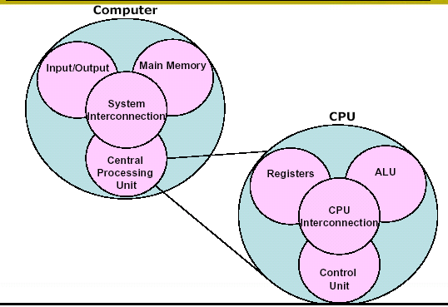
STRUCTURE - TOP LEVEL

Slide 124
COMPUTER ORGANIZATION
Synonymous with “architecture” in many uses and textbooks
We will use it to mean the underlying implementation of the architecture
Transparent to the programmer
An architecture can have a number of organizational implementations
  Control signals
  Technologies
  Device implementations

Slide 125
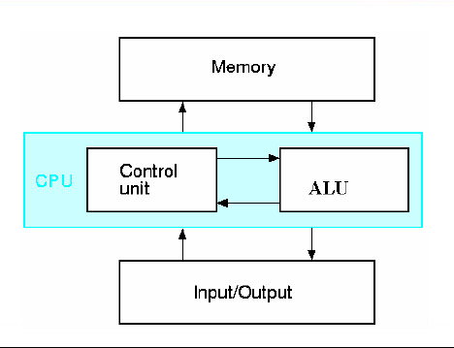
COMPUTER

Slide 126
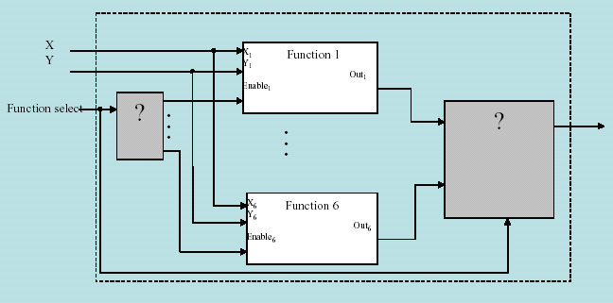
BASIC COMPUTER

Slide 127
Cont..
A basic computer making several operations like addition, multiplication
  Requires Command decoding
  Requires data
  Requires data and output separation / combination
  Requires function implementation

Slide 128
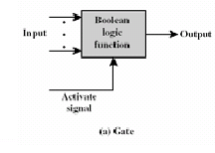
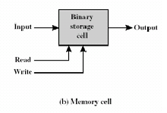
Cont…
• Basic operations in a computer
– data storage
– data processing
– data movement
– control
• These operations can be performed by using gates and memory cells.

Slide 129
GENERATIONS OF COMPUTER
• Vacuum tube - 1946-1957
• Transistor - 1958-1964
• Small scale integration - 1965
  Up to 100 devices on a chip
• Medium scale integration - to 1971
  100-3,000 devices on a chip
• Large scale integration - 1971-1977
  3,000 - 100,000 devices on a chip
• Very large scale integration - 1978 to date
  100,000 - 100,000,000 devices on a chip
• Ultra large scale integration
  Over 100,000,000 devices on a chip

Slide 130
Cont..
• Increased density of components on chip
• Number of transistors on a chip will double every year
• Since 1970’s development has slowed a little
– Number of transistors doubles every 18 months
• Cost of a chip has remained almost unchanged
• Higher packing density means shorter electrical paths, giving higher performance
• Smaller size gives increased flexibility
• Reduced power and cooling requirements
• Fewer interconnections increases reliability

Slide 131
SPEEDING IT UP
Pipelining
• On board cache
• Branch prediction
• Data flow analysis
• Speculative execution

Slide 132
PENTIUM EVOLUTION (1)
• 8080
– first general purpose microprocessor
– 8 bit data path
– Used in first personal computer – Altair
• 8086
– much more powerful
– 16 bit
– instruction cache, prefetch few instructions
– 8088 (8 bit external bus) used in first IBM PC
• 80286
– 16 Mbyte memory addressable
– up from 1Mb
• 80386
– 32 bit
– Support for multitasking

Slide 133
PENTIUM EVOLUTION (2)
80486
– sophisticated powerful cache and instruction pipelining
– built in maths co-processor
• Pentium
– Superscalar
– Multiple instructions executed in parallel
• Pentium Pro
– Increased superscalar organization
– Aggressive register renaming
– branch prediction
– data flow analysis
– speculative execution

Slide 134
Cont..
Pentium II
  MMX technology
  graphics, video & audio processing
Pentium III
  Additional floating point instructions for 3D graphics
Pentium 4
  Note Arabic rather than Roman numerals
  Further floating point and multimedia enhancements
Itanium
  64 bit

Slide 135
COMPUTER TECHNOLOGY PROGRESS
The rapid rate of improvement has come both from:
  advances in the technology used to build computers and from
  innovation in computer design.
1960s - large mainframes.
  Typical applications included business data processing and large-scale scientific computing.
1970s - birth of the minicomputer:
  scientific laboratories, multiple users sharing a computer through independent terminals.
late 1970s – microprocessor:
  improvements in integrated circuit technology, cost advantages, mass-produced, ubiquitous µPs.
  generalization of high-level language programming reduced the need for object-code compatibility.
  creation of standardized, vendor-independent operating systems, lowered the cost and risk of bringing out a new architecture.

Slide 136
Cont…
These changes made it possible to successfully develop a new set of architectures, called RISC (Reduced Instruction Set Computer) architectures, in the early 1980s.
The RISC-based machines focused the attention of designers on two
critical performance techniques,
  the exploitation of instruction-level parallelism (initially through pipelining and later through multiple instruction issue)
  the use of caches (initially in simple forms and later using more sophisticated organizations and optimizations).
1980s desktop computer based on microprocessors
  (personal computers and workstations).
1990s Internet and the World Wide Web,
  first successful handheld computing devices (PDAs), and high-performance digital consumer electronics

Slide 137
BROAD CLASSIFICATION OF TODAY COMPUTER CATEGORIES
Desktops
  Examples: PCs, workstations
  Metrics: latency (graphics & IO)
Servers - to provide file and computing services.
  Examples: Web, database servers
  Metrics: throughput, reliability, scalability
Embedded Systems
  Examples:PDAs, cell phones, ATMs
  Metrics: complexity, power, latency

Slide 138
CONCLUSIONS
Computer architecture
  Instruction Set Architecture
  Implementation
Organization
Hardware
Components of Basic Computer
Computer Technology Progress

Slide 139
REGISTER TRANSFER AND MICROOPERATIONS

Slide 140
REGISTER TRANSFER AND MICROOPERATIONS
• Register Transfer Language
• Register Transfer
• Bus and Memory Transfers
• Arithmetic Microoperations
• Logic Microoperations
• Shift Microoperations
• Arithmetic Logic Shift Unit

Slide 141
SIMPLE DIGITAL SYSTEMS
Combinational and sequential circuits can be used to create simple digital systems.
These are the low-level building blocks of a digital computer.
Simple digital systems are frequently characterized in terms of
  the registers they contain, and
  the operations that they perform.
Typically,
  What operations are performed on the data in the registers
  What information is passed between registers

Slide 142
MICROOPERATIONS (1)
Register Transfer Language
The operations on the data in registers are called microoperations.
The functions built into registers are examples of microoperations
  Shift
  Load
  Clear
  Increment
  …

Slide 143
MICROOPERATION (2)
Register Transfer Language
An elementary operation performed (during
one clock pulse), on the information stored
in one or more registers
Registers
(R)
ALU
(f)
1 clock cycle
R ← f(R, R)
f: shift, load, clear, increment, add, subtract, complement,
and, or, xor, …

Slide 144
ORGANIZATION OF A DIGITAL SYSTEM
Definition of the (internal) organization of a computer
- Set of registers and their functions
- Microoperations set
Set of allowable microoperations provided
by the organization of the computer
- Control signals that initiate the sequence of
microoperations (to perform the functions)

Slide 145
REGISTER TRANSFER LEVEL
Register Transfer Language
Viewing a computer, or any digital system, in this way is called the register transfer level
This is because we’re focusing on
  The system’s registers
  The data transformations in them, and
  The data transfers between them.
RTL is used to specify micro-operations

Slide 146
REGISTER TRANSFER LANGUAGE
Register Transfer Language
Rather than specifying a digital system in words, a specific notation is used, register transfer language
For any function of the computer, the register transfer language can be used to describe the (sequence of) microoperations
Register transfer language
  A symbolic language
  A convenient tool for describing the internal organization of digital computers
  Can also be used to facilitate the design process of digital systems.

Slide 147
RTL
1. A kind of hardware description language (HDL) used in describing the registers of a computer or digital electronic system, and the way in which data is transferred between them.
2. An intermediate code for a machine with an infinite number of registers, used for machine-independent optimization.
RTL was developed by Chris Fraser and J. Davidson at the University of Arizona in the early 1980s.
Register Transfer Language (RTL) is also a language used to describe the operation of instructions within a processor.
RTL describes the requirements of data and control units in terms of digital logic to execute an assembly language instruction.
Each instruction from the architecture's instruction set is defined in RTL. The resulting modules are sufficiently defined to allow the actual wiring of processor circuits to be derived.

Slide 148
DESIGNATION OF REGISTERS
Register Transfer Language
Registers are designated by capital letters, sometimes followed by numbers (e.g., A, R13, IR)
Often the names indicate function:
  MAR - memory address register
  PC - program counter
  IR - instruction register
Registers and their contents can be viewed and represented in various ways
  A register can be viewed as a single entity:
  Registers may also be represented showing the bits of data they contain
MAR

Slide 149
DESIGNATION OF REGISTERS
Register Transfer Language
Designation of a register
- a register
- portion of a register
- a bit of a register
Common ways of drawing the block diagram of a register
Register
Showing individual bits
R1
7 6 5 4 3 2 1 0
15
0
15
8
7
0
R2
PC(H)
PC(L)
Numbering of bits
Subfields

Slide 150
RTL Syntax
Bits are numbered from
  the rightmost (0) least significant to the leftmost (n-1)bit most significant
  R1(0-3) denotes bits R1₃,R1₂,R1₁,R1o
  R2 ← R1

Slide 151
REGISTER TRANSFER
Register Transfer
Copying the contents of one register to another is a register transfer
A register transfer is indicated as
  R2 ← R1
  In this case the contents of register R2 are copied (loaded) into register R1
  A simultaneous transfer of all bits from the source R1 to the destination register R2, during one clock pulse
  Note that this is a non-destructive; i.e. the contents of R1 are not altered by copying (loading) them to R2

Slide 152
REGISTER TRANSFER
Register Transfer
A register transfer such as
  R3 ← R5
  Implies that the digital system has
  the data lines from the source register (R5) to the destination register (R3)
  Parallel load in the destination register (R3)
  Control lines to perform the action

Slide 153
CONTROL FUNCTIONS
Register Transfer
Often actions need to only occur if a certain condition is true
This is similar to an “if” statement in a programming language
In digital systems, this is often done via a control signal, called a control function
  If the signal is 1, the action takes place
This is represented as:
P: R2 ← R1
  Which means “if P = 1, then load the contents of register R1 into register R2”, i.e.,
  if (P = 1) then (R2 ← R1)

Slide 154
HARDWARE IMPLEMENTATION OF CONTROLLED TRANSFERS
Implementation of controlled transfer
P: R2 ← R1
Block diagram
Control
Circuit
P
Load
R2
Clock
n
R1
Timing diagram
t
t+1
Clock
Load
Transfer occurs here
The same clock controls the circuits that generate the control
function and the destination register
Registers are assumed to use positive-edge-triggered flip-flops

Slide 155
SIMULTANEOUS OPERATIONS
Register Transfer
If two or more operations are to occur simultaneously, they are separated with commas
  P: R3 ← R5, MAR ← IR
Here, if the control function P = 1, load the contents of R5 into R3, and at the same time (clock), load the contents of register IR into register MAR

Slide 156
BASIC SYMBOLS FOR REGISTER TRANSFERS
Symbols
Description Examples
Capital letters Denotes a register MAR, R2
& numerals
Parentheses () Denotes a part of a register R2(0-7), R2(L)
Arrow ← Denotes transfer of information R2 ← R1
Colon : Denotes termination of control function P:
Comma , Separates two micro-operations A ← B, B ← A

Slide 157
Cont…
Register Transfer
Register Transfer Language (RTL)
If (condition) then (register-transfer)
is written as
condition: register-transfer
So, T1^p4: R1 ←  R2
is read as
If (T1 ^ p4) then R1 ←  R2
If T1 and p4, then R1 gets the contents of R2

Slide 158
RTL ASSUMPTIONS
Register Transfer
All chips are connected to a common clock
  The clock edge is assumed, and is not explicitly included in the condition
Computer registers are denoted by capital letters
  PC for Program Counter
  IR for Instruction Register
  AC for accumulator
^ is AND + is OR if it occurs in condition,
+ is “plus” if it occurs in register-transfer statement is
OR

Slide 159
RTL SYNTAX
Bits are numbered from the rightmost bit 0 (least significant) to leftmost bit n-1 (most significant)
R1(0 - 3) denotes bits R13, R12, R11, and R10
R1 ←  M[AR] denotes that register R1 gets the data from memory “pointed to” by the contents of the address register
  A register transfer language statement has a one-to-one correlation with hardware connections

Slide 160
CONNECTING REGISTRS
Register Transfer
In a digital system with many registers, it is impractical to have data and control lines to directly allow each register to be loaded with the contents of every possible other registers
To completely connect n registers → n(n-1) lines O(n²) cost
  This is not a realistic approach to use in a large digital system
Instead, take a different approach
  Have one centralized set of circuits for data transfer – the bus
  Have control circuits to select which register is the source, and which is the destination

Slide 161
BUS AND BUS TRANSFER
Bus and Memory Transfers
Bus is a path(of a group of wires) over which information is transferred, from any of several sources to any of several destinations.
From a register to bus: BUS ← R
Register A
Register B
Register C
Register D
Bus lines
Register A
Register B
Register C
Register D
1
2
3
4
1
2
3
4
1
2
3
4
1
2
3
4
B
C
D
B
C
D
B
C
D
B
C
D
1
1
1
2
2
2
3
3
3
4
4
4
0
4 x1
0
4 x1
0
4 x1
0
4 x1
MUX
MUX
MUX
MUX
x
select
y
4-line bus

Slide 162
TRANSFER FROM BUS TO A DESTINATION REGISTER
Bus and Memory Transfers
Bus lines
Reg. R0
Reg. R1
Reg. R2
Reg. R3
Load
D
D
D
D
z
0
1
2
3
E (enable)
Select
w
2 x 4
Decoder
Three-State Bus Buffers
Normal input A
Output Y=A if C=1
High-impedence if C=0
Control input C
Bus line with three-state buffers
Bus line for bit 0
A0
B0
C0
D0
S0
0
Select
S1
1
2
Enable
3

Slide 163
BUS TRANSFER IN RTL
Bus and Memory Transfers
Depending on whether the bus is to be mentioned explicitly or not, register transfer can be indicated as either
or
In the former case the bus is implicit, but in the latter, it is explicitly indicated
R2 ← R1
BUS ← R1, R2 ← BUS

Slide 164
MEMORY (RAM)
Bus and Memory Transfers
Memory (RAM) can be thought as a sequential circuits containing some number of registers
These registers hold the words of memory
Each of the r registers is indicated by an address
These addresses range from 0 to r-1
Each register (word) can hold n bits of data
Assume the RAM contains r = 2k words.
It needs the following
  n data input lines
  n data output lines
  k address lines
  A Read control line
  A Write control line
data input lines
n
address lines
k
RAM
unit
Read
Write
n
data output lines

Slide 165
MEMORY TRANSFER
Bus and Memory Transfers
Collectively, the memory is viewed at the register level as a device, M.
Since it contains multiple locations, we must specify which address in memory we will be using
This is done by indexing memory references
Memory is usually accessed in computer systems by putting the desired address in a special register, the Memory Address Register (MAR, or AR)
When memory is accessed, the contents of the MAR get sent to the memory unit’s address lines
M
Memory
unit
Read
AR
Write
Data out
Data in

Slide 166
MEMORY READ
Bus and Memory Transfers
To read a value from a location in memory and load it into a register, the register transfer language notation looks like this:
This causes the following to occur
  The contents of the MAR get sent to the memory address lines
  A Read (= 1) gets sent to the memory unit
  The contents of the specified address are put on the memory’s output data lines
  These get sent over the bus to be loaded into register R1
R1 ← M[MAR]

Slide 167
MEMORY WRITE
Bus and Memory Transfers
To write a value from a register to a location in memory looks like this in register transfer language:
This causes the following to occur
  The contents of the MAR get sent to the memory address lines
  A Write (= 1) gets sent to the memory unit
  The values in register R1 get sent over the bus to the data input lines of the memory
  The values get loaded into the specified address in the memory
M[MAR] ← R1

Slide 168
SUMMARY OF R. TRANSFER MICROOPERATIONS
Bus and Memory Transfers
A ← B Transfer content of reg. B into reg. A
AR ← DR(AD) Transfer content of AD portion of reg. DR into reg. AR
A ← constant Transfer a binary constant into reg. A
ABUS ← R1, Transfer content of R1 into bus A and, at the same time,
R2 ← ABUS transfer content of bus A into R2
AR Address register
DR Data register
M[R] Memory word specified by reg. R
M Equivalent to M[AR]
DR ← M Memory read operation: transfers content of
memory word specified by AR into DR
M ← DR Memory write operation: transfers content of
DR into memory word specified by AR

Slide 169
MICROOPERATIONS
The operations on the data in registers are called
microoperations
Computer system microoperations are of four types:
- Register transfer microoperations
- Arithmetic microoperations
- Logic microoperations
- Shift microoperations

Slide 170
ARITHMETIC MICROOPERATIONS
Arithmetic Microoperations
The basic arithmetic microoperations are
  Addition
  Subtraction
  Increment
  Decrement
The additional arithmetic microoperations are
  Add with carry
  Subtract with borrow
  Transfer/Load
  etc. …
Summary of Typical Arithmetic Micro-Operations
  R3 ← R1 + R2 Contents of R1 plus R2 transferred to R3
  R3 ← R1 - R2 Contents of R1 minus R2 transferred to R3
  R2 ← R2’ Complement the contents of R2
  R2 ← R2’+ 1 2's complement the contents of R2 (negate)
  R3 ← R1 + R2’+ 1 subtraction
  R1 ← R1 + 1 Increment
  R1 ← R1 - 1 Decrement

Slide 171
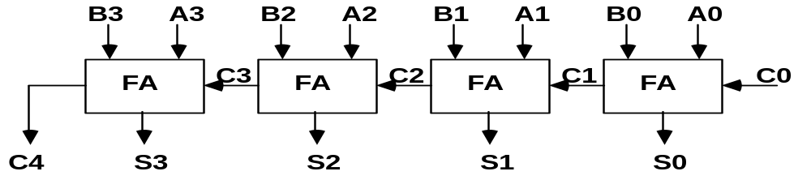
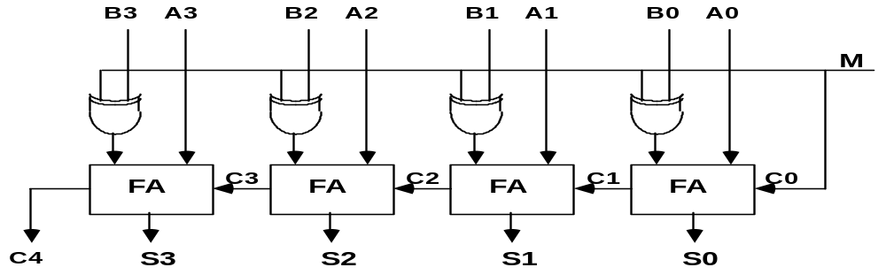
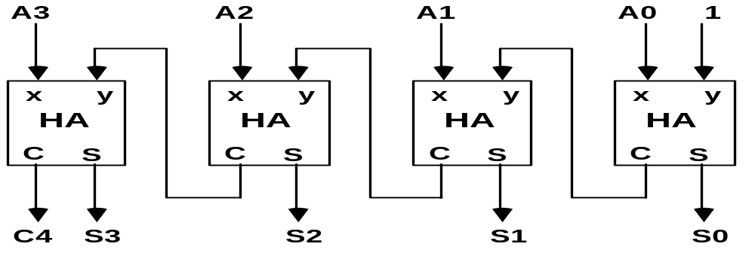
BINARY ADDER / SUBTRACTOR / INCREMENTER
Arithmetic Microoperations
Binary Adder
Binary Adder-Subtractor
Binary Incrementer

Slide 172
ARITHMETIC CIRCUIT
Arithmetic Microoperations
Cin
S1
S0
A0
X0
C0
S1
FA
D0
B0
S0
4x1
Y0
C1
0
1
MUX
2
3
A1
X1
C1
S1
FA
D1
B1
S0
4x1
Y1
C2
0
1
MUX
2
3
A2
X2
C2
S1
FA
D2
B2
S0
4x1
Y2
C3
0
1
MUX
2
3
A3
X3
C3
S1
FA
D3
B3
S0
4x1
Y3
C4
0
1
MUX
2
Cout
0
1
3
S1 S0 Cin Y Output Microoperation
0 0 0 B D = A + B Add
0 0 1 B D = A + B + 1 Add with carry
0 1 0 B’ D = A + B’ Subtract with borrow
0 1 1 B’ D = A + B’+ 1 Subtract
1 0 0 0 D = A Transfer A
1 0 1 0 D = A + 1 Increment A
1 1 0 1 D = A - 1 Decrement A
1 1 1 1 D = A Transfer A

Slide 173
LOGIC MICROOPERATIONS
Logic Microoperations
Specify binary operations on the strings of bits in registers
  Logic microoperations are bit-wise operations, i.e., they work on the individual bits of data
  useful for bit manipulations on binary data
  useful for making logical decisions based on the bit value
There are, in principle, 16 different logic functions that can be defined over two binary input variables
However, most systems only implement four of these
  AND (∧), OR (∨), XOR (⊕), Complement/NOT
The others can be created from combination of these
A B F₀ F₁ F₂ … F₁₃ F₁₄ F₁₅
0 0 0 0 0 … 1 1 1
0 1 0 0 0 … 1 1 1
1 0 0 0 1 … 0 1 1
1 1 0 1 0 … 1 0 1

Slide 174
LIST OF LOGIC MICROOPERATIONS
Logic Microoperations
List of Logic Microoperations
- 16 different logic operations with 2 binary vars.
- n binary vars → functions
2
2
n
Truth tables for 16 functions of 2 variables and the
corresponding 16 logic micro-operations
x 0 0 1 1
y 0 1 0 1
Boolean
Function
Micro-
Operations
Name
  0 0 0 0 F0 = 0 F ← 0 Clear
  0 0 0 1 F1 = xy F ← A ∧ B AND
  0 0 1 0 F2 = xy' F ← A ∧ B’
  0 0 1 1 F3 = x F ← A Transfer A
  0 1 0 0 F4 = x'y F ← A’∧ B
  0 1 0 1 F5 = y F ← B Transfer B
  0 1 1 0 F6 = x ⊕ y F ← A ⊕ B Exclusive-OR
  0 1 1 1 F7 = x + y F ← A ∨ B OR
  1 0 0 0 F8 = (x + y)' F ← (A ∨ B)’ NOR
  1 0 0 1 F9 = (x ⊕ y)' F ← (A ⊕ B)’ Exclusive-NOR
  1 0 1 0 F10 = y' F ← B’ Complement B
  1 0 1 1 F11 = x + y' F ← A ∨ B
  1 1 0 0 F12 = x' F ← A’ Complement A
  1 1 0 1 F13 = x' + y F ← A’∨ B
  1 1 1 0 F14 = (xy)' F ← (A ∧ B)’ NAND
  1 1 1 1 F15 = 1 F ← all 1's Set to all 1's

Slide 175
HARDWARE IMPLEMENTATION OF LOGIC MICROOPERATIONS
A
i
0
B
i
1
4 X 1
F
MUX
i
2
3
Select
S
1
S
0
Function table
S₁ S₀
Output
μ-operation
0 0 F = A ∧ B AND
0 1 F = A ∨ B OR
1 0 F = A ⊕ B XOR
1 1 F = A’ Complement

Slide 176
APPLICATIONS OF LOGIC MICROOPERATIONS
Logic microoperations can be used to manipulate individual bits or a portions of a word in a register
Consider the data in a register A. In another register, B, is bit data that will be used to modify the contents of A
  Selective-set A ← A + B
  Selective-complement A ← A ⊕ B
  Selective-clear A ← A • B’
  Mask (Delete) A ← A • B
  Clear A ← A ⊕ B
  Insert A ← (A • B) + C
  Compare A ← A ⊕ B
  . . .

Slide 177
SELECTIVE SET
Logic Microoperations
In a selective set operation, the bit pattern in B is used to set certain bits in A
1 1 0 0 A_{t}
1 0 1 0 B
1 1 1 0 A_{t+1} (A ← A + B)
If a bit in B is set to 1, that same position in A gets set to 1, otherwise that bit in A keeps its previous value

Slide 178
SELECTIVE COMPLEMENT
In a selective complement operation, the bit pattern in B is used to complement certain bits in A
1 1 0 0 A_{t}
1 0 1 0 B
0 1 1 0 A_{t+1} (A ← A ⊕ B)
If a bit in B is set to 1, that same position in A gets complemented from its original value, otherwise it is unchanged

Slide 179
SELECTIVE CLEAR
Logic Microoperations
In a selective clear operation, the bit pattern in B is used to clear certain bits in A
1 1 0 0 A_{t}
1 0 1 0 B
0 1 0 0 A_{t+1} (A ← A ⋅ B’)
If a bit in B is set to 1, that same position in A gets set to 0, otherwise it is unchanged

Slide 180
MASK OPERATION
Logic Microoperations
In a mask operation, the bit pattern in B is used to clear certain bits in A
1 1 0 0 A_{t}
1 0 1 0 B
1 0 0 0 A_{t+1} (A ← A ⋅ B)
If a bit in B is set to 0, that same position in A gets set to 0, otherwise it is unchanged

Slide 181
CLEAR OPERATION
Logic Microoperations
In a clear operation, if the bits in the same position in A and B are the same, they are cleared in A, otherwise they are set in A
1 1 0 0 A_{t}
1 0 1 0 B
0 1 1 0 A_{t+1} (A ← A ⊕ B)

Slide 182
INSERT OPERATION
Logic Microoperations
An insert operation is used to introduce a specific bit pattern into A register, leaving the other bit positions unchanged
This is done as
  A mask operation to clear the desired bit positions, followed by
  An OR operation to introduce the new bits into the desired positions
  Example
    Suppose you wanted to introduce 1010 into the low order four bits of A: 1101 1000 1011 0001 A (Original) 1101 1000 1011 1010 A (Desired)
    1101 1000 1011 0001 A (Original)
    1111 1111 1111 0000 Mask
    1101 1000 1011 0000 A (Intermediate)
    0000 0000 0000 1010 Added bits
    1101 1000 1011 1010 A (Desired)

Slide 183
SHIFT MICROOPERATIONS
Shift Microoperations
There are three types of shifts
  Logical shift
  Circular shift
  Arithmetic shift
What differentiates them is the information that goes
into the serial input
A right shift operation
A left shift operation
Serial
input
Serial
input

Slide 184
LOGICAL SHIFT
Shift Microoperations
In a logical shift the serial input to the shift is a 0.
A right logical shift operation:
A left logical shift operation:
In a Register Transfer Language, the following notation is used
  shl for a logical shift left
  shr for a logical shift right
  Examples:
    R2 ← shr R2
    R3 ← shl R3
0
0

Slide 185
CIRCULAR SHIFT
Shift Microoperations
In a circular shift the serial input is the bit that is shifted out of the other end of the register.
A right circular shift operation:
A left circular shift operation:
In a RTL, the following notation is used
  cil for a circular shift left
  cir for a circular shift right
  Examples:
    R2 ← cir R2
    R3 ← cil R3

Slide 186
ARITHMETIC SHIFT
Shift Microoperations
An arithmetic shift is meant for signed binary numbers (integer)
An arithmetic left shift multiplies a signed number by two
An arithmetic right shift divides a signed number by two
The main distinction of an arithmetic shift is that it must keep the sign of the number the same as it performs the multiplication or division
A right arithmetic shift operation:
A left arithmetic shift operation:
sign
bit
0
sign
bit

Slide 187
ARITHMETIC SHIFT
Shift Microoperations
An left arithmetic shift operation must be checked for the overflow
0
sign
bit
Before the shift, if the leftmost two
bits differ, the shift will result in an
overflow
V
In a RTL, the following notation is used
  ashl for an arithmetic shift left
  ashr for an arithmetic shift right
  Examples:
    R2 ← ashr R2
    R3 ← ashl R3

Slide 188
HARDWARE IMPLEMENTATION OF SHIFT MICROOPERATIONS
Serial
input (I_{R})
Select
0 for shift right (down)
1 for shift left (up)
Functional Table
S
H0
0
MUX
Select | Output
S | H₀ | H₁ | H₂ | H₃
0 | I_{R} | A₀ | A₁ | A₂
1 | A₁ | A₂ | A₃ | I_{L}
1
A0
A1
S
H1
0
MUX
A2
1
A3
S
0
MUX
H2
1
S
H3
0
MUX
1
Serial
input (I_{L})
4-BIT COMBINATIONAL SHIFTER

Slide 189
ARITHMETIC LOGIC SHIFT UNIT
S3
S2
C
S1
i
S0
Arithmetic
D
i
Circuit
Select
C
0
4 x 1
F
i+1
1
MUX
i
2
3
Logic
E
B
i
i
Circuit
A
i
shr
One stage of arithmetic logic unit
A
i-1
shl
A
i+1

Slide 190
ARITHMETIC LOGIC SHIFT UNIT
  S3 S2 S1 S0 Cin Operation Function
  0 0 0 0 0 F = A Transfer A
  0 0 0 0 1 F = A + 1 Increment A
  0 0 0 1 0 F = A + B Addition
  0 0 0 1 1 F = A + B + 1 Add with carry
  0 0 1 0 0 F = A + B’ Subtract with borrow
  0 0 1 0 1 F = A + B’+ 1 Subtraction
  0 0 1 1 0 F = A - 1 Decrement A
  0 0 1 1 1 F = A Transfer A
  0 1 0 0 X F = A ∧ B AND
  0 1 0 1 X F = A ∨ B OR
  0 1 1 0 X F = A ⊕ B XOR
  0 1 1 1 X F = A’ Complement A
  1 0 X X X F = shr A Shift right A into F
  1 1 X X X F = shl A Shift left A into F

Slide 191
CONCLUSIONS
Significance of RTL
Design of ALU

Slide 192
OBJECTIVE QUESTIONS
The status bits are also called ____________
ALU is capable of
a. Performing Calculations b. Monitoring System
c. Controlling Operations d. Storage of Data
In addition of two signed numbers, represented in 2’s complement form generates an overflow if
  a. A.B=0 b. A+B=1
  c. A Ex-or B=0 d. A Ex-or B-1
Addition of 1 to a (1111)₂ 4 bit binary number ‘A’ results:-
a. Incrementing A b. Addition of (F)_{H}
c. No change d. Decrementing A
6. In a positive edge triggered JK flip-flop a low J and a low K produce
a. no change b. set
c. reset d. none

Slide 193
OBJECTIVE QUESTIONS
Primary storage can also be called ________and is generally implemented using _________
A sequence of events performed on the bus for transfer of one byte of data through the data bus is called _________
Elementary operations inside the computers are macro-operations/microperations.
A layout of bits of an instruction stored in the main memory Instruction/Microinstruction format
A CPU has 12 bit address for memory addressing. The memory addressability of CPU is
  a. 4 kilolocations b. 4 bytes
  c. 16 KB d. 12
The opcode indicated the exact
  a. Microprogram b. Microperation
  c. Macrooperation d. Macroprogram
Register A holds the 8-bit binary 11011001. After the logic micro-operation being performed the value of A is changed to 01101101.Which logic micro operation need to be executed?
Is mask operation similar to selective clear (T/F)

Slide 194
Cont…
How many flip-flops will be complemented in a 10-bit binary counter to reach the next count after 1001100111
What is the use of micro operation ‘subtract with borrow ‘ when we have ‘subtract’ micro operation?
Which logical micro operations are same Exclusive OR
a. Selective complement b. Clear
c. Selective set d. Selective Set
Scratch pad registers are not addressable by instruction. The following can them (strike out the odd)
a. Compiler b. Operating system
c. Control unit d. Input unit
Parallel adder is
a. sequential circuits
b. combinational circuits
c. either sequential or combinational circuits
d. none of above
inputs to a 3 bit binary adder are 1112 and 1102. The output will be
a.101
b.1101
c.1111
d.1110

Slide 195
Cont…
A half adder can be used only for adding
a. 1s
b. 2s
c. 4s
d. 8s
A 3 bit binary adder should be
a. 3 full adders
b. 2 full adders and 1 half adder
c. 1 full adder and 2 half adder
d. 3 half adders
when two 4 bit parallel adders are cascaded we get
a. 4 bit parallel adder
b. 8 bit parallel adder
c. 16 bit parallel adder
d. none of above
The widely used binary multiplication method is
a. repeated addition
b. add and shift
c. shift and add
d. any of above

Slide 196
Cont..
When microprocessor processes both positive and negative numbers, the representation used is
a. 1’s complement
b. 2’s complement
c. signed binary
d. any of above
Decimal -90 =………….in 8 bit 2s complement
a.1000 1000
b.1010 0110
c.1100 1100
d.0101 0101
In 2’s complement addition, the carry generated in the last stage is
a. added to LSB
b. neglected
c. added to bit next to MSB
d. added to the bit next to LSB
The number of inputs and outputs in a full adder are
a. 2 and 1
b. 2 and 2
c. 3 and 3
d. 3 and 2

Slide 197
Cont..
.In a 7 segment display the segments a,c,d,f,g are lit. The decimal number displayed will be
a. 9
b. 5
c. 4
d. 2
In a 7 segment display the segments b and c are lit up. The decimal number displayed will be
a. 9
b. 7
c. 3
d. 1
A device which converts BCD to seven segments is called
a. encoder
b. decoder
c. multiplexer
d. none of these

Slide 198
Cont..
Which device changes parallel data to serial data
a. decoder
b. multiplexer
c. demultiplexer
d. flip flop
131.A 1 of 4 multiplexer requires…… data select line
a. 1
b. 2
c. 3
d. 4
132. It is desired to route data from many registers to one register. The device needed is
a. decoder
b. multiplexer
c. demultiplexer
d. counter
133.Which device has one input and many outputs
a. flip flop
b. multiplexer
c. demultiplexer
d. counter
134.Two 16:1 and one 2:1 multiplexers can be connected to form a
a. 16:1 multiplexer
b. 32:1 multiplexer
c. 64:1 multiplexer
d. 8:1 multiplexer

Slide 199
Cont..
A flip flop is a
a. combinational circuit
b. memory element
c. arithmetic element
d. memory or arithmetic
I n a D latch
a. data bit D is fed to S input and D’ to R input
b. data bit D is fed to R input and D’ to S input
c. data bit D is fed to both R and S inputs
d. data bit D’ is not fed to any input
I n a D latch
a. a high D sets the latch and low D resets it
b. a low D sets the latch and high D resets it
c. race can occur
d. none of above
In a positive edge triggered JK flip flop
a. High J and High K produce inactive state
b. Low J and High K produce inactive state
c. High J and Low K produce inactive state
d. Low J and Low K produce inactive state

Slide 200
Cont…
In a positive edge triggered D flip flop
a. D input is called direct set
b.Preset is called direct reset
c. present and clear are called direct set and reset respectively
d. D input overrides other inputs
In a positive edge triggered JK flip flop
J=1,K=0 and clock pulse is rising.Q will
a. be 0
b. be 1
c. show no change
d. toggle
For edge triggering in flip flops manufacturers use
a. RC circuit
b. direct coupled design
c. either RC circuit or direct coupled design
d. none of these
In a JK flip flop toggle means
a. set Q=1 and Q’=0
b. set Q=0 and Q’=1
c. change the output to the opposite state
d. no change in input

Slide 201
Cont..
A mod 4 counter will count
a. from 0 to 4
b. from 0 to 3
c. from any number n to n+4
d. none of above
A counter has N flip flops. The total number of states are
a. N
b. 2N
c. 2N
d. 4N
A counter has modulus of 10. The number of flip flops are
a. 10
b. 5
c. 4
d. 3
In a ripple counter
a. whenever a flip flop sets to 1,the next higher FF toggles
b. whenever a flip flop sets to 0,the next higher FF remains unchanged
c. whenever a flip flop sets to 1,the next higher FF faces race condition
d. whenever a flip flop sets to 0,the next higher FF faces race cond

Slide 202
Cont..
A 3 bit up-down counter can count from
a. 000 to 111
b. 111 to 000
c. 000 to 111 and also from 111 to 000
d. none of above
IC counters are
a. synchronous only
b. asynchronous only
c. both synchronous and asynchronous
d. none of above
Shifting digits from left to right and vice versa is needed in
a. storing numbers
b. arithmetic operations
c. counting
d. storing and counting
The basic storage element in a digital system is
a. flip flop
b. counter
c. multiplexer
d. encoder

Slide 203
Cont..
The simplest register is
a. buffer register
b. shift register
c. controlled buffer register
d. bidirectional register
The basic shift register operations are
a. serial in serial out
b. serial in parallel out
c. parallel in serial out
d. all of above
A universal shift register can shift
a. from right to left b. from left to right
c. both from right to left and left to right
d. none of above
In a shift register, shifting a bit by one bit means
a. division by 2
b. multiplication by 2
c. subtraction by 2
d. any of above
An 8 bit binary number is to be entered into an 8 bit serial shift register. The number of clock pulses required is
a. 1
b. 2
c. 4
d. 8

Slide 204
Cont..
A counter has 4 flip flops.It divides the input frequency by
a.4
b. 2
c. 8
d. 16
A decade counter skips
a. binary states 1000 to 1111
b. binary states 0000 to 0011
c. binary states 1010 to 1111
d. binary states 1111 and higher
The number of flip flops needed for Mod 7 counter are
a. 7
b. 5
c. 3
d. 1
A presettable counter with 4 flip flops start counting from
a. 0000
b. 1000
c. any number from 0000 to 1111
d. any number from 0000 to 1000
A 4 bit down counter can count from
a. 0000 to 1111
b. 1111 to 0000
c. 000 to 111
d. 111 to 000

Slide 205
Cont..
A 3 bit up-down counter can count from
a. 000 to 111
b. 111 to 000
c. 000 to 111 and also from 111 to 000
d. none of above
IC counters are
a. synchronous only
b. asynchronous only
c. both synchronous and asynchronous
d. none of above
Shifting digits from left to right and vice versa is needed in
a. storing numbers
b. arithmetic operations
c. counting
d. storing and counting
The basic storage element in a digital system is
a. flip flop
b. counter
c. multiplexer
d. encoder
The simplest register is
a. buffer register
b. shift register
c. controlled buffer register
d. bidirectional register

Slide 206
Cont..
The basic shift register operations are
a. serial in serial out
b. serial in parallel out
c. parallel in serial out
d. all of above
A universal shift register can shift
a. from right to left b. from left to right
c. both from right to left and left to right
d. none of above
In a shift register, shifting a bit by one bit means
a. division by 2
b. multiplication by 2
c. subtraction by 2
d. any of above
An 8 bit binary number is to be entered into an 8 bit serial shift register. The number of clock pulses required is
a. 1
b. 2
c. 4
d. 8

Slide 207
Cont..
147.A counter has 4 flip flops.It divides the input frequency by
a.4
b. 2
c. 8
d. 16
148. A decade counter skips
a. binary states 1000 to 1111
b. binary states 0000 to 0011
c. binary states 1010 to 1111
d. binary states 1111 and higher
149.The number of flip flops needed for Mod 7 counter are
a. 7
b. 5
c. 3
d. 1
150.A presettable counter with 4 flip flops start counting from
a. 0000
b. 1000
c. any number from 0000 to 1111
d. any number from 0000 to 1000
151.A 4 bit down counter can count from
a. 0000 to 1111
b. 1111 to 0000
c. 000 to 111
d. 111 to 000

Slide 208
SHORT QUESTIONS
On what basis are digital computer classified? Name four types of computers.
Name two ways on which microcomputer are classified.
What is a bus cycle? Name four type of bus cycles.
If a memory has a total capacity of 16 KB what is the word length of memory?
Which factors contribute to the speed of operation of an instruction?
Name two major type of computer organizations.
What is wrong with the following register transfer statement
xT: AR← (AR)’, AR← 0
How many bits wide memory addresses have to be if the computer had 16 MB of memory? (Use the smallest value possible)
Why Effective Address is required?
A main memory has an access time of 45 ns. A 5 ns time gap is necessary for the completion of one access to beginning of next cycle. Calculate the bandwidth of the memory.
Justify or refute the statement clearly, citing examples “Code written in RTL helps us to design digital systems systemically”.

Slide 209
LONG QUESTIONS
Design a typical stage that implement the following logic micro-operation
P1: A← AV B’ P2: A← (AV B)’
P3: A← A^ B P4: A← A Ex-or B
Give the sequence of actions that take place in the computer immediately after switching on.
Show the block diagram that executes the statement
T: A← B, B← A
List the micro operations that transfer bit 1-8 of register A to bits of register B and bits 1-8 of register B to bits 9-16 of register A. Draw the block of the hardware required.
Design a 4-bit combinational circuit decrementer using four full adder circuits.
Design an arithmetic circuit with one selection input S and two n-bit data inputs A and B. The circuit generates the following four arithmetic operations:
S | Cin=0 | Cin=01
0 | D = A + 1 | D = A + B
1 | D = A + B’ + 1 | D = A - 1

Slide 210
RESEARCH PROBLEM
1. The performance of two different computers A and B (having same architecture) are being compared by a consultant as part of evaluation process. Computer A operates at 100 MHz clock and gives 100 MIPS whereas computer B operates at 120 MHz clock gives 80 MIPS. Due to various reasons, computer B was chosen by the consultant. He came out with few suggestions for improving the performance of computer B in future design. Some of his suggestions are given below.
Replace the existing main memory with a faster memory
Introduce small cache memory
Increase the clock frequency to 200 MHz.
Suppose you are asked to select only one of these suggestions keeping the cost as the main factor, which one will you select? Which one need a change in architecture? Which one needs better technology

Slide 211
REFERENCES
Hayes P. John, Computer Architecture and Organisation, McGraw Hill Comp., 1988.
Mano M., Computer System Architecture, Prentice-Hall Inc. 1993.
Patterson, D., Hennessy, J., Computer Architecture - A
Quantitative Approach, second edition, Morgan Kaufmann
Publishers, Inc. 1996;
Stallings, William, Computer Organization and Architecture, 5th edition, Prentice Hall International, Inc., 2000.
Tanenbaum, A., Structured Computer Organization, 4th ed., Prentice- Hall Inc. 1999.
Hamacher, Vranesic, Zaky, Computer Organization, 4th ed., McGraw Hill Comp., 1996.

