Slide 1
Unit 1 Introduction to DBMS

Slide 2
Common Terms
Data: collection of interrelated information about world being modeled
DBMS: general-purpose software to define, create, modify, retrieve, delete and manipulate a database
Goals:
Efficient data management (faster than files)
Large amount of data
High reliability
Information sharing (multiple users)

Slide 3
Data Abstraction
Hiding system complexity and physical storage details from users and applications
Customized views
View1
View 2
View n
Conceptual representation
Logical Level
Physical data description and storage
Physical level

Slide 4
Classification of DBMS
Relational DBMS:
Modeling concept: tables and constraints on tables
Query Language: SQL
Applications: suited for traditional business processing
Object-Oriented DBMS
Modeling concepts: objects, classes, inheritance
Query Language: object oriented OQL
Applications: suited for CAD databases, CASE databases
Object-Relational DBMS:
Incorporate OO concepts into relational model
Similar functionality as OO-DBMS, but different implementations
XML DBMS

Slide 5
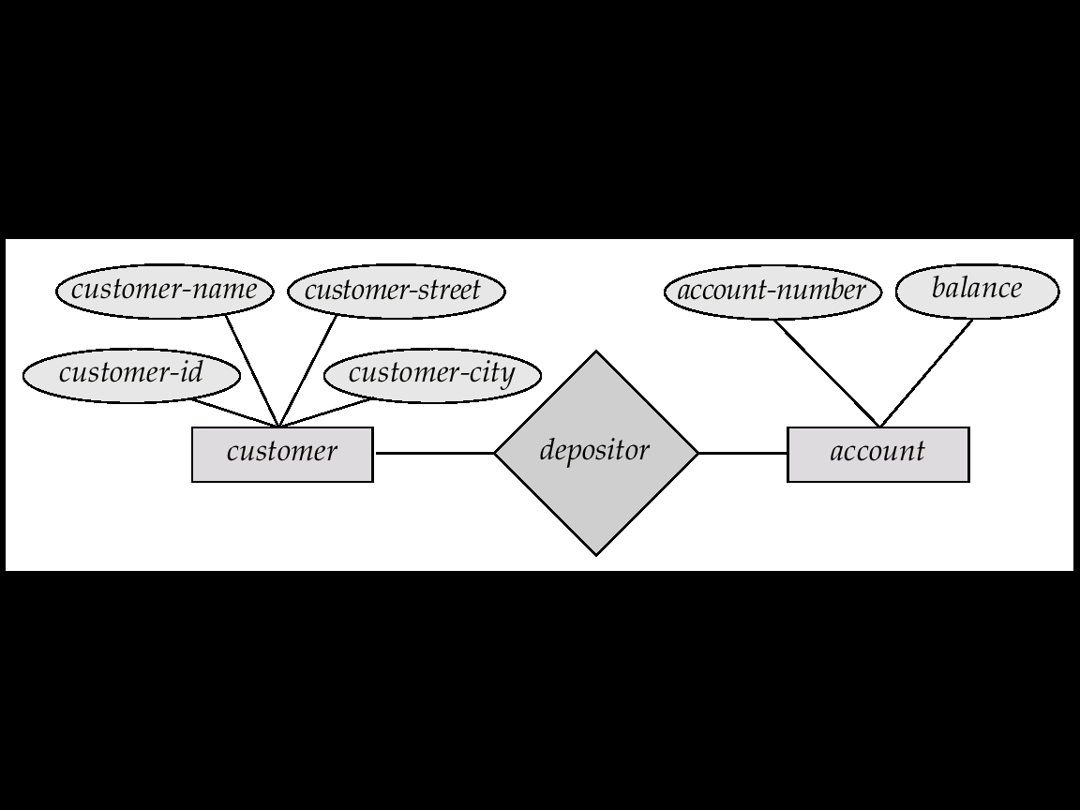
Entity-Relationship Model
A schema in E/R

Slide 6
E/R Model (Cont.)
Entities:
Represent objects
Example: customers, accounts, bank branch
Relationships:
Associate entities
Examples:
Account “A-101” is held by customer “Johnson”
Relationship set “depositor” associates customers with accounts
Widely used for database design

Slide 7
Relational Model
Data represented as tables
Attributes
Customer-id
street
city
account-
number
name
192-83-7465
019-28-3746
192-83-7465
321-12-3123
019-28-3746
Johnson
Smith
Johnson
Jones
Smith
Main
Jamboree
Culver
Peltason
Campus
Irvine
Los Angeles
San Diego
Santa Ana
Riverside
A-101
A-215
A-201
A-217
A-201

Slide 8
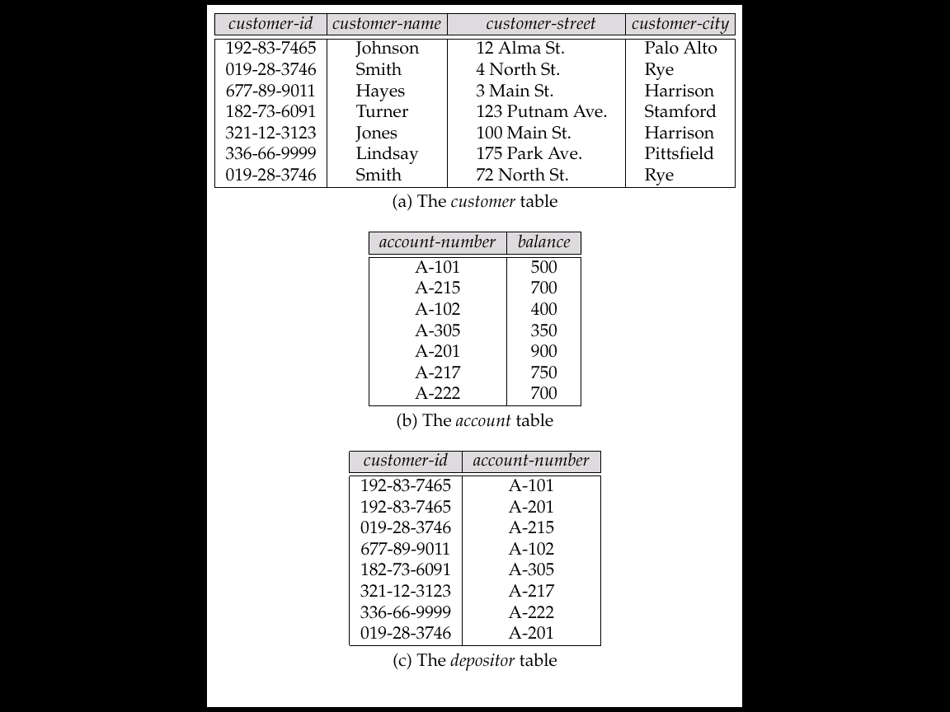
Sample Relational Database

Slide 9
Schemas and Instances
Schema:
overall structure, and constraints over database
changes infrequently
Instance:
data currently instantiated in database
changes frequently
Schema
Instances
Tables
Emp (ename, did)
Dept(did, dname, mgr)
Constraints
each department has a single manager
Emp
(John, 10), (Cindy, 15), (Martha, 10)
Dept
(10, Toy, John), (15, Sales, Cindy)

Slide 10
DBMS Languages
Data Definition Language (DDL)
Used to describe a schema
Data Manipulation Language (DML)
Used by users to query the DB and change the data
Storage Definition Language (SDL)
Define the internal storage schema
View Definition Language (VDL)
Define views

Slide 11
Data Definition Language (DDL)
Specification notation for defining database schema
CREATE TABLE account(accountID char(10), balance integer);
DDL compiler generates metadata
i.e., “data about data”
Other info, such as indexes, constraints

Slide 12
Data Manipulation Language (DML)
Language for accessing and manipulating the data organized by the appropriate data model
A query specifies what data is required
Two classes of languages
Procedural: user specifies how to get data
Nonprocedural: user does not specify how to get data
SQL is the most widely used query language

Slide 13
SQL (Structured Query Language)
Widely-used nonprocedural language
“Find the name of the customer with id 192-83-7465.” SELECT customer-name FROM customer WHERE customer-id = ‘192-83-7465’;
Basic SQL has limited expressive power:
Some functions cannot be implemented
Application programs access DB through one of
Language extensions to allow embedded SQL
Application program interface (e.g. ODBC/JDBC) that allow SQL queries to be sent to a database

Slide 14
DBMS Interface
Provides users means to interact with database:
Menu driven interface
Graphical interface
Forms based interface
Natural Language Interface
WWW connectivity.

Slide 15
People Involved with DBMS
DBMS designers and implementers
Database administrator (DBA)
“superuser” of a database, similar to a system administrator.
Define schemas, views, authorization, indexes, tuning parameters, etc.
Application programmers
Online users
Naïve users

Slide 16
Database-design process
Entity/Relationship Model
Entity sets
Relationship sets
Constraints on entity sets
Constraints on relationship sets
Weak entity sets
Superclass/subclass relationships
Aggregation
Good design Principles

Slide 17
Database-Design Process
Requirement Analysis
Functional requirements
Data requirements
conceptual design
logical design
physical design
functional analysis
application design
transaction implementation
conceptual schema
logical schema
(in DBMS model)
High-level specs
application programs
Physical schema
Functional Design
Database Design

Slide 18
Database-Design Tools
Help partially automate the design cycle.
Graphical interface to specify conceptual schemas.
Partially automated techniques to map to logical (DBMS dependent) model.
Features of a good design tool:
Iterative: errors/shortcomings of original design found later can be corrected without full restart.
Interactive: any design choices made by system during design should be based on interaction with designer.
Feedback: a designer’s change made at logical and/or physical levels should be automatically translated to changes at higher levels.
Example design tools: Developer 2000 by Oracle, Rational Tools

Slide 19
Entity/Relationship (E/R) Model
Entities: objects
Relationships: associate entities
Roles of entities in a relationship
Constraints on entities:
domain constraints
key constraints
Constraints on relationships:
Cardinality constraints
Participation constraints
Weak Entity Sets
Multiway relationships
Subclass/superclass Relationships
Aggregation

Slide 20
Entities and Entity Sets
name
street
number
city
balance
id
Customer
custacct
Account
Entities:
nouns, “things” in the world
Have attributes: course name, id, address, dept, age, room, …
Entity sets: a set of entities
In OO terminology, entity set = “class,” and entity = “instance.”

Slide 21
Attributes
Single-valued versus multi-valued:
“telephone number”: multi-valued
“Salary”: single-valued
Atomic versus composite:
“Age”: atomic
“Address”: composite
Derived versus stored:
Derived: derived from other attributes or entities, e.g., “age” derived from “date of birth.”
Stored: all other attributes

Slide 22
Relationships
Relationship: association of multiple entities
Relationship Set:
set of relationships over the same entity sets
binary, ternary, 4-nary, …n-nary
Custom-Account
Relationship set
account
customer
259, 10K
Tom, 62900, Main, LA
Jane, 62901, North, Irvine
305, 20K
245, 2400
Visualizing relationships as a table. Each row: pair of entities participating in the relationship

Slide 23
ER Diagram
id
name
street
city
balance
number
age
Customer
custacct
Account
dob
tel
opendate
Graphical representation of ER schema. Put as much information as possible.
Entity set: rectangle
Attribute: ellipse
Derived attribute: dashed ellipse (“age”)
Multivalued attribute: double ellipse (“tel”)
Relationship set: diamond, with lines connected to its entity sets. May have attributes, called “relationship attributes.”

Slide 24
Key Constraints on Entity Sets
Associate each entity set with a “key,” which is set of attributes that uniquely identify an entity in entity set.
In ER diagram: denoted by underlining the attributes
Multiple keys possible:
One primary key is chosen and underlined.
Other keys, called secondary keys, either not indicated or listed in a side comment attached to the diagram.
dept
name
number
balance
course
student
Account
No two accounts have the same number.
No two students have the same
name in the same dept.

Slide 25
Domain Constraints on Entity Sets
An attribute is associated with a domain.
The value of the attribute for each entity is constrained to be in the domain only.
Example:
Gender: “F” or “M”
Age: “> 20”

Slide 26
Cardinality Constraints
A
B
A
B
A
B
Many-to-many
Many-to-one
One-to-one
Multiplicity of binary relationship set R between entity sets A and B
Example: For “One-to-one,” an entity in A is associated with at most one entity in B, and vice versa. (A = B = “person”, R = “married-to”)

Slide 27
Many-to-many Relationship
customer
custacct
account
legal
opendate
Multiple customers can share an account
Many accounts may have one owner
(We use customer names as the ids.)
legal

Slide 28
Many-to-One Relationship
customer
N
custacct
1
account
Illegal ☹
opendate
Multiple customers can share an account, but one customer can have only one account.
Represented by an arrow pointing to “one.”
Note: could have no account!
legal ☺

Slide 29
Many-to-One Relationship (cont)
customer
custacct
account
opendate
In a many-to-one relationship, relationship attributes can be repositioned to the entity set on the “many” side.
customer
custacct
account
opendate

Slide 30
One-to-one Relationship
customer
custacct
account
opendate
Illegal
1 customer can have (at most) 1 account.
1 account can be owned by (at most) 1 customer
Relationship attributes “opendate” can be shifted to either entity set.
One-to-one relationship is considered as a special case of many-to-one relationship
Illegal
Legal

Slide 31
Participation Constraints
Two kinds of participation constraints
Total participation (also called existential dependency): each employee must belong to at least one department.
Otherwise, partial participation.
employee
Belongs-to
department

Slide 32
Example
Ss#
name
amount
loandid
customer
borrower
loan
Belongs-to
Customer-of
branch
Keys: ss#, loanid, branchid
Cardinality constraint: each loan belongs to a single branch
Participation constraints:
--- Each customer must be a customer of at least one branch
---- Each loan must belong to at least one branch
branchid
location

Slide 33
Weak Entity Sets
Weak entity sets: they do not have sufficient attributes to form a key.
They need to “borrow” attributes from other entity sets to form a key.
Example:
Transactions of different accounts could have the same trans#, so “trans#” cannot be a key
By borrowing attribute “number” from “account,” we have a key for “transaction.”
“Transaction” is a weak entity set related to accounts via log relationship.
number
balance
trans#
account
log
transaction

Slide 34
Weak Entity Sets (cont’)
A weak entity set depends upon (one or more) strong entity sets via a one-to-many relationship from whom they derive their key.
The “helper” entity set that provides the attributes is called the “owner” entity set.
A weak entity set may have a discriminator (or a partial key) that distinguish between weak entities related to the same strong entity
Key of weak entity set = key of owner entity set(s) + discriminator
number
balance
trans#
amount
account
log
transaction

Slide 35
Multiway Relationships
Usually binary relationships (connecting two E.S.) suffice.
Sometimes we need more E.S. connected by one relationship.
Similar to binary relationship, cardinality and participation constraints defined over multiway relationships
name
CAB Relationship Set
branch
acct#
SSN
customer
CAB
account
balance

Slide 36
Cardinality Constraints over Multiway Relationships
name
Illegal: Jane has account 1001 at 2 branches
branch
acct#
SSN
customer
CAB
account
balance
Legal
Many-to-many-to-1 relationship
Meaning: each (customer, account) determines the branch.

Slide 37
Cardinality Constraints over Multiway Relationships
name
Illegal: Jane has 2 accounts in Tokyo Branch
branch
acct#
SSN
customer
CAB
account
balance
Many-to-1-to-1 relationship
Meaning:
Each (customer, branch) related to a single account
Each (customer, account) pair related to a single branch
Legal

Slide 38
Cardinality Constraints over Multiway Relationships
name
Illegal: Both Tom and Jane have account 1002 in Tokyo Branch
branch
acct#
SSN
customer
CAB
account
balance
1-to-1-to-1 relationship
Meaning:
Each (customer, branch) related to a single account
Each (customer, account) pair related to a single branch
Each (branch, account) pair can have single customer
Legal

Slide 39
(Strong) Entity Sets to Relations
ssno
name
salary
employee
Relation: Employee(ssno, name, salary)
Key: ssno

Slide 40
Relationship Sets to Relations
ssno
name
salary
startdate
Proj#
mgr
employee
WorksOn
project
Relation: WorksOn(ssno,proj#,startdate)
Key: ssno,proj#
IND (INclusion Dependencies):
workson[proj#] ⊆ project[proj#]
workson[ssno] ⊆ employee[ssno]

Slide 41
Multiway Relationships
name
salary
startdate
proj#
mgr
ssno
WorksUsing
employee
project
tool
toolid
spec
Relation: worksusing(ssno,proj#,toolid, startdate)
Key: ssno,toolid
IND: worksusing[proj#] ⊆ project[proj#]
worksusing[ssno] ⊆ employee[ssno]
worksusing[toolid] ⊆ tools[toolid]
employee[ssno] ⊆ worksUsing[ssno]

Slide 42
Subclass/Superclass
ssno
name
salary
Relations:
employee(ssno, name, salary)
staff(ssno, position)
faculty(ssno, rank) studentassistant(ssno, percentage_time)
Key: ssno for all relations
IND: staff[ssno] ⊆ employee[ssno]
faculty[ssno] ⊆ employee[ssno]
studentassistant[ssno] ⊆ employee[ssno]
Cannot represent a total constraint.
employee
Isa
staff
faculty
student assistant
position
rank
Percentage
Time

Slide 43
Alternative design
name
salary
Relation:
employee(ssno, name, salary, Isstaff, position, Isfaculty, rank, IsStudentassistant, percentage-time)
Key : ssno
IsStaff, IsFaculty, Isstudent_assistant are boolean values (either true or false).
Contain many null values.
Still cannot represent a total constraint. (We cannot say something like “One of IsStaff, IsFaculty, IsStudentassistant must be non NULL.”)
ssno
employee
Isa
staff
faculty
Student assistant
position
rank
Percentage
Time

Slide 44
Weak Entity Sets
Acct#
balance
trans#
customer
amount
log
transaction
account
Relation:
account(acct#,customer, balance)
transaction(acct#,trans#, amount)
Key of Transaction: acct#, trans#
IND: transaction[acct#] ⊆ account[acct#]
No relation for the weak relationship set “Log.”

Slide 45
Referential integrity constraints
Asserts that exactly one value exists in a role
customer
custacct
account
opendate
Every customer has exactly one account
Represented as a rounded arrow entering “Account”
Same as:
customer
custacct
account
opendate

Slide 46
Subclass/Superclass Relationships
account#
accounts
balance
ISA
rate
savings
checkings
overdraft
“Savings” and “checkings” are subclasses of the “account” ES.
“Accounts” is a superclass of savings and checkings ES’s.
An entity in a subclass must belong to the superclass as well.
Every savings/checking account is also an account.
Attribute Inheritance:
Subclasses inherit all attributes of the superclass.
Key of the subclass is the same as the key for the superclass.
Subclasses inherit all relationships in which the superclass participates.

Slide 47
Superclass/Subclass relationships (cont)
Superclass and Subclass relationships arise during schema design due to the process of specialization and generalization
Specialization: process of classifying a class of objects into more specialized subclasses
E.g., start with an employee ES, then specialize it into different types of employees.
Generalization: Reverse of specialization. A process of synthesis of two or more lower-level ES to produce a higher-level ES.
E.g., identified a car, a sports utility vehicle, and a truck, then generalize them to create an automobile ES.

Slide 48
Superclass/Subclass Lattice
Class/Subclass relationships form a hierarchy (tree) or a lattice
persons
ISA
o
employees
alumnus
students
ISA
d
ISA
ISA
d
staff
faculty
student
assistants
grads
undergrads
ISA
o
RAs
TAs

Slide 49
Multiple Inheritance
Subclass inherits all its attributes from its superclass.
If a subclass has 2 or more superclasses, then it inherits from all the superclasses.
Resolve attribute-name conflicts:
ER model doesn’t specify how to resolve
Several options:
Choose a default attribute
Rename the conflicting attributes
id
employees
students
id
ISA
ISA
student
assistants

Slide 50
Review of ER Model
Basic Model:
Entities: strong, weak
Attributes
Relationships: binary, ternary, multiway
Role of entity sets in a relationship
Constraints on entity set: domain, key
Constraint on relationships: cardinality (1-1, 1-N, M-N), participation, referential integrity, single-value
Extended Model:
Superclass and subclass
Aggregation

Slide 51
E/R Design Cycle
A good design is important since schemas do not change often
The first version is almost always wrong.
Typical Schema Design Cycle
1: Requirement Analysis: Learn about the application.
what problem does the application solve, what questions does the application ask about the data, what data does the application need to answer these questions.
2: Design a trial schema
top-down strategy: define high-level concepts and then use successive refinements
bottom-up strategy: start with schema containing basic abstractions and then combine or add to them
3: Evaluate schema for quality and completeness.
consider the future: how is the application likely to change? Account for change.
4: Iterate until satisfied

Slide 52
Schema Design Issues
There may be many ER schemas for one target database.
Decisions that need to be made:
whether to use an attribute or entity set to represent an object
whether to model a concept as a relationship or an entity set
whether to use ternary relationship or a set of binary ones
whether to use a strong entity set of a weak entity set
whether using generalization/specializations is appropriate
whether using aggregates is appropriate
But there are no straightforward answers to these questions. No two design teams will come up with the same design.
There are some simple design principles that should be followed during ER design.

Slide 53
E/R Design Principles
Keep the same schema: Schemas should not change often. So store frequently changing information as instances.
currently each project consists of 10 members. Since later projects may have more or less employees, do not hard code the 10 employees as 10 attributes of the project entity
Avoid redundancy: schemas should prevent representing the same facts multiple times.
An attribute/relationship is redundant if deleting it does not result in a loss of any information
Redundancy may cause:
wastage of space
application programming more difficult: need to update all instances of a fact to avoid inconsistency of database
Consistent and clear names for attributes, entities, and relationships

Slide 54
Case Study 1
Design a DB representing cities, counties, and states in the US:
For states, record the name, population, and state capital (a city).
For counties, record the name, the population, and the located state.
For cities, record the name, the population, the located state and the located county.
Uniqueness assumptions:
Names of states are unique.
Names of counties are unique within a state (e.g., 26 states have Washington Counties).
Cities are unique only within a state (e.g., there are 24 Springfields among the 50 states).
Some counties and cities have the same name, even within a state (e.g., Los Angeles).
All cities are located within a single county
Notes:
9

Slide 55
Design 1: bad
Co. Popu.
Co. name
Popu.
cities
Located
states
name
Ci. Popu.
Ci. name
capital
Problem: County Population is repeated for each city.

Slide 56
Design 2: good
Co. Popu.
Co. name
Popu.
name
counties
Located
states
Belongs-to
cities
capitals
Ci. Popu.
Ci. name
The population of a county is derived from those of its cities.

Slide 57
Database-Design Process
Process
Conceptual Modeling -- ER diagrams
ER schema transformed to relational schema
Designer may add additional integrity constraints to reflect real-world constraints.
Resulting relational schema is normalized to generate a good schema (schema normalization process)
Schema is tested over example databases to evaluate its quality and correctness
Results are analyzed, and corrections to schema are made
Corrections may be translated back to conceptual model to keep the conceptual description of data consistent
Tools can automate this process

Slide 58
Schema Normalization
Decompose relational schemes to
remove redundancy
remove anomalies
Result of normalization:
Semantically-equivalent relational scheme
Represent the same information as the original
Be able to reconstruct the original from decomposed relations.

Slide 59
Redundancy and Anomalies
Project
Redundancy:
For students in the same project, their presentation date is repeated
Anomalies:
Update: To modify the presentation date for the “CdMgmt” project, we need to modify it for ALL its students. Otherwise, the table will be inconsistent.
Delete: Mary dropped out of the “CdMgmt” project. What if we want to keep her info, without using NULL values?

Slide 60
Functional Dependencies
Generalization of “Superkey”
Motivation: avoid redundancy in database design.
Relation R(A1,...,An,B1,...,Bm,C1,...,Cl)
Definition: A1,...,An functionally determine B1,...,Bm,i.e.,
(A1,...,An →B1,...,Bm)
iff for any two tuples r1 and r2 in R,
r1(A1,...,An ) = r2(A1,...,An )
implies r1(B1,...,Am) = r2(B1,...,Bm)
By definition: a superkey → all attributes of the relation.
In general, the left-hand side of a FD might not be a superkey.

Slide 61
Example
Take(StudentID, CID, Semster, Grade)
FD: (StudentId,Cid,semester) → Grade
Illegal
What if FD: (StudentId, Cid) → Semester?
Illegal
“Each student can take a course only once.”

Slide 62
FD Sets
A set of FDs on a relation: e.g., R(A,B,C), {A→B, B→C, A→C, AB→A}
Some dependencies can be derived
e.g., A→C can be derived from {A→B, B→C}.
Some dependencies are trivial
e.g., AB→A is “trivial.”

Slide 63
Trivial Dependencies
Those that are true for every relation
A1A2…An→B1B2…Bm is trivial if B’s are a subset of the A’s. Example: AB→A
Called nontrivial if at least one of the B’s are not among the A’s. Examples: AB→AC
Called completely nontrivial if none of the B’s is one of the A’s. Example: AB→C
We are more interested in completely nontrivial FDs.
Can always change a FD X→Y to an equivalent FD that’s completely nontrivial by removing attributes in Y that appear in X.

Slide 64
Closure of FD Set
Definition: Let F be a set of FDs of a relation R. We use F⁺ to denote the set of all FDs that must hold over R, i.e.:
F⁺ = { X → Y | F logically implies X → Y}
F⁺ is called the closure of F.
Example: F = {A→B, B→C}, then A→C is in F⁺.
F⁺ could have many FDs!
Example:
Let F = {A→B1, A→B2, ..., A→Bn}, then any A→Y (Y is a subset of {B1, B2, ..., Bn}) is in F+.
Cardinality of F+ is more than 2^n.
Fortunately, a given X→Y can be tested efficiently as we will see later

Slide 65
Armstrong’s Axims: Inferring All FDs
Given a set of FDs F over a relation R, how to compute F⁺?
Reflexivity:
If Y is a subset of X, then X →Y.
Example: AB→A, ABC→AB, etc.
Augmentation:
If X→Y, then XZ→YZ.
Example: If A→B, then AC→BC.
Transitivity:
If X→Y, and Y→Z, then X→Z.
Example: If AB→C, and C→D, then AB→D.

Slide 66
More Rules Derived from AAs
Union Rule:
If X→Y, X→Z, then X→YZ
Proof:
Since X→Y, using augmentation, X→XY (fd1)
Since X→Z, using augmentation, XY→YZ (fd2)
Using (fd1) and (fd2) and transitivity: X→YZ.
Pseudo-Transitivity Rule:
If X→Y, WY→Z, then WX→Z
Proof:
Since X→Y, using augmentation: XW→YW (fd3)
Given WY→Z and (fd3), using transitivity: WX→Z.

Slide 67
“Superkey” Revisited
Using FDs, we can formally define superkeys.
Given:
R(A1, A2, …,An): a relation
X: a subset of {A1, A2, …An}
F: a set of FDs on R
X is a superkey of R iff X→A1,A2, …,An is in F⁺.
Naïve algorithm to test if X is a superkey:
Compute F⁺ using AAs
If X →A1,A2,…,An is in F⁺, then X is a superkey.
Better algorithm: check if A1,…,An are in X⁺.

Slide 68
Representing FDs in ER?
Not all FDs can be represented in the ER model.
For example, we wish to build a table address(street, city, zip) with FDs:
street, city → zip
zip → city
Can these constraints be modeled in ER?
One design:
An ES with three attributes.
Two candidate keys: {street, city} and {street, zip}
Problem:
Zip→city cannot be enforced.
Example: (campus, irvine, 92612) and (main, santa ana, 92612) could be allowed in this ER diagram. But it violates “zip → city”
In fact, it can be formally shown that no ER schema can represent these FDs. (Try other possibilities to convince yourself.)
street
city
zip
address

Slide 69
Find candidate keys
Given a set F of FDs for a relation, how to find the candidate keys?
One naïve approach: consider each subset X of the relation attribute, and compute X⁺ to see if it includes every attribute.
Tricks:
If an attribute A does not appear in any RHS in FD, A must be in every candidate key
As a consequence, if A must be in every candidate key, and A → B is true, then B should not be in any candidate key.
Example:
R(A,B,C,D,E,F,G,H)
{A → B, ACD → E, EF → GH}
Candidate key: {ACDF}

Slide 70
RELATIONAL ALGEBRA

Slide 71
Outline
A few set-based operators to manipulate relations:
Union, Intersection, Difference:
Usual set operators
Relations must have the same schema
Selection: choose rows from a relation.
Projection: choose columns from a relation.
Cartesian Product and Join: construct a new relation from several relations
Renaming: rename a relation and its attributes
Combining basic operators to form expressions

Slide 72
Union ∪, Intersection ∩, Difference -
Set operators. Relations must have the same schema.
R(name, dept)
S(name, dept)
R∪S
R ∩ S
R-S

Slide 73
Selection σ
σ _{c} (R): return tuples in R that satisfy condition C.
Emp (name, dept, salary)
σ _{salary>35K} (Emp)
σ _{dept=ics and salary<40K} (Emp)

Slide 74
Projection Π
Π_{A1,…,Ak}(R): pick columns of attributes A1,…,Ak of R.
Emp (name, dept, salary)
Π_{name,dept} (Emp)
Π_{name} (Emp)
Duplicates (“Jack”) eliminated.

Slide 75
Cartesian Product: ×
R × S: pair each tuple r in R with each tuple s in S.
Emp (name, dept)
Contact(name, addr)
Emp × Contact

Slide 76
Join
R S = σ _{c} (R × S)
C
Join condition C is of the form:
<cond_1> AND <cond_2> AND … AND <cond_k>
Each cond_i is of the form A op B, where:
A is an attribute of R, B is an attribute of S
op is a comparison operator: =, <, >, ≥, ≤, or ≠.
Different types:
Theta-join
Equi-join
Natural join

Slide 77
Theta-Join
R S
R.A>S.C
R(A,B)
S(C,D)
R × S
Result

Slide 78
Theta-Join
R S
R.A>S.C, R.B ≠ S.D
R(A,B)
S(C,D)
Result
R × S

Slide 79
Equi-Join
Special kind of theta-join: C only uses the equality operator.
R(A,B)
S(C,D)
R S
R × S
R.B=S.D
Result

Slide 80
Natural-Join
Relations R and S. Let L be the union of their attributes.
Let A1,…,Ak be their common attributes.
R S = Π _{L} (R S)
R.A1=S.A1,…,R.Ak=S.Ak

Slide 81
Natural-Join
Emp (name, dept)
Contact(name, addr)
Emp Contact: all employee names, depts, and addresses.
Emp × Contact
Result

Slide 82
Outer Joins
Motivation: “join” can lose information
E.g.: natural join of R and S loses info about Tom and Mary, since they do not join with other tuples.
Called “dangling tuples”.
R
S
Outer join: natural join, but use NULL values to fill in dangling tuples.
Three types: “left”, “right”, or “full”

Slide 83
Left Outer Join
R
S
R × S
Left outer join
R S
Pad null value for left dangling tuples.

Slide 84
Right Outer Join
R
S
R × S
Right outer join
R S
Pad null value for right dangling tuples.

Slide 85
Full Outer Join
R
S
R × S
Full outer join
R S
Pad null values for both left and right dangling tuples.

Slide 86
Combining Different Operations
Construct general expressions using basic operations.
Schema of each operation:
∪, ∩, -: same as the schema of the two relations
Selection σ : same as the relation’s schema
Projection Π: attributes in the projection
Cartesian product × : attributes in two relations, use prefix to avoid confusion
Theta Join : same as ×
Natural Join : union of relations’ attributes, merge common attributes
Renaming: new renamed attributes
C

Slide 87
Example 1
customer(ssn, name, city)
account(custssn, balance)
“List account balances of Tom.”
Π_{balance}
Tree representation
×
σ _{name=tom}
account
customer

Slide 88
Example 1(cont)
customer(ssn, name, city)
account(custssn, balance)
“List account balances of Tom.”
Π_{balance}
ssn=custssn
σ _{name=tom}
account
customer

Slide 89
NORMALIZATION

Slide 90
The Normalization Process
In relational databases the term normalization refers to a reversible step-by-step process in which a given set of relations is replaced by successive collections of relations that have a progressively simpler and more regular structure.

Slide 91
The Normalization Process
The objectives of the normalization process are:
To make it feasible to represent any relation in the database.
applies to First Normal Form
To obtain powerful relational retrieval algorithms based on a collection of primitive relational operators.
applies to First Normal Form

Slide 92
The Normalization Process
To free relations from undesirable insertion, update and deletion anomalies.
applies to all normal forms
To reduce the need for restructuring the relations as new data types are introduced.
applies to all normal forms

Slide 93
The Normalization Process
The entire normalization process is based upon
the analysis of relations
their schemes
their primary keys
their functional dependencies.

Slide 94
Relational Database Design
Given a relation schema, we need to decide whether it is a good design or we need to decompose it into smaller relations.
Such a decision must be guided by an understanding of what problems arise from the current schema.
To provide such guidance, several normal forms have been proposed.
If a relation schema is in one of these normal forms, we know that certain kinds of problems cannot arise.

Slide 95
Normalization
Unnormalized Relations
First normal form
Functional dependencyof nonkey attributes on the primary key - Atomic values only
No transitive dependency between nonkey attributes
Second normal form
Third normal form
Boyce-
Codd and
Higher
All determinants are candidate keys - Single multivalued dependency
Full Functional dependencyof nonkey attributes on the primary key

Slide 96
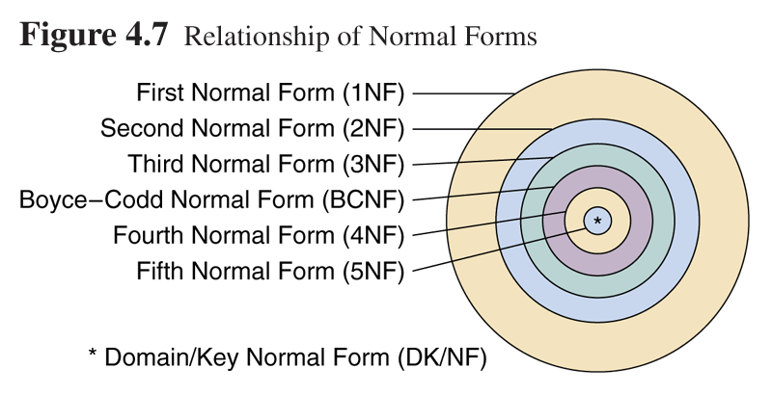
Relationship of Normal Forms

Slide 97
Unnormalized Relations
First step in normalization is to convert the data into a two-dimensional table
In unnormalized relations data can repeat within a column

Slide 98
Unnormalized Relation

Slide 99
Normal Forms
1st Normal Form | No repeating data groups
2nd Normal Form | No partial key dependency
3rd Normal Form | No transitive dependency
Boyce-Codd Normal Form | Reduce keys dependency
4th Normal Form | No multi-valued dependency
5th Normal Form | No join dependency

Slide 100
First Normal Form
To move to First Normal Form a relation must contain only atomic values at each row and column.
No repeating groups
A column or set of columns is called a Candidate Key when its values can uniquely identify the row in the relation.

Slide 101
First Normal Form
Sometimes, during the process of designing a database it may be necessary to transform into a relation a given table that in some of its entries (the intersection of a row and a column) may have more than one value.
Example: the PROJECT table shown in the next slide where one or more employees may be assigned to a project.
Notice that for each Project ID (Proj-ID) every “row” of the table has more than one value under the columns Emp-ID, Emp-Name, Emp-Dpt, Emp-Hrly-Rate, and Total-Hrs.

Slide 102
First Normal Form
PROJECT
Proj-ID | Proj-Name | Proj-Mgr-ID | Emp-ID | Emp-Name | Emp-Dpt | Emp-Hrly-Rate | Total-Hrs
100 | E-commerce | 789487453 | 123423479 980808980 234809000 542298973 | Heydary Jones Alexander Johnson | MIS TechSupport TechSupport TechDoc | 65 45 35 30 | 10 6 6 12
110 | Distance-Ed | 820972445 | 432329700 689231199 712093093 | Mantle Richardson Howard | MIS TechSupport TechDoc | 50 35 30 | 5 12 8
120 | Cyber | 980212343 | 834920043 380802233 553208932 123423479 | Lopez Harrison Olivier Heydary | Engineering TechSupport TechDoc MIS | 80 35 30 65 | 4 11 12 07
130 | Nitts | 550227043 | 340783453 | Shaw | MIS | 65 | 07

Slide 103
First Normal Form
To refer to this type of table and how tables relate to relations some new terminology is necessary:
Table entries that have more than one value are called multivalue entries.
Tables with multivalue entries are called unnormalized tables.
Within an unnormalized table, we call a repeating group an attribute or a group of attributes that may have mulitvalue entries for single occurrences of the table identifier.
Refers to the attribute that allows us to distinguish the different rows of the unnormalized table.

Slide 104
First Normal Form
Three Formal definitions of First Normal Form
A relation r is said to be in First Normal Form (1NF) if and only if every entry of the relation (the intersection of the tuple and a column) has at most a single value.
A relation is in first normal form (1NF) if and only if all underlying simple domain contains atomic values only.
A relation is in 1NF if and only if all of its attributes are based upon a simple domain.
These two definitions are equivalent.
If all relations of a database are in 1NF, we can say that the database is in 1NF.

Slide 105
First Normal Form
PROJECT
The normalized representation of the PROJECT table
Proj-ID | Proj-Name | Proj-Mgr-ID | Emp-ID | Emp-Name | Emp-Dpt | Emp-Hrly-Rate | Total-Hrs
100 | E-commerce | 789487453 | 123423479 | Heydary | MIS | 65 | 10
100 | E-commerce | 789487453 | 980808980 | Jones | TechSupport | 45 | 6
100 | E-commerce | 789487453 | 234809000 | Alexander | TechSupport | 35 | 6
100 | E-commerce | 789487453 | 542298973 | Johnson | TechDoc | 30 | 12
110 | Distance-Ed | 820972445 | 432329700 | Mantle | MIS | 50 | 5
110 | Distance-Ed | 820972445 | 689231199 | Richardson | TechSupport | 35 | 12
110 | Distance-Ed | 820972445 | 712093093 | Howard | TechDoc | 30 | 8
120 | Cyber | 980212343 | 834920043 | Lopez | Engineering | 80 | 4
120 | Cyber | 980212343 | 380802233 | Harrison | TechSupport | 35 | 11
120 | Cyber | 980212343 | 553208932 | Olivier | TechDoc | 30 | 12
120 | Cyber | 980212343 | 123423479 | Heydary | MIS | 65 | 07
130 | Nitts | 550227043 | 340783453 | Shaw | MIS | 65 | 07

Slide 106
Partial Dependencies
Identifying the partial dependencies in the PROJECT-EMPLOYEE relation.
The PK of this relation is formed by the attributes Proj-ID and Emp-ID.
This implies that Proj-ID, Emp-ID uniquely identifies a tuple in the relation.
They functionally determine any individual attribute or any combination of attributes of the relation.
However, we only need attribute Emp-ID to functionally determine the following attributes:
Emp-Name, Emp-Dpt, Emp-Hrly-Rate and Total-Hrs.

Slide 107
Partial Dependencies
Attributes Emp-Name, Emp-Dpt, and Emp-Hrly-Rate are partially dependent on the key.
There are no partial dependencies in this table because the determinant of the key only has a single attribute.
Proj-ID
Emp-ID
Emp-Name
Emp-Dpt
Emp-Hrly-Rate

Slide 108
Second Normal Form
A relation is said to be in Second Normal Form when every nonkey attribute is fully functionally dependent on the primary key.
That is, every nonkey attribute needs the full primary key for unique identification

Slide 109
Transitive Dependencies
Assume the following functional dependencies of attributes A, B and C of relation r(R):
A
B
C

Slide 110
Transitive Dependencies
If all these conditions are true, we say that attribute C is transitively dependent on attribute A.
These functional dependencies determine the conditions for having a transitive dependency of attribute C on A.
If any of these functional dependencies are not satisfied then attribute C is not transitively dependent on attribute A.
In this diagram, attributes A and B are nonprime attributes.

Slide 111
Third Normal Form
A relation is in 3NF iff it is in 2NF and every non key attribute is non transitively dependent on the primary key.
A relation r(R) is in Third Normal Form (3NF) if and only if the following conditions are satisfied simultaneously:
r(R) is already in 2NF.
No nonprime attribute is transitively dependent on the key.
Can also be stated as “no nonprime attribute functionally determines any other nonprime attribute.

Slide 112
Third Normal Form
The objective of transforming relations into 3NF is to remove all transitive dependencies.
To transform a 2NF relation into a 3NF we will follow the approach indicated in the following diagram.
An asterisk indicates the key attribute
The arrows denote functional dependencies
The dashed line indicates an implicit functional dependency that is always present because it can be derived using the inference axioms.

Slide 113
Conversion to Third Normal Form
A*
A*
B
B
C
Convert to
B*
C

Slide 114
Data Anomalies in Third Normal Form
The Third Normal Form helped us to get rid of the data anomalies caused either by
transitive dependencies on the PK or
by dependencies of a nonprime attribute on another nonprime attribute.
However, relations in 3NF are still susceptible to data anomalies, particularly when
the relations have two overlapping candidate keys or
when a nonprime attribute functionally determines a prime attribute.

Slide 115
Boyce-Codd Normal Form (BCNF)
A relation is in BCNF iff every determinant is a candidate key. [ A determinant is any attribute on which some other attribute is (fully) functionally dependent.]
Role of FDs in detecting redundancy:
consider a relation R with three attributes, A,B,C
If no non-trivial FDs hold, no potential redundancy
If A → B, then tuples with the same A value will have the same (redundant) B values.
But if A is a superkey, then each A value is unique

Slide 116
Intuitively, in a BCNF relation, the only nontrivial dependencies are those in which a superkey determines some attributes.
Each tuple can be thought of as an entity or relationship, identified by a key and described by the remaining attributes
Key
Nonkey
attr_1
Nonkey
attr_2
Nonkey
attr_k
FDs in a BCNF Relation

Slide 117
Example
R = ( A, B, C )
F = { A → B, B → C }
Key = { A }
R is not in BCNF
A | B | C
a1 | b1 | c1
a2 | b1 | c1
a3 | b1 | c1
a4 | b2 | c2
A | B
a1 | b1
a2 | b1
a3 | b1
a4 | b2
Decomposition into
R₁ = ( A, B ), R₂ = ( B, C )
R₁ and R₂ are in BCNF
B | C
b1 | c1
b2 | c2
B → C
A → B

Slide 118
Motivation of 3NF
By making an exception for certain dependencies involving key attributes,
we can ensure that every relation schema can be decomposed into a collection of 3NF relations using only lossless-join, dependency-preserving decompositions.
Such a guarantee does not exist for BCNF relations.
It weaken the BCNF requirements just enough to make this guarantee possible.

Slide 119
Unlike BCNF, some redundancy is possible with 3NF.
The problems associate with partial and transitive dependencies persist if there is a nontrivial dependency
X→A and
X is not a superkey,
even if the relation is in 3NF because
A is part of a key.

Slide 120
Problems with decomposition
Some queries become more expensive.
Given instances of the decomposed relations, we may not be able to reconstruct the corresponding instance of the original relation – information loss.
Checking some dependencies may require joining the instances of the decomposed relations.

Slide 121
Lossless Join Decomposition
The relation schemas { R₁, R₂, …, R_{n} } is a
lossless-join decomposition of R if:
for all possible relations r on schema R,
r = Π_{R1}( r ) Π _{R2}( r ) … Π _{Rn}( r )

Slide 122
Example
R = ( A, B, C )
F = { A → B }
{ A, B } + { A, C } is a lossless join decomposition
{A,B } ∩ {A,C} = {A} is a key in {A,B}
{ A, B } + { B, C } is not a lossless join decomposition
{A,B } ∩ {B,C} = {B} is neither a key in {A,B} nor {B,C}
Also, consider the previous relation ‘Student’

Slide 123
Example
Student = ( sid, sname, major)
F = { sid → sname, sid → major}
{ sid, sname } + { sid, major } is a lossless join decomposition
the intersection = {sid} is a key in both schemas
{sid, major} + { sname, major } is not a lossless join decomposition
the intersection = {major} is not a key in either
{sid, major} or { sname, major }

Slide 124
Another Example
R = { A, B, C, D }
F = { A → B, C → D }.
introduce
virtually
Decomposition: { (A, B), (C, D), (A, C) }
Consider it a two step decomposition:
Decompose R into R₁ = (A, B), R₂ = (A, C, D)
Decompose R₂ into R₃ = (C, D), R₄ = (A, C)
This is a lossless join decomposition.
If R is decomposed into (A, B), (C, D)
This is a lossy-join decomposition.

Slide 125
Dependency Preservation
R - a relation schema
F - set of functional dependencies on R
{ R₁, R₂ } – a decomposition of R.
F_{i} - the set of dependencies in F⁺ involving only attributes in R_{i}.
F_{i} is called the projection of F on the set of attributes of R_{i}.
dependency is preserved if
a dependency-preserving decomposition allows us to enforce all FDs by examining a single relation instance on each insertion or modification of a tuple.
( F₁ U F₂ )⁺ = F ⁺

Slide 126
BCNF VS 3NF
always possible to decompose a relation into relations in 3NF and
the decomposition is lossless
dependencies are preserved
always possible to decompose a relation into relations in BCNF and
the decomposition is lossless
may not be possible to preserve dependencies

Slide 127
MULTIVALUED DEPENDENCIES
Definition: Let R be a relation and let A,B and C be subsets of the attributes of R. Then we say that B is multi-dependent on A in symbol A→→B iff in every possible legal value of R, the set of B values matching a given (A value, C value) pair depends only on the A value & is independent of the C value.

Slide 128
MULTIVALUED DEPENDENCIES (Cont..)
It can be shown that, given the relation R{A,B,C} the MVD A→→B holds iff the MVD A→→C also holds. MVDs always go together in pairs in this way. For this reason it is common to represent them in one statement i.e. A→B|C.
Multi valued dependencies are a generalization of functional dependencies in the sense that every FD is an MVD. More precisely, an FD is an MVD in which the set of dependent (RHS) values matching a given determinant (LHS) value is always a singleton set. Thus, if A→B, then certainly A→→B.

Slide 129
Fourth Normal Form
A relation R is in 4NF iff whenever there exists a multivalued dependency in R, say A→→B, then all attributes of R are also functionally dependent on A.
Any relation is in Fourth Normal Form if it is BCNF and any multivalued dependencies are trivial
Eliminate non-trivial multivalued dependencies by projecting into simpler tables

Slide 130
Join Dependency
Let R be a relation and let A,B,…..,Z be
subsets of the attributes of R. Then we say that R satisfies the Join Dependency or JD
*{A,B,…..,Z} iff every possible legal value of R is equal to the join of its projections on A,B,….,Z.

Slide 131
Fifth Normal Form
A relation R is in 5NF (also called Projection-Join Normal form or PJNF) iff every join dependency in the relation R is implied by the candidate keys of the relation R.
Implies that relations that have been decomposed in previous NF can be recombined via natural joins to recreate the original relation.

Slide 132
Questions
What is a schema? State the different types of schemas.
What are Object Oriented databases?
Explain the design process of a relational database.
What is a closure? How can we find the closure of a given set of FDs?
What is the difference between 3NF and BCNF?

Slide 133
Questions
Why do we need to normalize the relations?
Explain different types of anomalies with example.
What is the difference between cartesian product and join operations?
Explain different types of joins/
What is a relation? And what are the different types of relation algebra operations that we can perform on relations?

