Slide 1
Unit 2
Contents
Transaction Management
Concurrency Control
Recovery Management
Data Warehouse and OLAP
Data Mining

Slide 2
Transaction Management
A transaction is a logical unit of database processing .
E.g. transaction to transfer $50 from account A to account B:
1. read(A)
2. A := A – 50
3. write(A)
4. read(B)
5. B := B + 50
write(B)
Goal of transaction: ensure all the objects managed by a server remain in a consistent state when accessed by multiple transactions and in the presence of server crashes.

Slide 3
Examples of Transaction(SQL)
Any action that reads from and/or writes to a database may consist of
Simple SELECT statement to generate a list of table contents
A series of related UPDATE statements to change the values of attributes in various tables
A series of INSERT statements to add rows to one or more tables
A combination of SELECT, UPDATE, and INSERT statements

Slide 4
Transaction Properties
A transaction is a unit of program execution that accesses and possibly updates various data items.To preserve the integrity of data the database system must ensure:
Atomicity. Either all operations of the transaction are properly reflected in the database or none are.
Consistency. Execution of a transaction in isolation preserves the consistency of the database.
Isolation. Although multiple transactions may execute concurrently, each transaction must be unaware of other concurrently executing transactions. Intermediate transaction results must be hidden from other concurrently executed transactions.
Durability. After a transaction completes successfully, the changes it has made to the database persist, even if there are system failures.

Slide 5
Transaction States
Active – the initial state; the transaction stays in this state while it is executing
Partially committed – after the final statement has been executed.
Failed -- after the discovery that normal execution can no longer proceed.
Aborted – after the transaction has been rolled back and the database restored to its state prior to the start of the transaction. Two options after it has been aborted:
restart the transaction
can be done only if no internal logical error
kill the transaction
Committed – after successful completion.

Slide 6
Transaction States Diagram
BEGIN
END
TRANSACTION
TRANSACTION
active
partially
COMMIT
committed
committed
,
ROLLBACK
ROLLBACK
READ
WRITE
failed
terminated
6

Slide 7
Transaction Management with SQL
A COMMIT statement is reached- all changes are permanently recorded within the database
A ROLLBACK is reached – all changes are aborted and the database is restored to a previous consistent state
The end of the program is successfully reached – equivalent to a COMMIT
The program abnormally terminates and a rollback occurs

Slide 8
The Transaction Log
Keeps track of all transactions that updatethe database. It contains:
A record for the beginning of transaction
For each transaction component (SQL statement)
Type of operation being performed (update, delete, insert)
Names of objects affected by the transaction (the name of the table)
“Before” and “after” values for updated fields
Pointers to previous and next transaction log entries for the same transaction
The ending (COMMIT) of the transaction

Slide 9
The Transaction Log
Increases processing overhead but the ability to restore a corrupted database is worth the price
If a system failure occurs, the DBMS will examine the log for all uncommitted or incomplete transactions and it will restore the database to a previous state
The log it itself a database and to maintain its integrity many DBMSs will implement it on several different disks to reduce the risk of system failure

Slide 10
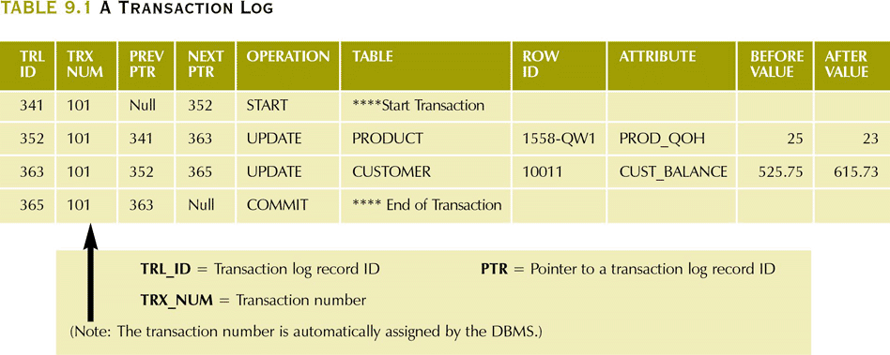
Transaction Log Example

Slide 11
Concurrency Control
Multiple transactions are allowed to run concurrently in the system. Advantages are:
increased processor and disk utilization, leading to better transaction throughput
E.g. one transaction can be using the CPU while another is reading from or writing to the disk
reduced average response time for transactions: short transactions need not wait behind long ones.
Concurrency control schemes – mechanisms to achieve isolation
that is, to control the interaction among the concurrent transactions in order to prevent them from destroying the consistency of the database

Slide 12
Schedules
Schedule – a sequences of instructions that specify the chronological order in which instructions of concurrent transactions are executed
a schedule for a set of transactions must consist of all instructions of those transactions
must preserve the order in which the instructions appear in each individual transaction.
A transaction that successfully completes its execution will have a commit instructions as the last statement
by default transaction assumed to execute commit instruction as its last step
A transaction that fails to successfully complete its execution will have an abort instruction as the last statement

Slide 13
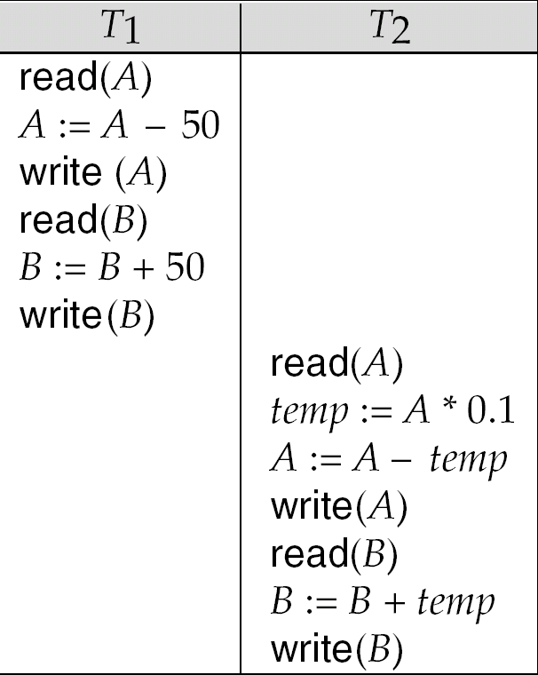
Schedule 1
Let T₁ transfer $50 from A to B, and T₂ transfer 10% of the balance from A to B.
A serial schedule in which T₁ is followed by T₂ :

Slide 14
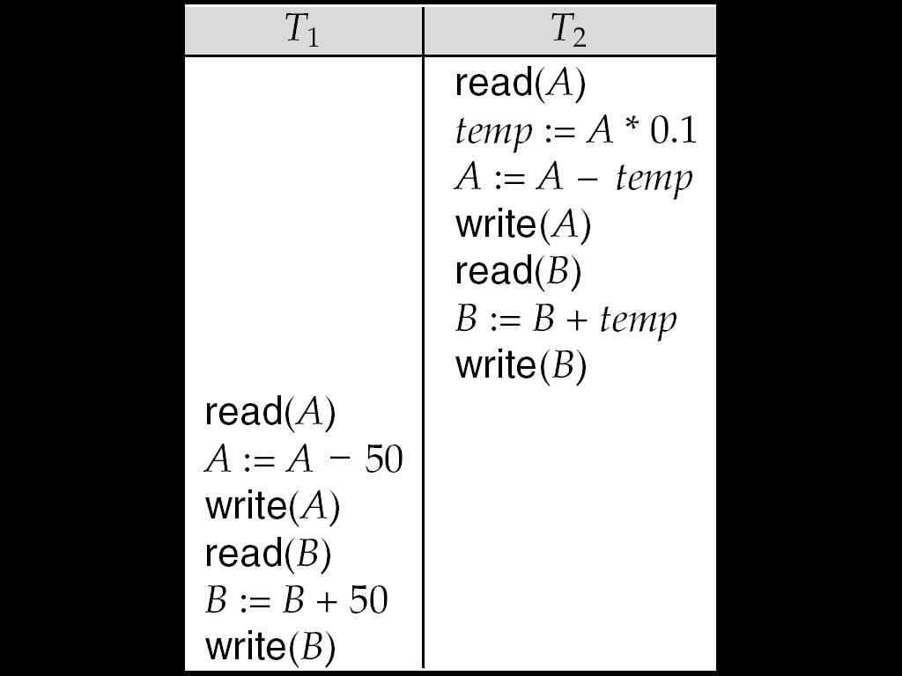
Schedule 2
A serial schedule where T₂ is followed by T₁

Slide 15
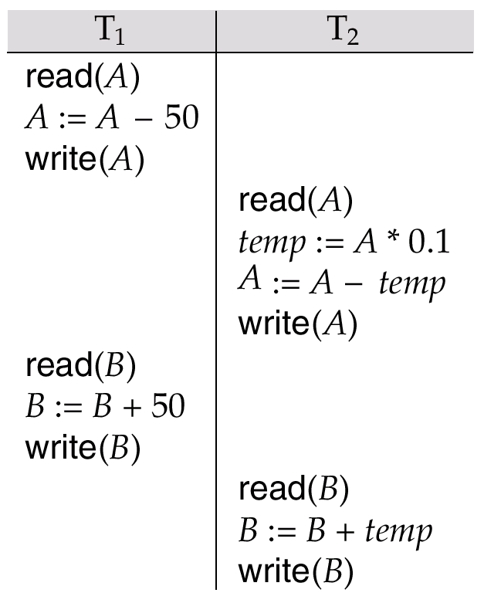
Schedule 3
Let T₁ and T₂ be the transactions defined previously. The following schedule is not a serial schedule, but it is equivalent to Schedule 1.
In Schedules 1, 2 and 3, the sum A + B is preserved.

Slide 16
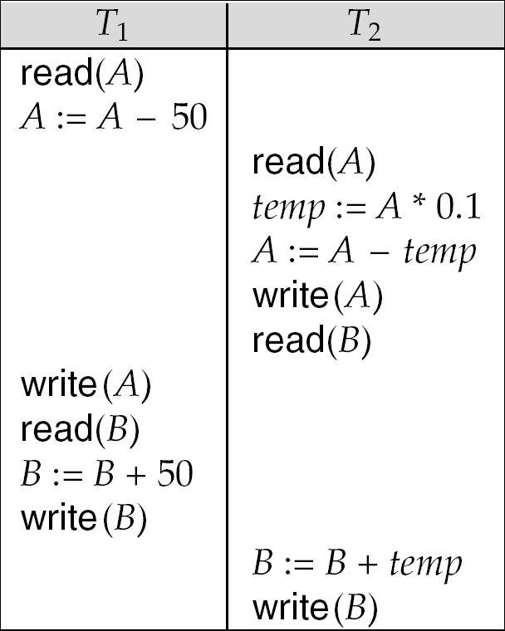
Schedule 4
The following concurrent schedule does not preserve the value of (A + B ).

Slide 17
Serializability
Basic Assumption – Each transaction preserves database consistency.
Thus serial execution of a set of transactions preserves database consistency.
A (possibly concurrent) schedule is serializable if it is equivalent to a serial schedule. Different forms of schedule equivalence give rise to the notions of:
1. conflict serializability
2. view serializability

Slide 18
Problems with Concurrent Transaction
Transaction Serializability
The effect on a database of any number of transactions executing in parallel must be the same as if they were executed one after another
Problems due to the Concurrent Execution of Transactions
The Lost Update Problem
The Incorrect Summary or Unrepeatable Read Problem
The Temporary Update (Dirty Read) Problem
≡

Slide 19
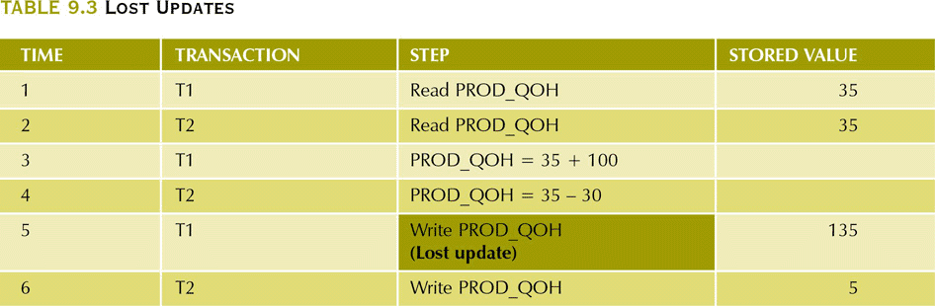
The Lost Update Problem
Two transactions accessing the same database item have their
operations interleaved in a way that makes the database item incorrect

Slide 20
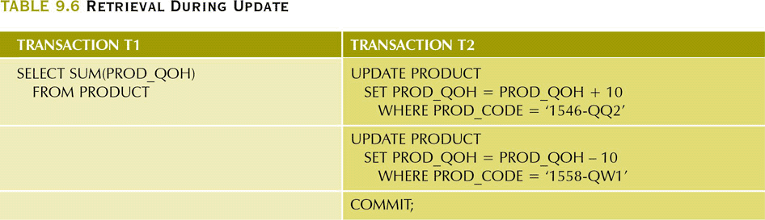
The Incorrect Summary or Unrepeatable Read Problem
One transaction is calculating an aggregate summary function on a number of records while other transactions are updating some of these records.
The aggregate function may calculate some values before they are updated and others after.

Slide 21
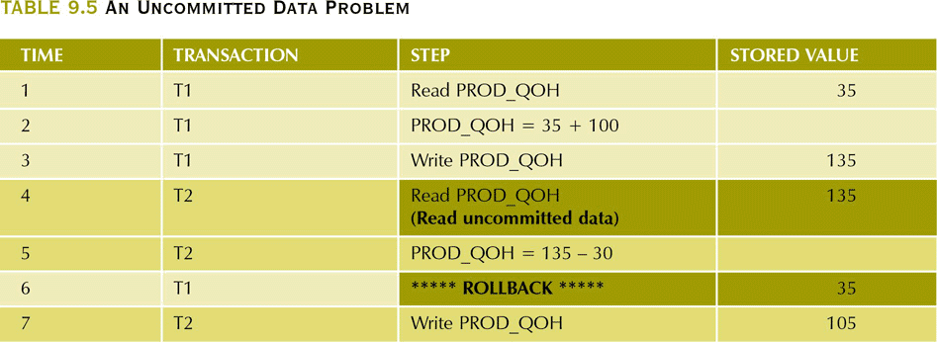
Dirty Read or The Temporary Update Problem
One transaction updates a database item and then the transaction fails. The updated item is accessed by another transaction before it is changed back to its original value
transaction T1 fails and must change the value of X back to its old value
meanwhile T2 has read the “temporary” incorrect value of X

Slide 22
Example of Serial Schedules
Schedule B
Schedule A
T1: | T2:
read_item(X);
X:= X - N;
write_item(X);
read_item(Y);
Y:=Y + N;
write_item(Y);
 | read_item(X);
 | X:= X + M;
 | write_item(X);
T1: | T2:
 | read_item(X);
 | X:= X + M;
 | write_item(X);
read_item(X);
X:= X - N;
write_item(X);
read_item(Y);
Y:=Y + N;
write_item(Y);

Slide 23
Example of Non-serial Schedules
Schedule D
Schedule C
T1: | T2:
read_item(X);
X:= X - N;
 | read_item(X);
 | X:= X + M;
write_item(X);
read_item(Y);
 | write_item(X);
Y:=Y + N;
write_item(Y);
T1: | T2:
read_item(X);
X:= X - N;
write_item(X);
 | read_item(X);
 | X:= X + M;
 | write_item(X);
read_item(Y);
Y:=Y + N;
write_item(Y);
We have to figure out whether a schedule is equivalent to a serial schedule
i.e. the reads and writes are in the right order

Slide 24
Conflicting Instructions
Instructions l_{i} and l_{j} of transactions T_{i} and T_{j} respectively, conflict if and only if there exists some item Q accessed by both l_{i} and l_{j}, and at least one of these instructions wrote Q.
1. l_{i} = read(Q), l_{j} = read(Q). l_{i} and l_{j} don’t conflict. 2. l_{i} = read(Q), l_{j} = write(Q). They conflict. 3. l_{i} = write(Q), l_{j} = read(Q). They conflict 4. l_{i} = write(Q), l_{j} = write(Q). They conflict
Intuitively, a conflict between l_{i} and l_{j} forces a (logical) temporal order between them.
If l_{i} and l_{j} are consecutive in a schedule and they do not conflict, their results would remain the same even if they had been interchanged in the schedule.

Slide 25
Conflict Serializability
If a schedule S can be transformed into a schedule S´ by a series of swaps of non-conflicting instructions, we say that S and S´ are conflict equivalent.
We say that a schedule S is conflict serializable if it is conflict equivalent to a serial schedule

Slide 26
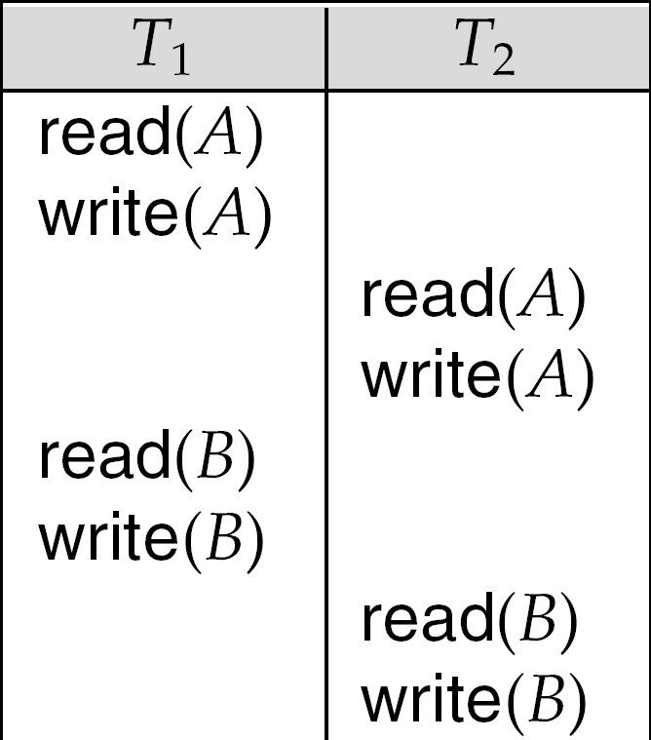
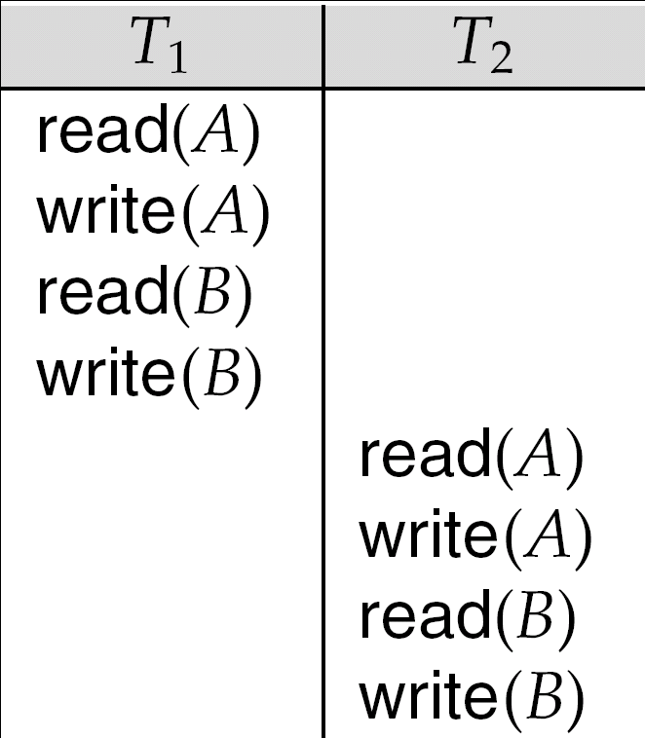
Conflict Serializability (Cont.)
Schedule 1 can be transformed into Schedule 2, a serial schedule where T₂ follows T₁, by series of swaps of non-conflicting instructions.
Therefore Schedule 3 is conflict serializable.
Schedule 1
Schedule 2

Slide 27
View Serializability
Let S and S´ be two schedules with the same set of transactions. S and S´ are view equivalent if the following three conditions are met, for each data item Q,
If in schedule S, transaction T_{i} reads the initial value of Q, then in schedule S’ also transaction T_{i} must read the initial value of Q.
If in schedule S transaction T_{i} executes read(Q), and that value was produced by transaction T_{j} (if any), then in schedule S’ also transaction T_{i} must read the value of Q that was produced by the same write(Q) operation of transaction T_{j} .
The transaction (if any) that performs the final write(Q) operation in schedule S must also perform the final write(Q) operation in schedule S’.

Slide 28
Concurrency Control Mechanisms
Lock Based Protocols
Timestamp Based Protocols
Tree (or Graph) Based Protocols
Deadlock handling techniques

Slide 29
Locking Schemes
To ensure serializability, it is required that when one transaction is accessing a data item no other transaction can modify it.
There are 2 ways to lock a data item:
Shared lock (Read mode)
Exclusive lock (Write mode)
Shared locks are compatible with only other shared locks and not with exclusive locks.

Slide 30
Starvation
Starvation may occur due to 2 reasons:
Allowing a higher priority trans to acquire lock may result in starvation of lower priority trans waiting for an x lock.
When a shared lock is acquired by a series of trans on a data item and at the same time any other trans is waiting for x-lock on it.

Slide 31
Solution to Starvation
When a trans Ti requests a lock on data item Q, the concurrency ctrl manager grants the lock only when:
There is no other trans holding a conflicting lock.
There is no other trans which is waiting for a lock on Q and made lock request before Ti.

Slide 32
2 PL
There are two phases in which a trans holds and releases a lock on a data item:
Phase 1: Growing Phase
transaction may obtain locks
transaction may not release locks
Phase 2: Shrinking Phase
transaction may release locks
transaction may not obtain locks
Problems with 2 PL:
It does not ensure freedom from deadlocks
Cascading rollbacks may occur.
Cascading rollbacks can be avoided by
Strict 2PL
Rigorous 2Pl

Slide 33
Lock Conversions
Two-phase locking with lock conversions:
– First Phase:
can acquire a lock-S on item
can acquire a lock-X on item
can convert a lock-S to a lock-X (upgrade)
– Second Phase:
can release a lock-S
can release a lock-X
can convert a lock-X to a lock-S (downgrade)
This protocol assures serializability. But still relies on the programmer to insert the various locking instructions.

Slide 34
Timestamp-Based Protocols
Each transaction is issued a timestamp when it enters the system. If an old transaction T_{i} has time-stamp TS(T_{i}), a new transaction T_{j} is assigned time-stamp TS(T_{j}) such that TS(T_{i}) <TS(T_{j}).
The protocol manages concurrent execution such that the time-stamps determine the serializability order.
In order to assure such behavior, the protocol maintains for each data Q two timestamp values:
W-timestamp(Q) is the largest time-stamp of any transaction that executed write(Q) successfully.
R-timestamp(Q) is the largest time-stamp of any transaction that executed read(Q) successfully.

Slide 35
Timestamp-Based Protocols (Cont.)
The timestamp ordering protocol ensures that any conflicting read and write operations are executed in timestamp order.
Suppose a transaction T_{i} issues a read(Q)
1. If TS(T_{i}) ≤ W-timestamp(Q), then T_{i} needs to read a value of Q
that was already overwritten. Hence, the read operation is
rejected, and T_{i} is rolled back.
2. If TS(T_{i})≥ W-timestamp(Q), then the read operation is
executed, and R-timestamp(Q) is set to the maximum of R-
timestamp(Q) and TS(T_{i}).

Slide 36
Timestamp-Based Protocols (Cont.)
Suppose that transaction T_{i} issues write(Q).
If TS(T_{i}) < R-timestamp(Q), then the value of Q that T_{i} is producing was needed previously, and the system assumed that that value would never be produced. Hence, the write operation is rejected, and T_{i} is rolled back.
If TS(Ti)>=R-timestamp(Q) then the write operation is executed, and W-timestamp(Q) is set to TS(T_{i}).
If TS(T_{i}) < W-timestamp(Q), then T_{i} is attempting to write an obsolete value of Q. Hence, this write operation is rejected, and T_{i} is rolled back.

Slide 37
Correctness of Timestamp-Ordering Protocol
The timestamp-ordering protocol guarantees serializability since all the arcs in the precedence graph are of the form:
Thus, there will be no cycles in the precedence graph
Timestamp protocol ensures freedom from deadlock as no transaction ever waits.
But the schedule may not be cascade-free, and may not even be recoverable.
transaction
with smaller
timestamp
transaction
with larger
timestamp

Slide 38
Graph-Based Protocols
Graph-based protocols are an alternative to two-phase locking
Impose a partial ordering → on the set D = {d₁, d₂ ,..., d_{h}} of all data items.
If d_{i} → d_{j} then any transaction accessing both d_{i} and d_{j} must access d_{i} before accessing d_{j}.
Implies that the set D may now be viewed as a directed acyclic graph, called a database graph.
The tree-protocol is a simple kind of graph protocol.

Slide 39
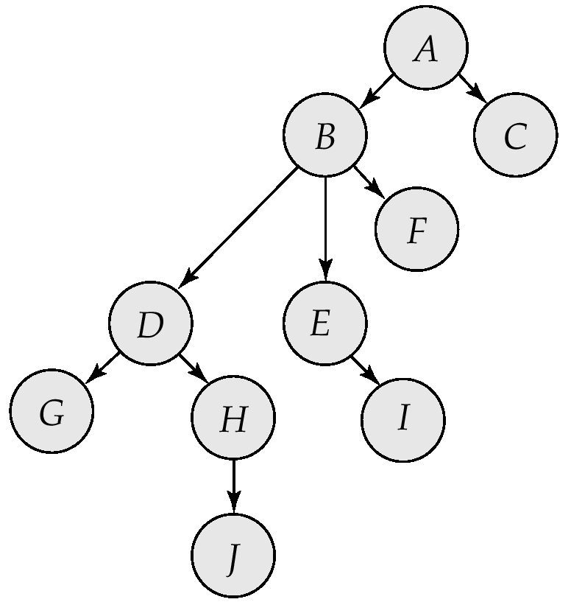
Tree Protocol
Only exclusive locks are allowed.
The first lock by T_{i} may be on any data item. Subsequently, a data Q can be locked by T_{i} only if the parent of Q is currently locked by T_{i}.
Data items may be unlocked at any time.

Slide 40
Deadlock Handling
T₁
T₂
lock-X on X
write (X)
lock-X on Y
write (X)
wait for lock-X on X
wait for lock-X on Y
Consider the following two transactions:
T₁: write (X) T₂: write(Y)
write(Y) write(X)
Schedule with deadlock

Slide 41
Deadlock Handling
System is deadlocked if there is a set of transactions such that every transaction in the set is waiting for another transaction in the set.
Deadlock prevention protocols ensure that the system will never enter into a deadlock state. Some prevention strategies :
Require that each transaction locks all its data items before it begins execution (predeclaration).
Impose partial ordering of all data items and require that a transaction can lock data items only in the order specified by the partial order (graph-based protocol).

Slide 42
Deadlock Detection
Deadlocks can be described as a wait-for graph, which consists of a pair G = (V,E),
V is a set of vertices (all the transactions in the system)
E is a set of edges; each element is an ordered pair T_{i} →T_{j}.
If T_{i} → T_{j} is in E, then there is a directed edge from T_{i} to T_{j}, implying that T_{i} is waiting for T_{j} to release a data item.
When T_{i} requests a data item currently being held by T_{j}, then the edge T_{i} T_{j} is inserted in the wait-for graph. This edge is removed only when T_{j} is no longer holding a data item needed by T_{i}.
The system is in a deadlock state if and only if the wait-for graph has a cycle. Must invoke a deadlock-detection algorithm periodically to look for cycles.

Slide 43
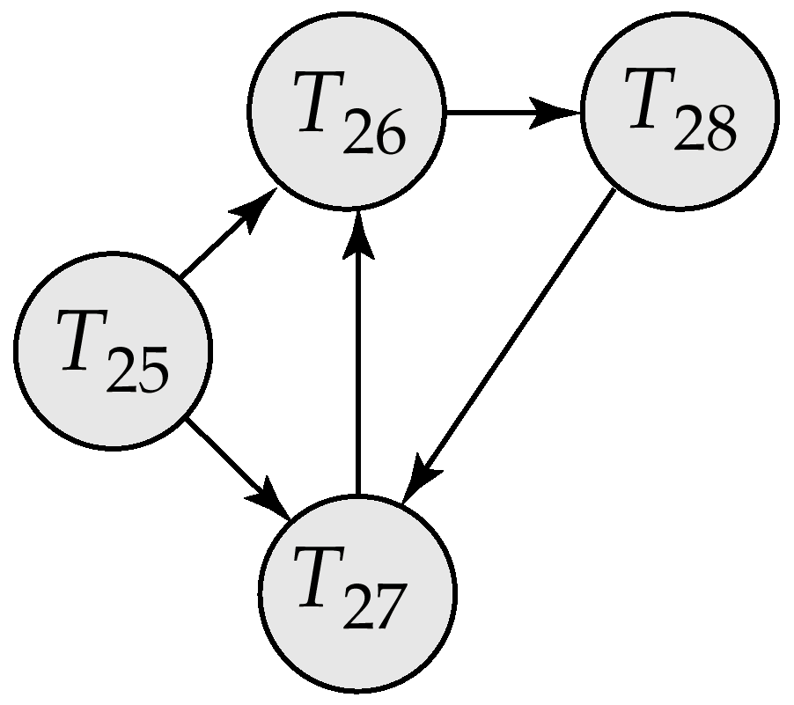
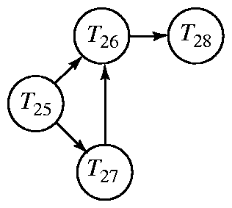
Deadlock Detection (Cont.)
Wait-for graph without a cycle
Wait-for graph with a cycle

Slide 44
Deadlock Recovery
When deadlock is detected :
Some transaction will have to rolled back (made a victim) to break deadlock. Select that transaction as victim that will incur minimum cost.
Rollback -- determine how far to roll back transaction
Total rollback: Abort the transaction and then restart it.
More effective to roll back transaction only as far as necessary to break deadlock.
Starvation happens if same transaction is always chosen as victim. Include the number of rollbacks in the cost factor to avoid starvation

Slide 45
Transaction as a Recovery Unit
If an error or hardware/software crash occurs between the begin and end, the database will be inconsistent
Computer Failure (system crash)
A transaction or system error
Local errors or exception conditions detected by the transaction
Concurrency control enforcement
Disk failure
Physical problems and catastrophes
The database is restored to some state from the past so that a correct state—close to the time of failure—can be reconstructed from the past state.
A DBMS ensures that if a transaction executes some updates and then a failure occurs before the transaction reaches normal termination, then those updates are undone.
The statements COMMIT and ROLLBACK (or their equivalent) ensure Transaction Atomicity

Slide 46
Recovery in Databases
Mirroring
keep two copies of the database and maintain them simultaneously
Backup
periodically dump the complete state of the database to some form of tertiary storage
System Logging
the log keeps track of all transaction operations affecting the values of database items. The log is kept on disk so that it is not affected by failures except for disk and catastrophic failures.

Slide 47
Log Based Recovery
A transaction log is a record in a DBMS that keeps track of all the transactions of a database system that update any values in the database.
A log file contains:
A Transaction begin marker
Transaction Id and user Id
Operation performed by the user
Data items affected
Before (old) values
After (new) values
Commit marker of the transaction

Slide 48
Log Based Recovery
Following log record describes the status of the transaction when failure occurred
Recovery will be done as follows
Trans Marker | Id | Oper | Undo values | Redo values | Commit marker
Y | T1 | Sub X Add Y | 500 800 | 400 Not Done | N
Y | T2 | Add A | 1000 | 1200 | N
Y | T3 | Sub Z | 900 | 400 | Y
Values | Initial | Before failure | Oper required | Recovered Values
X | 500 | 400 | Undo | 500
Y | 800 | 800 | Undo | 800
A | 1000 | 1200 | Undo | 1000
Z | 900 | 400 | Redo | 400

Slide 49
Log Based Recovery
Undo portion is required when partial updates made by an uncommitted transaction needs to be undone.
Redo portion is required when failure occurs after the transaction has finished its execution.
The following graph shows the status of various transactions when failure occurred:
T1
T2
T3 Failure
T4

Slide 50
Other Log based recovery techniques
Checkpoints
Deferred Mechanisms

Slide 51
Checkpoints
The simple ‘write ahead strategy’ (or log recovery) examines all records for those transactions and it redoes all those transactions that have been committed even hours earlier. So to improve this situation checkpoint mechanism is used.
Using this scheme, only uncommitted transactions that started before the checkpoint but did not commit, are considered or that started after the checkpoint.

Slide 52
Deferred modification scheme
It ensures transaction atomicity by recording all database modifications in the log, but deferring the write operations until the transaction partially commits.

Slide 53
Shadow Paging
In this scheme, a transaction that wants to update the database, first creates a complete copy (shadow copy) of the entire database. All updates are done on this new copy, leaving the original copy untouched.
If at any point the transaction has to be aborted, the system merely deleted the new copy, and the old copy remains in use.

Slide 54
Shadow Paging
to be deleted
Old copy
of database
new copy
of database

Slide 55
Shadow Paging
Advantages:
Recovery is inexpensive
No need of log records
Disadvantages:
Garbage collection
Each ‘transaction commits’ require updation of shadow page table with current page table. So commit overhead increases.

Slide 56
Data Warehouses

Slide 57
What a Producer wants to know
Which are our lowest/highest margin customers ?
Who are my customers and what products are they buying?
What is the most effective distribution channel?
What product prom- -otions have the biggest impact on revenue?
Which customers are most likely to go to the competition ?
What impact will new products/services
have on revenue and margins?

Slide 58
Data Warehouses
A data warehouse is
-subject-oriented,
-integrated,
-time-variant,
-nonvolatile
collection of data in support of management’s
decision making process.

Slide 59
What is Data Warehousing?
A process of transforming data into information and making it available to users in a timely enough manner to make a difference
Information
Data

Slide 60
Data Warehouse Architecture
Relational Databases
Extraction Cleansing
Optimized Loader
ERP
Systems
Data Warehouse Engine
Analyze Query
Purchased Data
Legacy Data
Metadata Repository

Slide 61
Characteristics of Data Warehouses
Summarized
Large Volume of data
Unnormalized
Metadata
Data Sources

Slide 62
Application Areas
Industry
Application
Finance
Credit Card Analysis
Insurance
Claims, Fraud Analysis
Telecommunication
Call record analysis
Transport
Logistics management
Consumer goods
promotion analysis
Data Service providers
Value added data
Utilities
Power usage analysis

Slide 63
Analyzing Data from Operational Systems
Data structures are complex
Systems are designed for high performance and throughput
Data is not meaningfully represented
Data is dispersed
TPS systems unsuitable for intensive queries
ERP
Production platforms
Operational reports

Slide 64
Data Warehouse Components
Data Warehouse server
almost always a relational DBMS,rarely flat files
OLAP servers
to support and operate on multi-dimensional data structures
Clients
Query and reporting tools
Analysis tools
Data mining tools

Slide 65
Data Warehouse vs Data Marts
Data
Warehouse
Data Mart
Property
Scope
Subjects
Data Source
Size (typical)
Implementation time
Data Warehouse
Enterprise
Multiple
Many
100 GB to > 1 TB
Months to years
Data Mart
Department
Single-subject
Few
< 100 GB
Months

Slide 66
End User Tools
High performance is achieved by pre-planning the requirements for joins, summations, and periodic reports by end-users.
There are five main groups of access tools:
Data reporting and query tools
Application development tools
Executive information system (EIS) tools
Online analytical processing (OLAP) tools
Data mining tools

Slide 67
Data Warehouse Schema
Star Schema
Fact Constellation Schema
Snowflake Schema
Notes:
We need subject oriented and multidimensional data amodel fro data warehouse which facilitates online analysis

Slide 68
Star Schema
A single,large and central fact table and one table for each dimension.
Every fact points to one tuple in each of the dimensions and has additional attributes.
Does not capture hierarchies directly.

Slide 69
Star Schema (contd..)
Store Dimension
Fact Table
Time Dimension
Store Key
Store Name
City
State
Region
Store Key
Product Key
Period Key
Units
Price
Period Key
Year
Quarter
Month
Product Key
Product Desc
Product Dimension
Benefits: Easy to understand, easy to define hierarchies, reduces no. of physical joins.

Slide 70
SnowFlake Schema
Variant of star schema model.
A single,large and central fact table and one or more tables for each dimension.
Dimension tables are normalized i.e. split dimension table data into additional tables

Slide 71
SnowFlake Schema (contd..)
Store Dimension
Fact Table
Time Dimension
Store Key
Product Key
Period Key
Units
Price
Period Key
Year
Quarter
Month
Store Key
Store Name
City Key
City Dimension
City Key
City
State
Region
Product Key
Product Desc
Product Dimension
Drawbacks: Time consuming joins,report generation slow

Slide 72
Fact Constellation
Multiple fact tables share dimension tables.
This schema is viewed as collection of stars hence called galaxy schema or fact constellation.
Sophisticated application requires such schema.

Slide 73
Fact Constellation (contd..)
Sales
Fact Table
Shipping
Fact Table
Store Key
Product Key
Period Key
Units
Price
Product Dimension
Shipper Key
Store Key
Product Key
Period Key
Units
Price
Product Key
Product Desc
Store Dimension
Store Key
Store Name
City
State
Region

Slide 74
Building Data Warehouse
Data Selection
Data Preprocessing
Fill missing values
Remove inconsistency
Data Transformation & Integration
Data Loading
Data in warehouse is stored in form of fact tables and dimension tables.

Slide 75
Data Warehousing includes
Build Data Warehouse
Online analysis processing(OLAP).
Presentation.
Cleaning ,Selection &
Integration
RDBMS
Presentation
Flat File
Client
Warehouse & OLAP server

Slide 76
OLTP vs Data Warehouse
OLTP
Application Oriented
Used to run business
Detailed data
Current up to date
Isolated Data
Repetitive access
Clerical User
Warehouse
Subject Oriented
Used to analyze business
Summarized and refined
Snapshot data
Integrated Data
Ad-hoc access
Knowledge User (Manager)

Slide 77
Need for Data Warehousing
Industry has huge amount of operational data
Knowledge worker wants to turn this data into useful information.
This information is used by them to support strategic decision making .

Slide 78
Need for Data Warehousing (contd..)
It is a platform for consolidated historical data for analysis.
It stores data of good quality so that knowledge worker can make correct decisions.

Slide 79
Need for Data Warehousing (contd..)
From business perspective
-it is latest marketing weapon
-helps to keep customers by learning more about their needs .
-valuable tool in today’s competitive fast evolving world.

Slide 80
Data Warehousing Tools
Data Warehouse
SQL Server 2000 DTS
Oracle 8i Warehouse Builder
OLAP tools
SQL Server Analysis Services
Oracle Express Server
Reporting tools
MS Excel Pivot Chart
VB Applications

Slide 81
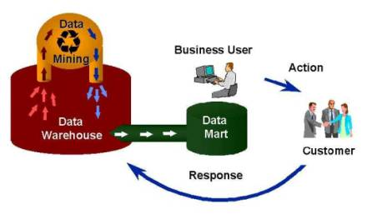
Data Mining

Slide 82
Questions
What are Concurrent transactions?
What are different concurrency control mechanisms?
What is shadow paging?
What is the difference between Log based recovery and checkpoint mechanism.
What is a data warehouse? Why it is called that the data warehouses are subject oriented and time variant?
What is data mining?

