Slide 1

Prediction of shuttle Landing using classification models
Department of Computer Science and Engineering
Seshadri Rao Gudlavalleru Engineering College, Gudlavalleru
Under the Guidance of
DR.G.Sridevi Mtech,ph.d
BY
Ch.Nikhitha(21481A0545)
Ch.Sri Datta(21481A0547)
D.Udaya Bindu(21481A0553)
B.Smily(21481A0515)

Slide 2

INDEX
Abstract
Introduction
Problem Statement
Methodology
Orange Tool
Model Representations
Conclusion

Slide 3
Abstract
The successful landing of space shuttles demands precise control systems capable of adapting to various environmental conditions and operational factors. The Shuttle Landing Control Dataset encompasses key attributes such as stability, surface error, wind conditions, and visibility, crucial for understanding the dynamics of shuttle landings. This dataset offers a rich collection of telemetry data captured during landing maneuvers, providing insights into the intricate interactions between control inputs and environmental variables.
The primary objective of this dataset is to facilitate the development and validation of control algorithms tailored to shuttle landing scenarios. By analyzing the correlations between input attributes and landing outcomes, researchers can refine control strategies and optimize landing performance under diverse conditions. Additionally, this dataset enables the assessment of the impact of environmental factors, such as wind and visibility, on landing stability and precision.
Through systematic analysis and modeling, insights gleaned from this dataset can inform the design of more resilient and adaptive landing control systems for future space missions. This abstract underscores the significance of leveraging the Shuttle Landing Control Dataset to advance the field of aerospace engineering and enhance the safety and reliability of shuttle landings in varying operational environments.

Slide 4
1.Introduction
The prediction of shuttle landing is crucial for ensuring the safety and efficiency of space missions. By employing classification models, which are a type of machine learning algorithm, we can analyze various factors and parameters to forecast the outcome of a shuttle landing. This predictive capability is essential for mission planning, risk assessment, and real-time decision-making during space exploration endeavors.
In this paper, we will explore the application of classification models in predicting shuttle landings. We will discuss the significance of accurate predictions in space missions and the challenges associated with forecasting such events.

Slide 5
Problem Definition
->Predicting shuttle landing using classification models involves designing a system that can analyze various factors and conditions during a shuttle's descent and predict whether the landing will be successful or not
->This typically involves collecting data on factors like weather conditions, altitude, speed, and shuttle health, then training a classification model to classify landings as either successful or unsuccessful based on historical data
->The goal is to create a model that can accurately predict the outcome of future shuttle landings to help ensure the safety and success of space missions.

Slide 6
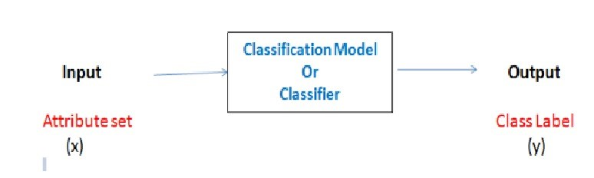
Classification
Classification is a machine learning technique where the goal is to categorize data points into predefined classes or categories based on their features or attributes.
It involves training a model on a dataset with labeled examples, where each example is associated with a class label.
The trained model then learns patterns and relationships in the data to predict the class labels of new, unseen data points.
Classification is widely used in various applications, including spam detection, sentiment analysis, medical diagnosis, and image recognition.

Slide 7
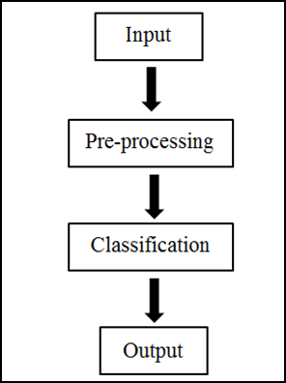
Methodology
The analysis of various data mining algorithms, the algorithms that are used in this model :
K nearest neighbours (KNN)
Neural Network
Support Vector Machine
Decision Tree algorithm
Logistic Regression

Slide 8
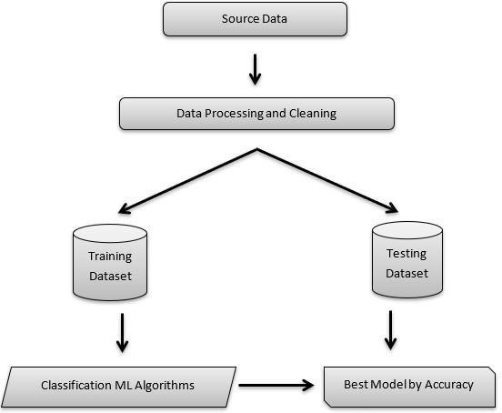
Block Diagram

Slide 9
Orange Tool
Orange is an open-source data visualization and analysis tool designed for users seeking intuitive yet powerful solutions in machine learning and data mining.
Its hallmark feature is a visual programming interface, facilitating the construction of data analysis workflows through interconnected components (widgets).
Moreover, its extensive collection of visualization tools enables users to explore datasets visually, uncovering relationships, distributions, and patterns.
Through integration with machine learning algorithms and ensemble learning methods, Orange empowers users to train models for classification, regression, clustering, and association rule mining.

Slide 10
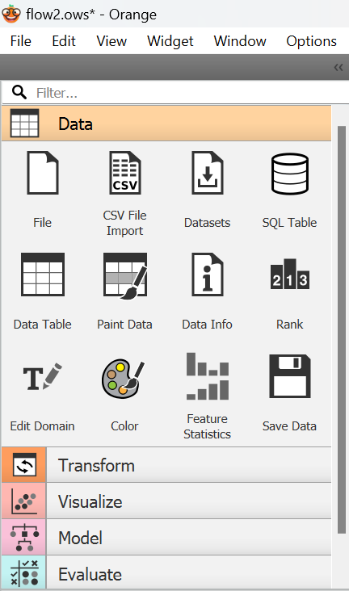
Main Features
Visual Programming Interface
Data Visualization
Data Preprocessing
Machine Learning Algorithms
Evaluation and Validation
Integration with Python
Educational and Research Tools

Slide 11
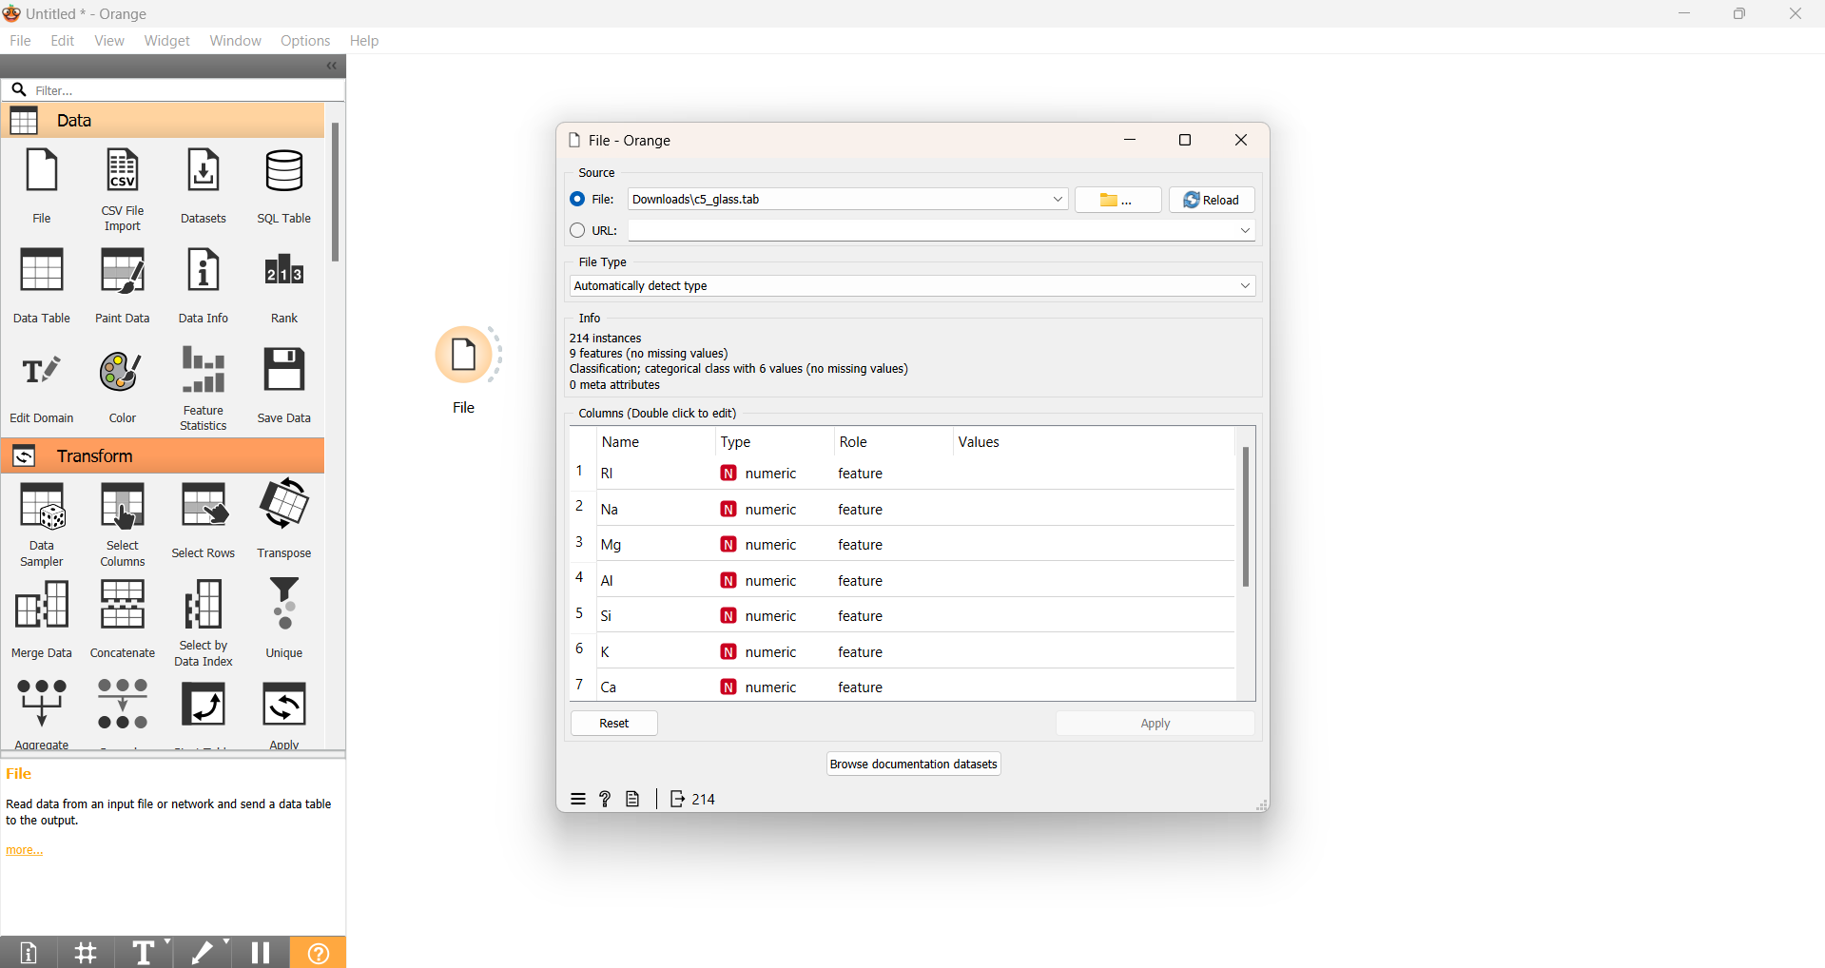
Orange Tool Interface

Slide 12
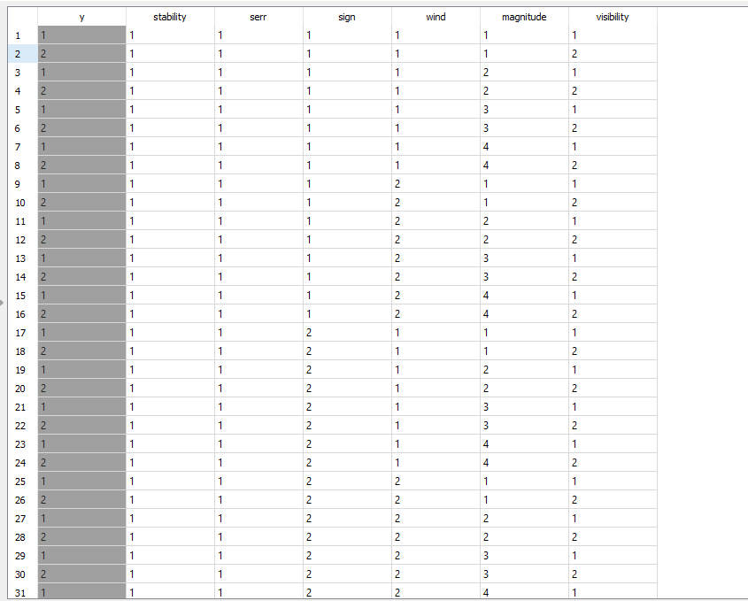
Data Table Representation

Slide 13
Data Set Attributes
1.STABILITY
2. SERR
3. SIGN
4. WIND
5. MAGNITUDE
6. VISIBILITY
7. CLASS

Slide 14
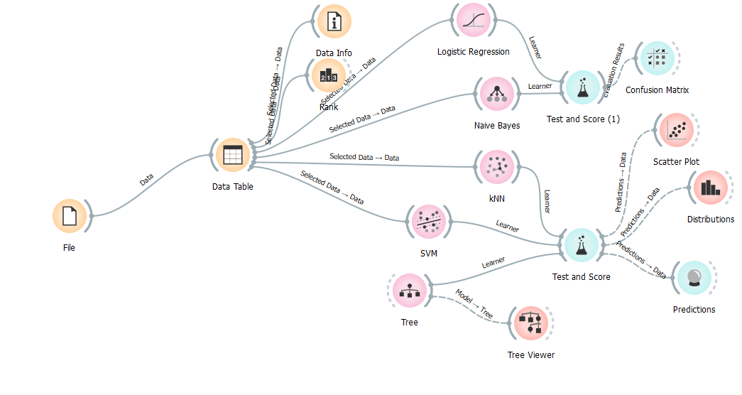
Model Before Preprocessing

Slide 15
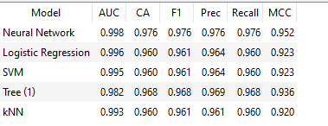
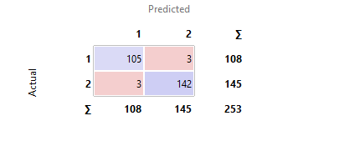
Model Performance Before Preprocessing
Test And Score Confusion Matrix

Slide 16
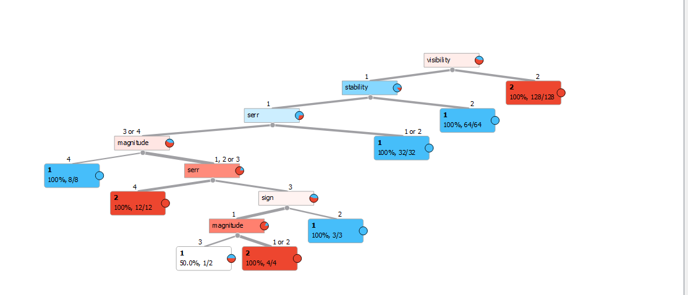
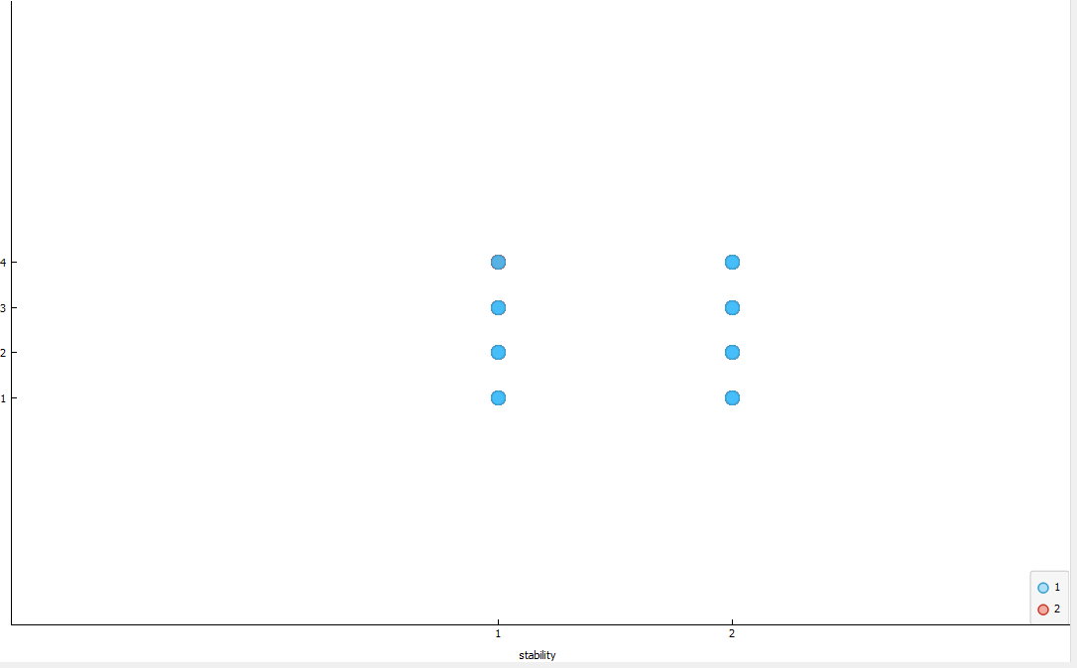
Model Visualization
Decision Tree Scatter Plot

Slide 17
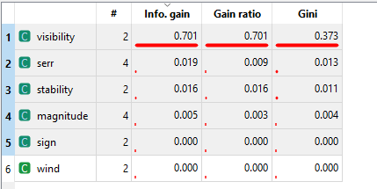

Rank

Slide 18
Pre Processing Techniques
Data Cleaning: Removing or correcting errors, inconsistencies, or irrelevant data from the dataset.
Data Transformation: Converting data into a suitable format for analysis, such as scaling or encoding categorical variables.
Data Normalization: Rescaling numeric attributes to a common scale to prevent one variable from dominating others.
Data Discretization: Converting continuous data into discrete intervals or bins, simplifying analysis and interpretation.
Feature Selection: Selecting the most relevant and informative features from the dataset to improve model performance and reduce complexity.
Missing Value Imputation: Filling in missing values in the dataset using techniques like mean imputation or regression.
Outlier Detection and Treatment: Identifying and handling outliers, which are data points significantly different from the rest of the dataset, to prevent skewing results.

Slide 19
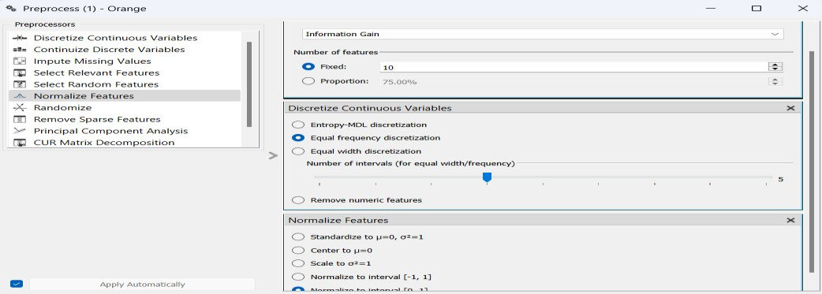
preprocessing techniques
Discretize Continuous Variables.
Normalize features
Select Relevent Features ,etc

Slide 20
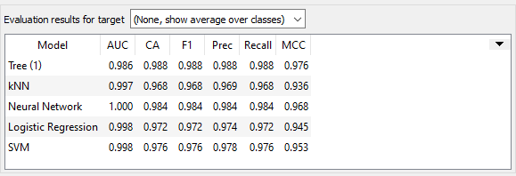
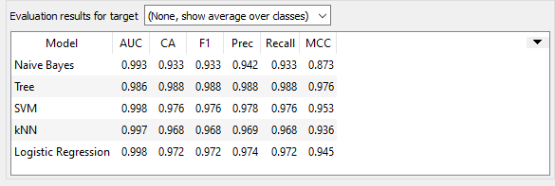
Discretize continuous variables Normalize features

Slide 21
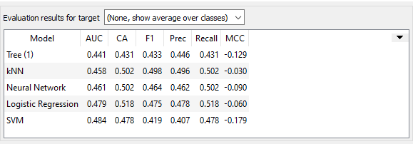
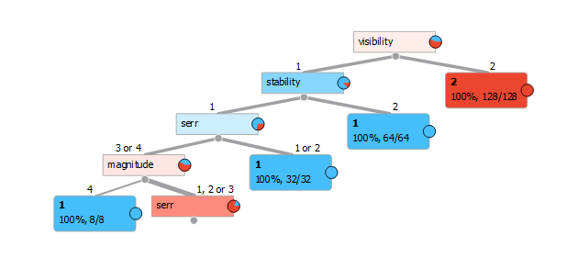
Select relevant features Tree

Slide 22
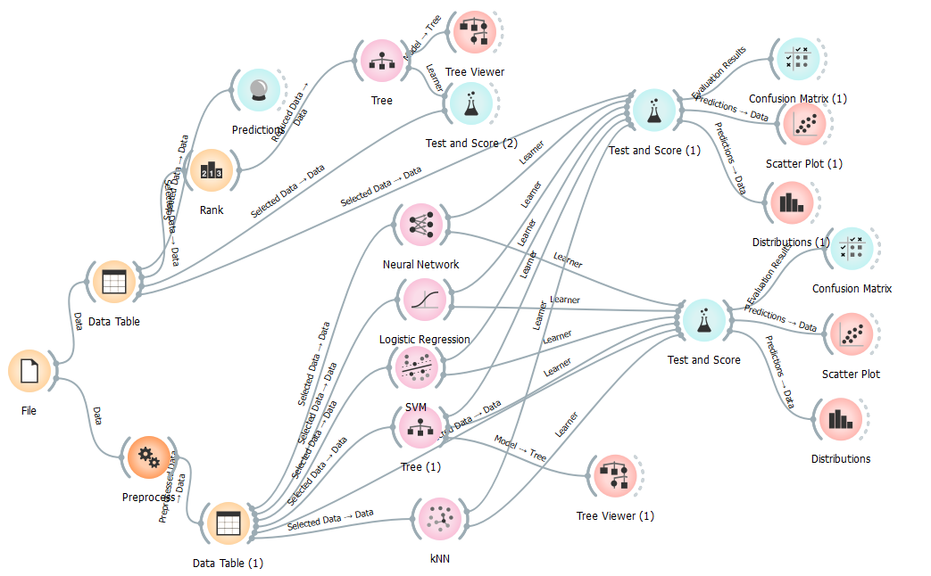
Model After Preprocessing

Slide 23
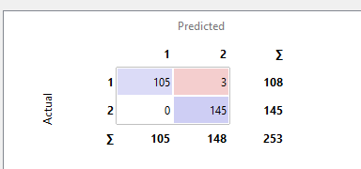
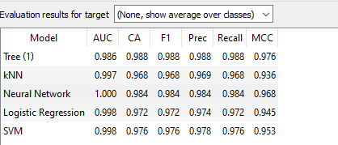
After pre Processing Confusion Matrix Test and Score

Slide 24
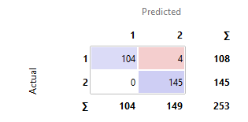
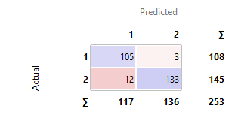
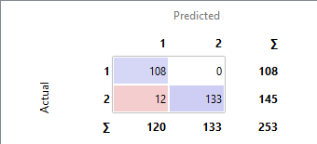
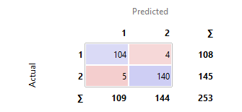
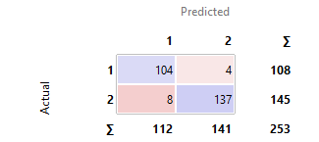
Confusion Matrix
Before Preprocessing
Tree
SVM Logistic Regression
KNN Neural Network

Slide 25
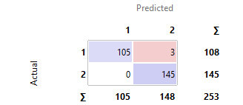
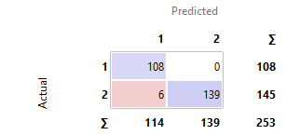
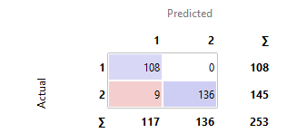
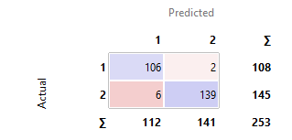
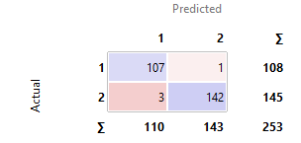
Confusion Matrix
After Preprocessing
Tree
SVM Logistic Regression
KNN Neural Network

Slide 26
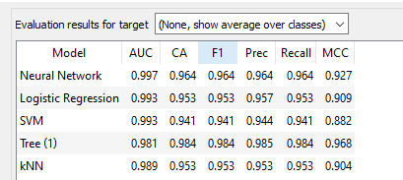
Model performance After Pre Processing
Test And Score
Before PreProcessing After PreProcessing

Slide 27
5. CONCLUSION
We have successfully identified a solution for “Prediction of Shuttle Landing using Classification Models”. The analytical process started from data cleaning and processing, missing value, exploratory analysis and finally model building and evaluation. The best accuracy on public test set is higher accuracy score will be find out by comparing each algorithm. The Decision Tree algorithm gives the best accuracy . The algorithms that are used are simple to comprehend. It can be inferred from this model that, it gives best accuracy for the Prediction of Shuttle Landing using Classification Models

Slide 28
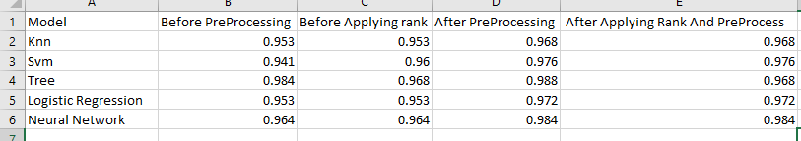
Analysis Report

Slide 29


