Slide 1
sketch it app
Assignment 3: iOS Application Development
Group X: Group name

Slide 2
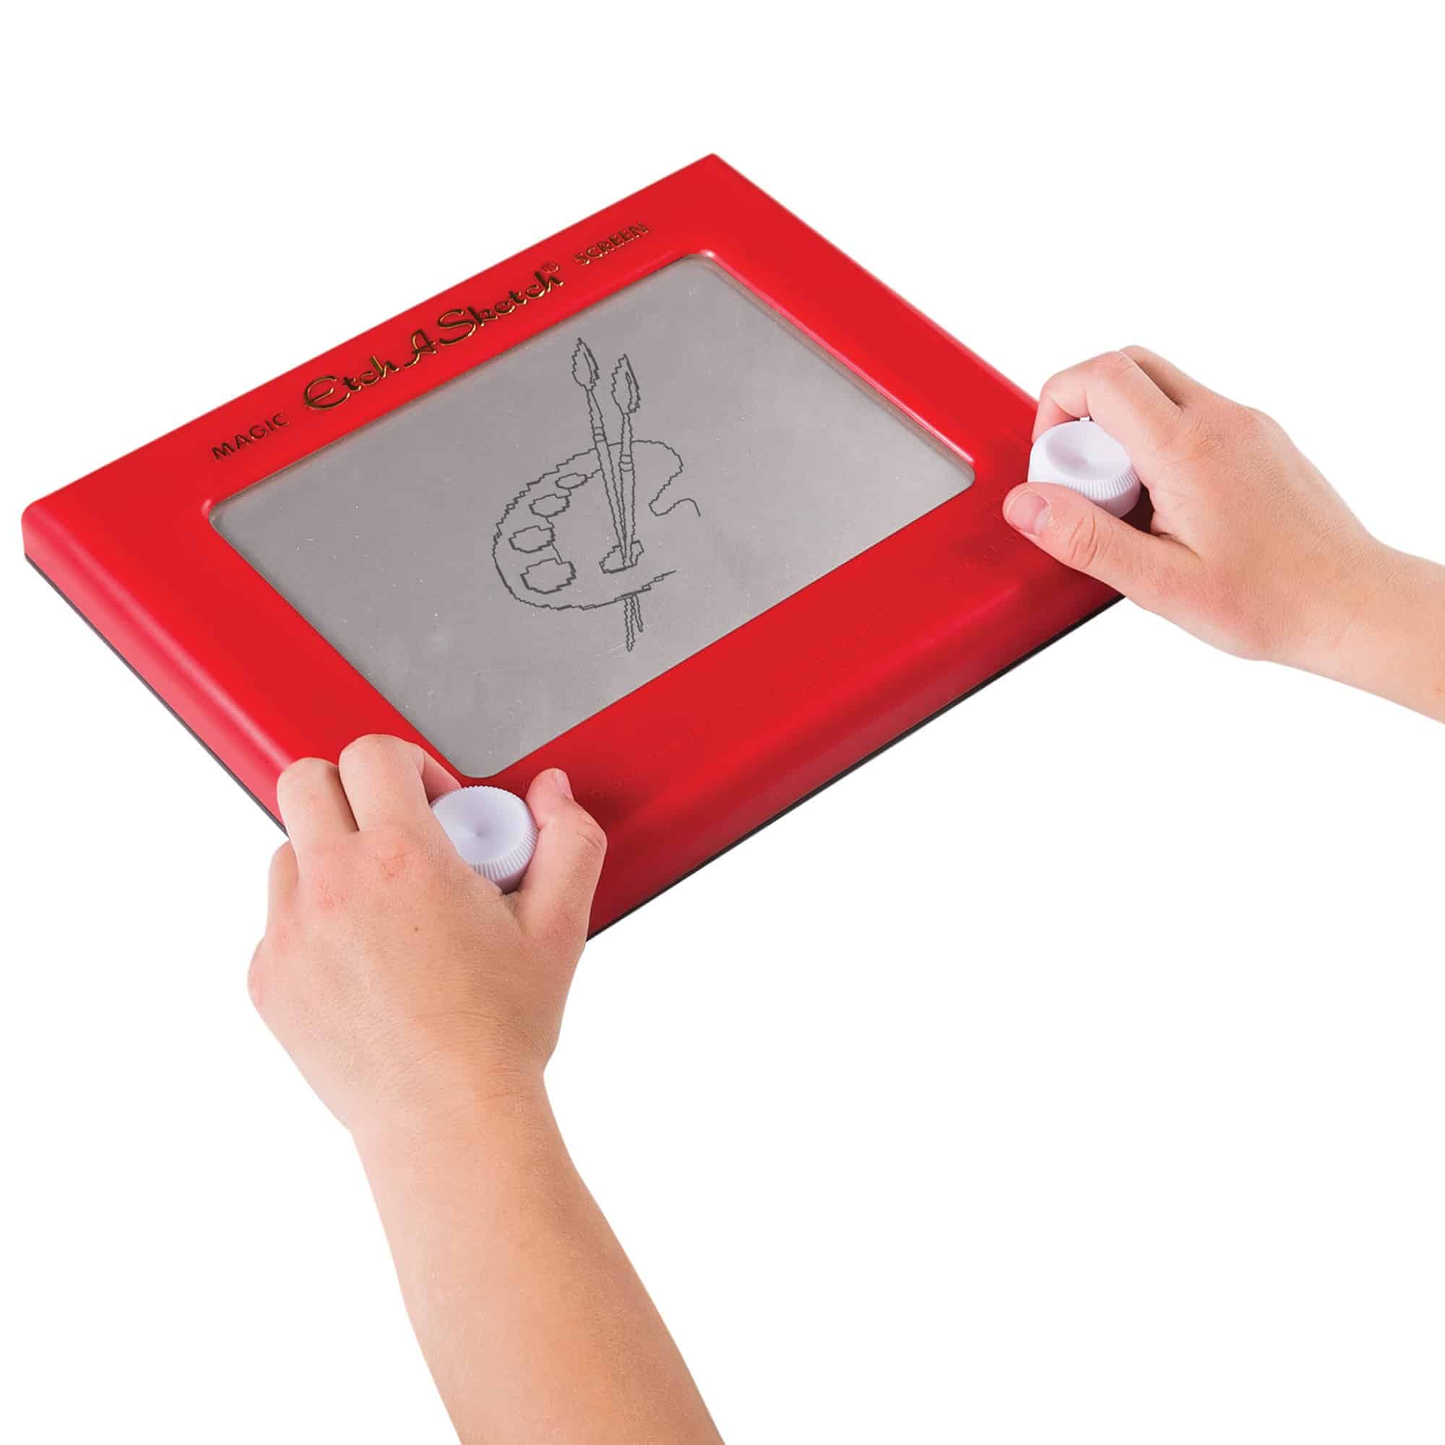
The Problem
Most drawing apps:
Cluttered & complex
Our app:
Minimal, tactile drawing experience

Slide 3


TARGET AUDIENCE
MILLENIALS & GEN x
kids

Slide 4
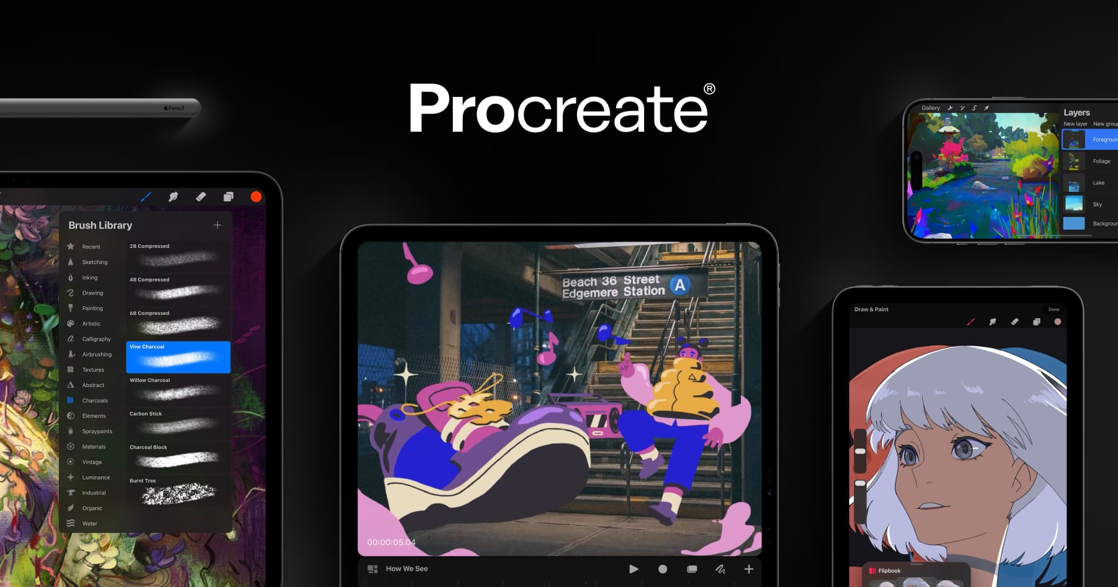
COMPARISONS
No color palletes, brush tools or layers.
Nostalgia & Simplicity

Slide 5
APP DEMONSTRATION

Slide 6
FRAMEWORKS USED
SWIFT UI
USER DEFAULTS
User Interface
Store saved sketches locally
CORE MOTION
CANVAS
Detect shake gesture
Drawing lines based on touch input

Slide 7
BIGGEST CHALLENGE
Replicating the knob behavior

Slide 8




ITERATIVE DESIGN
Prototyped drawing logic
Added knobs and controls
Integrated sketch saving
Added shake-to-clear and polish

Slide 9
CONCLUSION

