Slide 1
Filters in MVC
In ASP.NET MVC, a user request is routed to the appropriate controller and action method. However, there may be circumstances where you want to execute some logic before or after an action method executes. ASP.NET MVC provides filters for this purpose.
ASP.NET MVC Filter is a custom class where you can write custom logic to execute before or after an action method executes. Filters can be applied to an action method or controller in a declarative or programmatic way. Declarative means by applying a filter attribute to an action method or controller class and programmatic means by implementing a corresponding interface.

Slide 2
Filters in MVC
Filter Type | Description | Built-in Filter | Interface
Authorization filters | Performs authentication and authorizes before executing action method. | [Authorize], [RequireHttps] ChildActionOnly | IAuthorizationFilter
Action filters | Performs some operation before and after an action method executes. | [OutputCache] | IActionFilter
Result filters | Performs some operation before or after the execution of view result. |  | IResultFilter
Exception filters | Performs some operation if there is an unhandled exception thrown during the execution of the ASP.NET MVC pipeline. | [HandleError] | IExceptionFilter

Slide 3
Filters in MVC
MVC provides different types of filters.
Authorize
ChildActionOnly
HandleError
OutputCache
RequireHttps

Slide 4
Filters in MVC
HandleError
HandleErrorAttribute is used to display friendly error pages to end user when there is an unhandled exception
Authorize
In ASP.NET MVC, by default, all the controller action methods are accessible to both anonymous and authenticated users. If you want action methods, to be available only for authenticated and authorised users, then use Authorize attribute.
ChildActionOnly
1. Any action method that is decorated with [ChildActionOnly] attribute is a child action method.
2. Child action methods will not respond to URL requests. If an attempt is made, a runtime error will be thrown stating - Child action is accessible only by a child request.
3. Child action methods can be invoked by making child request from a view using "Action()" and "RenderAction()" html helpers.

Slide 5
Filters in MVC
RequireHttps:[RequireHttps] attribute forces an unsecured HTTP request to be re-sent over HTTPS.
[RequireHttps] public string Login() { return "This method should be accessed only using HTTPS protocol"; }
Note: RequireHttps attribute can be applied on a controller as well. In this case, it is applicable for all action methods with in that controller.
Sensitive data such as login credentials, credit card information etc, must always be transmitted using HTTPS. Information transmitted over https is encrypted.
OutputCacheAttribute :OutputCacheAttribute is used to cache the content returned by a controller action method, so that, the same content does not need to be generated each and every time the same controller action is invoked.

Slide 6
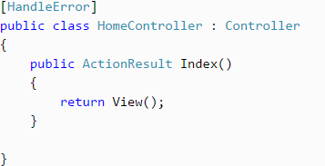
Filters in MVC
Register Filters
Filters can be applied at three levels.
1. Global Level
2. Controller level
3. Action method level
Controller level:
Filters can also be applied to the controller class. So, filters will be applicable to all the action method of Controller class if it is applied to a controller class.

Slide 7
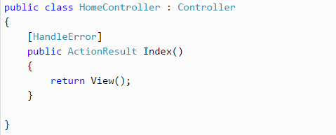
Filters in MVC
Action method level:
You can apply filters to an individual action method also. So, filter will be applicable to that particular action method only.

Slide 8
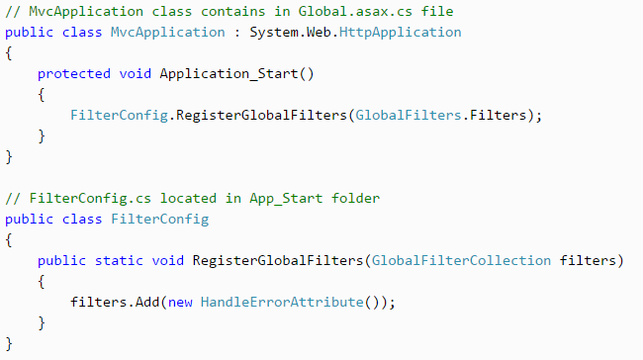
Filters in MVC
Global Level:
You can apply filters at global level in the Application_Start event of Global.asax.cs file by using default FilterConfig.RegisterGlobalFilters() mehtod. Global filters will be applied to all the controller and action methods of an application.
The [HandleError] filter is applied globaly in MVC Application by default in every MVC application

Slide 9
Filters in MVC
Filter Order:
As mentioned above, MVC includes different types of filters and multiple filters can be applied to a single controller class or action method. So, filters run in the following order.
Authorization filters
Action filters
Result filters
Exception filters

