Slide 1
Action Selectors
Action selectors are the attribute that can be applied to the action methods. It helps routing engine to select the correct action method to handle a particular request.
Or
Action selectors are the attributes which are applied on controller action methods to influence the selection of an action method.
MVC 5 includes the following action selector attributes:
ActionName
NonAction
ActionVerbs or AcceptVerbs

Slide 2
Action Selectors
ActionName:
ActionName attribute allows us to specify a different action name than the method name. Consider the following example.
Example: ActionName
public class StudentController : Controller {
public StudentController() { }
[ActionName("find")]
public ActionResult GetById(int id)
{
// get student from the database
return View(); } }
we have applied ActioName("find") attribute to GetById action method. So now, action name is "find" instead of "GetById". This action method will be invoked on http://localhost/student/find/1 request instead of http://localhost/student/getbyid/1 request.

Slide 3
Action Selectors
NonAction:
NonAction selector attribute indicates that a public method of a Controller is not an action method. Use NonAction attribute when you want public method in a controller but do not want to treat it as an action method.
For example, the GetStudent() public method cannot be invoked in the same way as action method in the following example.
public class StudentController : Controller
{
public StudentController() { }
[NonAction]
public Student GetStudnet(int id)
{
return studentList.Where(s => s.StudentId == id).FirstOrDefault();
} }

Slide 4
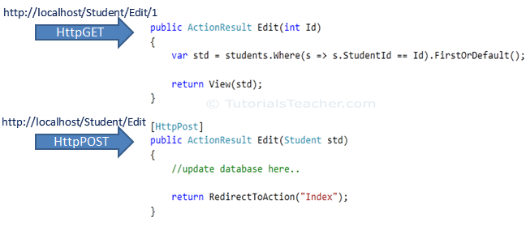
Action Selectors
ActionVerbs:
The ActionVerbs selector is used when you want to control the selection of an action method based on a Http request method. For example, you can define two different action methods with the same name but one action method responds to an HTTP Get request and another action method responds to an HTTP Post request.
MVC framework supports different ActionVerbs, such as HttpGet, HttpPost, HttpPut, HttpDelete. You can apply these attributes to action method to indicate the kind of Http request the action method supports. If you do not apply any attribute then it considers it a GET request by default.

Slide 5
Action Selectors
Http method | Usage
GET | To retrieve the information from the server. Parameters will be appended in the query string.
POST | To create a new resource.
PUT | To update an existing resource.
DELETE | To delete an existing resource.

Slide 6
Action Selectors
public class StudentController : Controller
{
public ActionResult Index()
{
return View();
}
[HttpPost]
public ActionResult PostAction()
{
return View("Index");
}
[HttpPut]
public ActionResult PutAction()
{ return View("Index");
}
[HttpDelete]
public ActionResult DeleteAction()
{ return View("Index");
}
[AcceptVerbs(HttpVerbs.Post | HttpVerbs.Get)]
public ActionResult GetAndPostAction() { return RedirectToAction("Index"); }
}

