Slide 1
Drivetrain design for the NREL 15 MW Offshore Reference Turbine
Latha Sethuraman, George Scott, Garrett Barter
10/17/2019

Slide 2
Proposed Generator design
Radial flux PM machine
Configuration | Outer rotor-inner rotor | Remarks /Comments
Location | Upwind
Rated torque | 20.64 MNm
Rated speed | 7.54 rpm
Tangential stress | 40 kN/m²
Peak air gap flux density | 0.7-1.2 Tesla
Specific current loading | 60kA/m | (higher for liquid cooled machine)
Type of cooling | Air cooled | either air/Liquid-cooled

Slide 3
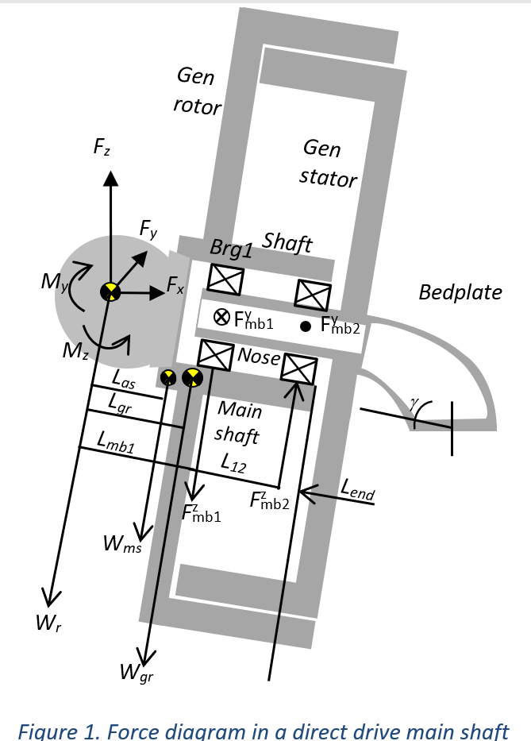
Proposed drivetrain layout
Configuration | Outer rotor –inner stator
Bearings | Double bearing
Support structure arrangement | Single-sided spoke arms or discs
Optimization Objective | Mass
Target full load efficiency | 94 %

Slide 4
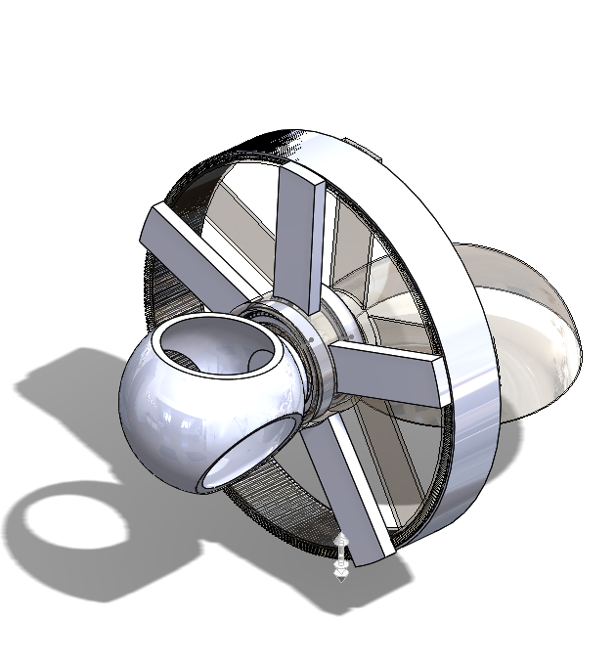
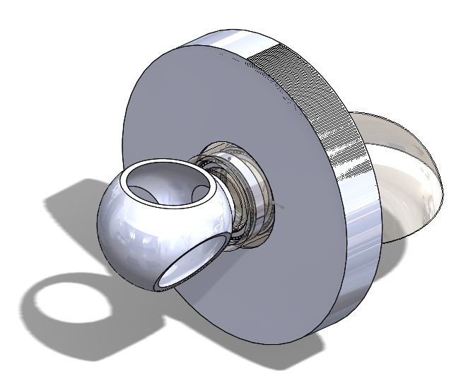
Spoke arm and disc configurations
Type 1
Support structure consisting of single-sided wheels with spoke arms
Type 2
Support structure consisting of single-sided wheels with discs

Slide 5
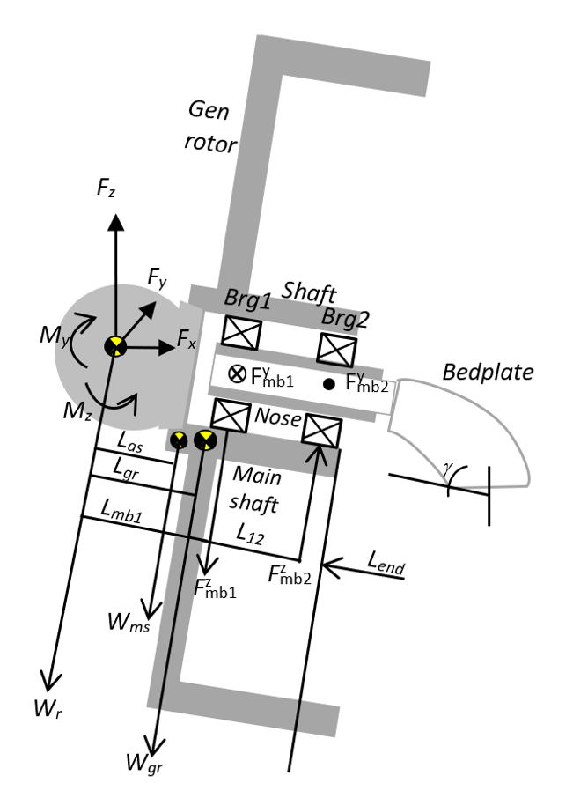
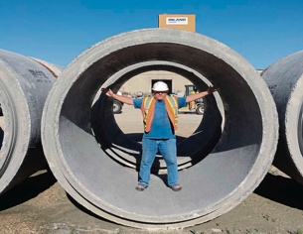
Main Shaft and nose modeling
Hollow cylinders of constant wall thicknesses.
Outer diameters and thicknesses determined from von mises stress criterion
Loads computed along the shaft length and reactions computed at the bearing locations
Length determined iteratively after checking for deflections at the bearing and generator locations.
Thickness –a design variable
L_{n}
Stator
L_{1n}
L_{an}
L_{2n}
L_{gs}
F^{x}_{mb1}
nose
F^{y}_{mb1}
F^{y}_{mb2}
Bedplate
F^{z}_{mb1}
W_{n}
F^{z}_{mb2}
W_{gs}
Minimum nose inner dia set for human access

Slide 6
Bedplate modeling
F_{nz}
Modeled as a hollow curved cantilever beam with elliptical profile .
Discretized using multiple circular hollow sections.
The path traversed along each centroid is also assumed to be an ellipse.
Smaller cross-section(radius r₁) at the nose and a larger cross-section (radius r₂)
Loads computed in Frame3DD.
Designed to resist stresses(hub loads and gravity) computed using Roark’s Formulas[1] for curved beams- normal stresses from bending, shear stress from torque and shear forces and radial stresses from moments and thrust.
Wall thickness is a design variable (L_{TOP} and H_{nose} can also be)
M_{ny}
F_{ny}
r₁
F_{nx}
M_{nz}
H_{nose}
R_{c}
r₂
L_{TOP}
Bedplate modeled as a curved beam
a
b
Neutral axis
r_{o}
r_{n}
r
r_{i}

Slide 7
GeneratorSE: support structure modeling- type 1
Rotor and stator structures modeled as single sided spoke wheels with certain rim thicknesses supporting the weight of the active materials.
Each spoke parametrized by a depth d, circumferential dimension b and thickness t_{w} .
Designed to minimize air-gap deflection; analytical models adapted from McDonald [2]
The number of spokes, arm dimensions and rim thicknesses are design variables.
GeneratorSE: A Sizing Tool for Variable-Speed Wind Turbine Generators
Spoke arm parametrization
h_{ss}

Slide 8
Generator support structure modeling- type 2
Rotor and stator structures modeled as single sided disks with certain rim thicknesses supporting the weight of the active materials.
Each disc parametrized by its thickness. .
Designed to minimize air-gap deflection; analytical models adapted from McDonald [2]
Disk and rim thicknesses are design variables.
t_{d}
h_{ss}
Disk parametrization

Slide 9

Generator support structure deflection modeling
W_{sr}
W_{ir}
W_{m}
W_{ss}
W_{is}
W_{cu}
t_{r}
L_{s}
Magnet
Rim (structural steel)
Stator teeth with windings
Support structure (arm/disc)
L_{r}
t_{s}
h_{sr}
h_{t}
h_{ys}
h_{yr}
R
R_{s}
R_{s}
R_{no}
e.g., weight components contributing to axial deflection
δx
δy=y(L_{sh})
δy=y(L_{bd})
Loads used for computing deflection
δx
θ(L_{sh})
θ(L_{bd})
Goal :Limit deflections caused by normal Maxwell stresses (q) , shear stress (torque (T)) and gravity(g)
Torque constraint : $r^{2}l≥\frac{T}{2πσ}$ $, $ =40kPa
Deflections at the shaft and bedplate factored into axial and radial components
Deflection at the shaft and nose/bedplate ends from bending

Slide 10
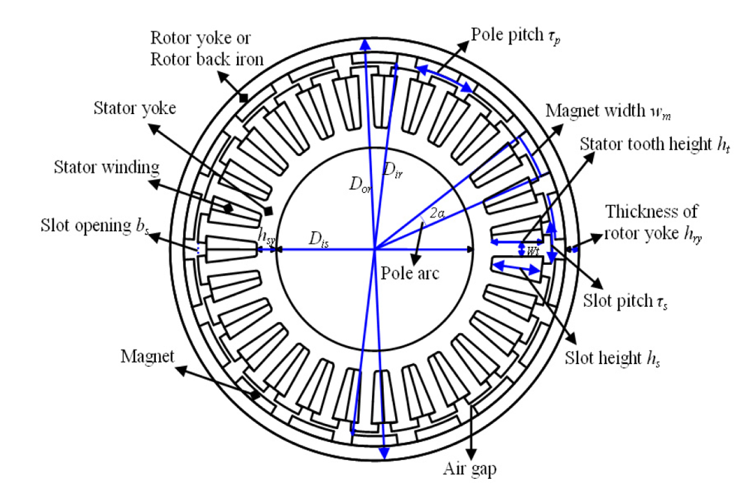
Electromagnetic design
Fractional slot , double layer concentrated winding machine.( Slot/pole =6/5)
Magnet width/pole pitch assumed to be 70%
0.15<Aspect ratio (L/D)<0.3
Maximum flux densities in the core limited to < 2Tesla
Winding current density limited to 3-6A/mm²
Specific current loading limited to 60kA/m
Leakage flux, edge effects of magnets, fringing neglected
Analytical models based on Hung [4]
Air-gap radius, core length, stator slot height, number of pole pairs, magnet height , stator and rotor yoke heights and tooth flux density are design variables
Exterior rotor PM machine[4]

Slide 11
Results summary
Parameter | Type 1 (Arms) | Type 2 (discs)
Air gap diameter (m) | 12.78 | 12.79
Core length (m) | 2.221 | 2.227
Pole pairs | 150 | 150
Generator output phase voltage (V) | 6399 | 6423
Efficiency at full load (%) | 94.0 | 94.05
Structural mass (tons) | 228 | 314
Active mass (magnets, copper, electrical steel) | 366 | 346
Total Mass (tons) | 594 | 660
Material cost (k$) | 8068 | 8129

Slide 12
References
R.J. Roark, W. C. Young, R. G. Budynas. (2002), Roark’s Formulas for Stress and Strain. New York: McGraw-Hill.
A.S. McDonald, Structural Analysis of Low Speed, High Torque Electrical Generators for Direct Drive Renewable Energy Converters. PhD diss., University of Edinburgh, 2008.
L.Sethuraman and K. Dykes, GeneratorSE: A Sizing Tool for Variable-Speed Wind Turbine Generators, NREL/TP-5000-66462.
V.X. Huang, Modeling of Exterior rotor permanent magnet machines with concentrated windings, PhD diss., TUDelft, 2012.

Slide 13
Acknowledgments
William Scott Carron for inputs on generator assembly and installation

