Slide 1
Airport Gate Scheduling
Laura Carandang, Jackie Li, Aparajita Maitra, Allison Peng
Notes:
Aparajita

Slide 2
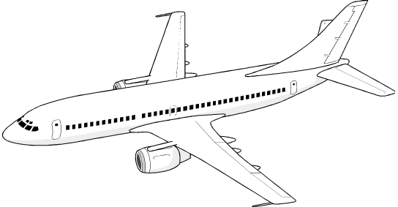
Airport Gate Scheduling
Due to growth of air transport traffic, allocating airline and airport resources have become increasingly important
There are several classes of decisions for which airport management is responsible (crew scheduling, ground operations, etc.) → gate scheduling is the most important and complicated of these.
Purpose of gate scheduling: to find an assignment of flights to aircraft stands and start and completion times for processing an aircraft at the position it has been assigned to.
Notes:
Aparajita: Gate scheduling for flights is a key activity at airports. Aircrafts are assigned to terminal, called gates, or ramp positions for the dura-
tion of a time period during which passengers and aircrafts are processed. Gate availability and times of arrivals/departures (as given by an estimated time of arrival/departure or ETA/ETD for each flight) can change during the course of the planning horizon due to operational contingencies (for example, delays, air traffic control). Such changes in turn impact on gate availability, since gates may become unavailable when required. A familiar scene at airports these days is when arriving flights are forced to wait on the ramp, sometimes for a long time, before finally proceeding to their gate because the gate is occupied by another aircraft. Airlines themselves have preferences for gates (within terminals) and time slots for commercial and operational reasons. For example, gates close to each other are preferred by airlines for transfer passengers while adherence to published time slots allows for smooth aircraft processing and is good for airline image. Both gates and time slots are scarce and expensive resources. Airport operators plan for better airport design and increasing gates to cope with increasing demand. For the airline, changes in time slots (including those resulting from poor gate assignment) incur additional operations costs (for example, landing and parking fees, staffing) and inconveniences for its passengers.

Slide 3
The Gate Assignment Problem (GAP)
A gate assignment must be suitable for airport services and convenient for passengers.
Rules and constraints for a well-constructed schedule:
1. one gate can process only one aircraft at the same time
2. service requirements and space restrictions with respect to adjacent gates must be fulfilled
3. minimum ground time and minimum time between subsequent aircraft have to be assured.
Some objectives:
1. the number of un-gated (open) aircraft activities must be minimized,
2. preferences of certain aircraft for particular gates have to be maximized
3. total walking distance for passengers must be minimized
4. the deviation of the current schedule from a reference schedule must be minimized in order to increase schedule attractiveness and passenger comfort
Notes:
Aparajita: Gate assignment affects the quality of service an airline provides its passengers. Good gate assignment can help airlines keep to pub-
lished schedules by reducing gate delays. Good gate assignment can minimize distances (times) passengers are required to walk from gate to gate or from gates to exits/entrances. In the case of connecting passengers, these distances are crucial since such passengers can easily miss flights, especially for connections with small minimum connecting times. Unavailability of gates leads to arrival/departure time changes that have a roll-on effect on other ground services. These include fuelling, aircraft cleaning, cargo loading, catering uplift, baggage handling and passenger handling, some of which require setup times. The impact is exacerbated when airlines cut down on turn-around/transit times for delayed flights to catch up with their schedules.

Slide 4
Solving the GAP
Problems: 0-1 Linear Program, Integer Program, Dynamic Programming
Algorithms: Genetic, Greedy, Branch and Bound
Heuristic: First Unused Gate Assignment, Most Unused Gate Assignment
Meta-Heuristic: Tabu Search, Simulated Annealing, Hybrid of Simulated Annealing with Tabu Search, Bee Colony Optimization
Notes:
These are some of the ways the Gate Assignment Problem is currently solved. As you can see, there are many problems, algorithms, heuristics and meta-heuristics. Out of these, we chose three to go over in-depth in the following slides.

Slide 5
Primal-Dual Simplex Method
l = # arrival gates
k = # departure gates
m = # arrival flights
PAX(i,j) = # passengers arriving on flight i and departing from gate j
i = 1,m j = 1,k
DIST(i,j) = # passenger distance units from gate i to gate j
i = 1,l j = 1,k
Objective:
Min. ∑c_{i,j}x_{i,j} where i = 1,m & j =1,k
and c_{i,j} are elements of the matrix product of:
PAX(i,j) * DIST(i,j)^{T}
Subject to:
∑x_{i,j} = 1 ∑x_{j,i} = 1 x_{i,j} = {0,1}
This is an assignment problem that solves the objective of minimizing the walking distance that passengers must travel for a given arrival-departure cycle
Objective function coefficients are passenger-distance weights for all possible assignments of arrival flights to arrival gates
The x_{i,j} constraints ensure that a flight is assigned to only one arrival gate and that all flights are assigned
Notes:
Allison: http://www.sciencedirect.com/science/article/pii/0360835290901223 (Bihr, 1990)
Now I am going to talk about the Primal-Dual Simplex Method, which solves one sort of gate assignment problem where the objective is the minimize the walking distance that passengers must travel for a given arrival-departure cycle. The formulation of this problem is quite simple. First there is PAX(i,j) which is a matrix representing the number of passengers arriving on flight i and departing from gate j. There is also DIST(i,j) which is a matrix representing the number of passenger-distance units from gate i to gate j. Our objective is to minimize the summation of the product c(i,j)*x(i,j). The c(i,j) represents the coefficient, which is the passenger-distance weights for all possible assignments of arrival flights to arrival gates. The x(i,j) is the assignment variable of whether to schedule the flight at the gate or not. Therefore, x(i,j) is a 0,1 variable. The coefficients c(i,j) are computed by determining the matrix product of PAX(i,j) * the transposition of DIST(i,j). Our objective function is subject to a few constraints which guarantee that a flight is assigned to only one arrival gate and that all flights are assigned.

Slide 6
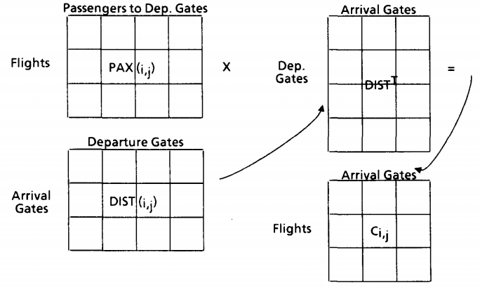
Visualization of the c_{i,j} coefficients
Solving the 0-1 Linear Program
This assignment problem can be solved through the primal-dual simplex method
Allows for sensitivity analysis
Simplex multipliers inform us of the penalty paid for non-optimal solutions
Notes:
Allison: Here, you can see the visualization of how the c (i,j) coefficients are determined, which is by the matrix product of PAX and DIST transposed. The 0-1 linear program formulation, which was seen on the previous slide, can be solved through the primal-dual simplex method. This allows for sensitivity analysis, because the simplex multipliers tell us about the penalties that are paid for non-optimal solutions.

Slide 7
Branch and Bound
Branch and bound is a common mathematical programming technique used to find an optimal solution to the gate assignment problem.
The objective is to reduce the number of passengers who have to walk maximum distances—at the cost of more passengers having to walk the minimum distances, compared to random aircraft position assignment.
In practice, a major airline hub terminal may handle more than 1000 daily flights at more than 50 gates, which in our formulation would result in billions of binary variables. Due to such a huge size, this model can not be handled by branch-and-bound based solvers within a reasonable time bound.
Branch and Bound does not take into account transfer passengers -- would need to use greedy heuristics and linear programming relaxation to determine this.
Notes:
Aparajita:

Slide 8
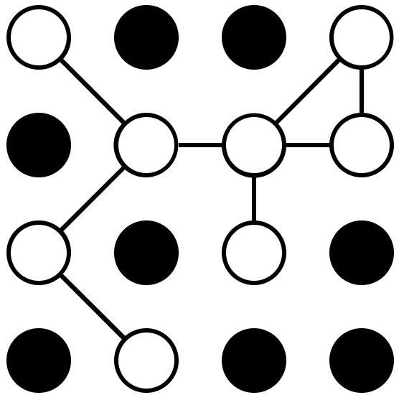



Tabu Search
GAP is complex, making it hard to find an optimal solution given time constraints
Meta-heuristic algorithms such as tabu search efficiently deal with combinatorial optimization problems, helping to reach an optimal solution in reasonable time
Tabu Search Objective: To maximize robustness of gate assignments meaning that the gate assignment is less sensitive to uncertain delays
Solutions to this objective improve ramp operations and passenger experience
Notes:
Since the Gate Assignment Problem is so complex, it is hard to find an optimal solution given the time constraints. Meta-heuristic algorithms are often used because they efficiently deal with combinatorial optimization problems. When focusing on maximizing robustness of gate assignments, meaning that the gate assignment is less sensitive to uncertain delays, many airports use tabu search. Maximizing robustness of gate assignments helps to improve ramp operations and the passenger experience.

Slide 9
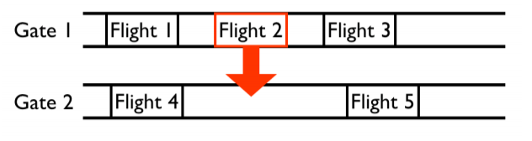
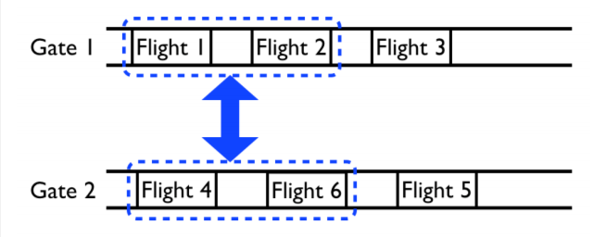
Tabu Search Moves
Insert Move
Interval Exchange Move
Each gate has a list of equipment types that the gate can serve, as well as flights with incompatible equipment with the gate, making them unable to be assigned to that gate
Iterations continue until there is no improvement of the objective value past the last best score
Notes:
In performing tabu search, each gate has a list of equipment types that the gate can serve, as well as flights with incompatible equipment with the gate, making them unable to be assigned to that gate. The two moves that can be performed are the insert move and the interval exchange move, as shown on the slide. The insert move changes a flight assignment from one gate to another that is also able to serve the equipment type of the flight and the interval exchange move swaps two groups of assignments if the corresponding gates are able to serve the equipment types of the groups. The insert move is evaluated at every iteration in order to intensify a local search around a narrow neighborhood of the current solution.The interval exchange move is evaluated periodically in order to diversify the search. Iterations of tabu search steps continue until there is no improvement of the objective value after some iterations past the last best score or the maximum iteration is reached.

Slide 10
Summary of Analyses
Tradeoffs are based on what you are trying to optimize when solving the GAP
Branch and bound only solves for one objective: reduce the number of passengers who have to walk maximum distances so it is limited and not very practical
Tabu search is more efficient than branch and bound, completing in a reasonable time when optimizing for robustness
The 0-1 Linear Program (solved by the primal-dual simplex method) only considers fixed arrivals in a hub
Inflexible because it does not account for uncertainties or changes in numbers of arrivals/departures
Problems occur when the arriving flights are also departing flights with fixed destinations
Best used for determination of initial gate assignments in a large hub and not the final assignments
Notes:
Jackie

Slide 11
Thank You!

