Slide 1
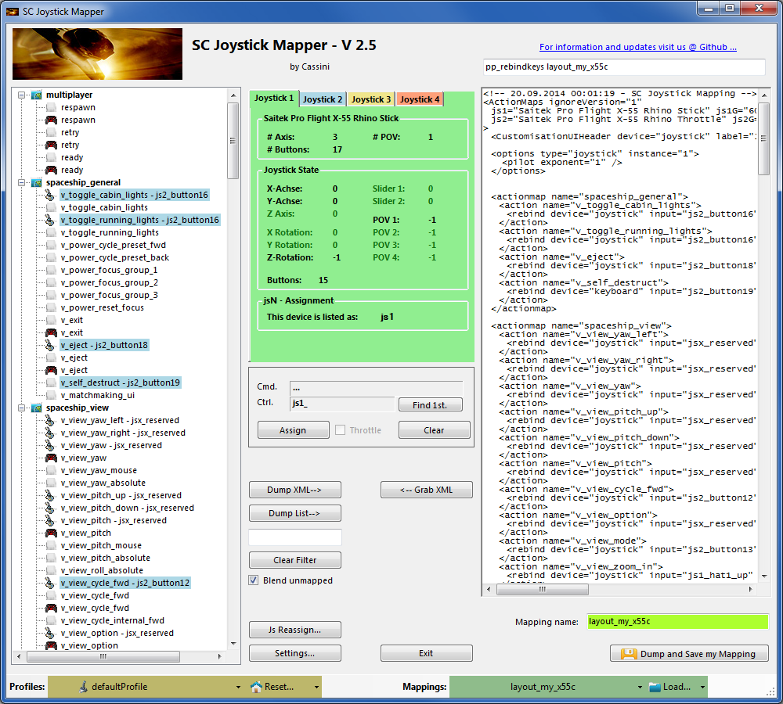
SC Joystick Mapper Quick Reference Guide V 2.5
20140920 – Cassini
ChangeLog: see ReadMe.txt
Disclaimer:
Usual stuff – no warranty whatsoever..
Freeware – made for the SC community
Hope it helps and does not suck.
Have fun in the verse …

Slide 2
Updating from V 2.x to V 2.5:
If you not have used 2.3 already: Check the jsN assignment and maybe de-assign unused devices See the new ‘js Reassign’ feature on page 17. Note: You may need to do this twice for each of the “VJoy virtual joystick” devices.
If you encounter an error or crash then read on…
You will find ‘log4net.config.OFF’ in the distribution zip. Rename it to ‘log4net.config’ and run the program. Then look for a file named ‘trace.log’ in the program folder and send this to cassini@burri-web.org along with a description of the problem and your system i.e. OS, CPU, Graphics card, Joystick(s) we may then finally solve the issue …

Slide 3
Contents
Page 2 Version Upgrade and Issue Handling
Page 3 Contents (this one…)
Page 4..10 General GUI and how to’s
Page 11..14 V2.0 new features
Page 15 V2.1 new features
Page 16 V2.2 new features + V2.5 refinement
Page 17 V2.3 new features + V2.4 refinement
Page 18 V2.5 new features
Last Page Common Workflows - Cheat sheet

Slide 4
Workflow
Connect the joystick devices to the PC
Start from scratch or load an existing map from a file
Make or refine mappings
Save the new map to an XML file
Use it in the game: e.g. pp_rebindkeys C:\maps\layout_my_joystick
V 2.0: You may load and save the map directly from your game folders so next time you just use pp_rebindkeys layout_my_joystick
Note: the predefined actions are the ones found in the AC game default profile – it is likely that some of them will not work at all as the game is not finished. There is no proper description for which one does what – you may get help in SC Forums.
As I had my issues with missiles here a finding..
To reallocate the missile fire command you should map the following 2 actions to the same joystick button:
v_target_missile_lock_selected
v_weapon_launch_missile
BTW: if you copy e.g. “pp_rebindkeys C:\maps\layout_my_joystick” from notepad you may use Ctrl-V to paste it in-game into the console – saves you some typing…

Slide 5
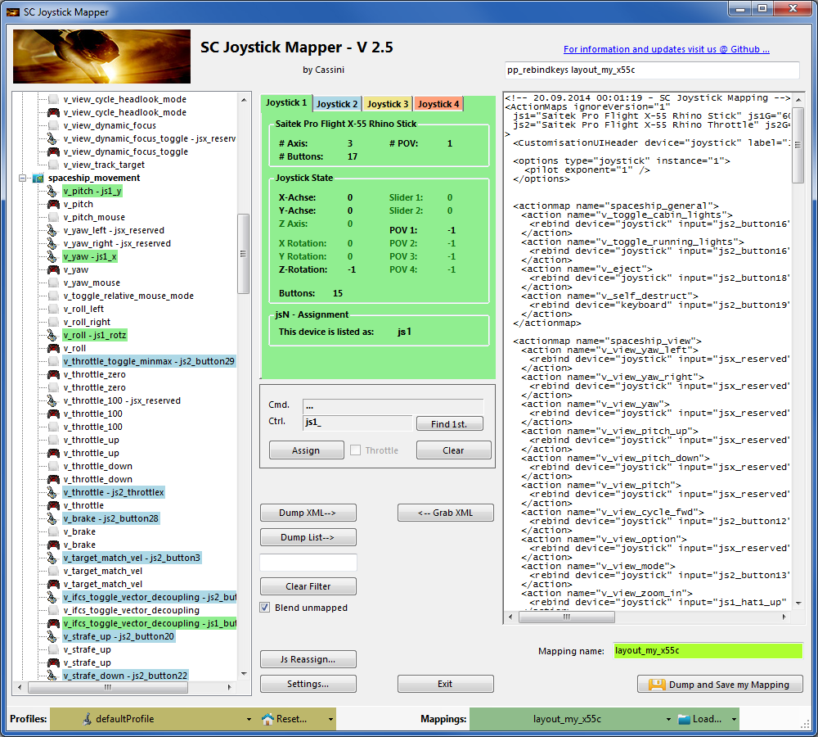
The GUI …
Action tree and mappings
XML dump of the mappings used
Detected Joystick devices
(up to 8 are shown)
Joystick properties
(greyed out ones are not available)
Joystick device map
Selected mapping
Action Mapping Buttons
Dump nice List
XML Area Buttons
V2: filter the action tree
V2.1: Blend unmapped option
V2: Load from game folders
V2: Save into game folders
V2.3, 2.4: Js Reassignment
V2: New Reset with options
V2: Resize the window

Slide 6
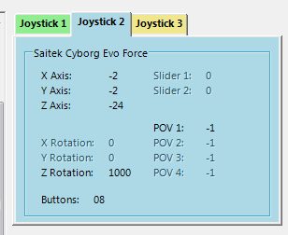
The Joystick Area…
V2.3 Update here
Here I pressed the Button 8 on the Cyborg Evo Joystick to capture the image
The tabs represent the joystick devices found connected to the PC also the number 1..8 shows the order the PC reports them which is crucial to the mapping as this will result in the default js_1, js_2 .. Names used to build the command name.
The elements are the ones the joystick seems to support – greyed ones are not available for this device.
V 2.4: you will see the actual Js assignment - or ‘not assigned’ – see page 17
The SC-Device to Joystick Mapping is a separate window accessed by hitting the ‘Js Reassign’ button.
Just hit any button, Axis and see how things are changing.

Slide 7
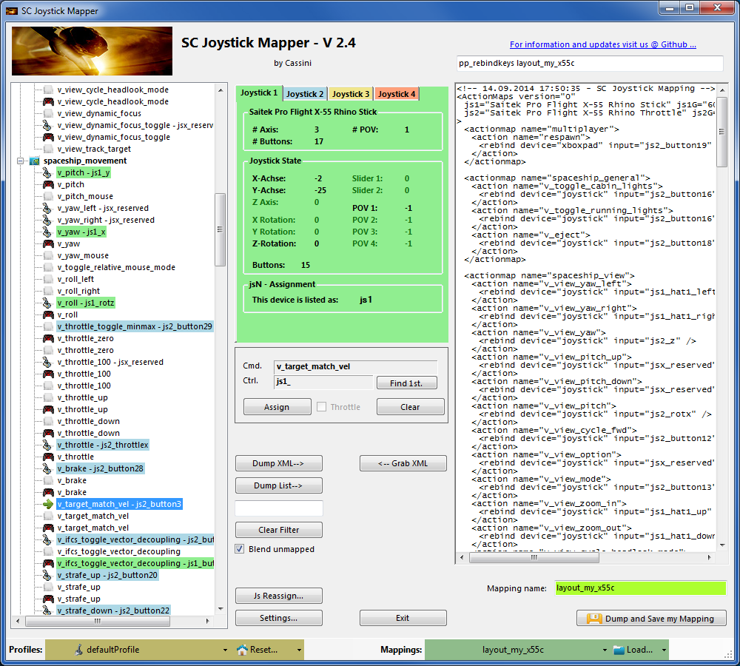
The Action Tree …
The tree is initially built from the known actions which are grouped along ‘actionmaps’ e.g. ‘spaceship_movement.
Each action is either a predefined joystick or keyboard action – this is given by the SC default profile.
By ‘rebinding’ or mapping and action with a different controls one does replace the default one i.e. overwriting keyboard actions will result in not having them available on the keyboard once you load the map in the game!
However no damage is done! This mapping is only valid until you exit the game or type pp_rebindkeys without a name
If actions are mapped (as shown) the color indicates to which joystick the mapping goes.
v_pitch – js1_y then means that the action v_pitch (joystick per default) is rebound to the joystick 1 (green) and there the Y-axis control.
If the background is white - there is no current mapping given.
Unmapped actions are ignored.
Click on any action to make it the used action in the mapping area. Once selected it is marked with the green arrow.

Slide 8
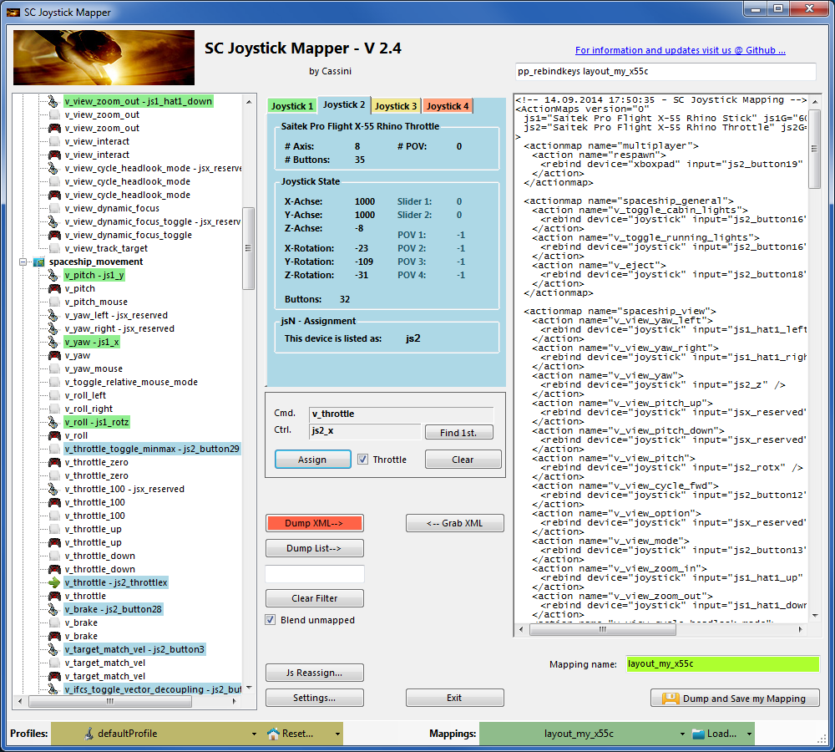
The Mapping Area…
Whenever you click on an action in the Action Tree it is copied into Cmd. and can be mapped to a Control.
The Control (Ctrl.) is the last joystick item you activated on the currently shown joystick tab.
I.e. if you want to map it for a control on the second joystick you have to select the “Joystick 2” Tab first.
Once you have a mapping that should be used, hit the “Assign” button.
The new mapping will be shown in the Action Tree – where it gets the back color of the joystick it is assigned to.
V2: To make any axis a Throttle axis – check the ‘Throttle’ box ! It is often the Z-Axis but the Rhino has it e.g. on js2_y.
If you do so the control assigned in changed to a throttle control (here js1_throttlez)
To clear a mapping – select it in the ActionTree and Click “Clear” - it gets a neutral color and no control in the ActionTree – it is now unmapped.
You may use “Find 1st” to find the first action where the currently shown Ctrl. (js1_z or if checked as shown js1_throttlez) is mapped.

Slide 9
The XML Area…
Mappings are sent to the game using XML formatted files.
The XML Area is where you may find the mapping after hitting the ‘Dump’ button.
Rightclick opens a menu where you may choose from:
Copy, Paste, PasteAll, Select All, Open…, Save As…
The usage is rather common here. Once you dumped the mapping you want to “Save” it as “filename.xml” somewhere.
To refine any mapping “Open” the file – the content is shown in the XML Area, then “Grab” it into the ActionTree.
Once the refinement is finished – again Save it to a file.
Load and Save much easier … read V2 Feature pages
Note: only use properly formatted ActionMaps here. The program may just break if it encounters something unexpected!

Slide 10
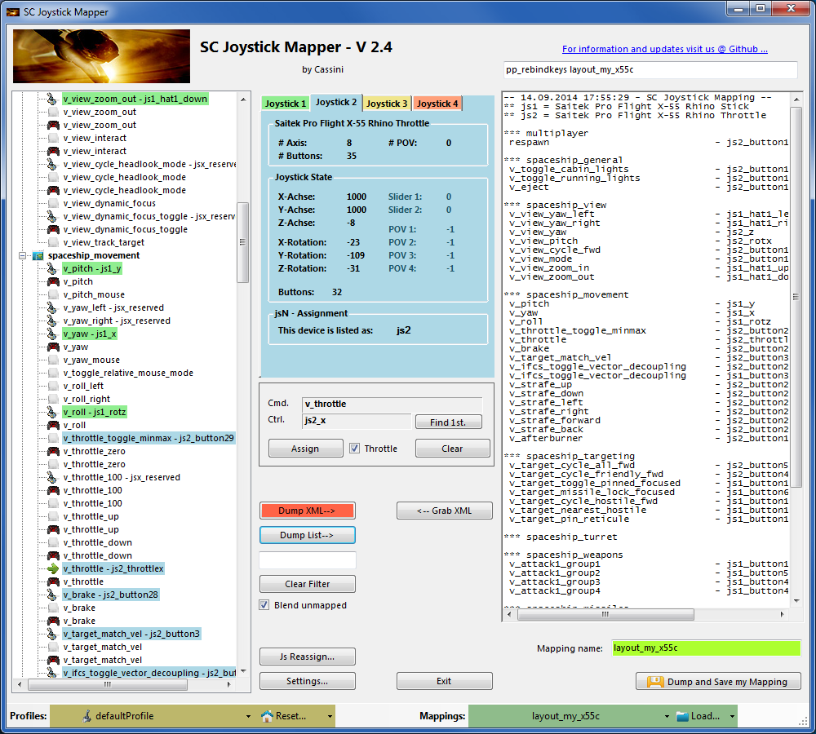
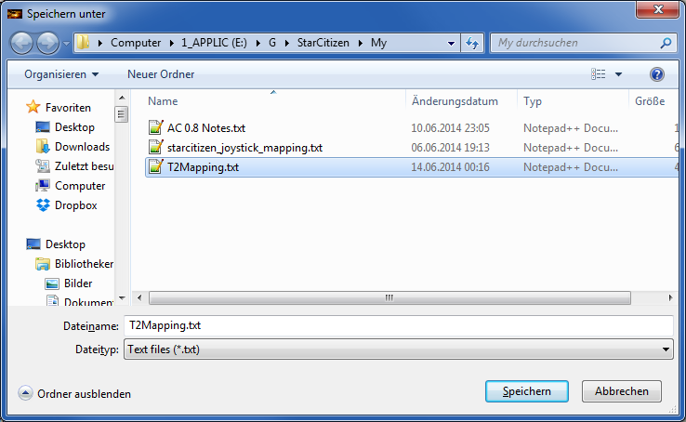
The XML Area…
If you hit “Dump List” a formatted list of the mapped actions is written into the XML area.
You may use the “Save As..” menu to save it e.g. as TXT file.

Slide 11
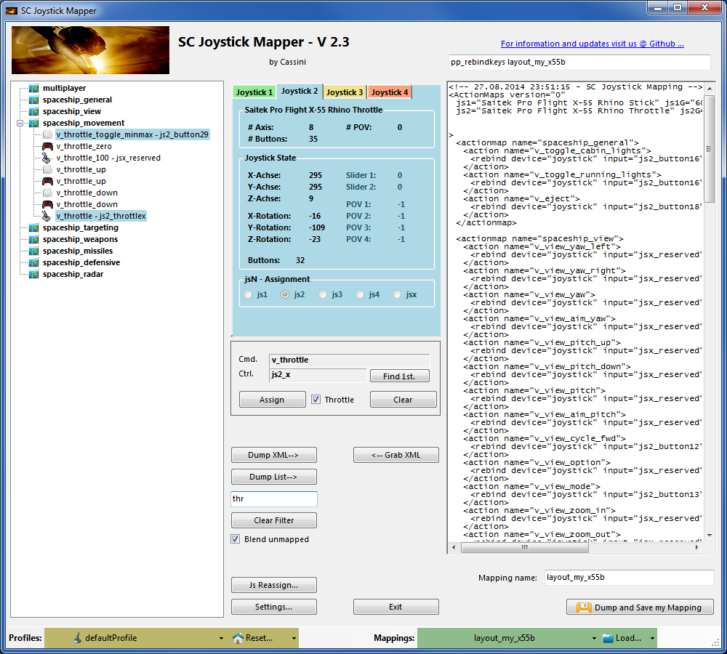
V2 – Features - 1
You may filter the action tree now
Start typing and the tree is reduced to the actions and controls that contain the characters typed
e.g. I typed ‘thr’ to see my throttles only
Try button and you get all your assigned buttons only etc.
Click ‘Clear Filter’ to get back to the complete list again.
Note: this will not change, remove or modify any of your mappings, it just reduces the tree to the ones you are interested in.

Slide 12
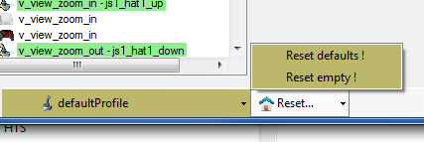
V2 – Features - 2
New working with profiles.
The program gets the actions from the real game asset – so you are always up to the actual values.
From here you may Reset the action list to the following
RESET EMPTY reverts to just an action list without any mappings
RESET DEFAULTS loads the Joystick actions mapped with what CIG is providing
Note: as CIG is providing a number of defaultProfiles you may chose one of those – however using the defaultProfile is usually the best option (This may be work in progress by CIG…)

Slide 13
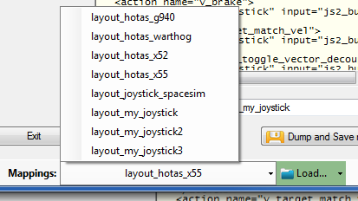
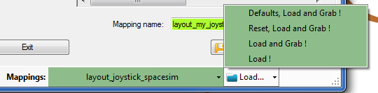
V2 – Features - 3
New working with actionmaps (Maps, Mapping etc..)
The program gets the actionsmaps from the real game asset – so you are always up to the actual values.
(…\StarCitizen\CitizenClient\Data\Controls\Mappings)
From here you may first chose a map, then ‘Load’ the actionmap – this will overwrite you XML window in any case
LOAD loads the map into the XML window only
LOAD and GRAB loads the map into the XML window and clicks Grab i.e. merges the existing mapping with the one loaded
RESET, LOAD and GRAB first Reset (empty) the action list (all mappings cleared) then it loads and grabs the new map
DEFAULT, LOAD and GRAB first Reset (defaults) the action list then it loads and grabs the new map and merges them with the defaults
See last page for some common workflows
And how to handle them easily

Slide 14

V2 – Features - 4
New working with your own actionmaps
The program not only gets the actionsmaps from the real game asset – but also can save your maps there.
(…\StarCitizen\CitizenClient\Data\Controls\Mappings)
Type a name (limitations see note)
Hit the button – it will then Dump and Save your map into the game folder (well asking you to overwrite it if it exists)
NOTE: your map name has always to start with ‘layout_my_’ to prevent modifying CIGs own actionmaps
Lowercase only, no spaces, tabs allowed else you see the red flag ..
A successful Save will show the green flag
Your own maps will then show up like the game provided maps
pp_rebindkeys layout_my_joystick should load it into the game
Note: For your convenience each Save also makes a copy of into your personal
“My Documents\SCJMapper” folder – no work is lost if there is an update
that cleans the Mappings folder.
2.0

Slide 15
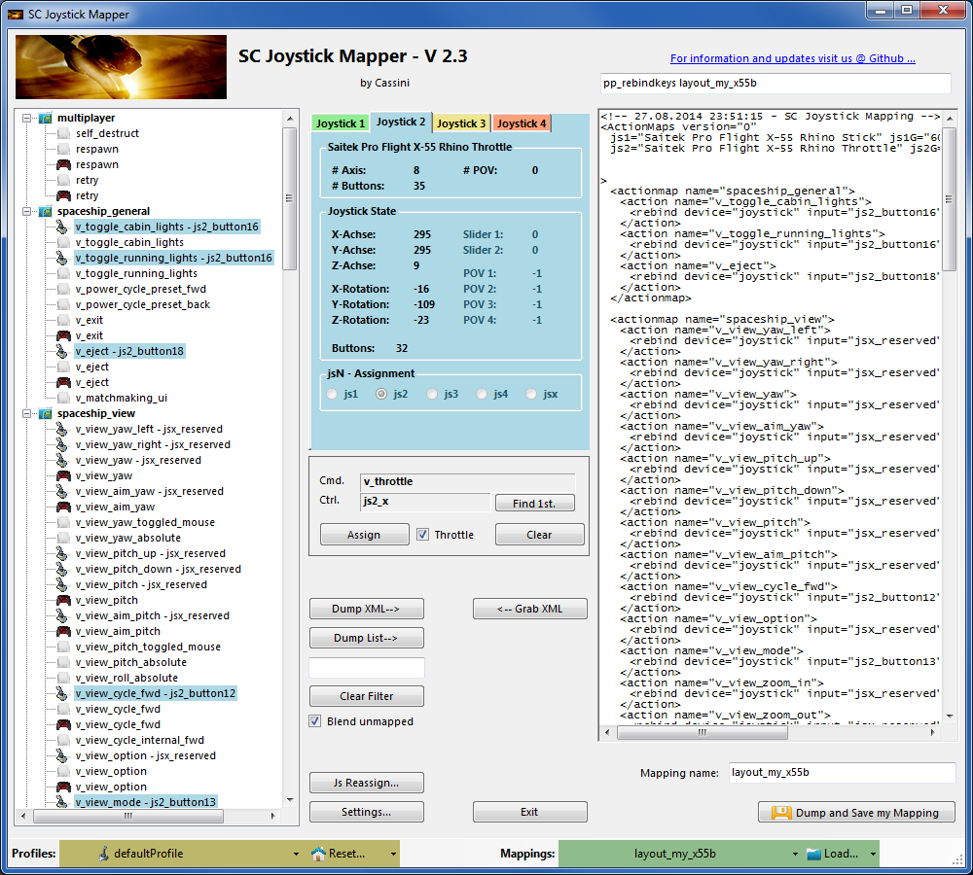
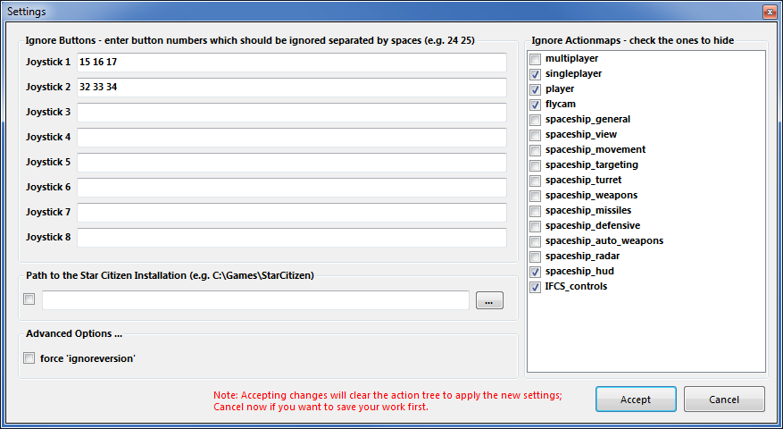
V2.1 – Features
New possibility to blend the unmapped joystick entries
If you wish to hide all the joystick actions that you don’t use – to make sure they are not active – check “Blend unmapped”
The program will then map all unmapped actions with ‘jsx_reserved’ preventing any profile settings on the joystick.
This is fully reversible – just uncheck the option and Dump the contents again.
New Settings window
As many are concerned about steady ON buttons that might interfere with assigning the proper control to an action we included a setting to IGNORE specific buttons. Just enter the button numbers to ignore separated by a Space.
Make sure you enter the numbers for the right Joystick.
Numbers are the same as in the main window.
There is also way to override the programs own detection of the Star Citizen install folder.
Make sure to use the Checkbox if you want to override!

Slide 16
V2.2, 2.5 – Features
New possibility to ignore unwanted actionmaps
If you wish to ignore some maps to unclutter the GUI
If you with to use the default ignored new actionmaps multiplayer, singleplayer, player
The program will ignore all actionmaps that are checked
In the example multiplayer, singleplayer, player and IFCS_controls are completely ignored and will not show up.
Just uncheck any to use it again.
V2.5 New option to force ‘ignoreversion=“1”’
If you wish to use the ignoreversion attribute rather
than any version=“n” ..
The prog is able to handle it now. Either type e.g.
‘version=“0”’ or ‘ignoreversion=“1”’
Into the ActionMaps Tag and the prog will maintain
it as you typed it.
Or just force it to use ‘ignoreversion=“1”’
by checking the box here
2.0

Slide 17
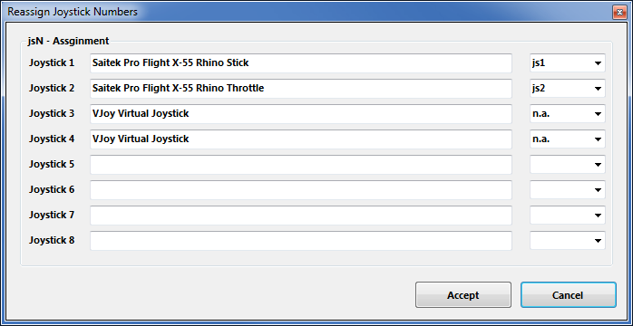
V2.3, 2.4 – Features
New possibility to (re) assign the joystick devices to the wanted js - number
Go here if you wish to assign a device to a particular js – number or to re-assign the devices to other numbers.
Per default the devices found are assigned along the sequence 1..8 but SC may remap them so here is the place to fix this without having to go through all commands and reassign them.
Notes: The color of the assigned items will not change as it is still the same device but js1 will become js2 for example.
You can leave this dialog with “Accept” only if each device is either assigned to a unique number or to n.a. (not assigned) otherwise an error pops to ask you to fix it or Cancel.
V2.4 allows to assign js1 .. Js8 now
Related SC console commands are:
i_DumpDeviceInformation
pp_ResortDevices joystick 1 2
2.0

Slide 18
V2.5 – Features
New possibility – support for options
The prog will now maintain the following 3 XML tags
<CustomisationUIHeader …>
<options …>
<deviceoptions …>
You may copy and paste or type whatever of those 3 tags you want to use – the program will maintain your typing and also read it from the mapping file when it is already there.
Note: There is no support to get proper options or let you interactively design those tags (sorry I know too little about all useful possibilities)
The program stores the tags as plain string and will not do anything but get them in and out again. Some pretty printing is applied.
Hint:
copy and just paste them into the editor – easy
Or load your modified mapping – the prog should maintain them
(testing by looking into the file the first time would be sensible…)

Slide 19
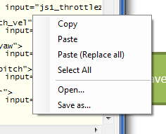
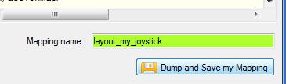
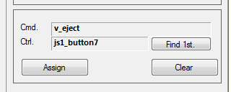
SCJMapper V 2 – Common Workflows
A
Start from ..
Do Reset or Load
Make it _my_ map
B
A
D
Empty
Reset empty !
Name _my_map
Dump and Save
A
D
C
CIG Defaults
Reset defaults !
Name _my_map
Dump and Save
D
B
D
E
D
Existing CIG map
Chose CIG map
Defaults, Load and Grab
Name _my_map
Dump and Save
Assign Ctrls
Dump and Save
B
D
Existing _my_ map
Chose _my_ map
Reset, Load and Grab !
Name _my_map
Dump and Save
E
Create a new version
A
D
Existing _other_ map
Reset empty !
Context Menu: Open… other map
Click Grab
Name _my_ map
Dump and Save
C
Create a new version

