Slide 1
Now till now we have developed the backend

Slide 2
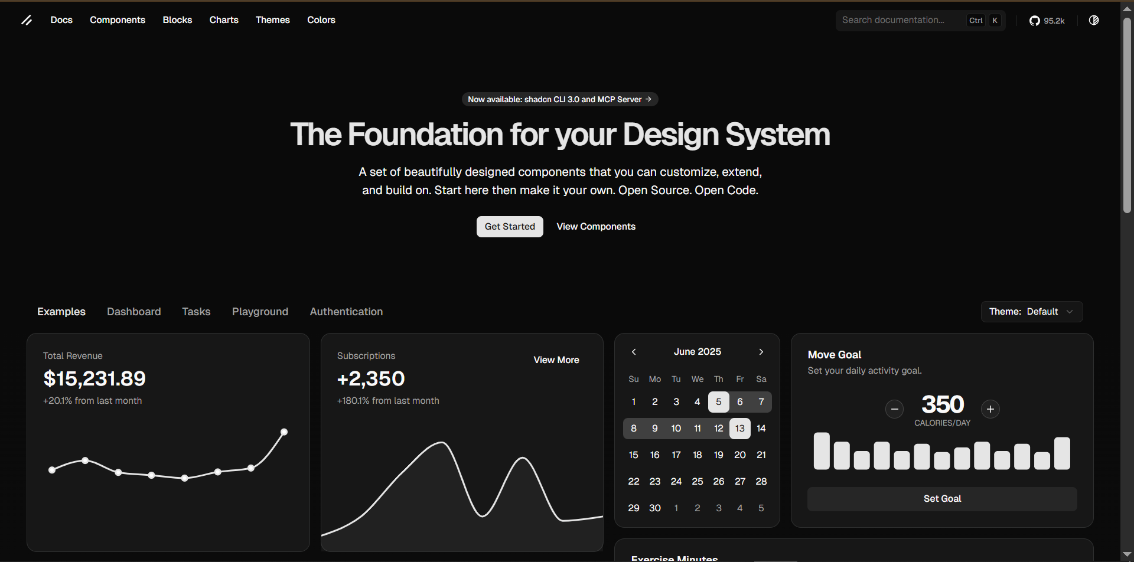
ShadCnui

Slide 3
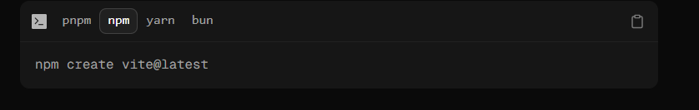
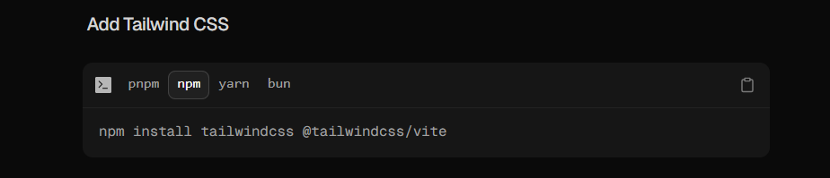

Slide 4
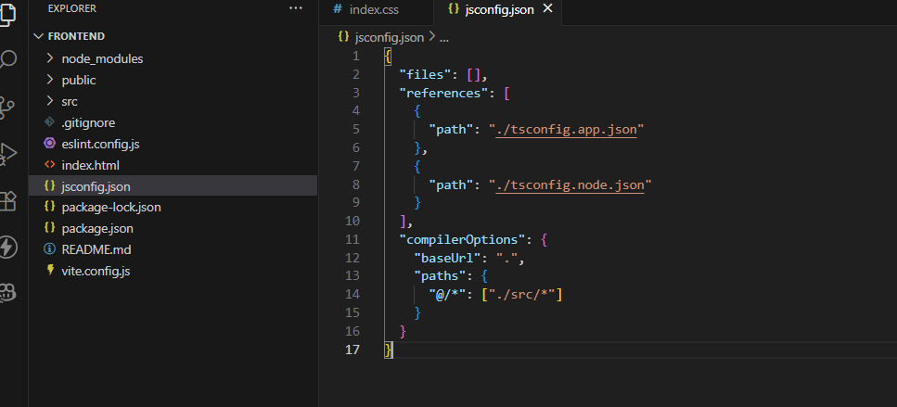

Slide 5
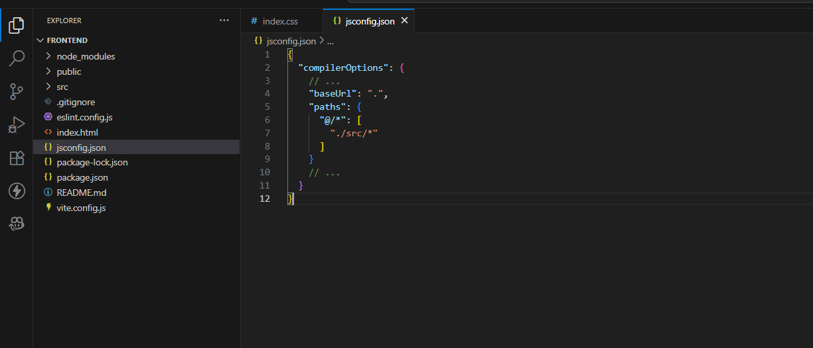

Slide 6
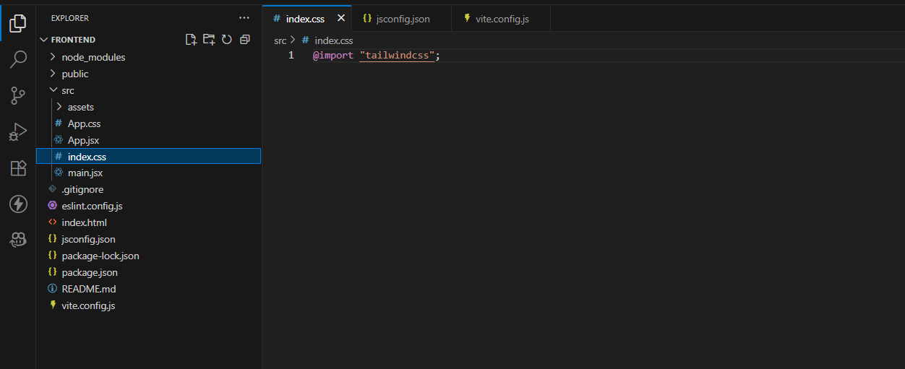

Slide 7
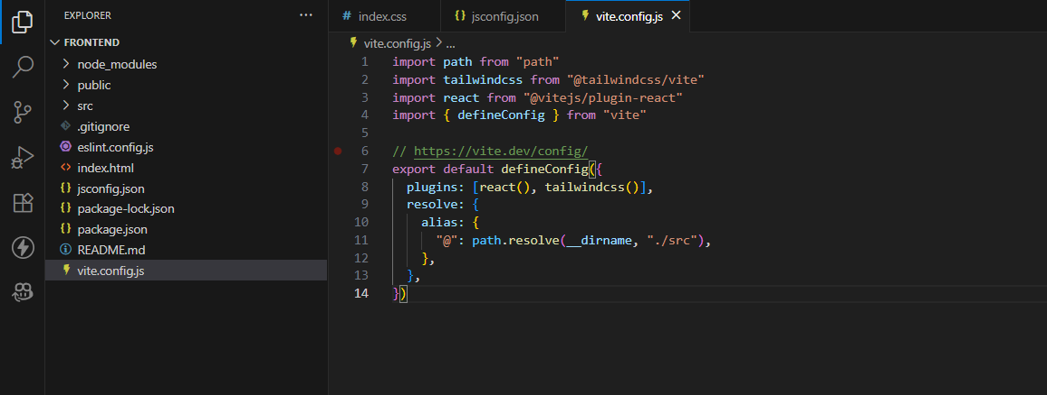

Slide 8
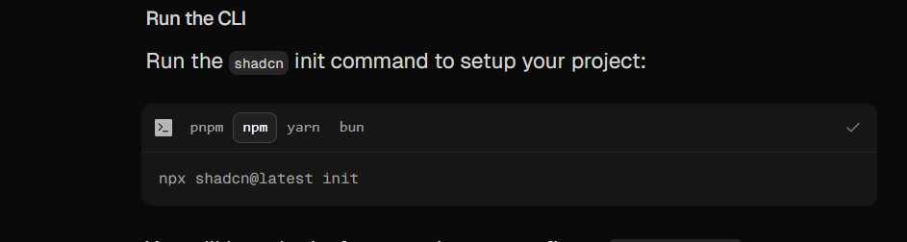

Slide 9
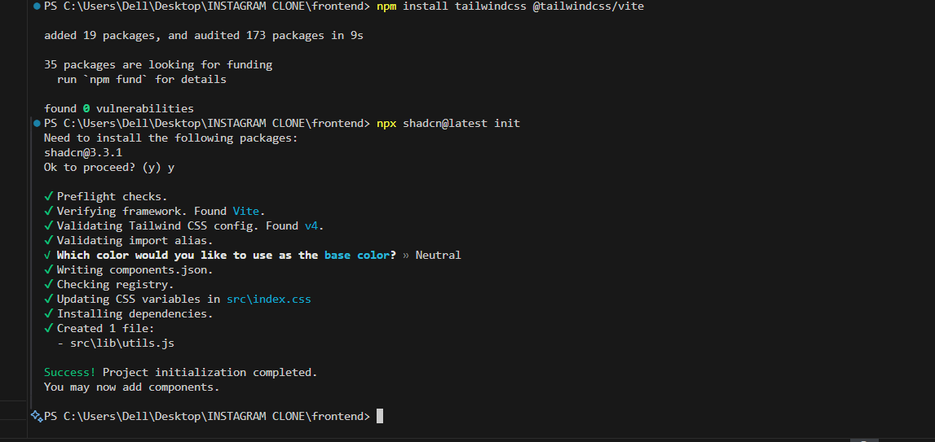

Slide 10
Now after adding all these…
We can start adding components in our project and start using shadcn ui components

Slide 11
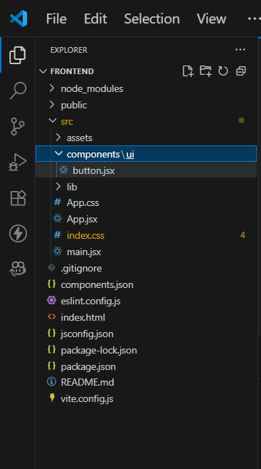
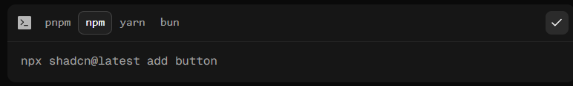
Adding button

Slide 12
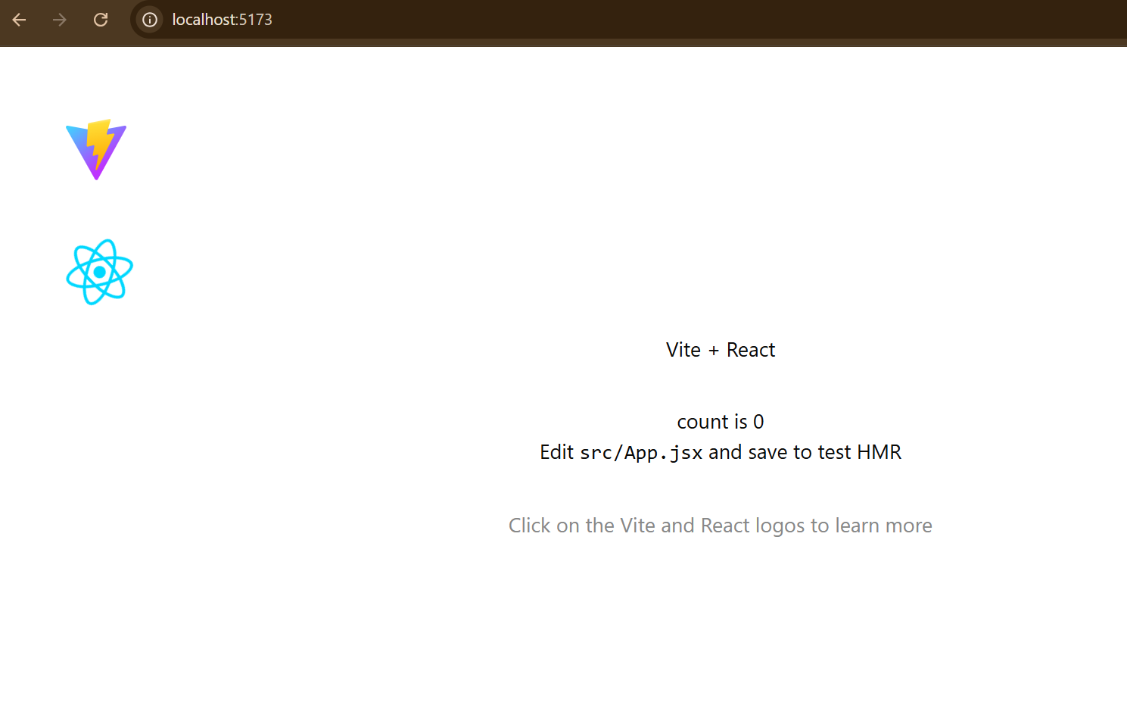
Sample running of localhost:5173

Slide 13
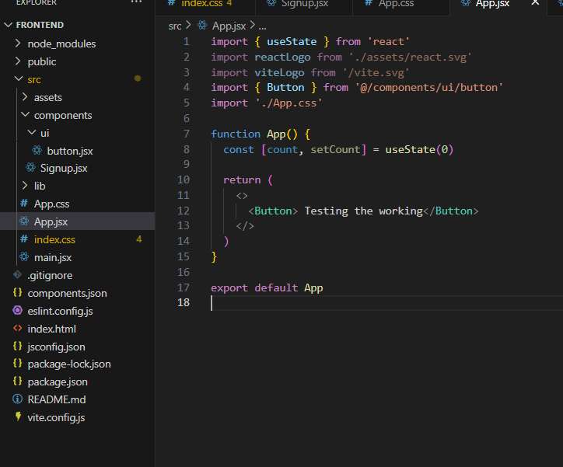
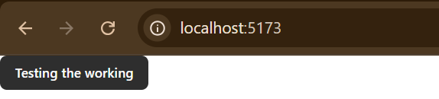
Testing the button working

Slide 14
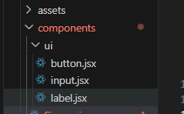
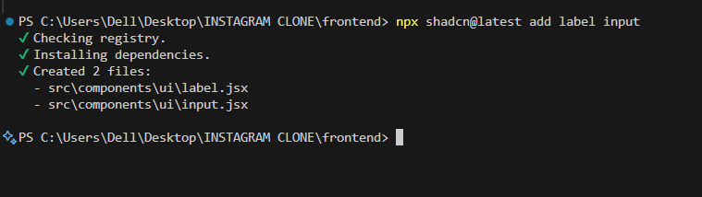

Slide 15
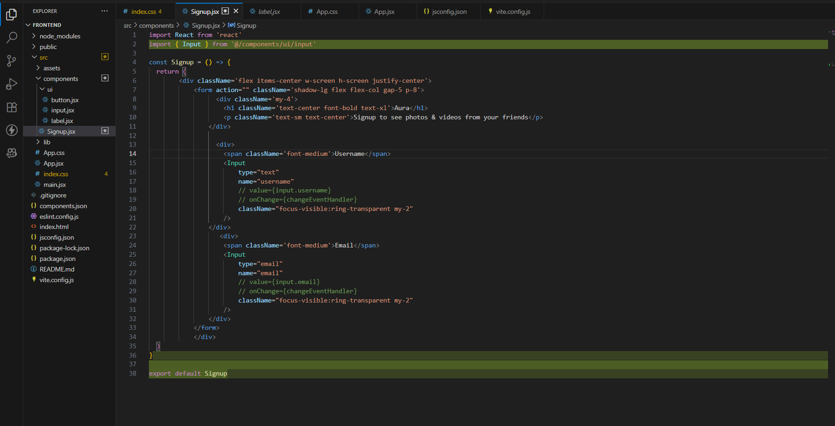
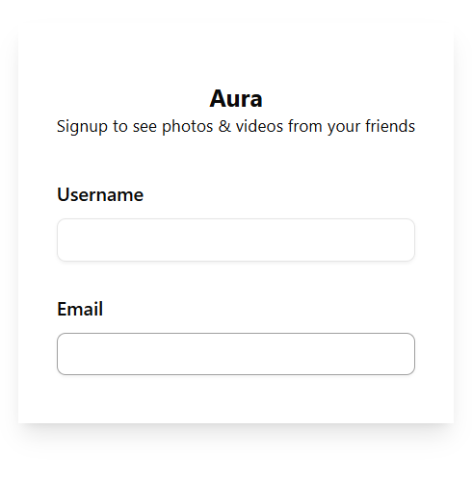

Slide 16
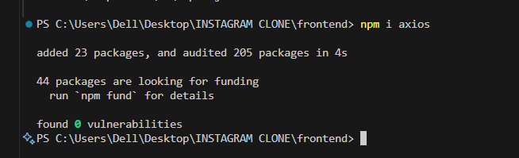
Supports GET, POST, PUT, DELETE, etc. Handles JSON automatically. Allows setting custom headers and interceptors. Works with async/await for cleaner code.
Axios is a popular JavaScript library used to make HTTP requests from the browser or Node.js. It supports promises and async/await, making it easy to fetch data from APIs, send data to servers, and handle responses and errors.

Slide 17
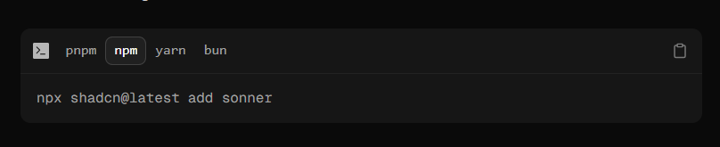
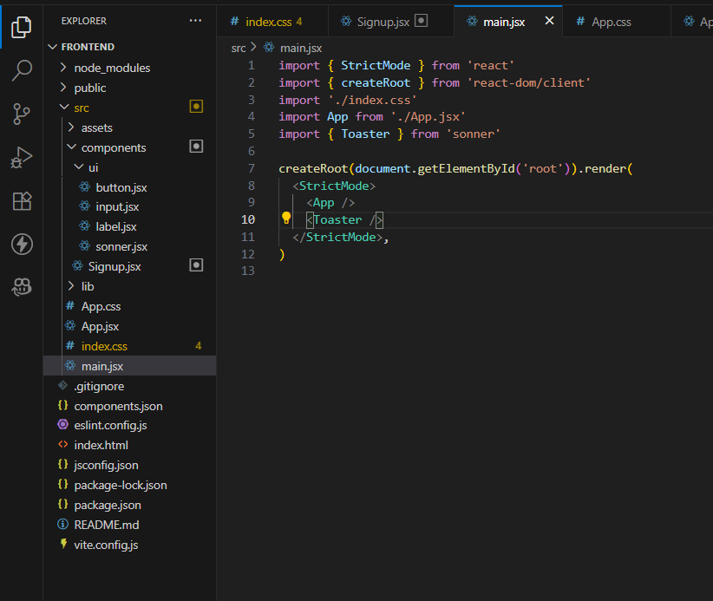
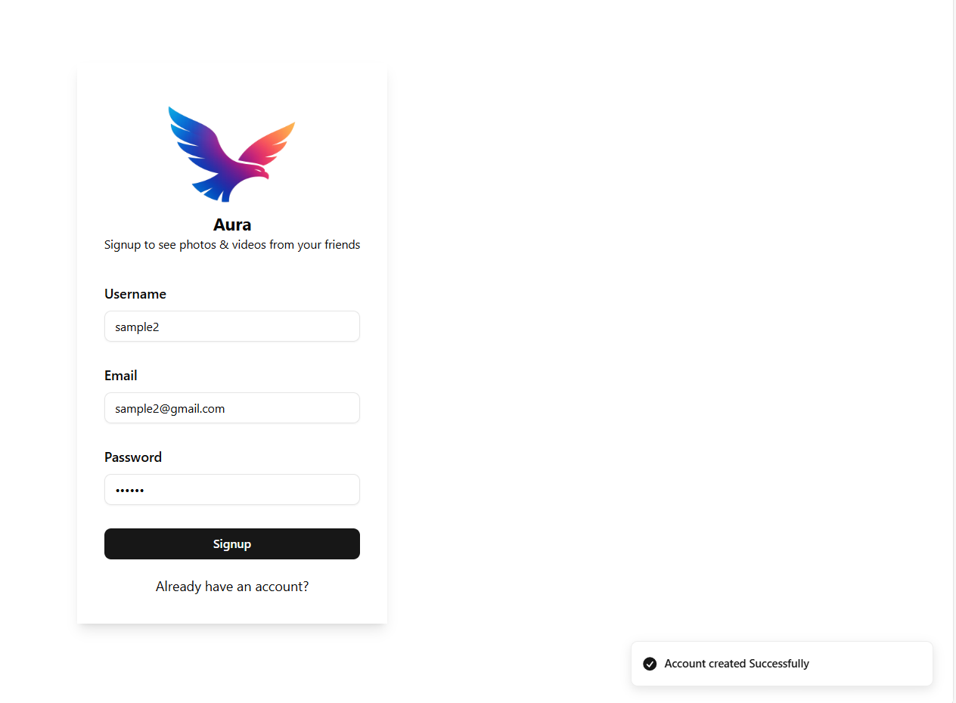
Sonner
Sonner has a comment
called Toaster
To make sonner work..
We need to attach Toaster in the
Main.jsx

Slide 18
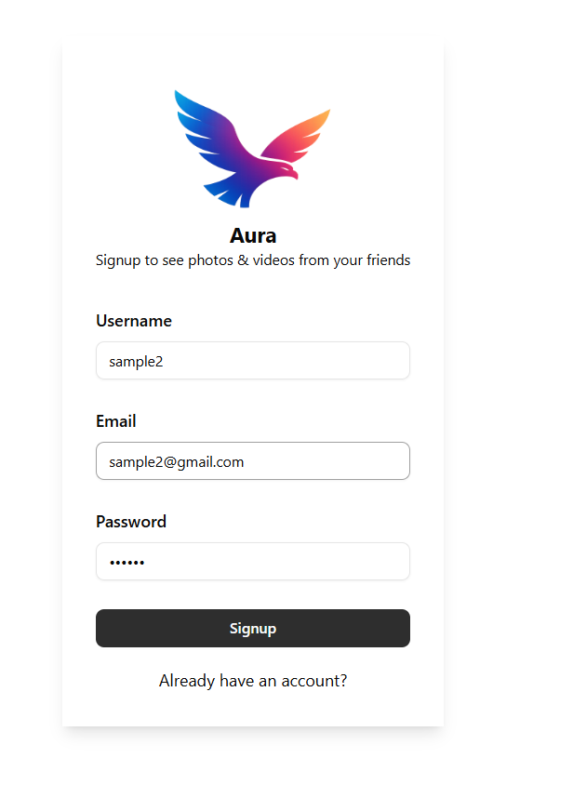
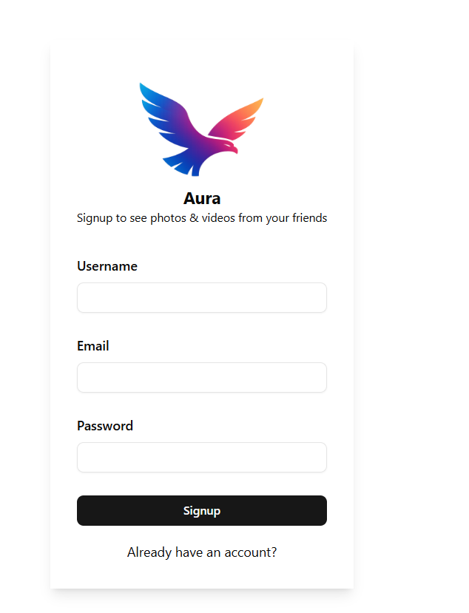

Slide 19
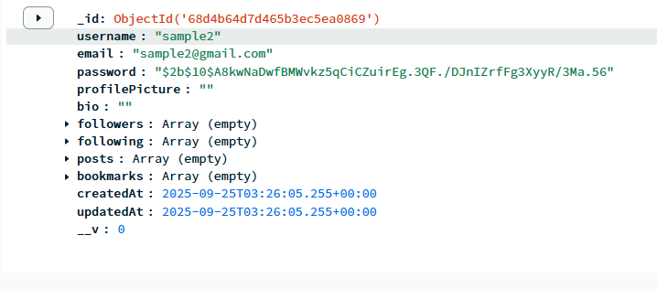

Slide 20
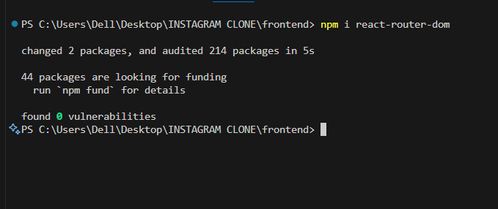
Now we are implementing react router dom
React router dom is simply used when we are implementing
Going from one page to anther in our project

Slide 21
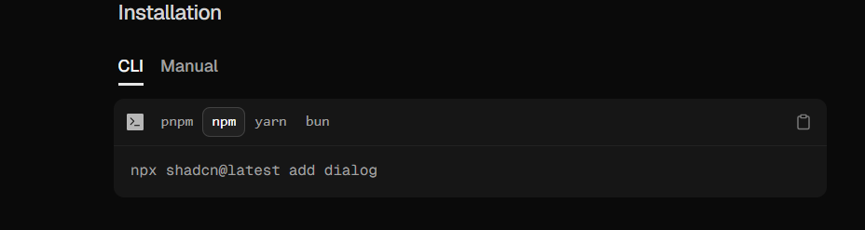
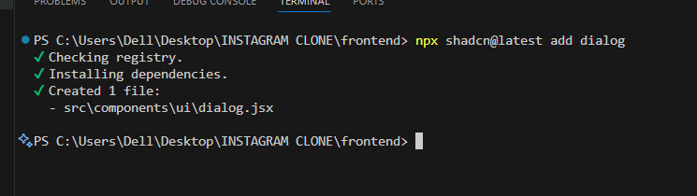
Dialog – shadcn ui component

Slide 22
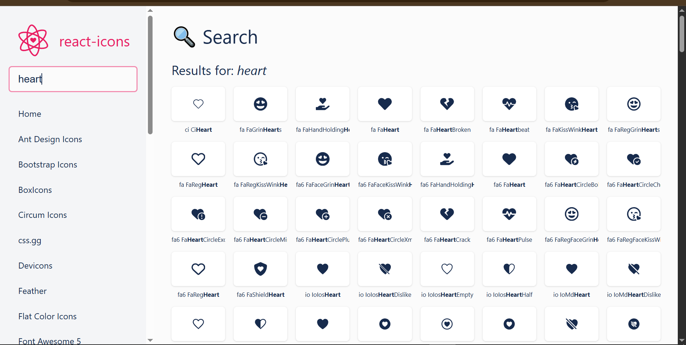
import { FaHeart } from "react-icons/fa";

Slide 23
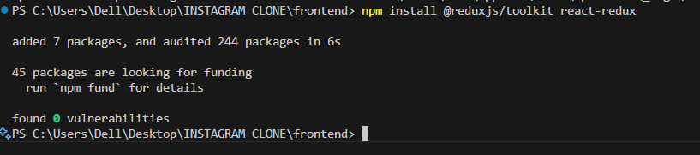
React has a problem of state management
So for that ..we are using redux– redux is used for global storage

Slide 24
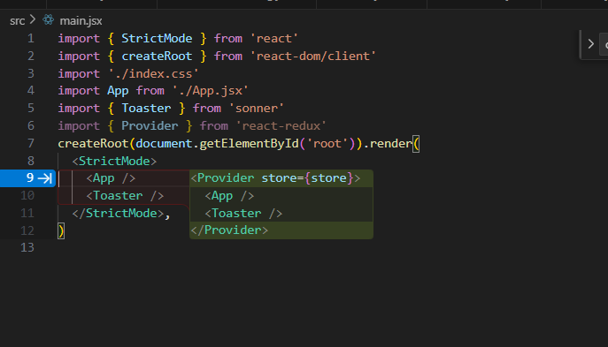

Slide 25
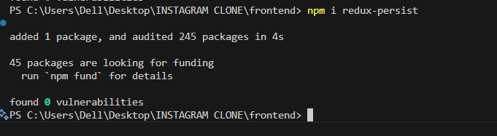
Redux persist

Slide 26
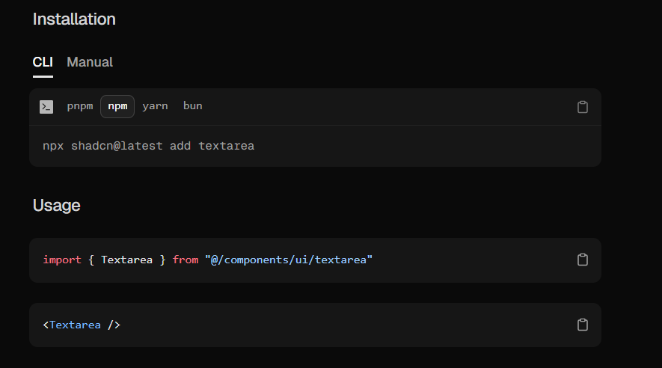
TextArea -- ShadCnui

Slide 27
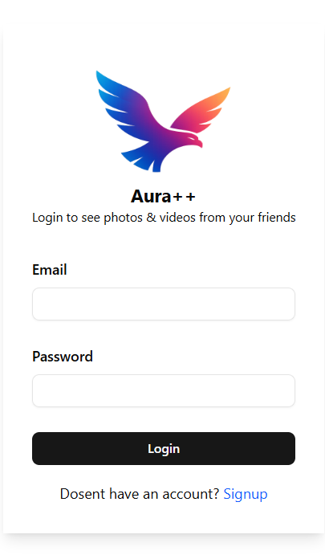
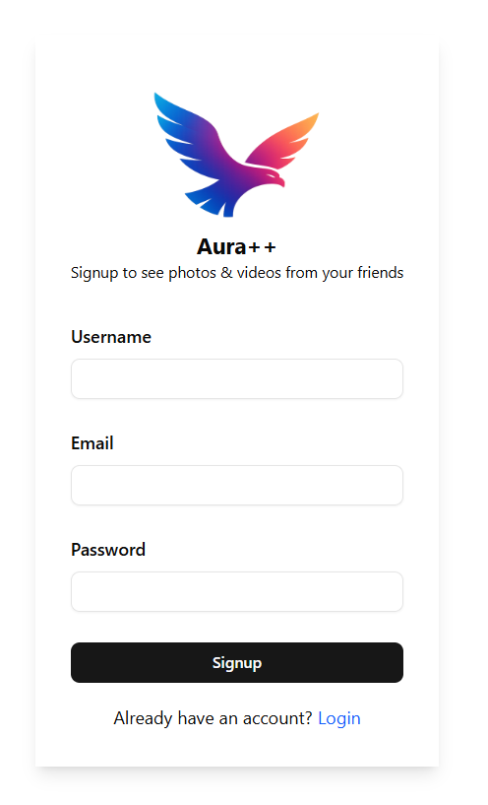
Signup.jsx

