Slide 1
Snapping Photos with a Superconducting Magnet
27 June 2016

Slide 2
§ Tools we use in Cog Sci
Protons spin and have angular momentum
This also gives them a magnetic moment
+
N
S
A moving charge creates a current, a current creates a magnetic field (and vice versa)
Think of brain as bulk matter with anisotropic distribution of magnetic moments (from H₂0 atoms)
Physiological Measures - MRI
Notes:
Biological substrates – are they necessary for a particular cognitive function?

Slide 3
§ Tools we use in Cog Sci
Physiological Measures - MRI
Protons spin and have angular momentum
This also gives them a magnetic moment
+
N
B
o
M_{o}
S
A moving charge creates a current, a current creates a magnetic field (and vice versa)
An externally applied magnetic field will
align the net magnetic moment in it’s own direction. They are still spinning – but out of phase with each other.
Notes:
Biological substrates – are they necessary for a particular cognitive function?

Slide 4
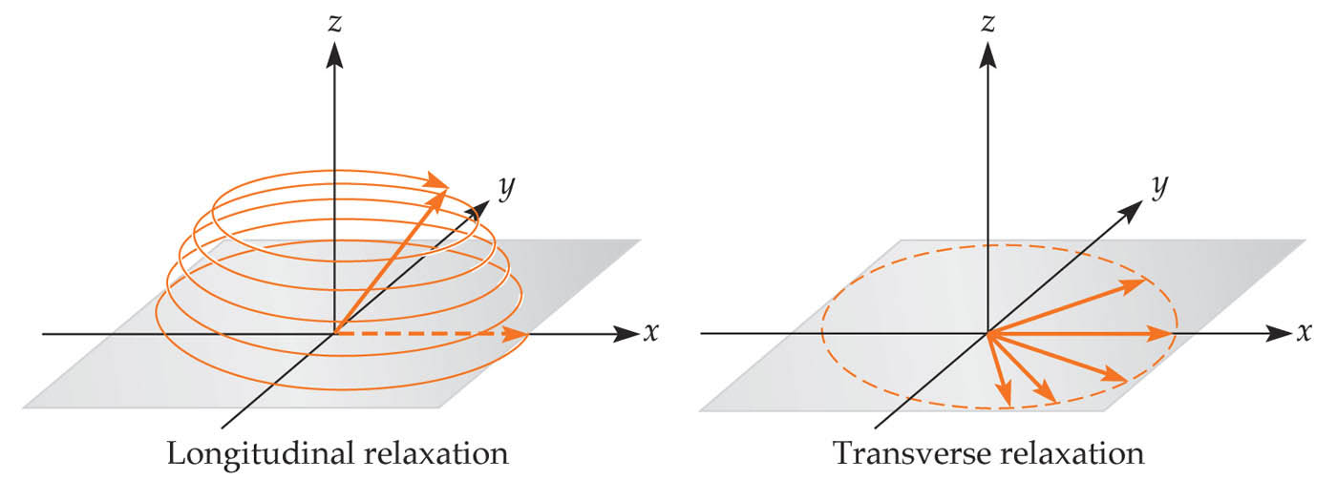
§ Tools we use in Cog Sci
Physiological Measures - MRI
z
y
x
* Align phases with a transient RF pulse. This tips over the atoms so that the magnetization
is now in the x-y plane (transverse).
* After RF pulse is removed, we measure the decay of the transverse magnetization (T2)
and increase in the longitudinal magnetization (T1).
* Relaxation emits radiation that we can use to measure proton density and magnetic field
inhomogeneities (i.e. T2*, BOLD).
Notes:
Biological substrates – are they necessary for a particular cognitive function?

Slide 5
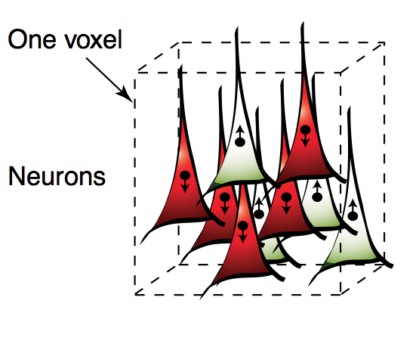
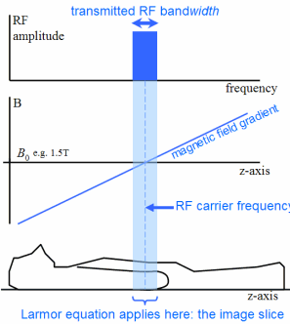
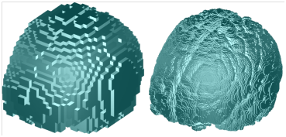
What is a voxel?
* RF pulse limited to a single slice at a time at coordinate z.
* Each slice is a landscape where each x, y coordinate corresponds to a unique frequency of relaxation (due to a gradient magnetic field).
* Fundamental limit of MRI resolution

