Slide 1
SolarSize
CSCI410 MOBILE APPLICATION · PROJECT 1 PROPOSAL
Size a home solar system in seconds: panels, batteries, inverter and cost on one live screen.
Maryam Bazzal
Flutter (Dart) · github.com/82330295-sketch/solarsize
November 2026
LIU
Notes:
Introduce SolarSize: a one-screen Flutter app that turns a list of home appliances into a solar system size (panels, batteries, inverter, cost). Working alone. Repository: github.com/82330295-sketch/solarsize.

Slide 2
From appliance list to solar system
THE IDEA
Many homes add solar panels to cope with power cuts, but few owners know how many panels or batteries they really need. SolarSize answers that in seconds, offline, on one screen.
STEP 1
STEP 2
STEP 3
Pick appliances
Set your conditions
Get your system
Fridge, TV, lights, fans… set quantity and hours per day for each.
Sun hours in your area and battery backup hours needed at night.
Panels, batteries, inverter (kVA) and estimated cost, updated live.
✓
One screen: everything happens on a single page
✓
No database: appliances are a const list in the code
✓
Original: my own idea, logic written from scratch
SolarSize · Maryam Bazzal · 2
Notes:
The problem: people buy solar systems by guesswork. SolarSize gives a quick, offline estimate. Three steps on one screen. It respects the project rules: single page, no database (the appliance catalog is a constant list in Dart), and an original idea.

Slide 3
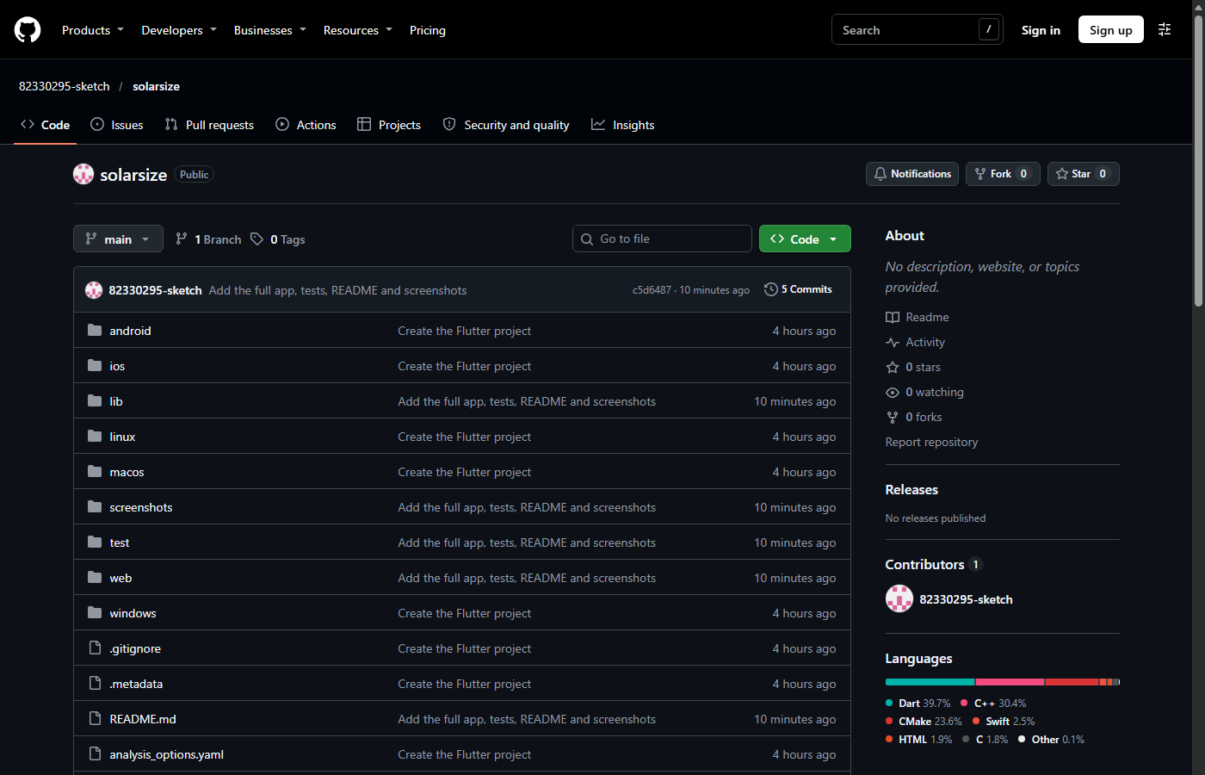
The project lives on GitHub
CLO-1 · GITHUB
REPOSITORY
github.com/82330295-sketch/solarsize
Account: 82330295-sketch · Flutter (Dart)
How I will use it
Sample Flutter project uploaded as proof of the account
One commit per feature, with a clear message
Screenshot of github.com/82330295-sketch/solarsize (November 2026)
README with screenshots and run steps; final URL posted on Classroom
Proof for CLO-1
Account created, repository public, SolarSize code and screenshots pushed.
SolarSize · Maryam Bazzal · 3
Notes:
CLO-1: the GitHub account 82330295-sketch exists and the public repository solarsize holds the sample Flutter project created with flutter create (android, ios, lib, test, web, windows, pubspec.yaml). The final code will be pushed here, one commit per feature, and the URL posted on Classroom.

Slide 4
How the code is organized
CLO-2 · CODE PLAN
I work alone, so I write the code myself. It is split into small Flutter files, each with one job.
lib/main.dart
lib/home.dart
lib/widgets.dart
App entry point, opens the home page
The one page; holds all state and callbacks
Slider, checkbox, appliance tile, results card
lib/appliance.dart
lib/solar_system.dart
test/solar_system_test.dart
Appliance class and the catalog list
SolarSystem class: panels, batteries, kVA, cost
Unit tests for every calculation
How a change flows through the app
User changes any input
setState() in home.dart
SolarSystem recomputes
Results card redraws
SolarSize · Maryam Bazzal · 4
Notes:
CLO-2: since I work alone, the code is distributed over files instead of people, the same way we split the code in class. main.dart starts the app, home.dart is the only page and holds the state and the callback functions, widgets.dart has the custom widgets, appliance.dart has the Appliance class and the catalog list, and solar_system.dart has the SolarSystem class with the calculation. Every input change calls setState, so SolarSystem recomputes and the results card redraws.

Slide 5
The math behind the results
CLO-2 · PROJECT LOGIC
1 Daily energy
WORKED EXAMPLE
E = Σ (watts × quantity × hours per day) [Wh/day]
Fridge, TV, 8 LED lights, 2 fans, washer, router · 5 sun hours · 8 h backup
2 Solar panels
panels = E ÷ (550 W × sun hours × 0.8), rounded up
6.4 kWh
energy per day
3 Batteries
3
solar panels (550 W)
batteries = E ÷ 24 × backup hours ÷ 0.8 ÷ 2,560 Wh, rounded up
2
batteries (2.56 kWh)
4 Inverter
kVA = (Σ watts × quantity) × 1.25 ÷ 0.8 ÷ 1000, next standard size
3 kVA
inverter
5 Estimated cost (the 15% is added only if installation is checked)
≈ $1,750
estimated cost
cost = (panels × $90 + batteries × $450 + inverter price) × 1.15
Panel size, battery size, efficiency and prices are constants at the top of solar_system.dart, so they are easy to update.
SolarSize · Maryam Bazzal · 5
Notes:
The project logic, in the SolarSystem class. Daily energy is the sum of watts x quantity x hours. Panels: energy divided by what one 550 W panel produces in the given sun hours at 80% efficiency. Batteries: average hourly use times backup hours, divided by 80% usable depth of discharge and a 2.56 kWh battery. Inverter: total running load with a 25% margin and 0.8 power factor, rounded up to a standard size (1, 1.5, 3, 5, 8, 10 kVA). Cost: unit prices plus 15% for wiring and installation. The worked example is the default appliance list.

Slide 6
Work plan: one developer, four steps
CLO-2 · WORK PLAN
Nov 9 – 12
Nov 13 – 19
Nov 20 – 26
Nov 27 – Dec 1
Proposal + GitHub
Logic
Interface
Polish + ship
Repository, sample Flutter project pushed, this proposal
Appliance model, catalog, SolarCalculator and unit tests
Sliders, appliance list with steppers, Add sheet, results card
Small-phone layout, README with screenshots, final push. Demo Dec 2 / 3
GUI 55%
Logic 25%
Tests 10%
Docs 10%
Each step ends with commits on GitHub, so progress is visible at any time.
SolarSize · Maryam Bazzal · 6
Notes:
Because I am working alone, the work is distributed over time instead of over team members: four steps from now to the December 2/3 presentation. Most of the time goes to the GUI because it is 62% of the Part 2 grade; logic and tests come first so the interface can be built on a tested calculator.

Slide 7
One screen, three zones
CLO-3 · GUI
Sketch of the single Flutter screen (Material 3)
9:41
SolarSize
Sun hours
5 h
1
1
Your conditions
Backup at night
8 h
Two sliders for sun hours and night backup, and a checkbox to include the installation cost.
✓
Include installation (+15%)
Appliances
+ Add
Fridge
−
1
+
150 W · 24 h/day
2
2
Your appliances
TV
−
1
+
Tap + Add to pick from the catalog, then set quantity with − / + and hours per day.
100 W · 6 h/day
LED light
−
8
+
10 W · 6 h/day
YOUR SYSTEM · 6.4 kWh/day
3
2
3
Your system (results card )
solar panels
batteries
3
3 kVA
≈ $1,750
Pinned to the bottom: panels, batteries, inverter kVA and estimated cost. Updates instantly.
inverter
estimated cost
SolarSize · Maryam Bazzal · 7
Notes:
CLO-3: the whole app is one scrollable screen in three zones. Zone 1: two sliders for sun hours and backup hours, and a checkbox to include the installation cost. Zone 2: the appliance list with quantity steppers and an Add button. Zone 3: a results card pinned to the bottom showing panels, batteries, inverter size and cost.

Slide 8
Everything happens on the same screen
CLO-3 · GUI
9:41
9:41
A bottom sheet, not a new page
SolarSize
SolarSize
Sun hours
5 h
Sun hours
5 h
The appliance catalog slides up over the screen and closes back to it, so the app stays one page.
Backup at night
8 h
Backup at night
8 h
✓
Include installation (+15%)
✓
Include installation (+15%)
Appliances
+ Add
Appliances
+ Add
Live results with setState()
Fridge
−
1
+
Fridge
−
1
+
Every slider move or − / + tap reruns the calculator. There is no Calculate button.
Add an appliance
150 W · 24 h/day
150 W · 24 h/day
Search appliances…
TV
−
1
+
TV
−
1
+
100 W · 6 h/day
+
100 W · 6 h/day
Air conditioner
1,200 W
LED light
−
8
+
Air conditioner
−
1
+
10 W · 6 h/day
+
1,200 W · 6 h/day
Washing machine
500 W
Water pump
750 W
+
Built for small phones
YOUR SYSTEM · 6.4 kWh/day
YOUR SYSTEM · 13.6 kWh/day
Microwave
1,000 W
+
Large tap targets, results always visible, and a sun-and-night color theme.
3
2
7
3
solar panels
batteries
solar panels
batteries
Laptop
65 W
+
3 kVA
≈ $1,750
5 kVA
≈ $2,910
Water heater
+
inverter
estimated cost
1,500 W
inverter
estimated cost
1. Tap + Add: catalog slides up
2. Results update instantly
SolarSize · Maryam Bazzal · 8
Notes:
Adding an appliance opens a bottom sheet on the same screen, not a new page. Here the user adds an air conditioner: as soon as it is added, the results card jumps from 3 to 7 panels, 2 to 3 batteries, a 5 kVA inverter and about $2,910. Every change is live through setState.

Slide 9
SolarSize: ready to build
SUMMARY
CLO-1
CLO-2
CLO-3
GitHub ready
Clear code plan
One live screen
Public repo github.com/82330295-sketch/solarsize with a sample Flutter project
Six focused modules, tested math, four dated steps for one developer
Sliders, appliance list and a results card that updates instantly
Thank you
Maryam Bazzal · CSCI410 Mobile Application
Notes:
Summary: the GitHub account and repository are ready (CLO-1), the code is split into modules with a dated plan (CLO-2), and the single screen is designed (CLO-3). Questions?

