Slide 1
A Distributed Network Performance Measuring System

Slide 2
Design and implement a system that can let a network administrator control a set of agents to measure the network performance from the agent to the destination IP address (for example, 10.3.8.211) or hostname (for example, www.baidu.com), gather the result and visualize.
The agent can execute ping or curl command to measure the network performance.
For example, you want to know the network performance of www.baidu.com from different city (Beijing, Shanghai …), this system helps the network administrator to control agents in different city to perform a measuring task.

Slide 3
1. Frontend (Website) (Server)
1.1 Task Dispatch
1.2 Task Result Visualization
2. Backend (Server)
2.1 Web Server
2.2 WebSocket Server
3. Agent (Client)
3.1 Task Receive - Task Execute - Task Result Upload

Slide 4
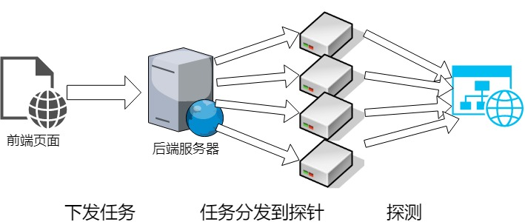

Slide 5
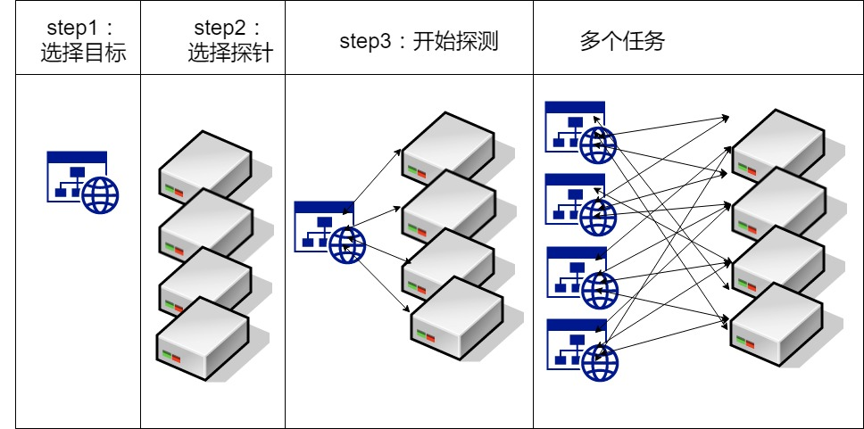

Slide 6
Frontend Side Task

Slide 7
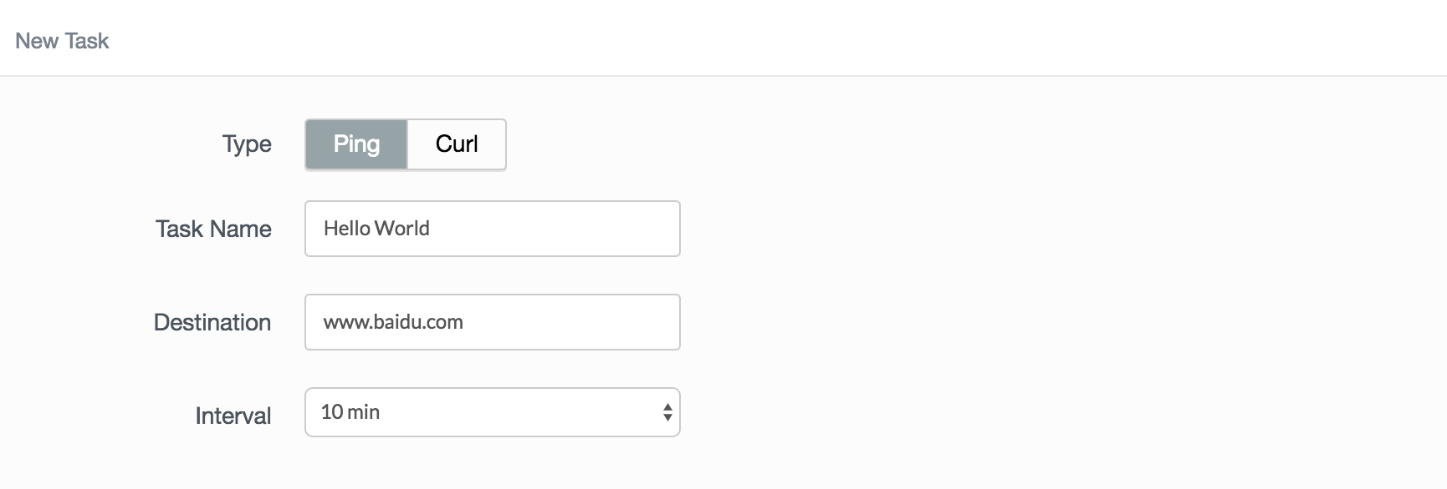
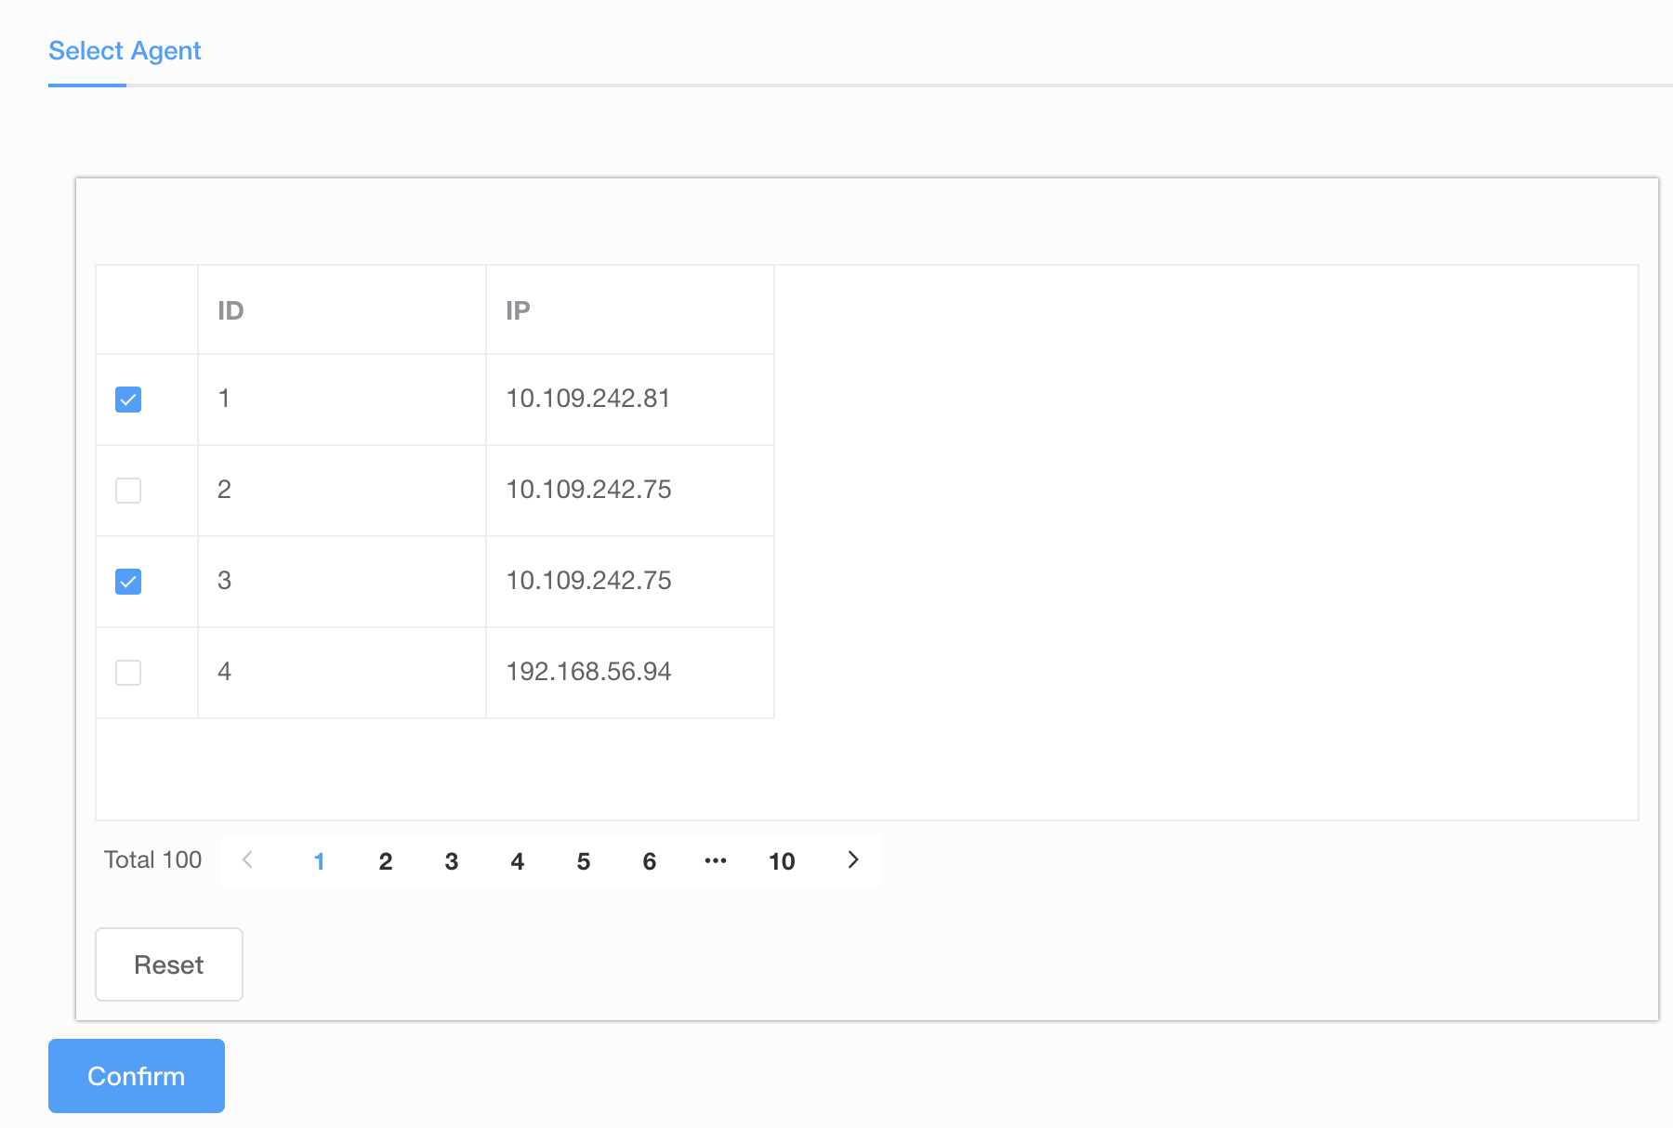
Task 1: Task creation page
the basic settings including
task name
type (ping, curl)
destination (IP or hostname)
interval (5min, 10min)
select agent

Slide 8
Task 1: Task creation page
the basic settings including
task name
type (ping, curl)
destination (IP or hostname)
interval (5min, 10min)

Slide 9
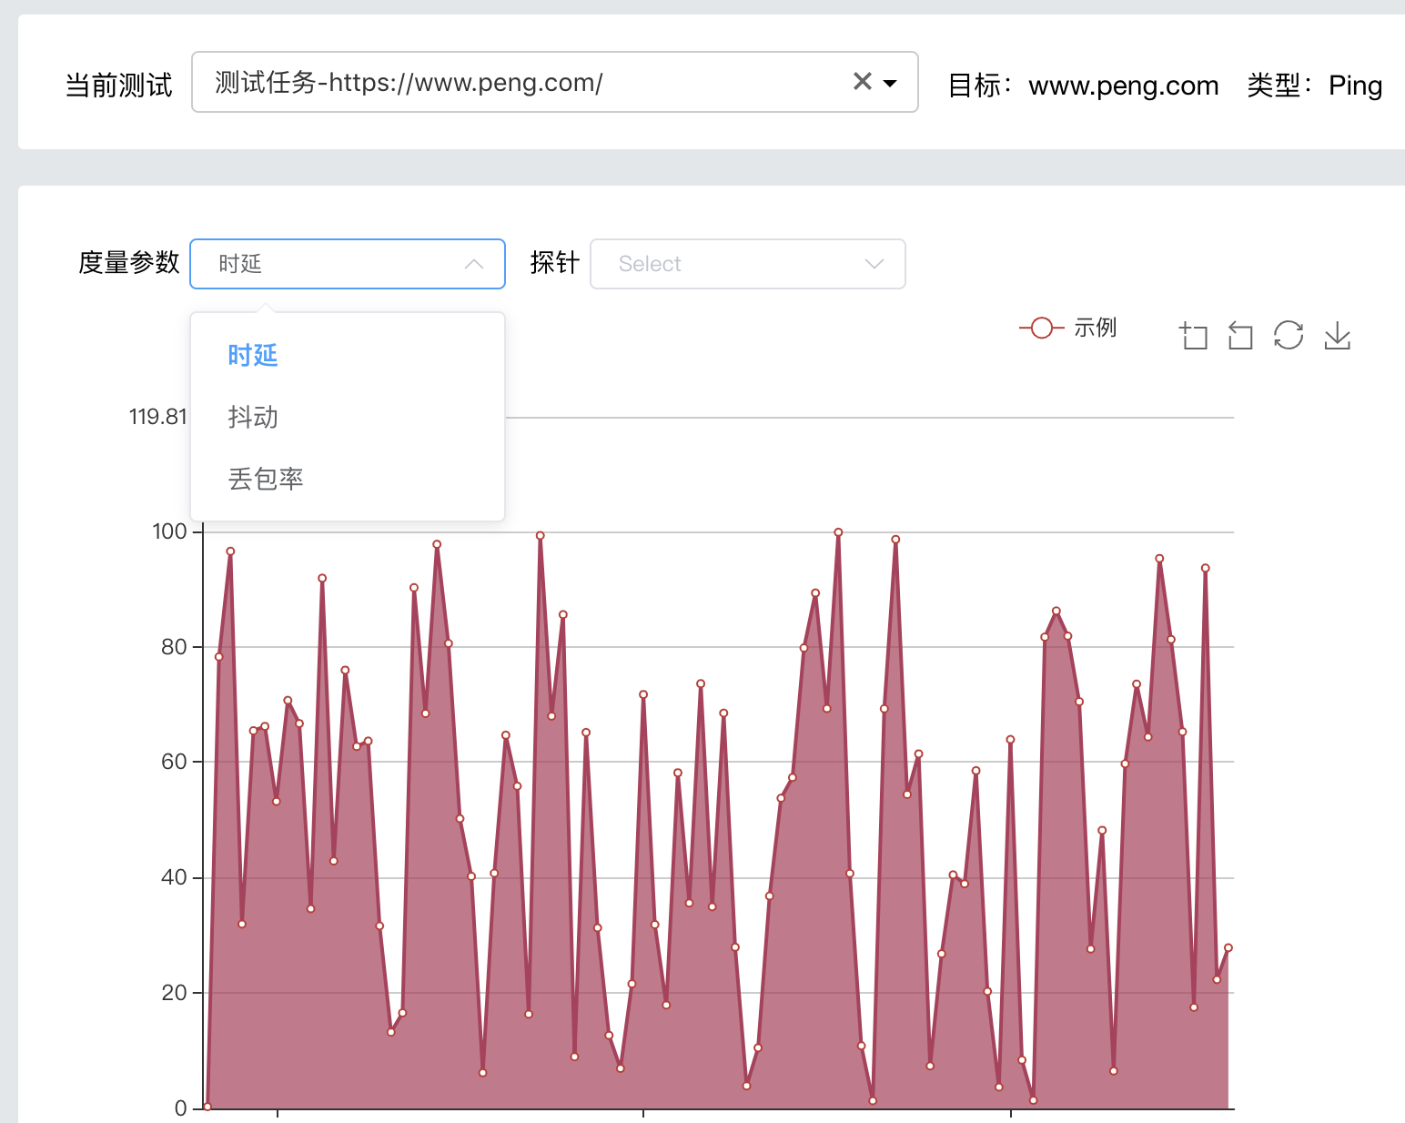
Task 2: Result visualization page
a ComboBox containing all tasks
select different tasks to show the result of the current test.
a chart showing the measurement results
different metrics (eg: rtt, packect_loss …)
different agents

Slide 10
Agent Side Task

Slide 11
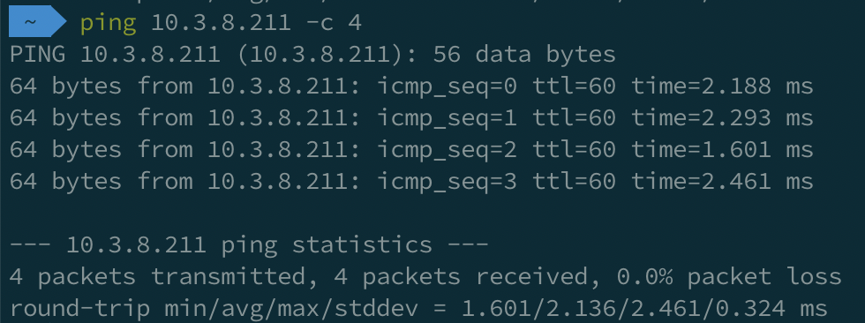
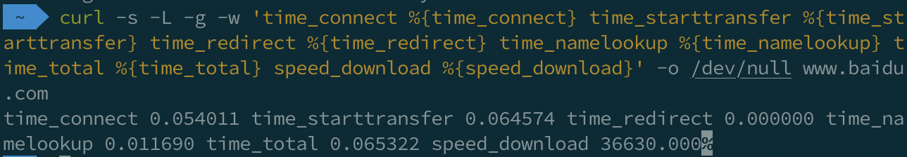
ping: rtt(avg), rtt(stddev or mdev), packet_loss
时延， 抖动， 丢包率
curl -s -L -g -w 'time_connect %{time_connect} time_starttransfer %{time_starttransfer} time_redirect %{time_redirect} time_namelookup %{time_namelookup} time_total %{time_total} speed_download %{speed_download}' -o /dev/null www.baidu.com
See man page of curl for more details …

Slide 12
Agent
Receive task from server by receiving JSON format data via WebSocket protocol
Resolve message and generate command ---- get information from JSON formatted string and generate a ping or curl command
Run the command and resolve the result ---- get information from the output of command
Transform result to JSON format and send back to server via WebSocket protocol

Slide 13
Agent
Receive task from server
Agent connects to the WebSocket Server, waiting for task messages
When a message is received (JSON formatted), pass message to the task execution module.
JSON message example：
{"id": 1, "type": "curl", "destination": "www.baidu.com", "interval": "300"}
{"id": 2, "type": "ping", "destination": "www.baidu.com", "interval": 600}

Slide 14
2. Resolve message and generate command
1. resolve JSON: resolve JSON string to a Python dict
msg = json.loads(msg_json)
2. generate command
if msg[‘type’] == ‘ping’:
cmd = “ping –c 4 %s” % msg[‘destination’]
elif msg[‘type’] == ‘curl’:
cmd = ……

Slide 15
3. Run the command and resolve the result
1. Command Execution
status, output = subprocess.getstatusoutput(cmd)
2. Resolve the result (Using regex)
if status == 0:
rtt = re.search(……) …
stddev = ……

Slide 16
4. Transform result to JSON format and send back to server
1. Put result in a dict, with probe ID
msg[‘rtt’] = rtt
msg[‘stddev’] = stddev
……
msg[‘probe_id’] = 123
2. transform dict to JSON
msg_json = json.dumps(msg)
3. Send back to server via WebSocket protocol
ws.send(msg_json)

Slide 17
Backend Side Task

Slide 18
Backend
Provide API for frontend to perform task creation and result visualization
Listen WebSocket port, record connected agents
Send task message to agents when creating task
Receive results and save to database (MongoDB)

Slide 19
Provide API for frontend to perform task creation and result visualization
class WebPage(tornado.web.RequestHandler):
def get(self):
……
def post(self):
……

Slide 20
2. Listen WebSocket port, record connected agents
class ProbeConnect (tornado.websocket.WebSocketHandler):
callbacks = [ ] # Save instance of connections
def open(self):
self.callbacks.append(self.callback)
def on_close(self):
self.callbacks.remove(self.callback)
def on_message(self, msg):
……
def notifyCallbacks(self, msg):
for callback in self.callbacks:
callback(msg)

Slide 21
3. Send task message to agents when creating task
Get arguments from POST request body
class WebPage(tornado.web.RequestHandler):
def post(self):
type = get_body_argument(‘type’, None)
……
2. Transform task information to a JSON formatted data and send to agents
msg = json.dumps(……)
# then do something to send msg to agents …

Slide 22
4. Receive results and save to database
class ProbeConnect (tornado.websocket.WebSocketHandler):
def on_message(self, msg_json):
msg = json.loads(msg_json)
self.mongodb.insert(msg)

Slide 23
Using git
ssh://git@10.3.242.253:/~/backend.git
ssh://git@10.3.242.253:/~/frontend.git
ssh://git@10.3.242.253:/~/agent.git
密码：software_design

Slide 24
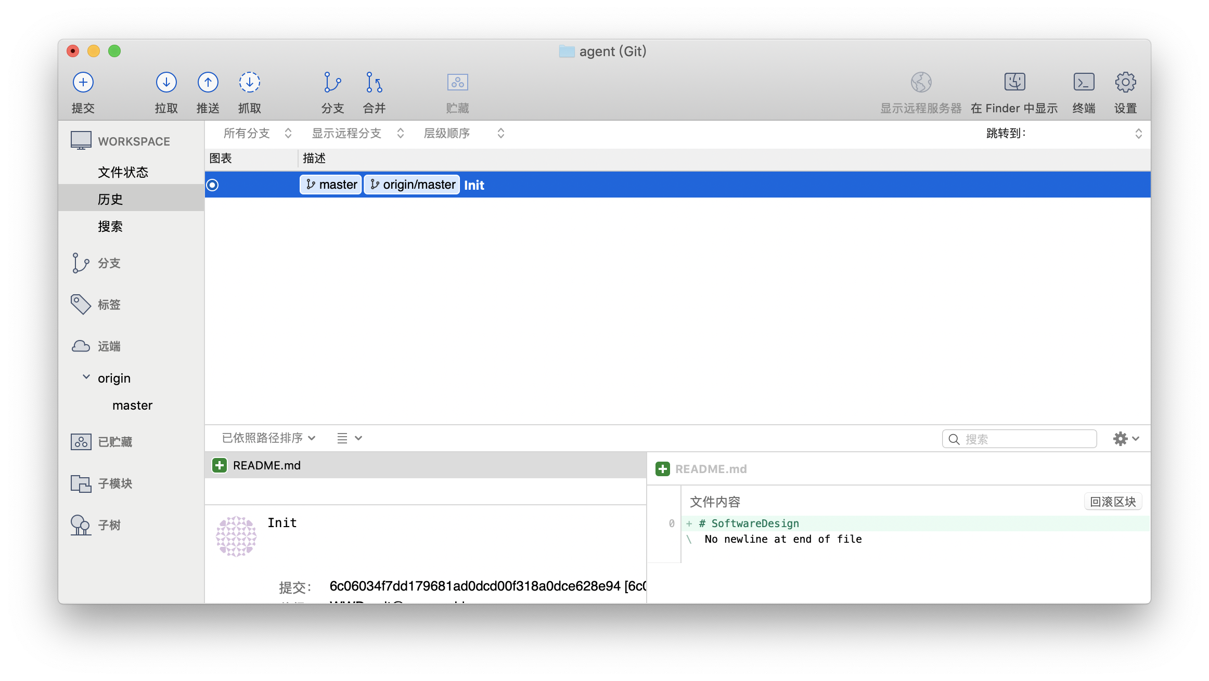
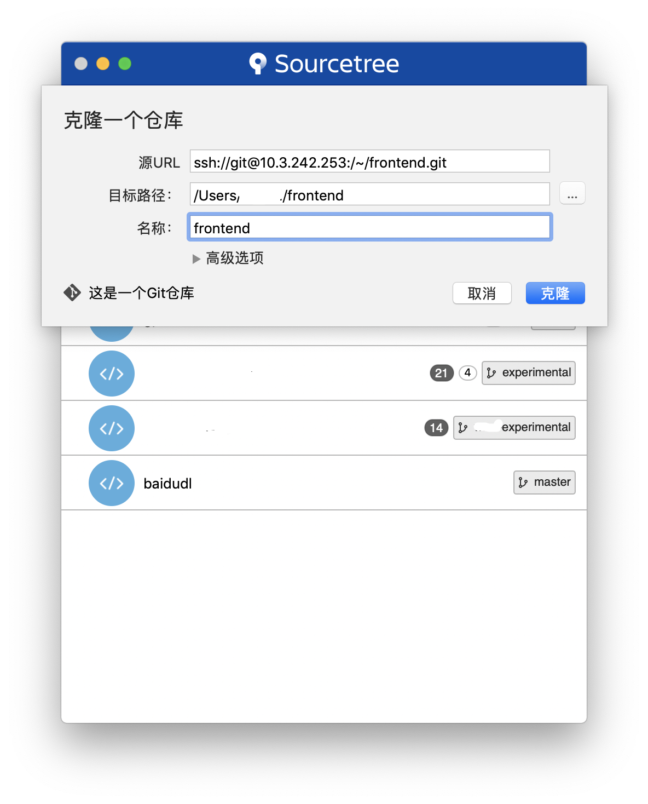
Git GUI client recommendation: Sourcetree

Slide 25
You may use RabbitMQ (not essential)
In computer science, message queues and mailboxes are software-engineering components used for inter-process communication (IPC), or for inter-thread communication within the same process. They use a queue for messaging – the passing of control or of content. Group communication systems provide similar kinds of functionality.
The message queue paradigm is a sibling of the publisher/subscriber pattern, and is typically one part of a larger message-oriented middleware system. Most messaging systems support both the publisher/subscriber and message queue models in their API, e.g. Java Message Service (JMS).
https://en.wikipedia.org/wiki/Message_queue

Slide 26
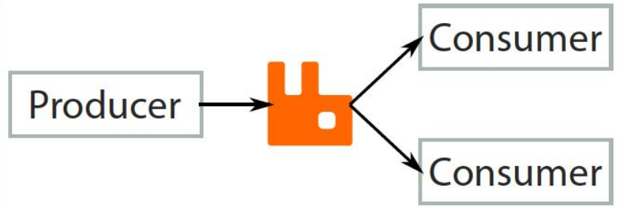
RabbitMQ

Slide 27
Frontend Web Page
client
Task Creation
WebSocket server
client
WebServer
RabbitMQ
Producer
Deliver task message
Consumer
client

Slide 28

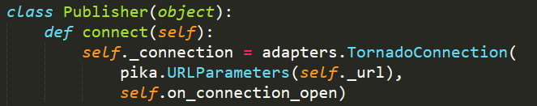
Publisher/Listener
Python RabbitMQ Library：pika
Perform with tornado

Slide 29
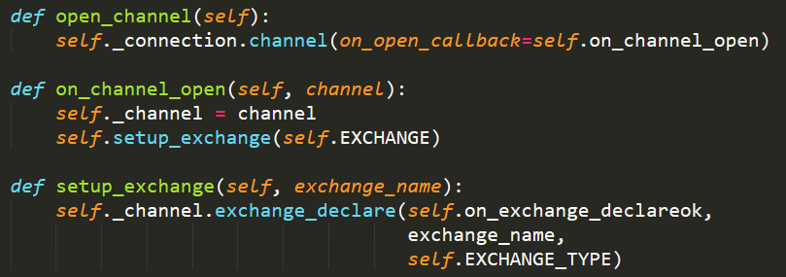
Publisher/Listener

Slide 30

WebServer and Publisher
WebServer creates a Publisher Object
Webserver received a new task, call Publisher.publish_message to save message in MQ

Slide 31
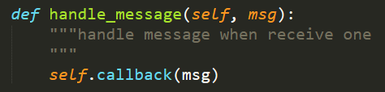
WebSocket Server nad Listener
WebSocket server creates Listener Object
When receiving message from RabbitMQ, call callback function to handle

