Slide 1
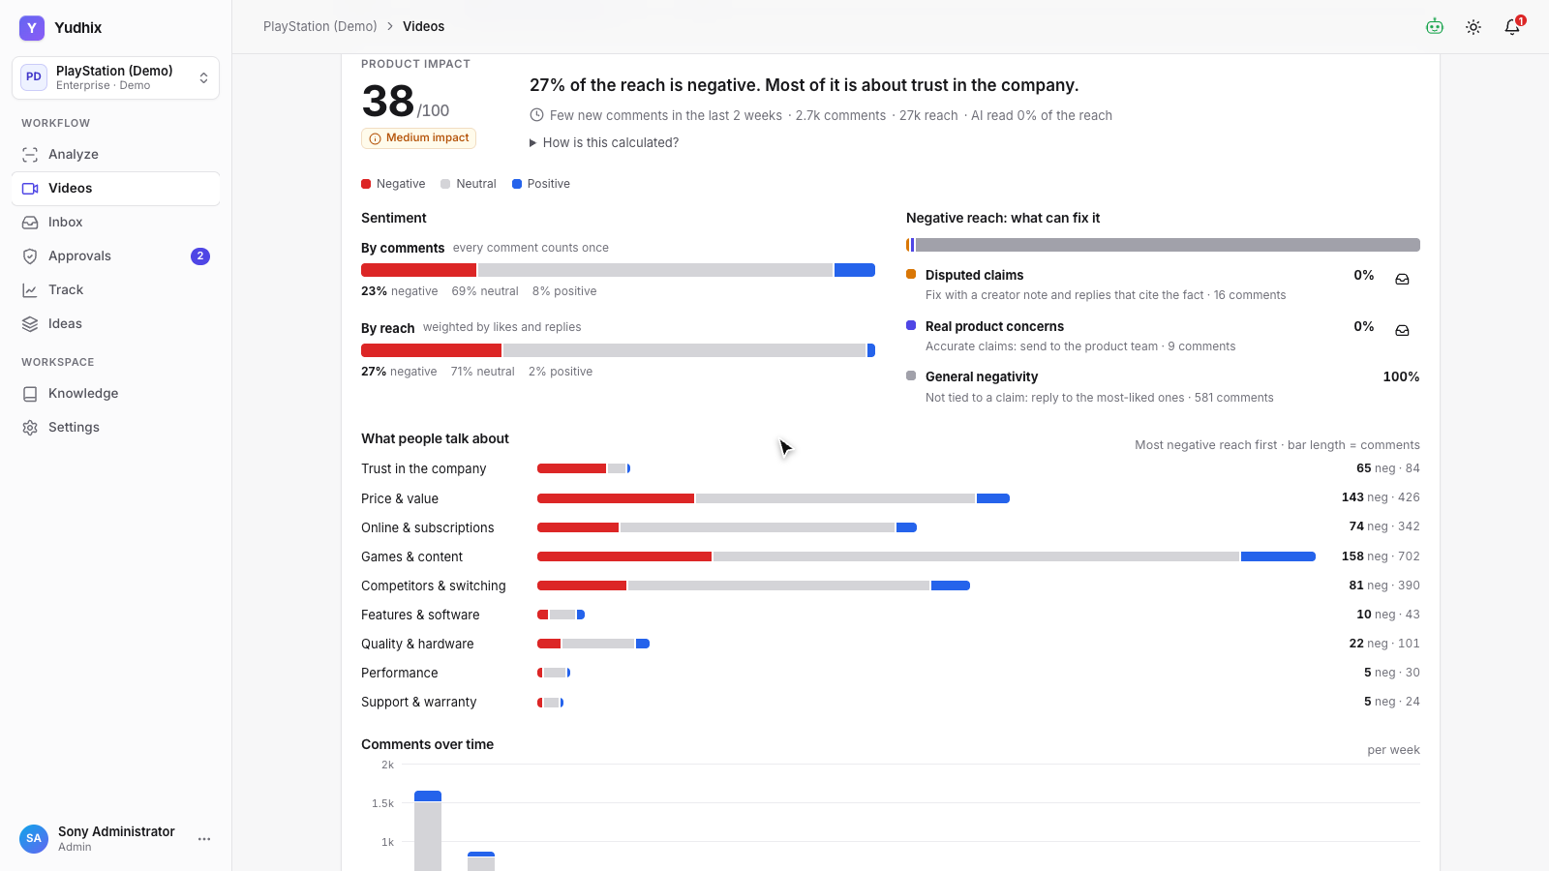
Y
Yudhix
PRODUCT DEMO
Know which claims hurt your product
Fact-check creator videos
trace every angry comment to its cause
answer with official facts
Notes:
This is Yudhix, truth-first social intelligence. When a creator says something wrong about your product, thousands of angry comments follow. Yudhix finds which claims are false, which reactions they caused, and what to do about it.

Slide 2
One wrong claim, thousands of angry comments
3 of 4
2.7k
597
claims in the video are disputed
comments under it
negative comments to answer
Without Yudhix, a brand can't tell which comments react to misinformation and which point to a real product problem, so it either stays silent or answers everyone the same way.
Example: “PlayStation Explains Why it’s Ending Physical Discs”, analyzed in the demo workspace.
Notes:
Set the scene with a real example from the demo workspace before showing the product.

Slide 3
HOW IT WORKS
From a video link to the right reply
1
2
3
4
5
Analyze a video
Fact-check every claim
Read the comments with AI
Link reactions to claims
Reply with official facts
Transcript, details and comments
Against your own knowledge base
Sentiment, topic and intent
Which claim caused which comment
AI drafts, human approval
Notes:
It works in five steps. Analyze a video. Fact-check every claim against your own knowledge base. Read the comments with AI. Link each reaction to the claim that caused it. And reply with the official facts.

Slide 4
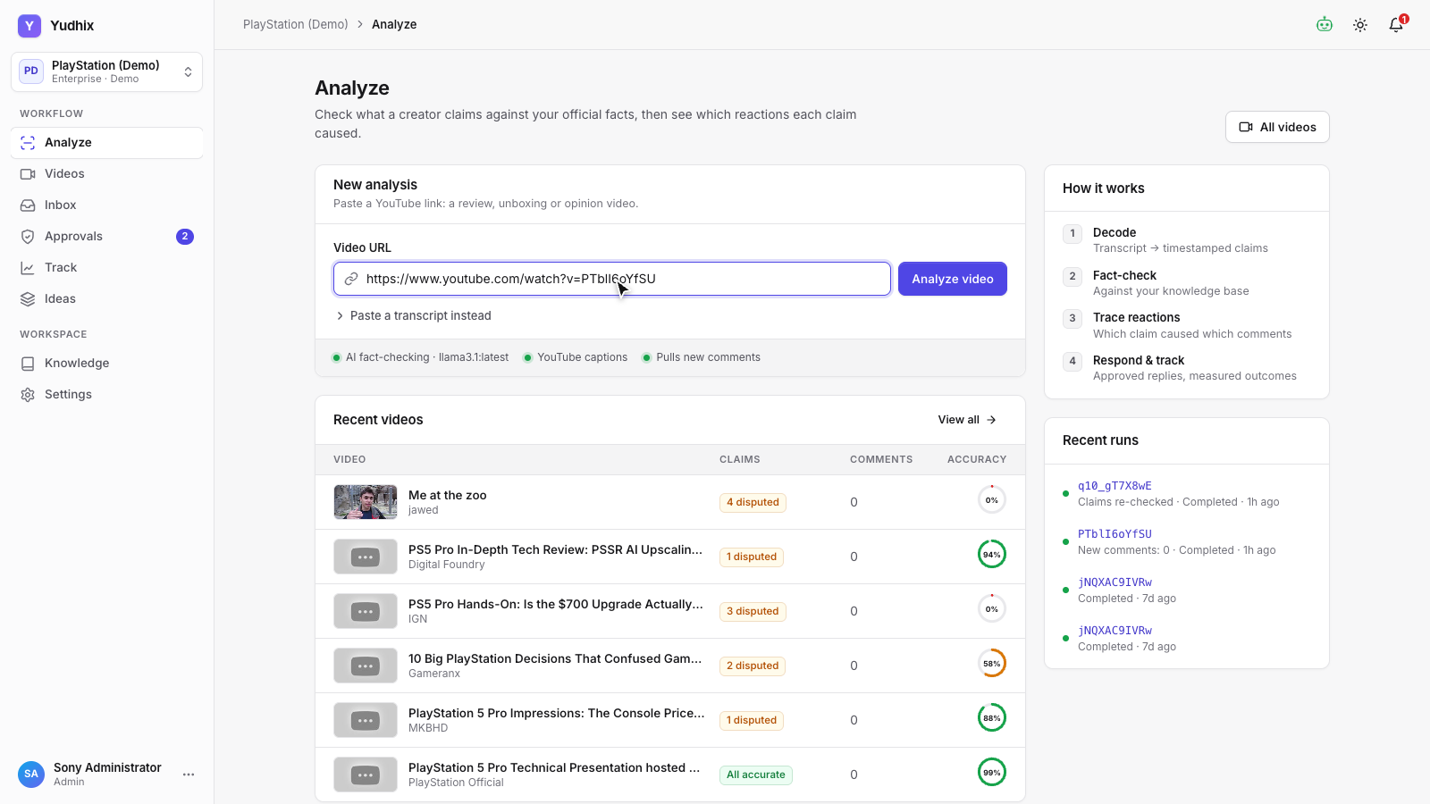
Analyze a video
3
Paste a YouTube link
Paste any YouTube link
Transcript, details and a comment sample pulled automatically
Runs in the background with live progress
Notes:
Everything starts here. Paste a YouTube link, and Yudhix pulls the transcript, the video details and a sample of comments, then runs the full check in the background.

Slide 5
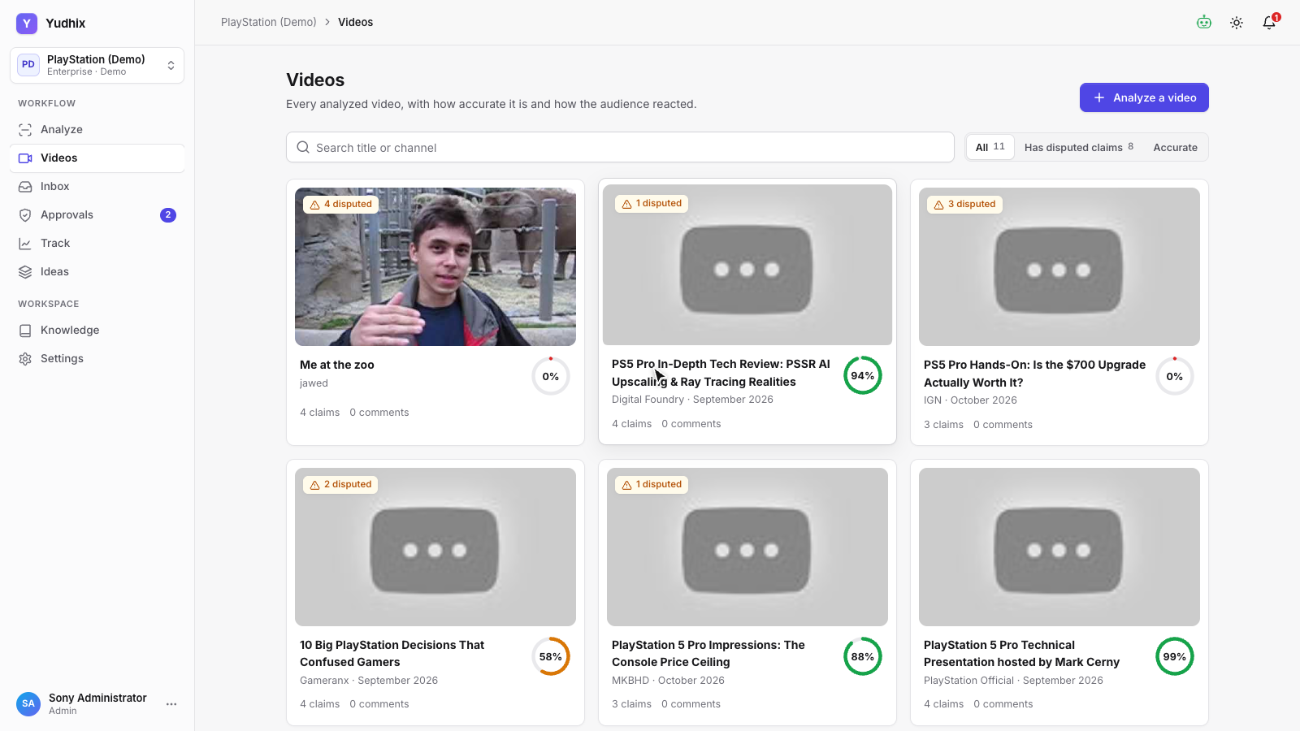
Video library
4
Every analyzed video at a glance
Factual accuracy per video
Disputed claims flagged at a glance
Comment volume and reach
Notes:
Every analyzed video lands in this library, with its factual accuracy, disputed claims and comment volume at a glance.

Slide 6
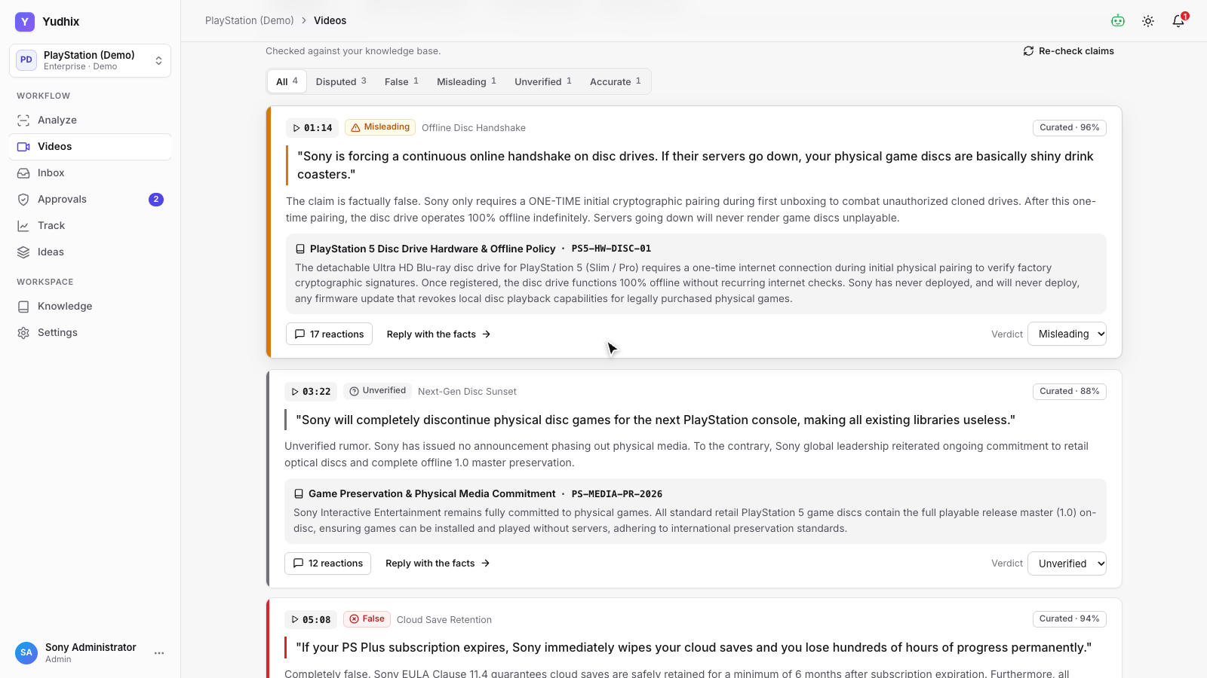
Truth report
5
Every claim, checked against official facts
Every claim time-stamped
Verdict quotes your official source word for word
Uncertain answers go to human review
Notes:
Open a video to see its truth report. Each claim is time-stamped and gets a verdict: accurate, misleading, false, or unverified. The verdict quotes the exact sentence from your official source, and anything the AI isn't sure about is flagged for a person to review.

Slide 7
Audience impact
6
What the comments mean for the product
Sentiment by comments and by reach
Misinformation vs. real product concerns
Topics and trend over time
Notes:
The audience impact tab shows what the comments mean for the product: sentiment by comments and by reach, how much of the anger comes from misinformation versus real product concerns, which topics people talk about, and how it changes over time.

Slide 8
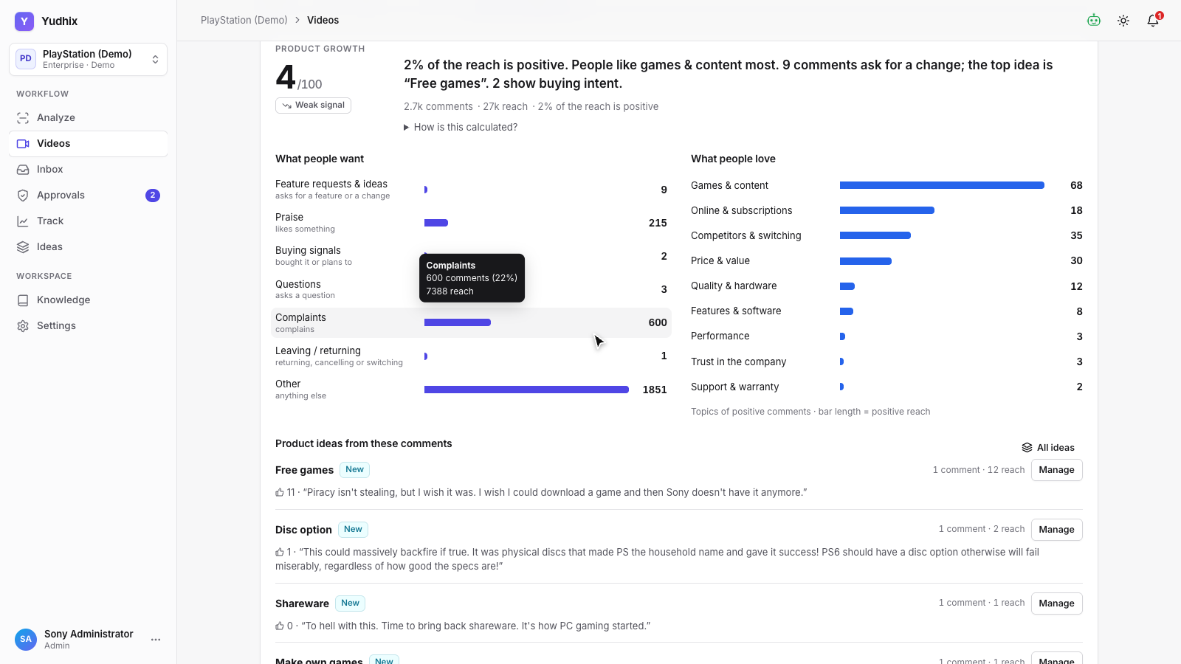
Product growth
7
Praise, buying signals and feature requests
What people love
Buying signals and churn risk
Feature requests grouped into ideas
Notes:
The product growth tab shows the positive side: what people love, who is ready to buy, and the feature requests hidden in the comments, grouped into product ideas.

Slide 9
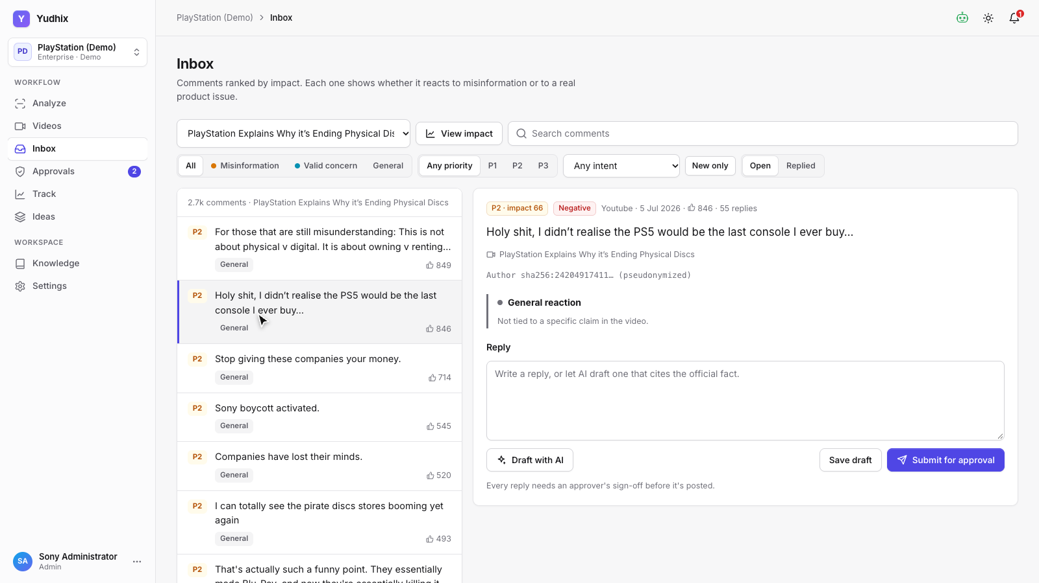
Respond in the inbox
8
Ranked by impact, tagged by cause
Ranked by impact, tagged by root cause
AI drafts that cite the official fact
Deep links from every chart
Notes:
The inbox ranks comments by impact. Each one shows whether it reacts to misinformation or to a real product issue, so the team replies with the right facts. Replies can be drafted by AI, citing the official source.

Slide 10
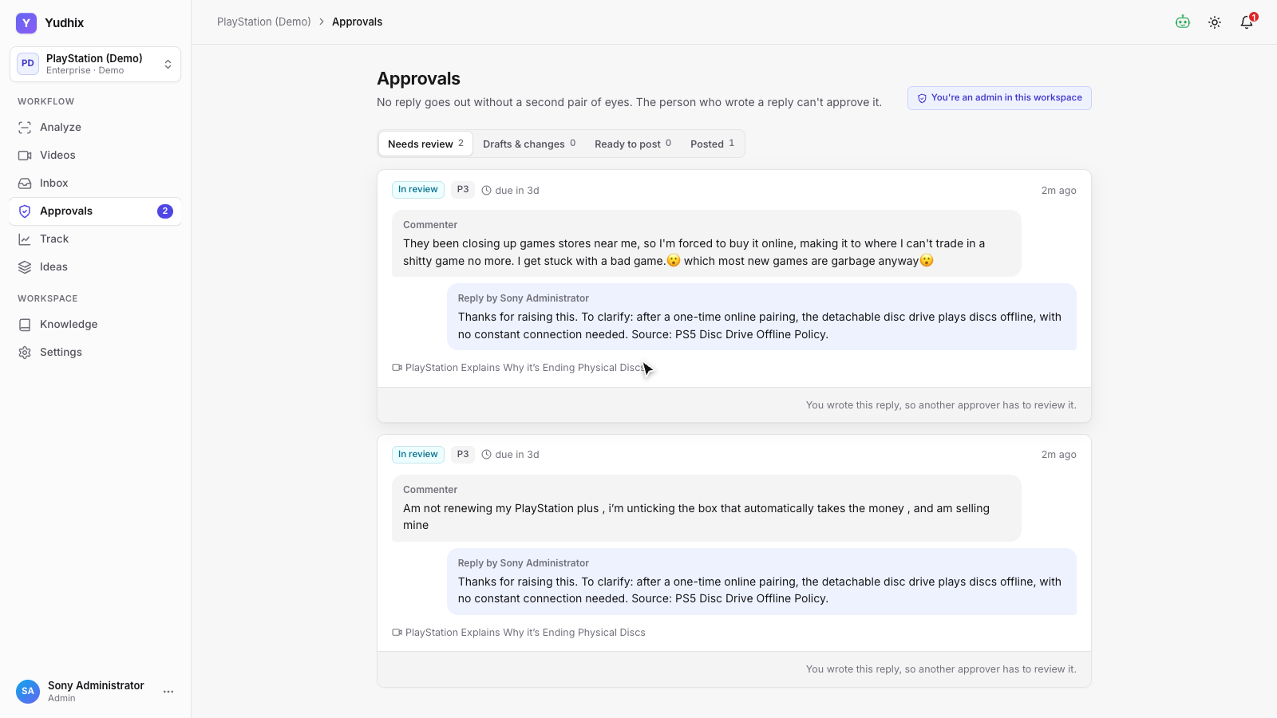
Approvals
9
Nothing is posted without sign-off
Every reply needs sign-off
Approve, reject or edit with reasons
Full audit trail
Notes:
Every reply goes through an approval step before it is posted, with an audit trail of who approved what.

Slide 11
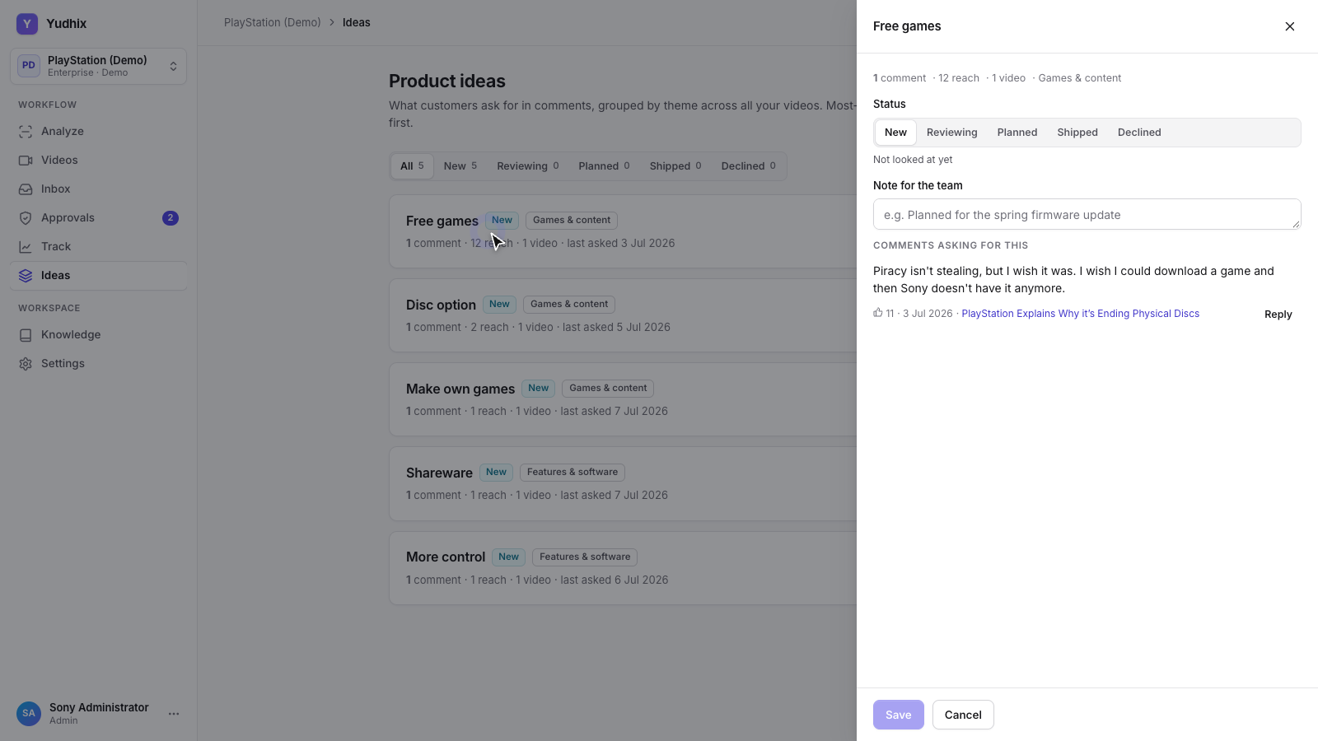
Product ideas
10
Feature requests from every video, in one backlog
Requests from every video, de-duplicated
New → Reviewing → Planned → Shipped
Original comments kept as evidence
Notes:
Feature requests from all videos come together on the ideas page. The product team moves each idea from new, to reviewing, planned and shipped, with the original comments attached as evidence.

Slide 12
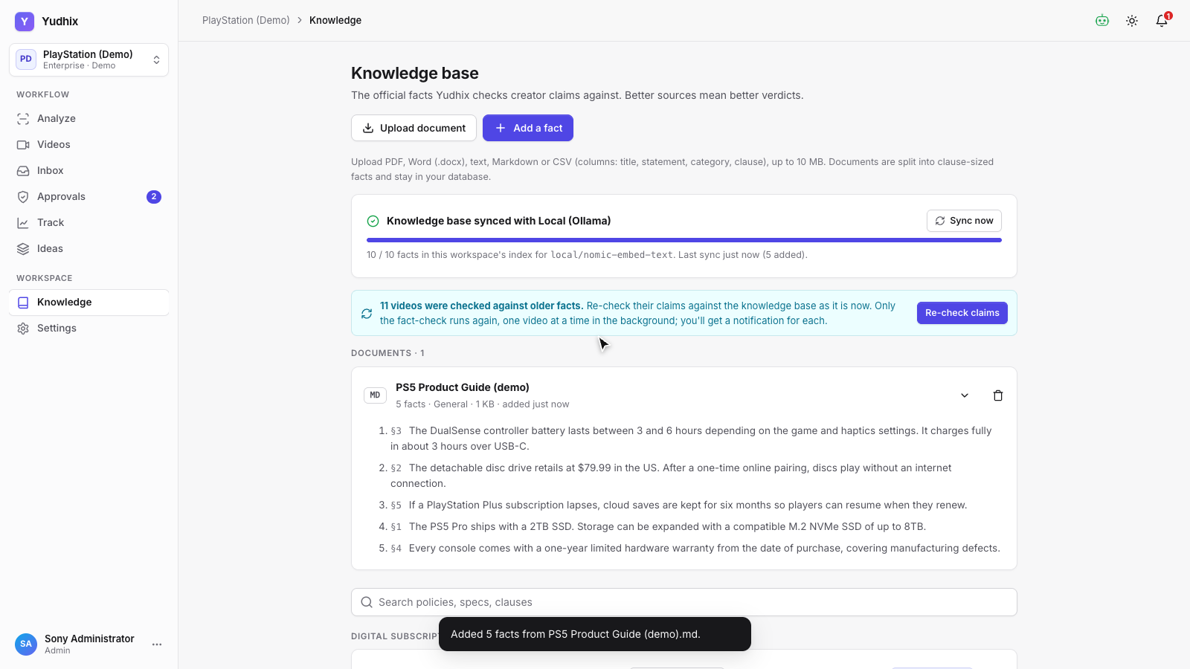
Knowledge base
11
Upload documents · synced with your AI
Upload PDF, Word, text, Markdown or CSV
Split into clauses the AI can quote
Synced with your AI, nothing lost while offline
Notes:
The knowledge base holds your official facts. Upload a PDF, Word or text document, and Yudhix splits it into clauses it can quote. Your documents stay in your own database, and sync with your AI connection, including anything added while AI was off.

Slide 13
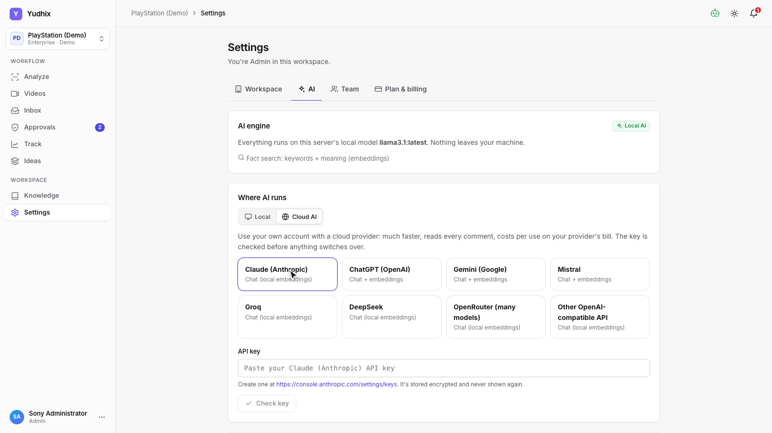
Bring your own AI
12
Local, or Claude, ChatGPT, Gemini and more
Local model or Claude, ChatGPT, Gemini and more
Key verified before switching over
Automatic fallback: cloud → local → rules
Notes:
Each workspace chooses where AI runs: locally on your own server, or with a cloud provider like Claude, ChatGPT or Gemini, using your own key. The key is checked before anything switches over, and if a provider fails, Yudhix falls back to the local model, then to rules.

Slide 14
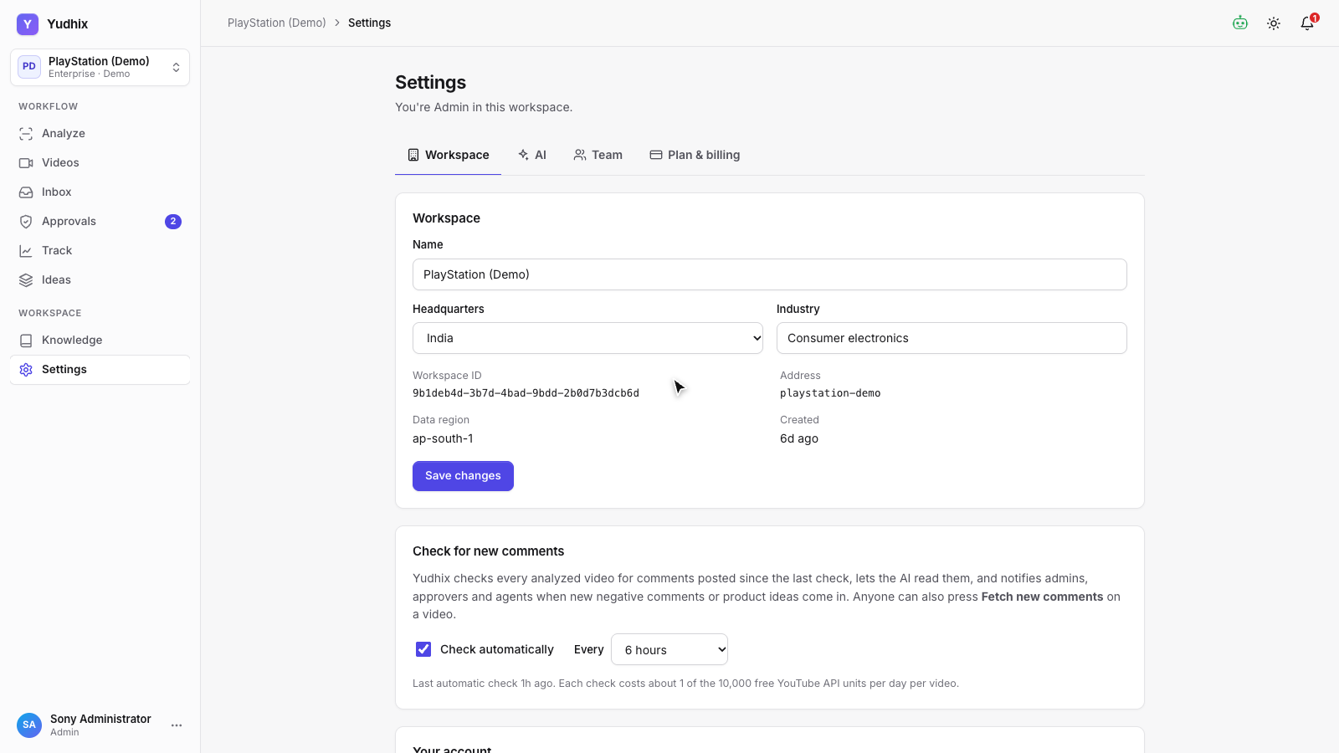
Always up to date
13
New comments, checked on a schedule
Checks every video on a schedule
Reads only the new comments
Alerts when negativity rises or ideas appear
Notes:
And new comments keep coming. Yudhix checks every analyzed video on a schedule, reads only the new comments, and notifies the team when negativity rises or new ideas appear.

Slide 15
Built so the AI can't make things up
1
No evidence, no AI
If nothing in your knowledge base matches, the claim is marked unverified without asking the model.
2
Quotes are checked
The AI must copy the source sentence it relied on, and that sentence must really be in your document.
3
Figures compared by code
Prices, sizes and dates are matched by the system, never trusted to the model.
4
Second opinion
With cloud AI every claim is read twice; when the two readings disagree, a person reviews it.
5
People have the last word
Anyone with edit rights can set a verdict; re-checks never overwrite it.
Notes:
Explain why verdicts can be trusted: evidence first, quotes verified, numbers by code, disagreements to people.

Slide 16
Y
Yudhix
Answer with facts. Learn what customers want.
Next steps
1
Pilot
2
Ground it
3
Choose AI
Analyze your 10 most-watched creator videos
Upload your official specs, prices and policies
Local, or your own Claude, ChatGPT or Gemini key
Notes:
Yudhix. Know which claims hurt your product, answer with facts, and learn what your customers want. Thank you for watching.

