Slide 1



EasyShop
The Shopping Hub
By : Harshal Kailas Wagh
MCA-1 , Div - D
Roll No : 23467
Guided by : Prof. Amruta Deshmukh

Slide 2
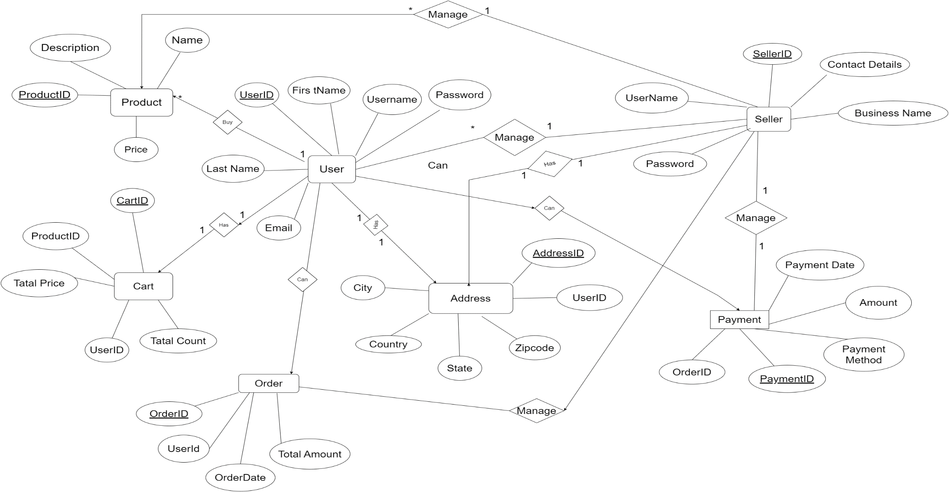
ER DIAGRAM

Slide 3
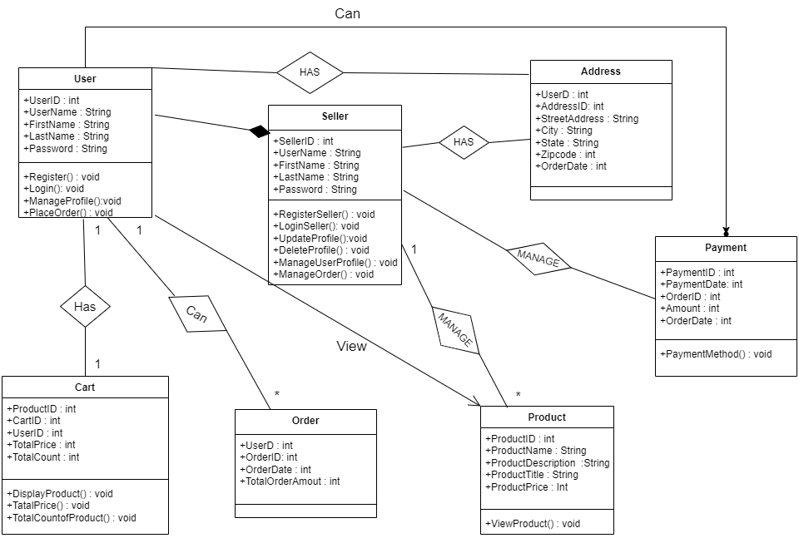
Class Diagram

Slide 4
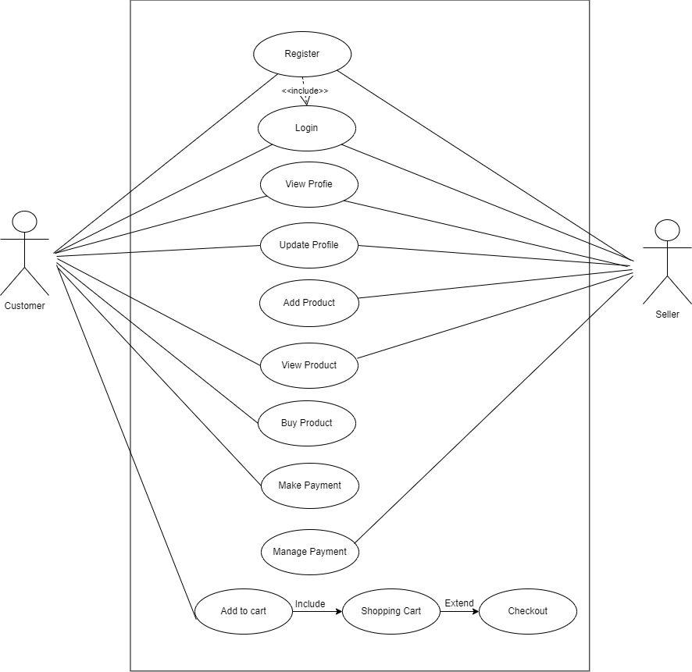
Use case Diagram

Slide 5
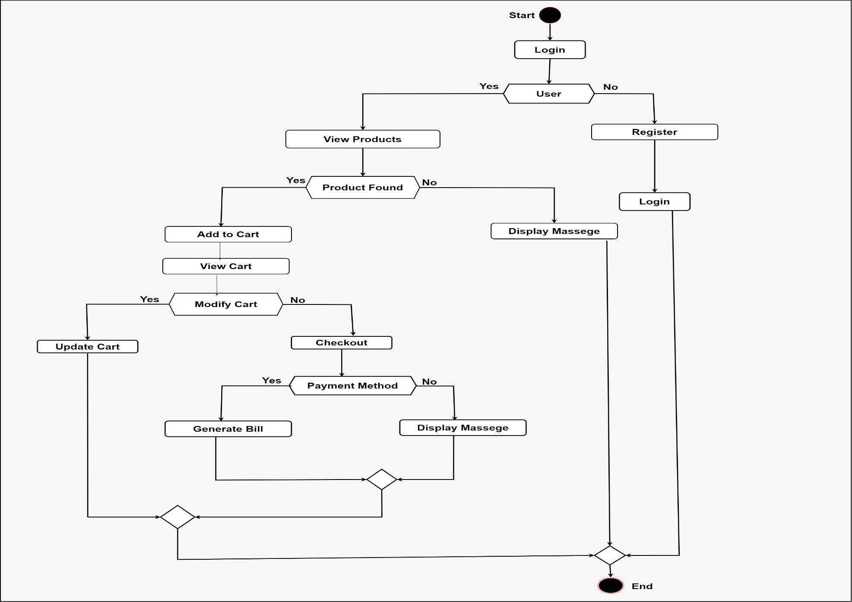
Activity Diagram

Slide 6
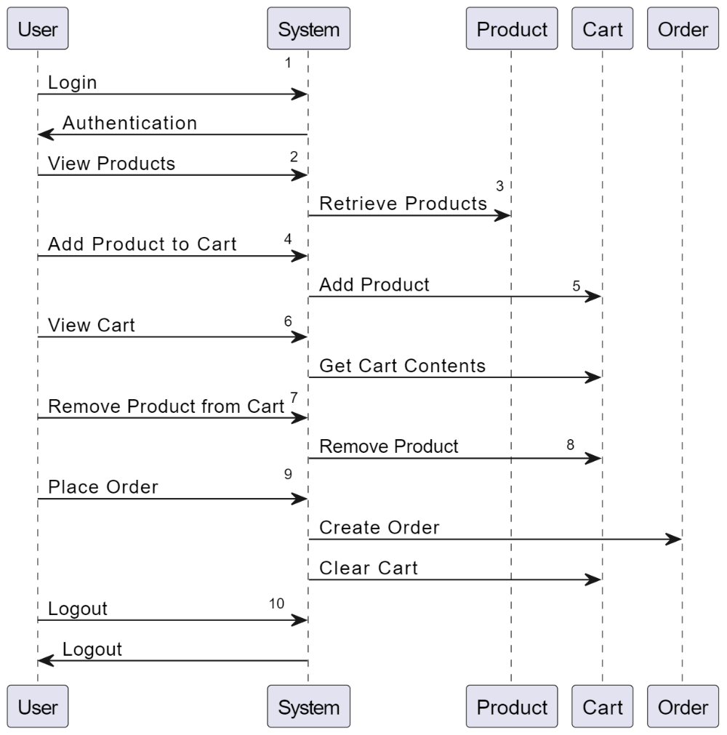
Sequence Diagram

Slide 7
Data Dictionary
Sr NO | Table Name | Field Name | Data Type | Constraints | Description | Example Value
1 | User | UserID | int | Primary Key |  | 1
2 | User | Username | string |  |  | Chunnu_p
3 | User | Password | string |  |  | *********
1 | Product | ProductID | int | Primary Key |  | 101
2 | Product | Name | string |  |  | Product A
3 | Product | Price | decimal |  |  | 19.99

Slide 8
Sr NO | Table Name | Field Name | Data Type | Constraints | Description | Example Value
1 | Collection | CollectionID | int | Primary key |  | 201
2 | Collection | Name | string |  |  | Collection 1
...
1 | Category | CategoryID | int | PK, AI |  | 301
2 | Category | Name | string |  |  | Category X
...
1 | Cart | CartID | int | Primary Key (PK), Auto Increment | Unique identifier for the cart | 101
2 | Cart | UserID | int | Foreign Key (FK) to User.UserID | User associated with the cart | 1
...

Slide 9
Sr NO | Table Name | Field Name | Data Type | Constraints | Description | Example Value
1 | Order | OrderID | int | Primary Key (PK), Auto Increment | Unique identifier for the order | 201
2 | Order | UserID | int | Foreign Key (FK) to User.UserID | User who placed the order | 1
...
1 | Seller | SellerID | int | Primary Key (PK), Auto Increment | Unique identifier for the seller | 301
2 | Seller | Username | string | Unique | Seller's username for login | seller123
3 | Seller | Password | string |  | Seller's password for login | *********

Slide 10
Sr NO | Table Name | Field Name | Data Type | Constraints | Description | Example Value
1 | Address | AddressID | int | Primary Key (PK), Auto Increment | Unique identifier for the address | 401
2 | Address | UserID | int | Foreign Key (FK) to User.UserID | User associated with the address | 1
3 | Address | StreetAddress | string |  | Street address for delivery | 123 Main St
4 | Address | City | string |  | City for delivery | Exampleville
5 | Address | State | string |  | State or province for delivery | Example State
6 | Address | ZipCode | string |  | Postal code for delivery | 12345

Slide 11
Thank You

